Slide 1
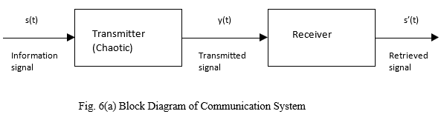
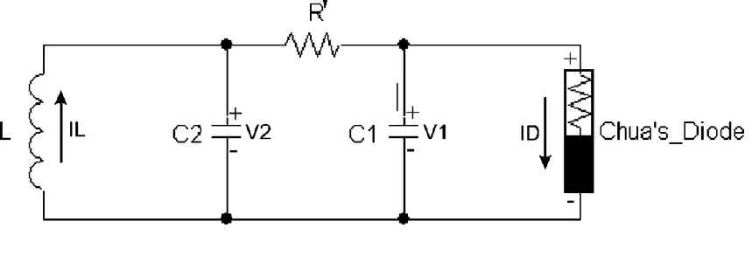
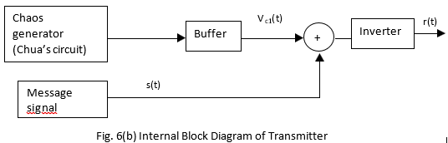
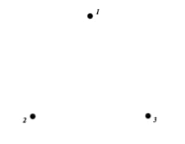
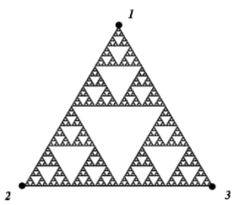
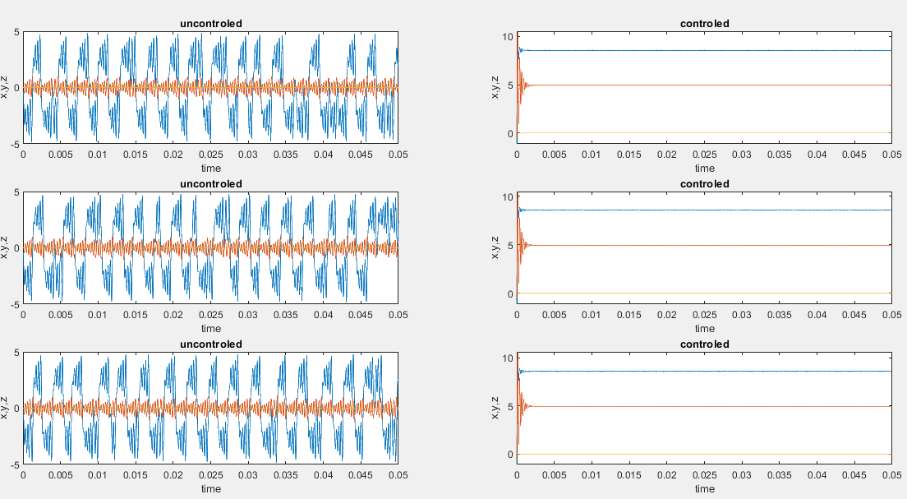
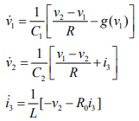
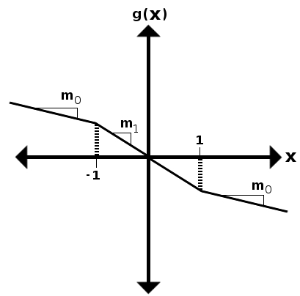
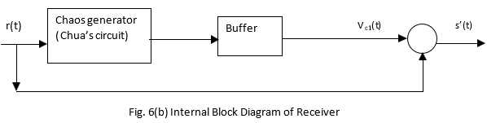

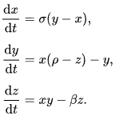
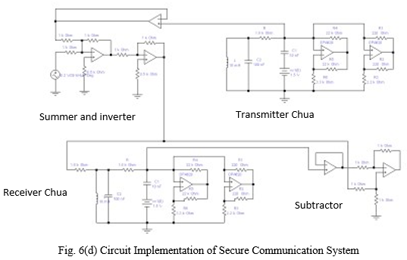
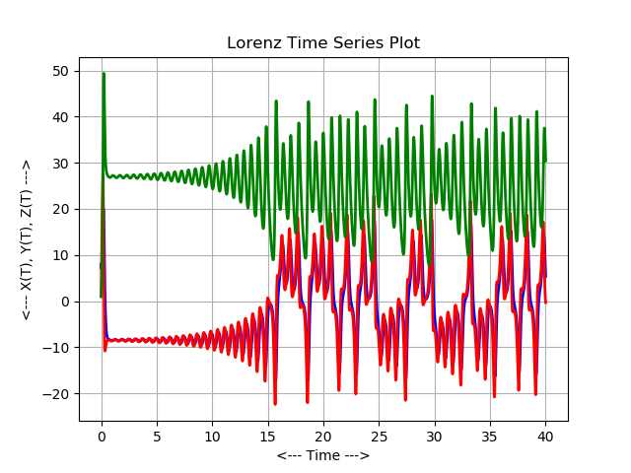
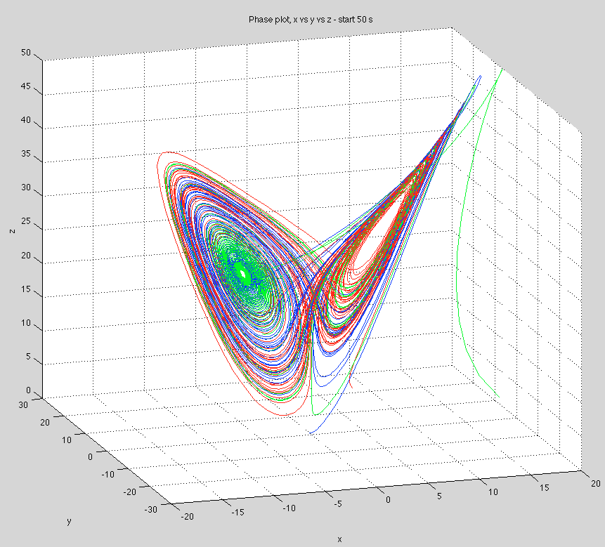

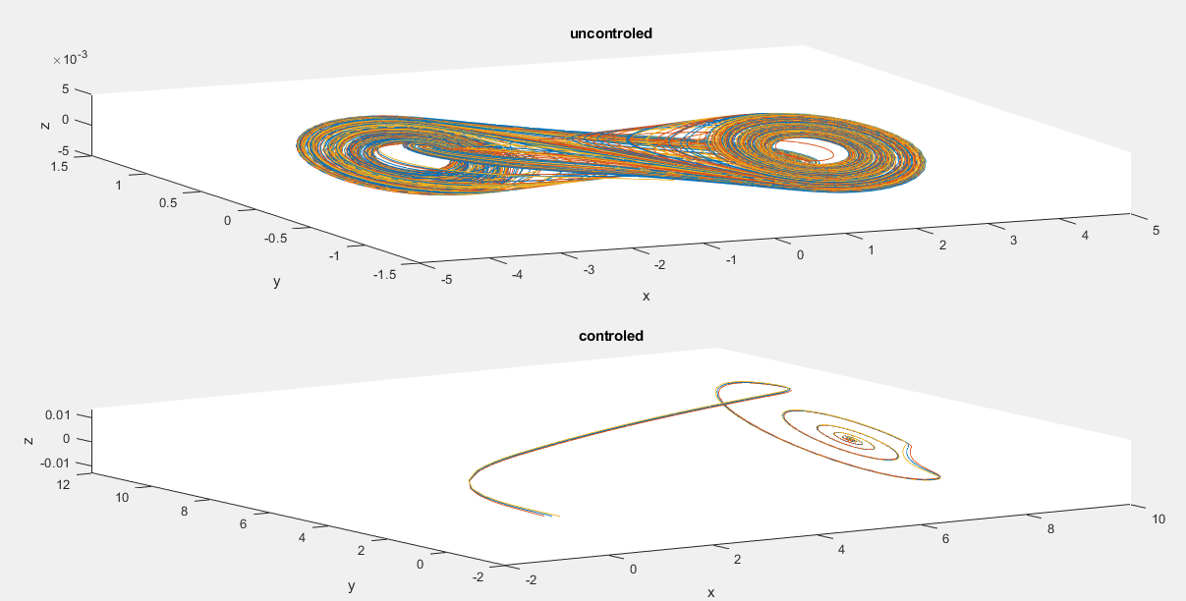



Simulating the Chaotic behavior of Chua circuit and how to control it
Zewail university of science and technology
Mohamed Sami, Mamhmoud Nafrawy, Hussein labib, Ahmed Hossam
Chua circuit is one of the simplest electrical samples of a chaotic system which displays a new kind of attractors, double scroll attractor, that will be demonstrated in upcoming simulation, graph… etc. Chua circuit is used in varies application, after using a certain control system needed for a certain purpose in applications.
Introduction
Theory
predictions
Application
To see how simple and beautiful chaos is create the following system, draw 3 equal distance vertices of equilateral triangle and label each vertex with 2 numbers from 0 to 6, choose a start point randomly from inside the 3 vertices, (triangle), and roll a dice, and mark the point midway between your start point and the vertex with the same number that appeared on the dice, use a ruler, roll the dice again and repeat the past procedures like a 10,000 times and you will get Sierpenski triangle
A)) Before adding control : chaotic behavior appear, oscillation of each parameter with time, attractor curve between each parameter and other.
A)) after adding control : oscillating curves will settle down to certain values, and attractor orbits of different IC will converge to one point.
secure communication:
A)) Chua circuit
Chua circuit looks like:
results
Transmitter:
And by applying Kirchhoff laws and neglect the internal inductor resistance, we can get equations that governs this circuit:
result1
Receiver
Lorentz attractor, it was the first system to be studied as chaotic system, Lorentz introduced a very simplified mathematical model for atmospheric convection in three coupled differential equations:
“Id” is piece wise differentiable function (abrupt changing slopes) and that is the non linear element in the circuit.
B)) Chaos control in Chua circuit
Different row of plots corresponds to different initial conditions.
Different color correspond to solution of one equations of the Chua system.
Curves resulted as predicted.
In general to control the chaos we enforce the error to be such that:
When these equations solved it yields
Where:
result2
By making some substitutions in Chua equations and adding control
Conclusion
In conclusion Chua circuit is a piece that contain some chaos of universe of it and after studying it was found that it shows double scroll attractor chaotic behavior and it can be controlled by adding extra components act as controllers as it may be more useful if the chaos controlled to some extent. The Chua circuit have many applications in secret telecommuting and cryptography
References:
By substituting in error enforcing equation:
Moumita Mujherjee, Suman Hadler, “Stabilization and Control of Chaos Based on Nonlinear Dynamic Inversion”, 2017.
Valentin Siderskiy. Chua’s circuit diagrams, equations, simlulations and how to build 2016://Chuacircuits.com.
Different colors corresponds to different initial conditions.
Curves resulted as predicted.

