Slide 1
Final Project
EDA (Exploratory Data Analysis) on E-commerce Behavior Data from Cosmetics Online Store
Using Python Programming.
Using Power bi .
Using Streamlit.

Slide 2
About
This project aims to gain consumer insight of a Cosmetics online store through Exploratory Data Analysis (EDA).
Various methods are utilised in order to obtain various angles and critically validate the analysis.

Slide 3
E-Commerce Behavior Data Dataset
E-Commerce
Is a business model that lets firms and individuals buy and sell things over the internet.
Dataset
The dataset contains behavior data for ITI Final project, from a Cosmetics online store in October and November 2019. Each row in the file represents an event. All events are related to products and users. Each event is like many-to many relation between products and users.
Data Dictionary
event_time :Time when event happened at (in UTC).
event_type : Four kinds of events ( View – cart – Remove from cart - Purchase )
product_id : ID of a product
category_id : Product's category ID
category_code : Product's category taxonomy (code name) if it was possible to make it. Usually present for meaningful categories and skipped for different kinds of accessories.
brand : Name of Brand.
price : Float price of a product. Present.
user_id : Permanent user ID.
user_session : Temporary user's session ID. Same for each user's session. Is changed every time user come back to online store from a long pause.
Behavioral data
Is data generated by, or in response to, a customer’s engagement with a business.

Slide 4
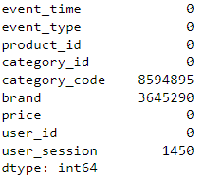
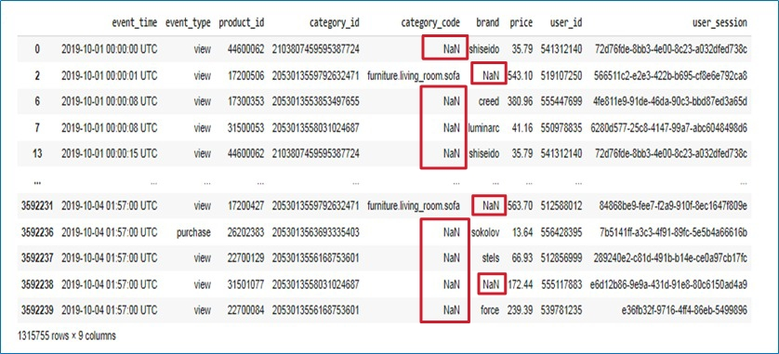
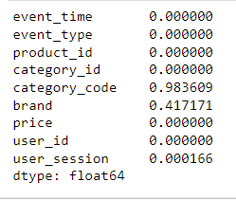
Checking Missing Data
Missing value in each column
Percentage of null values

Slide 5
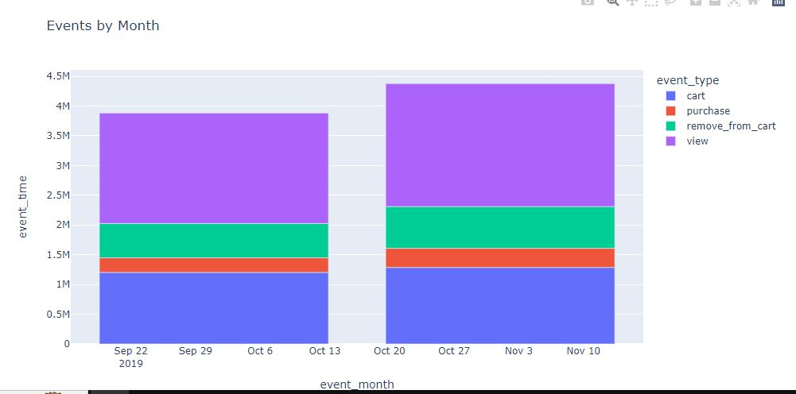
1 • Event_time
Ced it to date type
Extracting the month – hangweek – day – hour
2.Event_type
• Number of views 3938043
• Number of Cart 2493850
• Number of remove_from_cart 1278829
• Number of purchases 567550
3 • Product_ID
•Changed its type to str I don’t want to make any calculations to it .
4 • Category_id
•Changed its type to str I don’t want to make any calculations to it .
5 • Brand
•It has about 41% as null values ( 3451273 null rows )
•It has 244 brands
•We decided to fill the null values according to the product _id , we filled about 8959 rows only .. So we filled the rest of null values with FBX aka Fullfilled by X ( X refereeing to the website name )
Because every ecommerce store is divided into 2 sections ( Marketplace for large corporates and small sellers And the website itself as a seller in the website).

Slide 6
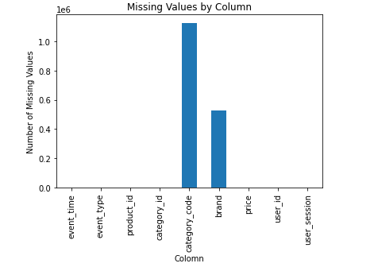
8-User_ID
•Changed its type to str I don’t want to make any calculations to it .
7-Category_Code
•Including 98% as null values
•We Decided to remove it for 2 reasons.. (98% nulls – its values not related to the Cosmetics such as furniture, Air condition and vacuums)
9-User_Session
•We have 1329 null rows so we removed them

Slide 7
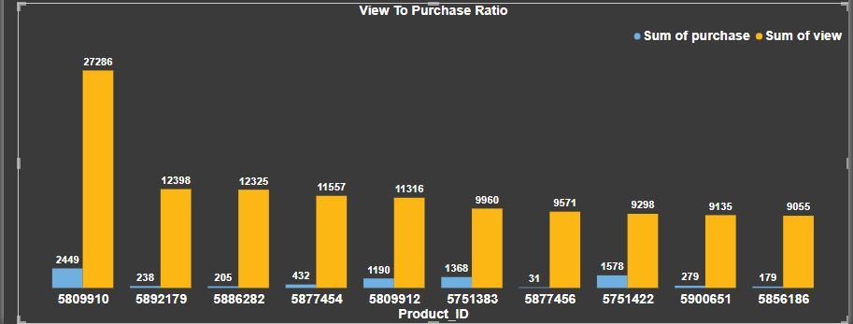
1-which products to feature in the next
advertising campaigns and promotions?
The Products with most views comparing to the low purchase rate.

Slide 8
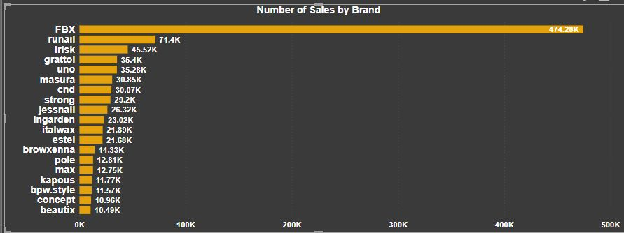
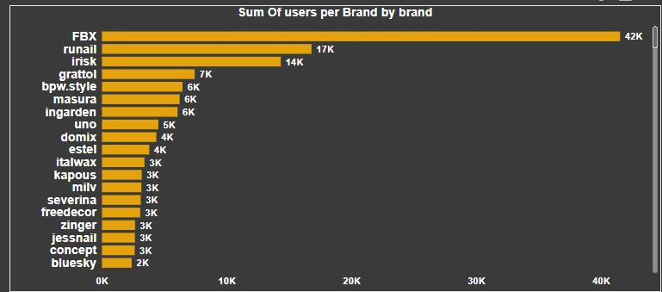
2-Which brands are customers most loyal to?
we can answer this question from 2 sides :
1- top sales per brand
2- Number of customers

Slide 9
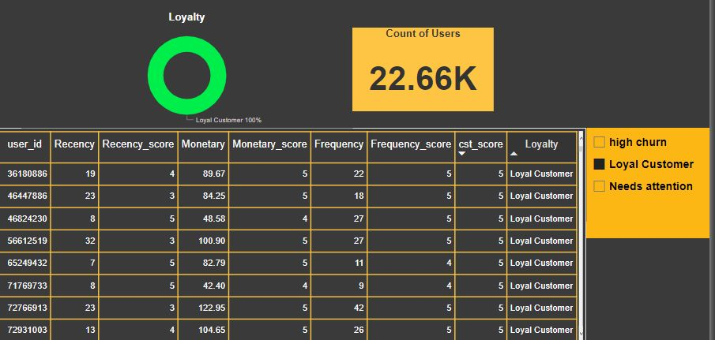
3-Who is the most valuable customers based on their purchase history?
We answered this question based on 2 sides: RFM analysis ( Recency - Frequency - Monetary ) then we gave each customer a score based on the average of the 3 metrics

Slide 10
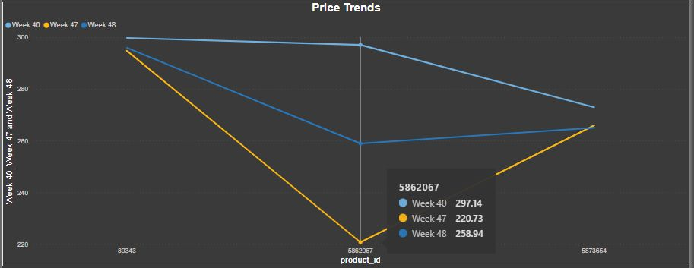
4- Are there any price trends for a particular product over time?
We looked for trends in prices for some products as following:

Slide 11
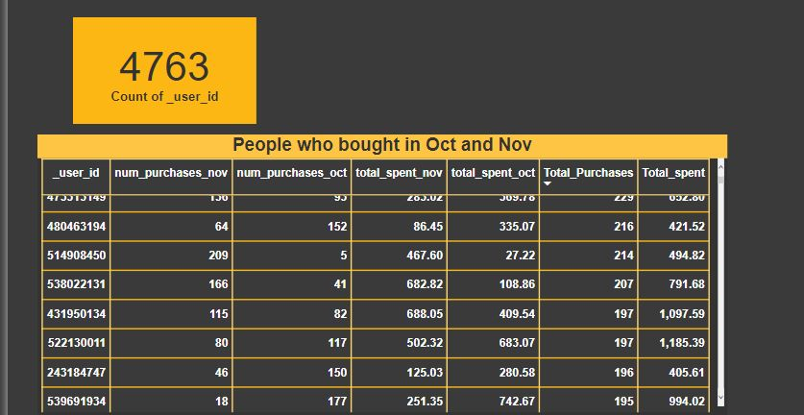
5-Define a KPI that measures customer loyalty from the data?
the customers who bought in both Oct and Nov , and we can add RFM top scorer customers to it

Slide 12
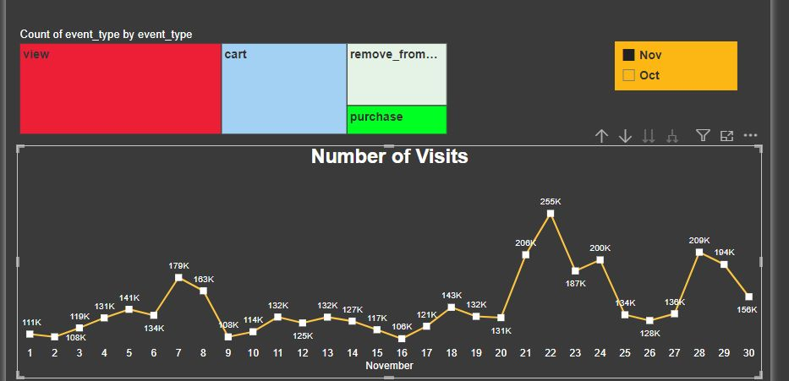
6-Total Number of visits
The peak was in 2 Oct 190k of visits and in 22 of Nov 255k visits

Slide 13
Recommendation
&
Association rules

Slide 14

Recommendation

Slide 15
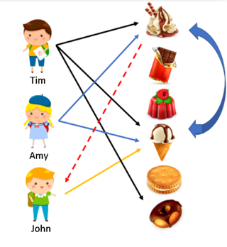
Item-Based Collaborative Filtering
Item-Based Collaborative Filtering

Slide 16
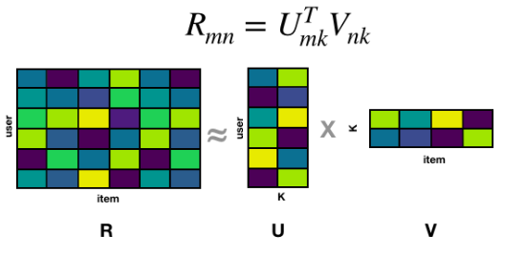
Matrix Factorization

Slide 17
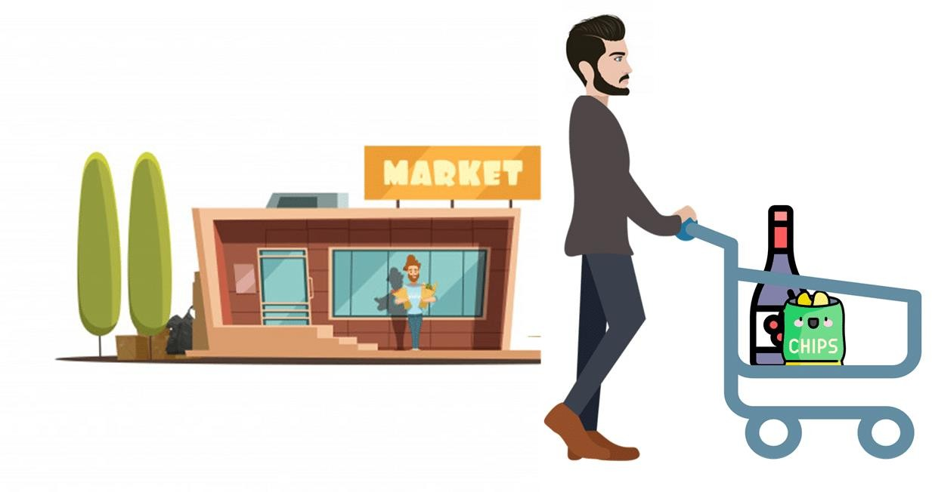
Association rules

Slide 18
What is Association rules?
Association rule mining is a technique to identify underlying relations between different items.
For instance, if item A and B are bought together more frequently then several steps can be taken to increase the profit. For example:
A and B can be placed together so that when a customer buys one of the product he doesn't have to go far away to buy the other product.
People who buy one of the products can be targeted through an advertisement campaign to buy
the other.
Collective discounts can be offered on these products if the customer buys both of them. Both
A and B can be packaged together.

Slide 19
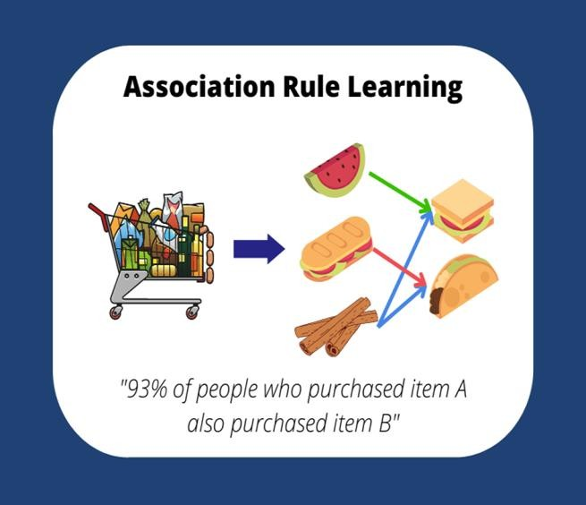
Apriori Algorithm for Association Rule Mining?
Mining for associations among items in a large database of sales transaction is an important database mining function
For example, the information that a customer who purchases a keyboard also tends to buy a mouse at the same time is represented in association rule
Keyboard ⇒Mouse
[support = 60%, confidence = 70%]
There are three major components of Apriori algorithm:
Support
Confidence
Lift

Slide 20
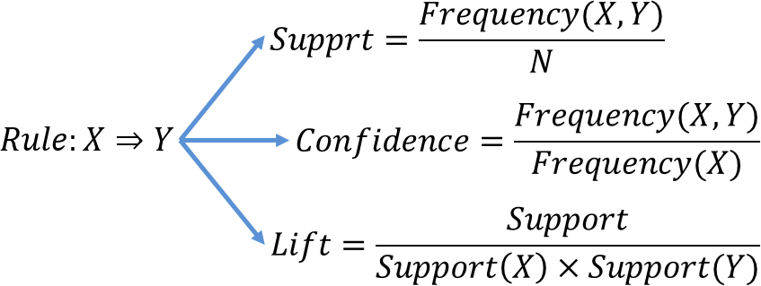
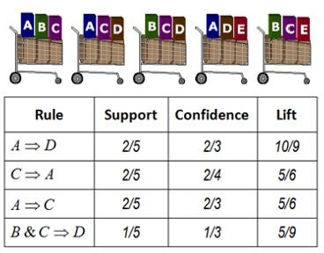
Apriori Algorithm for Association Rule Mining

Slide 21
THANKS!

