Slide 1
Advanced Database
INF413

Slide 2
Course Books
SQL Books
Ado.Net Books

Slide 3
Course Contents
DB Intro.
MySql Programming:
  DDL.
  DML.
  DCL.
  Stored procedures.
  Functions.
  Triggers.
ADO.Net:
  C#.
  MySql.
  Excel & Access.
  Text File.

Slide 4
Course Schedule
Lec 1 : Introduction 29/9.
Lec 2 : MySql 13/10.
Lec 3 : MySql 20/10.
Lec 4 : MySql 27/10.
Lec 5 : MySql 3/11.
Lec 6 : Midterm Exam 10/11.
Lec 7 : Ado.Net 17/11.
Lec 8 : Ado.Net 24/11.
Lec 9 : Ado.Net 1/12.
Lec 10 : Ado.Net 8/12.
Lec 11 : Ado.Net 15/12.
Lec 12 : Revision 22/12.

Slide 5
Course Grades
Final Exam 60
Midterm Exam 15
Practical Exam 15
Project 5
Section 5
Final Exam 50
Midterm Exam 20
Practical Exam 20
Project 5
Section 5

Slide 6
OVERVIEW
Databases are extremely common in businesses. The ordinary database is typically held on a central server and people log in to the system to query or update the database.
Database systems have taken us from a paradigm of data processing in which each application defined and maintained its own data to one in which the data are defined and administered centrally.

Slide 7
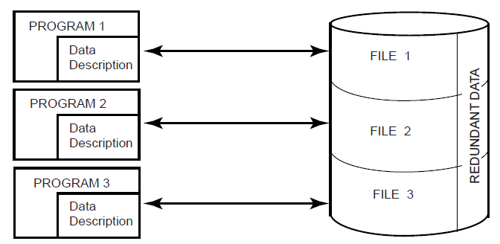

Traditional File Processing

Slide 8
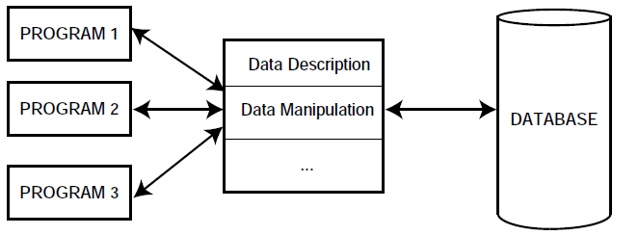
Database Processing

Slide 9
At first glance it might be difficult to understand how these two contrasting approaches can possibly be synthesized to produce a technology that is more powerful and more promising than either one alone.
The key to this understanding is the realization that the most important objective of the database technology is integration, not centralization. It is important to realize that either one of these terms does not necessarily imply the other. It is possible to achieve integration without centralization.

Slide 10
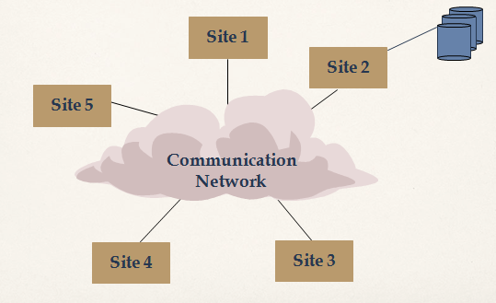
Central Database on a Network

Slide 11
The database is centrally managed by one computer system site 2 and all the requests are routed to that site. The only additional consideration has to do with transmission delays.

Slide 12
Introduction
Traditional database applications
New applications: multimedia databases,
geographic information system,
data warehouses, …
Database: A collection of related data.
Data: Known facts that can be recorded and have an implicit meaning.
(e.g., names, telephone numbers, addresses, …)
Metadata are data that describe the properties or characteristics of end-user data and the context of that data.
1-2

Slide 13
DBMS
Query
Query
Query
Application
Data
DataBase Management System (DBMS)

Slide 14
Example: At a Company
Query 1: Is there an employee named “Nemo”?
Query 2: What is “Nemo’s” salary?
Query 3: How many departments are there in the company?
Query 4: How many employees have Salary >= 80K?
Query 5: What is the name of “Nemo’s” department?
Query 6: How many employees are there in the
“Accounts” department?
Employee
Department
ID | Name | DeptID | Salary | …
10 | Nemo | 12 | 120K | …
20 | Dory | 156 | 79K | …
40 | Gill | 89 | 76K | …
52 | Ray | 34 | 85K | …
… | … | … | … | …
ID | Name | …
12 | IT | …
34 | Accounts | …
89 | HR | …
156 | Marketing | …
… | … | …

Slide 15

(DBMS)
High-level
Query Q
Answer
Translates Q into
best execution plan
for current conditions,
runs plan
DBMS
Data

Slide 16
1-<number>
Advantages of Using a DBMs
Controlling Redundancy in data storage and in development and
maintenance efforts.
‧duplication efforts ‧waste space ‧inconsistent
( see 1-12 controlled redundancy)
Restricting Unauthorized Access (security and authorization)
Providing Multiple User Interfaces
Representing Complex Relationships Among data.
Enforcing Integrity Constraints
Providing Backup and Recovery

Slide 17
DBMS Languages
Data definition language (DDL)
  Defines both schemas
Storage definition language (SDL)
  Specifies the internal schema
Data manipulation language (DML)
  Allows retrieval, insertion, deletion, modification

Slide 18
Centralized and Client/Server Architectures for DBMSs
Centralized DBMSs Architecture
  All DBMS functionality, application program execution, and user interface processing carried out on one machine

Slide 19
Data Modeling Using the
Entity-Relationship (ER) Model
Entity-Relationship (ER) model
  Popular high-level conceptual data model
ER model describes data as:
  Entities
  Relationships
  Attributes

Slide 20
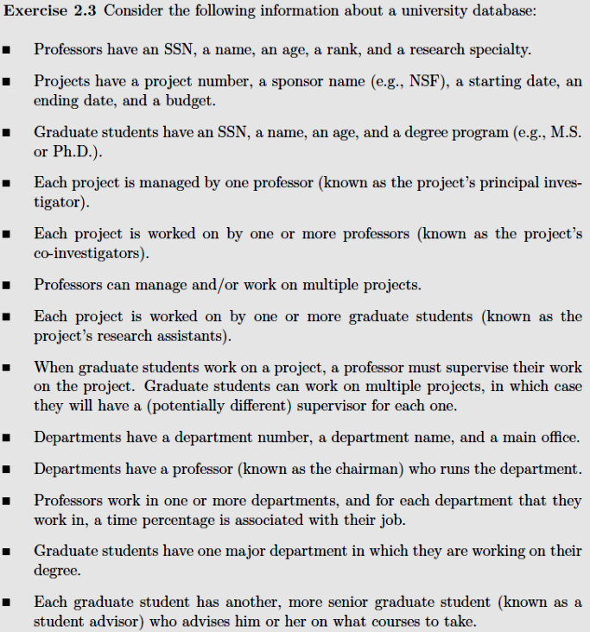
Example

Slide 21
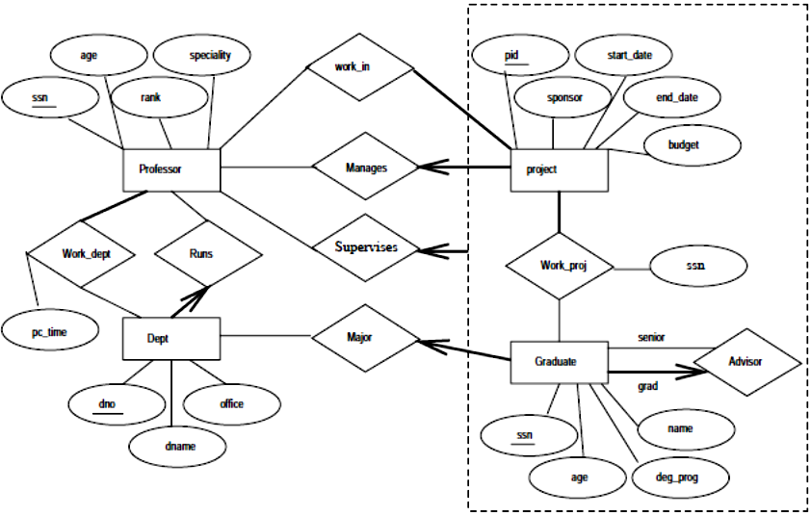
Example

Slide 22
The Enhanced Entity-Relationship (EER) Model
Enhanced ER (EER) model
  Created to design more accurate database schemas
  More complex requirements than traditional applications

Slide 23
Subclasses, Superclasses, and Inheritance
EER model includes all modeling concepts of the ER model
In addition, EER includes:
  Subclasses and superclasses
  Specialization and generalization
  Category or union type
  Attribute and relationship inheritance

Slide 24
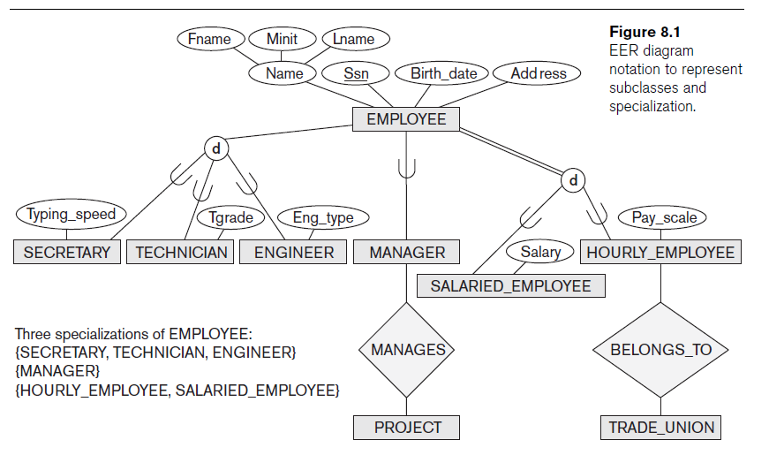

Slide 25
Data Normalization
Primarily a tool to validate and improve a logical design so that it satisfies certain constraints that avoid unnecessary duplication of data.
The process of decomposing relations with anomalies to produce smaller, well-structured relations.

Slide 26
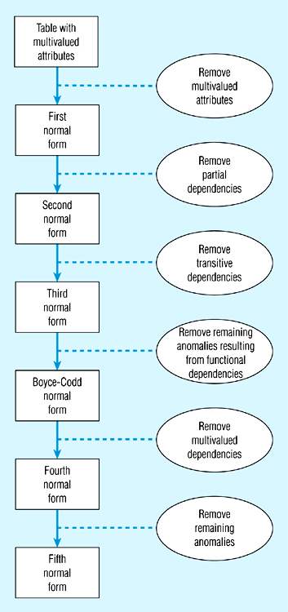
Steps in normalization

