Slide 1
Advanced Database
IS411

Slide 2
Joins
Writing Inner Joins with the Comma Operator
mysql> SELECT Name, Language
-> FROM CountryLanguage, Country;
mysql> SELECT Name, Language FROM CountryLanguage, Country
-> WHERE CountryCode = Code;
mysql> SELECT COUNT(*), Name
-> FROM CountryLanguage, Country
-> WHERE CountryCode = Code
-> GROUP BY Name
-> HAVING COUNT(*) > 10;
SELECT Name, Language FROM CountryLanguage INNER JOIN Country
ON CountryCode = Code;
If the name of the joined column is the same in both tables, you can add USING() rather than ON
SELECT Name, Language
FROM CountryLanguage INNER JOIN Country USING(Code);
MySQL 5 Certification Study Guide <number>

Slide 3
Joins
Writing Outer Joins
mysql> SELECT Name, Language
-> FROM Country INNER JOIN CountryLanguage ON Code = CountryCode;
mysql> SELECT Name, Language
-> FROM Country LEFT JOIN CountryLanguage ON Code = CountryCode;
mysql> SELECT Name, Language FROM Country LEFT JOIN CountryLanguage ON Code = CountryCode WHERE CountryCode IS NULL;
mysql> SELECT Name FROM Country LEFT JOIN CountryLanguage ON Code = CountryCode WHERE CountryCode IS NULL;
Writing RIGHT JOIN Queries
mysql> SELECT Name
-> FROM CountryLanguage RIGHT JOIN Country ON CountryCode = Code
-> WHERE CountryCode IS NULL;
MySQL 5 Certification Study Guide <number>

Slide 4
Joins
Qualifying Column Names
mysql> SELECT Name, Name FROM Country, City
-> WHERE Code = CountryCode;
ERROR 1052 (23000): Column: 'Name' in field list is ambiguous
mysql> SELECT Country.Name, City.Name FROM Country, City
-> WHERE Country.Code = City.CountryCode;
Qualifying and Aliasing Table Names
A table name is always ambiguous when you join the table to itself using a self-join. For example, the Country table in the world database contains an IndepYear column indicating the year in which each country achieved independence. To find all countries that have the same year of independence as some given country, you can use a self-join. However, you cannot write the query like this:
mysql> SELECT t1.IndepYear, t1.Name, t2.Name
-> FROM Country AS t1, Country AS t2
-> WHERE t1.IndepYear = t2.IndepYear AND t1.Name = 'Qatar';
MySQL 5 Certification Study Guide <number>

Slide 5
Subqueries
A subquery is a SELECT statement that is placed within parentheses inside another SQL statement.
we divide subqueries into four general categories, which affect the contexts in which they can be used:
  Scalar subqueries return a single value; that is, one row with one column of data.
  Row subqueries return a single row with one or more columns of data.
  Column subqueries return a single column with one or more rows of data.
  Table subqueries return a result with one or more rows containing one or more columns of data.
MySQL 5 Certification Study Guide <number>

Slide 6
Subqueries
The following example shows how a simple subquery works. We use the two tables Country and CountryLanguage from the world database to find the languages spoken in Finland:
mysql> SELECT Language
-> FROM CountryLanguage
-> WHERE CountryCode = (SELECT Code
-> FROM Country
-> WHERE Name='Finland');
The following statement uses a subquery to determine which country has the most populous city in the world:
mysql> SELECT Country.Name
-> FROM Country, City
-> WHERE Country.Code = City.CountryCode
-> AND City.Population = (SELECT MAX(Population) FROM City);
MySQL 5 Certification Study Guide <number>

Slide 7
Subqueries
Subqueries as Scalar Expressions
The following example shows how to use a scalar subquery as a parameter to the CONCAT() function:
mysql> SELECT CONCAT('The country code for Finland is: ',
-> (SELECT Code
-> FROM Country
-> WHERE Name='Finland')) AS s1;
The next example shows the use of scalar subqueries in a mathematical expression that calculates the ratio of the people living in cities to that of the world population:
mysql> SELECT (SELECT SUM(Population) FROM City) /
-> (SELECT SUM(Population) FROM Country) AS ratio;
A scalar subquery result can be assigned to a user variable for later use. The previous example can be written with user variables as follows:
SET @city_pop = (SELECT SUM(Population) FROM City);
SET @country_pop = (SELECT SUM(Population) FROM Country);
SELECT @city_pop / @country_pop;
MySQL 5 Certification Study Guide <number>

Slide 8
Subqueries
Correlated Subqueries
A correlated subquery contains references to the values in the outer query and cannot be evaluated independently of it. In the following correlated subquery, we calculate which country on each populated continent has the largest population.
mysql> SELECT Continent, Name, Population
-> FROM Country c
-> WHERE Population = (SELECT MAX(Population)
-> FROM Country c2
-> WHERE c.Continent=c2.Continent
-> AND Population > 0
-> );
Comparing Subquery Results to Outer Query Columns
mysql> SELECT Code c, Name
-> FROM Country
-> WHERE 100 > (SELECT Population
-> FROM City
-> WHERE CountryCode = c);
ERROR 1242 (21000): Subquery returns more than 1 row
MySQL 5 Certification Study Guide <number>

Slide 9
Subqueries
Using ALL, ANY, and SOME
To perform a comparison between a scalar value and a subquery that returns several rows of data in a single column (a column subquery), we must use a quantified comparison. The quantifier keywords ALL, ANY, and SOME allow comparison to multiple-row results.
Now, suppose that we would like to know all the countries in the world where the population is larger than the average country population of all of the world's continents. To get this information, we can use ALL in conjunction with the > operator to compare the value of the country population with every average continent population from the preceding result:
mysql> SELECT Name, Population
-> FROM Country
-> WHERE Population > ALL (SELECT AVG(Population)
-> FROM Country
-> GROUP BY Continent)
-> ORDER BY Name;
MySQL 5 Certification Study Guide <number>

Slide 10
Subqueries
Comparisons using the word ANY will, as the name implies, succeed for any values in the column of data found by the subquery which succeed in the comparison. The following example finds the countries on the European continent, and, for each one, tests whether the country is among the worldwide list of countries where Spanish is spoken:
mysql> SELECT Name
-> FROM Country
-> WHERE Continent = 'Europe'
-> AND Code = ANY (SELECT CountryCode
-> FROM CountryLanguage
-> WHERE Language = 'Spanish')
-> ORDER BY Name;
To Find all the countries on the European continent where Spanish is not spoken
mysql> SELECT Name
-> FROM Country
-> WHERE Continent = 'Europe'
-> AND Code <> ANY (SELECT CountryCode
-> FROM CountryLanguage
-> WHERE Language = 'Spanish')
-> ORDER BY Name;
The word SOME is an alias for ANY
MySQL 5 Certification Study Guide <number>

Slide 11
Subqueries
Using IN
mysql> SELECT Name
-> FROM Country
-> WHERE Code IN ('DEU', 'USA', 'JPN');
Using EXISTS
The EXISTS predicate performs a simple test: It tells you whether the subquery finds any rows. The following example finds countries on the European continent where Spanish is spoken.
SELECT Code c, Name
-> FROM Country
-> WHERE Continent = 'Europe'
-> AND EXISTS (SELECT *
-> FROM CountryLanguage
-> WHERE CountryCode = c
-> AND Language = 'Spanish');
EXISTS can be negated using NOT EXISTS, which, as the name implies, returns TRUE for subquery result sets with no rows. Replacing EXISTS with NOT EXISTS in the previous example shows those 42 countries on the European continent in which Spanish is not spoken at all.
MySQL 5 Certification Study Guide <number>

Slide 12
Subqueries
Comparison Using Row Subqueries
For row subqueries, we can perform an equality comparison for all columns in a row. The subquery must return a single row. In the following example, we find the name of the capital of Finland.
mysql> SELECT City.Name
-> FROM City
-> WHERE (City.ID, City.CountryCode) =
-> (SELECT Capital, Code
-> FROM Country
-> WHERE Name='Finland');
Row constructors can be used only for equality comparison using the = operator.
mysql> SELECT Name, Population
-> FROM Country
-> WHERE (Continent, Region) = ('Europe', 'Western Europe');
MySQL 5 Certification Study Guide <number>

Slide 13
Subqueries
Using Subqueries in the FROM Clause
Subqueries may be used in the FROM clause of a SELECT statement. In the following query, we find the average of the sums of the population of each continent:
mysql> SELECT AVG(cont_sum)
-> FROM (SELECT Continent, SUM(Population) AS cont_sum
-> FROM Country
-> GROUP BY Continent
-> ) AS t;
Every table that appears in a FROM clause must have a name, so a subquery in the FROM clause must be followed by a table alias.
MySQL 5 Certification Study Guide <number>

Slide 14
Subqueries
Using Subqueries in Updates
Use of subqueries is not limited to SELECT statements. Any SQL statement that includes a WHERE clause or scalar expression may use subqueries. For example, to create a new table containing every North American city, and then later remove all cities located in countries where the life expectancy is less than 70 years, use these statements:
mysql> CREATE TABLE NACities
-> SELECT * FROM City
-> WHERE CountryCode IN (SELECT Code
-> FROM Country
-> WHERE Continent='North America');
mysql> DELETE FROM NACities
-> WHERE CountryCode IN (SELECT Code
-> FROM Country
-> WHERE LifeExpectancy < 70.0);
MySQL 5 Certification Study Guide <number>

Slide 15
Views
A view is a database object that is defined in terms of a SELECT statement that retrieves the data you want the view to produce. Views are sometimes called "virtual tables." A view can be used to select from regular tables (called "base tables") or other views. In some cases, a view is updatable and can be used with statements such as UPDATE, DELETE, or INSERT to modify an underlying base table.
Reasons to Use Views
Access to data becomes simplified:
  A view can be used to perform a calculation and display its result.
  A view can be used to select a restricted set of rows by means of an appropriate WHERE clause, or to select only a subset of a table's columns.
  A view can be used for selecting data from multiple tables by using a join or union.
Views can be used to display table contents differently for different users, so that each user sees only the data pertaining to that user's activities.
MySQL 5 Certification Study Guide <number>

Slide 16
Views
Creating Views
mysql> CREATE VIEW CityView AS SELECT ID, Name FROM City;
mysql> SELECT * FROM CityView;
Views and base tables share the same namespace, so CREATE VIEW results in an error if a base table or view with the given name already exists. To create the view if it does not exist, or replace a view of the same name if it does exist, use the OR REPLACE clause:
mysql> CREATE VIEW CityView AS SELECT ID, Name FROM City;
ERROR 1050 (42S01): Table 'CityView' already exists
mysql> CREATE OR REPLACE VIEW CityView AS SELECT ID, Name FROM City;
The OR REPLACE clause works only if the existing object is a view. You cannot use it to replace a base table.
MySQL 5 Certification Study Guide <number>

Slide 17
Views
View column names must be unique within the view.
mysql> CREATE VIEW v
-> AS SELECT Country.Name, City.Name
-> FROM Country, City WHERE Code = CountryCode;
ERROR 1060 (42S21): Duplicate column name 'Name'
mysql> CREATE VIEW v (CountryName, CityName)
-> AS SELECT Country.Name, City.Name
-> FROM Country, City WHERE Code = CountryCode;
Updatable Views
A view is updatable if it can be used with statements such as UPDATE or DELETE to modify the underlying base table. The following example demonstrates updatability. First, use the following statement to create a CountryPop table containing three columns from the Country table.
mysql> CREATE TABLE CountryPop
-> SELECT Name, Population, Continent FROM Country;
MySQL 5 Certification Study Guide <number>

Slide 18
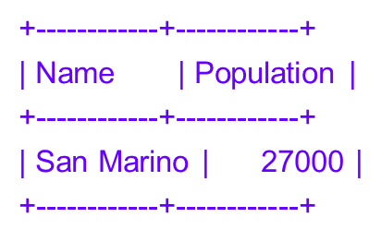
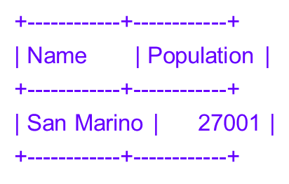
Views
mysql> CREATE VIEW EuropePop AS
-> SELECT Name, Population FROM CountryPop
-> WHERE Continent = 'Europe';
mysql> SELECT * FROM EuropePop WHERE Name = 'San Marino';
mysql> UPDATE EuropePop SET Population = Population + 1
-> WHERE Name = 'San Marino';
mysql> SELECT * FROM EuropePop WHERE Name = 'San Marino';
mysql> SELECT * FROM CountryPop WHERE Name = 'San Marino';
+------------+------------+-----------+
| Name | Population | Continent |
+------------+------------+-----------+
| San Marino | 27001 | Europe |
+------------+------------+-----------+
MySQL 5 Certification Study Guide <number>

Slide 19
Views
mysql> DELETE FROM EuropePop WHERE Name = 'San Marino';
mysql> SELECT * FROM EuropePop WHERE Name = 'San Marino';
Empty set (0.00 sec)
mysql> SELECT * FROM CountryPop WHERE Name = 'San Marino';
Empty set (0.01 sec)
CREATE TABLE ... LIKE
mysql> CREATE TABLE t
-> (i INT NOT NULL AUTO_INCREMENT,
-> PRIMARY KEY (i))
-> ENGINE = InnoDB;
mysql> CREATE TABLE copy1 SELECT * FROM t WHERE 0;
mysql> CREATE TABLE copy2 LIKE t;
MySQL 5 Certification Study Guide <number>

Slide 20
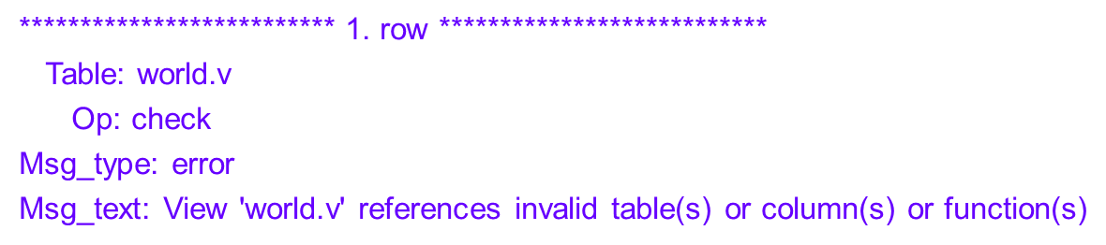
Views
Altering Views
ALTER VIEW LargePop AS
SELECT Name, Population FROM CountryPop
WHERE Population >= 100000000;
Dropping Views
mysql> DROP VIEW IF EXISTS v1, v2;
Checking Views
mysql> CREATE TABLE t1 (i INT);
mysql> CREATE VIEW v AS SELECT i FROM t1;
mysql> RENAME TABLE t1 TO t2;
mysql> CHECK TABLE v\G
MySQL 5 Certification Study Guide <number>

Slide 21
Prepared Statements
Using Prepared Statements from the mysql Client
MySQL Server supports prepared statements, which are useful when you want to run several queries that differ only in very small details. For example, you can prepare a statement, and then execute it multiple times, each time with different data values.
mysql> PREPARE my_stmt FROM
-> 'SELECT COUNT(*) FROM CountryLanguage WHERE CountryCode = ?';
mysql> SET @code = 'ESP'; EXECUTE my_stmt USING @code;
+----------+
| COUNT(*) |
+----------+
| 4 |
+----------+
mysql> DEALLOCATE PREPARE my_stmt;
MySQL 5 Certification Study Guide <number>

Slide 22
Prepared Statements
The following examples show two equivalent ways of preparing a statement that computes the hypotenuse of a triangle given the lengths of the two sides.
mysql> SET @s = 'SELECT SQRT(POW(?,2) + POW(?,2)) AS hypotenuse';
mysql> PREPARE stmt2 FROM @s;
mysql> SET @a = 6;
mysql> SET @b = 8;
mysql> EXECUTE stmt2 USING @a, @b;
+------------+
| hypotenuse |
+------------+
| 10 |
+------------+
mysql> DEALLOCATE PREPARE stmt2;
MySQL 5 Certification Study Guide <number>

Slide 23
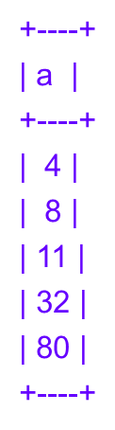
Prepared Statements
Here is an additional example that demonstrates how to choose the table on which to perform a query at runtime, by storing the name of the table as a user variable:
mysql> USE test;
mysql> CREATE TABLE t1 (a INT NOT NULL);
mysql> INSERT INTO t1 VALUES (4), (8), (11), (32), (80);
mysql> SET @table = 't1';
mysql> SET @s = CONCAT('SELECT * FROM ', @table);
mysql> PREPARE stmt3 FROM @s;
mysql> EXECUTE stmt3;
mysql> DEALLOCATE PREPARE stmt3;
MySQL 5 Certification Study Guide <number>

Slide 24
Stored Procedures and Functions
MySQL provides capabilities for defining and executing stored procedures and functions. A client sends the definition of a procedure or function to the server, which stores it for later use. Clients then invoke it whenever necessary to cause SQL operations to be performed or to produce values.
Stored procedures and functions have a great deal in common and much of the discussion here applies to both. However, to avoid many repetitions of the term "procedures and functions," the following discussion often uses "routine" to indicate material that applies to both.
The most general difference between procedures and functions is that they are invoked differently and for different purposes:
  A procedure does not return a value. Instead, it is invoked with a CALL statement to perform an operation such as modifying a table or processing retrieved records.
  A function is invoked within an expression and returns a single value directly to the caller to be used in the expression. That is, a function is used in expressions the same way as a constant, a built-in function, or a reference to a table column.
  You cannot invoke a function with a CALL statement, nor can you invoke a procedure in an expression.
MySQL 5 Certification Study Guide <number>

Slide 25
Stored Procedures and Functions
Defining Stored Routines
mysql> delimiter //
mysql> CREATE PROCEDURE world_record_count ()
-> BEGIN
-> SELECT 'Country', COUNT(*) FROM Country;
-> SELECT 'City', COUNT(*) FROM City;
-> SELECT 'CountryLanguage', COUNT(*) FROM CountryLanguage;
-> END;
-> //
mysql> delimiter ;
Call world_record_count ();
CREATE PROCEDURE rect_area (width INT, height INT)
SELECT width * height AS area;
CREATE FUNCTION circle_area (radius FLOAT)
RETURNS FLOAT
RETURN PI() * radius * radius;
select circle_area(5);
MySQL 5 Certification Study Guide <number>

Slide 26

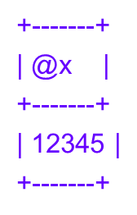

Stored Procedures and Functions
Working with parameters
mysql> CREATE TABLE t (s1 INT);
mysql> INSERT INTO t VALUES (5);
mysql> DELIMITER //
CREATE PROCEDURE p1 () SELECT * FROM t; //
mysql> CALL p1() //
mysql> CREATE PROCEDURE p5(p INT) SET @x = p //
mysql> CALL p5(12345)//
mysql> SELECT @x//
mysql> CREATE PROCEDURE p6 (OUT p INT)
-> SET p = -5 //
mysql> CALL p6(@y)//
mysql> SELECT @y//

Slide 27
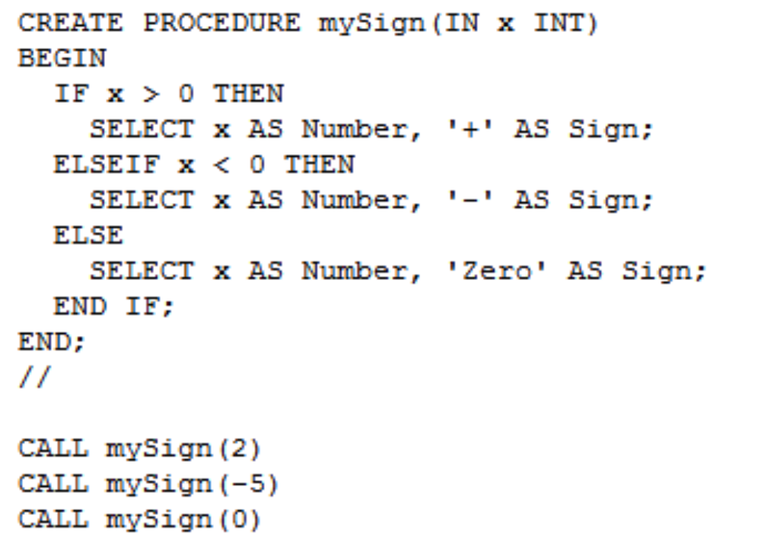
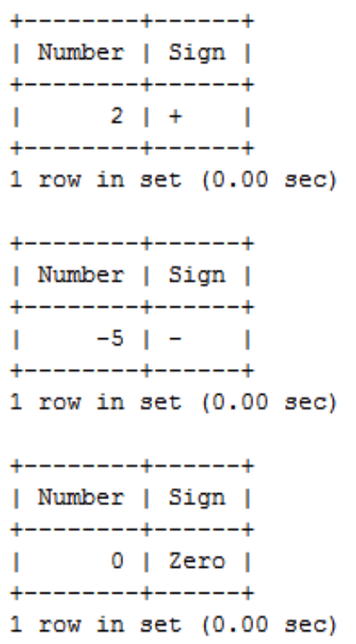
Stored Procedures and Functions

Slide 28
Stored Procedures and Functions
CREATE PROCEDURE p13 (IN parameter1 INT)
BEGIN
  DECLARE variable1 INT;
  SET variable1 = parameter1 + 1;
  CASE variable1
    WHEN 0 THEN INSERT INTO t VALUES (17);
    WHEN 1 THEN INSERT INTO t VALUES (18);
    ELSE INSERT INTO t VALUES (19);
  END CASE;
END;
CREATE PROCEDURE p14 ()
BEGIN
  DECLARE v INT;
  SET v = 0;
  WHILE v < 5 DO
    INSERT INTO t VALUES (v);
    SET v = v + 1;
  END WHILE;
END;

Slide 29
Stored Procedures and Functions
Dynamic Sql
CREATE PROCEDURE dynamic(IN tbl CHAR(64), IN col CHAR(64))
BEGIN
  SELECT col FROM tbl;
END
CREATE PROCEDURE dynamic(IN tbl CHAR(64), IN col CHAR(64))
BEGIN
  SET @s = CONCAT('SELECT ',col,' FROM ',tbl );
  PREPARE stmt FROM @s;
  EXECUTE stmt;
  DEALLOCATE PREPARE stmt;
END

Slide 30
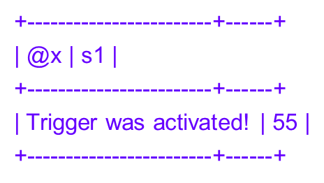
Triggers
A trigger provides a means to execute an SQL statement or set of statements when you insert, update, or delete rows in a table.
Triggers can be defined to activate either before or after the event. This means there can be two triggers per event (for example, one trigger to activate before an UPDATE and one to activate after).
DELIMITER //
CREATE TABLE t22 (s1 INTEGER)//
CREATE TRIGGER t22_bi
BEFORE INSERT ON t22
FOR EACH ROW
BEGIN
SET @x = 'Trigger was activated!';
SET NEW.s1 = 55;
END;//
mysql> INSERT INTO t22 VALUES (1)//
mysql> SELECT @x, t22.* FROM t22//
MySQL 5 Certification Study Guide <number>

Slide 31

Triggers
CREATE TABLE account (acct_num INT, amount DECIMAL(10,2));
CREATE TRIGGER ins_sum BEFORE INSERT ON account
FOR EACH ROW
SET @sum = @sum + NEW.amount;
SET @sum = 0;
INSERT INTO account VALUES(137,14.98),(141,1937.50),(97,-100.00);
SELECT @sum AS 'Total amount inserted';
The following example illustrates these points. It defines an UPDATE trigger that checks the new value to be used for updating each row, and modifies the value to be within the range from 0 to 100. This must be a BEFORE trigger because the value needs to be checked before it is used to update the row:
mysql> delimiter //
mysql> CREATE TRIGGER upd_check BEFORE UPDATE ON account
-> FOR EACH ROW
-> BEGIN
-> IF NEW.amount < 0 THEN
-> SET NEW.amount = 0;
-> ELSEIF NEW.amount > 100 THEN
-> SET NEW.amount = 100;
-> END IF;
-> END;//
mysql> delimiter ;
MySQL 5 Certification Study Guide <number>

Slide 32
Triggers
CREATE TABLE test1(a1 INT);
CREATE TABLE test2(a2 INT);
CREATE TABLE test3(a3 INT NOT NULL AUTO_INCREMENT PRIMARY KEY);
CREATE TABLE test4(
a4 INT NOT NULL AUTO_INCREMENT PRIMARY KEY,
b4 INT DEFAULT 0
);
delimiter |
CREATE TRIGGER testref BEFORE INSERT ON test1
FOR EACH ROW
BEGIN
INSERT INTO test2 SET a2 = NEW.a1;
DELETE FROM test3 WHERE a3 = NEW.a1;
UPDATE test4 SET b4 = b4 + 1 WHERE a4 = NEW.a1;
END;
|
delimiter ;
INSERT INTO test3 (a3) VALUES (NULL), (NULL), (NULL), (NULL), (NULL),
(NULL), (NULL), (NULL), (NULL), (NULL);
INSERT INTO test4 (a4) VALUES (0), (0), (0), (0), (0), (0), (0), (0), (0), (0);
MySQL 5 Certification Study Guide <number>

Slide 33


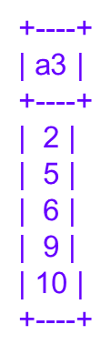
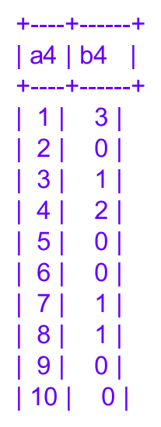
Triggers
Suppose that you insert the following values into table test1 as shown here:
mysql> INSERT INTO test1 VALUES (1), (3), (1), (7), (1), (8), (4), (4);
As a result, the four tables contain the following data:
mysql> SELECT * FROM test1;
mysql> SELECT * FROM test2;
mysql> SELECT * FROM test3;
mysql> SELECT * FROM test4;
MySQL 5 Certification Study Guide <number>

Slide 34
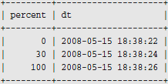
Triggers
The following example shows a trigger bi_t for INSERT statements for a table t that has an integer percent column for storing percentage values (0 to 100) and a DATETIME column. The trigger uses BEFORE so that it can examine data values before they are inserted into the table.
CREATE TABLE t (percent INT, dt DATETIME);
CREATE TRIGGER bi_t BEFORE INSERT ON t
FOR EACH ROW BEGIN
SET NEW.dt = CURRENT_TIMESTAMP;
IF NEW.percent < 0 THEN
SET NEW.percent = 0;
ELSEIF NEW.percent > 100 THEN
SET NEW.percent = 100;
END IF;
END;
INSERT INTO t (percent) VALUES(-2);
DO SLEEP(2);
INSERT INTO t (percent) VALUES(30);
DO SLEEP(2);
INSERT INTO t (percent) VALUES(120);
SELECT * FROM t;
MySQL 5 Certification Study Guide <number>

