Slide 1
Advanced Database
IS411

Slide 2
ADO.Net
ADO.NET is a set of classes that comes with the Microsoft .NET framework to facilitate data access from managed languages. ADO.NET has been in existence for a long time and it provides a comprehensive and complete set of libraries for data access.
The strength of ADO.NET is firstly that it lets applications access various types of data using the same methodology. If I know how to use ADO.NET to access a SQL Server database then the same methodology can be used to access any other type of database (like Oracle or MS Access) by just using a different set of classes.
http://www.codeproject.com/Articles/361579/A-Beginners-Tutorial-for-Understanding-ADO-NET

Slide 3
ADO.Net
Secondly, ADO.NET provides two models for data access: a connected model where I can keep the connection with the database and perform data access, and another way is to get all the data in ADO.NET objects that let us perform data access on disconnected objects.
The next diagram shows that ADO.NET can be used with any kind of application, i.e., it can be used from a Windows Forms application, an ASP.NET application, or from a WPF and/or Silverlight application.
Also, the data store underneath can be any data store, MySQL Server, Access, or Oracle. It is just a matter of using the right set of classes specific to that data store and the methodology will remain the same.

Slide 4
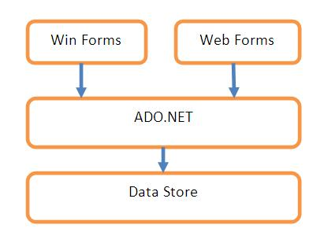
ADO.Net

Slide 5
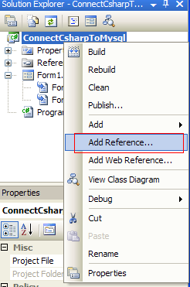
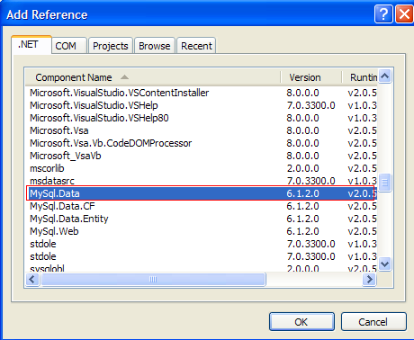
ADO.Net
Connect C# with MySql using MySql Connect/NET.
Downloading Connector/Net
Adding Reference and Creating the MySQL Connector DLL from the Project

Slide 6
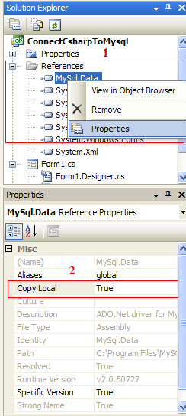
ADO.Net
using MySql.Data.MySqlClient;

Slide 7
ADO.Net
ADO.NET relies on data providers to provide access to the underlying data source. Each data provider exposes a set of objects that you use to manage connections, retrieve data, and update data. The core objects are the following:
Connection
Command
DataReader
DataAdapter
In MySQL
create database ConnectCsharpToMysql;
use ConnectCsharpToMysql;
create table tableInfo
(
  id INT NOT NULL AUTO_INCREMENT,
  name VARCHAR(30),
  age INT,
  PRIMARY KEY(id)
);

Slide 8
ADO.Net
MySqlConnection
MySqlConnection connection = new MySqlConnection("server=localhost;database=connectcsharptomysql;uid=root;pwd=root");
Orrrrrrrrrrrrrrrrr
MySqlConnection connection = new MySqlConnection();
connection.ConnectionString = "server=localhost;database=connectcsharptomysql;uid=root;pwd=root";
connection.Open();
MessageBox.Show("hiiiiiiiiiiiiii");
connection.Close();

Slide 9
ADO.Net
MySqlCommand
No Output
MySqlCommand cmd = new MySqlCommand(“INSERT INTO tableinfo (name, age) VALUES('John Smith', '33')”, connection);
Orrrrrrrrrrrrrr
MySqlCommand cmd = connection.CreateCommand();
cmd.CommandText = " INSERT INTO tableinfo (name, age) VALUES('John Smith', '33')";
Orrrrrrrrrrrrrrrrrrrrr
MySqlCommand cmd = new MySqlCommand();
cmd.Connection = connection;
cmd.CommandText = "INSERT INTO tableinfo (name, age) VALUES('John Smith', '33')";
connection.Open();
cmd.ExecuteNonQuery(); //also delete, update, create, alter, drop
connection.Close();

Slide 10
ADO.Net
Output (Console)
cmd.CommandText = "SELECT * FROM tableinfo";
connection.Open();
MySqlDataReader dataReader = cmd.ExecuteReader();
Console.WriteLine("ID" + "\t\t" + "Name" + "\t\t" + "Age");
while (dataReader.Read()){
Console.WriteLine(dataReader[0].ToString() + "\t\t" + dataReader[1].ToString() + "\t\t" + dataReader[2].ToString());
}
Orrrrrrrrrrrrrrrrrrrrrrrrrrr
Console.WriteLine("ID" + "\t\t" + "Name" + "\t\t" + "Age");
while (dataReader.Read()){
Console.WriteLine(dataReader[“id”].ToString() + "\t\t" + dataReader[“name”].ToString() + "\t\t" + dataReader[“age”].ToString());
}
dataReader.Close();
connection.Close();

Slide 11
ADO.Net
Output (Form)
cmd.CommandText = "SELECT * FROM tableinfo";
connection.Open();
MySqlDataReader dataReader = cmd.ExecuteReader();
DataTable dt = new DataTable();
dt.Load(dataReader);
dataGridView1.DataSource = dt;
dataReader.Close();
connection.Close();
Output (Single Value)
cmd.CommandText = "SELECT Count(*) FROM tableinfo"
connection.Open();
Count = int.Parse(cmd.ExecuteScalar().ToString());
connection.Close();

Slide 12
ADO.Net
Command Type (Table Direct)
MySqlCommand cmd = new MySqlCommand();
cmd.CommandType = CommandType.TableDirect;
cmd.CommandText = "tableinfo";
cmd.Connection = connection;
MySqlDataReader dataReader = cmd.ExecuteReader();
DataTable dt = new DataTable();
dt.Load(dataReader);
dataGridView1.DataSource = dt;
dataReader.Close();
connection.Close();

Slide 13
ADO.Net
Command Type (Stored Procedure)
CREATE PROCEDURE MyStored()
BEGIN
select * from tableinfo;
END;
To run this procedure from MySql: Call MyStored();
To run this procedure from C#: (1)
MySqlCommand cmd = new MySqlCommand();
cmd.CommandText = "Call MyStored()";
cmd.Connection = connection;
MySqlDataReader dataReader = cmd.ExecuteReader();
DataTable dt = new DataTable();
dt.Load(dataReader);
dataGridView1.DataSource = dt;
dataReader.Close();
connection.Close();

Slide 14
ADO.Net
To run this procedure from C#: (2)
MySqlCommand cmd = new MySqlCommand();
cmd.CommandType = CommandType.StoredProcedure;
cmd.CommandText = "MyStored";
cmd.Connection = connection;
MySqlDataReader dataReader = cmd.ExecuteReader();
DataTable dt = new DataTable();
dt.Load(dataReader);
dataGridView1.DataSource = dt;
dataReader.Close();
connection.Close();

Slide 15
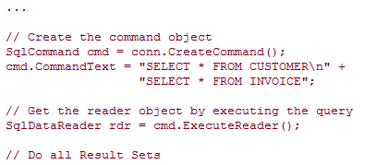
ADO.Net
Multiple Select:

Slide 16
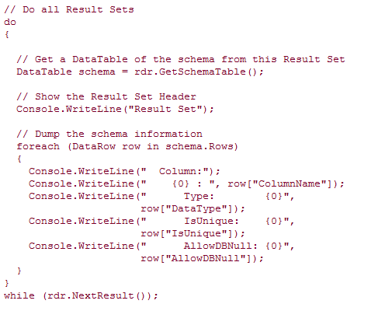
ADO.Net

Slide 17
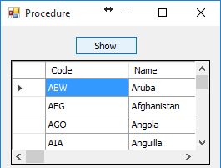
ADO.Net
Procedure Parameters: (1)
In Mysql:
CREATE PROCEDURE p1()
SELECT * from country;
In C#:
MySqlConnection con = new MySqlConnection("server=localhost;database=world;uid=root;pwd=root");
con.Open();
MySqlCommand cmd = new MySqlCommand("p1",con);
cmd.CommandType = CommandType.StoredProcedure;
MySqlDataReader dr = cmd.ExecuteReader();
DataTable dt = new DataTable();
dt.Load(dr);
dataGridView1.DataSource = dt;
dr.Close();
con.Close();

Slide 18
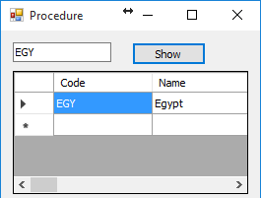
ADO.Net
Procedure Parameters: (2)
In Mysql:
create PROCEDURE p2 (in x nvarchr(3))
select * from country where code=x;
In C#:
MySqlConnection con = new MySqlConnection("server=localhost;database=world;uid=root;pwd=root");
con.Open();
MySqlCommand cmd = new MySqlCommand("p2",con);
cmd.CommandType = CommandType.StoredProcedure;
cmd.Parameters.AddWithValue("x", textBox3.Text);
MySqlDataReader dr = cmd.ExecuteReader();
DataTable dt = new DataTable();
dt.Load(dr);
dataGridView1.DataSource = dt;
dr.Close();
con.Close();

Slide 19
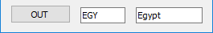
ADO.Net
Procedure Parameters: (3)
In Mysql:
create PROCEDURE p3 (x nvarchar(3), out y varchar(20))
select Name into y from country where code=x;
In C#:
MySqlConnection con = new MySqlConnection("server=localhost;database=world;uid=root;pwd=root");
con.Open();
MySqlCommand cmd = new MySqlCommand("p3",con);
cmd.CommandType = CommandType.StoredProcedure;
cmd.Parameters.AddWithValue("x", textBox1.Text);
cmd.Parameters.Add("y", MySqlDbType.VarChar, 20);
cmd.Parameters["y"].Direction = ParameterDirection.Output;
cmd.ExecuteNonQuery();
textBox2.Text = cmd.Parameters["y"].Value.ToString();
con.Close();

Slide 20
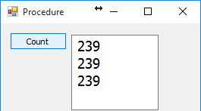
ADO.Net
Example:
You want to determine how many records there are in a country table.
Solution: Use one of the following three techniques:
Iterate over the rows in the DataReader.
Issue a COUNT(*) query as part of a batch query.
Use the FOUND_ROWS() function to return the number of rows.
In MySql:
Create procedure CountStored (Out rCount integer)
BEGIN
select * from country;
set rCount=FOUND_ROWS();
END

Slide 21
ADO.Net
MySqlConnection con = new MySqlConnection("server=localhost;database=world;uid=root;pwd=root");
con.Open();
MySqlCommand cmd = new MySqlCommand("select count(*) from country;select * from country;",con);
MySqlDataReader dataReader = cmd.ExecuteReader();
dataReader.Read();
int rowcount1 = Convert.ToInt32(dataReader[0]);
int rowcount2 = 0;
dataReader.NextResult();
while (dataReader.Read())
rowcount2++;
con.Close();
cmd = new MySqlCommand("CountStored",con);
cmd.CommandType = CommandType.StoredProcedure;
cmd.Parameters.Add("rCount", MySqlDbType.Int32).Direction = ParameterDirection.Output;
con.Open();
cmd.ExecuteNonQuery();
int rowcount3 = Convert.ToInt32(cmd.Parameters["rCount"].Value);
textBox4.Text = rowcount1.ToString() + "\r\n" + rowcount2.ToString() + "\r\n" + rowcount3.ToString();
dataReader.Close();
con.Close();

Slide 22
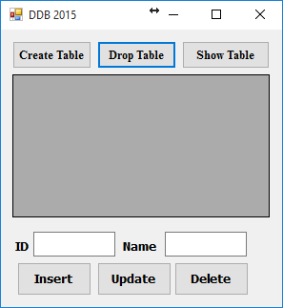
ADO.Net
MySqlConnection con;
MySqlCommand cmd;
private void Form2_Load(object sender, EventArgs e){
con = new MySqlConnection("server=localhost;database=world;uid=root;pwd=root");
con.Open();
}

Slide 23
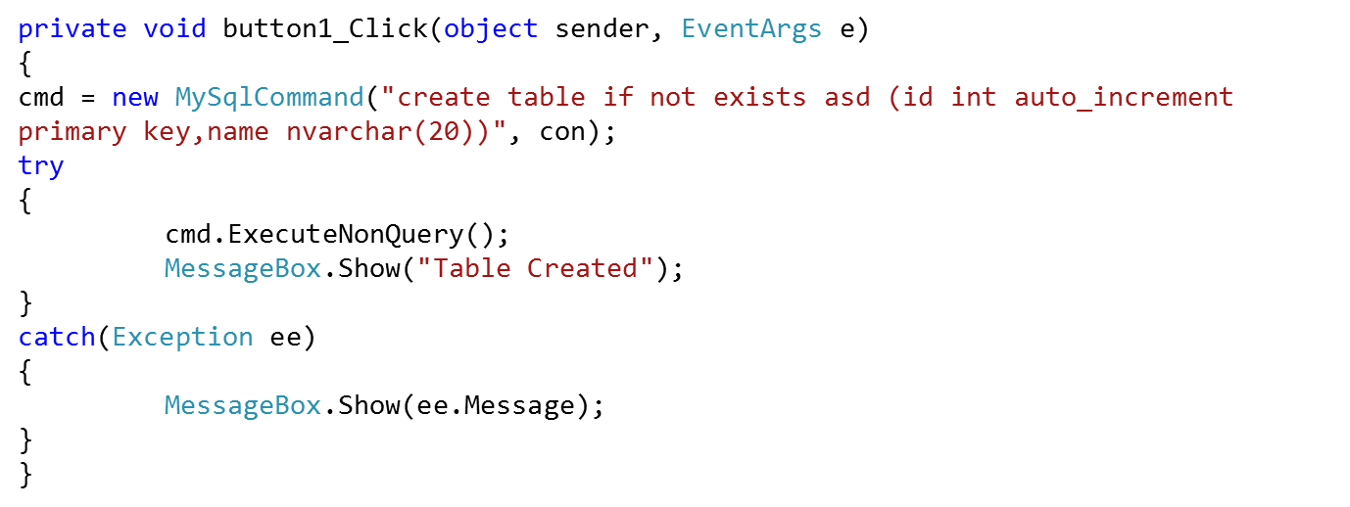
ADO.Net
Create Table:

Slide 24
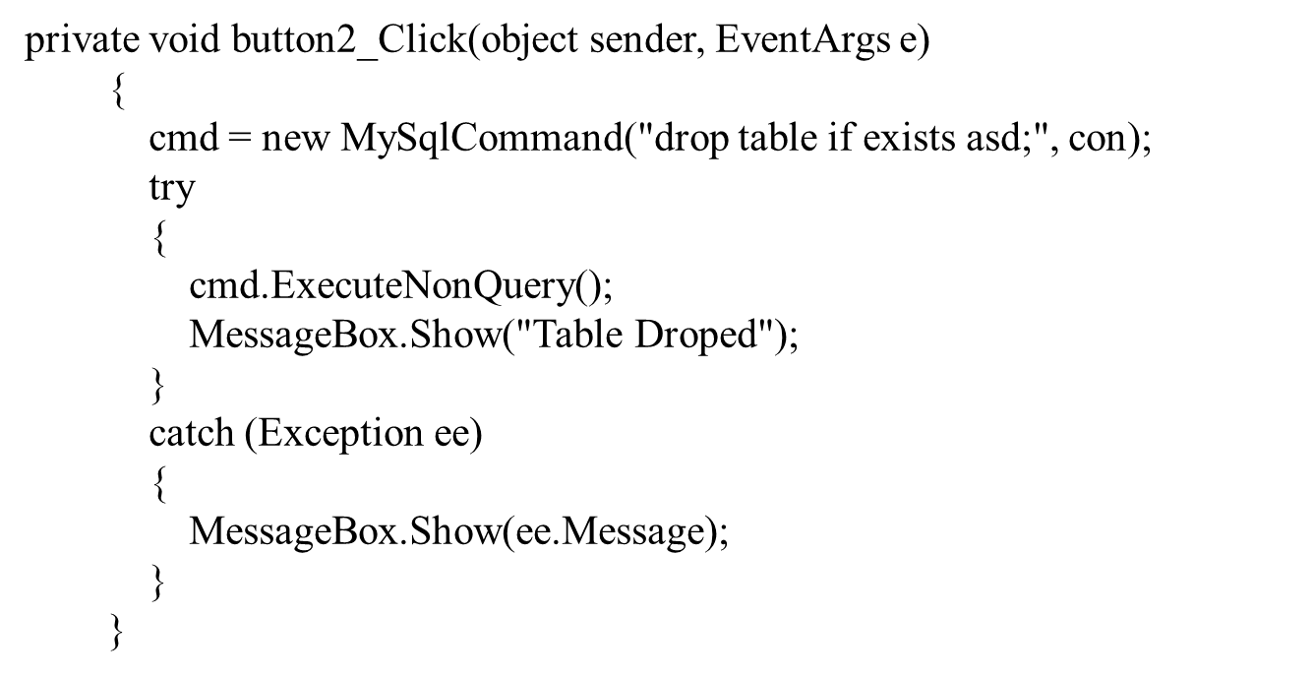
ADO.Net
Drop Table:

Slide 25
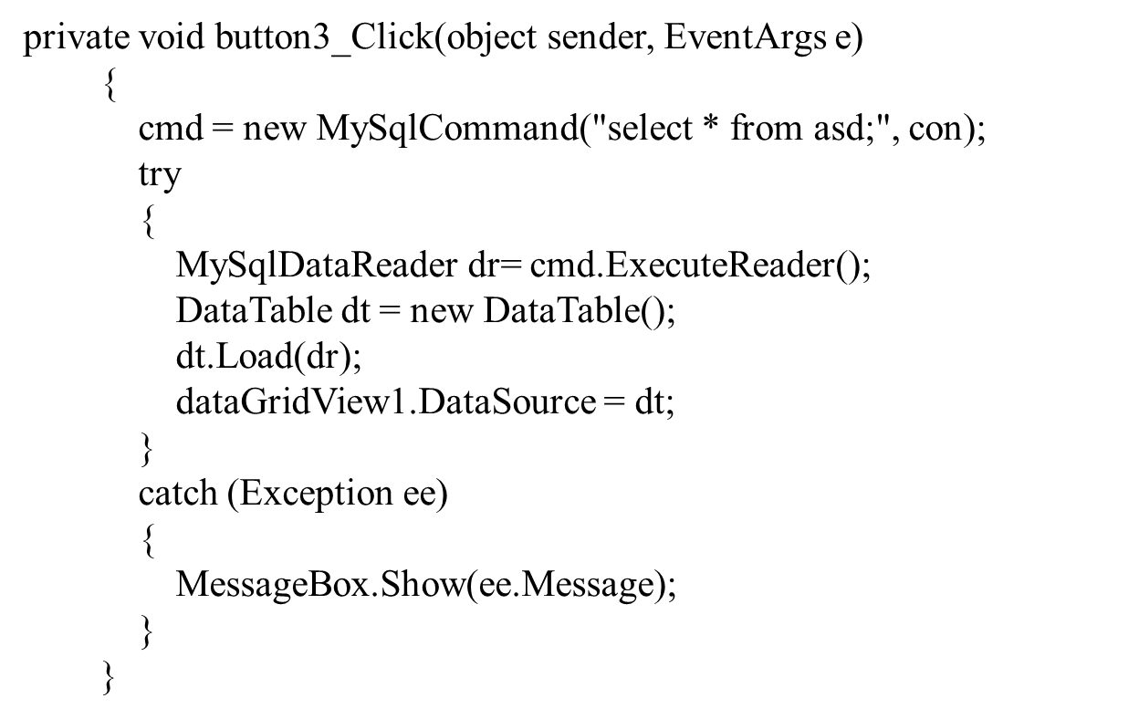
ADO.Net
Show Table:

Slide 26
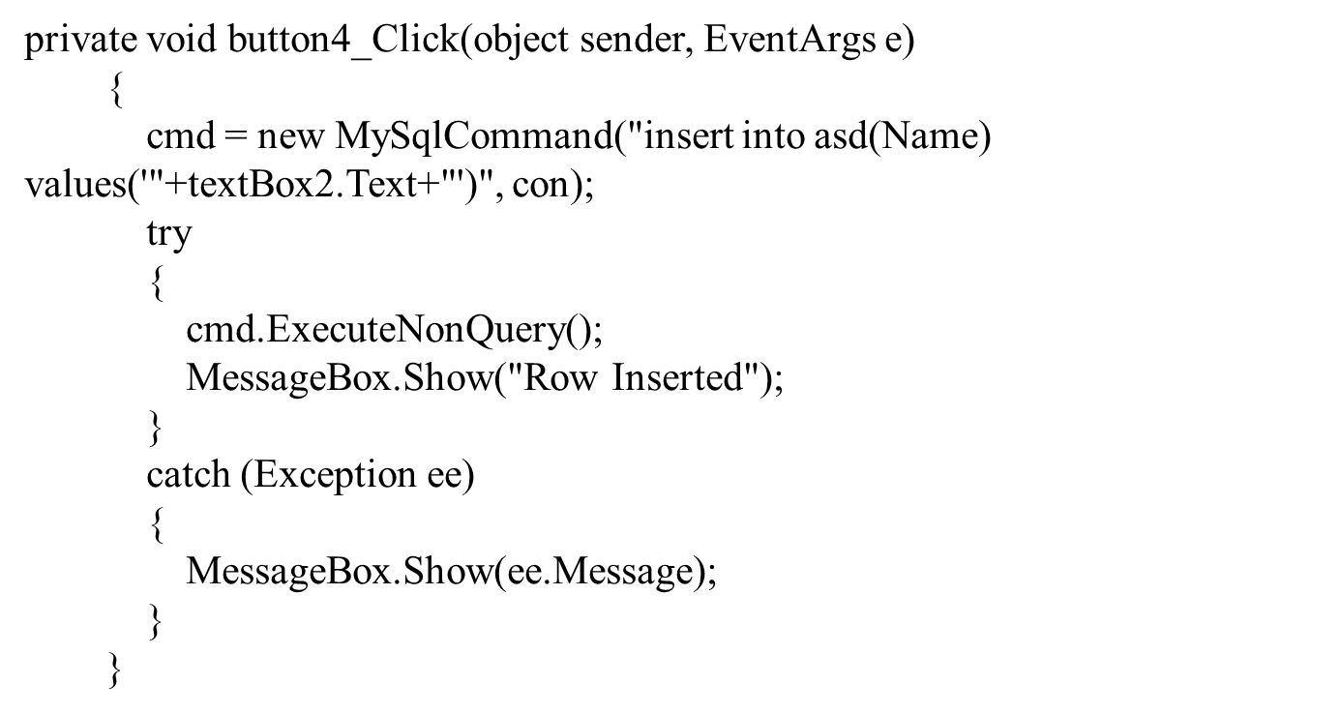
ADO.Net
Insert Row:

Slide 27
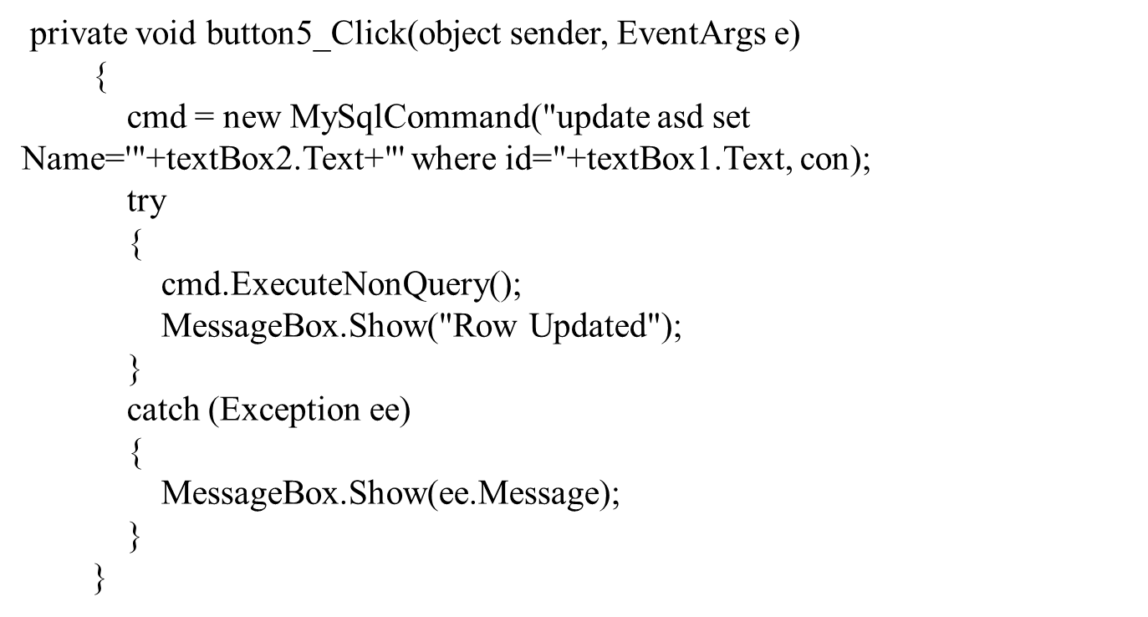
ADO.Net
Update Row:

Slide 28
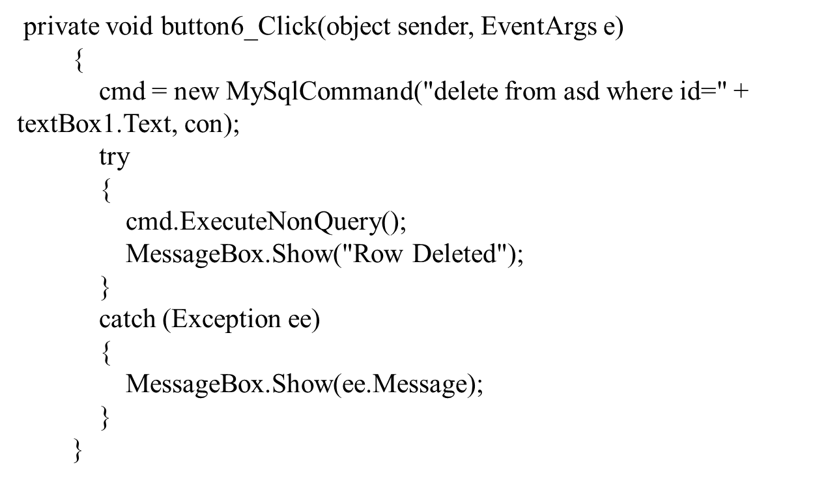
ADO.Net
Delete Row:

