Slide 1
Advanced Database
IS411

Slide 2
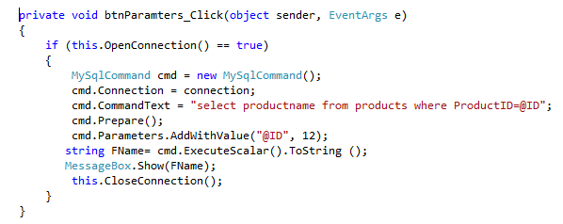
ADO.Net
Prepared statements
When we write prepared statements, we use placeholders instead of directly writing the values into the statements. Prepared statements are faster and guard against SQL injection attacks. The @ID is a placeholder, which is going to be filled later.

Slide 3
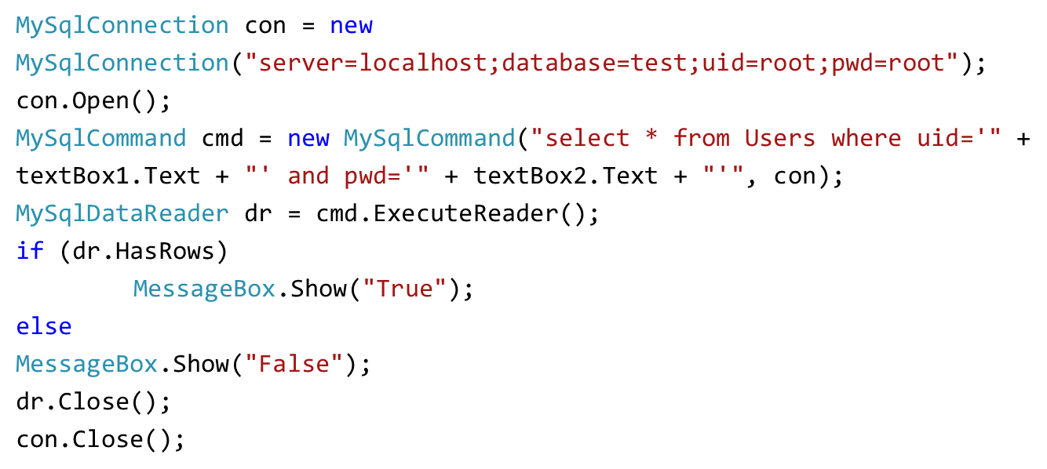
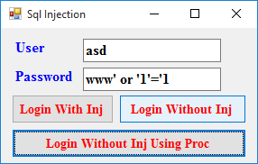
ADO.Net
SQL Injection
User: asd
Password: asd'; delete from aa where '1'='1

Slide 4
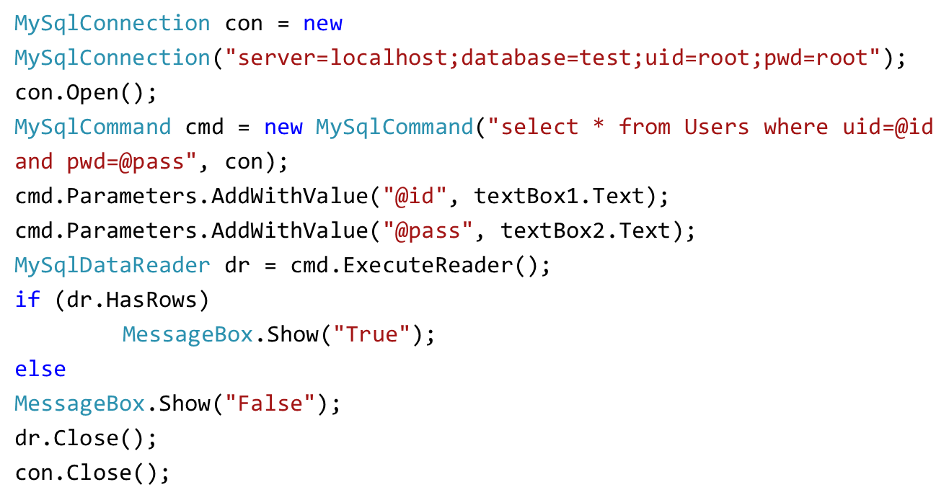
ADO.Net
SQL Injection: Solution 1

Slide 5
ADO.Net
SQL Injection: Solution 2
First create procedure Login in mysql:
create procedure Login(id varchar(255),pass varchar(255))
BEGIN
select * from users where uid=id and pwd=pass;
END
Then in C#:
MySqlConnection con = new MySqlConnection("server=localhost;database=test;uid=root;pwd=root");
con.Open();
MySqlCommand cmd = new MySqlCommand("Login", con);
cmd.CommandType = CommandType.StoredProcedure;
cmd.Parameters.AddWithValue("@id", textBox1.Text);
cmd.Parameters.AddWithValue("@pass", textBox2.Text);
MySqlDataReader dr = cmd.ExecuteReader();
if (dr.HasRows)
MessageBox.Show("True");
else
MessageBox.Show("False");
dr.Close();
con.Close();

Slide 6
ADO.Net
Dataset
DataSet is a major component of the ADO.NET architecture. The DataSet consists of a collection of DataTable objects that you can relate to each other with DataRelation objects.
The data stored in the DataSet object is disconnected from the database!
A DataSet is created in memory and used when extensive processing on data is needed or when we bind data tables to a Winforms control. When the processing is done, the changes are written to the data source. A MySqlDataAdapter is an intermediary between the DataSet and the data source. It populates a DataSet and resolves updates with the data source.
A DataTable class holds the Rows collection, which contains a set of data rows or DataRow objects, and the Columns collection, which contains a set of data columns or DataColumn objects.

Slide 7
ADO.Net
Creating and Using DataAdapter Objects
string strConn = @”";
MySqlConnection cn = new MySqlConnection(strConn);
string strSQL = “";
MySqlCommand cmd = new MySqlCommand(strSQL, cn);
MySqlDataAdapter da = new MySqlDataAdapter();
da.SelectCommand = cmd;
OR:Using connection and SQL statment
MySqlDataAdapter da = new MySqlDataAdapter(strSQL, strConn);
OR:Using Command
MySqlDataAdapter da = new MySqlDataAdapter(cmd);

Slide 8
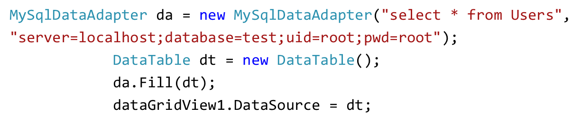
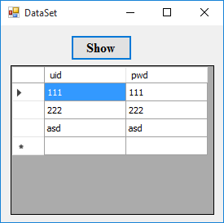
ADO.Net

Slide 9
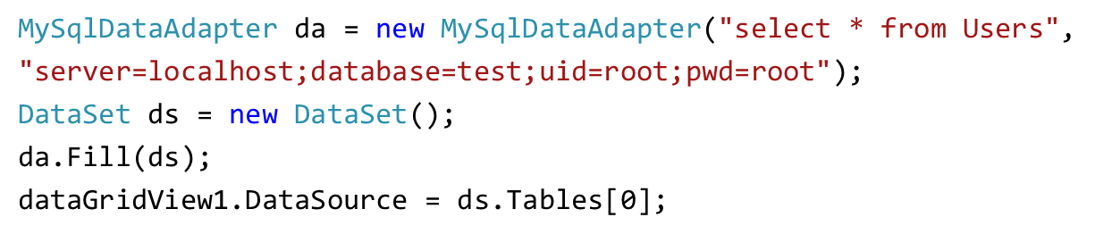
ADO.Net

Slide 10
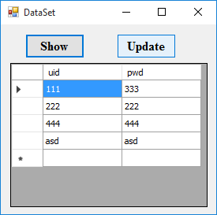
ADO.Net
MySqlDataAdapter da;
DataSet ds = new DataSet();
private void button1_Click(object sender, EventArgs e)
{
dataGridView1.DataSource = null;
ds.Tables.Clear();
dataGridView1.Rows.Clear();
dataGridView1.Refresh();
da = new MySqlDataAdapter("select * from Users",
"server=localhost;database=test;uid=root;pwd=root");
MySqlCommandBuilder cb = new MySqlCommandBuilder(da);
da.Fill(ds);
dataGridView1.DataSource = ds.Tables[0];
}
private void button2_Click(object sender, EventArgs e)
{
da.Update(ds);
}

Slide 11
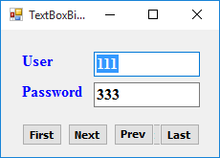
ADO.Net
Data binding
Keep the following two concepts in mind when you think about data binding:
The direction that data flows between data sources and the data-bound controls and When the data flows.
In one-way data binding, data flows only in one direction: values from properties of the data source are placed into properties on the user interface control, but there is no flow of data back from the control to the data source if those property values change within the control, at least not automatically.
In two-way data binding, changes to the bound properties of a control also result in those changed values updating the corresponding data source values in the object in memory on the client. Most data-binding mechanisms in Windows Forms are designed to be two-way.

Slide 12
ADO.Net
MySqlDataAdapter da;
DataSet ds = new DataSet();
int i = 0;
private void Form1_Load(object sender, EventArgs e)
{
da = new MySqlDataAdapter("select * from Users", "server=localhost;database=test;uid=root;pwd=root");
MySqlCommandBuilder cb = new MySqlCommandBuilder(da);
da.Fill(ds);
textBox1.DataBindings.Add("text", ds.Tables[0], "uid");
textBox2.DataBindings.Add("text", ds.Tables[0], "pwd");
}

Slide 13
ADO.Net
private void First_Click(object sender, EventArgs e)
{
i = 0;
textBox1.Text = ds.Tables[0].Rows[i][0].ToString();
textBox2.Text = ds.Tables[0].Rows[i][1].ToString();
}
private void Next_Click(object sender, EventArgs e)
{
i++;
if (i < ds.Tables[0].Rows.Count)
{
textBox1.Text = ds.Tables[0].Rows[i][0].ToString();
textBox2.Text = ds.Tables[0].Rows[i][1].ToString();
}
else
{
i--;
MessageBox.Show("Error");
}
}

Slide 14
ADO.Net
private void Prev_Click(object sender, EventArgs e)
{
i--;
if (i >= 0)
{
textBox1.Text = ds.Tables[0].Rows[i][0].ToString();
textBox2.Text = ds.Tables[0].Rows[i][1].ToString();
}
else
{
i++;
MessageBox.Show("Error");
}
}
private void Last_Click(object sender, EventArgs e)
{
i = ds.Tables[0].Rows.Count-1;
textBox1.Text = ds.Tables[0].Rows[i][0].ToString();
textBox2.Text = ds.Tables[0].Rows[i][1].ToString();
}

Slide 15
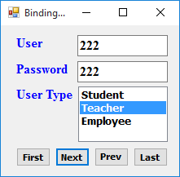
ADO.Net
Binding source
A binding source acts as a proxy between bound controls and their associated data source. It provides one-stop shopping for accessing or managing the data-binding context for one or more controls on a form. You bind controls on a form to a binding source, and then you bind the binding source to a data source.

Slide 16
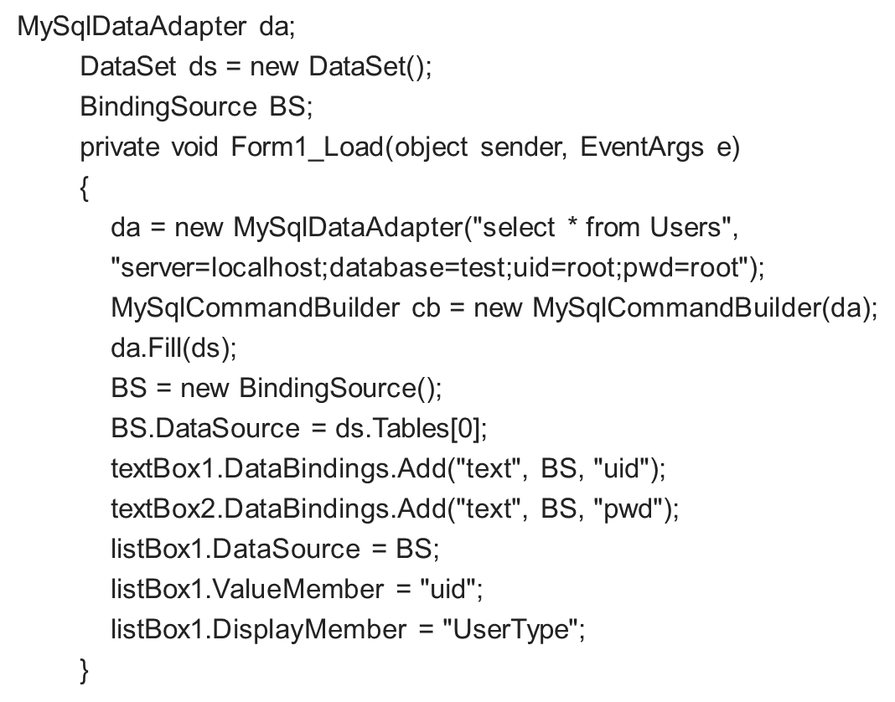
ADO.Net

Slide 17
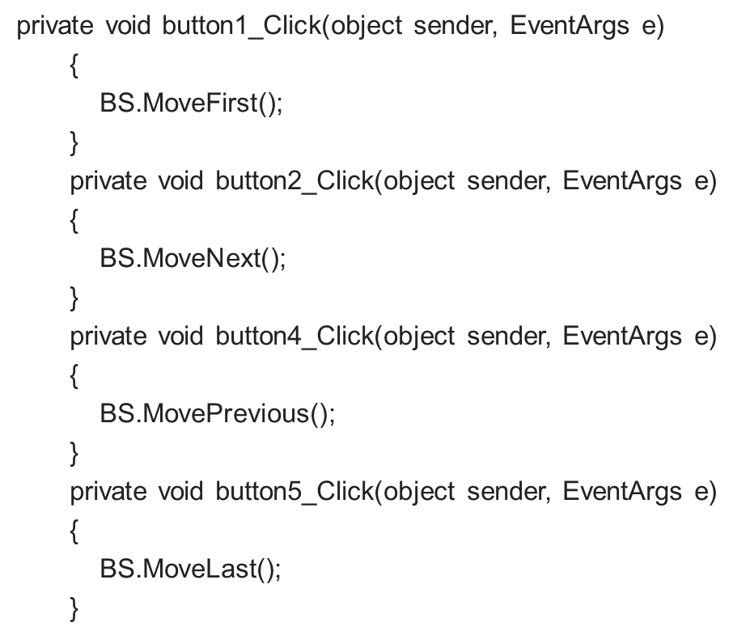
ADO.Net

Slide 18
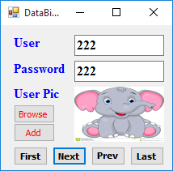
ADO.Net
Image Data Binding
uid varchar 255
pwd varchar 255
UserType varchar 255
UserImg longblob
create table image(img blob);
insert into image values(LOAD_FILE('D:/Untitled.bmp'))

Slide 19
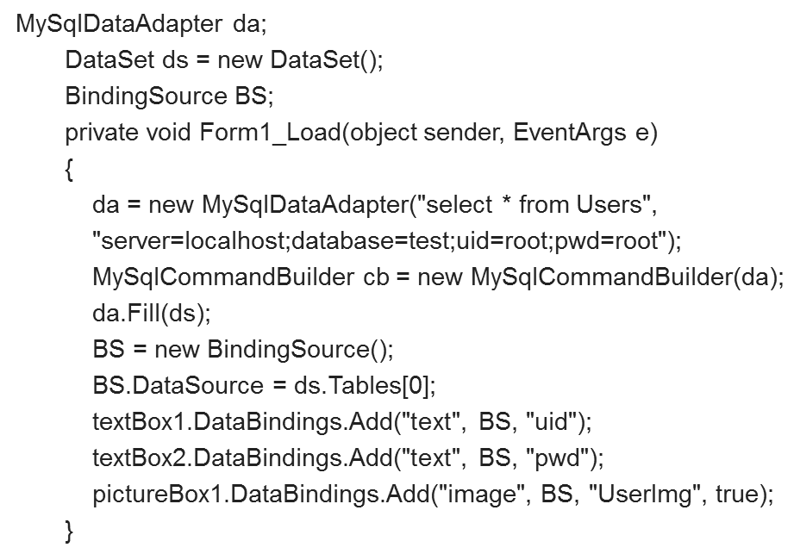
ADO.Net

Slide 20
ADO.Net

Slide 21
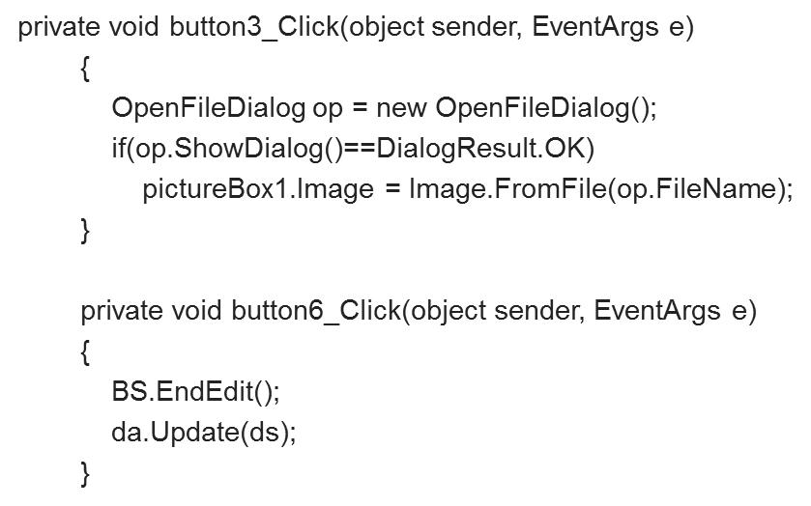
ADO.Net

Slide 22
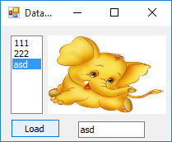
ADO.Net

Slide 23
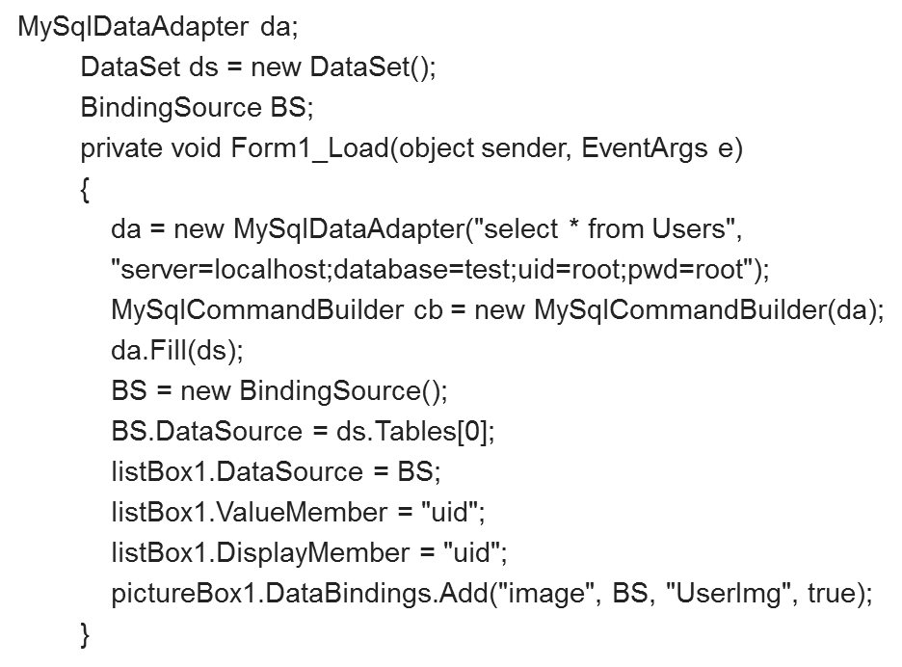
ADO.Net

Slide 24
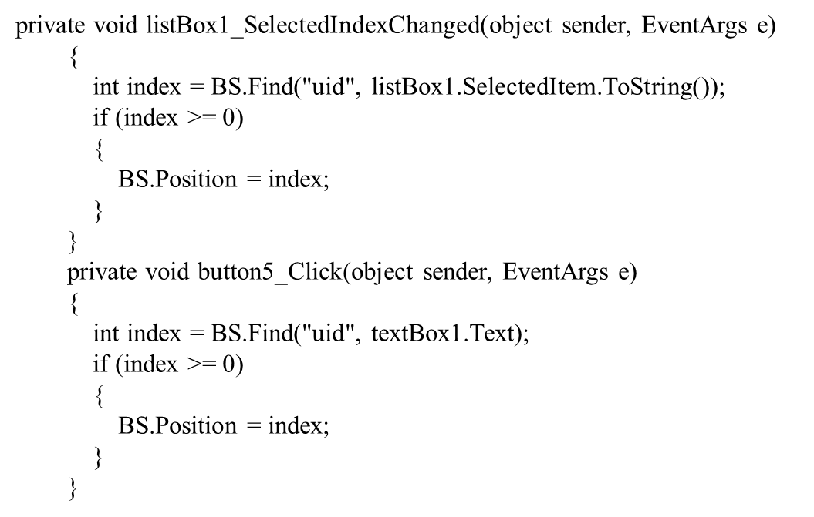
ADO.Net

