Slide 1
Unity

Slide 2
Creating and Using Scripts
The behavior of GameObjects is controlled by the Components that are attached to them.
Unity supports three programming languages natively:
C# (pronounced C-sharp), an industry-standard language similar to Java or C++;
UnityScript, a language designed specifically for use with Unity and modelled after JavaScript;
Boo, a .NET language with similar syntax to Python.

Slide 3
The initial contents of the file will look something like this:
using UnityEngine;
using System.Collections;
public class MainPlayer : MonoBehaviour {
// Use this for initialization
void Start () { }
// Update is called once per frame
void Update () { }
}

Slide 4
Each time you attach a script component to a GameObject, it creates a new instance of the object.
The name of the class is taken from the name you supplied when the file was created.
The class name and file name must be the same to enable the script component to be attached to a GameObject.

Slide 5
None of the code will be activated until an instance of the script is attached to a GameObject.
void Start () {
Debug.Log("I am alive!");
}

Slide 6
You must declare a variable as public to see it in the Inspector.
Unity creates the Inspector label by introducing a space wherever a capital letter occurs in the variable name.
public string myName;
// Use this for initialization
void Start () {
Debug.Log("I am alive and my name is " + myName);
}

Slide 7
Accessing Components
The simplest and most common case is where a script needs access to other Components attached to the same GameObject.
This is done with the GetComponent function.
void Start () {
Rigidbody rb = GetComponent<Rigidbody>();
// Change the mass of the object's Rigidbody.
rb.mass = 10f;
// Add a force to the Rigidbody.
rb.AddForce(Vector3.up * 10000f);
}

Slide 8
Note also that there is no reason why you can't have more than one custom script attached to the same object.
If you need to access one script from another, you can use GetComponent as usual and just use the name of the script class (or the filename) to specify the Component type you want.
If you attempt to retrieve a Component that hasn't actually been added to the GameObject then GetComponent will return null;
you will get a null reference error at runtime if you try to change any values on a null object.

Slide 9
Since some Component types are very commonly used, Unity provides built-in variables to access them in the MonoBehaviour class, so you can use things like:
void Start () {
transform.position = Vector3.zero;
}

Slide 10
Linking Objects with Variables
The most straightforward way to find a related GameObject is to add a public GameObject variable to the script.
public class Enemy : MonoBehaviour {
public GameObject player;
// Other variables and functions...
}
This variable will be visible in the Inspector.
You can now drag an object from the scene or Hierarchy panel onto this variable to assign it.
The GetComponent function and Component access variables are available for this object as with any other, so you can use code like the following:-
void Start() {
// Start the enemy ten units behind the player character.
transform.position = player.transform.position - Vector3.forward * 10f;
}

Slide 11
If declare a public variable of a Component type in your script, you can drag any GameObject that has that Component attached onto it.
This will access the Component directly rather than the GameObject itself.
public Transform playerTransform;

Slide 12
The previous method needs Unity editor rather than at runtime to link objects.
It is often convenient to locate objects at runtime and Unity provides two basic ways to do this:
Finding Child Objects
Finding Objects by Name or Tag

Slide 13
Finding Child Objects
It is better to manage a set of objects by making them all children of one parent object.
The child objects can be retreived using the parent's Transform Component (since all GameObjects implicitly have a Transform):-

Slide 14
Sometimes, a game scene will make use of a number of objects of the same type, such as waypoints.
public class WaypointManager : MonoBehaviour {
public Transform[ ] waypoints;
void Start() {
waypoints = new Transform[transform.childCount];
int i = 0;
foreach (Transform t in transform) { waypoints[i++] = t;}
}
}

Slide 15
You can also locate a specific child object by name using the Transform.Find function:-
transform.Find("Gun");

Slide 16
Finding Objects by Name or Tag
Individual objects can be retrieved by name using the GameObject.Find function:-
GameObject player;
void Start() {
player = GameObject.Find("MainHeroCharacter");
}

Slide 17
An object or a collection of objects can also be located by their tag using the GameObject.FindWithTag and GameObject.FindGameObjectsWithTag functions:-
GameObject player;
GameObject[] enemies;
void Start() {
player = GameObject.FindWithTag("Player");
enemies = GameObject.FindGameObjectsWithTag("Enemy");
}

Slide 18
Coroutines
When you call a function, it runs to completion before returning.
This effectively means that any action taking place in a function must happen within a single frame update; a function call can’t be used to contain a procedural animation or a sequence of events over time.

Slide 19
void Fade() {
for (float f = 1f; f >= 0; f -= 0.01f) {
Color c = renderer.material.color;
c.r = f;
renderer.material.color = c;
}
}
As it stands, the function will not have the effect you might expect.

Slide 20
The function will execute in its entirety within a single frame update. The intermediate values will never be seen.
It is possible to handle situations like this by adding code to the Update function that executes the fade on a frame-by-frame basis.
However, it is often more convenient to use a coroutine for this kind of task.
A coroutine is like a function that has the ability to pause execution and return control to Unity but then to continue where it left off on the following frame. In C#, a coroutine is declared like this:-

Slide 21
IEnumerator Fade() {
for (float f = 1f; f >= 0; f -= 0.01f) {
Color c = GetComponent<Renderer>().material.color;
c.r = f;
GetComponent<Renderer>().material.color = c;
yield return null;
}
}

Slide 22
It is essentially a function declared with a return type of IEnumerator and with the yield return statement included somewhere in the body.
The yield return line is the point at which execution will pause and be resumed the following frame.
To set a coroutine running, you need to use the StartCoroutine function:-

Slide 23
void Update() {
if (Input.GetKeyDown("f")) {
StartCoroutine("Fade");
}
}

Slide 24
By default, a coroutine is resumed on the frame after it yields but it is also possible to introduce a time delay using WaitForSeconds:-

Slide 25
IEnumerator Fade() {
for (float f = 1f; f >= 0; f -= 0.01f) {
Color c = renderer.material.color;
c.r = f;
renderer.material.color = c;
yield return new WaitForSeconds(.1f);
}
}

Slide 26
Attributes
Attributes are markers that can be placed above a class, property or function in a script to indicate special behaviour.
For example, the HideInInspector attribute can be added above a property declaration to prevent the property being shown in the inspector, even if it is public.
[HideInInspector]
public int strength;

Slide 27
Platform Dependent Compilation
Unity includes a feature named “Platform Dependent Compilation”. This consists of some preprocessor directives that let you partition your scripts to compile and execute a section of code exclusively for one of the supported platforms.

Slide 28
UNITY_EDITOR | Define for calling Unity Editor scripts from your game code.
UNITY_EDITOR_WIN | Platform define for editor code on Windows.
UNITY_EDITOR_OSX | Platform define for editor code on Mac OSX.
UNITY_STANDALONE_OSX | Platform define for compiling/executing code specifically for Mac OS (This includes Universal, PPC and Intel architectures).
UNITY_DASHBOARD_WIDGET | Platform define when creating code for Mac OS dashboard widgets.
UNITY_STANDALONE_WIN | Use this when you want to compile/execute code for Windows stand alone applications.
UNITY_STANDALONE_LINUX | Use this when you want to compile/execute code for Linux stand alone applications.
UNITY_STANDALONE | Use this to compile/execute code for any standalone platform (Mac, Windows or Linux).
UNITY_WEBPLAYER | Platform define for web player content (this includes Windows and Mac Web player executables).
UNITY_WII | Platform define for compiling/executing code for the Wii console.
UNITY_IPHONE | Platform define for compiling/executing code for the iPhone platform.
UNITY_ANDROID | Platform define for the Android platform.
UNITY_PS3 | Platform define for running PlayStation 3 code.
UNITY_XBOX360 | Platform define for executing Xbox 360 code.
UNITY_FLASH | Platform define when compiling code for Adobe Flash.
UNITY_BLACKBERRY | Platform define for a Blackberry10 device.
UNITY_WP8 | Platform define for Windows Phone 8.
UNITY_METRO | Platform define for Windows Store Apps (additionally NETFX_CORE is defined when compiling C# files against .NET Core).
UNITY_WINRT | Equivalent to UNITY_WP8 |UNITY_METRO

Slide 29
Testing precompiled code
We are going to show a small example of how to use the precompiled code.
This will simply print a message that depends on the platform you have selected to build your target.
First of all, select the platform you want to test your code against by clicking on File -> Build Settings. This will bring the build settings window to select your target platform.

Slide 30
using UnityEngine;
using System.Collections;
public class PlatformDefines : MonoBehaviour {
void Start () {
#if UNITY_EDITOR
Debug.Log("Unity Editor");
#endif
#if UNITY_IPHONE
Debug.Log("Iphone");
#endif

Slide 31
#if UNITY_STANDALONE_OSX
Debug.Log("Stand Alone OSX");
#endif
#if UNITY_STANDALONE_WIN
Debug.Log("Stand Alone Windows");
#endif
}
}

Slide 32
Creating a Game Over message
We shall display our Game Over text using a GUIText object.
Create from the main menu: GameObject>Create Other>GUI Text and rename it to GameOverText.
We’ll also need an empty GameObject. GameObject>Create Empty and rename it to Game Manager.
Let’s set up our Game Manager script. In the hierarchy panel select the Game Manager. In the Inspector panel click on Add Component. Select New Script and choose C# as the language. Name the script GameManager. Click Create and Add.

Slide 33
using UnityEngine;
using System.Collections;
using UnityEngine.UI;
public class GameManager : MonoBehaviour {
//create a reference for our Game Over text
public Text gameOverText;
//stores game over state
private bool gameOver = true;
void Update() {
//check if the game is over
if (gameOver)
gameOverText.text = "Game Over!";
} }

Slide 34
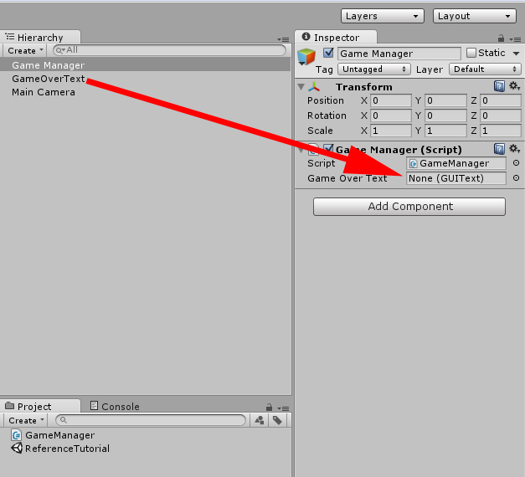

Slide 35
Rotate an object
using UnityEngine;
public class Rotator : MonoBehaviour {
public int xRotationSpeed = 0;
public int yRotationSpeed = 0;
public int zRotationSpeed = 0;
void Update () {
transform.Rotate(
Time.deltaTime * xRotationSpeed,
Time.deltaTime * yRotationSpeed,
Time.deltaTime * zRotationSpeed
);
}}

Slide 36
Multiplying by Time.deltatime allows you to rotate the object on a per second basis.
If you did not use this Unity would rotate the object on a per frame basis.
This would lead to different rotation speeds on slower/faster devices.
Use Time.deltatime to keep rotation speed consistent on all devices.

Slide 37
Scrolling texture
Go to GameObject>Create Other>Quad.
And Assets>Create>Material
Grab a simple grid texture from the Standard Assets package, but you can use any texture you like. (Assets>Import Package>Standard Assets)
With the material selected click the select button and choose the texture you want to apply:

Slide 38
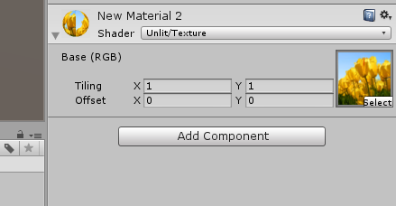

Slide 39
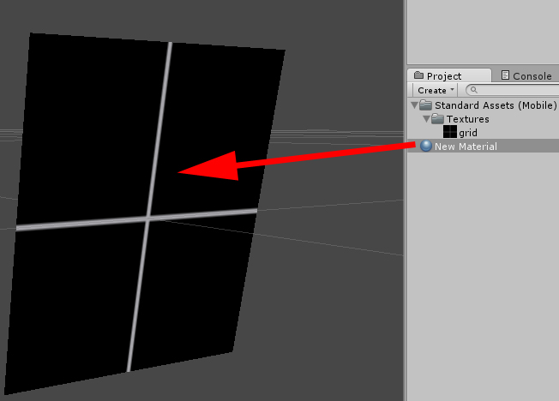
Click and drag the material on to the Quad

Slide 40
Select the Quad. Click Add Component in the Inspector and choose New Script.

Slide 41
using UnityEngine;
public class Scroller : MonoBehaviour {
//these variables will be visible in the Inspector
public float xScrollSpeed; public float yScrollSpeed;
//these variables will hold the offset calculations
private float xOffset; private float yOffset;
// Update is called once per frame
void Update() {
//this section calculates the speed and applies it the
//offset of the material every frame
xOffset = Time.time * xScrollSpeed;
yOffset = Time.time * yScrollSpeed;
GetComponent<Renderer>().material.mainTextureOffset = new Vector2(xOffset, yOffset); } }

Slide 42
Time.time keeps track of the seconds since the game started and multiplies it by the speed input into the Inspector. This gives our texture its motion.
You can now apply this script to any GameObject by dragging and dropping. The speed settings will be unique to each object.

Slide 43
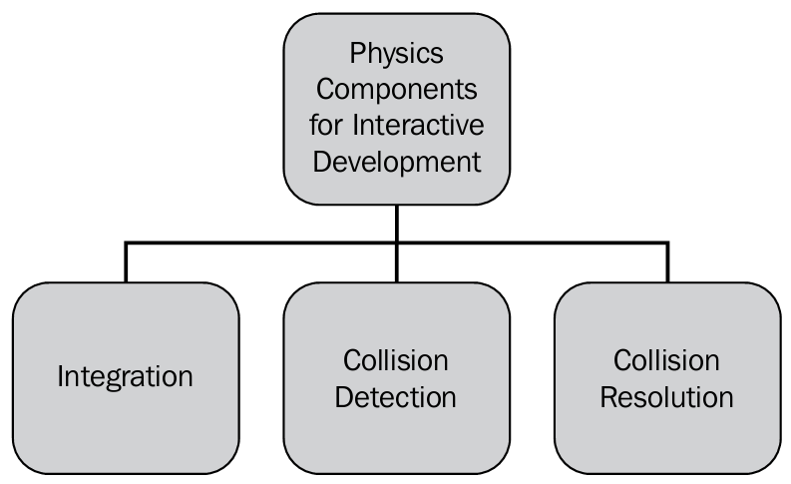
Basic components of Physics for interactive development

Slide 44
Integration
There are multiple factors that have to be considered when we are talking about the integration of Physics.
To implement Physics in interactive development, we normally track all the objects that are simulating.
To implement Physics for each object, we need to know some important information such as:
mass, current velocity, current position
orientation, the external forces acting on the object
the future time of an object (= the current time + the time slice for the frame).

Slide 45
Collision detection
In order to handle scenarios where collision occurs, the interactive development needs to know that two objects are colliding.
One of Physics' most important tasks is to identify these scenarios.

Slide 46
Collision resolution
What will happen after the collision?
In many cases, some specific rules are added to the interactive development.
Scripting based on collision
OnCollisionEnter: This function indicates that the collision is detected in the first update
void OnCollisionEnter(Collision collision) {Debug.Log ("OnCollisionEnter");}
OnCollisionStay: This function indicates that during the updates, the contact is maintained
void OnCollisionStay(Collision collisionInfo) {Debug.Log("OnCollisionStay");}
OnCollisionExit: This function indicates that the contact has been broken
void OnCollisionExit(Collision collisionInfo) {Debug.Log ("OnCollisionExit"); }

Slide 47
Physical simulation in Unity
Unity is a powerful tool. It is able to take care of many problems involved with interactive physical simulations. It embeds a state-of-the-art Physics engine called PhysX.
Unity has two separate Physics engines: one for 3D Physics and one for 2D Physics.

Slide 48
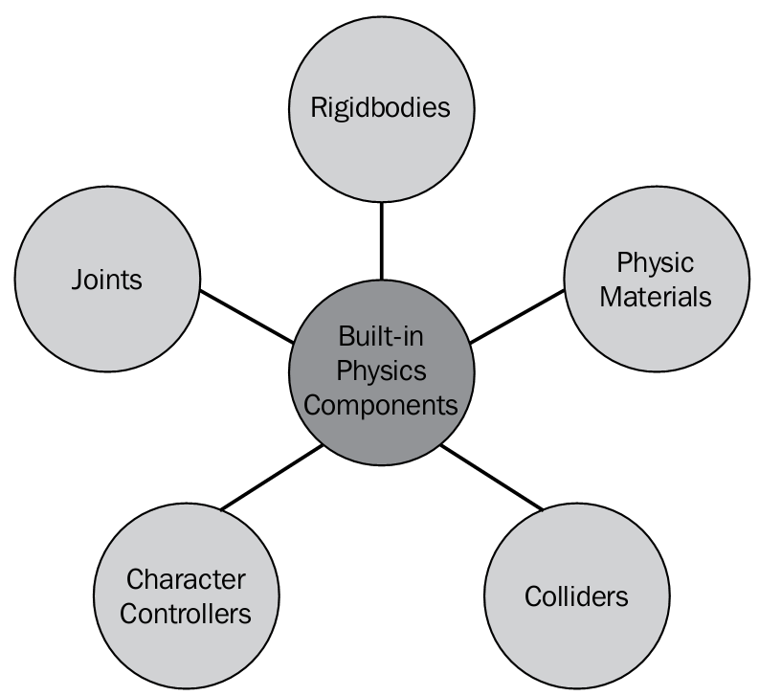
Built-in Physics components in Unity3D

Slide 49
Rigidbodies
The object to which a Rigidbody is attached can be made to respond to gravity.
If we want to create a ball and want it to respond to gravity, we need to add a Rigidbody component to the object and gravity will be enabled by default.

Slide 50
Rigidbody dynamics
Rigidbody dynamics is the most common component used in interactive development.
Rigidbody dynamics is based on the Newtonian principle of movement and mass.
What is a Rigidbody?
An idealized solid whose size and shape is fixed and remains unaltered when some external forces are applied and is used in Newtonian mechanics to model real objects.
For example, a box, wall, and so on.

Slide 51
Kinematic motion and Rigidbodies
Sometimes, it is desirable for a Rigidbody object's motion to not be controlled by the Physics engine but by the script code instead. This type of motion produced from a script is known as kinematic motion.
If Kinematic motion enabled, the object will not be driven by the Physics engine and can only be manipulated by its transform, which is more performance consuming.

Slide 52
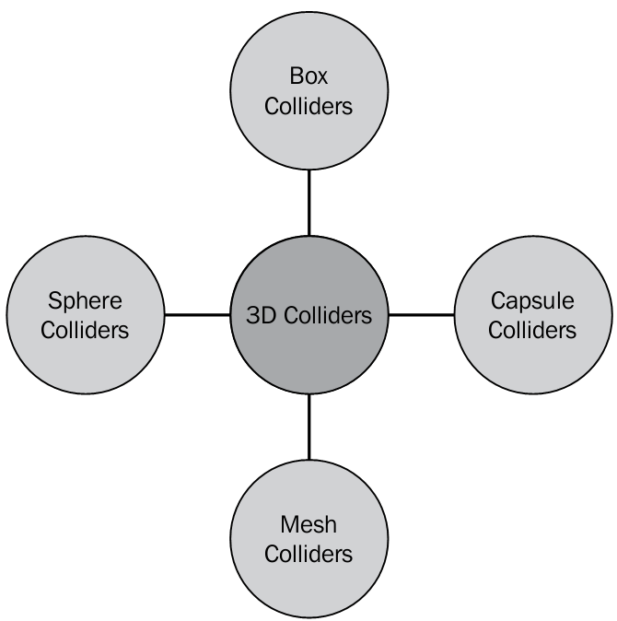
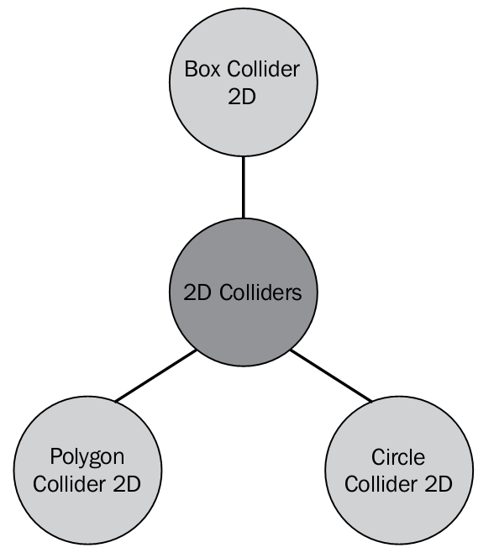
Colliders
A collider, which is invisible, need not be matched exactly to the shape of the object's mesh.
A collider component is used to define the shape for the physical collision.

Slide 53
Static colliders
Colliders can be added to an object without a Rigidbody component in order to create floors, walls, and so on.
To improve the performance, we should not reposition static colliders by changing the transformation position.

Slide 54
Dynamic colliders
Colliders attached to a Rigidbody object are known as dynamic colliders.

Slide 55
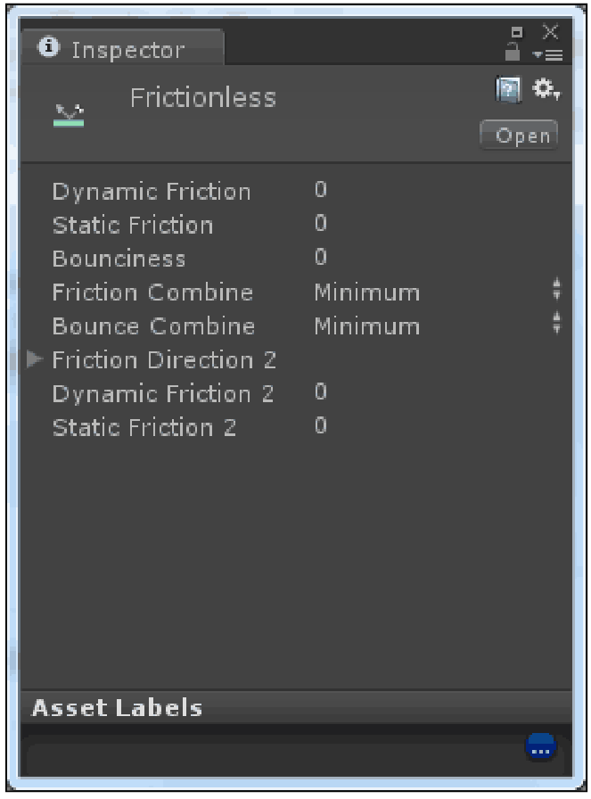
Physic Materials
We can configure the friction and bounce using Physic Materials.
Frictionless Physic Materials
In Unity3D, to create a completely frictionless material, we need to create a new Physic Materials asset in the Project view and set its properties as follows:

Slide 56
Triggers
We can configure a collider, which does not behave as a solid object, as a trigger using the “Is Trigger” property of Unity3D, and we will simply allow other colliders to pass through.
When a collision occurs, a trigger will call the OnTriggerEnter function on the trigger object's scripts.

Slide 57
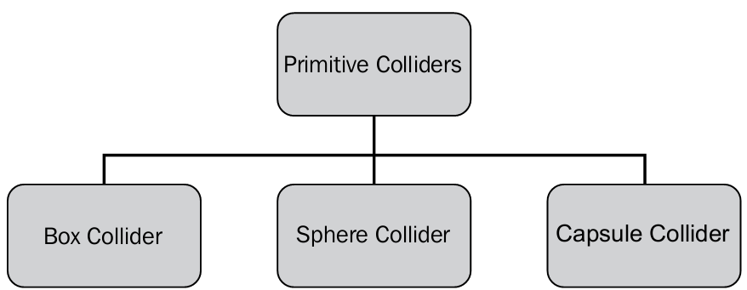
Primitive colliders

Slide 58
Box Collider 3D
Box Collider contains the cube shape and can be implemented for cube-shaped game objects, such as boxes, walls, and doors, that resemble the shape of a cube.
Box Collider has the Material property that determines the friction and bounciness of the game object, but it is irrelevant if we choose the Trigger Collider.

Slide 59
Mesh Collider
Mesh Collider defines accurate shape definition for collision, this is expensive in terms of performance.
Mesh Collider should be avoided wherever possible by using complex colliders in order to optimize the performance.

Slide 60
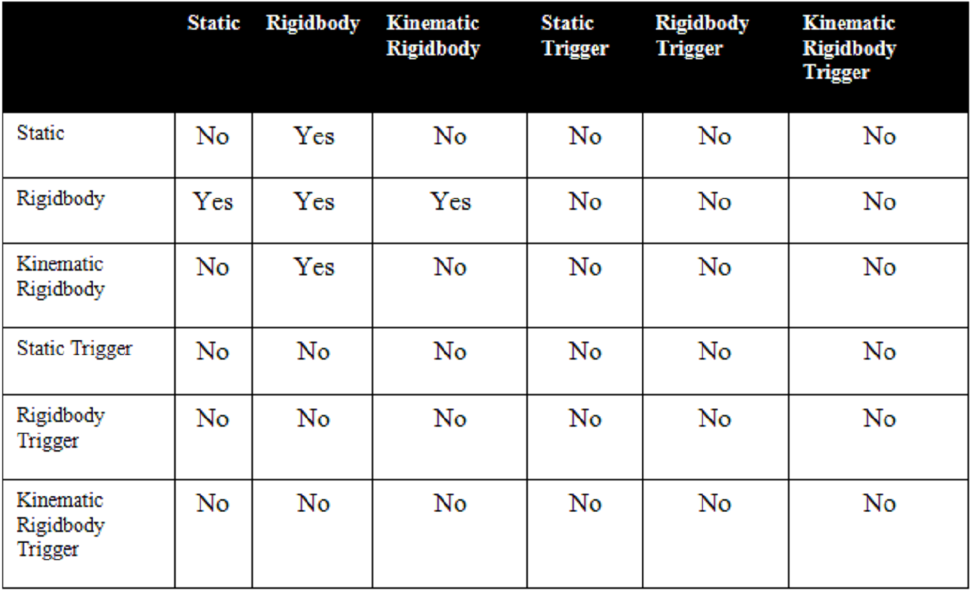
Collision Matrix 3D
OnCollsionEnter()
OnCollisionStay()
OnCollisionExit()

Slide 61
A static collider will detect collision with a Rigidbody
A Rigidbody Collider will detect collision with static, Rigidbody, and Kinematic Rigidbody Colliders
A Kinematic Rigidbody will show reaction on collision with a Rigidbody
In other conditions, no collision will be detected

Slide 62
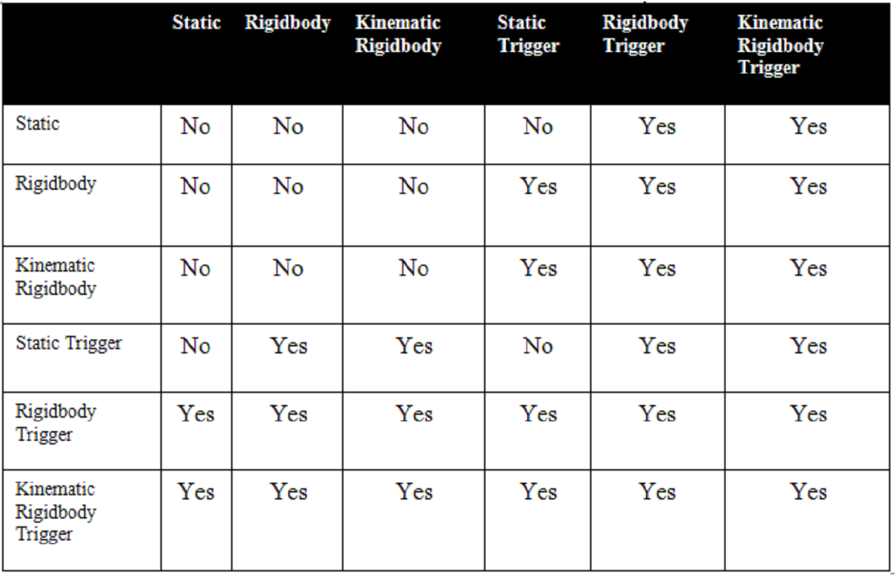
Trigger Matrix

Slide 63
The static collider will fire trigger events on collision with a Rigidbody Trigger Collider and Kinematic Rigidbody Collider
The Rigidbody Collider will fire trigger events on collision with a static Trigger Collider, Rigidbody Trigger Collider, and Kinematic Trigger Collider
The Kinematic Rigidbody Collider will fire trigger events on collision with a static Trigger Collider, Rigidbody Trigger Collider, and Kinematic Trigger Collider
The static Trigger Collider will fire trigger events on collision with a Rigidbody Collider, Kinematic Rigidbody Collider, Rigidbody Trigger and Kinematic Trigger Collider

Slide 64
void OnTiggerEnter(Collider other)
{
Debug.Log("OnTiggerEnter");
}
void OnTriggerStay(Collider other)
{
Debug.Log("OnTriggerStay");
}
void OnTriggerExit(Collider other)
{
Debug.Log("OnTriggerExit");
}

Slide 65
Hovering
public float hoverForce = 12f;
void OnTriggerStay(Collider other) {
other.GetComponent<Rigidbody>().AddForce(Vector3.up * hoverForce, ForceMode.Acceleration);
}

Slide 66
Using Physics to Move Objects
If you require a GameObject to be travelling at a certain speed and direction when the game starts, or when the GameObject is spawned (i.e. meteors, or asteroids) you can use Unity’s physics engine. We’ll use rigidbody.velocity to achieve this effect.
Before applying the script, attach a rigidbody component to your object. In the Inspector click Add Component>Physics>Rigidbody:

Slide 67
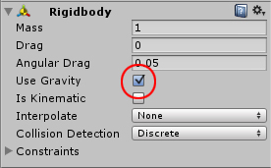
If you want a constant motion you need to uncheck Use Gravity

Slide 68
using UnityEngine;
public class MoveWithPhysics : MonoBehaviour {
//Used to store the initial speed along axes
public Rigidbody rb;
void Start() {
rb = GetComponent<Rigidbody>();
}
void Update() {
if (Input.GetButtonDown("Jump"))
rb.velocity = new Vector3(0, 10, 0);
} }

Slide 69
In most cases you should not modify the velocity directly, as this can result in unrealistic behavior.
Don't set the velocity of an object every physics step, this will lead to unrealistic physics simulation.

Slide 70
public Rigidbody rb;
public float amount= 1000f;
void Start () {rb = GetComponent<Rigidbody>(); }
void Update () {
float h = Input.GetAxis("Horizontal")*amount*Time.deltaTime;
float v = Input.GetAxis("Vertical")*amount*Time.deltaTime;
rb.AddTorque(transform.up * h);
rb.AddTorque(transform.right * v);
}
// change the Anglar Drag of the rigidbody

Slide 71
Basic Translate Movement
public float speed =1.0F;
void Update () {
transform.Translate(new Vector3(0,0,speed) * Time.deltaTime);
}

Slide 72
Brick Shooter
Add to the Main Camera
public class Shooter : MonoBehaviour
{
public Rigidbody projectile;
public Transform shotPos;
public float shotForce = 1000f;
public float moveSpeed = 10f;

Slide 73
void Update () {
float h = Input.GetAxis("Horizontal") * Time.deltaTime * moveSpeed;
float v = Input.GetAxis("Vertical") * Time.deltaTime * moveSpeed;
transform.Translate(new Vector3(h, v, 0f));
if(Input.GetButtonUp("Fire1")) {
Rigidbody shot = Instantiate(projectile, shotPos.position, shotPos.rotation) as Rigidbody;
shot.AddForce(shotPos.forward * shotForce);
}
}

Slide 74
Turn off the gravity for the cube Prefab

Slide 75
Creating a simple explosion of the wall using a particle system instantiated from the “Explosion” prefab
public GameObject Explosion1;
void OnCollisionEnter(Collision collision) {
Instantiate(Explosion1, transform.position, transform.rotation);
Destroy (gameObject);
}

Slide 76
Scatter some cubes on a plane
public GameObject FireComplex1;
void OnCollisionEnter(Collision collision) {
string s;
s = collision.collider.name;
if (s.Remove(3) == "Cub") {
Instantiate (FireComplex1, transform.position, transform.rotation);
Destroy (collision.collider);
}
}

Slide 77
public Rigidbody rb;
public float speed = 3.0f;
public float jumpSpeed = 100.0f;
void Start() {rb = GetComponent<Rigidbody>(); }
void Update(){
Vector3 x = Input.GetAxis("Horizontal") * transform.right * Time.deltaTime * speed;
Vector3 z = Input.GetAxis("Vertical") * transform.forward * Time.deltaTime * speed;
transform.Translate(x+z);
if (Input.GetButtonDown("Jump")){
rb.AddForce(Vector3.up * jumpSpeed);
}
}

Slide 78
Play an instance using attached AudioSource component
public AudioClip myClip;
void Start () {
GetComponent<AudioSource>().PlayOneShot(myClip);
}

Slide 79
Spawning/Destroying GameObjects
This script will spawn a number of spheres at random positions.
We’ll be using a sphere, and a Game Manager.
Create these from the main menu:
Game Object>Create Other>Sphere
Game Object>Create Empty

Slide 80
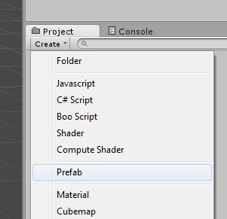
First, we need to turn the sphere into a Prefab. Click the Create button in the Project panel, choose Prefab and name it Sphere Now left-click drag the sphere from the Hierarchy panel on to the new prefab. The prefab icon should turn into a blue cube. You can now delete the Sphere from the scene as we will be using a script to spawn them while the game is running.

Slide 81
Next, we create a script for the sphere prefab. Select the sphere prefab and click the Add Component button in the Inspector panel. Create a new C# script and name it RandomPosition.
using UnityEngine;
public class RandomPosition : MonoBehaviour
{
void Start ()
{
transform.position = Random.insideUnitSphere * 5;
}
}

Slide 82
using UnityEngine;
using System.Collections;
public class GameManager : MonoBehaviour {
public GameObject spawnedObject;
void Start () { StartCoroutine(spawn()); }
IEnumerator spawn() {
for (int i = 0; i < 20; i++) {
Instantiate(spawnedObject);
yield return new WaitForSeconds(1); } } }

Slide 83
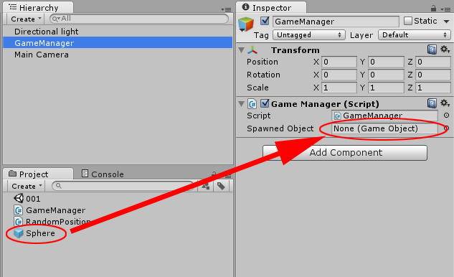
We need to provide a connection to the object we wish to spawn. We do this by using a public variable called spawnedObject. This will be visible in the Inspector. To make the connection click-drag the sphere prefab

Slide 84
We use a special function called a co-routine to control the spawn time of the spheres. If we had used a standard function all spheres would have been spawned in one frame.
We use yield to hand back control to Unity so it can continue running the game with no pauses. Unity keeps track of where yield was used and the time passed to WaitForSeconds. Once the time has passed, it will hand control back to the co-routine, which will then carry on where it left off.
You will notice that the spawn function is of a type called IEnumerator. This signals to Unity that this is a co-routine. To start a co-routine in Unity we use the StartCoroutine function, which is found in the Start function of this example.
The spawn function contains a simple for-loop that creates 20 spheres. Instantiate is the function that deals with creating the object. Note, there’s a yield command here to allow us to pause the for-loop and hence limit the creation of the spheres to one every second.

Slide 85
We will modify the script to create random colors and apply them to each sphere. The random color function.
private Color RandomColour() {
float r = Random.value;
float g = Random.value;
float b = Random.value;
return new Color(r, g, b);
}

Slide 86
void Start ()
{
transform.position = Random.insideUnitSphere * 5;
GetComponent<Renderer>().material.color = RandomColour();
}

Slide 87
Now we have learned how to spawn GameObjects, how do we get rid of them when we are finished?
We are going to write a script that destroys the GameObject after a set amount of time.
Create a new script file and name it DestructionTimer
Attach the script to the sphere prefab by click-dragging it

Slide 88
using UnityEngine;
public class DestructionTimer : MonoBehaviour
{
public float timeInSeconds;
void Start ()
{
Destroy(gameObject, timeInSeconds);
}
}
Using the gameObject keyword basically says to Unity: destroy the GameObject that this script is attached to.

Slide 89
Destroying Objects by Collision
Create a new project. From the GameObject>Create Other menu create some spheres, and a cube.
We want the spheres to be destroyed when the cube collides with them.
To achieve this we need to attach a rigidbody to the cube.
Turn off Use Gravity to stop our cube falling away when we start the game.
Set the cube’s collider to a trigger.

Slide 90
Create a C# script, name it DestroyByCollision, and attach it to the cube. Paste this code.
using UnityEngine;
public class DestroyByCollision : MonoBehaviour
{
void OnTriggerEnter(Collider other)
{
Destroy(other.gameObject);
}
}

Slide 91
Press play then switch to the Scene tab.
Here we’re are able to move the cube while the game is running. As the cube comes into contact with the sphere they will vanish.

Slide 92
Basic Collision Detection
To achieve this we need to attach a rigidbody to the cube.
Turn off Use Gravity to stop our cube falling away when we start the game.
Turn off the trigger of the cube’s collider (if it is ON).
void OnCollisionEnter(Collision theCollision) {
if(theCollision.gameObject.name == "Floor"){
Debug.Log("Hit the floor");
}
else if(theCollision.gameObject.name == "Wall"){
Debug.Log("Hit the wall");
} }

Slide 93
Adding Components via Script
public Rigidbody rb;
void OnCollisionEnter(Collision theCollision)
{
if(theCollision.gameObject.name == "Platform"){
if(! theCollision.gameObject.rigidbody){
theCollision.gameObject.AddComponent("Rigidbody");
//theCollision.gameObject.AddComponent(typeof(Rigidbody));
rb = theCollision.collider.GetComponent<Rigidbody>();
rb.AddForce(Vector3.up * 1000);
} } }

Slide 94
Switching Scenes
void OnCollisionEnter(Collision myCollision)
{
if(myCollision.gameObject.name == "Floor"){
Application.LoadLevel("scene1");
}
}

Slide 95
Tweaking Components via script
void OnCollisionEnter(Collision myCollision)
{
// attach point light to the object
if(myCollision.gameObject.name == "Floor"){
Light myLight = (Light) gameObject.GetComponent("Light");
myLight.enabled = true;
myLight.intensity = 5;
}
}

Slide 96
Local vs World Direction
void Update () {
GetComponent<Rigidbody>().AddForce(new Vector3(0,0,1) * 2); // World
//GetComponent<Rigidbody>().AddForce (transform.forward * 2); // Local
}

Slide 97
Camera following with LookAt()
// attach to the camera
public Transform myTransform;
void Update () {
transform.LookAt(myTransform);
}

Slide 98
Using simple GUI Textures and Mouse Events
void OnMouseEnter() {
Debug.Log(" OnMouseEnter ");
}
void OnMouseExit(){
Debug.Log(" OnMouseExit ");
}
void OnMouseDown(){
Debug.Log("clicked");
}

Slide 99
Using Time.timeScale to Pause
public bool paused = false;
void Update () {
if(Input.GetButtonUp("Jump")){
if(!paused){
Time.timeScale = 0;
paused=true;
}else{
Time.timeScale = 1;
paused=false;
}
}
}

Slide 100
SendMessage() to Call External Functions
void OnCollisionEnter(Collision myCollision) {
if(myCollision.gameObject.name == "Floor"){
GameObject.Find("Cube1").SendMessage("Cube_React");
} }
=================================
void Cube_React () {
gameObject.AddComponent<Rigidbody>();
}

Slide 101
Countdown Timer
First, we need something to display the countdown.
Let’s use a GUIText GameObject: GameObject>Create Other>GUI Text
Increase the font size
Create a C# script and attach it to any Gameobject. Name it Timer.

Slide 102
using UnityEngine;
using System.Collections;
using UnityEngine.UI;
public class Timer : MonoBehaviour {
public int time;
public Text timer;
void Start() { StartCoroutine (countdown()); }

Slide 103
IEnumerator countdown()
{
while (time > 0)
{
yield return new WaitForSeconds(1);
timer.text = time.ToString();
time -= 1;
}
timer.text = "Blast Off!";
}
}

Slide 104
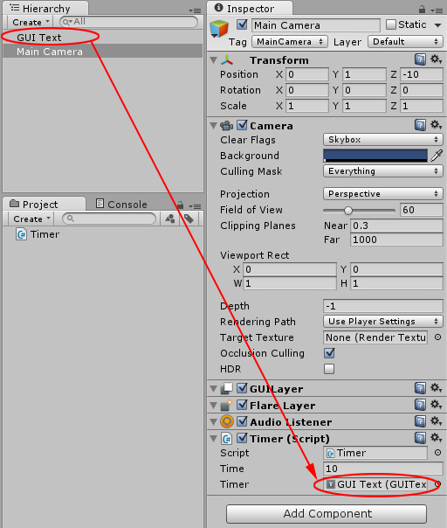
Drag the GUIText object to the reference:

Slide 105
Displaying an in-game fps counter
GameObject>Create Other>GUI Text
Create a C# script and name it fpsCounter.
Attach the script to the GUIText.

Slide 106
using UnityEngine;
using System.Linq;
using System.Collections.Generic;
using UnityEngine.UI;
public class FPS : MonoBehaviour
{
public Text fpsCounter;
public int sampleFrames = 30;
public int greenFrames = 60;
public int yellowFrames = 40;
List<float> frameTimes = new List<float>();
private float fps;

Slide 107
void Update ()
{
frameTimes.Add(Time.deltaTime);
if (frameTimes.Count() == (sampleFrames -1))
{
DisplayAverageFPS();
ChangeFrameColours();
frameTimes.Clear();
}
}

Slide 108
void DisplayAverageFPS() {
fps = 1 / frameTimes.Average();
fpsCounter.text = fps.ToString("F2");
}
void ChangeFrameColours() {
if (fps >= greenFrames)
fpsCounter.color = Color.green;
else if (fps >= yellowFrames)
fpsCounter.color = Color.yellow;
else
fpsCounter.color = Color.red;
} }

Slide 109
To use the average function we need to add using System.Linq; to the top of the script.
Calculate the time between frames by using Time.deltaTime. This returns the time in seconds between frames. To calculate the fps we use the formula 1 / average frame time.
Add “F2” to limit the number of decimal places to 2.

Slide 110
Sliding Door
Create a Door
Add animation component to the door
Create four animation clips: IdleClose, Open, IdleOpen, Close
Add bool1 as a parameter.
If bool1 is true, change state to Open, then IdleOpen.
If bool1 is false, change state to Close, then IdleClose.
Check the Trigger, and expand it
Add a Capsule and change the Tag to Player

Slide 111
Animator anim;
void Start () {anim = GetComponent<Animator> (); }
void OnTriggerEnter(Collider Col)
{if (Col.gameObject.tag == "Player") {
anim.SetBool ("bool1", true);
} }
void OnTriggerExit(Collider Col) {
if (Col.gameObject.tag == "Player") {
anim.SetBool ("bool1", false);
} }

Slide 112
Creating the clock
We start by creating a new Unity project without any packages. The default scene contains a camera positioned at (0, 1, -10) looking down the Z axis. To get a similar perspective as the camera in the scene view, select the camera and perform GameObject / Align View to Selected from the menu. We need an object structure to represent the clock. Create a new empty GameObject via GameObject / Create Empty, set its position to (0, 0, 0), and name it Clock. Create three empty child objects for it and name them Hours, Minutes, and Seconds. Make sure they are all positioned at (0, 0, 0) as well.
We'll use simple boxes to visualize the arms of the clock. Create a child cube for each arm via GameObject / Create Other / Cube. Give the cube for Hours position (0, 1, 0) and scale (0.5, 2, 0.5). For the minutes cube it's position (0, 1.5, 0) and scale (0.25, 3, 0.25). For seconds cube it's (0, 2, 0) and (0.1, 4, 0.1).

Slide 113
Animating the clock
Create a new C# script via Create / C# Script in the Project view and name it ClockAnimator.
Then attach it to the Clock object by dragging from the Project view to the Hierarchy view, or via the Add Component button.

Slide 114
To animate the arms, we need access to their Transform components first.
Add a public Transform variable for each arm to the script, then save it.
These public variables will become component properties which you can assign object to in the editor.
The editor will then grab the Transform components of these objects and assign them to our variables. Select the Clock object, then drag the corresponding objects to the new properties

Slide 115
using UnityEngine;
public class ClockAnimator : MonoBehaviour {
public Transform hours, minutes, seconds;
}

Slide 116
Next, we'll add an update method to the script.
This is a special method that will be called once every frame.
We'll use it to set the rotation of the clock arms.
After saving the script, the editor will notice that our component has an update method and will show a checkbox that allows us to disable it.
Of course we keep it enabled.

Slide 117
using UnityEngine;
public class ClockAnimator : MonoBehaviour {
public Transform hours, minutes, seconds;
void Update () {
// currently do nothing
}
}

Slide 118
Each hour, the Hours arm has to rotate 360/12 degrees.
The Minutes arm has to rotate 360/60 degrees per minute.
Finally, the Seconds arm has to rotate 360/60 degrees every second.
Let's define these values as private constant floating-point values for convenience.

Slide 119
using UnityEngine;
using System;
public class ClockAnimator : MonoBehaviour {
private const float
hoursToDegrees = 360f / 12f,
minutesToDegrees = 360f / 60f,
secondsToDegrees = 360f / 60f;
public Transform hours, minutes, seconds;
}

Slide 120
void Update () {
DateTime time = DateTime.Now;
hours.localRotation = Quaternion.Euler(0f, 0f, time.Hour * -hoursToDegrees);
minutes.localRotation = Quaternion.Euler(0f, 0f, time.Minute * -minutesToDegrees);
seconds.localRotation = Quaternion.Euler(0f, 0f, time.Second * -secondsToDegrees);
}

Slide 121
Each update we need to know the current time to get this thing to work.
The System namespace contains the DateTime struct, which is suited for this job. It has a static property named Now that always contains the current time. Each update we need to grab it and store it in a temporary variable

Slide 122
To get the arms to rotate, we need to change their local rotation.
We do this by directly setting the local Rotation of the arms, using quaternions. Quaternion has a nice method we can use to define an arbitrary rotation.
Because we're looking down the Z axis and Unity uses a left-handed coordinate system, the rotation must be negative around the Z axis.

Slide 123
Improving the clock
This works! When in play mode, our clock shows the current time. However, it behaves much like a digital clock as it only shows discrete steps.
Let's include an option to show analog time as well.
Add a public boolean variable analog to the script and use it to determine what to do in the update method.
We can toggle this value in the editor, even when in play mode.

Slide 124
public bool analog;
void Update () {
if (analog) {
TimeSpan timespan = DateTime.Now.TimeOfDay;
hours.localRotation =Quaternion.Euler(0f,0f,(float)timespan.TotalHours * -hoursToDegrees);
minutes.localRotation =Quaternion.Euler(0f,0f,(float)timespan.TotalMinutes * -minutesToDegrees);
seconds.localRotation =Quaternion.Euler(0f,0f,(float)timespan.TotalSeconds * -secondsToDegrees);
}
else { …}

Slide 125
For the analog option we need a slightly different approach.
Instead of DateTime.Now we'll use DateTime.Now.TimeOfDay, which is a TimeSpan.
This allows us easy access to the fractional elapsed hours, minutes, and seconds. Because these values are provided as doubles – double precision floating-point values – we need to cast them to floats

Slide 126
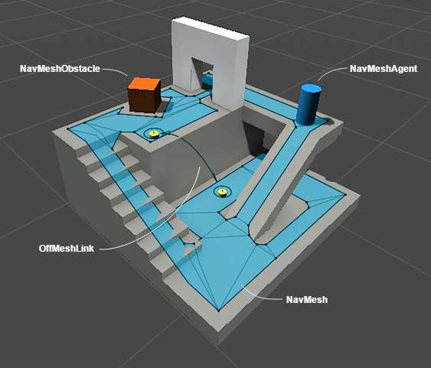
Navigation System in Unity

Slide 127
The Navigation System allows you to create characters which can navigate the game world.
The Unity NavMesh system consists of the following pieces:
NavMesh (short for Navigation Mesh) is a data structure which describes the walkable surfaces of the game world and allows to find path from one walkable location to another in the game world. The data structure is built, or baked, automatically from your level geometry.
NavMesh Agent component help you to create characters which avoid each other while moving towards their goal. Agents reason about the game world using the NavMesh and they know how to avoid each other as well as moving obstacles.
Off-Mesh Link component allows you to incorporate navigation shortcuts which cannot be represented using a walkable surface. For example, jumping over a ditch or a fence, can be all described as Off-mesh links.
NavMesh Obstacle component allows you to describe moving obstacles the agents should avoid while navigating the world. A barrel or a crate controlled by the physics system is a good example of an obstacle. While the obstacle is moving the agents do their best to avoid it, but once the obstacle becomes stationary it will carve a hole in the navmesh so that the agents can change their paths to steer around it, or if the stationary obstacle is blocking the path way, the agents can find a different route.

Slide 128
private NavMeshAgent agent;
public GameObject obj1;
void Start () {
agent = GetComponent<NavMeshAgent>();
}
void Update () {
agent.SetDestination(obj1.transform.position);
}

Slide 129
Using Cameras

Slide 130
Creating a picture-in-picture effect

Slide 131
Add a camera and, in the Inspector view, set its Depth to 1;
Add a script to the camera

Slide 132
using UnityEngine;
using System.Collections;
public class s1 : MonoBehaviour {
// Use this for initialization
public enum HorizontalAlignment { left, center, right} ;
public enum VerticalAlignment {top, middle, bottom} ;
public HorizontalAlignment horizontalAlignment = HorizontalAlignment.left;
public VerticalAlignment verticalAlignment = VerticalAlignment.top;
public enum ScreenDimensions { pixels, screen_percentage} ;

Slide 133
public ScreenDimensions dimensionsIn = ScreenDimensions.pixels;
public int width = 50;
public int height = 50;
public float xOffset = 0f;
public float yOffset = 0f;
public bool update = true;
private int hsize, vsize, hloc, vloc;

Slide 134
void Start ()
{
AdjustCamera ();
}
void Update ()
{
if (update)
AdjustCamera ();
}

Slide 135
void AdjustCamera ()
{
if (dimensionsIn == ScreenDimensions.screen_percentage) {
hsize = Mathf.RoundToInt (width * 0.01f * Screen.width);
vsize = Mathf.RoundToInt (height * 0.01f * Screen.height);
} else {
hsize = width;
vsize = height;
}
if (horizontalAlignment == HorizontalAlignment.left) {
hloc = Mathf.RoundToInt (xOffset * 0.01f * Screen.width);
} else if (horizontalAlignment == HorizontalAlignment.right) {
hloc = Mathf.RoundToInt ((Screen.width - hsize) - (xOffset * 0.01f * Screen.width));
} else {
hloc = Mathf.RoundToInt (((Screen.width * 0.5f) - (hsize * 0.5f)) - (xOffset * 0.01f * Screen.width));
}

Slide 136
if (verticalAlignment == VerticalAlignment.top) {
vloc = Mathf.RoundToInt ((Screen.height - vsize) - (yOffset * 0.01f * Screen.height));
} else if (verticalAlignment == VerticalAlignment.bottom) {
vloc = Mathf.RoundToInt (yOffset * 0.01f * Screen.height);
} else {
vloc = Mathf.RoundToInt (((Screen.height * 0.5f) - (vsize * 0.5f)) - (yOffset * 0.01f * Screen.height));
}
GetComponent<Camera>().pixelRect = new Rect (hloc, vloc, hsize, vsize);
}
}

Slide 137
Switching between multiple cameras

Slide 138
Add two more cameras to the scene.
Rename them cam1 and cam2.
Change the cam2 camera's position and rotation so it won't be identical to cam1.
Create an Empty game object by navigating to Game Object. Then, rename it Switchboard.
Disable the Camera and Audio Listener components of both cam1 and cam2.
In the Inspector view, set both Cameras and Shortcuts size to 3. Then, drag the scene cameras into the Cameras slots, and type 1, 2, and 3 into the Shortcuts text fields

Slide 139
using UnityEngine;
using System.Collections;
public class s2 : MonoBehaviour {
public GameObject[] cameras;
public string[] shortcuts;
public bool changeAudioListener = true;
void Update (){
int i = 0;
for(i=0; i<cameras.Length; i++){
if (Input.GetKeyUp(shortcuts[i]))
SwitchCamera(i);
}
}

Slide 140
void SwitchCamera ( int index ){
int i = 0;
for(i=0; i<cameras.Length; i++){
if(i != index){
if(changeAudioListener){
cameras[i].GetComponent<AudioListener>().enabled = false;
}
cameras[i].GetComponent<Camera>().enabled = false;
} else {
if(changeAudioListener){
cameras[i].GetComponent<AudioListener>().enabled = true;
}
cameras[i].GetComponent<Camera>().enabled = true;
}
}
}
}

Slide 141
The script captures the key pressed and enable its respective camera (and its Audio Listener, in case the Change Audio Listener option is checked).

Slide 142
Zooming a telescopic camera

Slide 143
we will create a telescopic camera that zooms in whenever the left mousebutton is pressed.
This can be very useful, for instance, if we have a sniper in our game.
The zooming effect is actually caused by the increment made by the script on the value of the camera's Field of View property, while the mouse button is pressed.
If you are using Unity Pro, you could also add a variable to control the Blur Vignette level of the Vignette image effect.

Slide 144
public float ZoomLevel = 2.0f;
public float ZoomInSpeed = 100.0f;
public float ZoomOutSpeed = 100.0f;
private float initFOV;
//private Vignetting vignette;
//public float vignetteAmount = 10.0f;

Slide 145
void Start(){ initFOV = Camera.main.fieldOfView;
//vignette = this.GetComponent("Vignetting") as Vignetting; } void Update () {
if (Input.GetKey(KeyCode.Mouse0)){
ZoomView();
}else{
ZoomOut();
} }

Slide 146
void ZoomView(){
if (Mathf.Abs(Camera.main.fieldOfView - (initFOV / ZoomLevel)) < 0.5f){
Camera.main.fieldOfView = initFOV / ZoomLevel;
// vignette. intensity = vignetteAmount;
}
else if (Camera.main.fieldOfView - (Time.deltaTime * ZoomInSpeed) >= (initFOV / ZoomLevel)){
Camera.main.fieldOfView -= (Time.deltaTime * ZoomInSpeed);
// vignette. intensity = vignetteAmount * (Camera.main.fieldOfView - initFOV)/((initFOV / ZoomLevel) - initFOV);
}
}

Slide 147
void ZoomOut(){
if (Mathf.Abs(Camera.main.fieldOfView - initFOV) < 0.5f){
Camera.main.fieldOfView = initFOV;
// vignette. intensity = 0;
}else if (Camera.main.fieldOfView + (Time.deltaTime * ZoomOutSpeed) <= initFOV){
Camera.main.fieldOfView += (Time.deltaTime * ZoomOutSpeed);
//vignette.intensity = vignetteAmount * (Camera.main.fieldOfView - initFOV)/((initFOV / ZoomLevel) - initFOV);
}
}

Slide 148
Making an inspect camera

Slide 149
Inspect cameras are a very popular way of displaying products online.
These virtual displays usually feature a camera that orbits around and zooms in and out the product.
In this recipe, we will learn how to implement such a camera using a standard Unity component as a starting point.

Slide 150
Add a directional light to the scene, making it cast light in the same direction the camera is facing.
In the Hierarchy view, drag the Directional Light into the Main Camera game object, making it a child of the Main Camera game object.

Slide 151
[AddComponentMenu("Camera-Control/Mouse Orbit with zoom")]
public class s3 : MonoBehaviour {
public Transform target;
public float distance = 5.0f;
public float xSpeed = 120.0f;
public float ySpeed = 120.0f;
public float yMinLimit = -20f;
public float yMaxLimit = 80f;
public float distanceMin = .5f;
public float distanceMax = 15f;

Slide 152
private Rigidbody rigidbody1;
float x = 0.0f;
float y = 0.0f;

Slide 153
void Start () {
Vector3 angles = transform.eulerAngles;
x = angles.y;
y = angles.x;
rigidbody1 = GetComponent<Rigidbody>();
// Make the rigid body not change rotation
if (rigidbody1 != null) { rigidbody1.freezeRotation = true; }
}

Slide 154
void LateUpdate () {
if (target) {
x += Input.GetAxis("Mouse X") * xSpeed * distance * 0.02f;
y -= Input.GetAxis("Mouse Y") * ySpeed * 0.02f;
y = ClampAngle(y, yMinLimit, yMaxLimit);
Quaternion rotation = Quaternion.Euler(y, x, 0);
distance = Mathf.Clamp(distance - Input.GetAxis("Mouse ScrollWheel")*5, distanceMin, distanceMax);

Slide 155
RaycastHit hit;
if (Physics.Linecast (target.position, transform.position, out hit)) {
distance -= hit.distance;
}
Vector3 negDistance = new Vector3(0.0f, 0.0f, -distance);
Vector3 position = rotation * negDistance + target.position;
transform.rotation = rotation;
transform.position = position;
}
}

Slide 156
public static float ClampAngle(float angle, float min, float max)
{
if (angle < -360F)
angle += 360F;
if (angle > 360F)
angle -= 360F;
return Mathf.Clamp(angle, min, max);
}}

Slide 157
Drag an object into the Target slot.
Play the scene. Move the mouse to look around the object.

Slide 158
Controlling Animations

Slide 159
Animation System Overview
Unity has a rich and sophisticated animation system (sometimes referred to as ‘Mecanim’). It provides:
Easy workflow and setup of animations for all elements of Unity including objects, characters, and properties.
Support for imported animation clips and animation created within Unity
Humanoid animation retargeting - the ability to apply animations from one character model onto another.
Simplified workflow for aligning animation clips.
Convenient preview of animation clips, transitions and interactions between them. This allows animators to work more independently of programmers, prototype and preview their animations before gameplay code is hooked in.
Management of complex interactions between animations with a visual programming tool.
Animating different body parts with different logic.
Layering and masking features

Slide 160
Animation Clips
Unity’s animation system is based on the concept of Animation Clips, which contain information about how certain objects should change their position, rotation, or other properties over time.
Each clip can be thought of as a single linear recording. Animation clips from external sources are created by artists or animators with 3rd party tools such as Max or Maya, or come from motion capture studios or other sources.

Slide 161
Animator Controller
Animation Clips are then organised into a structured flowchart-like system called an Animator Controller. The Animator Controller acts as a “State Machine” which keeps track of which clip should currently be playing, and when the animations should change or blend together.
A very simple Animator Controller might only contain one or two clips, for example to control a powerup spinning and bouncing, or to animate a door opening and closing at the correct time.
A more advanced Animator Controller might contain dozens of humanoid animations for all the main character’s actions, and might blend between multiple clips at the same time to provide a fluid motion as the player moves around the scene.

Slide 162
Avatar system
Unity’s Animation system also has numerous special features for handling humanoid characters which give you the ability to retarget humanoid animation from any source (Eg. motion capture, the asset store, or some other third-party animation library) to your own character model, as well as adjusting muscle definitions.
These special features are enabled by Unity’s Avatar system, where humanoid characters are mapped to a common internal format.

Slide 163
Moving your character with Root Motion and Blend Trees

Slide 164
Another feature for the animation system is Blend Trees, which can make transitions between animation states smooth and easy.
We will take advantage of these features to make our character walk and run forwards or backwards.

Slide 165
Attach a Character Controller component to it by going to Component | Physics | Character Controller.
Then, set the following coordinates for Center: (0, 0.9, 0); change the entry in the Radius field to 0.34 and the Height field to 1.79.

Slide 166
In the bottom-left corner of the Animator view, create a new parameter (Float value) named xSpeed.
Also, right-click on the gridded area and, from the context menu, select From New Blend Tree under Create State. Change its name to Move in the Inspector view.
Double-click on the Move state. You will see the empty Blend Tree you have created. Select it and rename it to Move in the Inspector view.
Add five Motion fields
Change the parameter to xSpeed.
Then, change the parameter values to -2 and 2

Slide 170
private Animator animator; private CharacterController controller; public float transitionTime = 0.25f; // Use this for initialization void Start () { controller = GetComponent<CharacterController>(); animator = GetComponent<Animator>(); if(animator.layerCount >= 2) animator.SetLayerWeight(1, 1); }

Slide 171
void Update () {
float accelerator = 1.0f;
if(controller.isGrounded){
if (Input.GetKey (KeyCode.RightShift) ||Input.GetKey
(KeyCode.LeftShift) ){
accelerator = 2.0f;
} else if(Input.GetKey (KeyCode.RightAlt) ||Input.
GetKey (KeyCode.LeftAlt) ){
accelerator = 1.5f;
} else {
accelerator = 1.0f;
}
float h = Input.GetAxis("Horizontal");

Slide 172
float v = Input.GetAxis("Vertical");
float xSpeed = h * accelerator;
float zSpeed = v * accelerator;
animator.SetFloat("xSpeed", xSpeed, transitionTime, Time.deltaTime);
animator.SetFloat("zSpeed", zSpeed, transitionTime, Time.deltaTime);
animator.SetFloat("Speed", Mathf.Sqrt(h*h+v*v), transitionTime, Time.deltaTime);
//transform.Rotate(Vector3.up * (Time.deltaTime * v *Input.GetAxis("Mouse X") * 90), Space.World);
}
}

Slide 173
Scripting Root Motion for “in-place” humanoid animations

Slide 174
Sometimes your animation comes as “in-place”, which means if you put it in a scene, it will not move the character that it’s on. In other words, the animation does not contain “root motion”. For this, we can modify root motion from script.

Slide 175
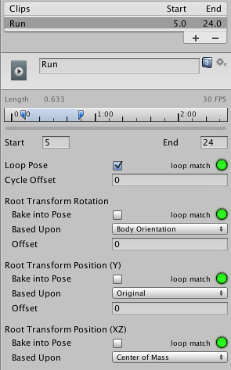
Select the animation clip from the available clips

Slide 176
Create a new Animator Controller
To control the motion, we will need to create a script (RootMotionScript.cs), that implements the OnAnimatorMove callback.

Slide 177
using UnityEngine;
using System.Collections;
[RequireComponent(typeof(Animator))]
public class RootMotionScript : MonoBehaviour {
public float Runspeed = 1.0f;
void OnAnimatorMove() {
Animator animator = GetComponent<Animator>();
if (animator) {
Vector3 newPosition = transform.position;
newPosition.z += Runspeed * Time.deltaTime;
transform.position = newPosition;
} } }

Slide 178
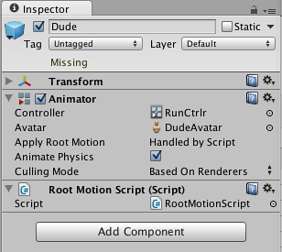
You should attach RootMotionScript.cs to the character. When you do this, the Animator component will detect that the script has an OnAnimatorMove function and show the Apply Root Motion property as Handled by Script

Slide 179
AnimationHelper

Slide 180
In the Project panel:Create new C# script, name it "AnimationHelper" and move it into that Editor/ folder

Slide 181
#if UNITY_EDITOR
using UnityEditor;
using UnityEditor.Animations;
using UnityEngine;
public class AnimationHelper : EditorWindow{
public GameObject target;
public AnimationClip idleAnim;
public AnimationClip walkAnim;
public AnimationClip runAnim;

Slide 182
[MenuItem ("Window/Animator Helper")]
static void OpenWindow () {
//Get existing open window or if none, make a new one:
GetWindow<AnimationHelper> (); }

Slide 183
void OnGUI () {
target = EditorGUILayout.ObjectField ("Target Object", target, typeof(GameObject), true) as GameObject;
idleAnim = EditorGUILayout.ObjectField ("Idle", idleAnim, typeof(AnimationClip), false) as AnimationClip;
walkAnim = EditorGUILayout.ObjectField ("Walk", walkAnim, typeof(AnimationClip), false) as AnimationClip;
runAnim = EditorGUILayout.ObjectField ("Run", runAnim, typeof(AnimationClip), false) as AnimationClip;
if (GUILayout.Button ("Create")) {
if (target == null) {
Debug.LogError ("No target for animator controller set.");
return;
}
Create ();
}
}

Slide 184
void Create () {
AnimatorController controller = AnimatorController.CreateAnimatorControllerAtPath ("Assets/" + target.name + ".controller");
// Adds a float parameter called Speed
controller.AddParameter ("Speed", AnimatorControllerParameterType.Float);
//Add states
AnimatorState idleState = controller.layers [0].stateMachine.AddState ("Idle");
idleState.motion = idleAnim;
//Blend tree creation
BlendTree blendTree;
AnimatorState moveState = controller.CreateBlendTreeInController ("Move", out blendTree);

Slide 185
//BlendTree setup
blendTree.blendType = BlendTreeType.Simple1D;
blendTree.blendParameter = "Speed";
blendTree.AddChild (walkAnim);
blendTree.AddChild (runAnim);
AnimatorStateTransition LeaveIdle = idleState.AddTransition (moveState);
AnimatorStateTransition leaveMove = moveState.AddTransition (idleState);
LeaveIdle.AddCondition (AnimatorConditionMode.Greater, 0.01f, "Speed");
leaveMove.AddCondition (AnimatorConditionMode.Less, 0.01f, "Speed");
target.GetComponent<Animator> ().runtimeAnimatorController = controller;
}
}
#endif

Slide 186
Applying ragdoll physics to a character

Slide 187
Add a character "Alpha@Alpha" and two cylinders ("Spawnpoint" and “Landmine”).

Slide 188
let's set up our ragdoll. Go to GameObject | Create Other | Ragdoll.... The Ragdoll Wizard should pop up.
Assign the transforms as follows:
Root: swat:Hips
Left Hips: swat:LeftUpLeg
. Left Knee: swat:LeftLeg
. Left Foot: swat:LeftFoot
. Right Hips: swat:RightUpLeg
. Right Knee: swat:RightLeg
. Right Foot: swat:RightFoot
. Left Arm: swat:LeftArm
. Left Elbow: swat:LeftForeArm
. Right Arm: swat:RightArm
. Right Elbow: swat:RightForeArm
. Middle Spine: swat:Spine1
. Head: swat:Head

Slide 189
using UnityEngine; using System.Collections; public class RagdollCharacter : MonoBehaviour { // Use this for initialization
private float hitTime;
private bool wasHit = false;
void Start () {
DeactivateRagdoll();
}
}

Slide 190
void Update () { if(wasHit){ if(Time.time >= hitTime + 5.0f) DeactivateRagdoll(); } } public void ActivateRagdoll(){ Debug.Log ("ActivateRagdoll"); //this.GetComponent<BasicController>().enabled = false; this.GetComponent<Animator>().enabled = false; foreach(Rigidbody bone in GetComponentsInChildren<Rigidbody>()){ bone.isKinematic = false; bone.detectCollisions = true; } wasHit = true; hitTime = Time.time; }

Slide 191
public void DeactivateRagdoll(){ Debug.Log ("DeactivateRagdoll"); // this.GetComponent<BasicController>().enabled = true; this.GetComponent<Animator>().enabled = true; foreach(Rigidbody bone in GetComponentsInChildren<Rigidbody>()){ bone.isKinematic = true; bone.detectCollisions = false; } transform.position = GameObject.Find("Spawnpoint").transform.position; transform.rotation = GameObject.Find("Spawnpoint").transform.rotation; wasHit = false; }
}

Slide 192
Attach the RagdollCharacter.cs script to the Character game object.
Create a new C# script named Landmine.cs.

Slide 193
using UnityEngine; using System.Collections; public class Landmine : MonoBehaviour { public float range = 50.0f; public float force = 2000.0f; public bool ThrowFlag = false; // Use this for initialization void Start () { }

Slide 194
void Update () { if(ThrowFlag){ ThrowObject (); ThrowFlag = false; } } void ThrowObject ( ){ GameObject.Find("Alpha@Alpha").GetComponent<RagdollCharacter>().ActivateRagdoll(); Vector3 explosionPos = transform.position; Collider[] colliders = Physics.OverlapSphere(explosionPos, range); foreach (Collider hit in colliders) { if (hit.GetComponent<Rigidbody>()) hit.GetComponent<Rigidbody>().AddExplosionForce(force, explosionPos, range, 3.0F); } } }

Slide 195
Change ThrowFlag to true

Slide 196
Rotating the character's torso to aim

Slide 197
When you're playing a third person character, you might want your character to aim his weapon at a target that is not directly in front of him.
We will rotate the character's torso.
Add the MouseAim.cs script to the character.

Slide 198
public Transform spine;
public Transform armedHand;
public bool lockY = false;
public float compensationYAngle = 20.0f;
public float minAngle = 308.0f;
public float maxAngle = 31.0f;
public Texture2D targetAim;
private Vector2 aimLoc;
private bool onTarget = false;

Slide 199
Vector3 point = Camera.main.ScreenToWorldPoint(new Vector3(Input.mousePosition.x, Input.mousePosition.y, Camera.main.farClipPlane));
if(lockY)
point.y = spine.position.y;
Vector3 relativePoint = transform.InverseTransformPoint(point.x, point.y, point.z);
if(relativePoint.z < 0){
Vector3 inverseZ = transform.InverseTransformPoint(relativePoint.x,relativePoint.y,-relativePoint.z);
point = inverseZ;
}

Slide 200
spine.LookAt(point, Vector3.up);
Vector3 comp = spine.localEulerAngles;
comp.y = spine.localEulerAngles.y + compensationYAngle;
spine.localEulerAngles = comp;

Slide 201
if(spine.localEulerAngles.y > maxAngle && spine.localEulerAngles.y < minAngle){
if(Mathf.Abs((spine.localEulerAngles.y - minAngle)) < Mathf.Abs((spine.localEulerAngles.y - maxAngle))){
Vector3 min = spine.localEulerAngles;
min.y = minAngle;
spine.localEulerAngles = min;
} else {
Vector3 max = spine.localEulerAngles;
max.y = maxAngle;
spine.localEulerAngles = max;
}
}

Slide 202
RaycastHit hit;
if (Physics.Raycast (armedHand.position, point, out hit))
{
onTarget = true;
aimLoc = Camera.main.WorldToViewportPoint(hit.point);
} else {
onTarget = false;
aimLoc = Camera.main.WorldToViewportPoint(point);
}
// Debug.DrawRay (armedHand.position, point, Color.red);
}

Slide 203
void OnGUI(){
int sw = Screen.width;
int sh = Screen.height;
GUI.DrawTexture(new Rect(aimLoc.x * sw - 8, sh-(aimLoc.y * sh) -8, 16, 16), targetAim, ScaleMode.StretchToFill, true, 10.0F);
}

Slide 204
The script starts by converting the bi-dimensional mouse cursor screen's coordinates to three-dimensional world space coordinates (stored in the point variable).
Then, it rotates the character's torso towards the point's location using the LookAt() command.
Additionally, it makes sure the spine does not extrapolate Min Angle and Max Angle, which could cause distortions to the character model.

Slide 205
In the process, we convert the target point from its absolute world coordinates to its position in relation to the character, and vice-versa.
This is done so that we can detect whether the target point is located behind the character, and if it is, manipulate the point so that the character keeps aiming forwards.

Slide 206
Also, we have included a Compensation YAngle variable that makes it possible for us to fine-tune the character's alignment with the mouse cursor.
Please note that all the commands are inside the LateUpdate() method. This is done to make sure that our transform manipulations override the character's animation clips.

Slide 207
In case you want to implement shooting, we have provided you with a place to start by casting a ray from the character's armed hand to the target point.
To see it as you test the scene, uncomment the line Debug.DrawRay (armedHand.position, point, Color.red);.
The ray cast detects collisions with surrounding objects for which the targetAim texture map, usually drawn over the mouse cursor location, should snap.

Slide 208
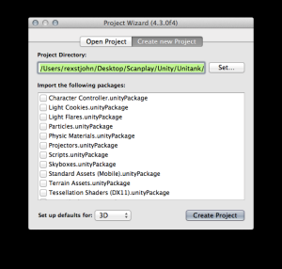

A Simple Tank Sprite With Physics
click “File -> New Project” in the menu.
Since we are making a 2D game, make sure to toggle the “Set up defaults for:” menu at the bottom to “2D.”

Slide 209
Add an Empty GameObject
Rename it to “Tank”
Click “Add Component -> Physics 2D -> Rigidbody 2D” to add 2D physics to your object.
Click “Add Component -> Physics 2D -> Box Collider 2D” to add the box collider.

Slide 210
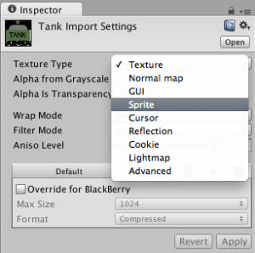

Drag and Drop tank.png into your Unity assets window.
Set this image as a Sprite. Select the Tank.png file and view the Inspector details as below.

Slide 211
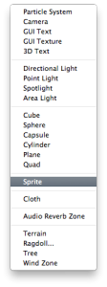

Creating A Sprite Renderer
In the “Hierarchy” window pane on the left of your Unity project select “Create” to reveal the below drop down. Choose “Sprite”
Rename this GameObject
“Tank Body Sprite”

Slide 212
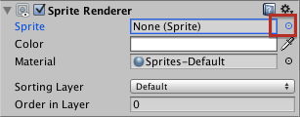
Click the little blue dot to the right of “Sprite” in the Sprite Renderer area of the Inspector panel as below.
Now click “Assets -> Tank” to select the Tank.png sprite

Slide 213

Drag and drop the Tank Body Sprite in the “Hierarchy” window into the “Tank” GameObject as below.

Slide 214
At this time our tank just falls off the screen.
Lets add a ground-body to prevent that from happening.
Create -> Sprite” in the “Hierarchy” pane to create an empty sprite renderer. Name this sprite renderer “Terrain” in the Inspector Window.

Slide 215
Drag and drop terrain.png file into your Unity3D assets folder.
Note: You will need to remember to set this asset to a “Sprite” in the Inspector window as below and then click “Apply” to make it official.
Select the “Terrain” sprite renderer. Click the little black dot to the right of “Sprite” in the Inspector and select your newly created “Terrain” sprite.
Click “Add Component -> Physics2D -> Polygon Collider 2D” to add a Polygon Collider 2D to your Terrain sprite renderer.
A Polygon Collider 2D is a form of collider which will automatically detect an associated sprite’s outline and turn it into an in-game object

Slide 216
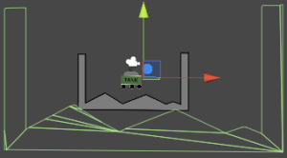
If you have done the listed steps, you should now see this in your scene window:

Slide 217
The Polygon Collider 2D has done it’s job and detected our sprite’s outline, but the dimensions are all wrong.
Also, notice that the detected Polygon Collider 2D (the green mesh outline) is off-center. Lets fix these problems now.
In the Assets area, select terrain.png and, in the inspector window, set the “Sprite Mode” to “Multiple” and the “Pixels To Units” to 40 instead of 100 as in the image below.
This tells Unity that there are multiple sprites in the terrain sprite, which is effectively a shortcut to get Unity to automatically crop and center the sprite for us.
Setting “Pixels To Units” to 40 will fix the problem where our terrain’s Polygon Collider 2D is much larger than it should be.
Note: Don’t forget to click the “Apply” button.

Slide 218
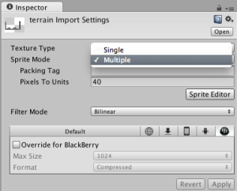
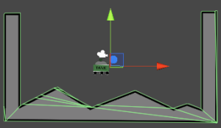

Slide 219
Adding A GroundDetector
We will now need to add a “GroundDetector” we can use to determine whether or not our tank is touching the ground.
This ground detector will be an empty GameObject (consisting of nothing more than a “transform” component and a red oval placeholder shape). The end user will not be able to see this object, but it will be useful in code.
Create an empty GameObject (GameObject -> Create Empty). Now select your new empty GameObject, rename it to “GroundDetector” in the Inspector window and choose a red pill outline for it (this makes it easy to see in the game scene).

Slide 220
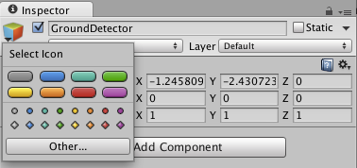
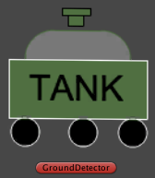

Slide 221
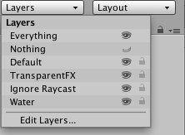
Add the “Terrain” to the “Terrain Layer” Start by selecting “Layers -> Edit Layers” in the upper right hand corner of the main Unity window.

Slide 222
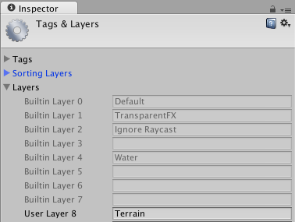
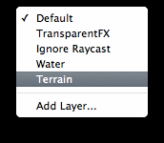
If we have a number of background game objects which never interact with anything on the screen (such as clouds or other scenic elements), we can simply move those objects into a “Scenery” layer to get them out of the way.
On the “Edit Layers” menu, add a “Terrain” layer
Click the “Terrain” object and set it’s layer to “Terrain”

Slide 223
Splicing Your Tank With Sprite Editor
Right now our tank is a single unified sprite. However, we need to chop it up a bit so we can allow fun behaviors like aiming the tank’s turret, allow individual wheel movements and (later) allow us to blow up our tank if we lose the game.
As before, click the tank’s sprite in the project panel at the very bottom of the Unity screen. Select “Sprite mode” -> “Multiple” to indicate that our Tank sprite actually contains many small sprites.

Slide 224
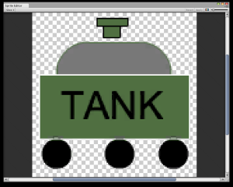
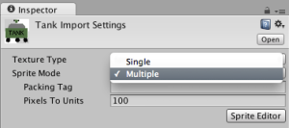
Click “Sprite Editor” .

Slide 225
Now click + drag inside the slice window to add “slice boxes” around the following components: Slice each tank wheel, slice the “turret barrel” and slice the “body” of the tank.
When you slice each section, a blue box will appear indicating the size of the current slice.
When you are done with a section, simply release the mouse and then click + drag again somewhere else to initiate a new slice.
When you are done slicing, click “Apply” to perform the slice and then close the window.
click each sprite slice and name them like so: turrent, shell, wheel_1, wheel_2, wheel_3. Click “apply” to update the sprite names.

Slide 226
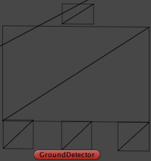
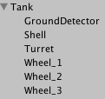
Add all these sprites back into our scene under our “Tank” GameObject. As you can see, our Tank Body Sprite now consists of just our turret.
Next, systematically create new sprite renderers, nest them inside the tank GameObject and select the appropriate sprites from the sprite sheet we just carved up and put all the pieces back where they were before. The result (in wireframe mode) should look something like this:

Slide 227
using UnityEngine;
using System.Collections;
public class TankController : MonoBehaviour {
[HideInInspector]
public bool jump = false;
public float moveForce = 365f;
public float maxSpeed = 5f;
public float jumpForce = 1000f;
private Transform groundDetector;
private bool grounded = false;

Slide 228
void Awake() {
// Setting up references.
groundDetector = transform.Find("GroundDetector"); }
void Update() {
// The player is grounded if a linecast to the groundcheck position hits anything on the ground layer.
grounded = Physics2D.Linecast(transform.position, groundDetector.position, 1 << LayerMask.NameToLayer("Terrain"));
// If the jump button is pressed and the player is grounded then the player should jump.
if(Input.GetButtonDown("Jump") && grounded)
jump = true;
}

Slide 229
void FixedUpdate () {
// Cache the horizontal input.
float h = Input.GetAxis("Horizontal");
if(h * rigidbody2D.velocity.x < maxSpeed)
rigidbody2D.AddForce(Vector2.right * h * moveForce);
if(Mathf.Abs(rigidbody2D.velocity.x) > maxSpeed)
rigidbody2D.velocity = new Vector2(Mathf.Sign(rigidbody2D.velocity.x) * maxSpeed, rigidbody2D.velocity.y);
// If the player should jump...
if(jump) {
rigidbody2D.AddForce(new Vector2(0f, jumpForce));
jump = false; } } }

Slide 230

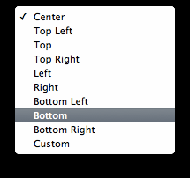
Adding A Cannon
Drag and drop it into the project and open up the Sprite Editor. Make sure to click Sprite Mode: “Multiple” to get the Sprite Editor to show up.
Modify the pivot point so that our cannon will pivot at the base instead of the center (default). It will look like this initially.
Move the pivot to the bottom center by clicking the Pivot drop down and selecting “Bottom.”
Now the pivot should appear in the center,
bottom of the cannon.

Slide 231
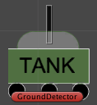
Name this sprite renderer “Turret”
Make it look like this:

Slide 232
Make the cannon point at the mouse, this will require a new script. Create a new script called “TurretController” and drop it onto the Turret Sprite Renderer you just created.

Slide 233
using UnityEngine;
using System.Collections;
public class TurretController : MonoBehaviour {
private Vector3 mouse_pos;
private Vector3 object_pos;
private float angle;
// Use this for initialization
void Start () { }

Slide 234
void Update () {
//
mouse_pos = Input.mousePosition;
mouse_pos.z = 0.0f;
object_pos = Camera.main.WorldToScreenPoint(transform.position);
mouse_pos.x = mouse_pos.x - object_pos.x;
mouse_pos.y = mouse_pos.y - object_pos.y;
angle = Mathf.Atan2(mouse_pos.y, mouse_pos.x) * Mathf.Rad2Deg - 90;
Vector3 rotationVector = new Vector3 (0, 0, angle);
transform.rotation = Quaternion.Euler(rotationVector);
}
}

Slide 235
Prefabs And Tags
Drag the Tank into the Project view at the bottom. This will turn it’s title blue and automatically convert it into a Prefab.
Also create a “Prefabs” folder just to stay organized and drop our tank into it.

Slide 236

A Simple Enemy
Drag and drop it into the Unity Assets folder, set it’s type to “Sprite,” create a new Sprite Renderer GameObject, use this as the sprite and then name it to “Alien.”
Drag and drop it into the Assets folder to convert it into a Prefab.

Slide 237
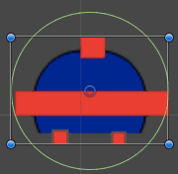
Add a “Circle Collider” so it looks like this.
Note, you may want to tighten up the circle collider to more closely fit the alien sprite than what I have below.

Slide 238
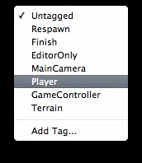
Before moving our alien, we need to introduce the concept of tags. Open your Tank and click the “Tag” drop down in the Inspector window. Choose “Player.”

Slide 239
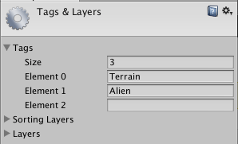
Do the same with Alien and Terrain, respectively adding the “Terrain” and “Alien” tags by clicking the “Add Tag” button.
Tags are words we can apply to items in the scene to help categorize them for scripting purposes. Tags may also be used to search for GameObjects in the scene.

Slide 240
We will use these for some collision detection later on.
Now add this movement script to the Alien prefab. Make sure to also add a RigidBody2D (required for collisions) and click the “isKinematic” to disable physics on it.

Slide 241
using UnityEngine;
using System.Collections;
public class AlienController : MonoBehaviour {
public float alienSpeed = .02f;
void Start () { }
// Update is called once per frame
void Update () {
transform.position += new Vector3(0, -alienSpeed, 0);
}
void OnCollisionEnter(Collision collision) {} }

Slide 242
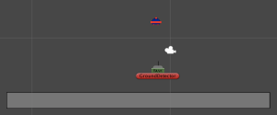
remove the old jagged terrain and replace it with a flat terrain. This terrain is just a grey sprite with a box collider.

Slide 243
To check for collisions, we will need to make use of the tags which we added in the last scene.
Converting a collider to a trigger causes it to be ignored by the physics engine and also enables us to intercept trigger events from colliding with other objects.
Make sure that our Alien’s Circle Collider 2D has been set to a trigger.
Add a Rigidbody 2D (this is required for collisions to work properly with triggers) and set it’s gravity scale to 0 to prevent it from interfering with my alien motion logic.

Slide 244
Update the script for the AlienController to make it look like this:
using UnityEngine;
using System.Collections;
public class AlienController : MonoBehaviour {
public float alienSpeed = .02f;
void Start () { }
void Update () {
transform.position += new Vector3(0, -alienSpeed, 0);
}

Slide 245
void OnTriggerEnter2D(Collider2D col)
{
// If the alien hits the trigger...
if (col.gameObject.tag == "Player") {
Destroy (gameObject);
} else if (col.gameObject.tag == "Terrain") {
Destroy (gameObject);
}
}
}

Slide 246
By adding the OnTriggerEnter2D function, we can now intercept any and all colliders which pass into the space occupied by our alien spaceship.
We then check their tags and can destroy the space ship on command.
NOTE: we will run into problems with triggers and collisions if some of the Z-values on a few of my prefabs were off. Because we are working in 2D, all Z-values must be the same if you expect collisions to get triggered.
If your objects don’t seem to be colliding double check that they are all on the same plane.

Slide 247
A Basic Scoreboard
Click GameObject -> Create Other -> GUIText
Name this object “Score”

Slide 248
using UnityEngine;
using System.Collections;
public class ScoreController : MonoBehaviour {
public int score = 0; // The player's score.
private int previousScore = 0; // The score in the previous frame.
void Awake () { }
void Update () {
guiText.text = "Score: " + score;
previousScore = score;
}
}

Slide 249
Note: GUI elements behave in a different manner than other game objects, the coordinates for the “transform” are not in world coordinates but in screen coordinates.
Therefore, you must make sure to constrain them between 0 and 1 if you want the GUI elements to appear in the screen.
Otherwise, you won’t see your text.
Verify the Score is within 0 – 1 for both it’s X and Y coordinates.

Slide 250
Open up the AlienController script and add the following script update
using UnityEngine;
using System.Collections;
public class AlienController : MonoBehaviour {
public float alienSpeed = .02f;
private ScoreController score;
void Start () { score = GameObject.Find("Score").GetComponent();}
void Update () { transform.position += new Vector3(0, -alienSpeed, 0);}

Slide 251
void OnTriggerEnter2D(Collider2D col) {
// If the alien hits the trigger...
if (col.gameObject.tag == "Player") {
Destroy (gameObject);
if(score.score >= 100) score.score -= 100;
else if(score.score > 0) score.score = 0;
} else if (col.gameObject.tag == "Terrain") {
score.score += 100; Destroy (gameObject);
} } }
When the alien dies by crashing into the ground, the score will update.

Slide 252
Graphs, visualizing data
We start by opening a new project without any packages. We'll be creating our graphs inside a unit cube, placed between (0, 0, 0) and (1, 1, 1).
Let's set up the editor so we get a good view of this area. The 4 Split is a handy predefined view configuration so let's select that. It's in Window / Layout / 4 Spit or in the dropdown list at the top right of the screen.
Set the view mode of all of them to Textured. Also rotate the perspective view so that all three axes are pointing towards you.
Now we create a cube via GameObject / Create Other / Cube and set its position to (0.5, 0.5, 0.5). This gives us a reference point for calibrating our views. Now zoom and pan the views so they're focused on the unit cube.
Finally, select the Main Camera and make it match the perpective view via GameObject / Align With View (we did the opposite in the Clock tutorial). If that doesn't work right, make sure the correct view is active by clicking in it and then try again.

Slide 253
The cube is no longer needed, so we remove it.
We then create a particle system via GameObject / Create Other / Particle System and reset its transform.
Right now it's producing random particles, which we don't want. So we deactivate everything except its renderer.
Uncheck Looping, Play On Awake, Emission, and Shape. This leaves us with an inert particle system that we can use to visualize graph data.

Slide 254
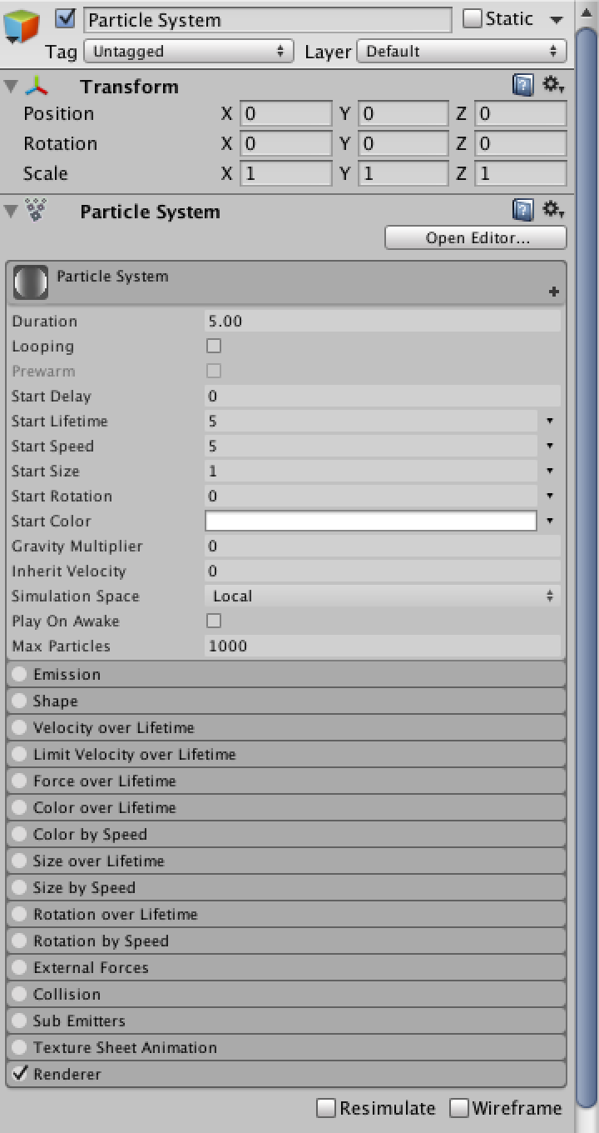

Slide 255
void Start () {
if (resolution < 10 || resolution > 100) {
Debug.LogWarning("Grapher resolution out of bounds, resetting to minimum.", this);
resolution = 10; }
points = new ParticleSystem.Particle[resolution];
float increment = 1f / (resolution - 1);
for (int i = 0; i < resolution; i++) {
float x = i * increment;
points[i].position = new Vector3(x, 0f, 0f);
points[i].color = new Color(x, 0f, 0f);
points[i].size = 0.1f; } }
void Update () { particleSystem.SetParticles(points, points.Length);}

Slide 256
The first thing we need to do is create some particles that will serve as the points of our graph.
We'll create them inside the special Start method, which is a Unity event method that is called once before updates start happening.
How much particles should we use? The more particles, the higher the sample resolution of our graph. Let's make it customizable, with a default resolution of 10.

Slide 257
When playing, nothing shows up. That's because we need to feed our particles to the particle system. Conveniently, every component has a particleSystem property that we can use to access its particle system, if it has one. All we need to do is call its SetParticles methods, providing our array of particles and the amount of particles we wish it to use.
Because we want the system to use all particles, we simply provide the array's length. We will add an Update method to do this every frame.

Slide 258
Right now, resolution is only taken into account when the graph is initialized. Updating its value while in play mode doesn't do anything. Let's change that.

Slide 259
using UnityEngine;
public class Grapher1 : MonoBehaviour {
public int resolution = 10;
private int currentResolution;
private ParticleSystem.Particle[] points;
void Start () { CreatePoints(); }
private void CreatePoints () {
if (resolution < 10 || resolution > 100) {
Debug.LogWarning("Grapher resolution out of bounds, resetting to minimum.", this);
resolution = 10; }

Slide 260
currentResolution = resolution;
points = new ParticleSystem.Particle[resolution];
float increment = 1f / (resolution - 1);
for(int i = 0; i < resolution; i++){
float x = i * increment;
points[i].position = new Vector3(x, 0f, 0f);
points[i].color = new Color(x, 0f, 0f);
points[i].size = 0.1f; }
}
void Update () {
if (currentResolution != resolution) {CreatePoints();}
particleSystem.SetParticles(points, points.Length);
} }

Slide 261
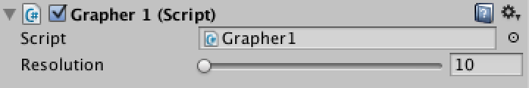
Now the graph is recreated as soon as we change the value of resolution.
However, you'll notice that the console will spit out warnings whenever resolution goes out of bounds, even while typing.
We can make this experience better by using the Range attribute to tell the Unity editor to use a slider instead of a number box.
As we only care about valid editor input and won't change our resolution via code, we can now remove our own resolution check, though you may decide to keep it.
[Range(10, 100)]
public int resolution = 10;

Slide 262
Now it's time to set the Y position of the points. Let's start simple and make Y equal to X.
In other words, we're visualizing the mathematical equation y = x or the function f(x) = x.
To do this, we need to loop over all points, get their position, use the X value to compute the Y value, then set their new position.
Once again we use a for loop, which we'll execute each update.

Slide 263
void Update () {
if (currentResolution != resolution) {
CreatePoints();
}
for (int i = 0; i < resolution; i++) {
Vector3 p = points[i].position;
p.y = p.x;
points[i].position = p;
}
particleSystem.SetParticles(points, points.Length);
}

Slide 264
The next step is to make the point's green color component the same as its Y position.
As red plus green becomes yellow, this will cause the line to go from black to yellow.

Slide 265
void Update () {
if (currentResolution != resolution) {CreatePoints();}
for (int i = 0; i < resolution; i++) {
Vector3 p = points[i].position;
p.y = p.x;
points[i].position = p;
Color c = points[i].color;
c.g = p.y;
points[i].color = c;
}
particleSystem.SetParticles(points, points.Length);
}

Slide 266
You might have noticed that when you change the code and go back to Unity while you're still in play mode, you will be presented with NullReferenceException error messages.
This is because our private points variable was not remembered by Unity when everything got reloaded.
We could solve this problem by checking whether points is null besides checking for a resolution change.
This will allow us to stay in play mode all the time while editing our code, which is quite convenient.
Note that this check also removes the need for the Start method, so we can delete it.

Slide 267
using UnityEngine;
public class Grapher1 : MonoBehaviour {
[Range(10, 100)]
public int resolution = 10;
private int currentResolution;
private ParticleSystem.Particle[] points;
private void CreatePoints () {
currentResolution = resolution;
points = new ParticleSystem.Particle[resolution];
float increment = 1f / (resolution - 1);
for(int i = 0; i < resolution; i++){
float x = i * increment;
points[i].position = new Vector3(x, 0f, 0f);
points[i].color = new Color(x, 0f, 0f);
points[i].size = 0.1f;
}
}

Slide 268
void Update () {
if (currentResolution != resolution || points == null) {
CreatePoints();
}
for (int i = 0; i < resolution; i++) {
Vector3 p = points[i].position;
p.y = p.x;
points[i].position = p;
Color c = points[i].color;
c.g = p.y;
points[i].color = c;
}
particleSystem.SetParticles(points, points.Length);
}
}

Slide 269
Showing multiple graphs
It would be nice if we had multiple graphs to show. All that's needed is different ways to compute p.y, the rest of the code can stay the same.
Let's make this explicit by extracting the code that computes p.y and put it in its own method, which we'll call Linear.
All this method does is mimic the mathematical function f(x) = x. We're making this method static because it doesn't require an object to function. All it needs is an input value.

Slide 270
void Update () {
if (currentResolution != resolution || points == null) {
CreatePoints();
}
for (int i = 0; i < resolution; i++) {
Vector3 p = points[i].position;
p.y = Linear(p.x);
points[i].position = p;
Color c = points[i].color;
c.g = p.y;
points[i].color = c;
}
particleSystem.SetParticles(points, points.Length);
}
private static float Linear (float x) { return x; }

Slide 271
private static float Exponential (float x) {
return x * x;
}
private static float Parabola (float x){
x = 2f * x - 1f;
return x * x;
}
private static float Sine (float x){
return 0.5f + 0.5f * Mathf.Sin(2 * Mathf.PI * x);
}

Slide 272
Having to change the code each time we want to switch between these three options isn't very handy, even though we can remain in play mode.
Let's create an enumeration type which contains an entry for each function we want to show.
We call it FunctionOption, but because we define it inside our class it's officially known as Grapher1.FunctionOption.
Add a public variable named function of the new type. This gives us a nice field in the inspector for selecting functions.

Slide 273
public enum FunctionOption {
Linear,
Exponential,
Parabola,
Sine
}
public FunctionOption function;

Slide 274
Selecting a function in the inspector is nice, but it doesn't do anything yet.
Each update, we need to decide which method to call based on the value of function. There are various ways to do this and we'll use an array of delegates.

Slide 275
private delegate float FunctionDelegate (float x);
private static FunctionDelegate[] functionDelegates = {
Linear,
Exponential,
Parabola,
Sine
};

Slide 276
void Update () {
if(currentResolution != resolution){
CreatePoints();
}
FunctionDelegate f = functionDelegates[(int)function];
for(int i = 0; i < resolution; i++){
Vector3 p = points[i].position;
p.y = f(p.x);
points[i].position = p;
Color c = points[i].color;
c.g = p.y;
points[i].color = c;
}
particleSystem.SetParticles(points, points.Length);
}

Slide 277
Adding an extra dimension
private void CreatePoints () {
currentResolution = resolution;
points = new ParticleSystem.Particle[resolution * resolution];
float increment = 1f / (resolution - 1);
int i = 0;
for (int x = 0; x < resolution; x++) {
for (int z = 0; z < resolution; z++) {
Vector3 p = new Vector3(x * increment, 0f, z * increment);
points[i].position = p;
points[i].color = new Color(p.x, 0f, p.z);
points[i++].size = 0.1f;
}
}
}

Slide 278
void Update () {
if (currentResolution != resolution || points == null) {
CreatePoints();
}
FunctionDelegate f = functionDelegates[(int)function];
for (int i = 0; i < points.Length; i++) {
Vector3 p = points[i].position;
p.y = f(p.x);
points[i].position = p;
Color c = points[i].color;
c.g = p.y;
points[i].color = c;
}
particleSystem.SetParticles(points, points.Length);
}

Slide 279
Let's update our function code so we can take advantage of the new dimension.
First change the input paramaters of FunctionDelegate to a vector and a float instead of just a single float.
While we could specify the X and Z position separately, we'll simply give it the entire position vector.
We'll also include the current time, instead of having to look it up inside the functions themselves.

Slide 280
private delegate float FunctionDelegate (Vector3 p, float t);

Slide 281
void Update () {
if (currentResolution != resolution || points == null) {
CreatePoints();
}
FunctionDelegate f = functionDelegates[(int)function];
float t = Time.timeSinceLevelLoad;
for (int i = 0; i < points.Length; i++) {
Vector3 p = points[i].position;
p.y = f(p, t);
points[i].position = p;
Color c = points[i].color;
c.g = p.y;
points[i].color = c;
}
particleSystem.SetParticles(points, points.Length);
}

Slide 282
private static float Linear (Vector3 p, float t) { return p.x; }
private static float Exponential (Vector3 p, float t) { return p.x * p.x;}
private static float Parabola (Vector3 p, float t){ p.x = 2f * p.x - 1f;
return p.x * p.x; }
private static float Sine (Vector3 p, float t){ return 0.5f + 0.5f * Mathf.Sin(2 * Mathf.PI * p.x + t); }

Slide 283
We're ready to include Z in our mathematical functions! For example, change the Parabola function to f(x,z) = 1 - (2x - 1)² × (2z - 1)².
We can also go wild with the Sine function, layering multiple sines to get a complex oscillating effect.

Slide 284
private static float Parabola (Vector3 p, float t){
p.x += p.x - 1f;
p.z += p.z - 1f;
return 1f - p.x * p.x * p.z * p.z;
}
private static float Sine (Vector3 p, float t){
return 0.50f + 0.25f * Mathf.Sin(4f * Mathf.PI * p.x + 4f * t) * Mathf.Sin(2f * Mathf.PI * p.z + t) + 0.10f * Mathf.Cos(3f * Mathf.PI * p.x + 5f * t) * Mathf.Cos(5f * Mathf.PI * p.z + 3f * t) + 0.15f * Mathf.Sin(Mathf.PI * p.x + 0.6f * t);
}

Slide 285
Adding a Ripple function, which is a single sine wave emanating from the center of the grid. Here's the entire script.

Slide 286
public enum FunctionOption { Linear, Exponential, Parabola, Sine, Ripple }
private static FunctionDelegate[] functionDelegates = { Linear, Exponential, Parabola, Sine, Ripple };
private static float Ripple (Vector3 p, float t){
p.x -= 0.5f; p.z -= 0.5f;
float squareRadius = p.x * p.x + p.z * p.z;
return 0.5f + Mathf.Sin(15f * Mathf.PI * squareRadius - 2f * t) / (2f + 100f * squareRadius);
}

Slide 287
Volumetric Representations
First, we'll limit resolution to 30, which translates to 27,000 points.
Make sure you adjust the resolution slider so it's in range.
If you created it from a duplicate graph set to a higher resolution, it will still have this value.
We also need to initialize the Y position of the points and the green color component.

Slide 288
[Range(10, 30)]
public int resolution = 10;
private void CreatePoints () {
currentResolution = resolution;
points = new ParticleSystem.Particle[resolution * resolution * resolution];
float increment = 1f / (resolution - 1);
int i = 0;
for (int x = 0; x < resolution; x++) {
for (int z = 0; z < resolution; z++) {
for (int y = 0; y < resolution; y++) {
Vector3 p = new Vector3(x, y, z) * increment;
points[i].position = p;
points[i].color = new Color(p.x, p.y, p.z);
points[i++].size = 0.1f;
}
}
}
}

Slide 289
void Update () {
if (currentResolution != resolution || points == null) {
CreatePoints();
}
FunctionDelegate f = functionDelegates[(int)function];
float t = Time.timeSinceLevelLoad;
for (int i = 0; i < points.Length; i++) {
Color c = points[i].color;
c.a = f(points[i].position, t);
points[i].color = c;
}
particleSystem.SetParticles(points, points.Length);
}

Slide 290
Let's change the function computed by Linear into f(x,y,z) = 1 - x - y - z.
That way it starts solid at (0, 0, 0) and fades to transparent along a straight line.
We can do a similar thing with Exponential as well.
Even better, let's animate them a bit so it's more interesting to look at.

Slide 291
private static float Linear (Vector3 p, float t) {
return 1f - p.x - p.y - p.z + 0.5f * Mathf.Sin(t);
}
private static float Exponential (Vector3 p, float t) {
return 1f - p.x * p.x - p.y * p.y - p.z * p.z + 0.5f * Mathf.Sin(t);
}

Slide 292
Next, we update Parabola so it will produce a cylinder, once again with a little pulsating animation.
We also add the third dimension to Ripple, turning it into a sphere-spawning animation.

Slide 293
private static float Parabola (Vector3 p, float t){
p.x += p.x - 1f;
p.z += p.z - 1f;
return 1f - p.x * p.x - p.z * p.z + 0.5f * Mathf.Sin(t);
}
private static float Ripple (Vector3 p, float t){
p.x -= 0.5f;
p.y -= 0.5f;
p.z -= 0.5f;
float squareRadius = p.x * p.x + p.y * p.y + p.z * p.z;
return Mathf.Sin(4f * Mathf.PI * squareRadius - 2f * t);
}

Slide 294
we'll update Sine too. We transform it into eight blobs by multiplying the square sines of X, Y, and Z together.
We only animate the Z-based sine, but we make a distinction here.
The top and bottom half of the graph will move in opposite directions.

Slide 295
private static float Sine (Vector3 p, float t){
float x = Mathf.Sin(2 * Mathf.PI * p.x);
float y = Mathf.Sin(2 * Mathf.PI * p.y);
float z = Mathf.Sin(2 * Mathf.PI * p.z + (p.y > 0.5f ? t : -t));
return x * x * y * y * z * z;
}

Slide 296
A nice variant of our current graph would be one where all voxels are either fully visible or fully transparent.
It would result in a solid but pixelated appearance.
Let's add an absolute field to toggle such behaviour, along with a threshold field that determines how solid a voxel must be before it becomes visible.
Each update, we check whether asbolute is on and use that to decide how to set the alpha of the points. Here's the complete script.

Slide 297
public bool absolute;
public float threshold = 0.5f;

Slide 298
void Update () {
if (currentResolution != resolution || points == null) { CreatePoints(); }
FunctionDelegate f = functionDelegates[(int)function];
float t = Time.timeSinceLevelLoad;
if (absolute) { for (int i = 0; i < points.Length; i++) {
Color c = points[i].color;
c.a = f(points[i].position, t) >= threshold ? 1f : 0f;
points[i].color = c;
} }
else { for (int i = 0; i < points.Length; i++) {
Color c = points[i].color;
c.a = f(points[i].position, t);
points[i].color = c;
} }
particleSystem.SetParticles(points, points.Length);
}

Slide 299
Constructing a Fractal
Create a new empty game object and place it at the origin.
This will be the base of our fractal.
Then create a new C# script named Fractal and add it to the object.

Slide 300
using UnityEngine;
using System.Collections;
public class Fractal : MonoBehaviour {
public Mesh mesh;
public Material material;
private void Start () {
gameObject.AddComponent<MeshFilter>().mesh = mesh;
gameObject.AddComponent<MeshRenderer>().material = material;
}
}

Slide 301
Making Children
private void Start () {
gameObject.AddComponent<MeshFilter>().mesh = mesh;
gameObject.AddComponent<MeshRenderer>().material = material;
new GameObject("Fractal Child").AddComponent<Fractal>();
}
The problem is that every new fractal instance will create yet another one. This happens each frame, without end.

Slide 302
To prevent this from happening, we introduce the concept of a maximum depth.
Our initial fractal instance will have a depth of zero. It's child will have a depth of one. The child of this child will have a depth of 2. And so on, until the maximum depth is reached.
Add a public maxDepth integer variable and set it to 4 in the inspector.
Also add a private depth integer. Then only create a new child if we are below the maximum depth.

Slide 303
public int maxDepth;
private int depth;
private void Start () {
gameObject.AddComponent<MeshFilter>().mesh = mesh;
gameObject.AddComponent<MeshRenderer>().material = material;
if (depth < maxDepth) {
new GameObject("Fractal Child").AddComponent<Fractal>();
}
}

Slide 304
Exactly one child got created. Why? Because we never gave depth a value, it's always zero. Because zero is less than 4, our root fractal object created a child. The child's depth value is also zero.
However, we never set the child's maxDepth either, so it is also zero. Therefore the child did not create another one. Besides that, the child also lacks a material and a mesh.
We need to copy these values from its parent. Let's add a new method that takes care of all the neccesary initializations.

Slide 305
private void Start () {
gameObject.AddComponent<MeshFilter>().mesh = mesh;
gameObject.AddComponent<MeshRenderer>().material = material;
if (depth < maxDepth) {
new GameObject("Fractal Child").AddComponent<Fractal>().Initialize(this);
}
}
private void Initialize (Fractal parent) {
mesh = parent.mesh;
material = parent.material;
maxDepth = parent.maxDepth;
depth = parent.depth + 1;
}

Slide 306
When we enter play mode this time, four children will be created, as was expected.
But they're not really children, as they all appear in the hierarchy root.
The parent–child relationship between game objects is defined by their transformation hierarchy.
So a child needs to make the parent of it's transform component equal to it's fractal parent's transform.

Slide 307
private void Initialize (Fractal parent) {
mesh = parent.mesh;
material = parent.material;
maxDepth = parent.maxDepth;
depth = parent.depth + 1;
transform.parent = parent.transform;
}

Slide 308
So far the children are superimposed on their parent, which means we still only see a single box.
We need to move them inside their local space so that they become visible.
And because they are supposed to be smaller than their parent, we have to scale them down too.
First the scaling. How much? Let's make it configurable with a new variable named childScale and assign it a value of 0.5 in the inspector.
Don't forget to pass this value from parent to child as well. Then use it to set the child's local scale.

Slide 309
Next, where shall we move the children? Let's simply move them straight up, so that they touch their parent.
We assume that the parent has a size of one in all directions, which is true for the cube that we're using.
Moving up by a half puts us at the point where parent and child should touch.
So we have to move an additional amount equal to half the size of the child.

Slide 310
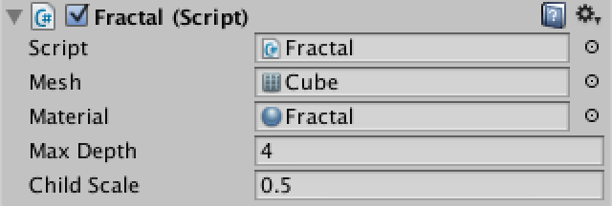
public float childScale;
private void Initialize (Fractal parent) {
mesh = parent.mesh;
material = parent.material;
maxDepth = parent.maxDepth;
depth = parent.depth + 1;
childScale = parent.childScale;
transform.parent = parent.transform;
transform.localScale = Vector3.one * childScale;
transform.localPosition = Vector3.up * (0.5f + 0.5f * childScale);
}

Slide 311
Making Multiple Children
What we are creating now looks like a tower, but not really a fractal. We need it to branch, by creating multiple children per parent.
It is easy to just create a second object, but it also has to grow in a different direction. So let's add a direction parameter to our Initialize method and use that to position the second child to the right instead of up.

Slide 312
private void Start () {
gameObject.AddComponent<MeshFilter>().mesh = mesh;
gameObject.AddComponent<MeshRenderer>().material = material;
if (depth < maxDepth) {
new GameObject("Fractal Child").AddComponent<Fractal>().Initialize(this, Vector3.up);
new GameObject("Fractal Child").AddComponent<Fractal>().Initialize(this, Vector3.right);
}
}

Slide 313
private void Initialize (Fractal parent, Vector3 direction) {
mesh = parent.mesh;
material = parent.material;
maxDepth = parent.maxDepth;
depth = parent.depth + 1;
childScale = parent.childScale;
transform.parent = parent.transform;
transform.localScale = Vector3.one * childScale;
transform.localPosition = direction * (0.5f + 0.5f * childScale);
}

Slide 314
it's good to slow this process down so we can watch it happen. We can do this by using a coroutine to create the children. Think of coroutines as methods in which you can insert pause statements. While the method invocation is paused, the rest of the program continues.
This method needs to have IEnumerator as a return type, which exists in the System.Collections namespace. That's why Unity includes it in their default script template.
Instead of just calling this method in Start, we have to call it as an argument for Unity's StartCoroutine method.
Then add a pause directive before creating each child. Do this by creating a new WaitForSeconds object for half a second or so, then yielding it back to Unity.

Slide 315
private void Start () {
gameObject.AddComponent<MeshFilter>().mesh = mesh;
gameObject.AddComponent<MeshRenderer>().material = material;
if (depth < maxDepth) {
StartCoroutine(CreateChildren());
}
}

Slide 316
private IEnumerator CreateChildren () {
yield return new WaitForSeconds(0.5f);
new GameObject("Fractal Child").AddComponent<Fractal>().Initialize(this, Vector3.up);
yield return new WaitForSeconds(0.5f);
new GameObject("Fractal Child").AddComponent<Fractal>().Initialize(this, Vector3.right);
}

Slide 317
Now we can watch it grow! Did you see a problem in the way it did? Let's add a third child per parent, this time on the left side.

Slide 318
private IEnumerator CreateChildren () {
yield return new WaitForSeconds(0.5f);
new GameObject("Fractal Child").AddComponent<Fractal>().Initialize(this, Vector3.up);
yield return new WaitForSeconds(0.5f);
new GameObject("Fractal Child").AddComponent<Fractal>().Initialize(this, Vector3.right);
yield return new WaitForSeconds(0.5f);
new GameObject("Fractal Child").AddComponent<Fractal>().Initialize(this, Vector3.left);
}

Slide 319
The problem is that the children have the same orientation as their parent. This means that a left child whose parent is itself a right child will find itself inside its grandparent, and vice versa.
To solve this, we have rotate the children so that their upward direction will point away from their parent.
We will solve this by adding an orientation parameter to Initialize. It will be a quaternion used to set the local rotation of the new child. The upward child needs no rotation, the right child needs to rotation 90 degrees clockwise, and the left child needs to rotate in the opposite direction.

Slide 320
private IEnumerator CreateChildren () {
yield return new WaitForSeconds(0.5f);
new GameObject("Fractal Child").AddComponent<Fractal>().
Initialize(this, Vector3.up, Quaternion.identity);
yield return new WaitForSeconds(0.5f);
new GameObject("Fractal Child").AddComponent<Fractal>().
Initialize(this, Vector3.right, Quaternion.Euler(0f, 0f, -90f));
yield return new WaitForSeconds(0.5f);
new GameObject("Fractal Child").AddComponent<Fractal>().
Initialize(this, Vector3.left, Quaternion.Euler(0f, 0f, 90f));
}

Slide 321
private IEnumerator CreateChildren () {
yield return new WaitForSeconds(0.5f);
new GameObject("Fractal Child").AddComponent<Fractal>().
Initialize(this, Vector3.up, Quaternion.identity);
yield return new WaitForSeconds(0.5f);
new GameObject("Fractal Child").AddComponent<Fractal>().
Initialize(this, Vector3.right, Quaternion.Euler(0f, 0f, -90f));
yield return new WaitForSeconds(0.5f);
new GameObject("Fractal Child").AddComponent<Fractal>().
Initialize(this, Vector3.left, Quaternion.Euler(0f, 0f, 90f));
}

Slide 322
Better Code For More Children
Let us generalize by moving the direction and orientation data to static arrays.
Then we can reduce CreateChildren to a short loop and use the child index as a parameter for Initialize.

Slide 323
private static Vector3[] childDirections = {
Vector3.up,
Vector3.right,
Vector3.left
};
private static Quaternion[] childOrientations = {
Quaternion.identity,
Quaternion.Euler(0f, 0f, -90f),
Quaternion.Euler(0f, 0f, 90f)
};

Slide 324
private IEnumerator CreateChildren () {
for (int i = 0; i < childDirections.Length; i++) {
yield return new WaitForSeconds(0.5f);
new GameObject("Fractal Child").AddComponent<Fractal>().Initialize(this, i);
}
}

Slide 325
private void Initialize (Fractal parent, int childIndex) {
mesh = parent.mesh;
material = parent.material;
maxDepth = parent.maxDepth;
depth = parent.depth + 1;
childScale = parent.childScale;
transform.parent = parent.transform;
transform.localScale = Vector3.one * childScale;
transform.localPosition = childDirections[childIndex] * (0.5f + 0.5f * childScale);
transform.localRotation = childOrientations[childIndex];
}

Slide 326
Now let's introduce two more children by simple adding their data to the arrays. One going forward, the other going backward.

Slide 327
private static Vector3[] childDirections = {
Vector3.up,
Vector3.right,
Vector3.left,
Vector3.forward,
Vector3.back
};
private static Quaternion[] childOrientations = {
Quaternion.identity,
Quaternion.Euler(0f, 0f, -90f),
Quaternion.Euler(0f, 0f, 90f),
Quaternion.Euler(90f, 0f, 0f),
Quaternion.Euler(-90f, 0f, 0f)
};

Slide 328
Adding Color
The fractal is a little dull. Let's liven it up by adding some color variation.
We do this by interpolating from white at the root to yellow at the smallest children.
The static Color.Lerp method is a handy way to do this. The interpolator goes from zero to one, which we do by dividing our current depth by the maximum depth.
Because we don't want an integer division here, we convert depth to a float first.

Slide 329
private void Start () {
gameObject.AddComponent<MeshFilter>().mesh = mesh;
gameObject.AddComponent<MeshRenderer>().material = material;
renderer.material.color = Color.Lerp(Color.white, Color.yellow, (float)depth / maxDepth);
if (depth < maxDepth) {
StartCoroutine(CreateChildren());
}
}

Slide 330
Let's create only one material duplicate per depth instead of per cube.
Add a new array variable to hold the materials. Then check whether that array exists in Start and if not call a new InitializeMaterials method.
In this method, we will explicitly duplicate our material and change its color per depth.

Slide 331
private Material[] materials;
private void InitializeMaterials () {
materials = new Material[maxDepth + 1];
for (int i = 0; i <= maxDepth; i++) {
materials[i] = new Material(material);
materials[i].color = Color.Lerp(Color.white, Color.yellow, (float)i / maxDepth);
}
}

Slide 332
private void Start () {
if (materials == null) {
InitializeMaterials();
}
gameObject.AddComponent<MeshFilter>().mesh = mesh;
gameObject.AddComponent<MeshRenderer>().material = materials[depth];
if (depth < maxDepth) {
StartCoroutine(CreateChildren());
}
}

Slide 333
private void Initialize (Fractal parent, int childIndex) {
mesh = parent.mesh;
materials = parent.materials;
maxDepth = parent.maxDepth;
depth = parent.depth + 1;
childScale = parent.childScale;
transform.parent = parent.transform;
transform.localScale = Vector3.one * childScale;
transform.localPosition = childDirections[childIndex] * (0.5f + 0.5f * childScale);
transform.localRotation = childOrientations[childIndex];
}

