Slide 1

Data Science

Slide 2
Content
Project ( Data Classification )
Project ( Data Regression )
Bouns ( Data Classification)
Some of Machine Learning Algorithms
- Linear Regression
- Logistics Regression
- Decision Tree
- Random Forest Tree

Slide 3
Target
Most of the audience make at least one project.
Tips and Tricks for Working with Data.

Slide 4
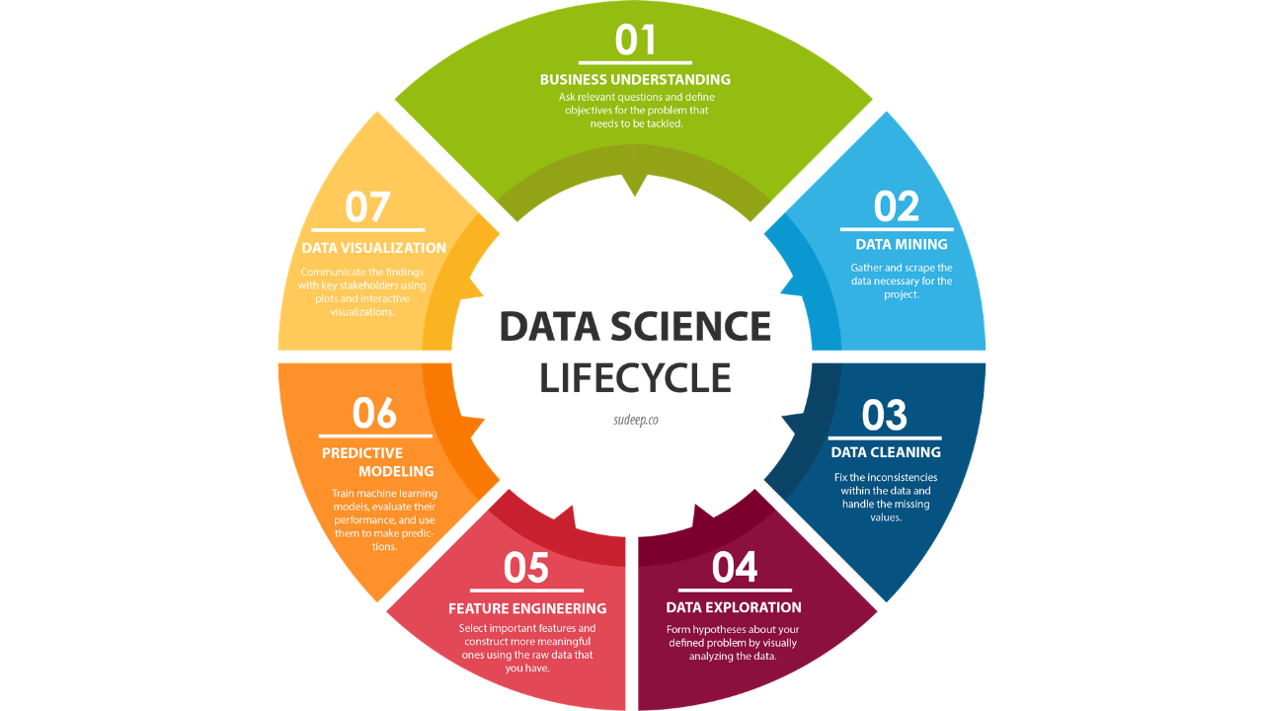
Project Step

Slide 5
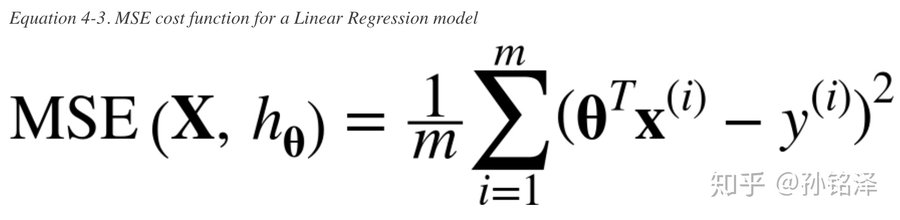
Linear Regression
equation
y = theta0 + theta1 * x
y = theta0 + theta1 * x1+theta2 * x2+theta n* xn
Y = h(x) = Theta*X
Line Fit

Slide 6
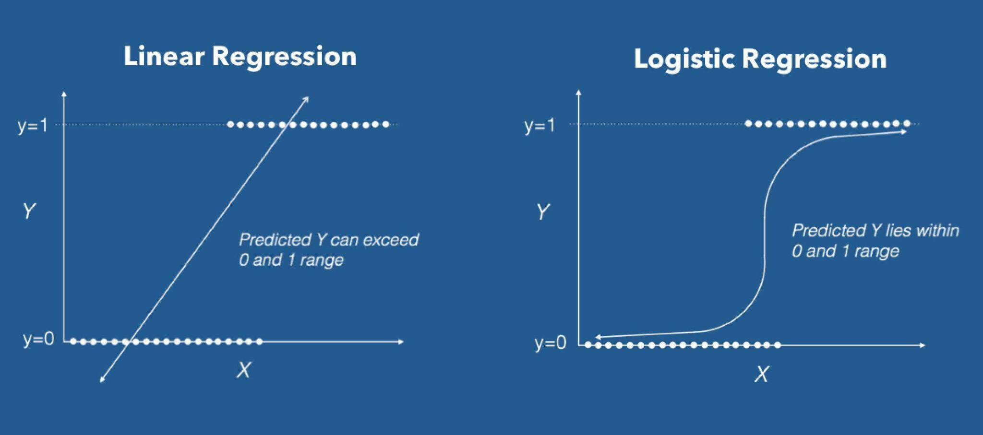
Logistic Regression

Slide 7
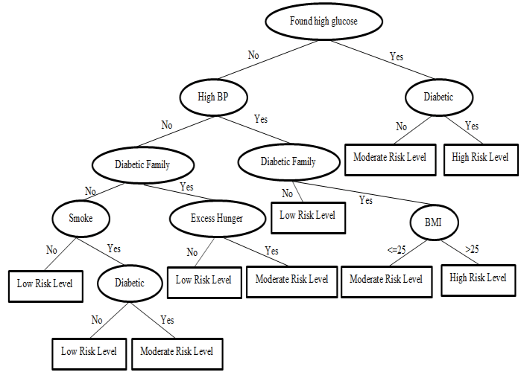
Decision Tree

Slide 8
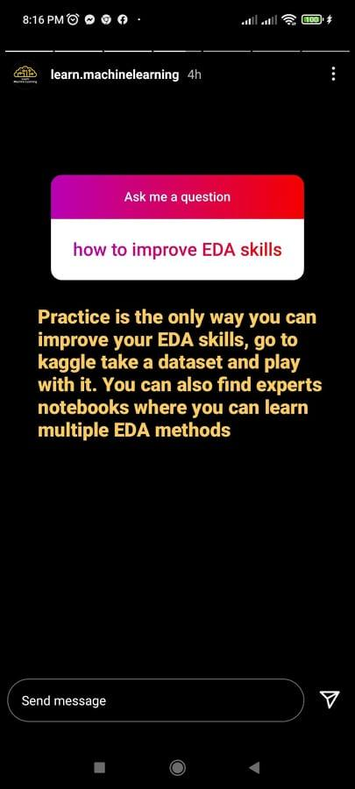
EDA

