Slide 1
Hate Speech Detection using Transformers and Deep Learning
By:
Farheen Fatima
Mohamed Derbeli

Slide 2
Introduction
Dataset
Data preprocessing
Models
Results

Slide 3
The term hate speech is understood as any type of verbal, written or behavioral communication that attacks or uses derogatory or discriminatory language against a person or group based on what they are. In other words, based on their religion, ethinicity, natiionality, race, color, ancestry, sex or other identity factor, In the problem, we will take you through a hate speech detection model with Machine Learning, Deep Learning and Python.
Hate Speech Detection is generally a task of sentiment classification. So, for training a model that can classify hate speech from a certain piece of text can be achieved by training it on data that is generally used to classify sentiments. So, for the task of hate speech detection model, we will use the Twitter tweets to identity tweets containing Hate Speech.

Slide 4
Dataset & Preprocessing
We have used Twitter tweets and this datasets contains 31962 instances and 3 features id, tweets and the label.
We removed the id feature since it does not contribute towards our prediction.
We removed the stopwords, punctuation marks, urls etc.
We performed tokenization and lemmatization on our data.
The dataset had 29720 hate speech tweets and 2242 free speech tweets in the target feature. So we did oversampling of the data for balancing the data.

Slide 5
Models
We implemented various Machine Learning algorithms such as Logistic Regression, Random Forest, Super Vector Machine and Naive Bayes.
We implemented a Neural Network and LSTM model without using transformers and then we built an LSTM model using the Glove Transformer.

Slide 6
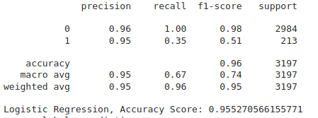
Logistic Regression Model with Imbalanced Data

Slide 7
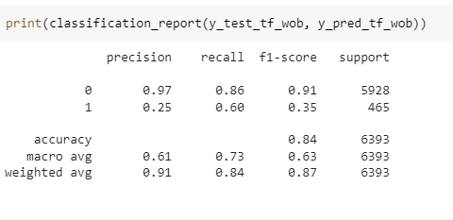
Naive Bayes Model with Imbalanced Data

Slide 8
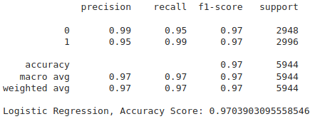
Logistic Regression Model with Balanced Data

Slide 9
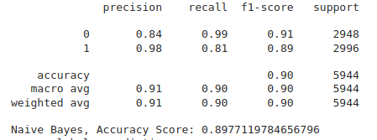
Naive Bayes Model with Balanced Data

Slide 10
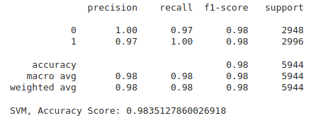
SVM Model with Balanced Data

Slide 11
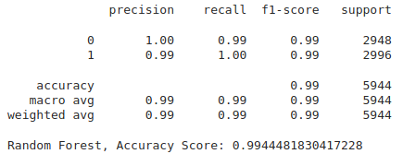
Random Forest Model with Balanced Data

Slide 12
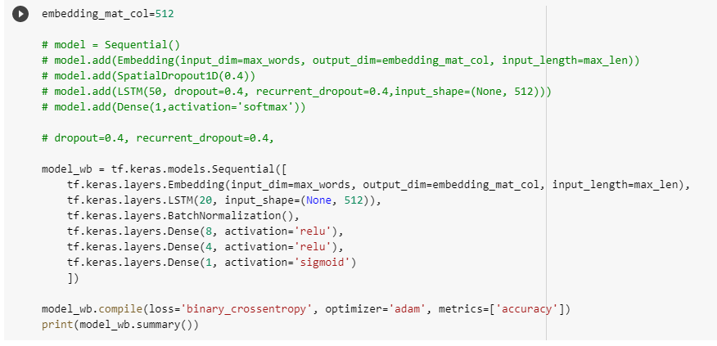
LSTM Model without Transformer

Slide 13
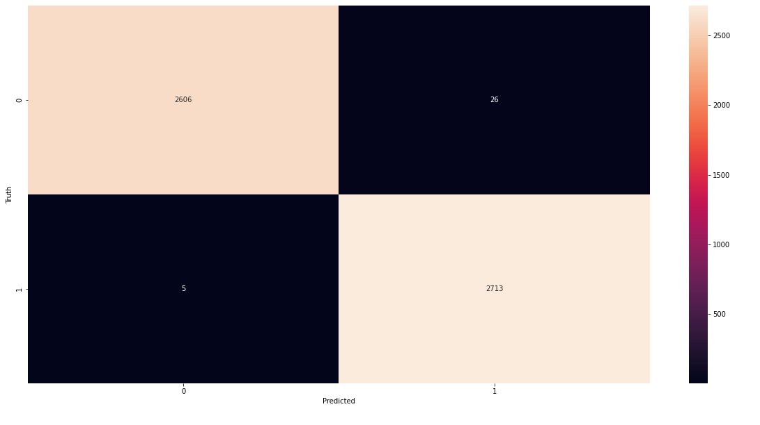
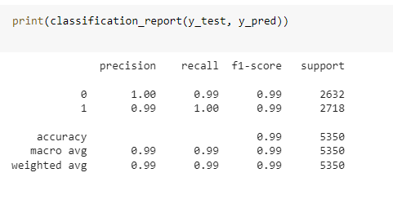
Confusion Matrix

Slide 14
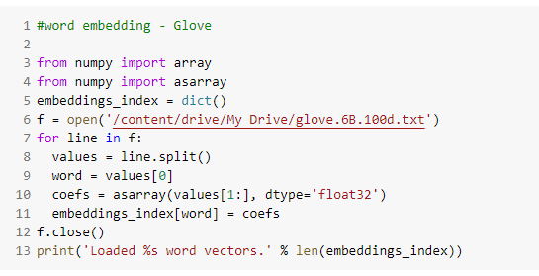
Results using Glove Transformer

Slide 15
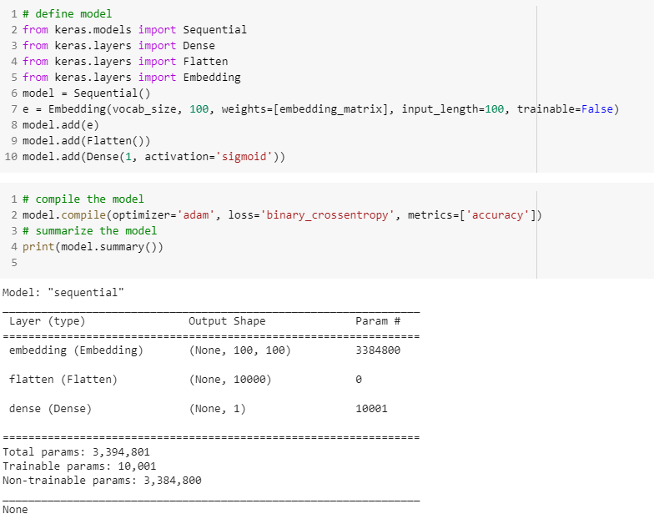
NN Model using Glove

Slide 16
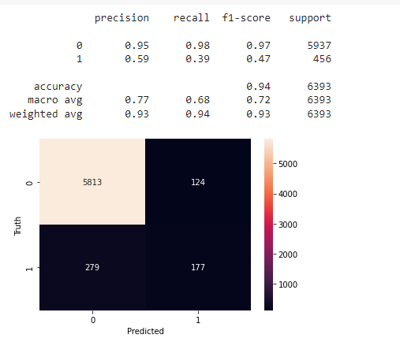
Confusion Matrix and Classification Report

Slide 17
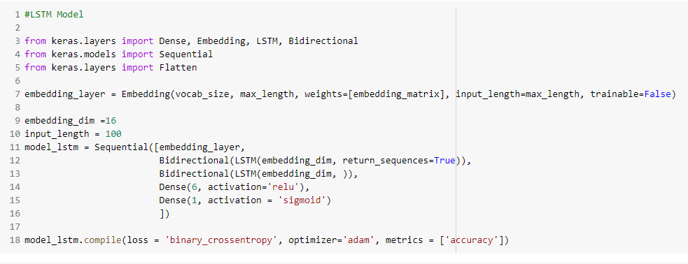
LSTM Model using Glove:

Slide 18
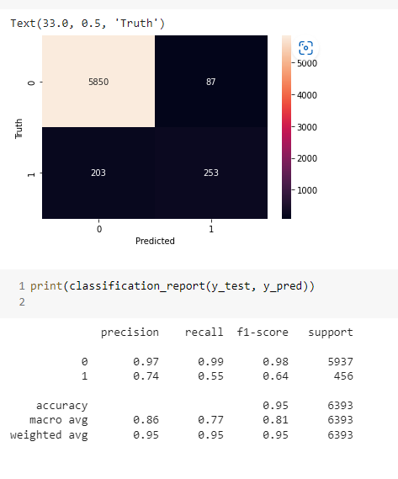
Confusion Matrix & Classification Report

Slide 19
Conclusion
The model performed much better when the data is balanced. Hence, we understood the importance of balanced data while training the model.
LSTM Model performed much better than Naive Bayes and Neural Network Models.

