Slide 1
Optical Center
Lecturer name:
Dr. Yasser Omar
Students:
Ahmed Rady 19106585
Adham Sabry 19105661
Mohamed Fawzy 19105542
Lecture time:
Monday 8:30

Slide 2
Project Description
An Optical management System works as a desktop application that aims to reduce the work load, containing secure database and contains all the functionality which could be used in an optical store.
The application is responsible for many things. From storing product and customer data, to preforming transactions.
One of the main the functionalities is creating promotions which helps in one of the main objectives, attracting customers that are source of the company’s margin.

Slide 3
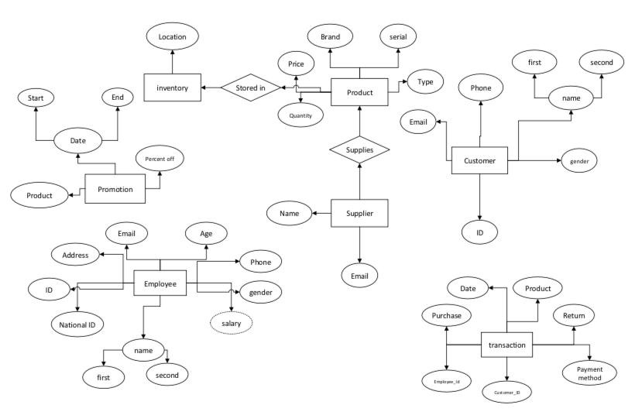
Rough Schema

Slide 4
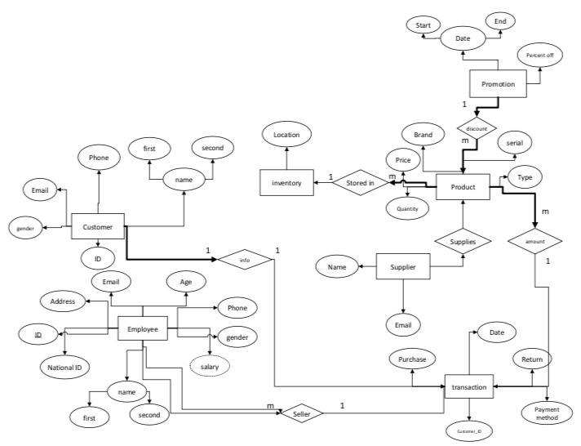
Final ER

Slide 5
Mapping
Customer:
ID | First name | Last name | Phone | Email | Gender
Employee:
ID | first name | Last name | National ID | address | Gender | Phone | Email | Age
Transaction:
Customer ID | Payment method | Date | Purchase | Return
Supplier:
Name | Email
Product:
Serial | Brand | Price | Type | Quantity
Inventory:
Promotion:
Start date | Percent off | End date
Location

Slide 6
Relation Algebra Queries
A) Retrieve all the female customer
customer ℑCOUNT gender=’female’;
B) Retrieve all the employees live in Cairo
π employee_name ( σ address=Cairo (Employee)).
C) Retrieve all the types Lacoste
π brand ( σ brand=Lacoste (Product)).
D) Retrieve all promotions before end of the year
π discount value (σ date <3l/12/2021’(Promotion))

Slide 7
Relation Algebra Queries
E) Retrieve all the customer that make transaction and their serial number in specific month
π customer_id,serial_number (σ date <3/11/2021’(Transactions))
F) Retrieve all the inventories
inventories ℑCOUNT capacity;
1

Slide 8
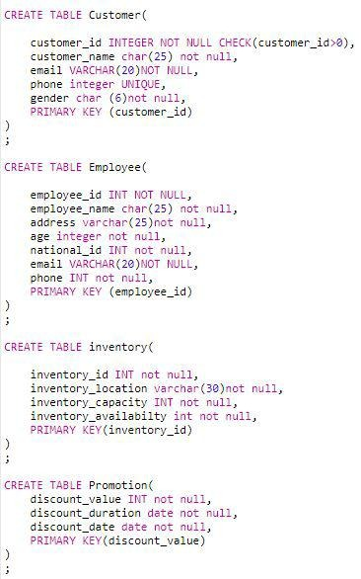
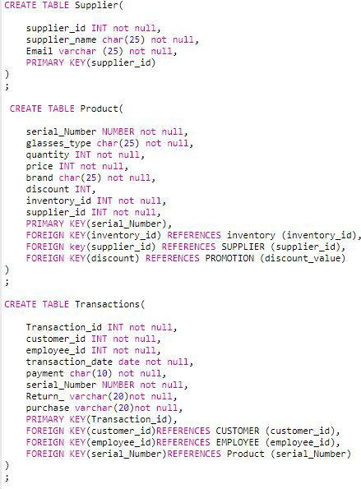
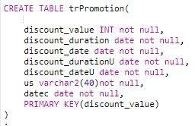
Tables

Slide 9
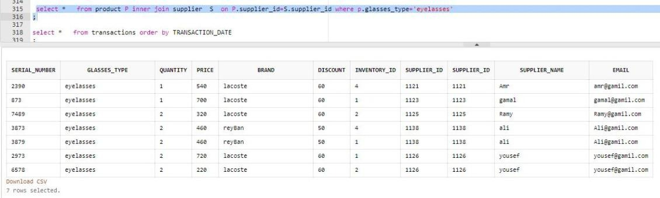
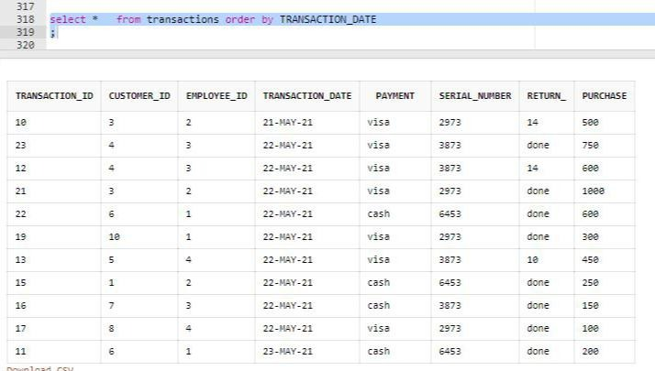
Complex Queries

Slide 10
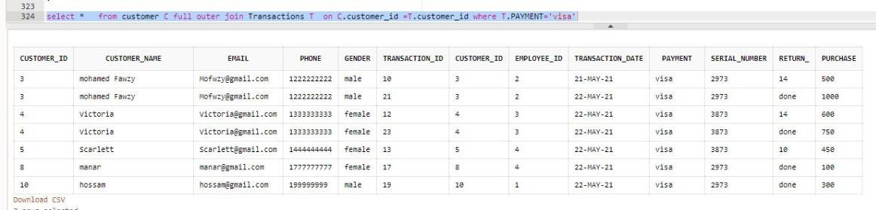
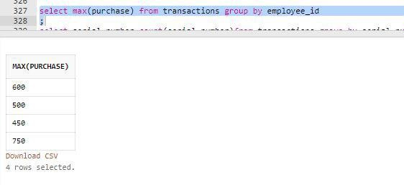
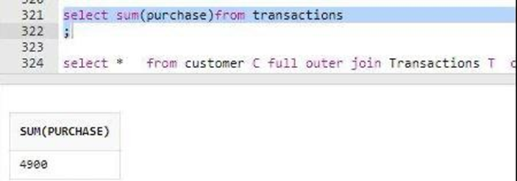
Complex Queries

Slide 11
Implementation of SQL & DDL
insert into TRANSACTIONS (TRANSACTION_ID,PAYMENT,RETURN_,PURCHASE,CUSTOMER_ID,TRANSACTION_DATE,serial_Number,EMPLOYEE_ID) values (19,'visa', 'done', 300, 10, date'2021-5-22', 2973, 1);
insert into TRANSACTIONS (TRANSACTION_ID,PAYMENT,RETURN_,PURCHASE,CUSTOMER_ID,TRANSACTION_DATE,serial_Number,EMPLOYEE_ID) values (20,'visa', 14, 144, 1, date'2021-5-22', 2973, 5);
insert into PRODUCT (serial_Number,GLASSES_TYPE,PRICE,DISCOUNT,INVENTORY_ID,SUPPLIER_ID,QUANTITY,BRAND) values(6458, 'sunglasses', 560, 50, 1,1135,1,'reyBan’);
insert into PRODUCT (serial_Number,GLASSES_TYPE,PRICE,DISCOUNT,INVENTORY_ID,SUPPLIER_ID,QUANTITY,BRAND) values(3879, ‘eyeglasses', 460, 50, 1, 1138, 2,'reyBan');
insert into SUPPLIER
(SUPPLIER_ID,EMAIL,SUPPLIER_NAME) values (1122,'zaki@gamil.com','zaki’);
insert into SUPPLIER
(SUPPLIER_ID,EMAIL,SUPPLIER_NAME) values (1133,'may@gamil.com','may');
insert into PROMOTION (DISCOUNT_VALUE,DISCOUNT_DURATION,DISCOUNT_DATE) values (60,date'2021-2-4',date'2021-8-1’);
insert into PROMOTION (DISCOUNT_VALUE,DISCOUNT_DURATION,DISCOUNT_DATE) values (20,date'2021-8-8',date'2022-6-20');

Slide 12
Implementation of SQL & DDL
insert into INVENTORY
(inventory_id,inventory_location,inventory_capacity,inventory_availabilty)VALUES(3,'maadi',1000,800);
insert into INVENTORY
(inventory_id,inventory_location,inventory_capacity,inventory_availabilty)VALUES(5,'nasr city',500,50);
insert into SUPPLIER
(SUPPLIER_ID,EMAIL,SUPPLIER_NAME) values (1126,'yousef@gamil.com','yousef’);
insert into SUPPLIER
(SUPPLIER_ID,EMAIL,SUPPLIER_NAME) values (1135,'khalid@gamil.com','khalid');
insert into EMPLOYEE
(employee_id, employee_name, address, age, national_id, email, phone, gender) values (3, 'rana amgd', 'cairo', 26, 2133949, 'rana@gmail.com','01035542340', 'female’) ;
insert into EMPLOYEE
(employee_id, employee_name, address, age, national_id, email, phone, gender) values (4, 'mahetab yosef', 'cairo', 29, 8793739, 'mahetab@gmail.com','01134323340', 'female’) ;
insert into customer
(CUSTOMER_id,CUSTOMER_name,EMAIL,PHONE,GENDER)
VALUES(9,'cilia','cilia@gmail.com',01888888888,'female’) ;
insert into customer
(CUSTOMER_id,CUSTOMER_name,EMAIL,PHONE,GENDER)
VALUES(10,'hossam','hossam@gmail.com',0199999999,'male') ;

