Slide 1


NUDJ
BUTCHER · COOKING ADVISOR
WEBSITE WALKTHROUGH — SEPTEMBER 2026
Tell us the occasion.
We'll cut it to the gram.
A simple walk through the NUDJ website — every step a customer takes, every feature on the way, and the dashboard that runs it all.
Customer journey
All features
Admin dashboard
mohamed-sr-designer.github.io/nudj/en
Notes:
- Welcome. This is a walk through the NUDJ website, from the first visit to the admin dashboard.
- One line to remember: NUDJ is a butcher that asks before it cuts.
- We'll follow one customer through the site, then switch to the store team's side.

Slide 2

01 THE IDEA
A butcher that
asks before it cuts.
NUDJ IN NUMBERS
6
animals
Lamb, goat, camel, veal, beef, buffalo
Most people don't know how many kilos they need for ten guests, or which cut works for mandi.
NUDJ starts with that question. You tell us the occasion. We work out the rest — the meat, the cutting, the marinade, even the charcoal.
52
products
40 cuts, 5 carcasses, 7 BBQ extras
0
SAR for cutting
Any style you like, always free
1
tap to order
The whole plan goes to the cart
WEBSITE WALKTHROUGH
02 / 33
Notes:
- NUDJ is a Saudi online butcher with a cooking advisor built in.
- The problem: people know the occasion, not the kilos. "Ten guests for a BBQ" — how much lamb is that?
- So the site starts with the occasion, then works out the meat, the cut, the marinade and the charcoal.
- Numbers on the right: 6 animals, 52 products, cutting is always free, and the whole plan goes to the cart in one tap.

Slide 3
02 WHY IT EXISTS
Three questions every host asks.
Three answers built into the site.
01
02
03
“How much do I buy?”
“How should it be cut?”
“What else do I need?”
The advisor works it out to the gram, from the number of guests and the dish.
Pick any cutting style — cubes, slices, steaks, kabsa pieces, mince. Cutting is always free.
Marinade, skewers, charcoal and spices are part of the plan, each with a clear price.
THE ADVISOR
FREE CUTTING
MEAT + KIT IN ONE PLAN
WEBSITE WALKTHROUGH
03 / 33
Notes:
- Every host asks the same three questions before a gathering.
- The site answers each one with a feature: the advisor, free cutting, and a plan that includes the kit.
- This is the heart of the product. Everything else supports these three answers.

Slide 4
03 THE JOURNEY AT A GLANCE
One journey.
Seven simple steps.
01
02
03
04
05
06
07
Discover
Plan
Choose
Cart
Checkout
Track
Come back
Home page, occasions, the herd
The advisor builds a plan to the gram
Shop, search, cut map, product page
A draft receipt you can adjust
Phone sign-in, address, time, payment
Printed receipt and 4-step status
Saved plans, order again, wishlist
Behind every step: the admin dashboard — orders, stock, analytics, reports and every word and price on the site.
WEBSITE WALKTHROUGH
04 / 33
Notes:
- The whole customer journey fits in seven steps.
- Steps 1 to 4 happen before sign-in: people can explore and plan freely.
- Sign-in only appears at checkout, with a phone number and a 4-digit code.
- Under everything sits the admin dashboard: orders, stock, analytics and content.

Slide 5
04 UX JOURNEY · THE CUSTOMER
Meet Khalid.
Guests on Thursday.
PERSONA CARD
K
Khalid, 34
Khalid is 34 and lives in Riyadh. He is hosting a BBQ for ten friends. He knows what he wants to cook — he just doesn't know how much to buy.
Riyadh · Host of the week
Occasion
BBQ party
Guests
10 people
Enough meat for ten, ready to grill, delivered before 6 pm.
When
Thursday, 3 – 6 pm
GOAL
Device
iPhone · Arabic + English
WORRIES
Buying too little, spending too much, forgetting the charcoal.
Budget feel
“Around 35–40 SAR a head”
“Just tell me what to buy — and make sure it's enough.”
USES
His phone, between meetings, in Arabic or English.
WEBSITE WALKTHROUGH
05 / 33
Notes:
- To keep it concrete, we follow one person: Khalid.
- He knows the occasion — a BBQ for ten on Thursday — but not the kilos.
- His worries are the real design brief: too little meat, too much spend, and wasted time.
- Keep him in mind; the next slide shows how he feels at each step.

Slide 6
05 UX JOURNEY · HOW KHALID FEELS
From “how much do I need?”
to “same again next week”.
“Same again next Thursday.”
“It did the maths — even the charcoal.”
GREAT
“I can see the price of every extra.”
“Is it enough? Yes — it's clear per person.”
“It's on the butcher's block now.”
OK
“Phone, code, time slot. Done.”
“How many kilos for ten people?”
01 DISCOVER
02 PLAN
03 CHOOSE
04 CART
05 CHECKOUT
06 TRACK
07 COME BACK
Advisor in the hero · 6 occasions
Grams per person · plan receipt
Free cutting · price per kg
Draft receipt · free delivery 300+
OTP sign-in · 5 ways to pay
4-step tracking · printed receipt
Saved plans · order again
WEBSITE WALKTHROUGH
06 / 33
Notes:
- This is Khalid's emotional journey, step by step.
- He starts unsure. The advisor is the big lift — it does the maths for him.
- The small dip is checkout: any form is effort. We keep it short — phone, code, slot, pay.
- The high point is after delivery: he can order the same plan again in one tap.
- The full map, with pain points and opportunities, is in the Figma journey file.

Slide 7
06 USER FLOW
Two ways in. One way out.
help me plan
Advisor
Plan receipt
Occasion → guests → questions
Adjust · save · add occasion
Arrives
Home page
Cart
Instagram · Snapchat · Google · direct
Advisor in the hero
Draft receipt
Shop · Search · Herd
Product page
Filters, cut map
Weight · cut · marinade
I know what I want
if needed
My account
Receipt + tracking
Checkout
Sign in
Order it again
Orders · plans · wishlist
Received → delivered
Address · time · payment
Phone + 4-digit code
Dashboard Every order lands in Orders. The team moves it Received → Cutting → On the way → Delivered, and the customer's tracking updates.
WEBSITE WALKTHROUGH
07 / 33
Notes:
- Two ways in, one way out.
- People who need help go to the advisor. People who know what they want browse the shop, search or the cut map.
- Both paths meet in the cart. Sign-in only happens if needed, right before checkout.
- After the order, the receipt tracks the status live, and the account keeps plans and orders for next time.
- The dashed line is the link to the store team: every order lands in the dashboard.

Slide 8
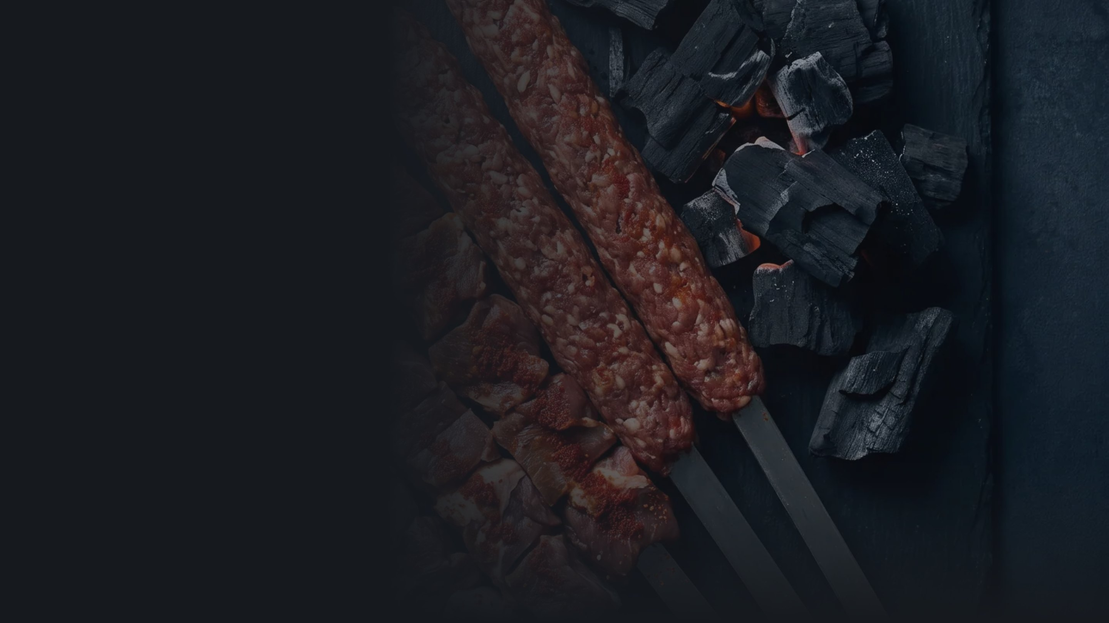
PART
01
The customer side
Home · Advisor · The Herd · Shop & search · Product page · Prices · Cart · Sign in · Checkout · Tracking · Account · Mobile · Languages
WEBSITE WALKTHROUGH
08 / 33
Notes:
- Part one: the customer side. We'll go page by page, in the order Khalid meets them.

Slide 9
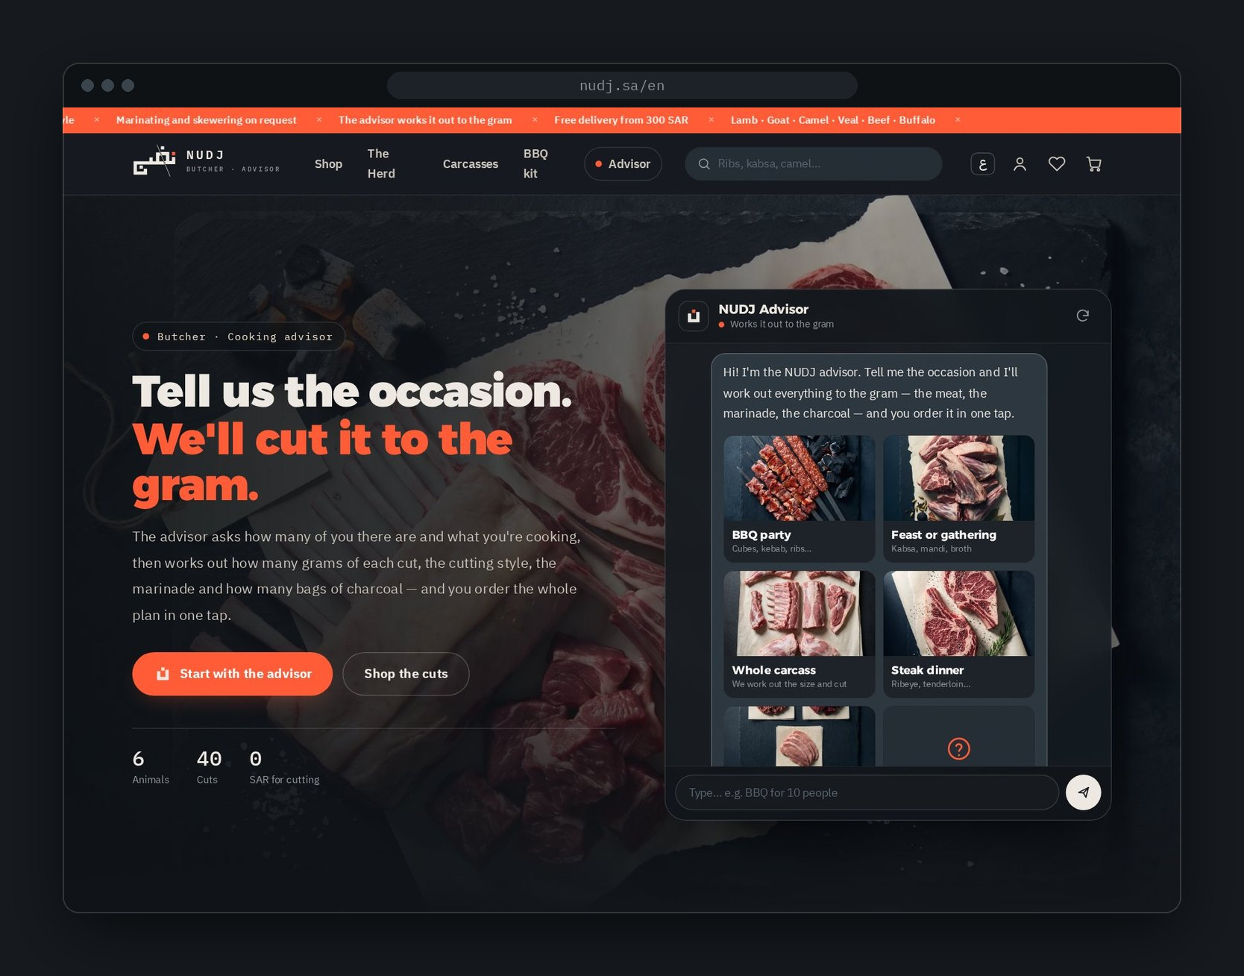
07 DISCOVER · HOME PAGE
The home page
starts a
conversation.
01
The advisor, in the hero
02
Six occasions to start from
03
The herd — six animals
04
How it works, in 3 steps
05
Shop by dish
06
Services and cutting styles
07
Carcasses and FAQ
WEBSITE WALKTHROUGH
09 / 33
Notes:
- The home page doesn't open with a sale banner. It opens with a question: what's the occasion?
- The advisor sits right in the hero, so planning can start in the first second.
- Scrolling down, every section answers a question a buyer has: which animal, how it works, what it costs, how it's cut.
- Sections can be reordered or hidden from the dashboard.

Slide 10
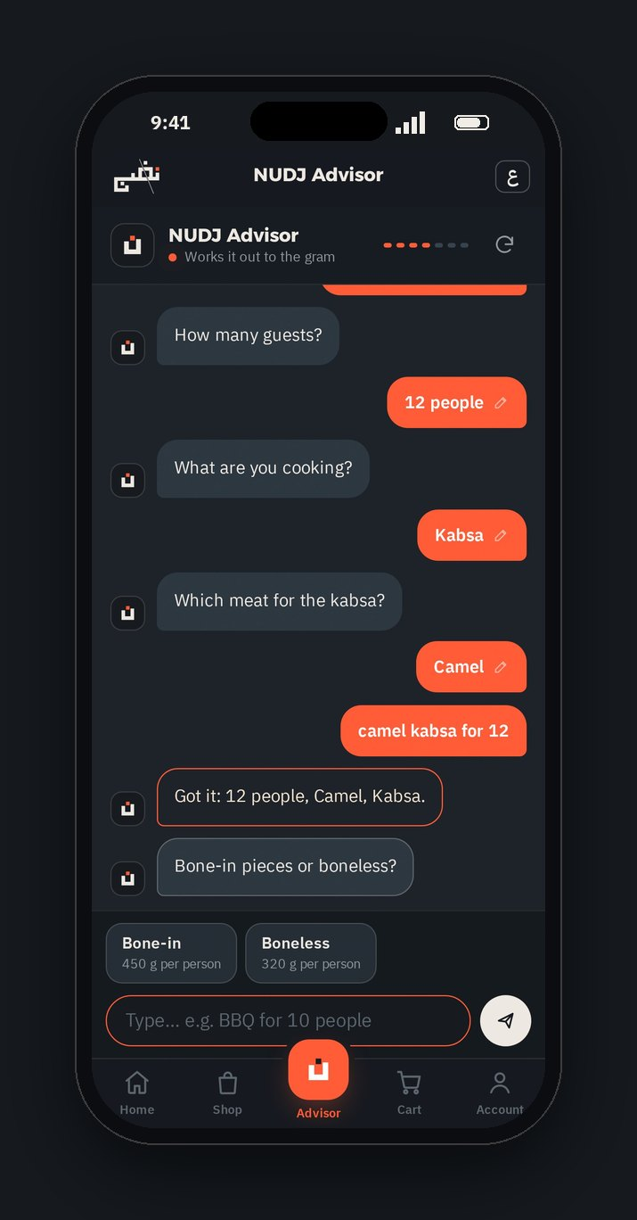
08 PLAN · THE ADVISOR
It talks like a butcher.
A guided chat. One question at a time — tap an answer or type it your way.
THE QUESTIONS
Occasion
Guests
Cut shape
Animal
Marinade
Skewers
BBQ kit
Receipt
OR JUST TYPE IT
bbq for 8 lamb
camel kabsa for 12
عايز اعمل عزومه ل 15 نفر كبسه جمل بالعظم
↑ Egyptian Arabic for “a feast for 15 — camel kabsa, bone-in”
Understands English, Saudi and Egyptian Arabic, typos and numbers in words.
Answers side questions — delivery, payment, prices — then carries on.
WEBSITE WALKTHROUGH
10 / 33
Notes:
- The advisor is a guided chat. It asks what a good butcher would ask, one question at a time.
- Tap an answer, or just type in your own words — Arabic dialect or English, typos included.
- It fills in as much as it can from one sentence, then asks only what's missing.
- It never tells people they typed something wrong. If it's not sure, it offers the closest options.
- Every answer can be tapped later to change it.

Slide 11
09 PLAN · THE RECEIPT
ADVISOR'S PLAN
A plan you can
order in one tap.
BBQ party · 10 people
Lamb shoulder
144.00
THE MATHS BEHIND IT
Skewer cubes · 2 kg × 72.00
350 g
per person — boneless BBQ
+ Hot grill marinade 2 kg × 10
20.00
+ Ready skewered 2 kg × 6
12.00
450 g
per person — bone-in kabsa, mandi
Minced lamb
130.00
300 g
per person — steak
Kebab · 2 kg × 65.00
+ Hot grill marinade 2 kg × 10
20.00
250 g
per person — broth and stew
+ Ready skewered 2 kg × 6
12.00
1 bag
of charcoal per 4.5 kg of grilling
Natural charcoal 3 kg
22.00
1 bag per 4.5 kg of meat · 1 × 22.00
WHAT YOU CAN DO WITH IT
Meat
274.00
Adjust any weight with − and +
Services
64.00
Change the number of guests
BBQ kit
22.00
Add a second dish — one combined plan
Delivery
Free
Plan total
360.00
Save the plan to your account
Send the whole plan to the cart
Per person, approx.
36.00 SAR
WEBSITE WALKTHROUGH
11 / 33
Notes:
- This is the result: a receipt, not a suggestion. Every line has a weight and a price.
- The maths is simple and visible: grams per person by dish, and one bag of charcoal per 4.5 kg of grilling.
- Khalid's BBQ for ten comes to 360 SAR — about 36 SAR a head, with free delivery.
- He can change any weight, change the headcount, add a second dish, save the plan, or send it all to the cart.

Slide 12
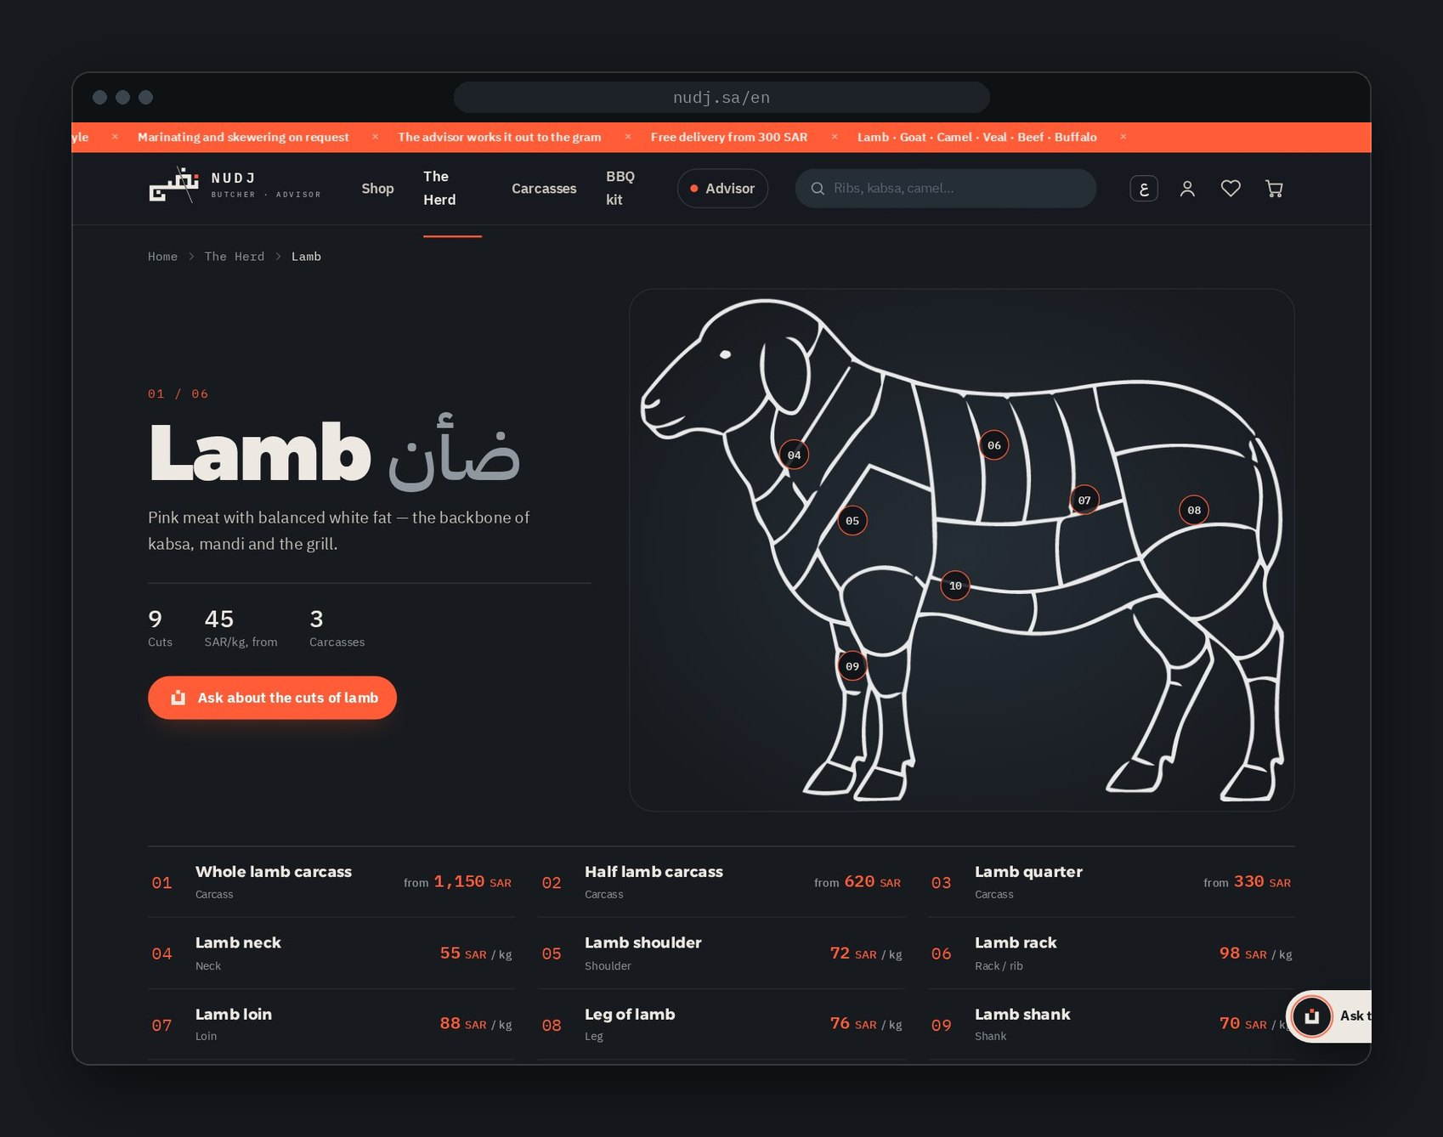
10 CHOOSE · THE HERD
Six animals.
Every cut has
a number.
Tap a numbered dot on the drawing to open that cut.
ANIMAL
ITEMS
FROM / KG
Lamb
12
45 SAR
Goat
7
52 SAR
Camel
6
45 SAR
Veal
7
48 SAR
Beef
8
49 SAR
Buffalo
5
44 SAR
WEBSITE WALKTHROUGH
12 / 33
Notes:
- For people who like to choose themselves, there's the herd.
- Each animal has a line drawing with numbered dots. Every dot is a cut you can order.
- Tap a dot and you go straight to that cut. It's a map, not a list.
- Six animals, 45 meat products, starting from 44 SAR per kilo.

Slide 13
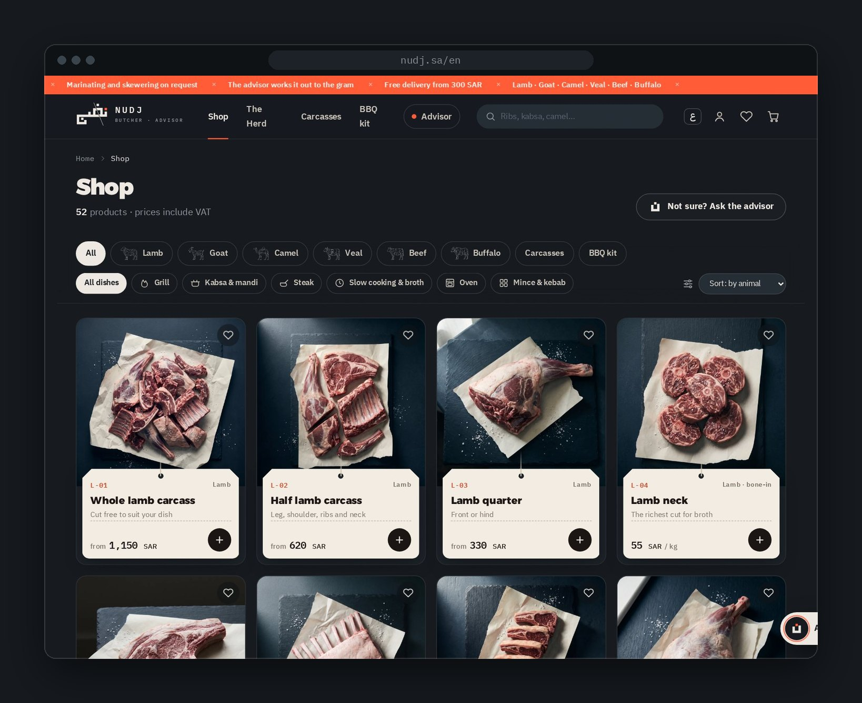
11 CHOOSE · SHOP AND SEARCH
Find it by animal
or by dish.
52 products, prices include VAT
Filter by animal: lamb to buffalo, carcasses, BBQ kit
Filter by dish: grill, kabsa & mandi, steak, slow cooking, oven, mince & kebab
Sort by animal or by price
Search with suggestions — and every search with no results is logged for the team
Wishlist: tap the heart to save any cut
WEBSITE WALKTHROUGH
13 / 33
Notes:
- The shop shows all 52 products, with prices that already include VAT.
- Two filters matter most: by animal, and by dish — grill, kabsa and mandi, steak, slow cooking, oven, mince.
- Search suggests popular words and shows the herd. Searches with no results are logged, so the team sees what people want but can't find.
- A heart on any card saves it to the wishlist.

Slide 14
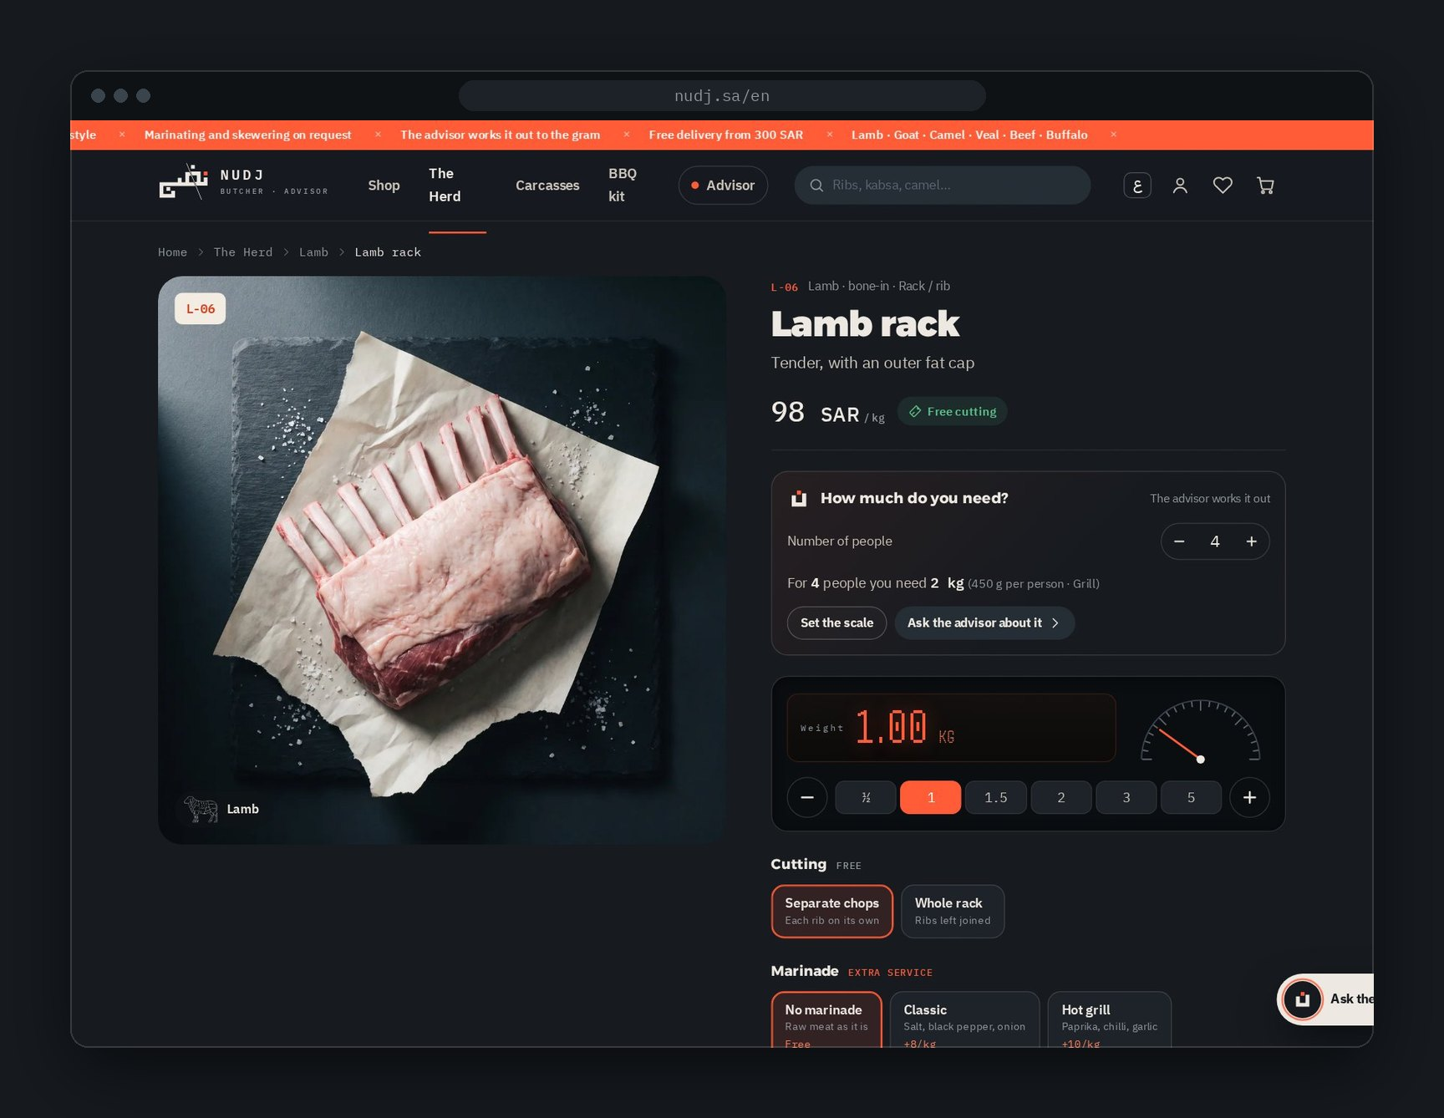
12 CHOOSE · PRODUCT PAGE
A butcher's counter,
with a scale.
01
Digital scale ½ to 5 kg
02
“How much do you need?” guests → weight
03
Cutting style free
04
Marinade +8 to +12 SAR/kg
05
Vacuum packing +3 SAR/kg
06
Note for the butcher
07
About the cut tenderness, fat, flavour
08
Goes well with charcoal, spices, skewers
WEBSITE WALKTHROUGH
14 / 33
Notes:
- The product page works like a butcher's counter with a digital scale.
- Pick the weight, or let the page work it out from the number of people.
- Then choose how it's cut (free), the marinade and packing (priced per kilo). The price updates live.
- Below: what this cut is good for, where it sits on the animal, and the kit that goes with it.

Slide 15
13 CLEAR PRICES
Clear prices.
No surprises.
PRICE LIST · SAR
Cuts
44 – 210
per kg, by product
Every extra shows its price before you add it. Cutting never costs anything.
Carcasses
330 – 1,690
whole, half, quarter — by size
Cutting
FREE
any style
Marinade
8 – 12
four recipes, per kg
Ready skewered
6
per kg
Vacuum packing
3 · 35
per kg · per carcass
BBQ kit & spices
8 – 25
per item
Delivery
25
free from 300 SAR
All prices in SAR, 15% VAT included. Delivery to Riyadh, Jeddah, Dammam, Khobar, Makkah and Madinah. Demo prices.
The advisor
FREE
plans to the gram
WEBSITE WALKTHROUGH
15 / 33
Notes:
- Prices are simple and shown before anything is added.
- Cutting is always free. The only paid extras are marinating, skewering and vacuum packing — per kilo.
- Delivery is 25 SAR, free from 300 SAR. All prices include 15% VAT.
- Note: these are proposed prices for the demo version.

Slide 16
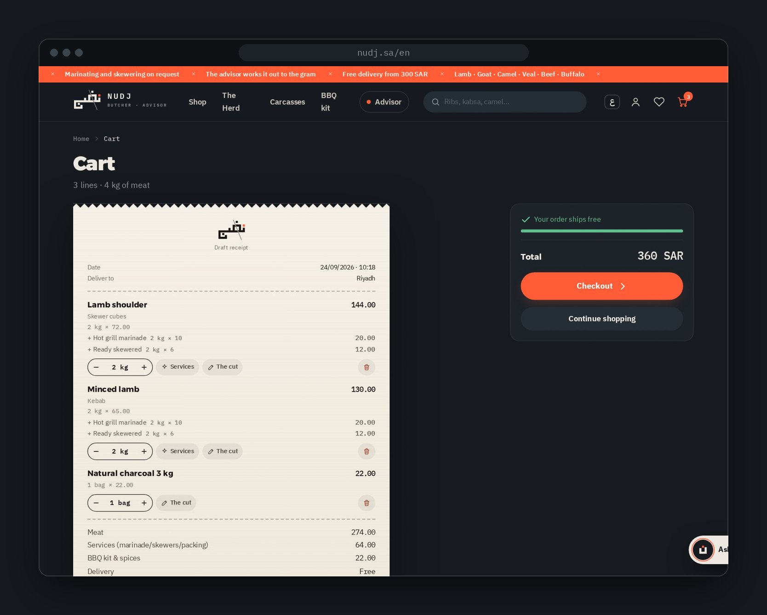
14 CART
The cart is a
draft receipt.
Change weights with − and + on every line
See the cut and the services on each item
Free-delivery bar shows how close you are to 300 SAR
Totals split into meat, services and kit, with VAT
No sign-in needed until checkout
WEBSITE WALKTHROUGH
16 / 33
Notes:
- The cart looks like a receipt — because that's what it becomes.
- Weights can still change here, and each line shows its services and the cut.
- A bar shows how far you are from free delivery.
- Sign-in isn't needed to reach this point.

Slide 17
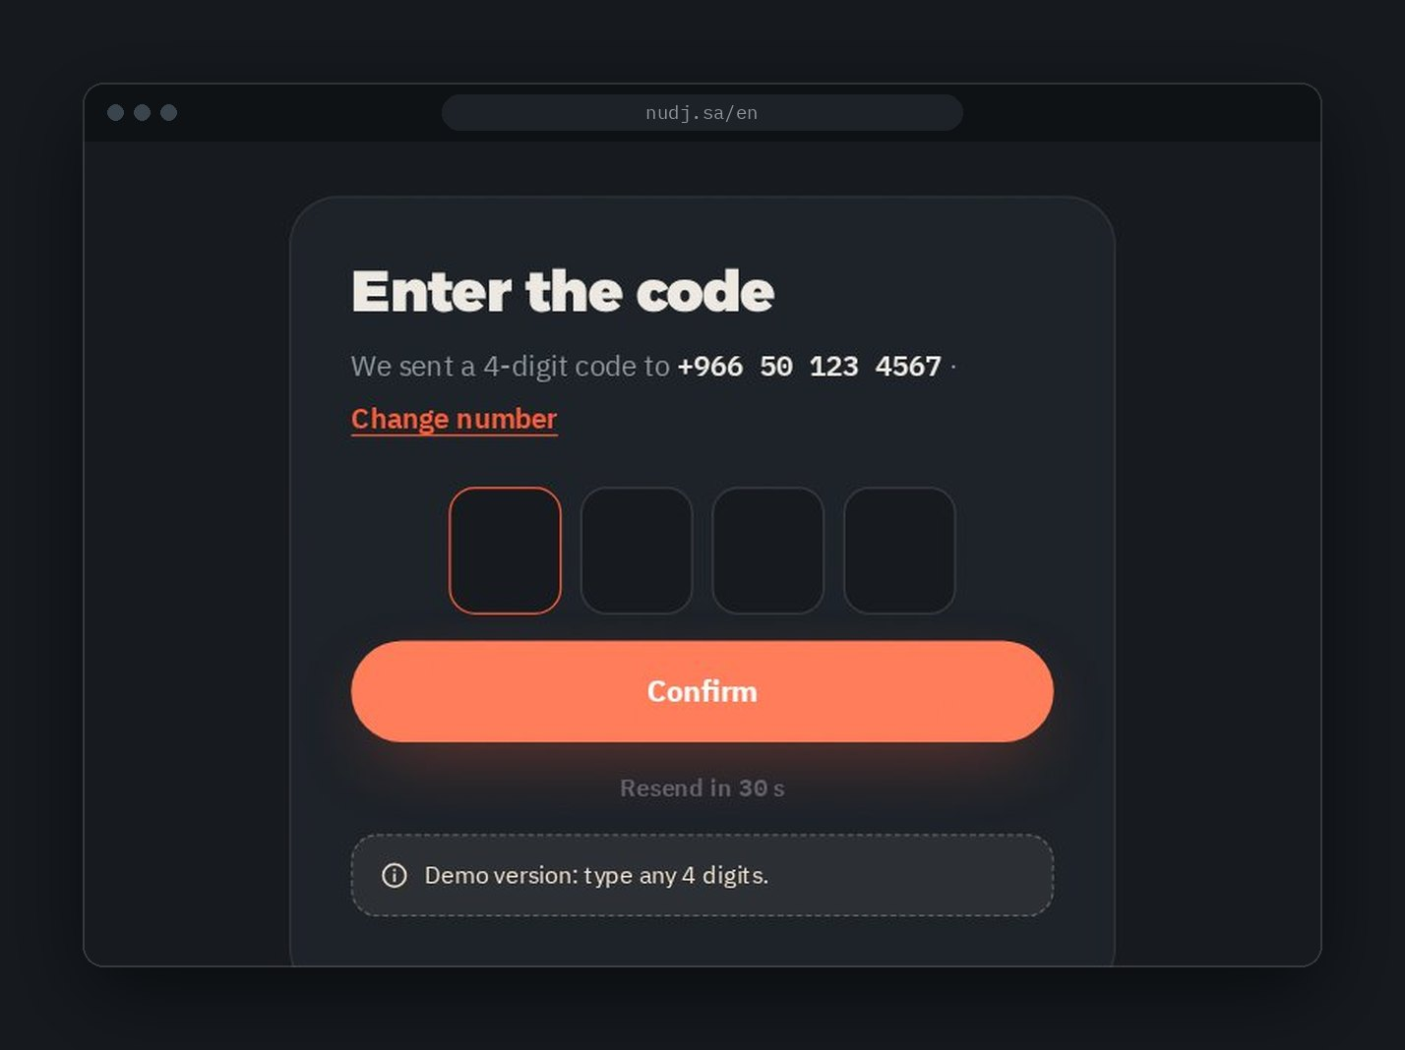
15 SIGN IN
Mobile number.
4-digit code. Done.
No passwords and no long forms. The number confirms the order and keeps orders, plans and addresses together.
01
Type your mobile number
+966 5X XXX XXXX
02
Enter the 4-digit code
sent by SMS
03
Add your name once
then you go straight back to checkout
WEBSITE WALKTHROUGH
17 / 33
Notes:
- Sign-in is one field: the mobile number. Then a 4-digit code. No passwords, no long forms.
- It only appears when needed — at checkout, or when opening the account.
- In the demo, any 4 digits work. At launch this needs an SMS provider.

Slide 18
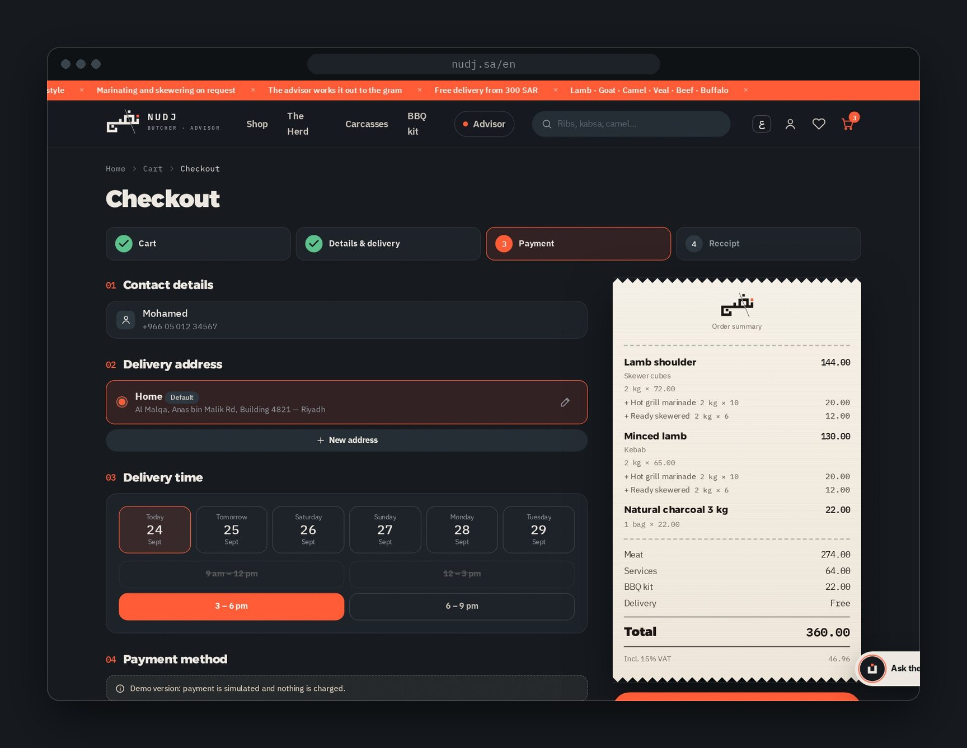
16 CHECKOUT
One page.
Four clear steps.
Contact from sign-in
Address home, work or other
Delivery day & slot next 6 days, 4 time slots
Payment Apple Pay, mada, card, Tamara, cash on delivery
Discount code e.g. NUDJ10
Summary a compact receipt with VAT
WEBSITE WALKTHROUGH
18 / 33
Notes:
- Checkout is one page with a clear 4-step progress bar: Cart, Details & delivery, Payment, Receipt.
- Saved address, a day and a time slot, then payment: Apple Pay, mada, card, Tamara or cash on delivery.
- The order summary is a compact receipt that updates with discount codes.
- On phones, the total and the Place order button stay fixed at the bottom.

Slide 19
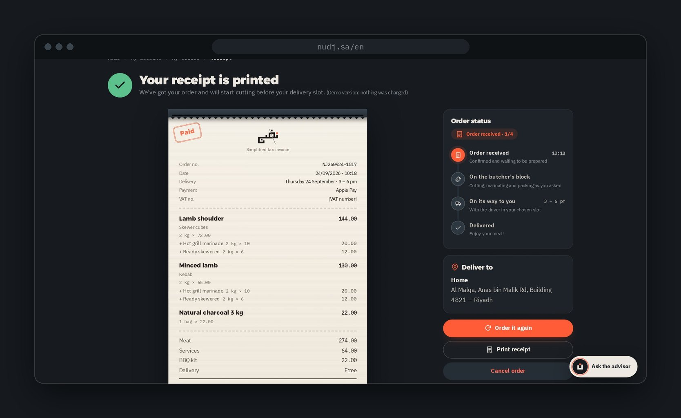
17 RECEIPT AND TRACKING
Your receipt is printed.
Now watch it move.
1
Order received
Confirmed, waiting to be prepared
2
On the butcher's block
Cutting, marinating, packing
3
On its way
With the driver, in your slot
4
Delivered
Enjoy your meal!
Plus: order it again · print receipt · cancel before cutting
WEBSITE WALKTHROUGH
19 / 33
Notes:
- After paying, Khalid gets a printed-style receipt — a simplified tax invoice with a barcode.
- Next to it, the order status in four steps. Each step is moved by the team in the dashboard.
- From here he can order the same again, print the receipt, or cancel before cutting starts.

Slide 20
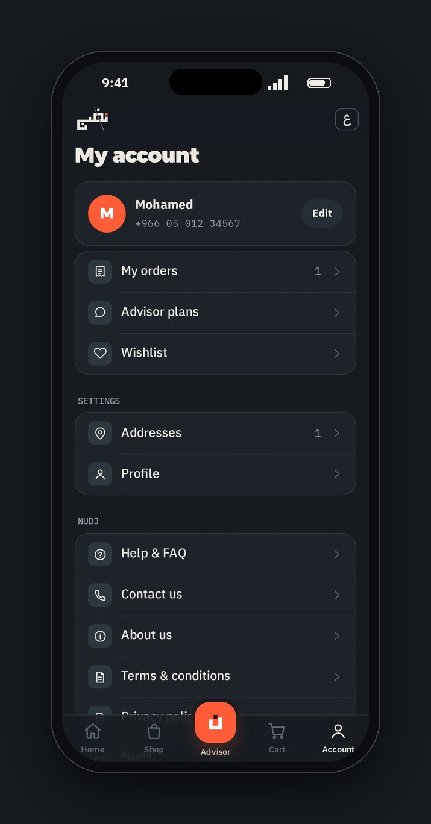
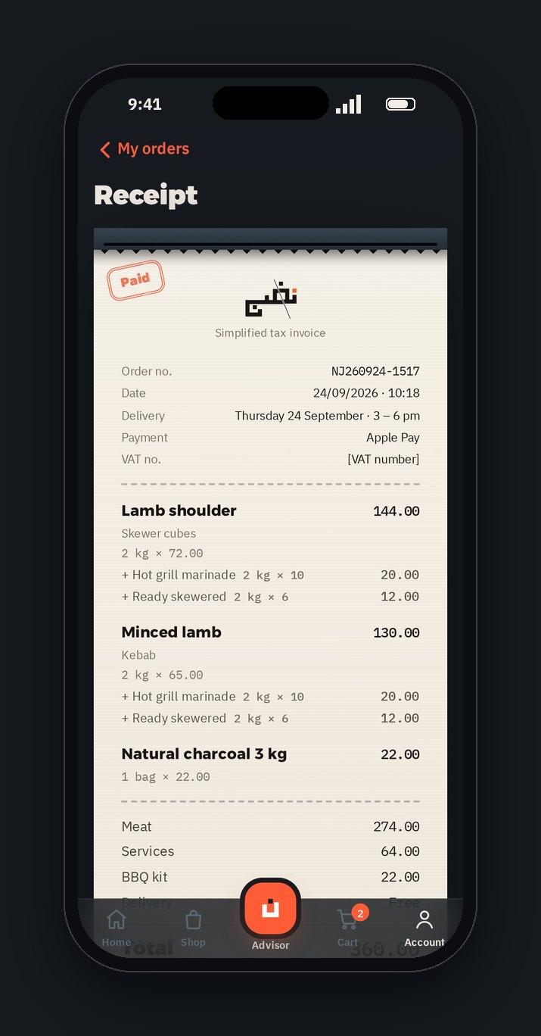
18 COME BACK · MY ACCOUNT
Everything you need
to order again.
My orders
Advisor plans
every receipt and its status
saved plans, ready to reorder
Wishlist
Addresses
cuts saved with the heart
home, work, other — one is default
Profile
Help & language
name and mobile number
FAQ, contact, العربية / English
WEBSITE WALKTHROUGH
20 / 33
Notes:
- The account is where people come back.
- Orders with their receipts, saved advisor plans, the wishlist and saved addresses.
- Help, contact, legal pages and the language switch live here too.

Slide 21
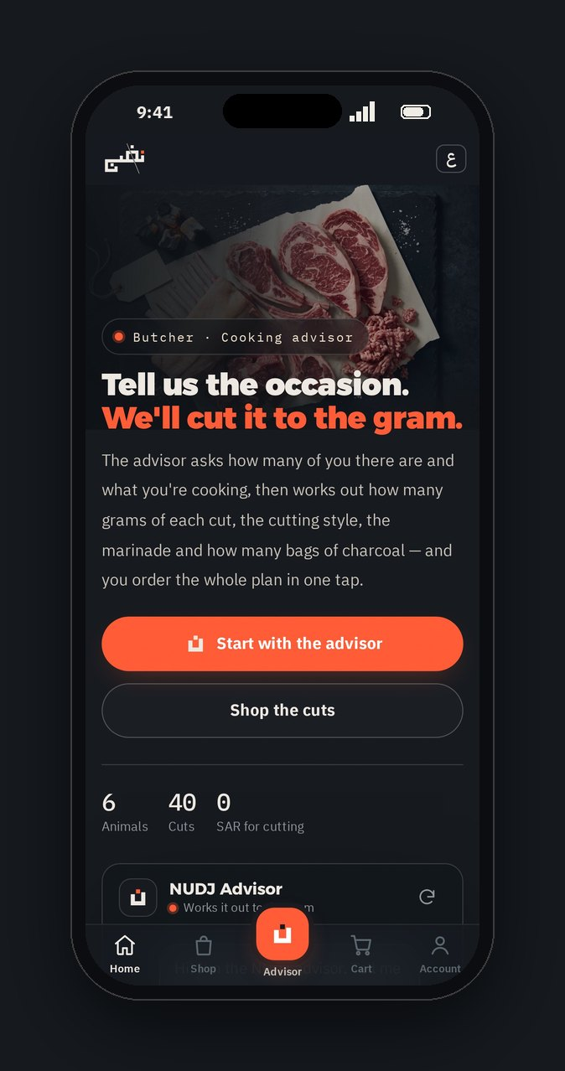
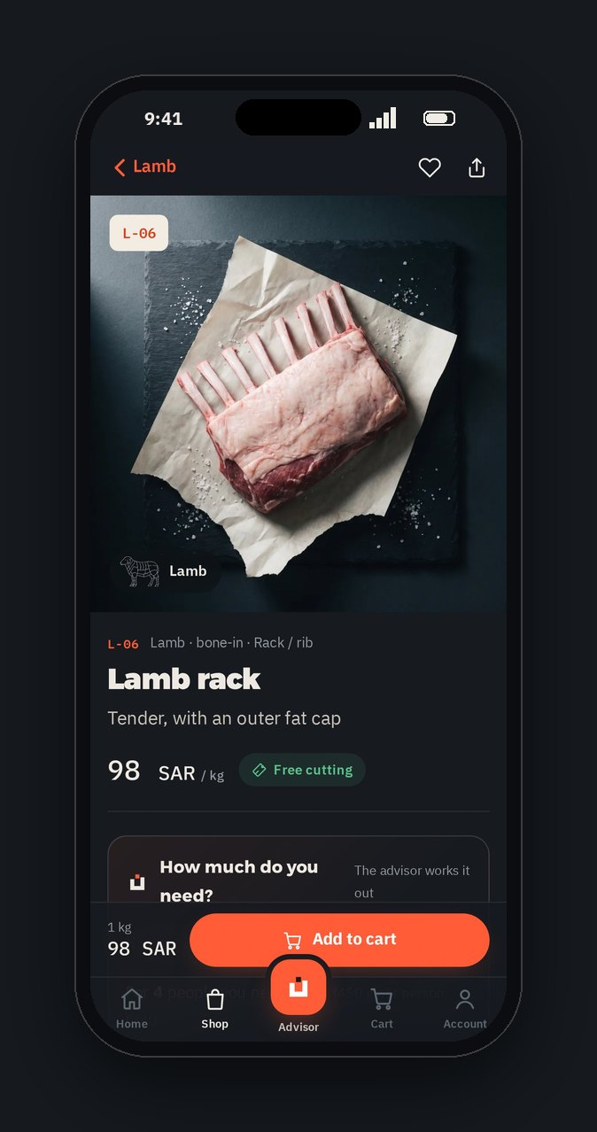
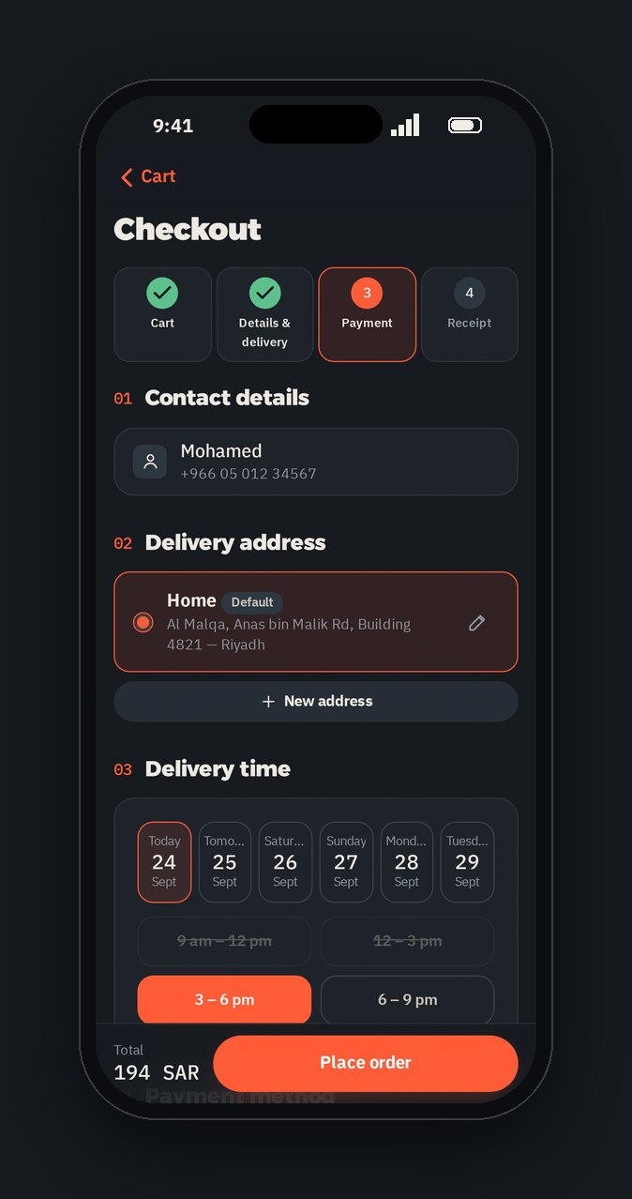
19 ON THE PHONE
On a phone,
it feels like an app.
Tab bar with the advisor in the middle
Large titles that shrink as you scroll
Bottom sheets for choices and addresses
Fixed action bar with the live total
Install it to the home screen (PWA)
WEBSITE WALKTHROUGH
21 / 33
Notes:
- Most customers will be on a phone. Below 900 pixels wide, the site switches to an app-style layout.
- A tab bar with the advisor in the middle, large titles, bottom sheets, and a fixed action bar with the total.
- It can be installed on the home screen like an app (PWA).

Slide 22
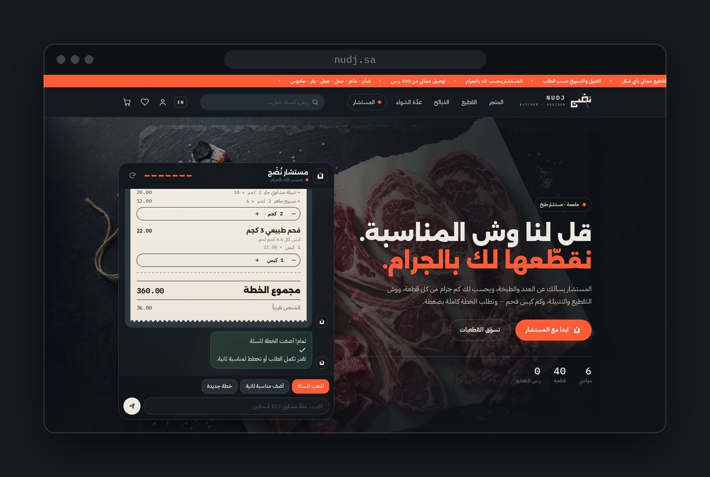
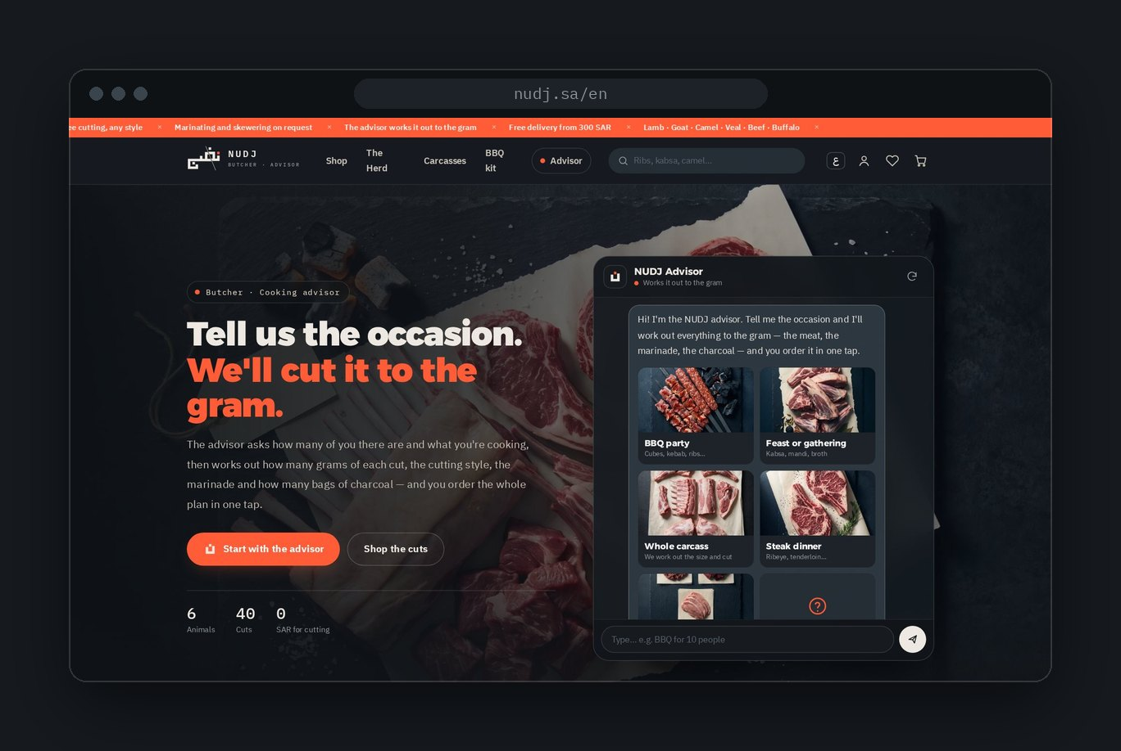
20 TWO LANGUAGES
Arabic first. Full English too.
One tap on EN / ع keeps you on the same page. Cart, orders and addresses are shared.
العربية Right to left · the main site
English Left to right · every page under /en/
WEBSITE WALKTHROUGH
22 / 33
Notes:
- The site is Arabic first, right to left, with a complete English version under /en/.
- The EN / ع button keeps you on the same page in the other language.
- Cart, orders and addresses are shared between both languages, and the advisor understands both.

Slide 23
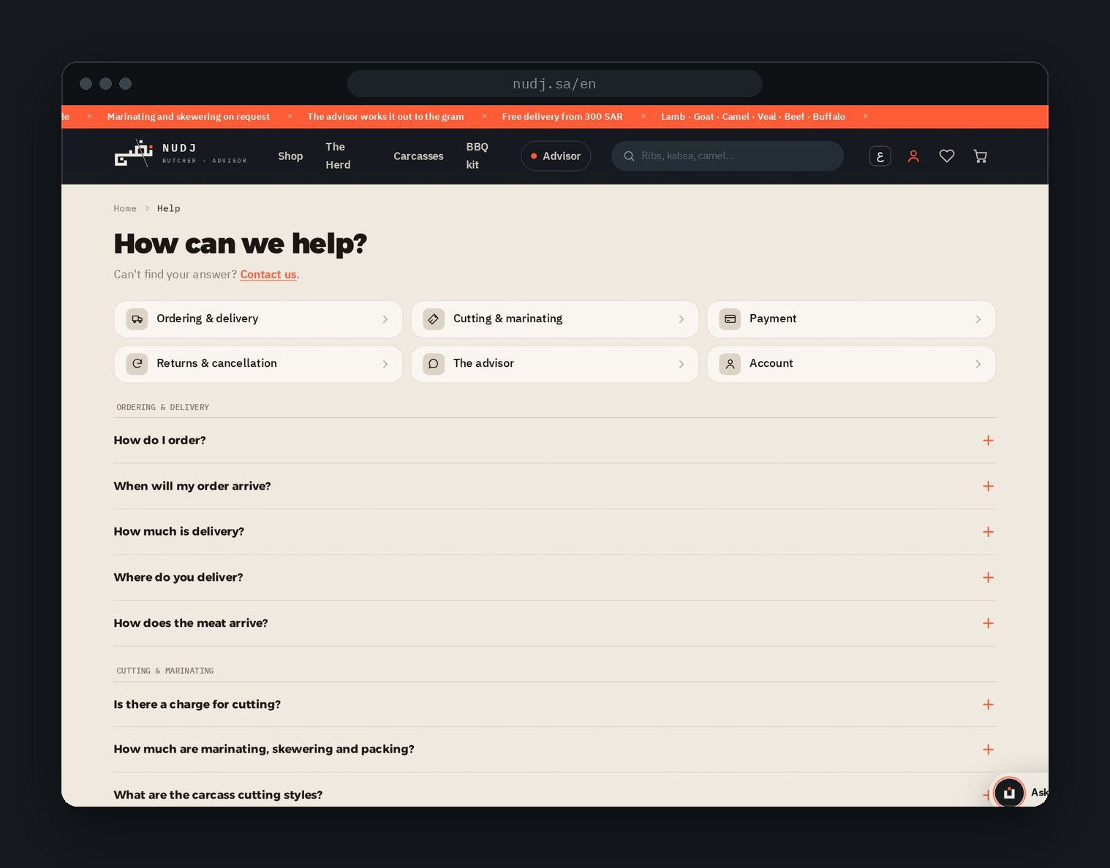
21 HELP, TRUST AND SEARCH
Answers before
people have to ask.
Help center
6 topics, 20+ questions: delivery, cutting, payment, returns, the advisor, account.
Contact
Phone, WhatsApp, email, and a form with topics and an order number.
About, terms, privacy
Clear company details and policies.
Found on Google and AI
A static page per product and animal, a sitemap, and llms.txt for AI assistants.
WEBSITE WALKTHROUGH
23 / 33
Notes:
- Trust pages are complete: help center, contact form, about, terms and privacy.
- For search engines, every product and animal has its own static page, plus a sitemap.
- There's also an llms.txt file, so AI assistants can read the catalogue and prices correctly.

Slide 24
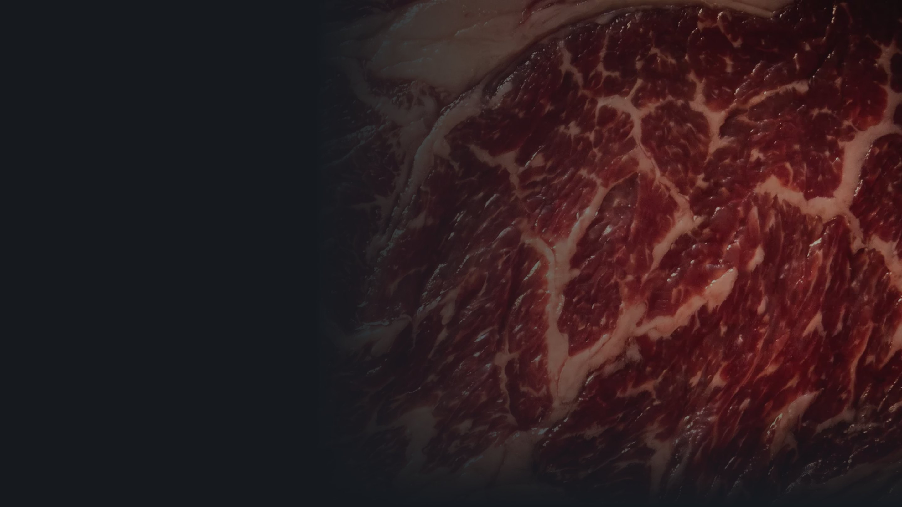
PART
02
The dashboard
Home · Orders · Analytics · Reports · Customers · Stock · Editing the site · Publishing
WEBSITE WALKTHROUGH
24 / 33
Notes:
- Part two: the store side. The dashboard is where the team runs the shop and edits every part of the site.

Slide 25
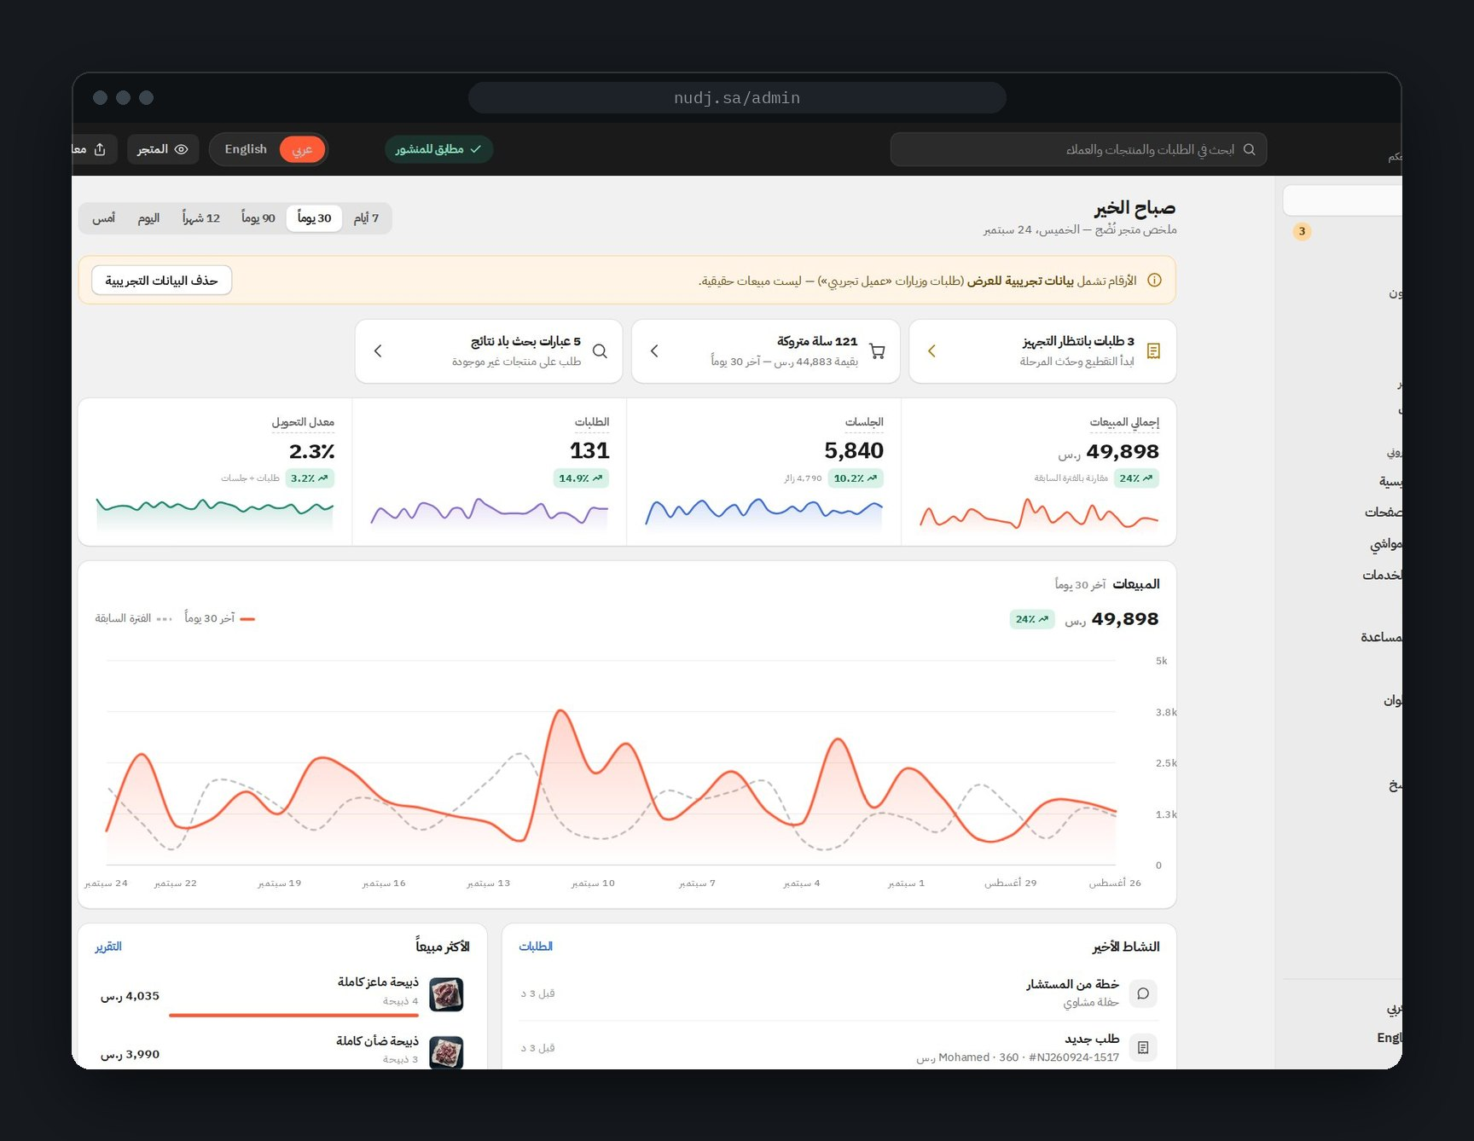
22 DASHBOARD · HOME
Good morning.
Here's your
store.
Tasks first: orders to prepare, abandoned carts, low stock, failed searches
Four key numbers: sales, sessions, orders, conversion — vs the last period
Sales chart with last period as a dotted line
Time ranges: today, yesterday, 7 / 30 / 90 days, 12 months
Activity feed and best sellers
DASHBOARD
25 / 33
Notes:
- The dashboard is built like Shopify: dark top bar, side menu, light cards.
- The home screen starts with tasks: orders waiting, abandoned carts, low stock, searches with no results, unpublished edits.
- Then the four numbers that matter, each compared with the previous period, and the sales chart.
- Time ranges go from today (by hour) to the last 12 months.
- The interface is in Arabic; content can be edited in both languages. Numbers here are clearly marked demo data.

Slide 26
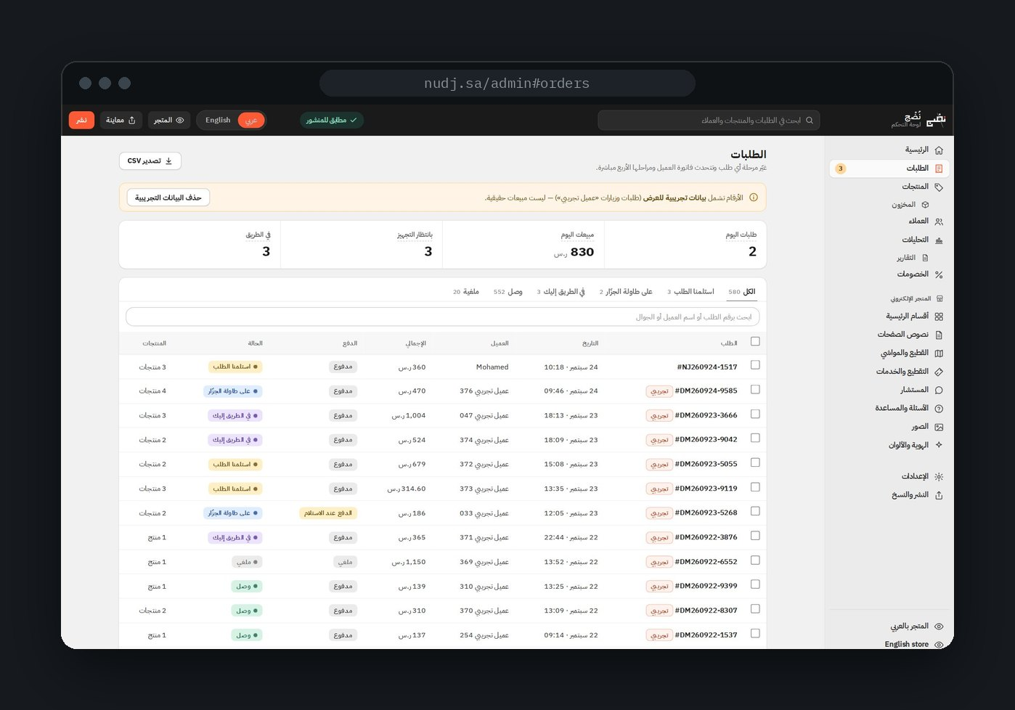
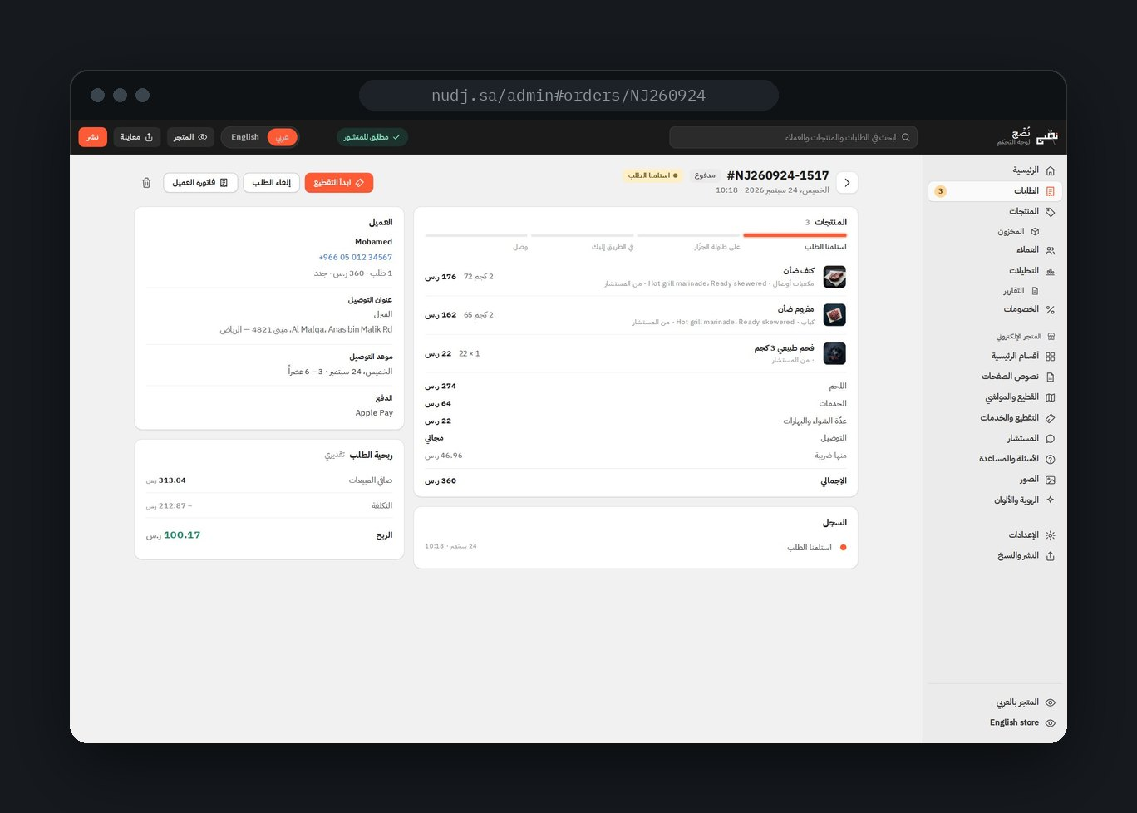
23 DASHBOARD · ORDERS
Move an order.
The customer's tracking moves with it.
Tabs by stage · bulk move · search · CSV export
Items · history · customer · profit per order
DASHBOARD
26 / 33
Notes:
- Orders are grouped by stage in tabs: received, cutting, on the way, delivered, cancelled.
- Select several and move them together, search, or export to CSV.
- Each order page shows the items, the history, the customer and their segment, the address, the slot, payment — and the profit on that order.
- Moving an order to the next stage updates what the customer sees on their receipt.

Slide 27
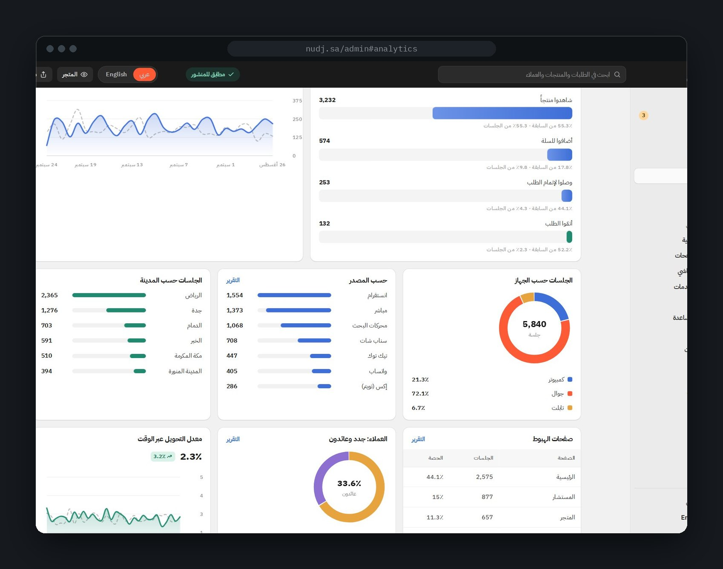
24 DASHBOARD · ANALYTICS
See where people
drop — and why.
8 key numbers: sales, orders, average order, profit, sessions, visitors, conversion, returning customers
Sales breakdown: gross → discounts → returns → net
Conversion funnel: visit → product → cart → checkout → order
Traffic: device, source, city, landing page
Advisor funnel: chats → plans → cart, and its share of sales
Search: top words and words with no results
Abandoned carts and profit
DASHBOARD
27 / 33
Notes:
- Analytics answers: where do people come from, where do they drop, and what do they buy?
- Eight headline numbers, the sales breakdown from gross to net, and the conversion funnel.
- Traffic by device, source, city and landing page. New versus returning customers.
- Two NUDJ-specific views: the advisor funnel — chats, plans, carts — and on-site search, including words with no results.

Slide 28
25 DASHBOARD · REPORTS
10
Sales
31 reports.
Chart, table, CSV.
Over time, breakdown, by product, animal, city, payment, discount code, hour, weekday, services
4
Orders
Over time, average order value, by stage, by delivery slot
Every report follows the selected time range and exports to CSV in one click.
5
Traffic
Sessions over time, by source, device, city, landing pages
5
Behaviour
Conversion funnel and rate, product performance, search, abandoned carts
4
Customers
New vs returning, segments (RFM), cohorts, top customers
2
Profit
Profit over time, profit by product
1
Advisor
Chats → plans → carts, sales and occasions
DASHBOARD
28 / 33
Notes:
- 31 ready-made reports in seven groups.
- Every report has a chart, a table and a CSV export, and follows the chosen time range.
- Customer reports include RFM segments, cohort analysis and top customers.

Slide 29
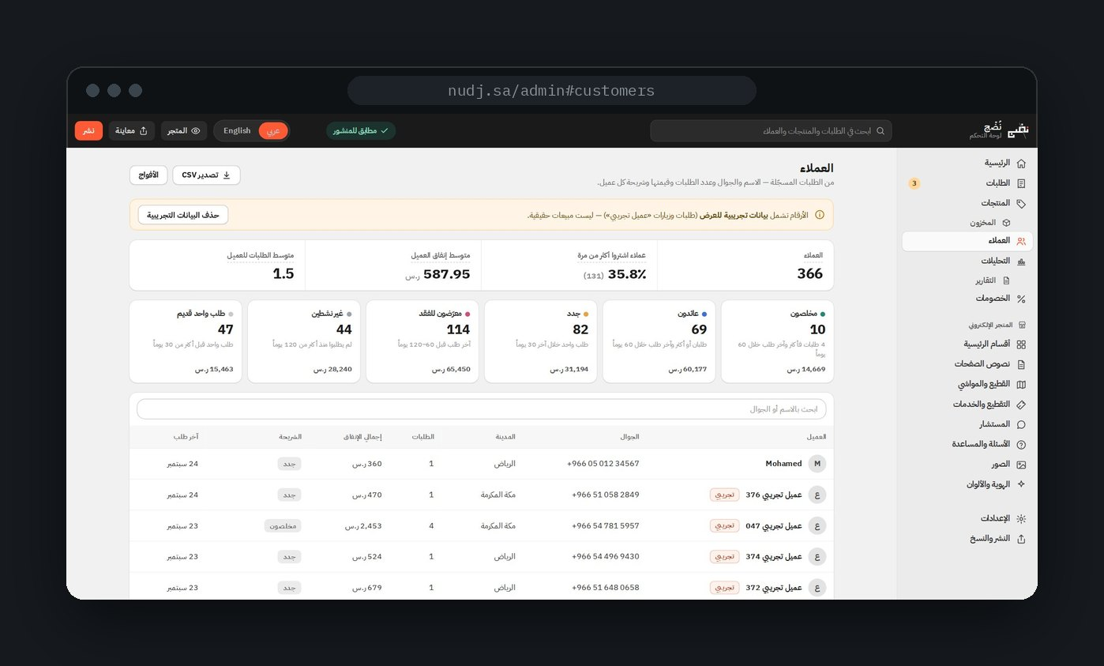
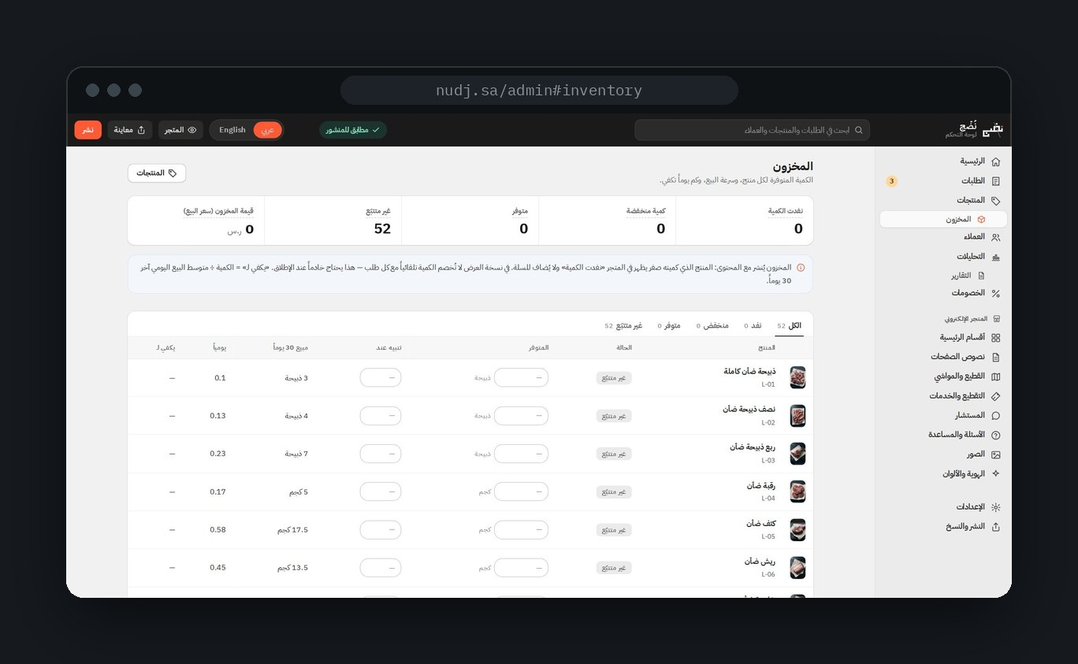
26 DASHBOARD · CUSTOMERS AND STOCK
Know who to thank.
Never sell what you don't have.
Loyal
Returning
New
At risk
Inactive
One old order
Stock + alert level · days of cover · 0 = sold out in the shop
DASHBOARD
29 / 33
Notes:
- Customers are grouped into six segments automatically: loyal, returning, new, at risk, inactive, and one old order.
- Each segment can be filtered, so the team knows who to thank and who to win back.
- Stock: set the quantity and an alert level per product. The page shows 30-day sales, daily sales and how many days the stock will last.
- When a product hits zero, the shop shows it as sold out and it can't be added to the cart — from the card, the page or the advisor.

Slide 30
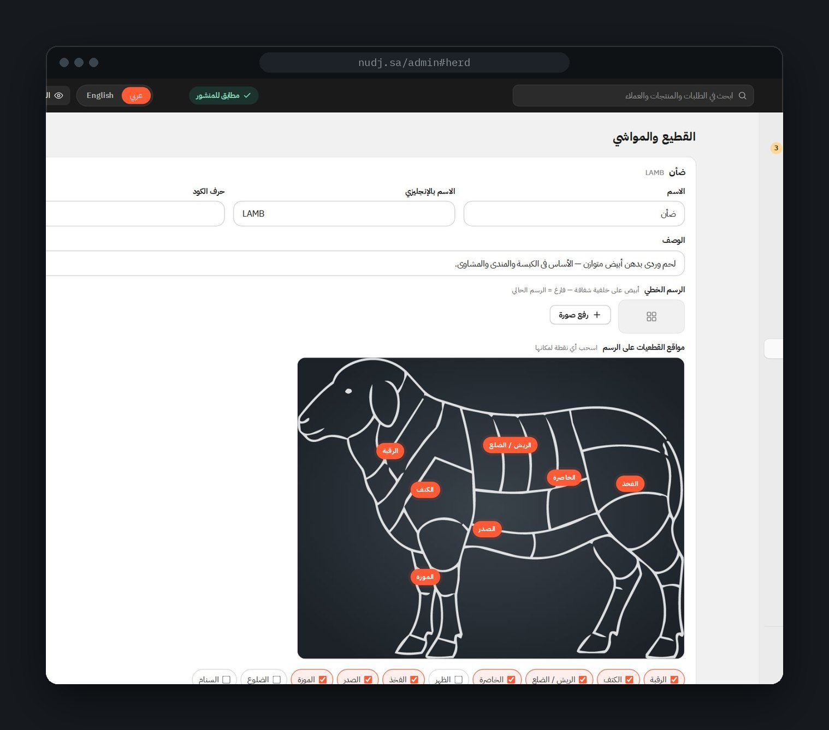
27 DASHBOARD · EDIT THE WHOLE SITE
Change anything.
No code.
Products
price, name, photos, weights, stock, hide
The herd
drag the dots on the drawing
Services
marinades, cutting styles, packing
The advisor
grams per person, charcoal, questions
Home page
order, show / hide, dark or paper
All texts & FAQ
every title on every page
Images
upload or link
Payment & delivery
methods, fees, cities, slots, coupons
Brand colour
the ember accent
عربي / English toggle on every field
DASHBOARD
30 / 33
Notes:
- Every part of the site can be edited without code.
- Products and prices, the herd drawings — you can even drag the numbered dots on the animal —, services, the advisor's rules, the home page sections, every text, the FAQ, images, payment and delivery settings, and the brand colour.
- A toggle switches the fields to English, so both languages are edited from one place.

Slide 31
28 DASHBOARD · PUBLISHING
Draft. Preview. Publish.
Live in about a minute.
01
02
03
04
Draft
Preview
Publish
Live
Every edit saves automatically in the browser.
See the real site with your changes.
Images upload and content.js is written to GitHub.
About a minute later, everyone sees it.
Backup route: download content.js and upload it by hand. Then node build.js bakes the content into the static pages for search engines.
DASHBOARD
31 / 33
Notes:
- Edits are safe by default: they save as a draft in the browser.
- Preview shows the real site with the draft applied.
- Publish uploads images and writes the content file to GitHub. About a minute later, everyone sees it.
- No token? Download the content file and upload it by hand.

Slide 32
29 WHERE WE ARE
Working demo today.
Five things before launch.
WORKS END TO END TODAY
NEEDED BEFORE LAUNCH
The full customer journey, desktop and phone
Payment gateway — payment is simulated
The advisor, in Arabic and English
SMS provider — for the sign-in code
Orders, tracking and account
Server + database — orders live in the browser today
The dashboard: analytics, reports, editing, publishing
Secure admin login — the PIN is a light lock
Visit tracking (sessions, sources, funnel)
Automatic stock deduction with every order
Good news: visit tracking already sends everything through one function — connecting a server is one change.
WEBSITE WALKTHROUGH
32 / 33
Notes:
- To be clear about where we are: this is a working demo.
- The full journey works end to end, but payment, the SMS code and data storage are simulated in the browser.
- Before launch we need: a payment gateway, an SMS provider, a server and database, secure admin login, and automatic stock deduction.
- The dashboard's tracking already has one function ready to send data to a server.

Slide 33

30 SUMMARY
One site.
Two sides.
FOR CUSTOMERS
FOR THE TEAM
Occasion → plan → order → tracking. In a few taps.
See what sells, fix what drops, change anything.
English site
mohamed-sr-designer.github.io/nudj/en
Arabic site
mohamed-sr-designer.github.io/nudj
Dashboard
…/nudj/admin.html · demo PIN 2026
Thank you.
WEBSITE WALKTHROUGH
33 / 33
Notes:
- To close: one site, two sides.
- For customers, NUDJ turns an occasion into a plan, and a plan into an order.
- For the team, the dashboard shows what's happening and lets them change anything.
- Links are on the slide. Thank you — questions?

