Slide 1
Team Members:
Mohamed Adel Abd El-Fattah Hamed.
Mahmoud Mohamed Hussian Abdrabo.
Ahmed Abd elmoneim Ali Ahmed.
Mohamed Gamal Mohamed Mohamed.

Slide 2
Hotel Management System
Description:
C# windows form Hotel Management System using visual studio 2019, Microsoft SQL server for (database) The project is about booking rooms by entering all the data such as the name, ID number, personal number, length of stay from and to when, room type and city, and making sure that the room is not booked in advance and personal data does not resemble any other personal data.

Slide 3
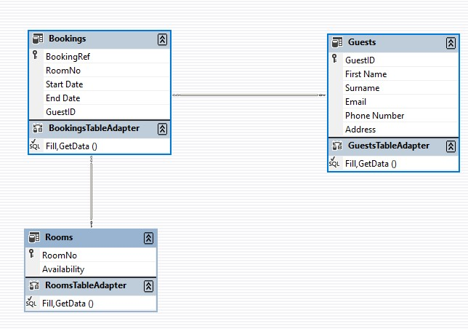
Data Base Diagram

Slide 4
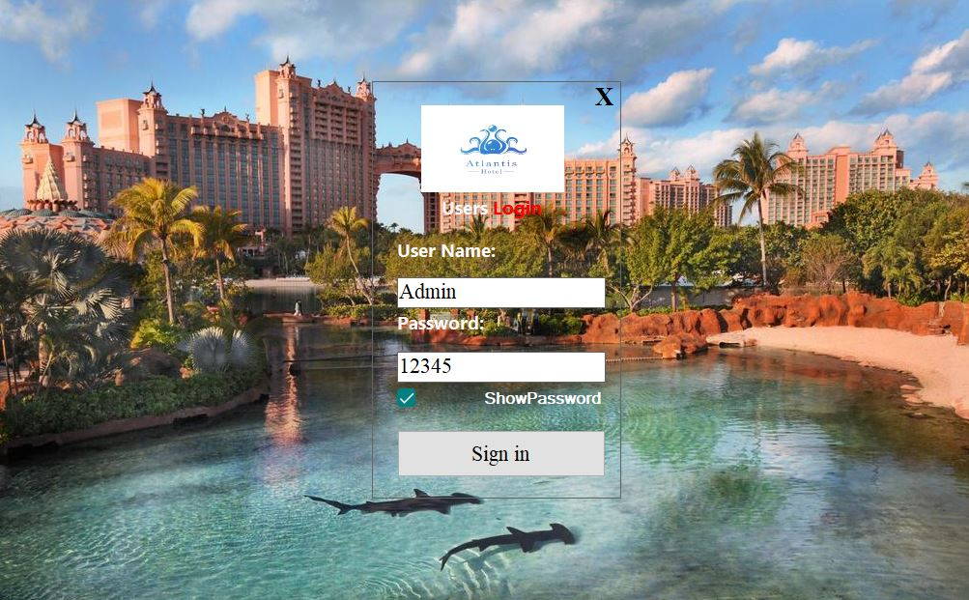
LOGIN FORM
3
2
1
1
When sign up show message.box “ welcome ”+ user name and go to guest mdi form.
2
Show password.
3
Exit.

Slide 5
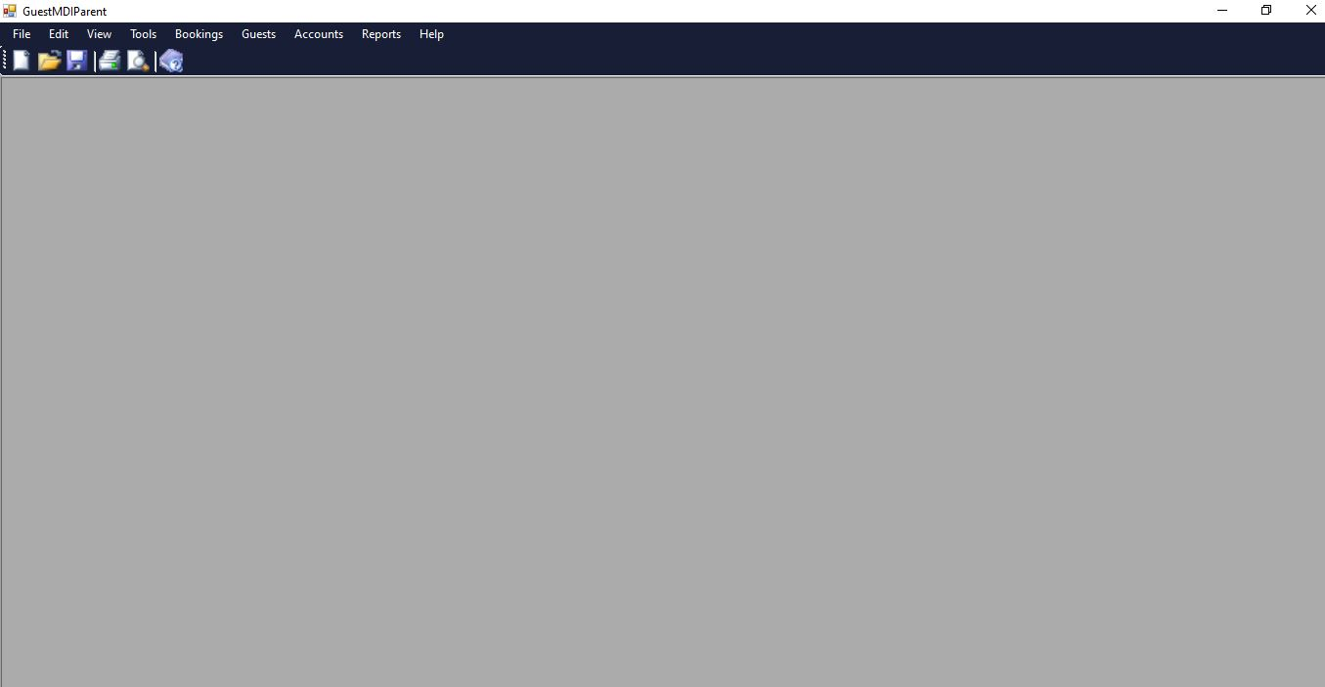
1
2
3
4
1
File =(new),(file),(save),(print).
2
Edit=( undo),( redo),(copy),(past).
3
view=(toolbar),( statues bar).
4
Tool=(option).

Slide 6
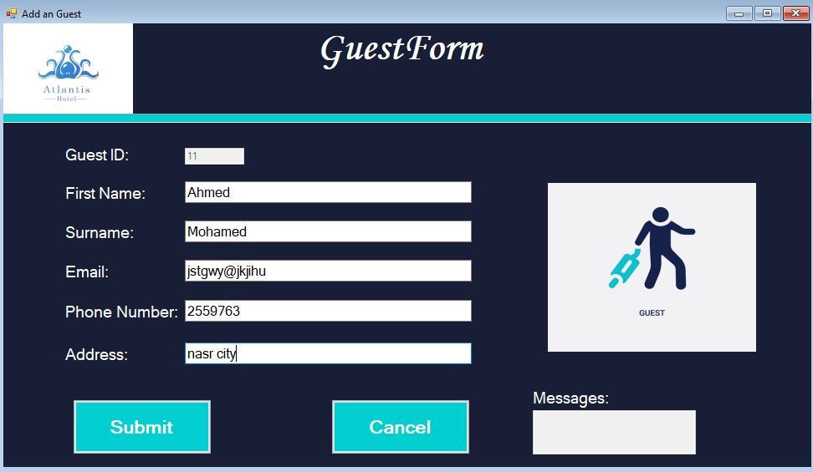
ADD GUEST
1
2
3
1
Go to account form.
2
Return back .
3
Show the error of add function.

Slide 7
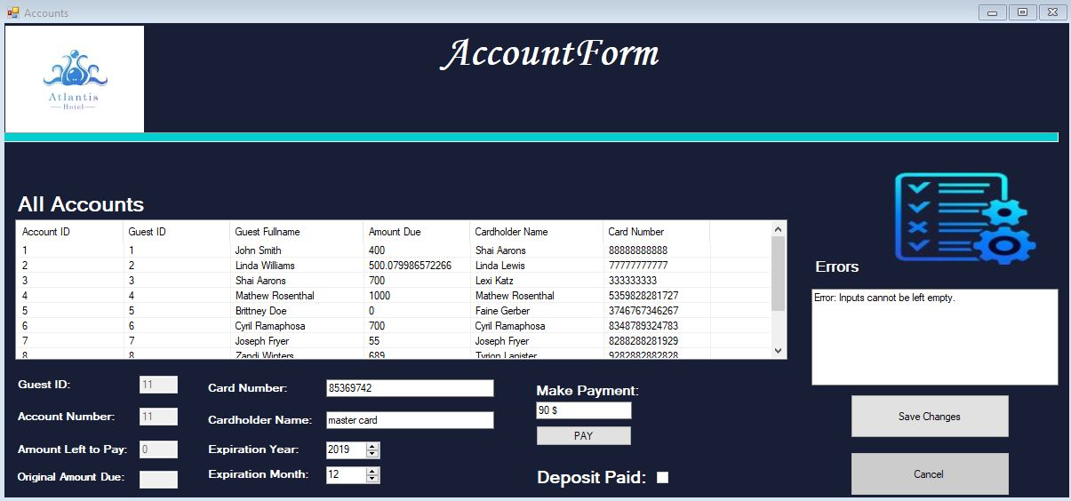
View all accounts and edit account
3
1
2
1
Save data .
2
Return back.
3
Show error when any incorrect action.

Slide 8
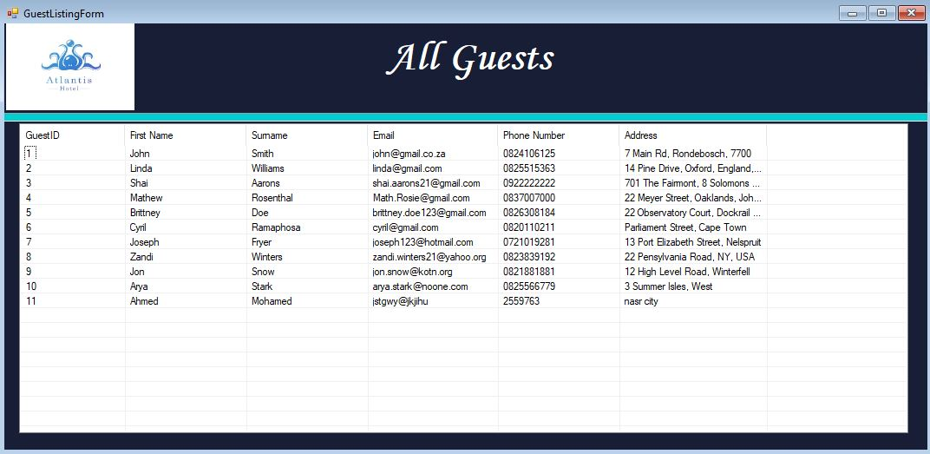
View all guests

Slide 9
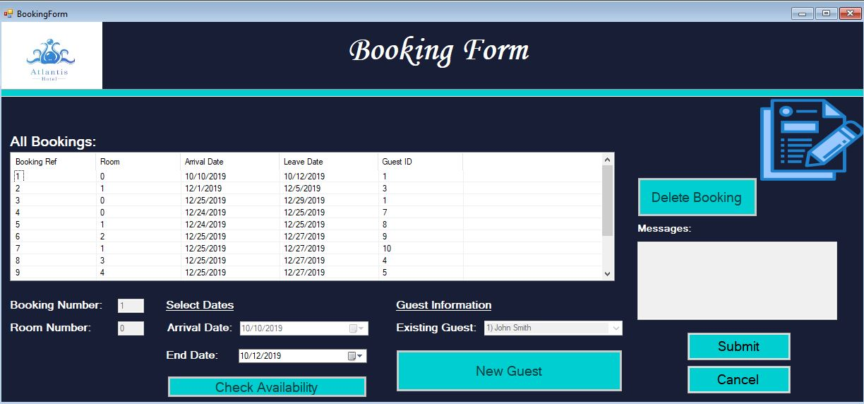
View all booking and create a new booking.
4
1
3
2
1
Save .
2
Return back.
3
Go to a new guest form.
4
Delete booking.

Slide 10
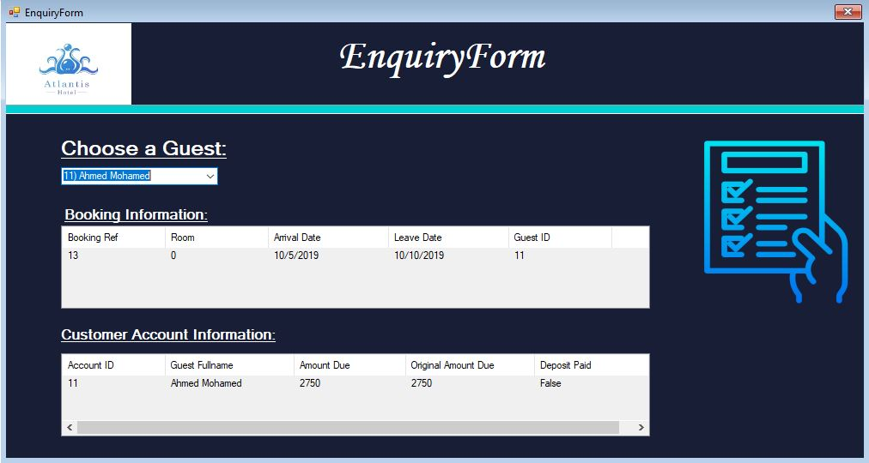
Enquire about a booking.

Slide 11
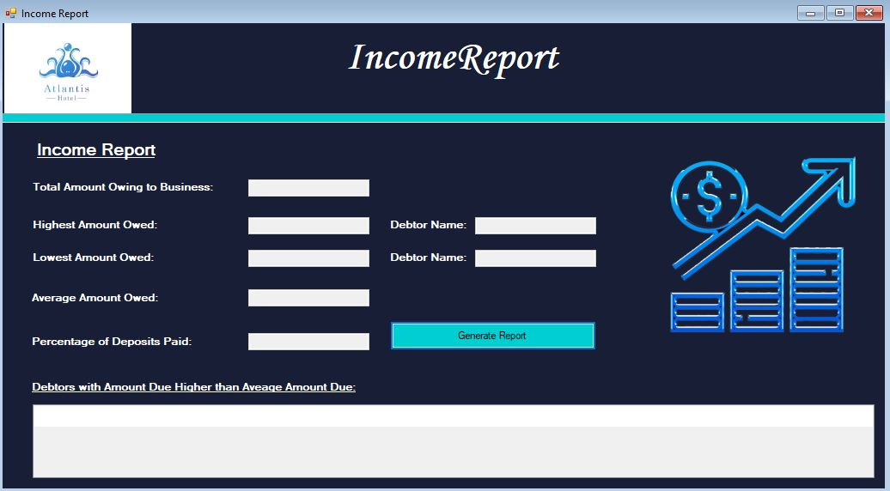
GENERATE INCOM REPORT
1
1
Show all information about account of guest.

Slide 12
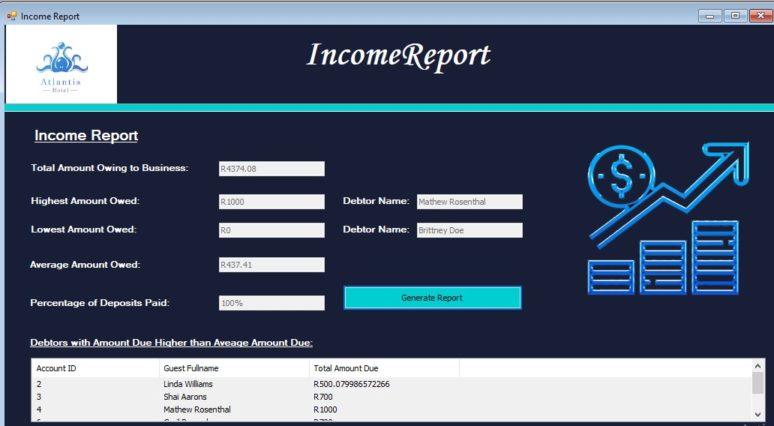
After GENERATE INCOM REPORT

Slide 13
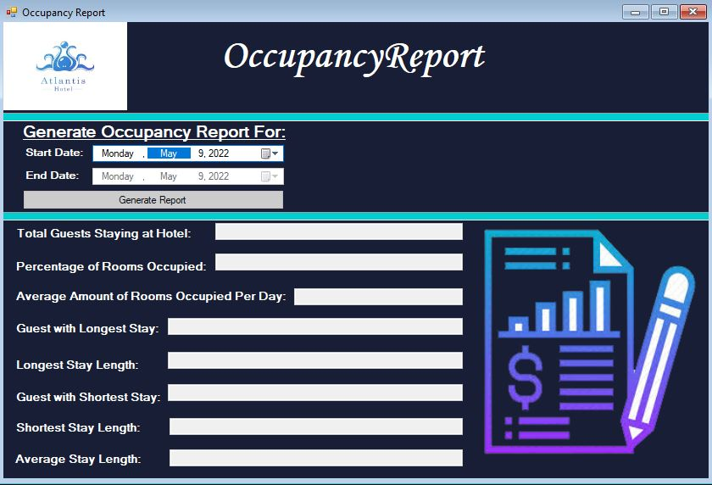
Generate occupancy report
1
1
Show occupancy report.

Slide 14
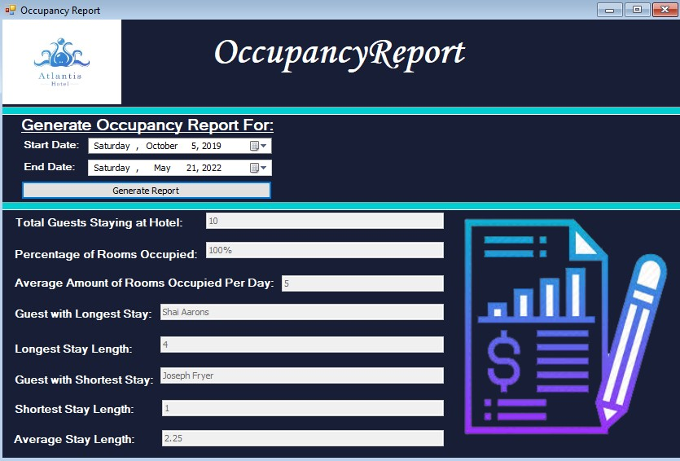
After Generate occupancy report

Slide 15
Thanks

