Slide 1

IS

Slide 2




AGENDA
Mohamad Fathy Abdul Azim Saleh
Muhammad Ahmed Mustafa
Mahmoud Sharif Saber Sharif

Slide 3
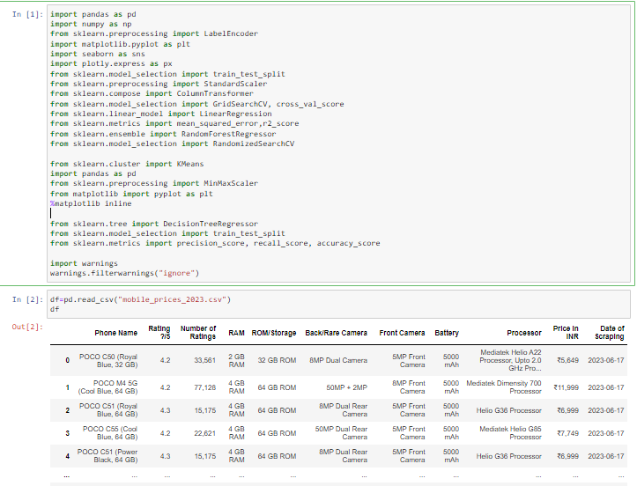
Preprocessing&Preparation

Slide 4
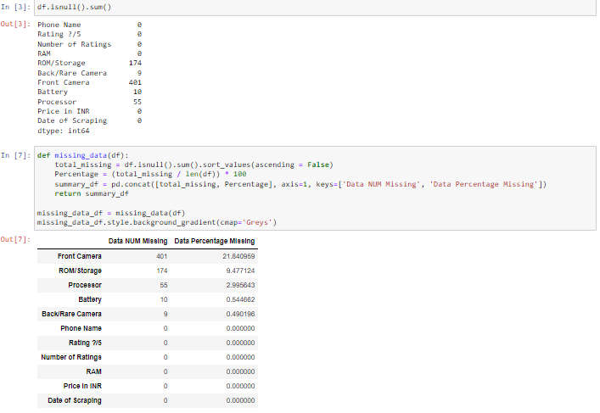
Data check

Slide 5
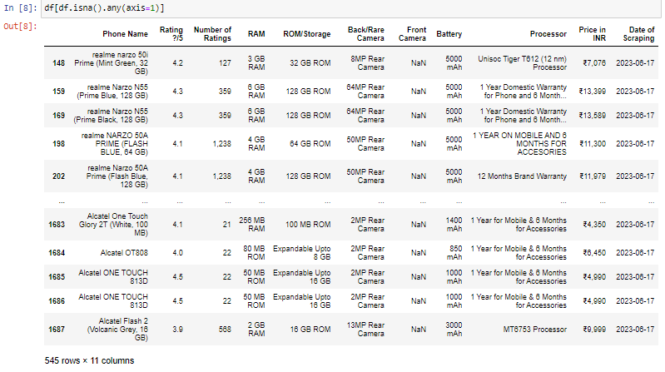
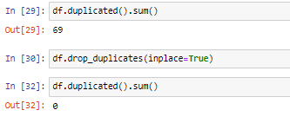
Null & Duplicalted

Slide 6
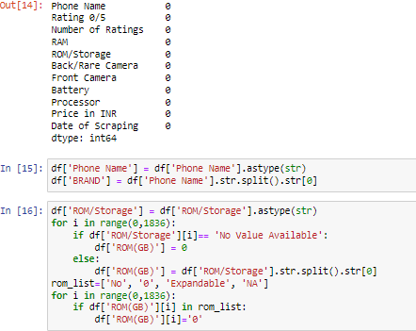
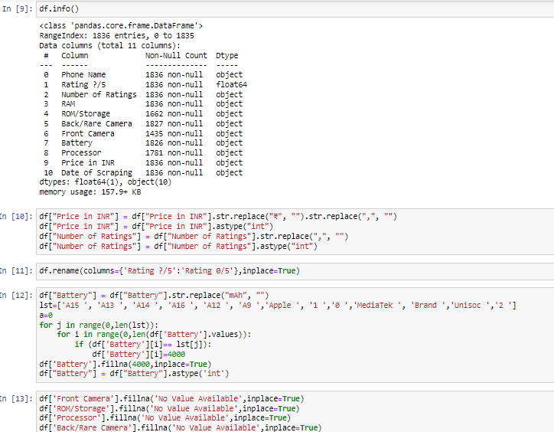
E_ncode data & fit

Slide 7
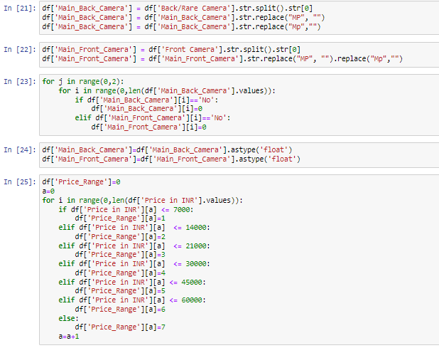
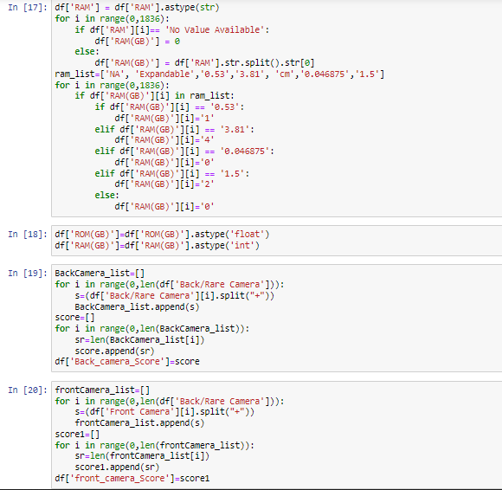
Fit data bart2

Slide 8
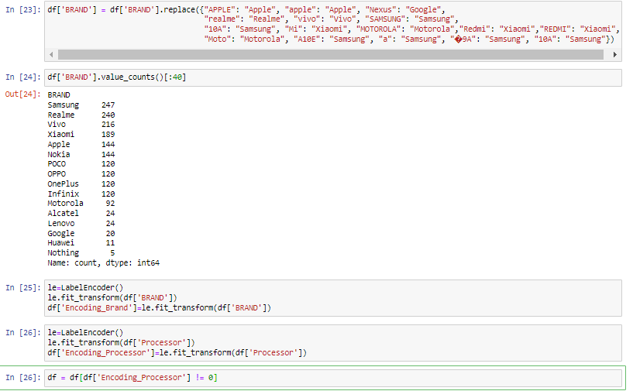
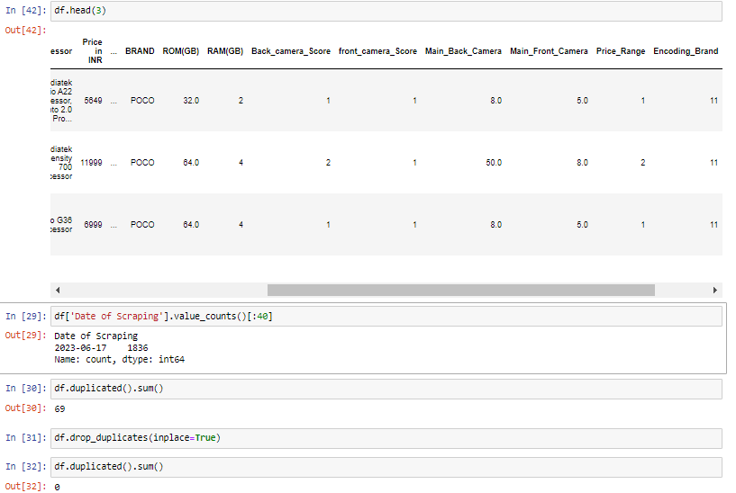
Fainal fit

Slide 9
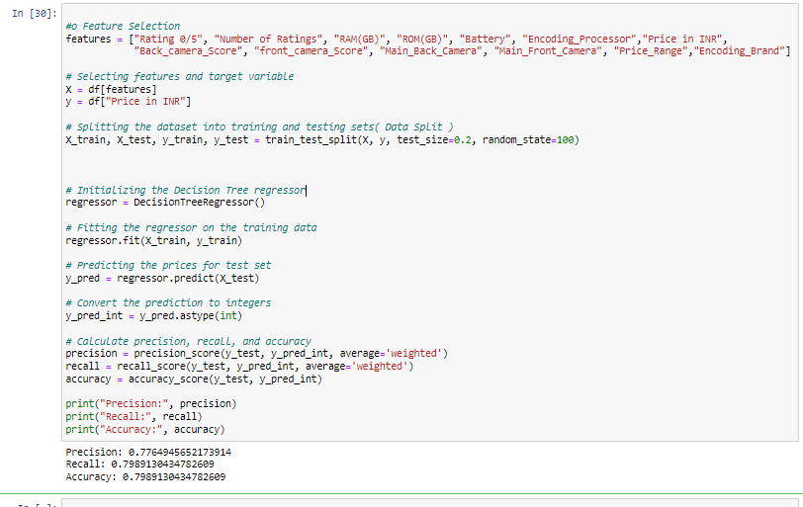
Decision Tree Classification

Slide 10
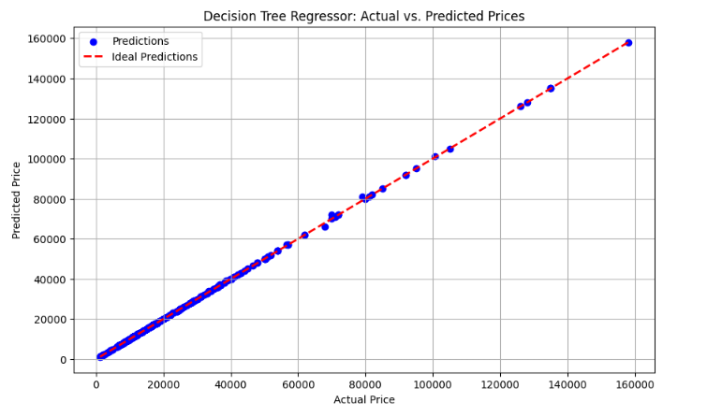
Plotting the predicted vs. actual prices

Slide 11
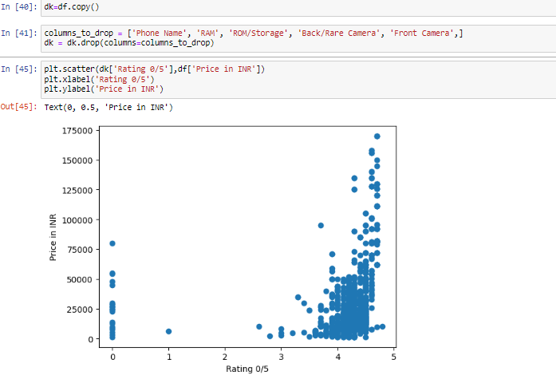
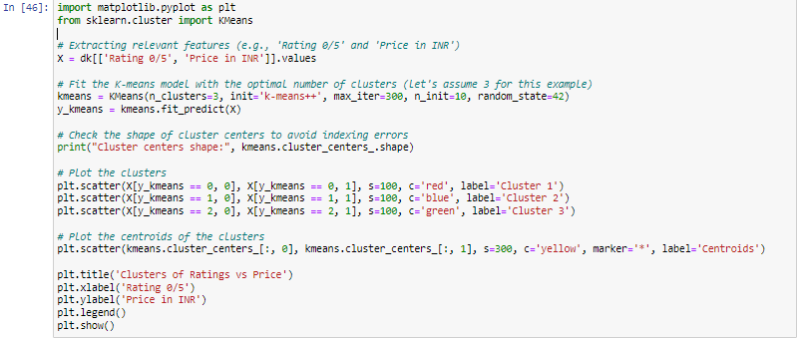
K-means Clustering
Get data
Code

Slide 12
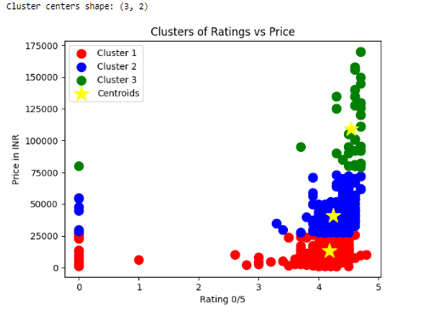
Out put of K-means

Slide 13
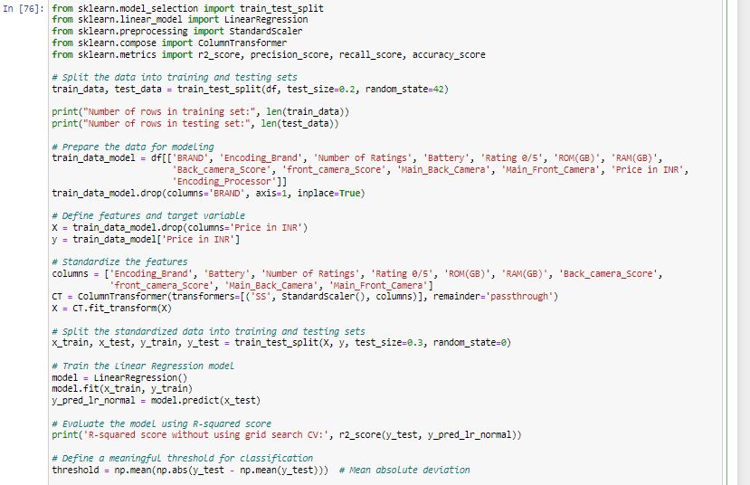


Linear Regression model
code1
Complete the code
Out put

Slide 14
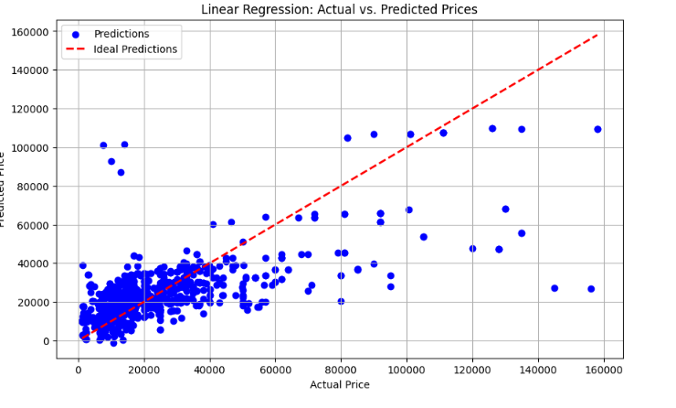
# Plotting the predicted vs. actual values

Slide 15
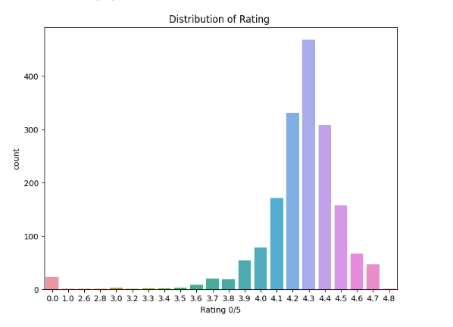
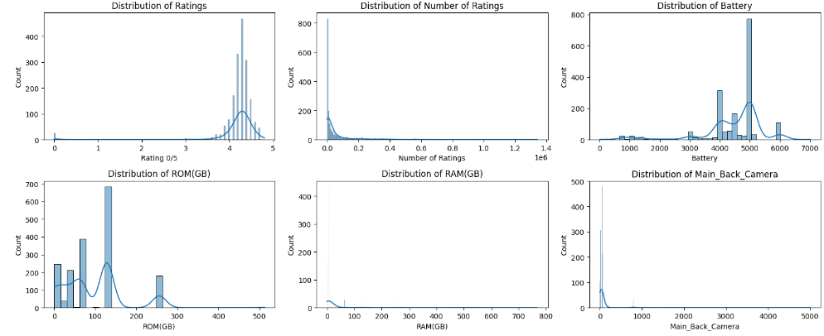
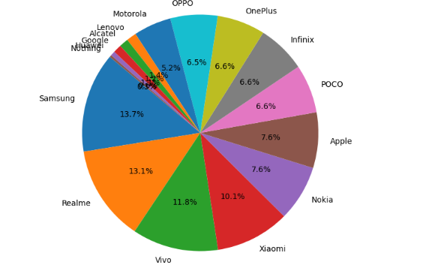
eda

Slide 16

THANK YOU

