Slide 1
Train before you touch the real plant
Operator training simulator, available for every Industial unit.
Mostafa Adel, Founder · Entrepreneurs Investment Program, Global Entrepreneurship Festival 2026
NEXIIVA · EIP Pitch · GEF 2026

Slide 2
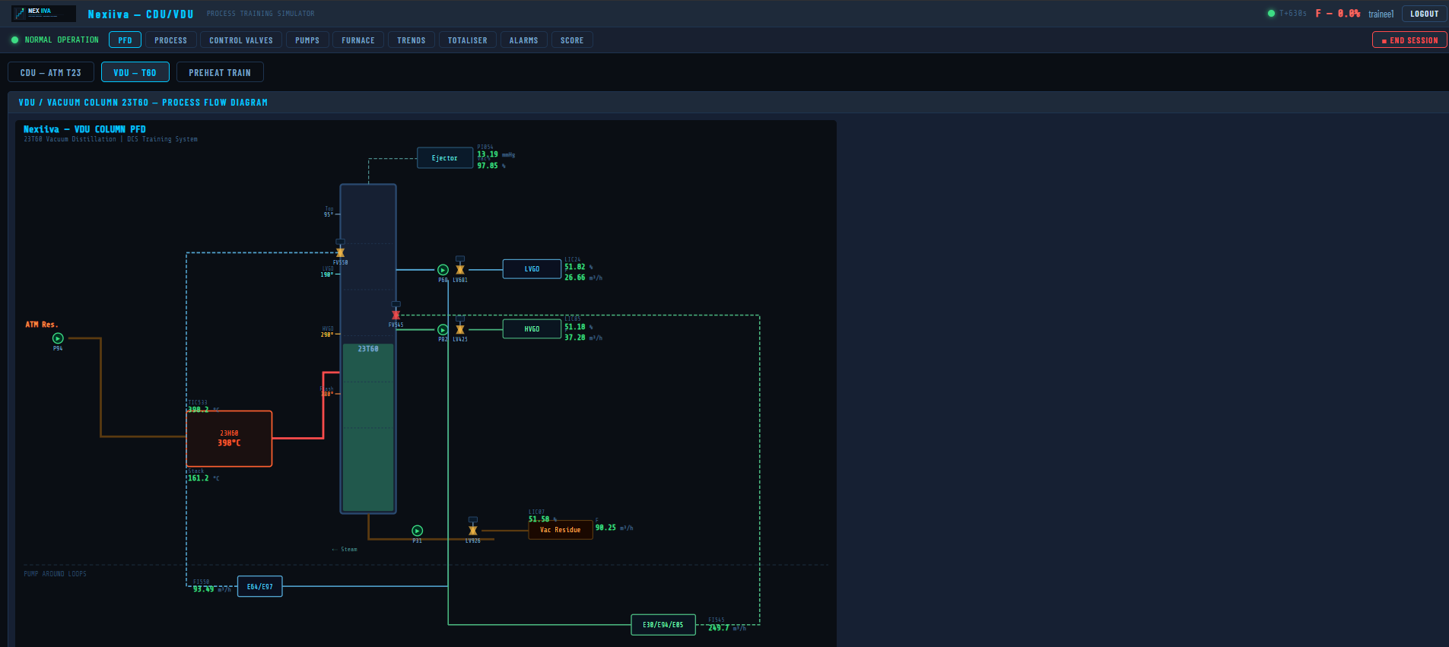
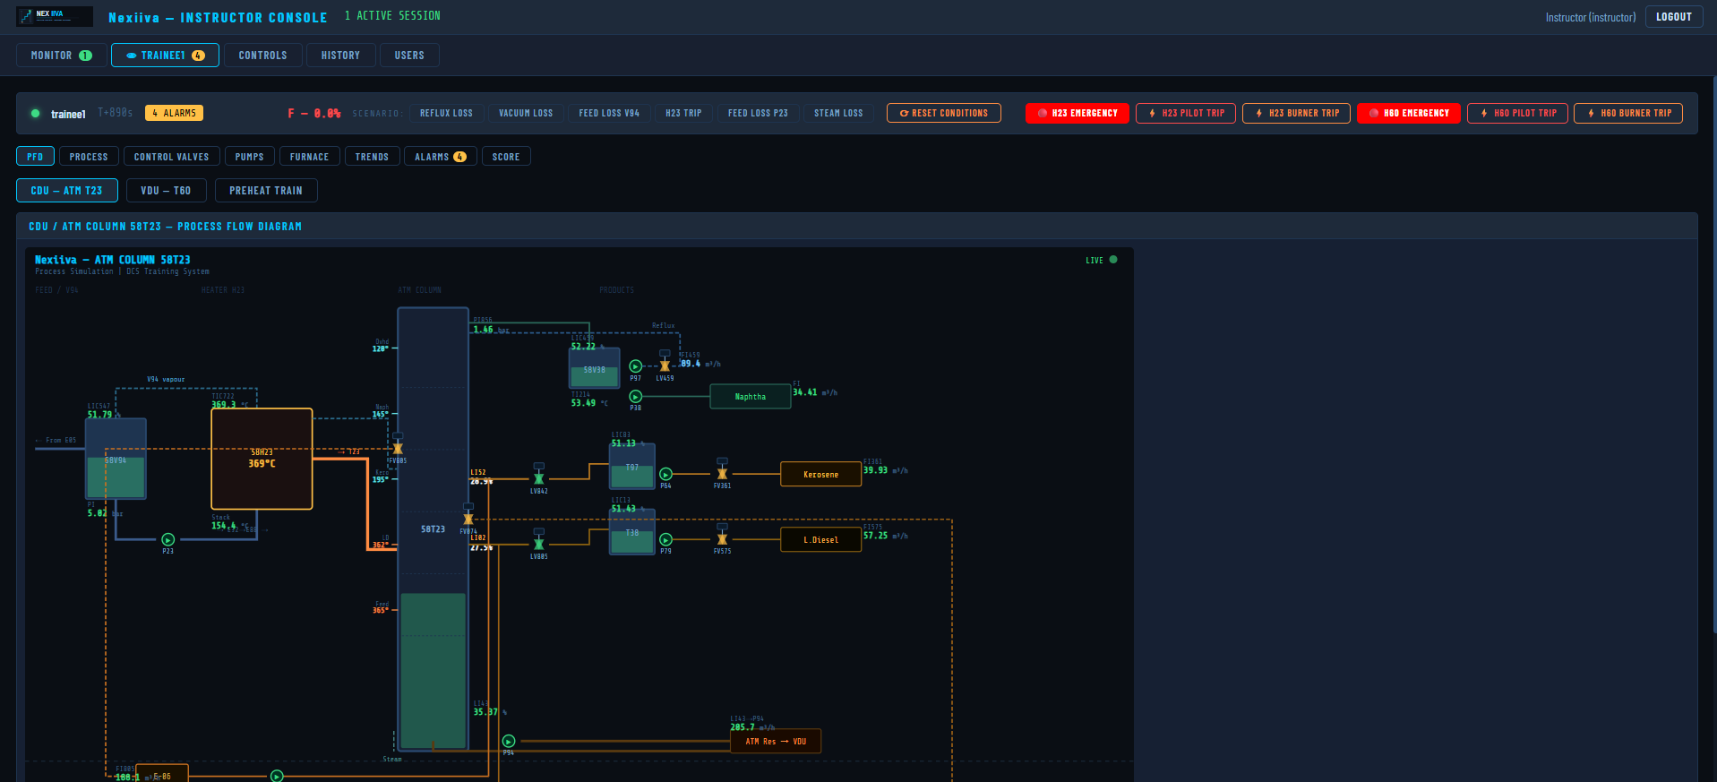
A simulator where process operators rehearse startups, upsets and emergency shutdowns before touching the real plant
For refineries, gas and petrochemical plants, training centers, and individual engineers and operators, at a price they can afford.
NEXIIVA · EIP Pitch · GEF 2026

Slide 3
Vision and impact
Vision
Impact
Build Nexiiva’s name in Egypt first, then the Gulf and other process industries.
Fewer operator errors, safer people and protected plant profits.
Training access for individuals and smaller companies.
NEXIIVA · EIP Pitch · GEF 2026

Slide 4
Operators cannot rehearse the moments that matter most
No room for error
High Prices
Slow to customize
Startups, upsets and shutdowns cannot be rehearsed on a live unit without real safety and operational risk.
Commercial simulators cost tens to hundreds of thousands of dollars per unit.
It takes long time to build a specific unit.
Result: much operator training still relies on theory, classrooms and on-the-job observation.
NEXIIVA · EIP Pitch · GEF 2026

Slide 5
NEXIIVA Offers:
Practice
Instruct
Certify
DCS-style trainee screens, live process diagrams, alarms and trends.
Inject faults, monitor sessions and score performance automatically.
A certificate with the full scoring breakdown after each scenario.
OTS Builder (in development)
An AI agent in Arabic and English builds a new unit from a 387-type equipment library. Works online through the API or fully offline. Target: about one week per unit, to be measured.
NEXIIVA · EIP Pitch · GEF 2026

Slide 6
A bottom-up market that starts with Egypt
Target market and size
TAM · Egypt, GCC and Africa (excl. Egypt)
Annual contract value by region ($K, low–high estimate)
$0.54–1.86M per year
50 companies · 97 sites · 194–388 units
SAM · Egypt, our first market
$0.14–0.48M per year
23 companies · 25 sites · 50–100 units
SOM · Year 3, base case
$44.7K revenue
6 customers · 6 units · 6–12% of Egypt’s units
Units = counted sites × 2–4 eligible process units (founder’s assumption). Annual value per unit $2,800–4,800: Cloud renewal $800 + $10 per trainee-hour (100 hours, 2–4 trainees). SOM = Year 3 base-case revenue from 6 customers at 1 unit each, including pilots, courses and builds. Estimates, not a forecast.
NEXIIVA · EIP Pitch · GEF 2026

Slide 7
Lower cost, faster customization, flexible deployment
NEXIIVA vs. Competitors
 | Large vendors | Specialist simulator firms | Nexiiva
Cost model | High, around $110K per unit | Typically $52K–$73K for the quoted configurations | More affordable: from about $4.5K per unit in the first year (launch price)
Customization | Often involves longer delivery times and vendor support | Solutions tailored to each customer’s requirements | Faster, more flexible customization using Nexiiva’s internal OTS Builder
Deployment | Depends on the vendor’s solution | Customized deployment based on customer requirements | Cloud or on-premise (installed on the client’s own servers), including offline operation
Nexiiva’s advantage: lower entry cost, flexible deployment, and an internal development platform designed to help Nexiiva build customized industrial simulations more efficiently.
NEXIIVA · EIP Pitch · GEF 2026

Slide 8
A paid pilot first, then a contract per unit
Pilot
Cloud
On-prem
Training centers
$800 for 3 months
$1,000 configuration + $1,000 per unit + $600 training
$4,000 per unit + $1,000 per station installation + $600 training
$100 per person (generic) or $500 (specific unit)
$800 per year annual renewal (up to 8 users) + $10 per trainee hour
$500 per station per year maintenance from Year 2
5 days, minimum 5 trainees
All prices in USD before VAT. 30% launch discount for company contracts in Year 1 only. Customers pay hardware and travel. All prices are hypotheses to test with the first customers.
NEXIIVA · EIP Pitch · GEF 2026

Slide 9
The product is built; the pilots will validate it
Traction and validation
Done
In progress
Not yet
CDU/VDU training unit running today
OTS Builder under development
No paying customers; pre-revenue
Second unit to measure the real build time
Not validated on real unit data; every pilot includes validation
Demo video
Early market feedback
We spoke with several companies. They showed strong interest in Nexiiva and gave very positive feedback.
These are early signals, not commitments; the paid pilots will turn them into proof.
NEXIIVA · EIP Pitch · GEF 2026

Slide 10
Egypt first: land with a paid pilot, then expand
Months 0–3
Months 3–6
Months 6–12
Years 2–3
Register the company
Run the first paid pilot
Convert pilots to contracts
Expand within customers
Complete OTS builder development
Collect structured feedback
Sell courses to training centers
Build a second unit
NEXIIVA · EIP Pitch · GEF 2026

Slide 11
A process operations engineer who built the product
Team and advisors
Mostafa Adel · Founder and CEO
Operations engineer with ten years in petrochemicals, refining and gas processing.
Worked at MIDOR, Sanmar, Agiba and Port Harcourt refinery.
Built the CDU/VDU simulator and OTS Builder.
Advisors:
NEXIIVA · EIP Pitch · GEF 2026

Slide 12
$10,000 to reach the first paid pilot in about three months
The Ask
$7,000
$3,000
Company registration, lawyer and accountant
API subscriptions, 3 months, Server, Domain and business email
Covers setup, the tools to finish OTS Builder and the second unit. The registration figure is an estimate; a quote is pending.
NEXIIVA · EIP Pitch · GEF 2026

Slide 13
Profitable from Year 1 in the base case
Financial projections
Base case: revenue, gross profit and net income (USD)
Cumulative net income by scenario (USD)
71% · 83% · 82%
$22.7K
$37.6K
Year 2
Gross margin, Years 1–3
Net income in Year 3
Cumulative net income, 3 years
Pessimistic case breaks even
Break-even: cumulative net income is positive in Year 1 (base) and Year 2 (pessimistic, Year 1 loss $2,733). After a 20% founder bonus per sale and 22.5% tax. New customers in the base case: 1 Cloud in Year 1; 1 Cloud and 1 on-prem in Year 2; 2 Cloud and 1 on-prem in Year 3; 75% retention. Assumptions, not proof of demand.
NEXIIVA · EIP Pitch · GEF 2026

Slide 14
Make operator training simulators available to everyone
We ask for
Next steps
Introductions to plants and training centers in Egypt
Register the company
Mentorship on pricing and contracts
Finish OTS Builder and the second unit
Support for the $10,000 ask
Start the first paid pilot within about three months
JOIN US ON OUR JOURNEY TO
NEXIIVA · EIP Pitch · GEF 2026

