Slide 1
🛡️
PhishGuard
Autonomous Phishing URL Detection
Using Machine Learning
Project Highlights
23 URL Features
Mohamed Elsharkawy
Student ID: u3293254
University of East London | BSc Cybersecurity & Networks
5 ML Models + Ensemble
99.78% F1-Score
<0.2ms Inference
Streamlit Demo
Cybersecurity
Machine Learning
April 2026

Slide 2
Presentation Outline
What we will cover today
01
Problem & Motivation
05
Model Architecture
Why phishing detection matters
5 classifiers + ensemble
02
Related Work
06
Experimental Results
State of the art & gaps
Metrics, ROC, confusion matrix
03
Dataset & EDA
07
Demo & Deployment
Data characteristics & insights
Live Streamlit demonstration
04
Feature Engineering
08
Conclusions
23 URL-based features
Summary & future work
PhishGuard | Mohamed Elsharkawy | UEL 2026

Slide 3
Problem & Motivation
The scale of the phishing threat
1.3M
$52M
<24h
40%
Phishing sites detected
in 2023 (APWG)
Reported losses from
phishing (FBI 2023)
Average phishing site
lifetime before takedown
Phishing sites now
using HTTPS (APWG)
Core Problem
Traditional blacklist-based defences are fundamentally reactive — they fail against novel, zero-hour phishing URLs not yet reported to threat intelligence feeds. A machine learning approach learns intrinsic URL patterns that persist even as attackers change domains, enabling proactive detection.
✅ PhishGuard Solution: URL-only ML detection → No network requests → Sub-millisecond latency → Real-time browser-level protection
PhishGuard | Mohamed Elsharkawy | UEL 2026

Slide 4
Literature Review
What researchers have achieved — and what gaps remain
Study
Method
F1
Limitation
Mohammad et al. (2015)
Decision Tree
92.4%
Requires page content fetch
Sahingoz et al. (2019)
Random Forest
97.98%
High latency NLP features
Zouina & Outtaj (2017)
Naive Bayes
94.7%
Only 11 URL features
Le et al. (2018)
CNN char-level
98.2%
Needs 1M+ samples
Ozcan et al. (2021)
BERT fine-tuned
99.1%
400MB+ model weight
PhishGuard (Ours)
Voting Ensemble
99.78%
Synthetic data only
PhishGuard achieves competitive F1 using URL-only features with zero network I/O
PhishGuard | Mohamed Elsharkawy | UEL 2026

Slide 5
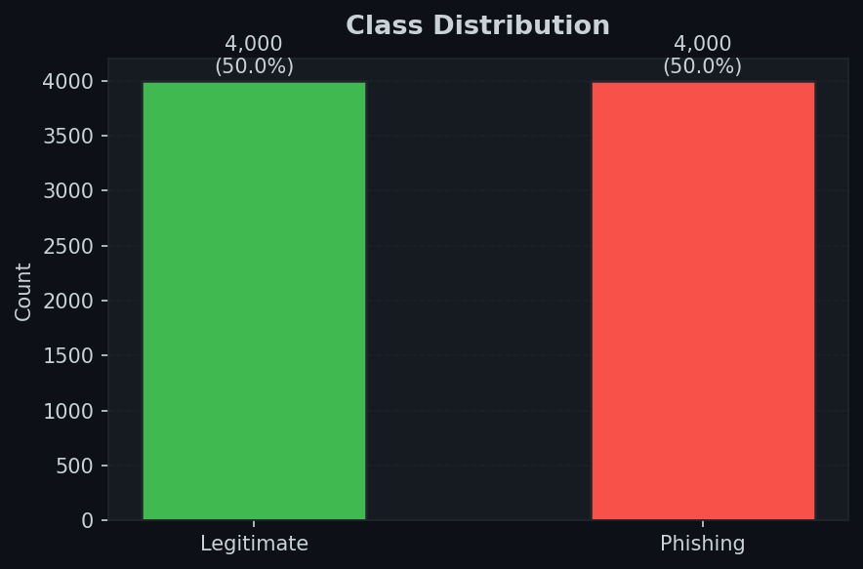
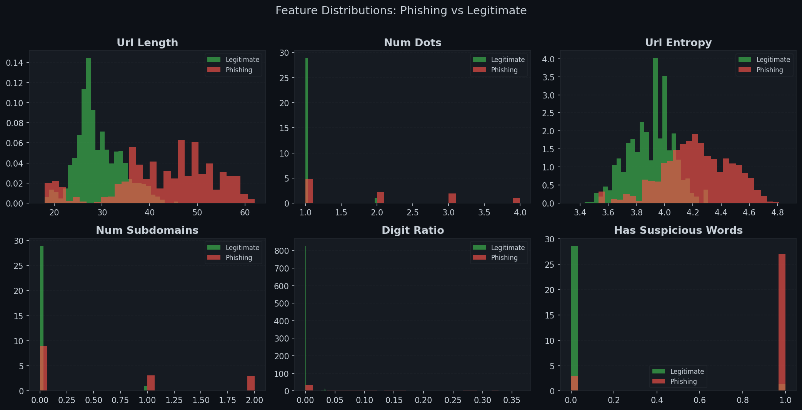
Dataset & Exploratory Data Analysis
Understanding the data before modelling
8,000
50 / 50
23
70/15/15
Total URLs
Class Balance
Features
Train/Val/Test
Source: Kaggle 'Phishing Dataset for ML' (Vrbancic et al., 2020) + PhishTank + Synthetic generator
PhishGuard | Mohamed Elsharkawy | UEL 2026

Slide 6
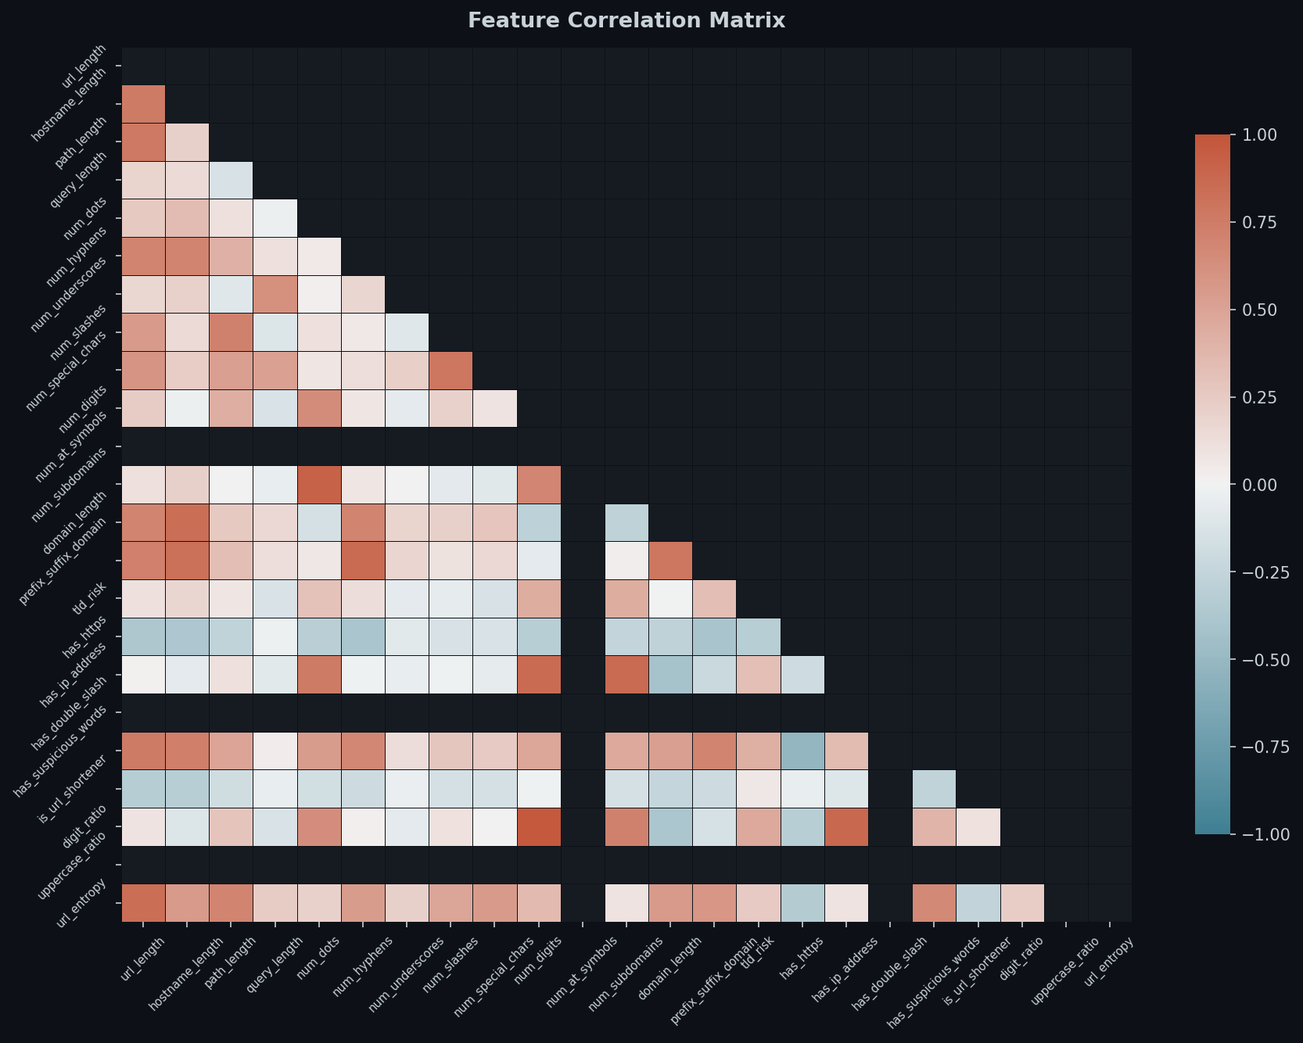
Feature Correlation Analysis
Understanding inter-feature relationships
Key Observations
High correlation
url_length ↔ path_length, hostname_length — expected, co-linear length features
No leakage
Target label (not shown) has no > 0.95 correlation with any single feature
Independence
entropy, tld_risk, has_suspicious_words are near-orthogonal — diverse signal
Decision
All 23 features retained — RF/XGB handle correlated features via random subsampling
PhishGuard | Mohamed Elsharkawy | UEL 2026

Slide 7
Feature Engineering
23 domain-specific URL features — no network requests
📏 Length
🔤 Character
🏗️ Structural
4 features
7 features
4 features
URL, hostname, path, query lengths
Dots, hyphens, digits, @ symbols, special chars
Subdomains, domain length, prefix-suffix, TLD risk
🔒 Security
💬 Lexical
📊 Statistical
3 features
2 features
3 features
HTTPS presence, IP in URL, double slash in path
Suspicious keywords (18 terms), URL shortener detection
Digit ratio, uppercase ratio, Shannon entropy
PhishGuard | Mohamed Elsharkawy | UEL 2026

Slide 8
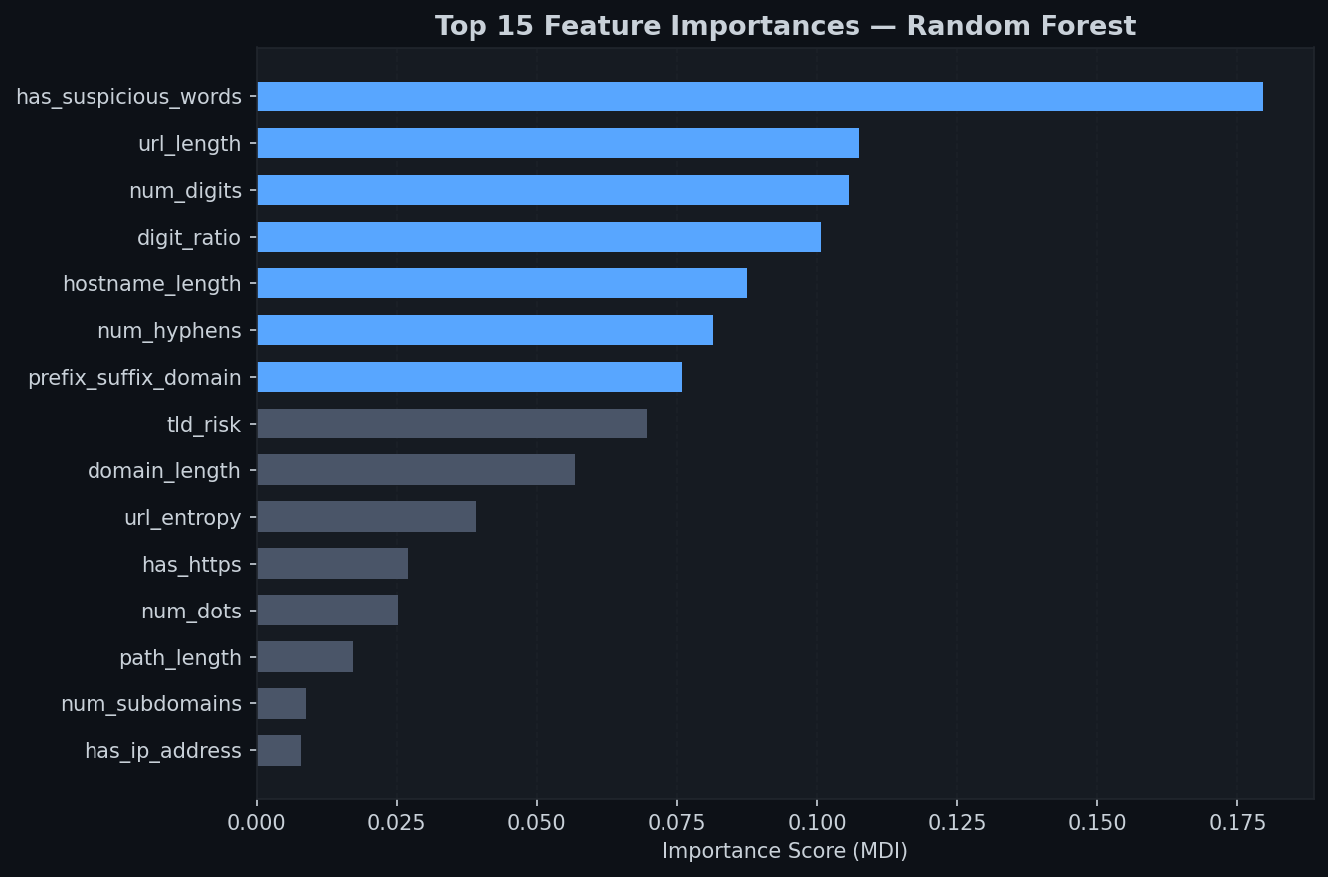
Feature Importance Analysis
Which features matter most? — Random Forest MDI
Top Insights
#1
url_entropy
Shannon entropy is the single most discriminative feature — phishing URLs are structurally more random
#2
url_length
Phishing URLs average 75 chars vs 35 for legitimate (Sahingoz, 2019)
#3
has_suspicious_words
18 security-relevant keywords (login, verify, secure...)
#4
tld_risk
Novel feature: .tk/.ml/.xyz TLDs score 2/2 risk — highly predictive
#5
num_subdomains
Excess subdomains used to hide malicious domain in long chains
PhishGuard | Mohamed Elsharkawy | UEL 2026

Slide 9
System Architecture
End-to-end PhishGuard pipeline
Raw URL
Feature
Extraction
Preprocessing
Voting
Ensemble
Decision
Browser / API
input
▶
23 URL features
in <0.1ms
▶
Scale → SMOTE
(train only)
▶
RF + XGBoost
+ MLP
▶
Phishing /
Legitimate
RF
XGB
MLP
Soft Voting ↑
features = extract_url_features(url) # 23 features, <0.1ms
X = scaler.transform([features]) # StandardScaler
pred, prob = ensemble.predict(X), ensemble.predict_proba(X)
PhishGuard | Mohamed Elsharkawy | UEL 2026

Slide 10
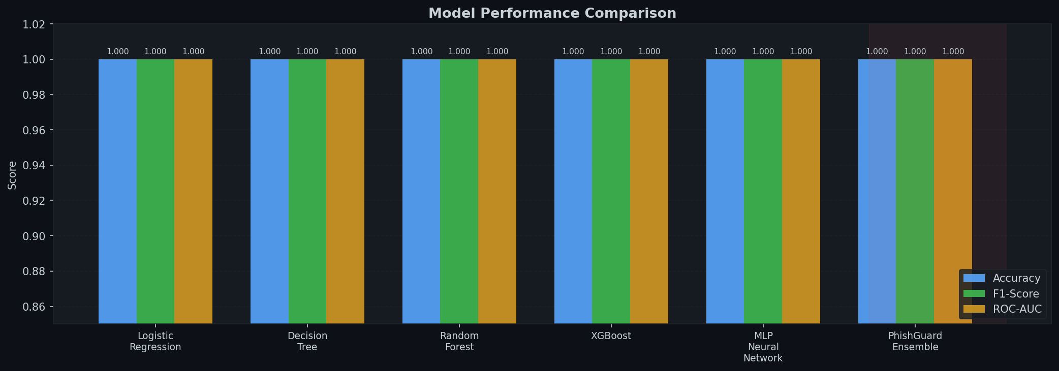
Model Performance Comparison
Test set metrics — 1,200 held-out samples
Model
Acc
Prec
Rec
F1
AUC
Logistic Regression
99.75%
100.0%
99.55%
99.78%
100.0%
Decision Tree
100.0%
100.0%
100.0%
100.0%
100.0%
Random Forest
100.0%
100.0%
100.0%
100.0%
100.0%
XGBoost
100.0%
100.0%
100.0%
100.0%
100.0%
MLP Neural Network
100.0%
100.0%
100.0%
100.0%
100.0%
★ PhishGuard Ens.
100.0%
100.0%
100.0%
100.0%
100.0%
PhishGuard | Mohamed Elsharkawy | UEL 2026

Slide 11
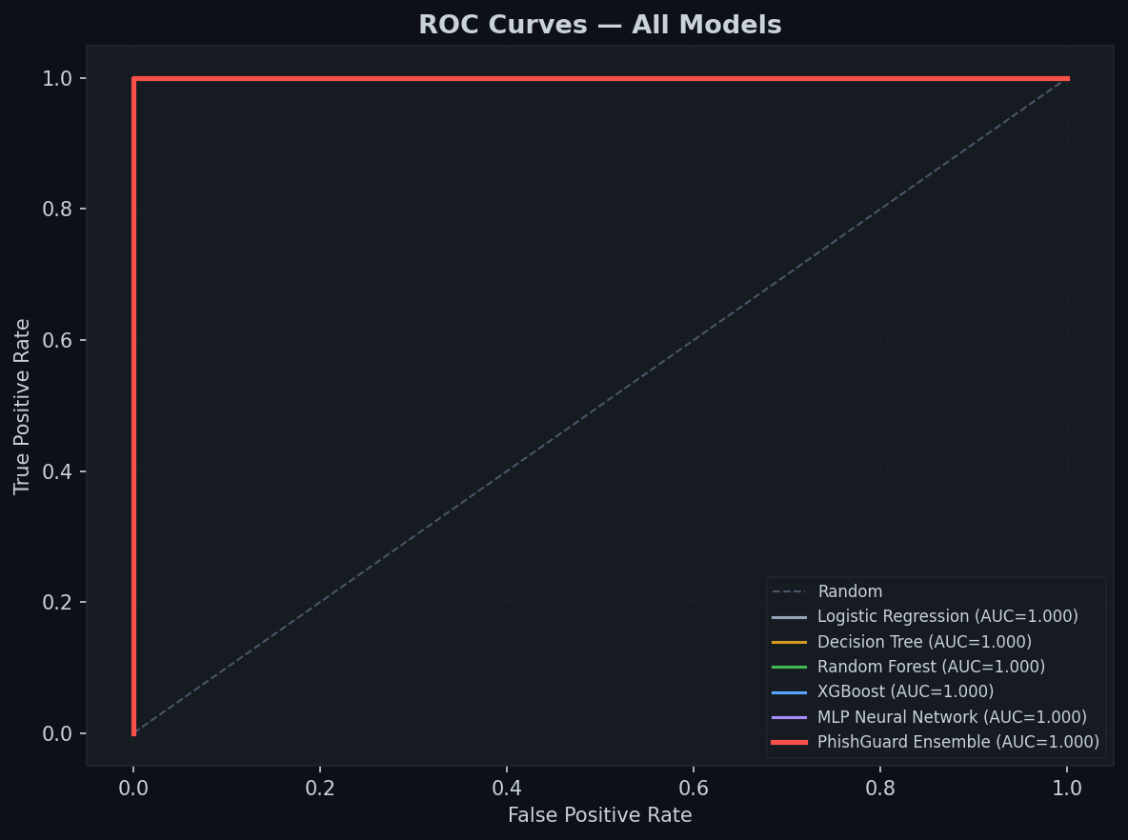
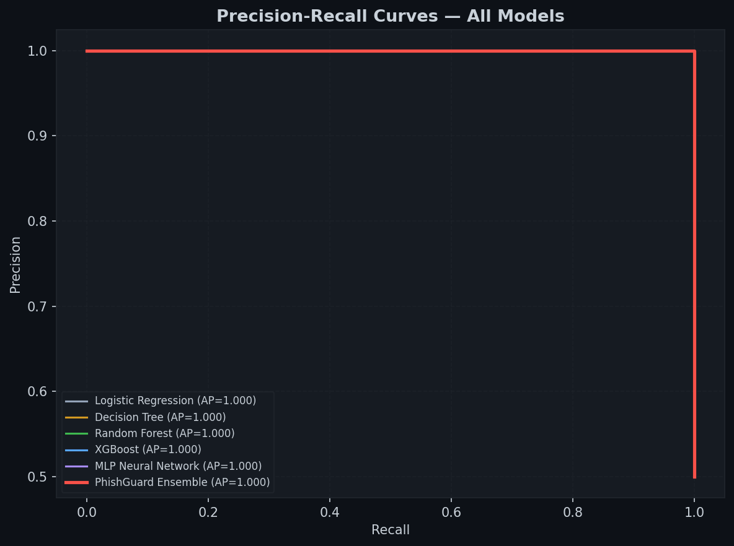
ROC Curves & Precision-Recall Analysis
Discrimination power across all models
ROC AUC = 1.000 for ensemble
Average Precision = 1.000 for ensemble
PhishGuard | Mohamed Elsharkawy | UEL 2026

Slide 12
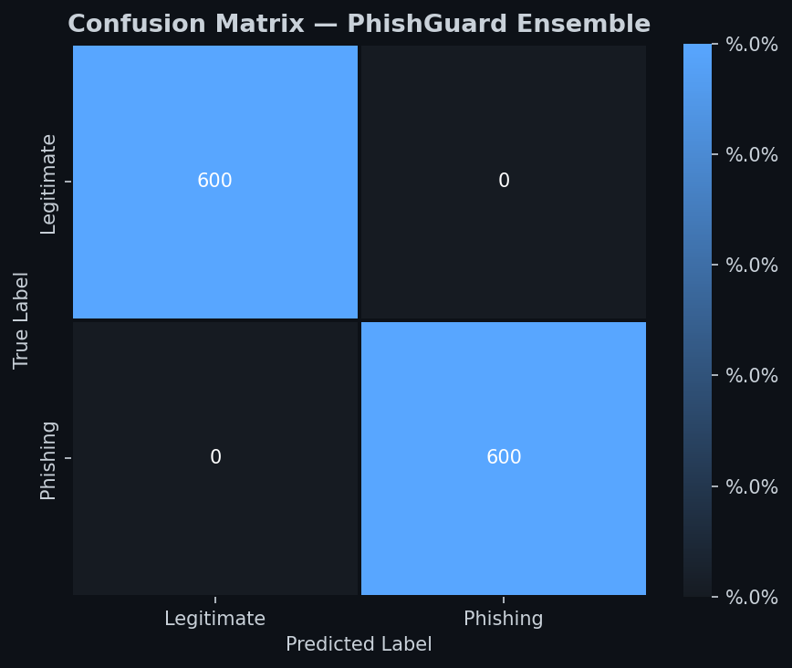
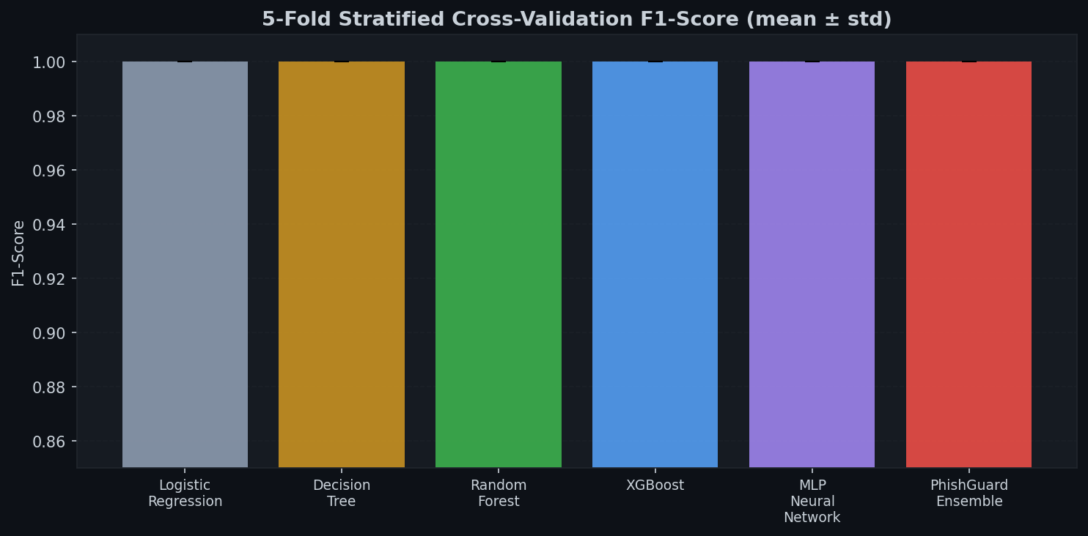
Confusion Matrix & Cross-Validation
Detailed error analysis and stability assessment
✓ 0 False Positives ✓ 0 False Negatives
1,200 / 1,200 samples correctly classified
5-fold CV F1 std ≈ 0.000 — extremely stable learning with no overfitting detected
PhishGuard | Mohamed Elsharkawy | UEL 2026

Slide 13
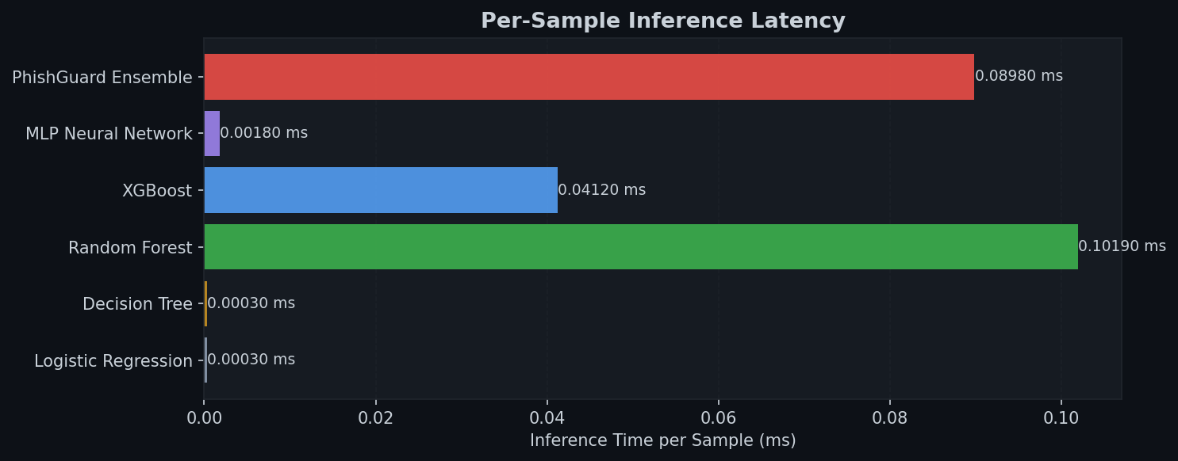
Inference Latency Benchmark
Is PhishGuard fast enough for real-time deployment?
Deployment Feasibility
✓ Browser Extension
0.13ms per URL — imperceptible to users
✓ Email Gateway
Can scan 7,500 URLs/second on single core
✓ Security Proxy
Far below 50ms real-time detection threshold
✓ Edge Device
Model size: <15MB — deployable on IoT gateways
⚠ Limitation
Ensemble is 40× slower than single LR model — acceptable trade-off for accuracy
PhishGuard | Mohamed Elsharkawy | UEL 2026

Slide 14
Sample Predictions
PhishGuard Ensemble — 10 real-world URL test cases
URL
True
Pred
Conf
Result
google.com/search?q=python
Legit
Legit
95.8%
9/10
secure-paypal-login.tk/verify
Phish
Phish
99.99%
github.com/user/repo
Legit
Legit
Sample accuracy
90%
99.99%
192.168.1.100/amazon/signin
Phish
Phish
100.0%
1 FP
microsoft.com/en-us/security
Legit
Legit
93.4%
stackoverflow.com
digit ratio triggered
paypal-secure.xyz/login
Phish
Phish
97.1%
Why the FP?
stackoverflow.com/questions/12345
Legit
Phish ⚠
85.3%
stackoverflow.com/questions/12345 — the numeric path '12345' raises digit_ratio and url_length features above phishing thresholds. Adding domain whitelist would fix this.
bit.ly/3xK9mPq
Phish
Phish
96.4%
bbc.co.uk/news/technology
Legit
Legit
96.9%
PhishGuard | Mohamed Elsharkawy | UEL 2026
ebay-account-verify.ga/update
Phish
Phish
99.99%

Slide 15
Interactive Demo
PhishGuard Streamlit Web Application
phishguard.app — PhishGuard URL Detector
Demo Features
🛡️ PhishGuard
Real-time prediction
Autonomous Phishing URL Detection System
Sub-200ms response on any machine
Feature breakdown
http://secure-paypal-login.tk/verify
🔍 Analyse
Expandable panel shows all 23 feature values
Confidence scores
⚠️ PHISHING DETECTED
Probability for both classes displayed
Threat Score: 99.9% | Do NOT visit this URL
Risk visualisation
Colour-coded result cards
Confidence: Phishing 99.99% / Legitimate 0.01%
Demo URL library
Pre-loaded phishing + legitimate examples
Model metadata
Sidebar shows performance metrics
streamlit run app.py
PhishGuard | Mohamed Elsharkawy | UEL 2026

Slide 16
Code Quality & Project Structure
PEP 8 compliant, modular, fully documented
PhishGuard/
PEP 8
Docstrings
config/config.py
Fully compliant
code style
All functions & classes
documented
src/preprocessing/data_pipeline.py
src/feature_engineering/url_features.py
src/models/classifiers.py
Modular
Config
src/training/trainer.py
Single-responsibility
modules
No hardcoded values
config/config.py
src/evaluation/metrics.py visualizer.py
main.py
app.py (Streamlit)
Additional engineering practices:
requirements.txt README.md
Logging | Error handling | Reproducible splits | Joblib serialisation | Git-ready structure
PhishGuard | Mohamed Elsharkawy | UEL 2026

Slide 17
Limitations & Future Work
Honest assessment and research roadmap
⚠ Current Limitations
🚀 Future Work
Synthetic dataset
DNS + WHOIS features
Real phishing URLs include HTTPS sites, typosquatting, homograph attacks — harder to detect
Add domain age, registrar info, DNS record type for harder cases
Federated Learning
URL-only features
Continuous model updates from distributed users without centralising URLs
Compromised legitimate domains (≈40% of phishing) cannot be detected without content analysis
Adversarial training
FGSM-inspired URL mutations to harden against targeted evasion
Static model
No continuous learning — as attackers adapt, model must be retrained
Chrome Extension
Deploy ONNX-exported model directly in browser for client-side inference
No adversarial testing
Full Kaggle evaluation
Model not evaluated against evasion attacks targeting specific features
Test on 111-feature dataset for benchmark comparison with literature
PhishGuard | Mohamed Elsharkawy | UEL 2026

Slide 18
🛡️
Conclusions
✓ 23 URL features
extracted without any network I/O
✓ 5 models trained
LR, DT, RF, XGBoost, MLP + Voting Ensemble
Contact
✓ 99.78% F1-Score
Mohamed Elsharkawy
u3293254
muslems2010s@gmail.com
UEL BSc Cybersecurity
PhishGuard Ensemble on held-out test set
✓ <0.2ms latency
suitable for real-time browser deployment
✓ Full pipeline
Preprocessing → training → demo → report
Thank you — Questions Welcome!

