Slide 1
PROJECT Traffic Sign Recognition
سكشن | الأسماء
7 | - محمد متولى مصطفى متولى.
7 | - محمد فتحى محمد محمد ابوالنجا.
 | - احمد ايمن احمد عبد الجليل.
7 | - محمد محمود عبدالستار حسن لاشين.
7 | - محمد عصام مسعد عبد المنعم.
7 | - محمد عماد محمود الوكيل .
د/ ابراهيم زغلول. م/ محمود منصور.

Slide 2

Project Idea

Slide 3
Abstract Upload
The problem is how do traffic lights know the road and recognize it automatically using images that the user enters for it
The GTSRB dataset containing more than 31,367 traffic light images can be used

Slide 4
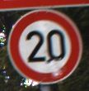

Some images to model about traffics and Traffic signs to know when cars and people should stop or continue walking or driving cars and what is the speed should drive car on it or what is the way must go (right , left).
Example this image means that speed should not exceed 20 .
this image means that you must go right .

Slide 5
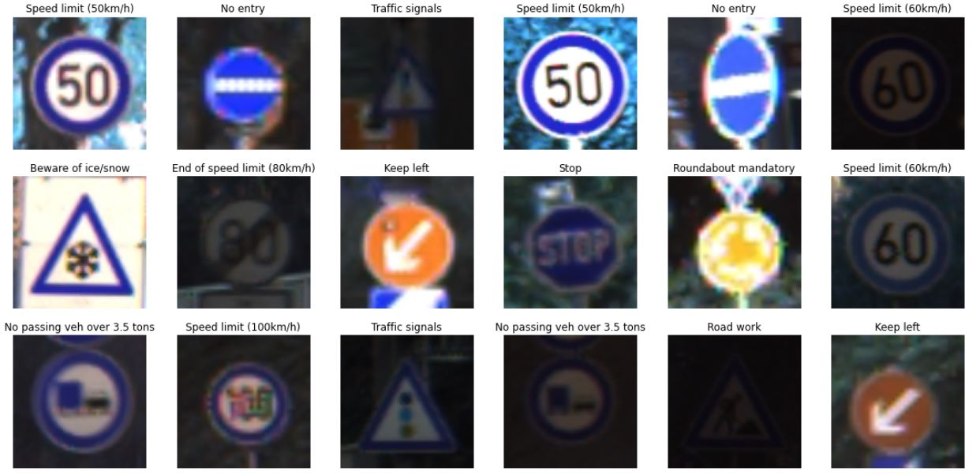
Testing accuracy of the prediction

Slide 6
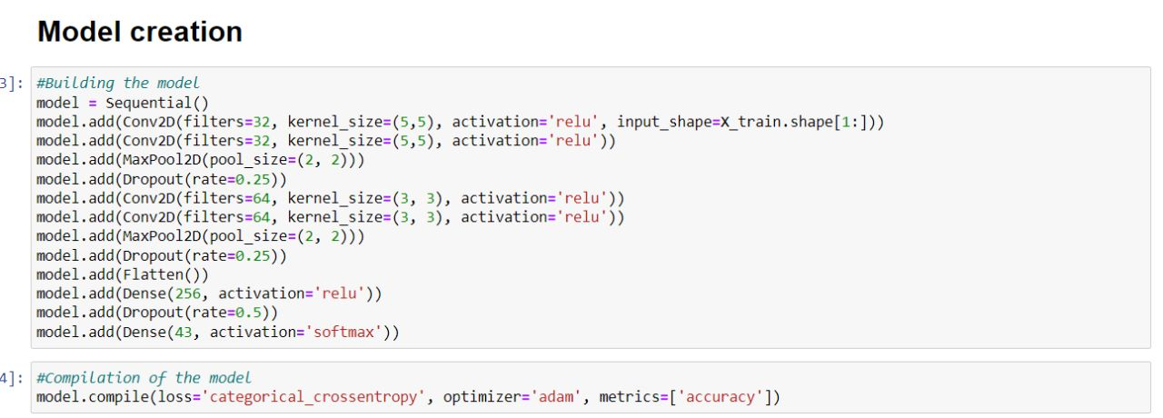
Model creation for training and testing

Slide 7
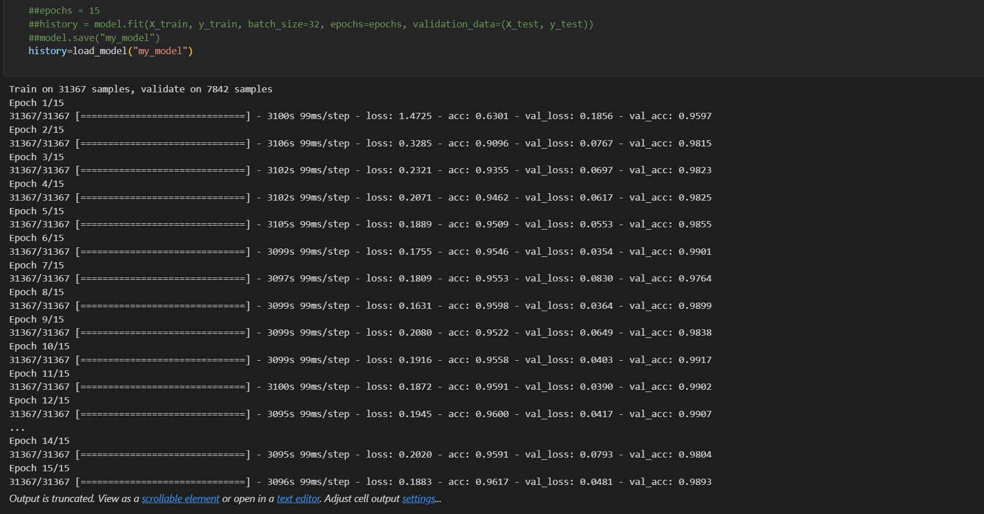
Model trainning
Notes:
**No overfitting or underfitting.

Slide 8

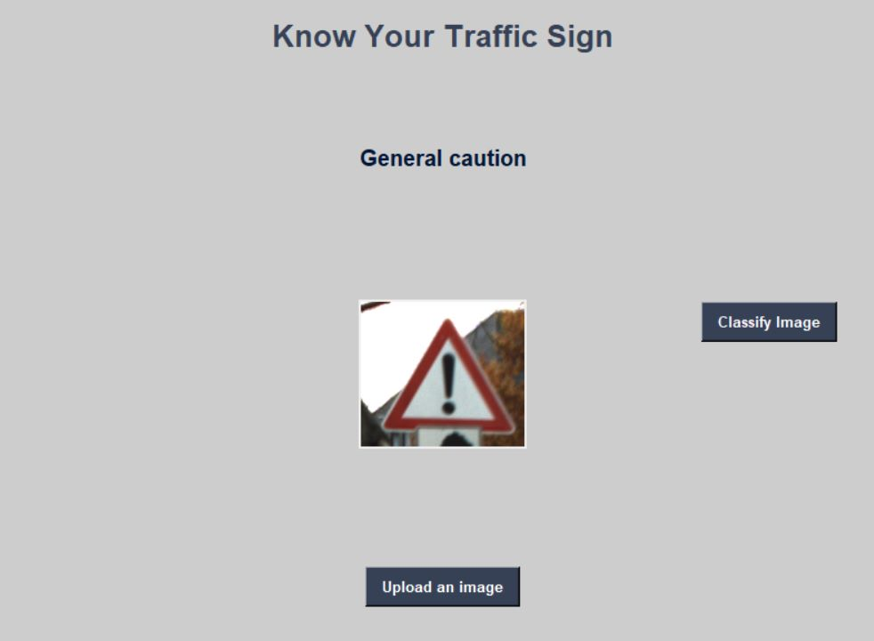
TRAiNING
Prediction to the model ,the final result is expected.

Slide 9
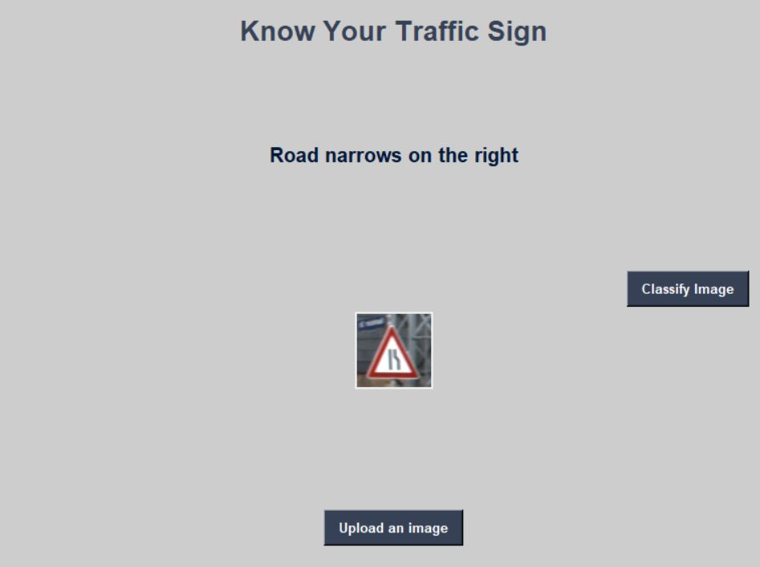
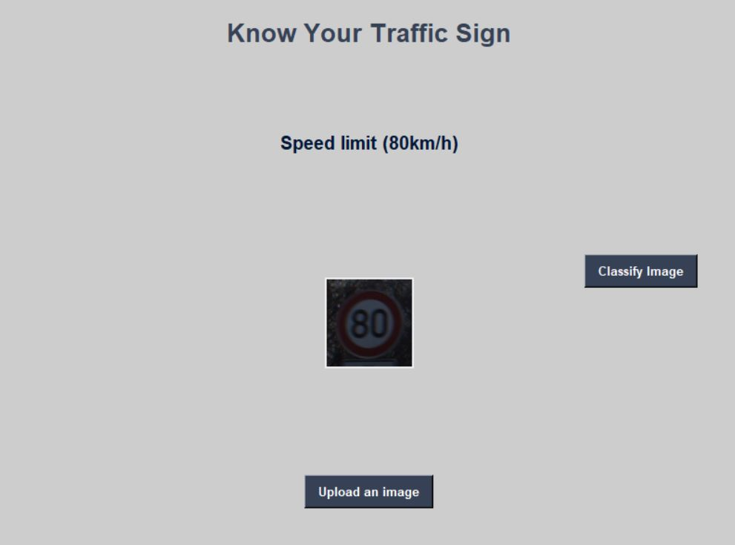

Slide 10
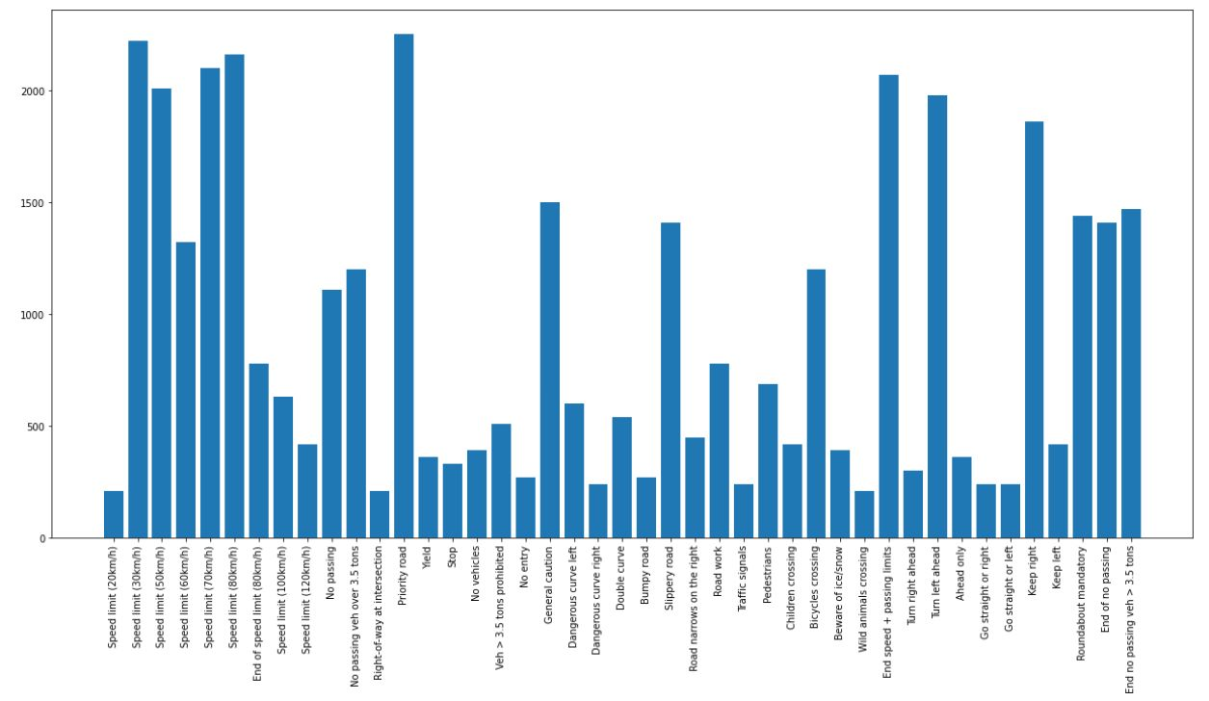
Plotting the number of images in each class

Slide 11
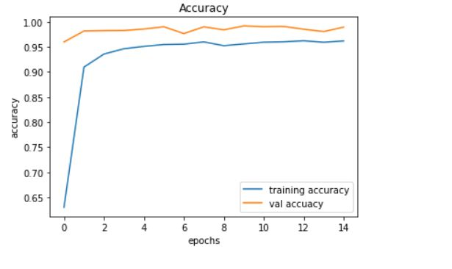
Accuracy and Loss of x_train and y_train graph

Slide 12
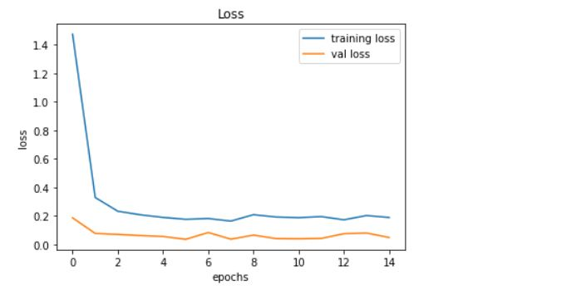
Validation Accuracy and Loss of x_test and y_test graph

Slide 13

THANK YOU

