Slide 1

College of Veterinary Medicine

Slide 2

Cathy French & Scott Ross
Cornell University Veterinary College
VMIT

Slide 3
Agenda
Our Story
Goals of CI/CD
High-level of our solution
Specific example (Live demo!)
Other industry examples, patterns, and best practices

Slide 4
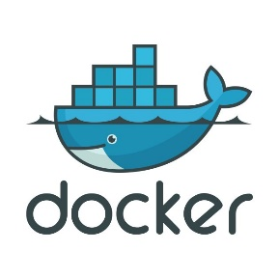


VMIT Developers Group: Our story
Support of:
Cornell University Hospital for Animals
Animal Health Diagnostic Center
College of Veterinary Medicine
Portfolio of:
More than 200 custom applications
Transitioning to microservices since 2016
NodeJS, Angular, TypeScript

Slide 5
VMIT Developers Group: Our story
7 FTE, 3 Contractors
WebOps
DevOps
Software Engineering
Cloud native
Drupal is a small part of our portfolio
Though, CI/CD is a huge part of our strategy

Slide 6
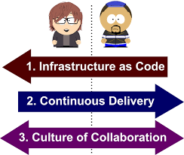
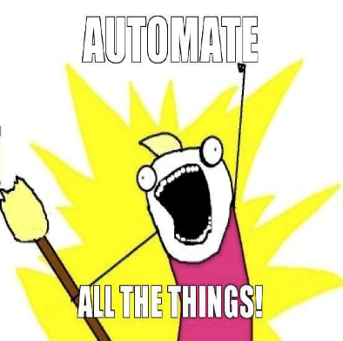
Goals of CI/CD Process
Time to Market
Improvement to code-quality
Efficient develops

Slide 7


Goals of CI/CD Process
Our Drupal infrastructure is hosted on Pantheon
Using git
The rest of our “world” is managed using Bitbucket
Why bitbucket instead of github, gitlab, or something else?
Canonical version in bitbucket
Match the rest of our infrastructure (Reduce cognitive load)
Protect our investment – infrastructure and code separated

Slide 8
For internal team
Instead of performing a weekly or a monthly release, moving to feature-driven releases enables faster and finer-grained upgrades and helps in debugging and regression detection by only altering one thing at a time.
By automating every step of the process, you make it self-documenting and repeatable.
By making the deployment to the server fully automated, a repeatable deployment process can be created.
By automating the release and deployment process, you can constantly release the ongoing work to the staging and QA servers thereby giving visibility to the state of development.

Slide 9
For stakeholders in the company
Instead of waiting for a fixed upgrade window, you can release features when they are ready thereby getting them to the customer faster. As you are constantly releasing to a staging server while developing them, internal customers can see the alterations and take part in the development process.
Managers will see the result of work faster and progress will be visible when you release more often
If a developer needs a few more hours to make sure that the feature is in perfect working condition, then the feature will go out a few hours later and not when the next release window opens.
Sysadmins will not have to perform the releases themselves. Small, discrete feature releases will enable easier detection of the alterations that have affected the system adversely.

Slide 10
Our CI/CD Process
Pull requests – 2 man rule
Trunk-based development
Ticketing system
Remedy -> Jira -> Branch -> Pull Request -> Deploy
Pantheon/Lando
Multi-dev, pantheon’s git
Notes:
Cathy takes over here
We have an internal process of having a minimum of 2 developers review all code changes.
Trunk-based development to us means we have 1 feature branch at all times. This allows us to get changes to market quicker.
Bugs/requests come in through Remedy. We create Jira tickets which our PR’s are based on.
Pantheon is our Drupal hosting provider.
Why Lando?
Quickly specify and painlessly spin up the services and tooling needed to develop their projects.
Automate complex build steps using recipes
free, open source, cross-platform, local development environment and DevOps tool built on Docker container technology
Standardizing your teams dev environments and tooling on OSX, Windows and Linux
Integrates nicely with Pantheon

Slide 11

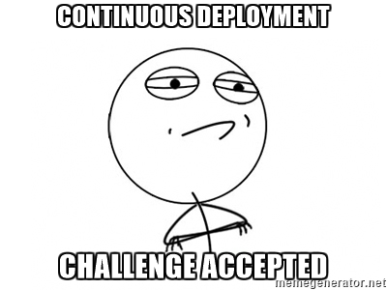

Slide 12
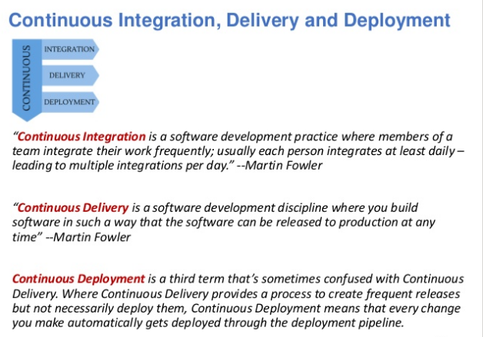
Notes:
Like Scott touched on earlier, our goal was to protect our investment and keep with the same process that was already in place.

Slide 13
Clone Bitbucket Respository

Slide 14
Setup of local environment
➜ drupalcampdemo git:(mayo) ✗ lando start
Let's get this party started! Starting app..
Starting landoproxyhyperion5000gandalfedition_proxy_1 ... done
Creating network "drupalcampdemo_default" with the default driver
…
Generating certs...
Generating RSA private key, 2048 bit long modulus
…
Killing drupalcampdemo_appserver_1 ... done
Starting drupalcampdemo_appserver_1 ... done
…
BOOMSHAKALAKA!!!
Your app has started up correctly.
Here are some vitals:
NAME drupalcampdemo
LOCATION /Users/clf16/drupalcampdemo
SERVICES appserver_nginx, appserver, database, cache, edge, edge_ssl, index
APPSERVER_NGINX URLS https://localhost:32772
http://localhost:32773
EDGE URLS http://localhost:32774
http://drupalcampdemo.lndo.site
https://drupalcampdemo.lndo.site
EDGE_SSL URLS https://localhost:32775
Notes:
Clone repo locally
Create branch
Start site using Lando
open source, cross-platform, local development environment and DevOps tool built on Docker container technology and developed by Tandem.
Mimics production environment locally using recipes
Standardizes team dev environments and tooling on OSX, Windows and Linux
Integrating with hosting providers like Pantheon
Full Disclosure –
It isn’t necessary to install Terminus since Lando installs Terminus proper. Last I knew version 1.9 was installed, so you will be prompted to upgrade if that is still the case.
I am running Lando v3.0.0-rc.14 and the latest version is v3.0.0-rc.20
*** Disclaimer ***
I deleted a lot of the output to the “lando start” command in order for it to fit on a single page slide; it is very verbose!

Slide 15
Copy database and files
➜ drupalcampdemo git:(mayo) ✗ lando pull
? Choose a Pantheon account clf16@cornell.edu
? Pull code from? none
? Pull database from? dev
? Pull files from? dev
Attempting to login via terminus...
[notice] Logging in via machine token.
Logged in as clf16@cornell.edu
Verifying that you have accesss to drupalcampdemo...
------------------ -------------------------------------------------------------------------------------
ID fe8a7f32-41a6-40f0-a0d4-e3fae83bb482
Name drupalcampdemo
Label drupalcampdemo
Created 2019-09-13 15:17:33
Framework drupal
Organization 893bc79a-3b2d-46cc-9d10-771370b74081
Service Level free
Max Multidevs 10
Upstream 21e1fada-199c-492b-97bd-0b36b53a9da0: git://github.com/pantheon-systems/drops-7.git
PHP Version 5.5
Holder Type user
Holder ID 4ddd827c-c1fe-473c-afeb-0c34d536d00d
Owner 4ddd827c-c1fe-473c-afeb-0c34d536d00d
Is Frozen? false
Date Last Frozen 1970-01-01 00:00:00
Pantheon LOCKR setup
Connected to appserver.dev.fe8a7f32-41a6-40f0-a0d4-e3fae83bb482.drush.in.
Fetching /srv/bindings/75d333dd38814e4cae2e35b8c40280a0/certs/binding.pem to /var/www/certs/binding.pem
/srv/bindings/75d333dd38814e4cae2e35b8c40280a0/certs/binding.pem 100% 3412 42.8KB/s 00:00
Certificate will not expire
Cert is good!
Validating whether mayo is a valid environment and that you have access to it
Destroying all current tables in database...
Downloading drush aliases...
[notice] Aliases file written to ~/.drush/pantheon.aliases.drushrc.php.
@pantheon.drupalcampdemo.dev
Clearing remote cache to shrink db size
No Drupal site found, only 'drush' cache was cleared. [warning]
[notice] OK >> dev-drupalcampdemo.pantheonsite.io responded
Pulling database from dev...
736KiB 0:00:03 [ 211KiB/s] [ <=>
Pulling files from dev...
receiving incremental file list
private/
sent 143 bytes received 59 bytes 80.80 bytes/sec
total size is 0 speedup is 0.00
Pull complete!
Notes:
I am not actually going to demo this step. I’m sure every shop has their own development stack. We use Lando.
This is an interactive command to pull down code, database and/or files from Pantheon. You will need to create a Pantheon machine token in order to authenticate. You will only be pulling down the database and files. NEVER pull down your sites code. This comes from Bitbucket.
Depending on the size of your site, this could take some time! I’ve had a complete download of our site take up to 45 minutes. There is a lando –rsync command that will sync the files only on subsequent pulls. You could use this to minimize your setup time.
My advise would be to leave your local site in tact and only update when necessary.
**************************
At this point you should be able to bring up your site in a browser using one of the URLs listed in the previous slide (under BOOMSHAKALAKA)
i.e. https://drupalcampdemo.lndo.site
At this point log in as admin and download a new theme to show the pipeline process in action
1. Appearance -> Install New Theme (browse to .tar file in downloads folder)
2. set new theme as default
3. commit changes to Bitbucket

Slide 16
Under the hood
Bitbucket-pipelines.yml
# This image will be used by all steps
image: quay.io/pantheon-public/build-tools-ci:4.x
options:
docker: true
pipelines:
branches:
master: # This only runs on merges to master branch
- step:
name: Deploy to dev (master)
deployment: staging # can be test, staging or production.
script:
- echo "Deploying to Pantheon dev environment"
- ./scripts/merge-multidev-to-dev.sh
'**’:
- step:
name: Deploy to multidev
# This moves code to a multidev environment for testing.
deployment: test # can be test, staging or production.
script:
- echo "Deploying to a Pantheon multidev environment"
- ./scripts/deploy-multidev.sh branches
Notes:
Just a quick overview of the scripts executed as part of the pipeline process
What is Bitbucket pipelines?
It is an integrated CI/CD service, built into Bitbucket. It allows you to automatically build, test and even deploy your code, based on a configuration file in your repository. ... The bitbucket-pipelines.yml file holds all the build configurations for your repository.

Slide 17
Deploy-multidev.sh – step #1
echo "Working with branch "$BITBUCKET_BRANCH
# Deploy any branch except master, dev, test, or live
echo "Checking branch name against protected names..."
if [ "$BITBUCKET_BRANCH" != "master" ] && [ "$BITBUCKET_BRANCH" != "dev" ] && [ "$BITBUCKET_BRANCH" != "test" ] && [ "$BITBUCKET_BRANCH" != "live" ] && ! [[ $BITBUCKET_BRANCH =~ (pull\/.*) ]]; then
# Normalize branch name to adhere with Multidev requirements
export normalize_branch="$BITBUCKET_BRANCH"
export valid="^[-0-9a-zA-Z]" # allows digits 0-9, lower case a-z, case A-Z, and -
if [[ $normalize_branch =~ $valid ]]; then
# Pantheon doesn't allow multidev names to exceed 11 chars.
export normalize_branch="${normalize_branch:0:11}"
#Remove - to avoid failures
export normalize_branch="${normalize_branch//[-_]}"
export normalize_branch="${normalize_branch,,}"
echo "Success: "$normalize_branch" is a valid branch name."
echo "$normalize_branch" > ./info.txt
git add info.txt
git commit -m "[skip ci] Updating info.txt with latest branch name."
git push
else
echo "Error: Multidev cannot be created due to invalid branch name: $normalize_branch"
exit 1
fi

Slide 18
Deploy-multidev.sh – step #2
terminus auth:login --machine-token=$PANTHEON_USER_MACHINE_TOKEN
echo "Checking to see if multidev exists..."
terminus env:list --format list --field=ID $SITE_NAME > ./env_list.txt
if grep -Fxq "$normalize_branch" ./env_list.txt; then
echo "Existing environment found for $normalize_branch"
echo "Recreating multidev environment..."
# Push code to multidev
git remote add pantheon $PANTHEON_GIT_URL
GIT_SSH_COMMAND="ssh -o UserKnownHostsFile=/dev/null -o StrictHostKeyChecking=no" git push pantheon $normalize_branch
# I'm not convinced we should revert all features at the risk of losing changes; this is a controversial practice
# terminus drush $SITE_NAME.$normalize_branch -- features-revert-all -y
terminus env:clear-cache $SITE_NAME.$normalize_branch
else
echo "Creating multidev environment $normalize_branch..."
terminus multidev:create $SITE_NAME.dev $normalize_branch
echo "Cloning database and files from dev..."
terminus env:clone-content $SITE_NAME.dev $normalize_branch
# Push code to multidev
git remote add pantheon $PANTHEON_GIT_URL
GIT_SSH_COMMAND="ssh -o UserKnownHostsFile=/dev/null -o StrictHostKeyChecking=no" git push pantheon $normalize_branch
terminus env:clear-cache $SITE_NAME.$normalize_branch
fi
fi
Notes:
A list of all existing multidev environments is written to a text file. If your current branch is not found, it will be created, otherwise it will be updated.
Full disclosure –
We are bypassing host verification here due to an evasive error “Host key verification failed”. We do not deem this as a securithy risk since this is running for a very short amount of time inside a docker container.
GIT_SSH_COMMAND="ssh -o UserKnownHostsFile=/dev/null -o StrictHostKeyChecking=no" git push pantheon $normalize_branch

Slide 19
Merge-multidev-to-dev.sh
#!/bin/bash
# Merges code commits from a multidev environment to dev
# Note: This script uses BITBUCKET environment variables
export bitbucket_source_branch=`cat info.txt`
echo "The source branch is "$bitbucket_source_branch""
# Deploy any branch except master, dev, test, or live
if [ "$bitbucket_source_branch" != "master" ] && [ "$bitbucket_source_branch" != "dev" ] && [ "$bitbucket_source_branch" != "test" ] && [ "$bitbucket_source_branch" != "live" ] && ! [[ $bitbucket_source_branch =~ (pull\/.*) ]]; then
# We don't need to normalize the branch name since it was done prior to saving it to info.txt.
echo "Code is merged in to dev. This runs update.php so that any changes to the database that modules/core have made are set up correctly."
terminus auth:login --machine-token=$PANTHEON_USER_MACHINE_TOKEN
git remote add pantheon $PANTHEON_GIT_URL
GIT_SSH_COMMAND="ssh -o UserKnownHostsFile=/dev/null -o StrictHostKeyChecking=no" git push pantheon master
echo "Deleting multidev $bitbucket_source_branch and it's associated Git branch..."
terminus multidev:delete $SITE_NAME.$bitbucket_source_branch --delete-branch --yes
fi

Slide 20
Commit changes
➜ drupalcampdemo git:(mayo) ✗ git add --all
➜ drupalcampdemo git:(mayo) ✗ git commit -m "installed Bootstrap theme"
[mayo 06503bff3] installed Bootstrap theme
125 files changed, 13239 insertions(+)
create mode 100644 .lando.yml
create mode 100644 sites/all/themes/bootstrap/.gitignore
create mode 100644 sites/all/themes/bootstrap/LICENSE.txt
.
.
.
➜ drupalcampdemo git:(mayo) git push --set-upstream origin mayo
Enumerating objects: 168, done.
Counting objects: 100% (168/168), done.
Delta compression using up to 12 threads
Compressing objects: 100% (149/149), done.
Writing objects: 100% (164/164), 161.74 KiB | 6.74 MiB/s, done.
Total 164 (delta 17), reused 0 (delta 0)
remote: Resolving deltas: 100% (17/17), completed with 3 local objects.
remote:
remote: Create pull request for mayo:
remote: https://bitbucket.org/cu-vmit/drupalcampdemo/pull-requests/new?source=mayo&t=1
remote:
To https://bitbucket.org/cu-vmit/drupalcampdemo.git
* [new branch] mayo -> mayo
Branch 'mayo' set up to track remote branch 'mayo' from 'origin'.
Notes:
This is the integration step (CI)

Slide 21
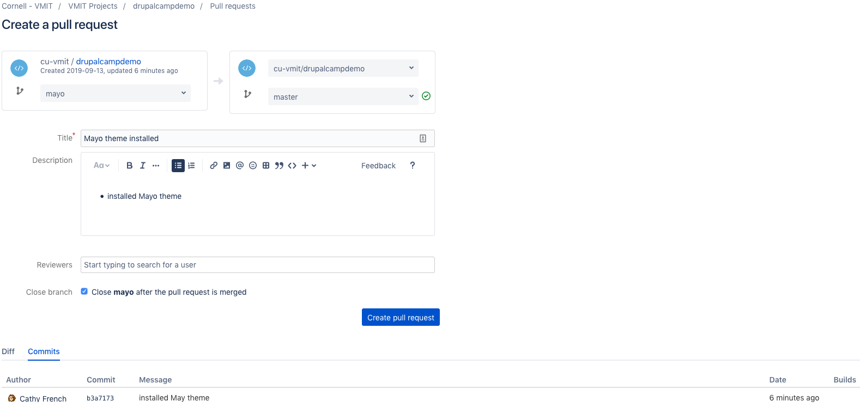
Create a PR
Notes:
Create a PR, approve and merge to kick off the final step. This is the delivery and deployment process (CD).

Slide 22
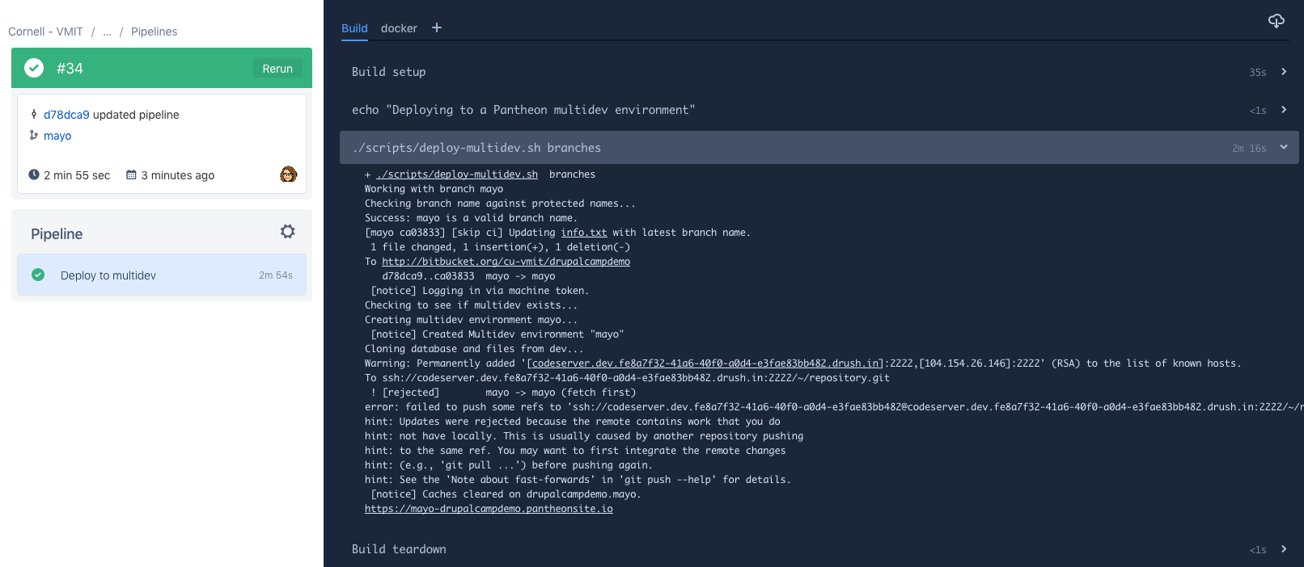
Pipeline executes on commit
Notes:
This creates a multidev in Pantheon with changes
- look at workflows
Show the newly created multidev and verify that theme was indeed installed.

Slide 23
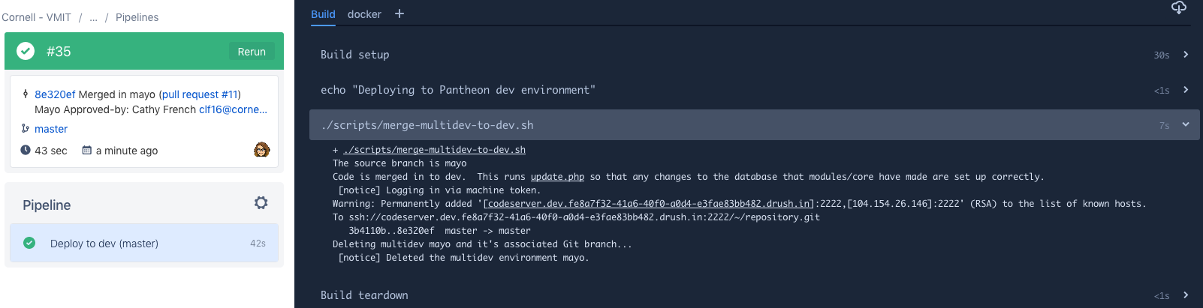
Create PR and merge to master
Notes:
Again, you can checkout the workflow in Pantheon
Also verify the the multidev was deleted and code was merged in to dev.
From here the process to push changes in to test and prod is manual.

Slide 24
Industry best practices
We put emphasis on:
Continuous delivery
Modern technology architecture
Products and process
Lean management and monitoring
Cultural

Slide 25
Industry best practice - CD
Version control for all artifacts
Automate deployment process
Trunk based development
*Test automation
*Test data management
*Shift left on security
Implement CI and CD

Slide 26
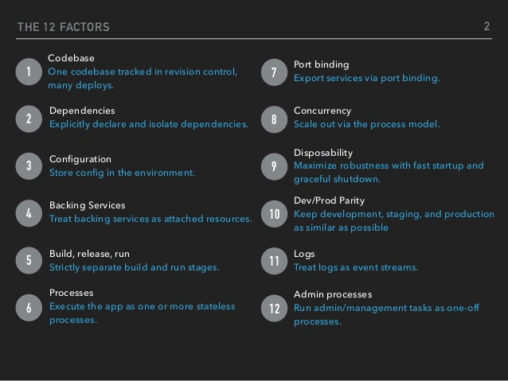
Our engineering culture

Slide 27
Other tools
Source code:
Github, bitbucket, gitlab
CI/CD tools:
Travis, CircleCI, Jenkins, Bitbucket pipelines
Hosting:
Pantheon, AWS, Roll your own
Other tools:
Lando, Docker

Slide 28

Resources
Accelerate: The Science of Lean Software and DevOps: Building and Scaling High Performing Technology Organization
Pantheon: https://pantheon.io/integrations/continuous-integration
https://12factor.net
https://www.adcisolutions.com/knowledge/continuous-integration-drupal-8-and-gitlab-cicd

