Slide 1
ALLOCATOR
PROJECT
DR. MARWA YOUSSEF

Slide 2
TEAM MEMBERS
Peter Latif
Hatem Ashraf
Mohamed Samy
Mohamed Ayman
Memory Management
Linked List
Json Handler +Allocator
Allocator+Json Handler

Slide 3
TABLE OF CONTENTS
01
03
02
04
About
Allocator
How does
It work
Allocation algorithms
Some cases

Slide 4
01
About Allocator

Slide 5

INTRODUCTION
Memory allocation is a process by which computer programs and services are assigned with physical or virtual memory space.
Memory allocation is the process of reserving a partial or complete portion of computer memory for the execution of programs and processes. Memory allocation is achieved through a process known as memory management.

Slide 6
Memory allocation is primarily a computer hardware operation but is managed through operating system and software applications. Memory allocation process is quite similar in physical and virtual memory management. Programs and services are assigned with a specific memory as per their requirements when they are executed. Once the program has finished its operation or is idle, the memory is released and allocated to another program or merged within the primary memory.

Slide 7
02
Allocation algorithms

Slide 8
BEST FIT
The best fit deals with allocating the smallest free partition which meets the requirement of the requesting process. This algorithm first searches the entire list of free partitions and considers the smallest hole that is adequate. It then tries to find a hole which is close to actual process size needed.

Slide 9
WORST FIT
Worst Fit allocates a process to the partition which is largest sufficient among the freely available partitions available in the main memory. If a large process comes at a later stage, then memory will not have space to accommodate it.

Slide 10
FIRST FIT
This method keeps the free/busy list of jobs organized by memory location, low-ordered to high-ordered memory. In this method, first job claims the first available memory with space more than or equal to it's size.

Slide 11
03
How does it work

Slide 12
How does it work
Our program basically consists of a fixed size array, and a linked list
The fixed size array acts like virtual memory from which processes can allocate and free.
The linked list represents the current processes that use part of the virtual memory

Slide 13
How does it work
The program reads from a JSON file which is the processes that need to allocate or free part of the virtual memory
In case of allocation request, there is a dynamic size array is created which contains the available free chunks of the virtual memory
Depending on the allocation algorithm (First fits, worst fit, best fit), a searching algorithm has to be executed
Then the selected chunk of memory is added to the linked list in order to represent that these locations of the virtual memory is now busy by the specific process
In case of free 'deallocation' request, the chunk is removed from the linked list

Slide 14
04
Some cases

Slide 15
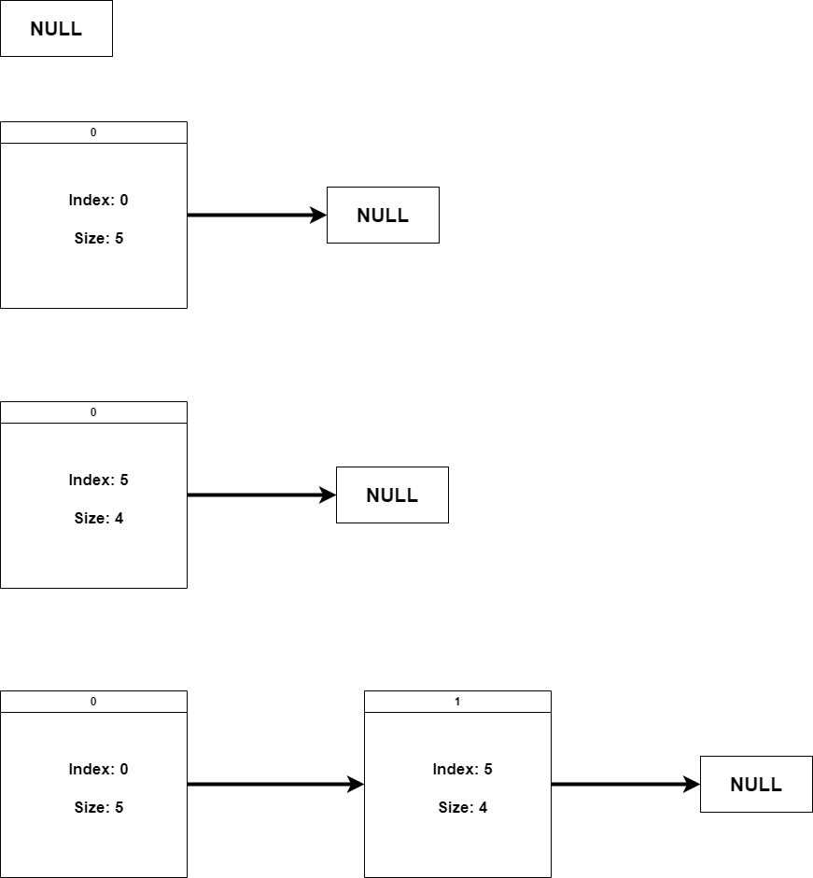
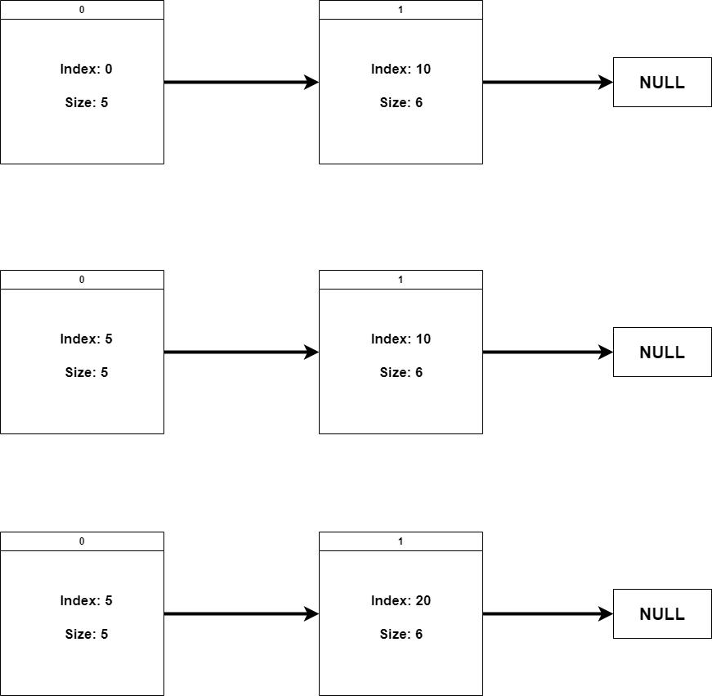
Overall

Slide 16
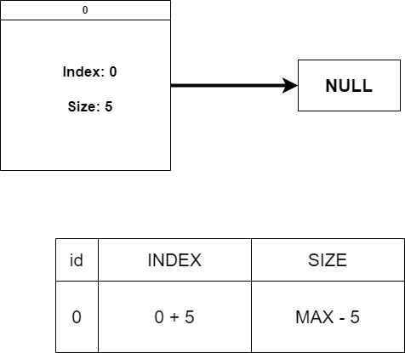
First Case

Slide 17
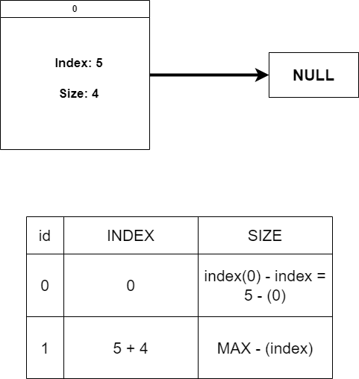
Second Case

Slide 18
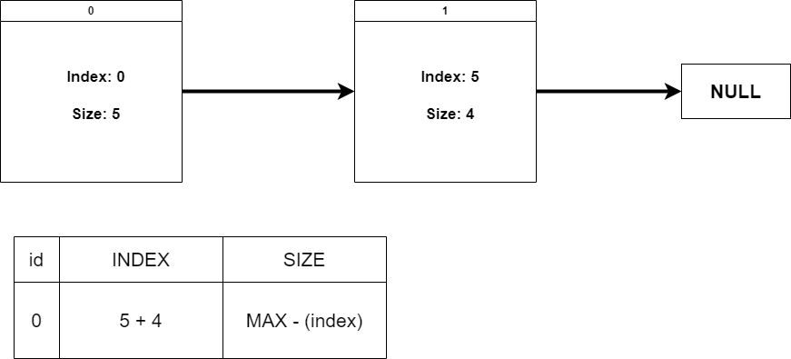
Third Case

Slide 19
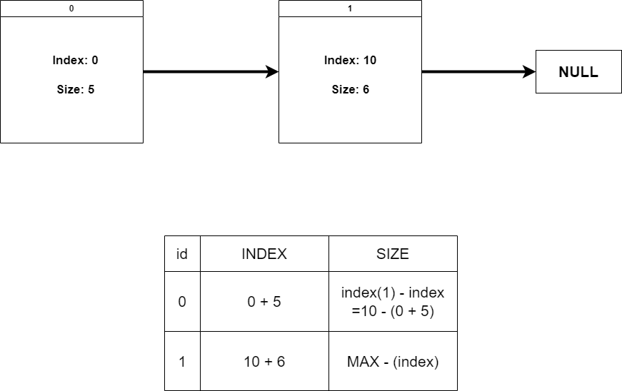
4Th Case

Slide 20
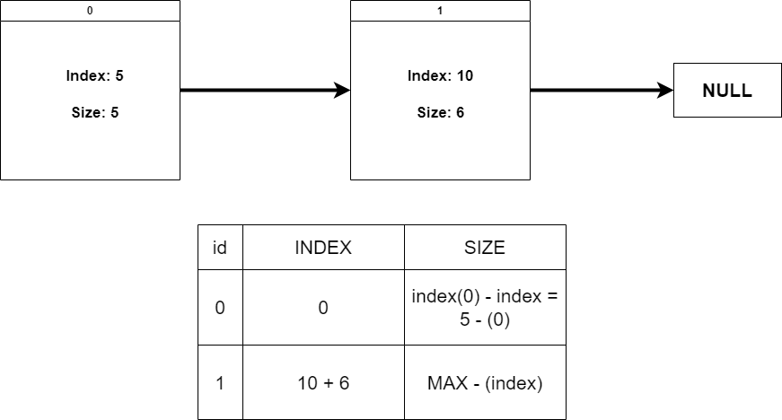
5Th Case

Slide 21
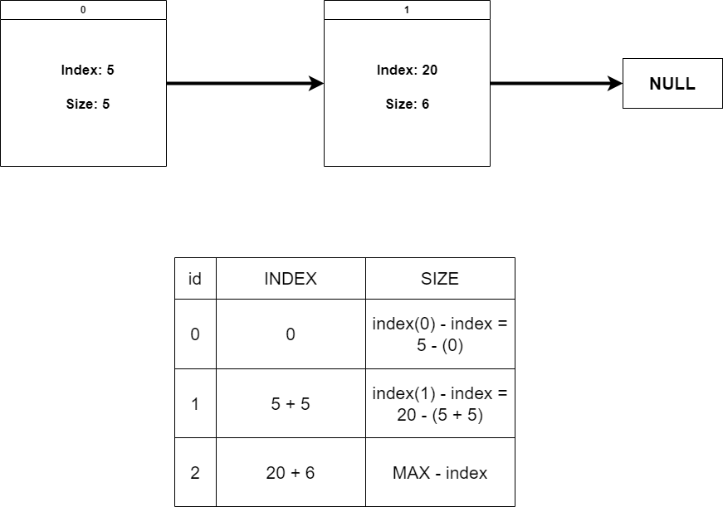
Last Case

Slide 22
THANKS

