Slide 1

FFT Project
Mohamed Adel Abdelrahem Ahmed
mhmdadel344@gmail.com
01129411207
8/14/2025
Eng. Omar Fahmy

Slide 2
Introduction – Design Phases
System modeling using MATLAB.
RTL design.
RTL verification.
ASIC implementation using (OpenLane).
We will go through the System modeling and RTL design , simple RTL verification , start of the ASIC.

Slide 3
Overview of FFT
It’s “fast fourier transform” an algorithm that computes the discrete fourier transform “DFT” of a sequence , or its inverse.
A fourier transform converts a signal from its original domain to a representation in the frequency domain and vice versa.
FFT manages to reduce the complexity of computing the DFT from O(n^2) to O(nxlog n ) where n is the data size.
we will implement 8-point FFT.
Architecture used is iterative (one butterfly reused across time steps) , and in-place (reuse the same memory for updates).
The input/outputs is bit-reversed
Radix-2 mean the input size N must be of power 2.
the algorithm recursively splits the signal into even and odd indexed parts ,compute FFT of both , and combines using twiddle factors.

Slide 4
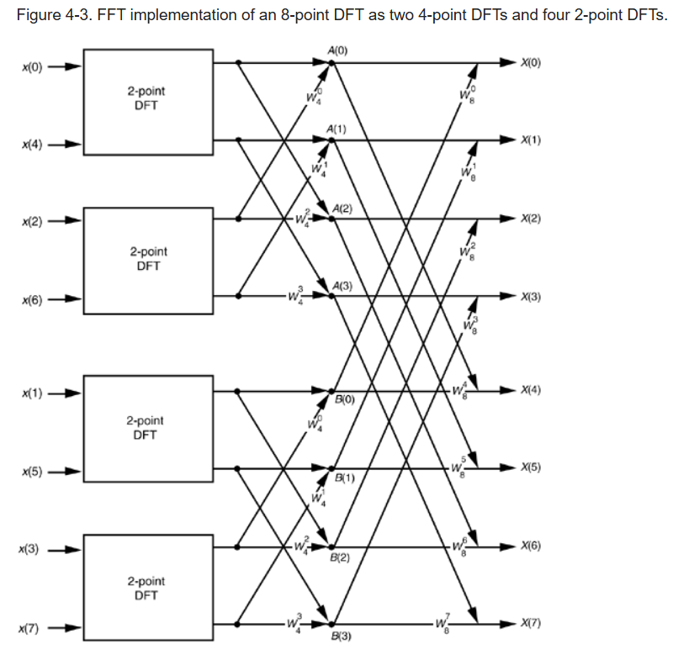
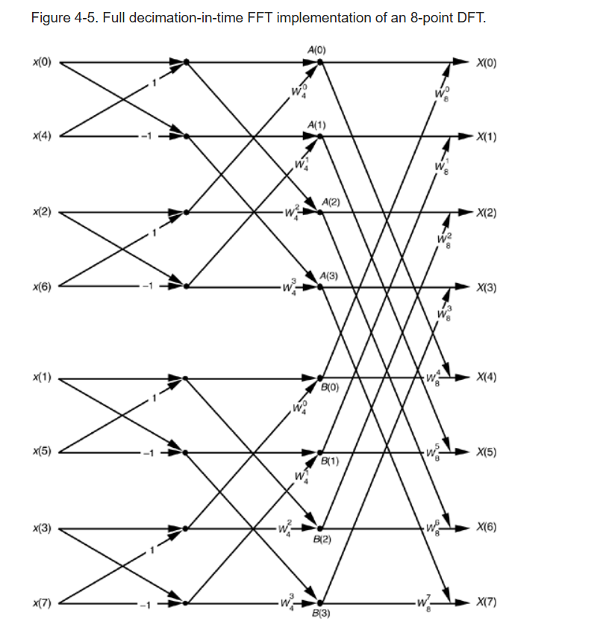
Overview of butterfly
We can replace the 2-point DFT with a butterfly

Slide 5


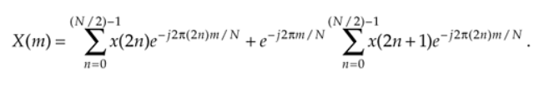

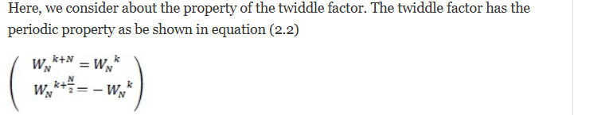
Overview of Twiddle Factor
W_{N}^{m}=e^{-j2pi(m/N)}
DERIVATION OF THE RADIX-2 FFT ALGORITHM | Chapter Four. The Fast Fourier Transform

Slide 6
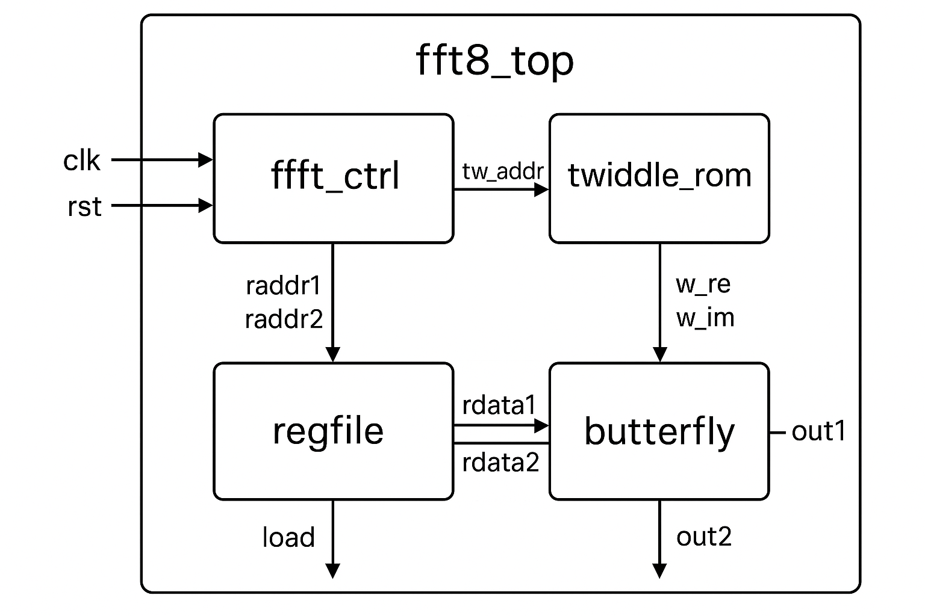
Block diagram
N=8 , W=12 , F=8
fft_ctrl is FSM that control the flow of the design
butterfly block of the 2-point DFT
-twiddle_rom
contain twiddles
factor values
-regfile have the
mem that store
the input and
rewrite the out
values

Slide 7
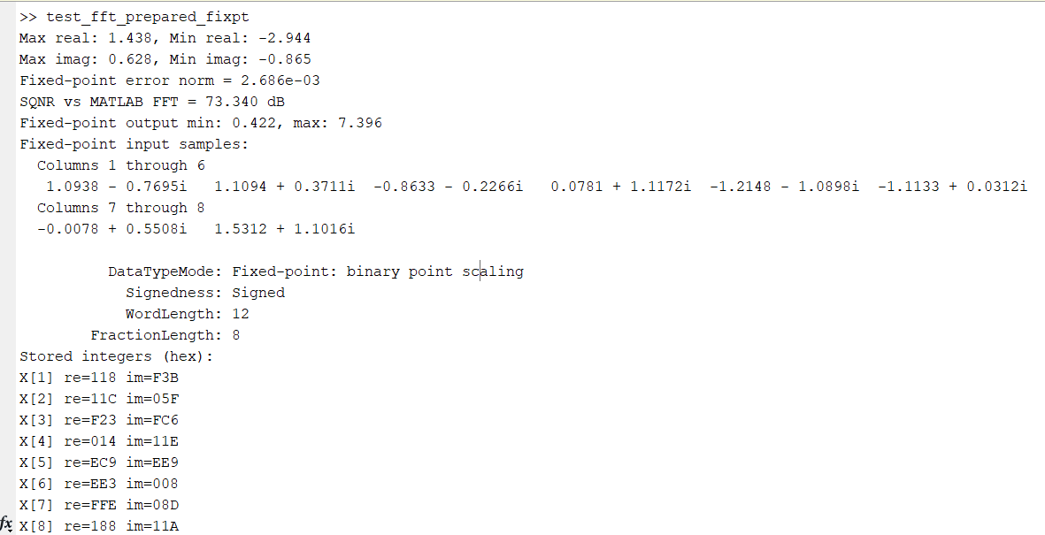
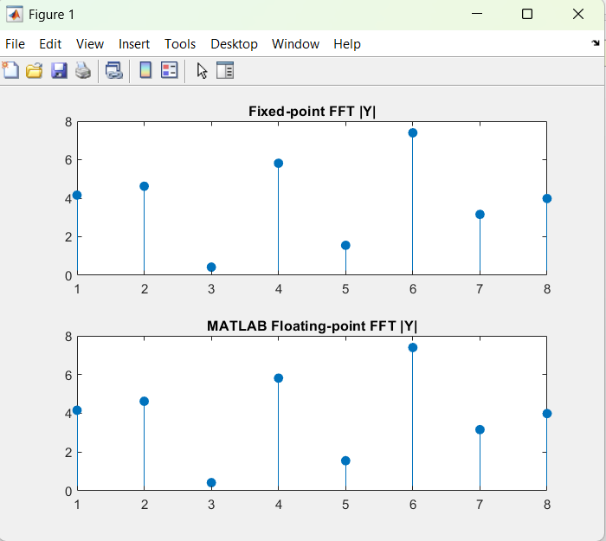
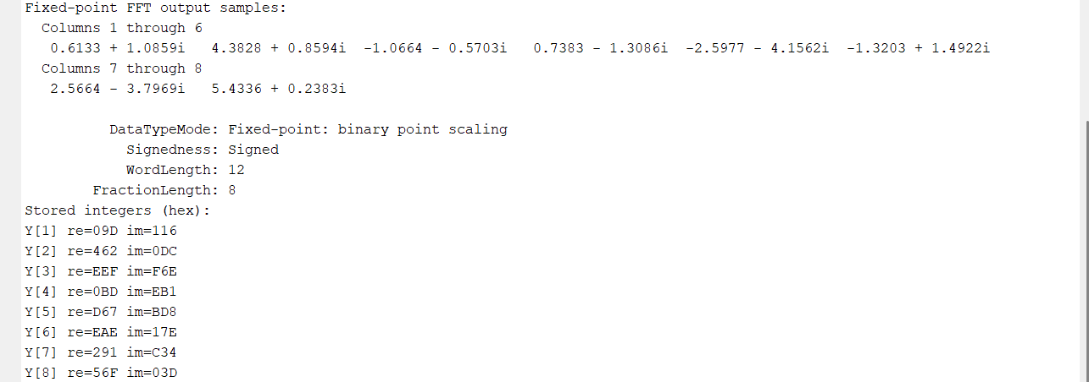
MATLAB

Slide 8
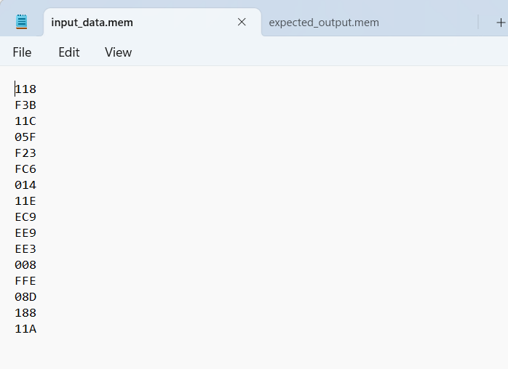
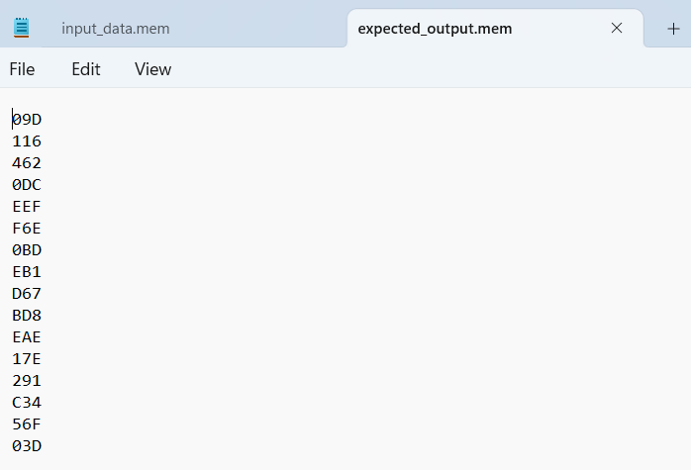
Input/output files
They will be sent to the testbench

Slide 9
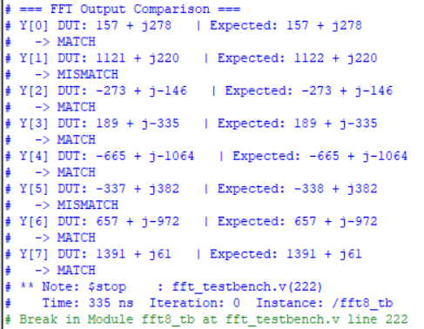
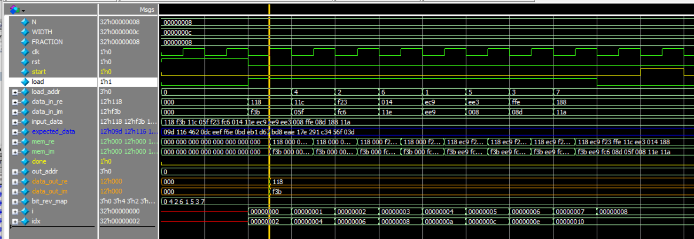
Questasim
For this result easily divide it by 256 to be in
form of Q4.8 just like matlab
Wave form loading inputs
It took 8 cycles

Slide 10
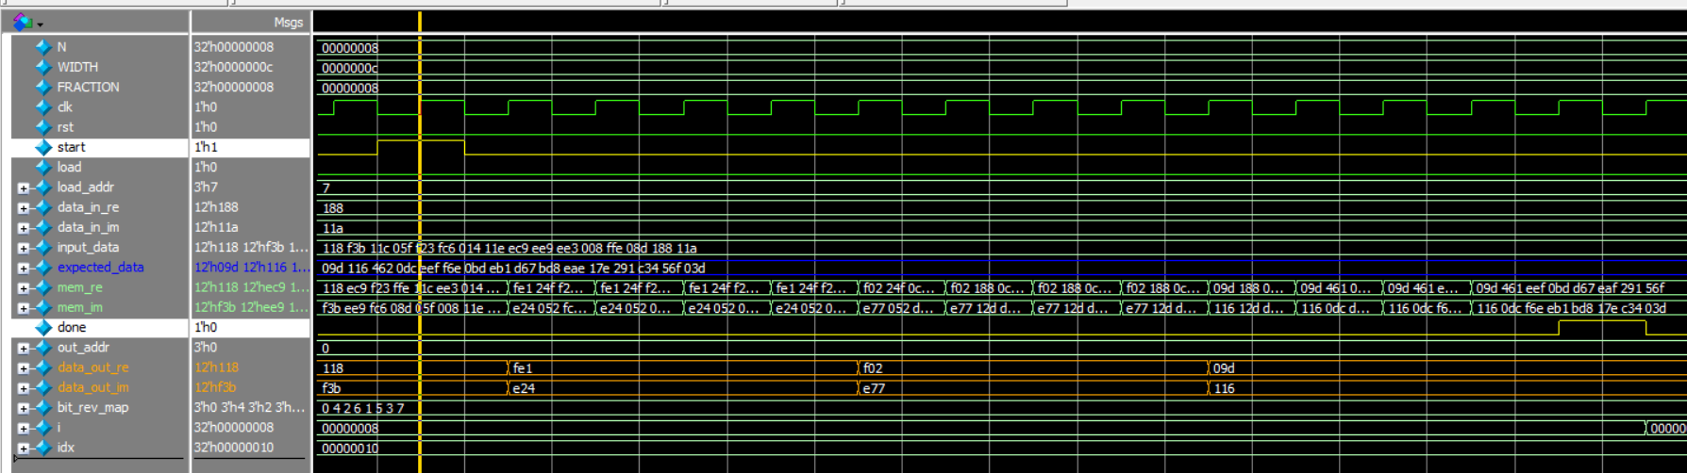
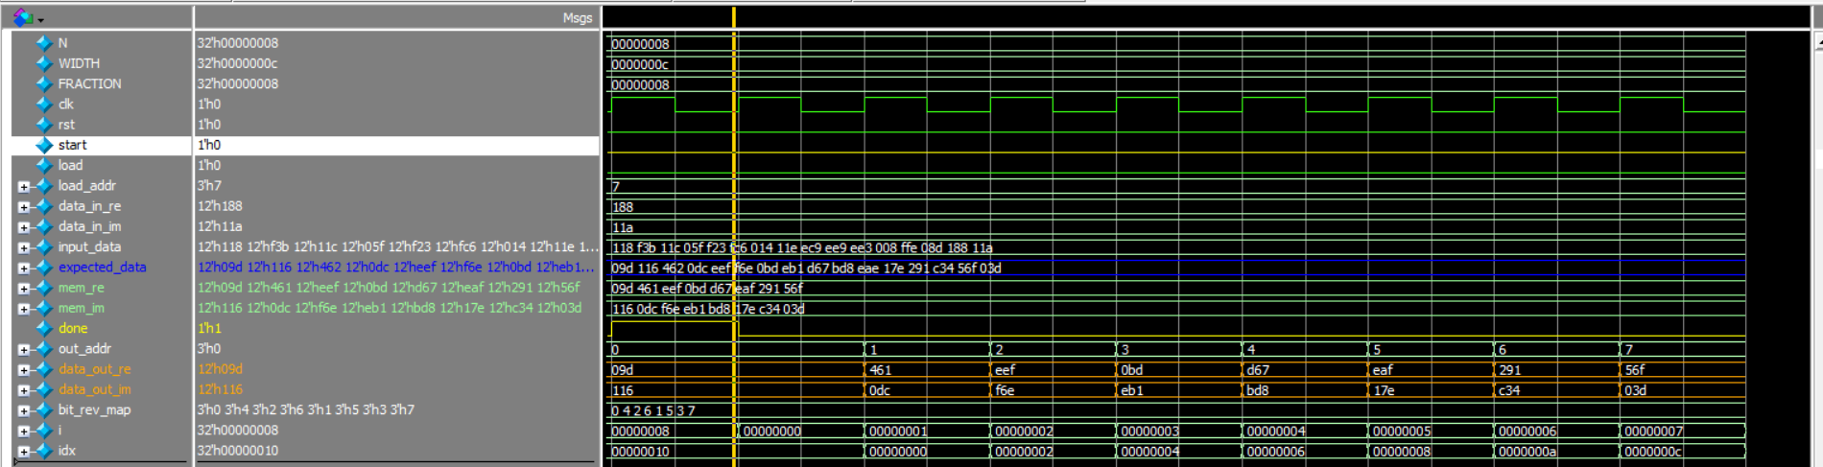
Questasim
Calculation phase & Output printing

Slide 11
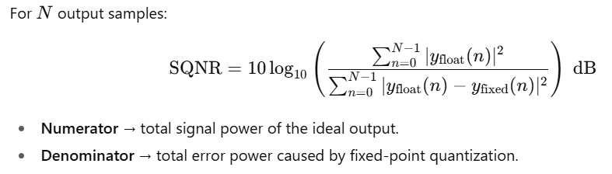
Latency from the previous slide
Latency = 9 cycles from all inputs loaded to the first output sample.
And = 12 cycles from all inputs loaded “start=1” to “done=1” all outputs calculated.
If we need it from the first input sample before start=1 the we will add 8 cycles since the inputs is loaded in 8-cycles.
Notes on SQNR
For higher sqnr it is more better
For my model in matlab the avg sqnr approx. =70dB for single run
But when I tried 10 or 50 or 100 it drop down to 38,40dB and 70 is perfect and between 30…60dB is accepted in most DSP blocks , but below 30dB is recognized easily.

Slide 12
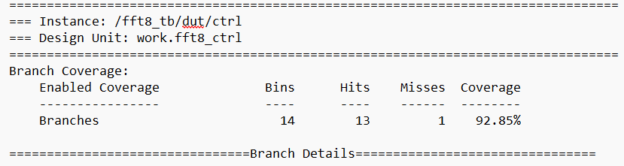
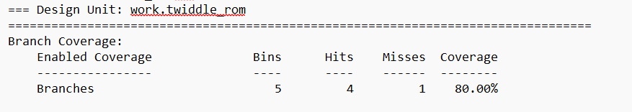
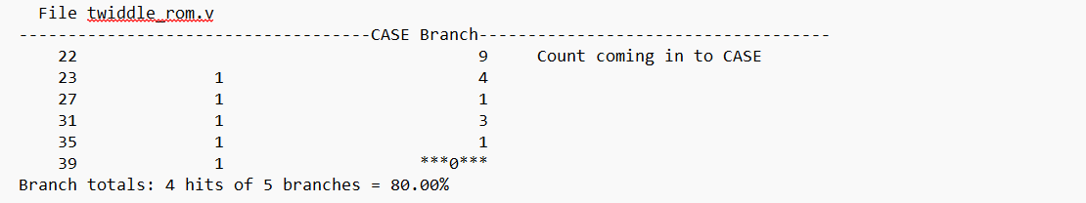
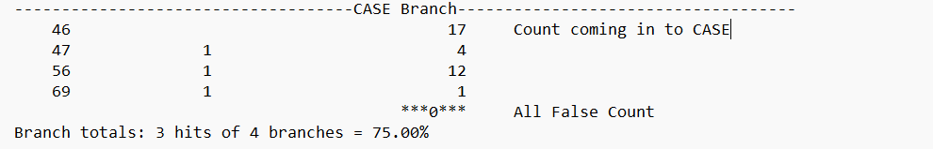
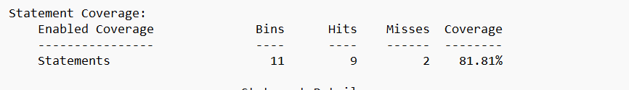
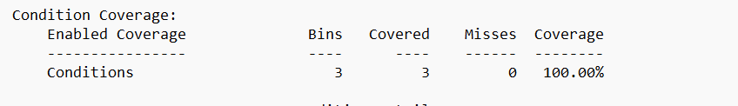
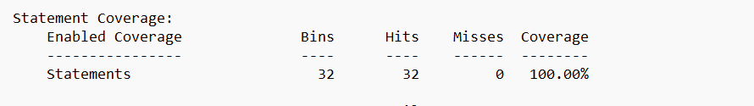
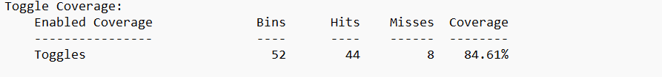
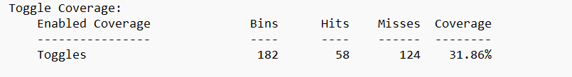
Coverage Report

Slide 13
