Slide 1
BERT with LORA: Enhancing Fine-tuning of Large Language Models
Mohamed Ahmed Ibrahim : 22101115
Abd El Rahman Marey : 22101325

Slide 2
Introduction
Communication is central to human connection.
NLP advancements improve language understanding.
Challenge: Fine-tuning large models is expensive.
Exploring efficient fine-tuning with LORA.

Slide 3
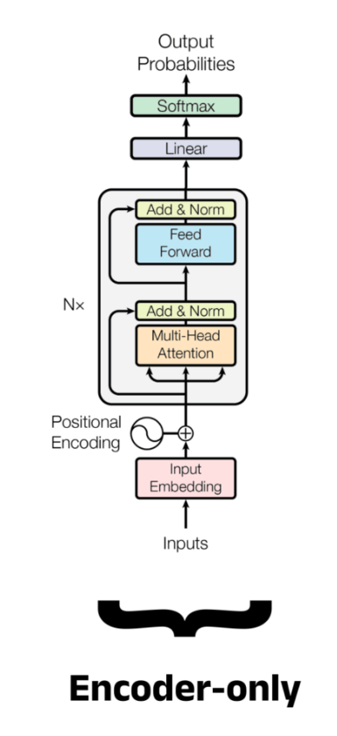
What is BERT?
Bidirectional Encoder Representations from Transformers (BERT) .
Developed by Google (2019).
Techniques: Masked Language Modeling (MLM) & Next Sentence Prediction (NSP).
Captures bidirectional context better than RNNs, LSTMs.

Slide 4
Problem with Traditional Fine-tuning
Updates all model parameters.
High memory and computational cost.
Not scalable for very large models.

Slide 5
Introducing LoRA
Low-Rank Adaptation (LORA) .
Freeze original model weights.
Insert small, trainable low-rank linear layers.
Benefits:
- Fewer trainable parameters.
- Maintains or improves performance.

Slide 6
Applying LoRA to BERT
Add LORA layers to:
- Key
- Query
- Value
Later expanded to all linear layers.

Slide 7
Hyperparameter Tuning
Adjusted parameters:
- Rank of LORA layers.
- Learning Rate.
Higher ranks and more LORA layers improved results.

Slide 8
Experimental Results
Tasks:
- Sentiment Analysis
- Paraphrase Detection
- Semantic Textual Similarity (STS)
Significant memory and runtime reductions.

Slide 9
Traditional vs. LoRA Fine-tuning
features | Traditional Fine-tuning | LORA Fine-tuning
Trainable Parameters | High | Low
Memory Requirements | High | Much Lower
Training Speed | Slower | Faster
Performance | Strong | Comparable or Better

Slide 10
Conclusion
LORA enables efficient, scalable fine-tuning.
Reduces computational costs.
Future work: Optimize LORA for various NLP tasks.

