Slide 1
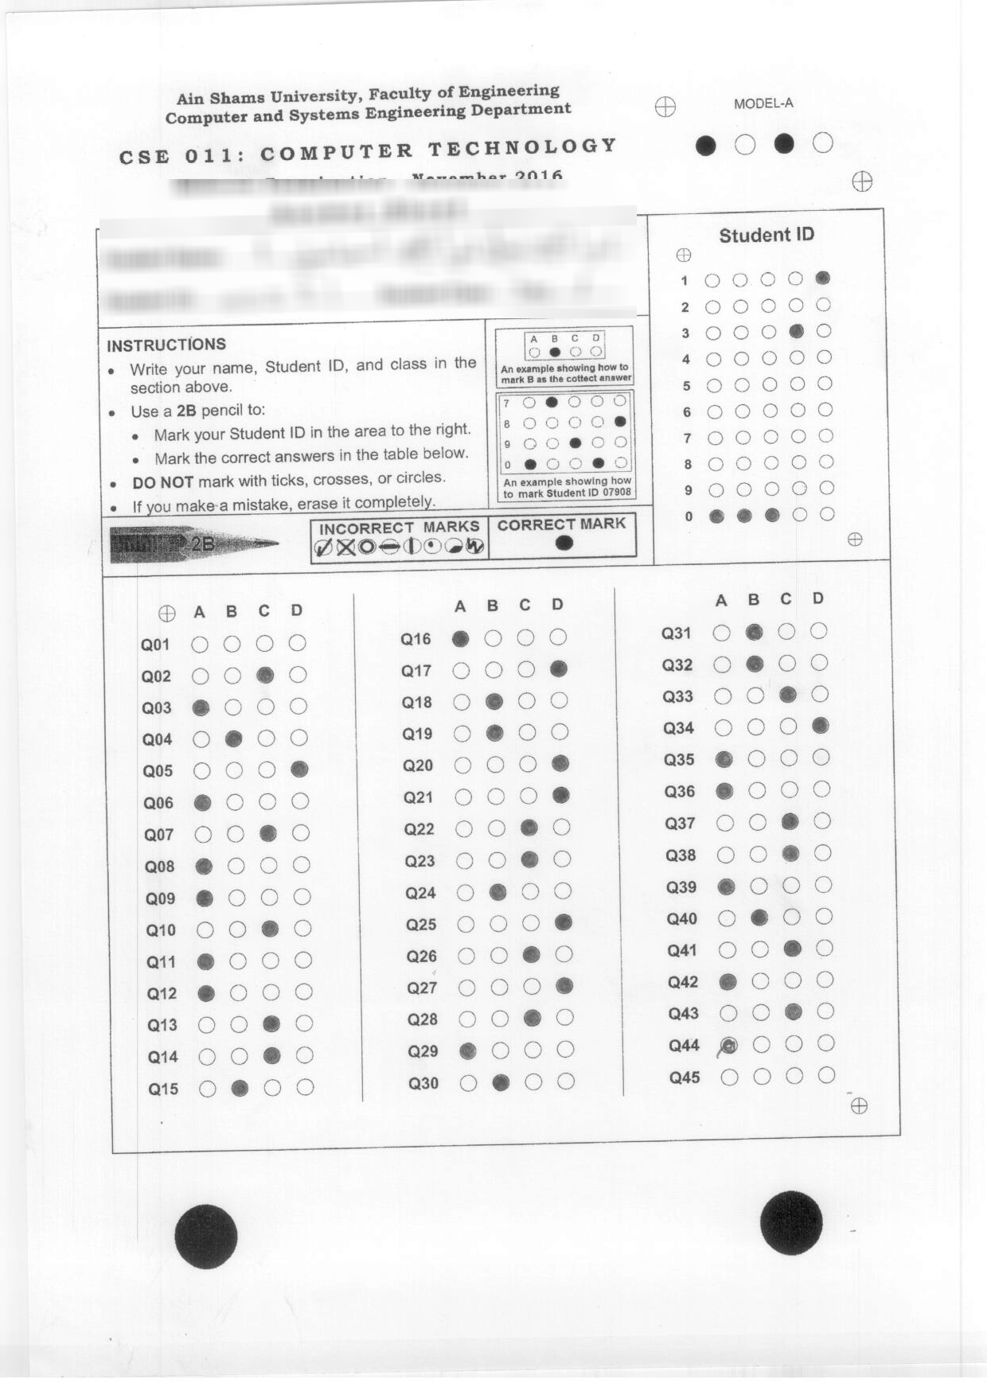
For each image

Slide 2
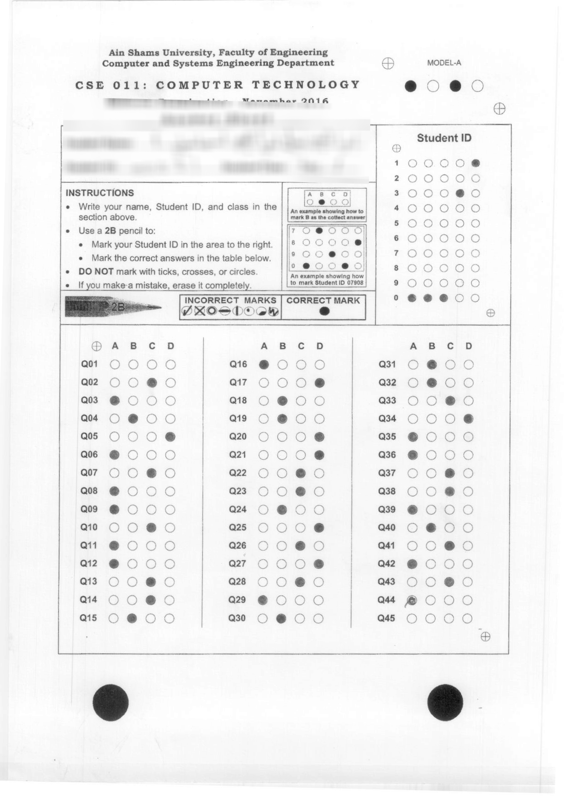
1) Rotate

Slide 3
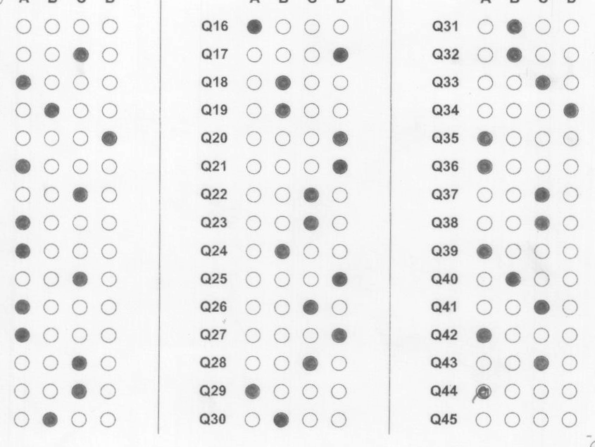
2) Crop

Slide 4
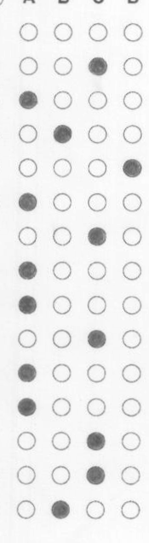
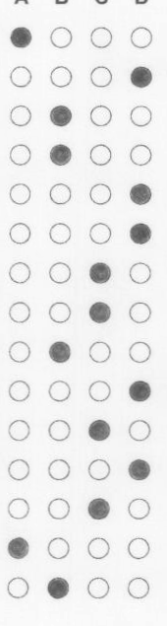
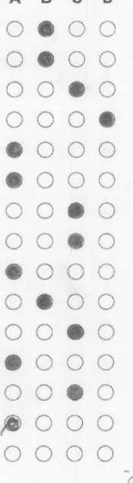
3) Divide into cols

Slide 5



4) Threshold each col

Slide 6



5) Erode

Slide 7
6) Compare
total = sum(counts)
max_count = max(counts)
max_idx = counts.index(max_count)
if total>0 and
1.0*max_count/total > 0.6 and max_count>50:
return max_idx

Slide 8

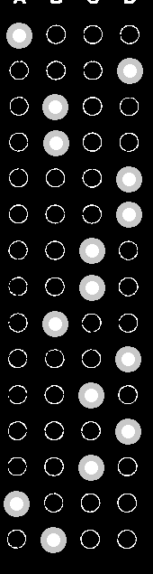
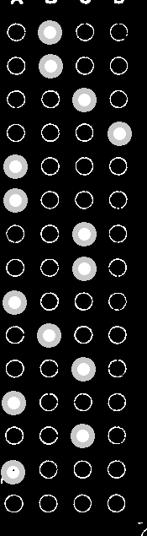
7) Evaluate

