Slide 1
AI-Powered Internal Tool Builder

Slide 2
Vision, Architecture & Value Proposition

Slide 3
The Goal
“Enable non-technical employees to build functional internal tools using natural language, without writing code.”

Slide 4
The Challenge
Traditional app development requires: - Technical expertise (HTML, CSS, JavaScript) - Development cycles (days to weeks) - IT involvement for every small tool
Result: Simple internal tools (calculators, dashboards, trackers) either don’t get built, or take weeks to deliver.

Slide 5
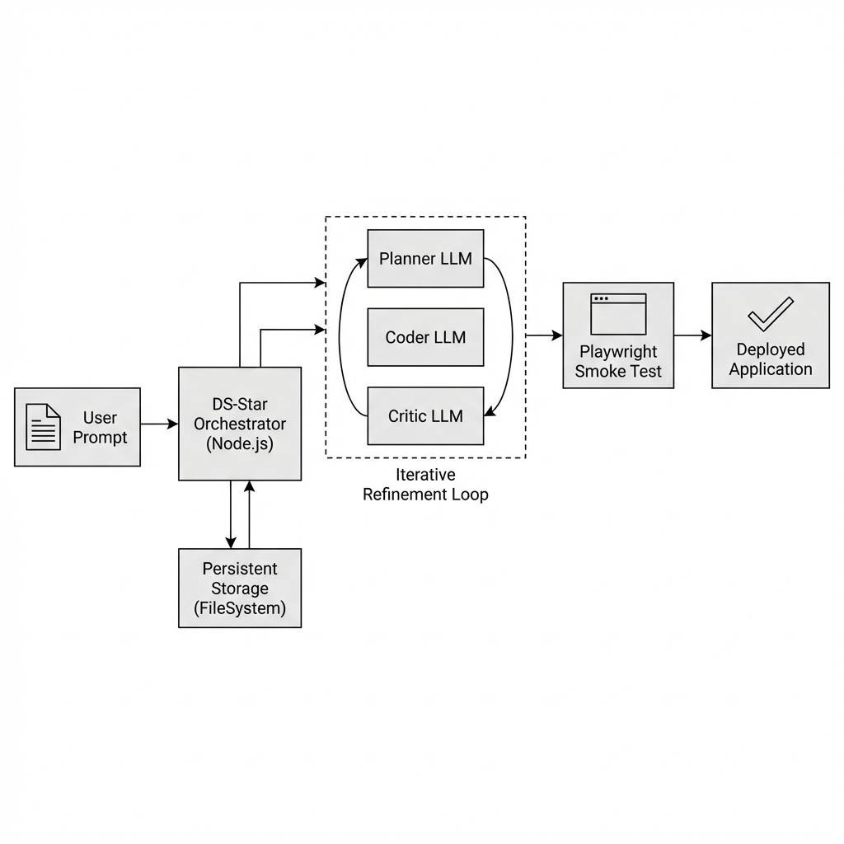
The Vision: From Prompt to Product
A user types: “Create an inventory tracker for my department”
Within minutes, they receive a working, tested, deployable application.
Architecture Diagram

Slide 6
Live Demo
🚀 Try it now: https://geappliances-ai-tool-prototype.onrender.com

Slide 7
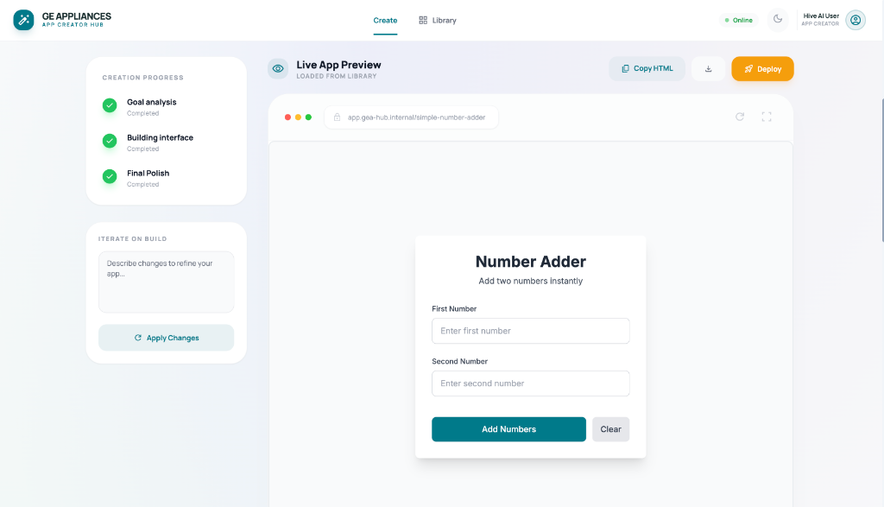
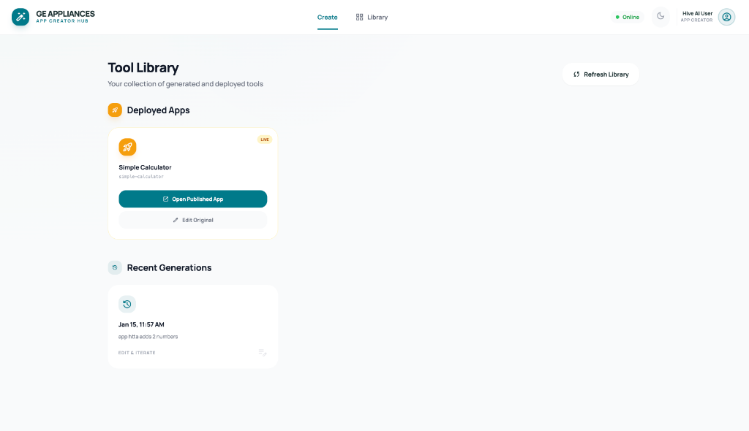
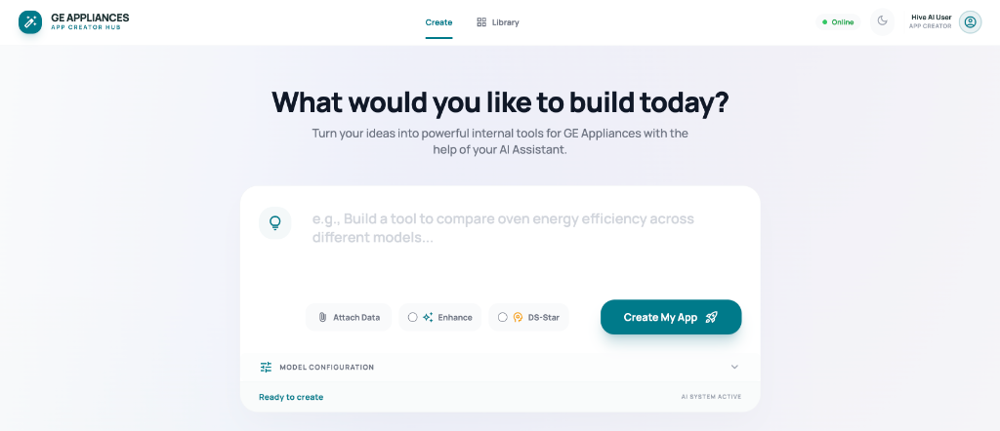
The User Interface
Live Preview: Watch Your App Come to Life
Library: Manage Your Deployed Tools
Home: Describe What You Want to Build
Home Screen
Live Preview
Tool Library

Slide 8
Core Architecture Principles
1. Multi-Agent Collaboration
Three specialized LLM agents work together: | Agent | Role | |——-|——| | Planner | Translates user intent into structured requirements | | Coder | Generates complete, functional HTML/CSS/JS | | Critic | Reviews output for security, completeness, and quality |
2. Iterative Self-Correction
Unlike single-shot generation: - Code is tested automatically using browser automation - Failures produce specific error messages fed back to the LLM - System iterates until the code actually works
3. Secure by Design
Generated apps run in a sandboxed environment
No access to external APIs or databases
All AI calls and data storage go through controlled runtime helpers

Slide 9
What Makes This Different?
Traditional Code Gen | DS-Star Pipeline
Generates code, hopes it works | Generates, tests, fixes until it works
Single LLM call | Multiple specialized agents
No validation | Playwright-based smoke tests
Static output | Self-correcting loop

Slide 10
Expected Outcomes
For Business Users
Hours → Minutes: Build tools in the time it takes to describe them
No Dependencies: Don’t wait for IT to build simple dashboards
Iterate Quickly: Refine with natural language
For IT/Engineering
Reduced Ticket Volume: Fewer requests for basic internal tools
Guardrails Built-In: Security policies enforced automatically
Audit Trail: Every generation logged with full history
For the Organization
Democratized Development: Anyone can create tools
Standardized Output: Consistent, branded, secure applications
Knowledge Capture: Tools can be deployed and shared

Slide 11
Use Cases
Operations: Inventory trackers, scheduling tools, status dashboards
Finance: Calculators, report generators, data visualizers
HR: Survey tools, onboarding checklists, training trackers
Engineering: Data explorers, log analyzers, internal utilities

Slide 12
Technical Differentiators
┌─────────────────────────────────────────────────────┐
│ ITERATIVE REFINEMENT │
│ │
│ Prompt → Plan → Code → Critique → Test → Deploy │
│ ↑ │ │
│ └────── Fix & Retry ←────┘ │
│ │
└─────────────────────────────────────────────────────┘
Accumulated Error Memory: Past failures inform future iterations
Structured Error Feedback: LLM receives actionable fix instructions
Runtime Helpers: Built-in AI and storage APIs for generated apps

Slide 13
Challenges & Considerations
Aspect | Current State
Simple tools (calculators, forms) | ✅ Works well
Data visualization | ⚠️ Requires iteration
Complex workflows | ❌ May need manual intervention
Production-ready apps | ⚠️ Needs human review
Security Risks
Prompt Injection: Malicious prompts could attempt to generate harmful code
Data Exposure: Generated apps must not access sensitive internal systems without proper auth
Code Execution: Even sandboxed apps carry risk if sandbox is bypassed
Mitigations: CSP headers, forbidden API blocking, runtime proxies, code scanning
Reliability Concerns
LLM Hallucinations: Generated code may appear correct but contain subtle bugs
Non-Determinism: Same prompt can produce different results across runs
Complex Requirements: Multi-step workflows may exceed single-page app capabilities
Mitigations: Automated smoke testing, iterative correction, human review before deployment
Current Limitations
No Database Access: Apps can only use local storage via runtime helpers
Single-Page Only: Cannot generate multi-file or backend applications
Styling Constraints: Output quality depends on LLM’s understanding of design
Honest Assessment

Slide 14
Summary
Aspect | Value
Speed | Minutes, not weeks
Quality | Tested and validated before delivery
Security | Sandboxed, no external access
Scalability | Self-serve for all employees
Flexibility | Iterate with natural language

Slide 15
Built with the DS-Star Iterative Pipeline

