Slide 1





HOISTING
CLOSURE
JavaScript
LECTURE THREE

Slide 2





HOISTING IN JAVASCRIPT
Hoisting: Makes some types of variables accessible/usable in the code before they are actually declared. “Variables lifted to the top of their scope”.
EXECUTION CONTEXT
Scope chain
this keyword
Variable environment
BEHIND THE SCENES
Before execution, code is scanned for variable declarations, and for each variable, a new property is created in the variable environment object.
HOISTED?
INITIAL VALUE
function declarations
YES
Actual function
var variables
YES
undefined
Technically, yes. But not in practice
let and const variables
NO
<uninitialized>, TDZ
function expressions and arrows
Depends if using var or let/const
Temporal Dead Zone

Slide 3
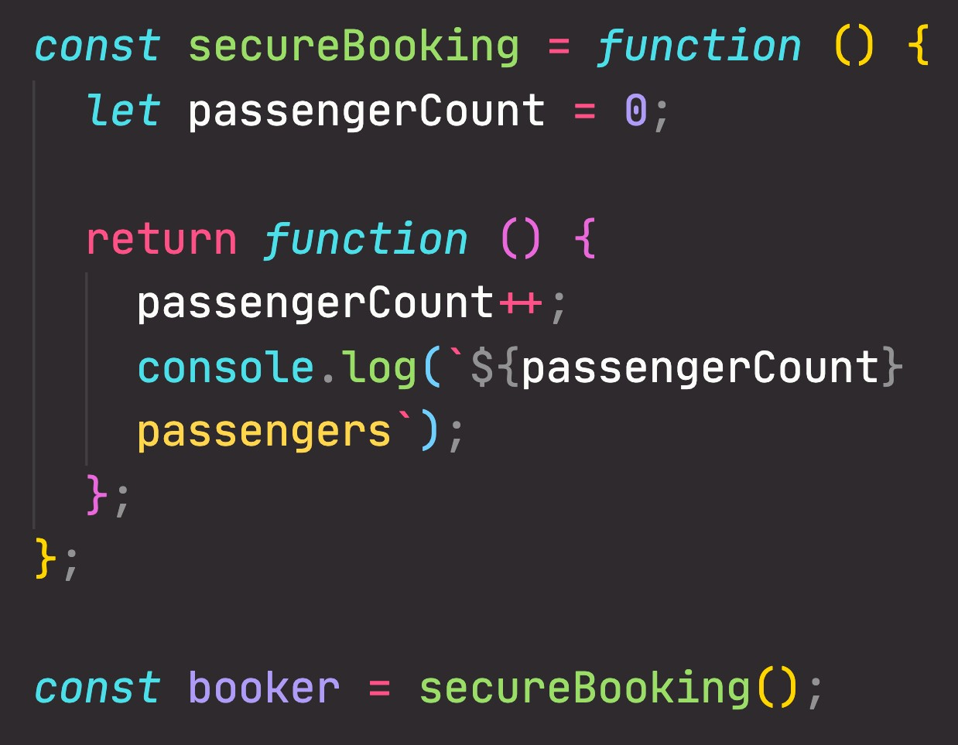
“CREATING” A CLOSURE
Global scope
secureBooking = <f>
booker = <f>
Variable Environment
secureBooking() scope
passengerCount = 0
secureBooking = <f> booker = <f>
secureBooking() EC
passengerCount = 0
Global EC
secureBooking = <f>
booker = <f>
CALL STACK
Order in which functions were called
Order in which functions are written in the code
SCOPE CHAIN

Slide 4
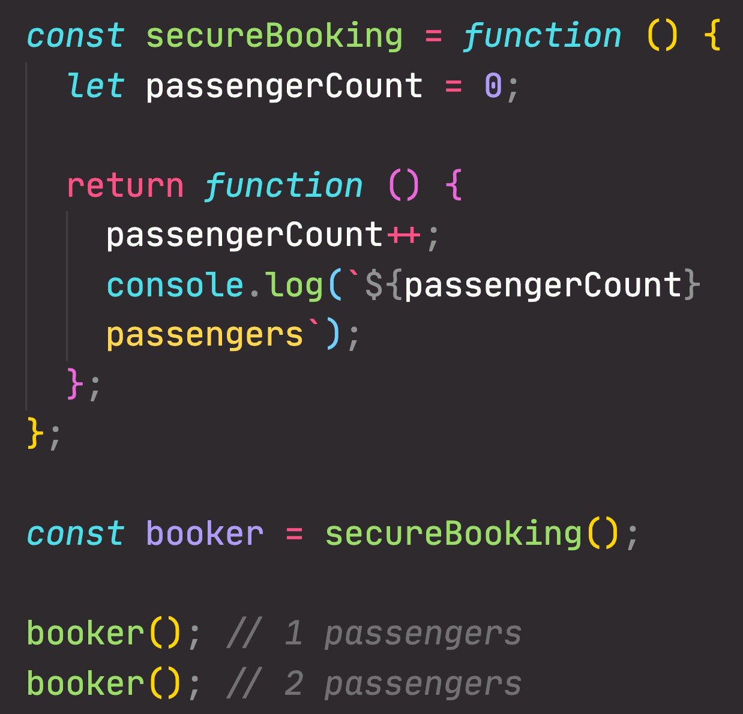

UNDERSTANDING CLOSURES
secureBooking() EC
passengerCount = 0
Variable Environment of Execution Context in which booker was created
passengerCount = 0
Global scope
secureBooking = <f>
booker = <f>
secureBooking() scope
passengerCount = 0
secureBooking = <f> booker = <f>
booker() EC
<empty>
This is the function
booker() scope
<empty>
secureBooking = <f> booker = <f>
Global EC
secureBooking = <f>
booker = <f>
CALL STACK
How to access
passengerCount?
SCOPE CHAIN

Slide 5
UNDERSTANDING CLOSURES
A function has access to the variable environment (VE) of the execution context in which it was created
Closure: VE attached to the function, exactly as it was at the time and place the function was created
Global scope
secureBooking = <f>
booker = <f>
secureBooking() scope
passengerCount = 0
secureBooking = <f> booker = <f>
(Priority over scope chain)
CLOSURE
booker() EC
<empty>
This is the function
booker() scope
<empty>
secureBooking = <f> booker = <f>
Global EC
01
secureBooking = <f>
booker = <f>
passengerCount = 2
CALL STACK
How to access
passengerCount?
SCOPE CHAIN

Slide 6


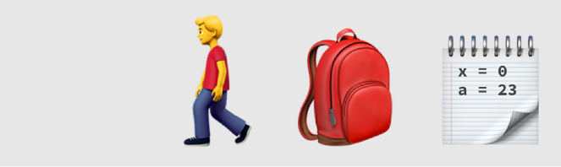

CLOSURES SUMMARY
A closure is the closed-over variable environment of the execution context in which a function was created, even after that execution context is gone;
Less formal
A closure gives a function access to all the variables of its parent function, even after that parent function has returned. The function keeps a reference to its outer scope, which preserves the scope chain throughout time.
Less formal
A closure makes sure that a function doesn’t loose connection to variables that existed at the function’s birth place;
Less formal
Function Connection Parent scope Variables
A closure is like a backpack that a function carries around wherever it goes. This backpack has all the variables that were present in the environment where the function was created.
Function
Closure
Variables
We do NOT have to manually create closures, this is a JavaScript feature that happens automatically. We can’t even access closed-over variables explicitly. A closure is NOT a tangible JavaScript object.

Slide 7
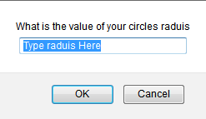
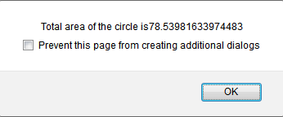
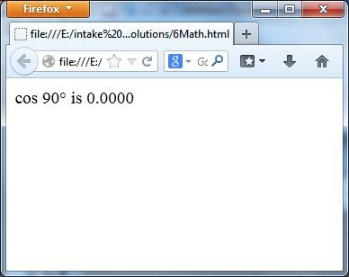
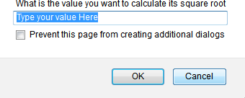
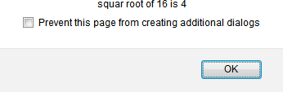
TASKS
1. Write a script that ask the user to
Enter the value of a circle’s radius in order to calculate its area as
shown in fig.
Enter an angle to calculate its cos value then display the output as shown in Fig.
Enter another value to calculate its square root and alert the result as shown in fig.

Slide 8
TASKS
2. Create array that contain some tips about JavaScript (Array of 10 strings, each string is tip about JS), and show random tip for the user each time he opens the page "Tip of the day".
3. Create an array of objects that hold student name along with his degree (Each element of the array is an object has 2 properties: Name and Degree).
Find student Name, who got degree between 90 and 100 [Use find()].
Print students names, who got a degree less than 60 [Use filter()].
Add a new student to the array [Use push()],()], and then use for…in to print all elements of the array.
Remove the last student of the array [Use pop()], and then use for…of to print all elements of the array.
Sort the array alphabetically based on the student name.
Use splice() function to add 2 new students after the second element of the array [Bonus].
Use splice() function to remove 1 student after the third element in the array [Bonus].

Slide 9
TASKS
4. Show prompt that ask user to enter his birth date and tell user to enter the date in the following format (DD – MM – YYYY) ex. 22–01–1999, and then create function that take user input as a parameter and ensure that the string is entered in this format (that user entered string is 10 characters and contains (-) after the second character and after fifth character).[Don't use RegExp, use string functions].
If the user input was correct: make the function create new date object, and initialize it with Day, Month, year values (using date constructor: Date(y,m,d)) and then show alert to the user with the date in date string format.
If user input wasn't correct, show alert saying "Wong Date Format".

