Slide 1





JavaScript
Data Types
LECTURE TWO

Slide 2



WHICH ARRAY METHOD TO USE?
“I WANT...:”
To mutate original array
Add to original:
A new array
An array index
Know if array includes
To transform to value
Computed from original:
Based on value:
Based on value:
Based on accumulator:
.push
(end)
.map
(loop)
.indexOf
.includes
.reduce
.unshift
(start)
(Boil down array to single value of any type: number, string, boolean, or even new array or object)
Filtered using condition:
Based on test condition:
Based on test condition:
.filter
.findIndex
.some
Remove from original:
.pop
(end)
.every
Portion of original:
.shift
(start)
.slice
.splice
(any)
An array element
Based on test condition:
A new string
Based on separator string:
To just loop array
Based on callback:
Adding original to other:
Others:
.concat
.reverse
.find
.join
.forEach
Flattening the original:
.sort
(Does not create a new array, just loops over it)
.flat
.fill
.flatMap

Slide 3
TASKS
1. Create an array that hold the following students grades : 60, 100,10,15,85, and handle the following:
Sort the array numerically descending.
Using the sorted Array find the highest student degree (first degree less than or equal to 100) [Use find()].
Print the grades of all students with grades below 60 [Use filter()].

Slide 4
Tasks
3. On your page, show alert for the user that say “Welcome to my site”, then show him prompt ask him to enter his name and write to the page “ welcome + his name”. (Remark what happen to the home page after writing welcome page).
5. On contact page prompt user to enter his name, make sure that name is string, and let the user enter his birth year and make sure that it is a number, and it is less than 2010, and then calculate his age. For each prompt if user input valid show him next prompt, if not valid show him the same prompt again until user enters it correctly (use loops). And after validating user input, write all user input on the page in that format:
Name: ahmed
Birth year: 1981
Age: 30
4. Ask the user to enter his Email, and use function strings (Don’t use RegExp) to check if the Email contains @, and not in the first or last index.

Slide 5
Tasks
6. Prompt user to enter his Full Name and email address, and use regular expression only (don't use string functions) to validate his input to make sure it is in correct format using these criteria:
Full Name should be characters only (without numbers or special characters) and has the following structure:
Characters (alphabetic only) more than 3.
Then one space.
And finally some other characters (alphabetic only) more than 3
This pattern may be repeated, so it can contain other spaces but after each space must be 3 alphabetic characters at least (like full name, each part is 3 letters at least, and separated by a space).
And shouldn’t start or end with spaces or special characters.
Email must be from Egypt (.eg domain), for example name@domain.com.eg (.com.eg, .net.eg, .edu.eg or .org.eg [.eg is a must], don’t allow any other domains).
Make the prompt appear to the user for each of the inputs until he enters correct format (Repeat the prompt for each wrong input of each one until he enters it correctly).

Slide 6
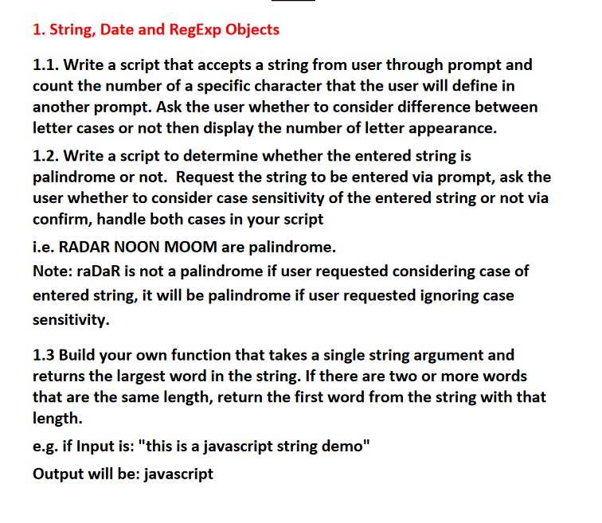
TASKS “BONUS”

