Slide 1
Normalization
Lecturer: Rana Salah
rsalah@mcit.gov.eg
Room:3005
Made by:
Shahinaz S. Azab
Edited by:
Mona Saleh

Slide 2
What is Normalization?
Normalization of data- a process that takes a table through a series of tests (normal forms) to certify the goodness of a design and thus to minimize redundancy and anomalies (insert, update, delete anomalies)
Notes:
database design may be performed using two approaches: bottom-up or top-down.
A bottom-up design methodology considers the basic relationships among individual attributes as the starting point and uses those to construct relation schemas (tables). This approach is not very popular in practice.
A top-down design methodology Perform a conceptual schema design using a conceptual model such as ER and map the conceptual design into a set of relations.
Normalization plays only a limited role in database schema design if a top-down modeling approach like the entity- relationship approach is used.
Normalization however plays a major role when the bottom-up approach is being used. Normalization is then essential to build appropriate relations to hold the information of the enterprise.

Slide 3
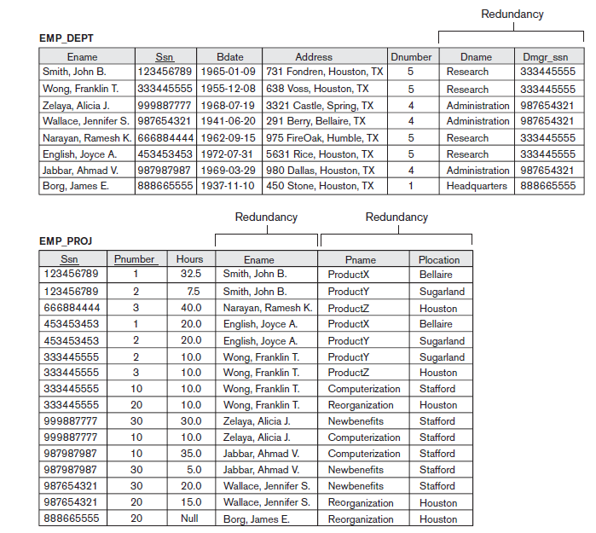
Why do we need Normalization?
Notes:
Four informal guidelines that may be used as measures to determine the quality of relation schema design:
Making sure that the semantics of the attributes is clear in the schema
Reducing the redundant information in tuples
Reducing the NULL values in tuples
Disallowing the possibility of generating spurious tuples
Guideline 1- Do not combine attributes from multiple entity types and relationship types into a single relation
Guideline 2- Design the base relation schemas so that no insertion, deletion, or modification anomalies are present in the relations
Guideline 3- As far as possible, avoid placing attributes in a base relation whose values may frequently be NULL
Guideline 4- Avoid relations that contain matching attributes that are not (foreign key, primary key) combinations because joining on such attributes may produce spurious tuples

Slide 4
Normalization Avoids
Duplication of Data
Insert Anomaly
Delete Anomaly
Update Anomaly
Frequent Null Values
Notes:
Normalization avoids:
Duplication of Data – The same data is listed in multiple lines of the database
Insert Anomaly – A record about an entity cannot be inserted into the table without first inserting information about another entity – Cannot enter a department without an employee
Delete Anomaly – A record cannot be deleted without deleting a record about a related entity. If we delete from EMP_DEPT an employee tuple that happens to represent the last employee working for a particular department, the information concerning that department is lost from the database.
Update Anomaly – Cannot update information without changing information in many places. To update department information, it must be updated for each employee working in this department.
Using frequent Null values: Attributes that are NULL frequently could be placed in separate relations (with the primary key)

Slide 5
When to use Normalization?
To certify the goodness of a relational schema design
When acquiring existing database design from previous legacy models, or from existing files
Notes:
Most practical design projects acquire existing designs of databases from previous designs, designs in legacy models, or from existing files. Normalization is carried out in practice so that the resulting designs are of high quality and meet these desirable properties:
minimizing redundancy
minimizing the insertion, deletion, and update anomalies

Slide 6
Functional Dependency
A constraint between two attributes (columns) or two sets of columns
A 🡪 B if “for every valid instance of A, that value of A uniquely determines the value of B”
Or …A 🡪B if “there exists at most one value of B for every value of A”
Notes:
Functional dependencies (FDs) are used to specify formal measures of the "goodness" of relational designs
FDs and keys are used to define normal forms for relations
FDs are constraints that are derived from the meaning and interrelationships of the data attributes
A set of attributes A functionally determines a set of attributes B if the value of A determines a unique value for B

Slide 7
Examples
Social security number determines employee name
SSN -> ENAME
Project number determines project name and location
PNUMBER -> {PNAME, PLOCATION}
Employee SSN and project number determines the hours per week that the employee works on the project
{SSN, PNUMBER} -> HOURS
So functional dependency is the technical term for determines

Slide 8
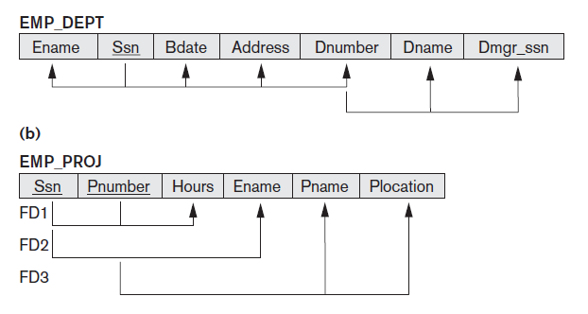
Types of Functional Dependency
FD4
FD5
Notes:
FD1 and FD4 are Full Functional Dependency
FD2 and FD3 are Partial Functional Dependency
FD5 is Transitive Functional Dependency

Slide 9
Types of Functional Dependency
Full Functional Dependency- X → Y is a FFD if removal of any attribute A from X means that the dependency does not hold any more
Partial Functional Dependency- X→Y is a PFD if some attribute A ε X can be removed from X and the dependency still holds
Transitive Functional Dependency- X→Y in a relation R is a TFD if there exists a set of attributes Z in R that is neither a primary key nor a subset of any key of R, and both X→Z and Z→Y hold

Slide 10
Definition
Normalization: The process of decomposing unsatisfactory "bad" relations by breaking up their attributes into smaller relations
Normal form: Condition using keys and FDs of a relation to certify whether a relation schema is in a particular normal form
Notes:
Normalization is carried out in practice so that the resulting designs are of high quality and meet the desirable properties
The practical utility of these normal forms becomes questionable when the constraints on which they are based are hard to understand or to detect
The database designers need not normalize to the highest possible normal form. (usually up to 3NF, BCNF or 4NF)
Denormalization: the process of storing the join of higher normal form relations as a base relation—which is in a lower normal form

Slide 11
First Normal Form
A relation is in 1NF if it contains no multivalued, repeating groups or composite attributes
To put a relation in 1NF
Remove each repeating group and place it in a new table carrying the PK as a FK
Remove each multivalued attribute and place it in a new table carrying the PK as a FK
Put composite attribute subparts each in a column when necessary
Notes:
1NF- Disallows composite attributes, multivalued attributes, and nested relations (relations within relations); attributes whose values for an individual tuple are non-atomic considered to be part of the definition of relation. It states that the domain of an attribute must include only atomic (simple, indivisible) values
Repeating groups are nested relations (i.e. set of multivalued columns that are related to each other)

Slide 12
School Example
Stud_ID | Name | Location | Tel | Level | Level_Mgr | Subject | Subj-Desc | G
11 | Ali | Cairo | 010 | Primary | Noha M. | DB, CN | Database, Networks | A,B
22 | Mai | Giza | 011, 010 | Primary | Noha M | CN, DB | Networks, Database | B, C
33 | Marwa | Giza | 010 | Secon. | Moh.A. | SW, DB | Software, Database | A, A
Notes:
1NF
(Stud_ID, Name, Loc, Level, Level_Mgr)
(Stud_ID, Tel)
(Stud_ID, Subject, Subj_desc, Grade)
2NF
(Stud_ID, Name, Loc, Level, Level_Mgr)
(Stud_ID, Tel)
(Stud_ID, Subject, Grade)
(Subject, Subj_desc)
3NF
(Stud_ID, Name, Loc, Level)
(Level, Level_Mgr)
(Stud_ID, Tel)
(Stud_ID, Subject, Grade)
(Subject, Subj_desc)

Slide 13
School Example 1NF
Stud_ID | Name | Location | Level | Level_Mgr
Stud_ID | Tel
Stud_ID | Subject | Subject_Desc | Grade

Slide 14
Second Normal Form
A relation is in 2NF if it is in 1NF and every nonkey
attribute is not partially dependent on the primary key
To put a relation in 2NF
Remove partial functional dependent non-keys carrying the key they depend on and place them in a new table

Slide 15
Guidelines
A relation is in 2NF if it is in 1NF and any one of these is true:
the PK consists of only 1 attribute
all attributes are part of the PK (no nonkey attributes)
every non key attribute is functionally dependent on the whole PK

Slide 16
School Example 2NF
Stud_ID | Name | Location | Level | Level_Mgr
Stud_ID | Tel
Stud_ID | Subject | Grade
Subject | Subject_Desc

Slide 17
Third Normal Form
A relation is in 3NF if it is in 2NF and no transitive dependencies exist
To put a relation in 3NF
Remove the nonkey attributes carrying the nonkey attribute they depend on and place them in a new table. (Hint: leave the nonkey they depend on in the same table as well)

Slide 18
School Example 3NF
Student
Stud_ID | Name | Location | Level
Level
Level | Level_Mgr
Student_Tel
Stud_ID | Tel
Stud_Subject
Stud_ID | Subject | Grade
Subject
Subject | Subject_Desc

Slide 19
ITI Example
ITI Students Sheet
Student Number: ITI205-40
Student Name: Hassan Ali Ahmed
Address(Street, City): 12 Haram st, giza
Tel no/Mobile: 33868420
01111111253
F-code: ENG
Faculty: Engineering
Major: Computer
Department Name | Department Description | Admission grade | Comments
ERP-SAP | ERP-SAP Functional Consultant | 59 | Average personality
Java -MAD | Java mobile applications developer | 70 | Very Good
CS | Cyber Security | 60 | Above average technical

Slide 20
1NF
Student (Stud_No,Stud_Name, F-code, Faculty, Major, Street, City)
Student_Tel (Stud_No, Tel_No)
Department_Student (Dept_Name, Stud_No, Dept_desc , Ad_Grade, Comments)

Slide 21
2NF
Student (Stud_No,Stud_Name, F-code, Faculty, Major, Street, City)
Student_Tel (Stud_No, Tel_No)
Department_Student (Dept_Name, Stud_No, Ad_Grade, Comments)
Department ( Dept_Name, Dept_Desc)

Slide 22
3NF
Student (Stud_No,Stud_Name, F-code,Major, Street, City)
Faculty (F-code, Faculty)
Student_Tel (Stud_No, Tel_No)
Department_Student (Dept_Name, Stud_No, Ad_Grade, Comments)
Department ( Dept_Name, Dept_Desc)

Slide 23
Real World - School Data
Student
First | Parent 1 | Parent 2 | Application No
Renee | Ann Jones | Theodore Smith | 123
Lucy | Barbara Mills | Steve Mills | 558
Brendan | Jennifer Jones | Stephen Jones | 145 | …
City | Postal Code | Birth date | Previous Teacher | Current Teacher
Annandale | 22003 | 6/25/1983 | Hamil | Burke
Annandale | 22003 | 8/14/1983 | Hamil | Burke
Fairfax | 22032 | 6/13/1984 | Hamil | Burke
Student_Phone | Course | Course-desc | Enrolled | Attended/ days
(703) 323-0893, (703) 3240708 | X,Y,Z | X,y,z | 96/97, 96/97, 97/98 | 0,0,0
(703) 764-5829 | Y | Y | 96/97 | 0
(703) 978-1083 | Z | Z | 96/97 | 0
Notes:
0NF
Student (App_No, Stud_Fname, Parent1, Parent2, City, Postal_Code, Birthdate, Prev_Teacher, Curr_Teacher, Student_Phone, Course, Course_Desc, Enrolled, Att_Days)
1NF
Student (App_No, Stud_Fname, Parent1, Parent2, City, Postal_Code, Birthdate, Prev_Teacher, Curr_Teacher)
Student_Course (App_No,Course, Course_Desc, Enrolled, Att_Days)
Student_Phone ( App_No,Phone)
2NF
Student (App_No, Stud_Fname, Parent1, Parent2, City, Postal_Code, Birthdate, Prev_Teacher, Curr_Teacher)
Student_Course (App_No,Course, Enrolled, Att_Days)
Student_Phone ( App_No,Phone)
Course (Course, Course_Desc)
3NF
Student (App_No, Stud_Fname, Parent1, Parent2, Postal_Code, Birthdate, Prev_Teacher, Curr_Teacher)
Student_Course (App_No,Course, Enrolled, Att_Days)
Student_Phone ( App_No,Phone)
Course (Course, Course_Desc)
City (City, Postal_Code)

Slide 24
ONF
Student (App_No, Stud_Fname, Parent1, Parent2, City, Postal_Code, Birthdate, Prev_Teacher, Curr_Teacher, Student_Phone, Course, Course_Desc, Enrolled, Att_Days)

Slide 25
1NF
Student (App_No, Stud_Fname, Parent1, Parent2, City, Postal_Code, Birthdate, Prev_Teacher, Curr_Teacher)
Student_Course (App_No,Course, Course_Desc, Enrolled, Att_Days)
Student_Phone ( App_No,Phone)

Slide 26
2NF
Student (App_No, Stud_Fname, Parent1, Parent2, City, Postal_Code, Birthdate, Prev_Teacher, Curr_Teacher)
Student_Course (App_No,Course, Enrolled, Att_Days)
Student_Phone ( App_No,Phone)
Course (Course, Course_Desc)

Slide 27
3NF
Student (App_No, Stud_Fname, Parent1, Parent2, Postal_Code, Birthdate, Prev_Teacher, Curr_Teacher)
Student_Course (App_No,Course, Enrolled, Att_Days)
Student_Phone ( App_No,Phone)
Course (Course, Course_Desc)
City (City, Postal_Code)

Slide 28
Suppliers Data
Relation (s#, country, currency, p#, qty)
where
s# supplier identification number (this is the primary key)
country name of country where supplier is located
currency: Currency of the country of each supplier
p# part number of part supplied
qty quantity of parts supplied to date
In order to uniquely associate quantity supplied (qty) with part (p#) and supplier (s#), a composite primary key composed of s# and p# is used.
Notes:
1NF
Supplier (S#, country, currency)
Supplier_Parts (S#,P#,qty)
2NF
Applied
3NF
Supplier (S#, Country)
Country (Country, Currency)
Supplier_Parts (S#,P#,qty)

Slide 29
1NF
Supplier (S#, country, currency)
Supplier_Parts (S#,P#,qty)

Slide 30
2NF
Same as First
Supplier (S#, country, currency)
Supplier_Parts (S#,P#,qty)

Slide 31
3NF
Supplier (S#, Country)
Country (Country, Currency)
Supplier_Parts (S#,P#,qty)

Slide 32
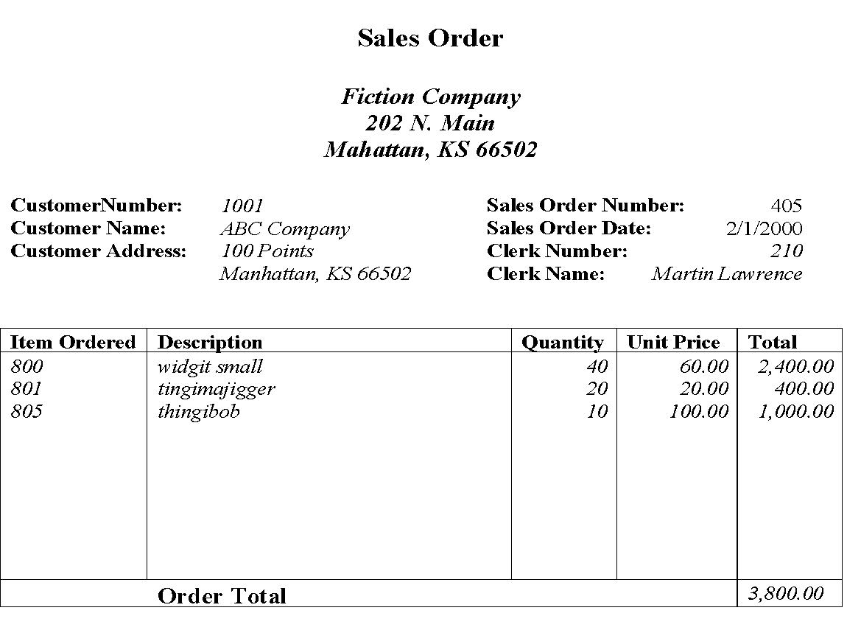

Slide 33
Questions?

