Slide 1
HTML & Css
Day1
ENG. Nawal Zaki Abdelhadi
iTi Staff

Slide 2
Introduction
1

Slide 3


Client Server architecture..

Slide 4
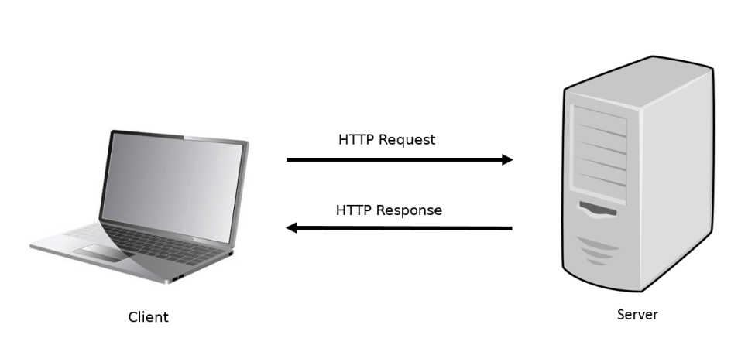
Client side and Server side..

Slide 5
Introduction to HTML
2

Slide 6
HTML is a Hyper-Text Markup Language..

Slide 7

What is HTML ?
HTML is a language for describing web pages.
HTML is not a programming language, it is a markup language.
A markup language is a set of markup tags.
HTML uses markup tags to describe web pages.
HTML is W3C Recommendation.
HTML language isn’t case- sensitive, and doesn’t affect by spaces and line breaks.
HTML is Browser Dependent language.

Slide 8
HTML Versions
HTML
HTML 3.2
XHTML
1991
1995
1997
1999
2000
2014
2000
2014
HTML 2.0
HTML 4.01
HTML 5

Slide 9
HTML Elements
<p>My first paragraph.</p>
<br>
<b>
      <i>
      <p> Welcome </p>
      </i>
</b>
Start Tags and end Tags with
the content
Self Close Tags without
content
HTML elements can be nested

Slide 10
HTML Comments
Comments are not displayed by the browser, but they can help document your HTML source code.
<!-- This is a comment -->
<p>
This is a paragraph.
</p>

Slide 11
HTML Attributes
HTML Elements can have attributes.
Attributes provide additional information about HTML elements.
Attributes usually come in name/value pairs like: name="value“.
<p title="I'm a tooltip">
This is a paragraph.
</p>

Slide 12
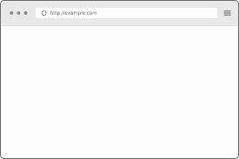
HTML Entities
Reserved characters in HTML must be replaced with character entities.
Entity names are case sensitive.
HTML Entities
Symbols entities reference
<p>Welcome &nbsp; &nbsp; &nbsp; iTi</p>
<p>Welcome iTi</p>
Welcome iTi
Welcome iTi

Slide 13
HTML Colors
In HTML, a color can be specified by using a color name, an RGB value, or a HEX value.
<p style=“color:red”>
Welcome iTi
</p>
Welcome iTi

Slide 14

Let’s Start ….
3

Slide 15
HTML Document structure
<html>
<head>
<title>A Simple Document</title>
</head>
<body>
<p>Page content</p>
</body>
</html>
Head Tag <head></head>
Body Tag <body></body>

Slide 16
HTML Document structure…..
A Simple Document
Let’s Try it …
Page content

Slide 17
Head Section…
Title Tag: Define Web Page’s title
My Page
<head>
<title>My page </title>
</head>

Slide 18
Head Section…
Meta Tags: used to store information usually relevant to browsers and search engines.
<head>
<meta charset="UTF-8">
<meta name="description" content="Free Web tutorials">
<meta name="keywords" content="HTML,CSS,XML,JavaScript">
<meta http-equiv="refresh" content="30;URL='http://www.iti.gov.eg/'">
<meta name="viewport" content="width=device-width, initial-scale=1">
<meta http-equiv="refresh" content="30;URL='http://www.iti.gov.eg/'">
</head>

Slide 19
Meta tags…
Keywords: Define Keywords for search engines.
<head>
<meta name=“keywords” content=“HTML , CSS , JavaScript”>
</head>
Description: Define Description for your web page.
<head>
<meta name=“description” content=“Free web for HTML”>
</head>

Slide 20
Meta tags…
Author: Define author of page.
<head>
<meta name=“author” content=“John Doe”>
</head>
Refresh: Refresh document every 30 seconds.
<head>
<meta http-equiv=“refresh” content=“30”>
</head>

Slide 21
Meta tags…
Viewport: setting the viewport to make your website responsive
<head>
<meta name=“viewport” content=“width=device-width initial-scale=1.0”>
</head>
Charset: To display an HTML page correctly, a web browser must know which character set (character encoding) to use.
<head>
<meta charset=“UTF-8”>
</head>

Slide 22

Self Study
Meta tags and SEO

Slide 23
Body Section…
<body bgcolor=“Red” link="blue">
<h1>hi</h1>
</body>
Attributes of Body Tag (All are deprecated attributes, use CSS instead):
1)link 2)vlink 3)alink
4)Bgcolor 5)Background
6)Topmargin / leftmargin / bottommargin / rightmargino

Slide 24
HTML Headings
<h1>Welcome</h1>
<h2>Welcome</h2>
<h3>Welcome</h3>
<h4>Welcome</h4>
<h5>Welcome</h5>
<h6>Welcome</h6>
Welcome
Welcome
Welcome
Welcome
Welcome
Welcome

Slide 25
HTML Text and Paragraphs
<p>This is Paragraph</p>
<p> This is
Paragraph </p>
<p> This is <br> <!– new line-->
Paragraph </p>
This is Paragraph
This is Paragraph
This is
Paragraph

Slide 26
HTML Blocks
<div style=“border:1px solid red”>
div1
<h1>I’m Div1</h1>
</div>
<div> div2</div>
<span style=“border:1px solid red“>span 1</span>
<span style=“border:1px solid red “>span 2</span>
div1
I’m Div1
div2
span 1 span 2

Slide 27
Block & Inline Elements
Block-level Elements:
A block-level element always starts on a new line and takes up the full width available (stretches out to the left and right as far as it can).
Examples of block-level elements: <div>, <h1> - <h6>, <p>, <form>.
Inline Elements:
An inline element does not start on a new line and only takes up as much width as necessary.
Examples of inline elements: <span>, <a>, <img>

Slide 28
Text Formatting Elements
<b>text</b> | writes text as bold
<strong> text </strong> | Important text
<i>text</i> | writes text in italics
<em> text </em> | Emphasized text
<u>text</u> | writes underlined text (Deprecated)
<sub>text</sub> | lowers text and makes it smaller
<sup>text</sup> | lifts text and makes it smaller
<del>text</del> | strikes a line through the text

Slide 29
Text Formatting Elements
<small> text </small> | Define Smaller text than the container
<mark> text </mark> | Marked or highlighted text
<font> text </font> | Defines font size, name and color (Deprecated).
<center>text</center> | Show the text on Center (Deprecated).

Slide 30
HTML Styles
<body style="background-color:red;">
<h1 style="color:blue;">This is a heading</h1>
<h2 style="text-align:center;">Centered Heading</h2>
<p style="font-family:courier; font-size:16">This is a paragraph.</p>
</body>
This is a heading
Centered Heading
This is a paragraph

Slide 31
HTML Images
<!-- Image from a website-->
<img src="http://www.iti.gov.eg/logo.gif">
<!-- Local Image-->
<img src="/images/logo.gif">
<img src="logo.gif">
<img src="../logo.gif">
<!-- Resizing Image-->
<img src=“logo.gif" width="60" height="60">
<img src=“logo.gif" width="50%" height="60%">
<!-- Alternative Text-->
<img src=“logo.gif" alt="image Not Found">
Image not load
Search Engine

Slide 32
HTML Links
<!—First, define bookmark using id attribute -->
<h2 id="tips">Useful Tips Section</h2>
<!-- Then add link to it-->
<a href="#tips">Go to Page Top</a>
<!-- When you link to anchors on external pages use this syntax -->
<a href="http://www.iti.gov.eg/rules/rules.htm#Section_a">Rules - Section a </a>

Slide 33
HTML Links “Target”
_blank : Opens the linked document in a new window or tab
_self :Opens the linked document in the same window/tab as it was clicked (this is default)
_parent : Opens the linked document in the parent frame
_top : Opens the linked document in the full body of the window
framename : Opens the linked document in a named frame
<a href="http://www.iti.gov.eg" target="_blank">ITI Website</a>

Slide 34
HTML Links
Image Link
<a href="myfile.htm"><img src="rainbow.gif"></a>
Link to Email
<a href="mailto:email@hotmail.com">Send Mail</a>
<a href="mailto:email@hotmail.com?subject=Hello">Send Email</a>

Slide 35
HTML Lists
Unordered List
<ul>
<li>Networks Dept.</li>
<li>Software Dept.</li>
<li>Multimedia Dept.</li>
</ul>
Network Dept.
Software Dept.
Multimedia Dept.

Slide 36
HTML Lists
Unordered List
<ul style="list-style-type:disc">
<li>Networks Dept.</li>
<li>Software Dept.</li>
<li>Multimedia Dept.</li>
</ul>
Network Dept.
Software Dept.
Multimedia Dept.

Slide 37
HTML Lists
Ordered List
<ol>
<li>Networks Dept.</li>
<li>Software Dept.</li>
<li>Multimedia Dept.</li>
</ol>
Multimedia Dept.
Network Dept.
Software Dept.

Slide 38
HTML Lists
Ordered List
The type attribute of the <ol> tag, defines the type of the list item
marker: type="1“, type="A“, type="a“, type="I“, type="i“.
<ol type="1">
<li>Networks Dept.</li>
<li>Software Dept.</li>
<li>Multimedia Dept.</li>
</ol>
Multimedia Dept.
Network Dept.
Software Dept.

Slide 39
HTML Lists
<ul>
<li>Coffee</li>
<li>Tea
<ul>
<li>Black tea</li>
<li>Green tea</li>
</ul>
</li>
<li>Milk</li>
</ul>
Nested List
Coffee
Tea
Black tea
Green tea
Milk

Slide 40


