Slide 1
Operating System Fundamentals

Slide 2
Table of Content
Overview
Introduction (Lect 1)
Computer System Structure(Lect 2)
Operating System Structure (Lect 2)
Process Management
Processes (Lect 3)
CPU Scheduling (Lect 4)
Deadlocks (Lect 5)
Storage Management
Memory Management (Lect 5)
Virtual Memory (Self Study)
File Management (Self Study)
Introduction to Cloud Computing (Lect 6)

Slide 3
Self Study Topics
Virtual Memory
Background.
Demand Paging.
Page Replacement.
Allocation of frames.
File-System Interface
File Concept.
Access Methods.
Directory Structure.
Protection.

Slide 4
Self Study Topics (cont’d)
File-System Implementation
File System Structure.
Allocation Methods.
Free-Space Management.
Directory Implementation.
Recovery.

Slide 5
Reference
Computer Operating System Concepts
Author: Silberschatz
Publisher: Wiley
ISBN: 0471250600
Handbook of Cloud Computing
Author: Borko Furht, Armando Escalante
Publisher: Springer
ISBN: 978-1-4419-6523-3

Slide 6
Introduction
Chapter One

Slide 7
Table of Content
Operating System
Mainframe Systems
Desktop Systems
Multiprocessor Systems
Distributed Systems
Clustered System
Real -Time Systems
Handheld Systems
Computing Environments

Slide 8
Operating system

Slide 9
Operating System
What is an Operating System?
It acts as an intermediary between a user and his hardware
Operating system objective
Executes users programs
Solves its problems
Uses HW in an efficient manner
Makes user life easier ;)

Slide 10
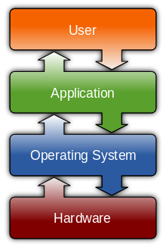
Computer System Components
Notes:
1. Hardware – provides basic computing resources (CPU, memory, I/O devices)
2. Operating system – controls and coordinates the use of the hardware among the various application programs for the various users
3. Applications programs – define the ways in which the system resources are used to solve the computing problems of the users (compilers, database systems, video games, business programs)
4. Users (people, machines, other computers)
Examples of Application:
Compiler
Games
Text editors
Database systems

Slide 11
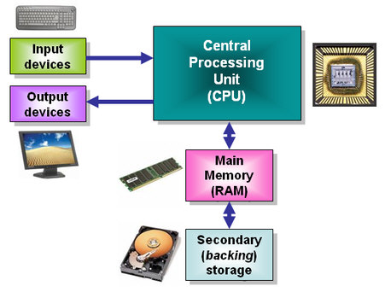
1. Computer Hardware

Slide 12
2. Operating System
It controls and coordinates the use of the HW among the various application programs for the various users
It manages and allocates resources
It controls the execution of user programs and operations of I/O devices
Kernel – the one program running at all times

Slide 13
3. Application Programs
Compilers
Web browsers
Spread sheets
Word processors
…

Slide 14
4. Users
People
Machines
Other Computers

Slide 15
Mainframe Systems

Slide 16
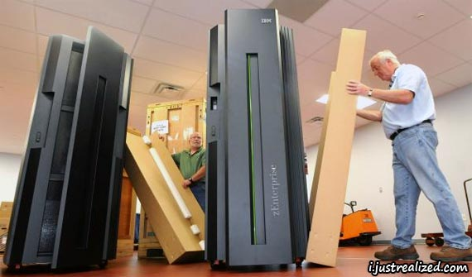
Mainframe Systems
Reduce setup time by batching similar jobs
Automatic job sequencing
Automatically transfers control from one job to another.
First rudimentary operating system

Slide 17
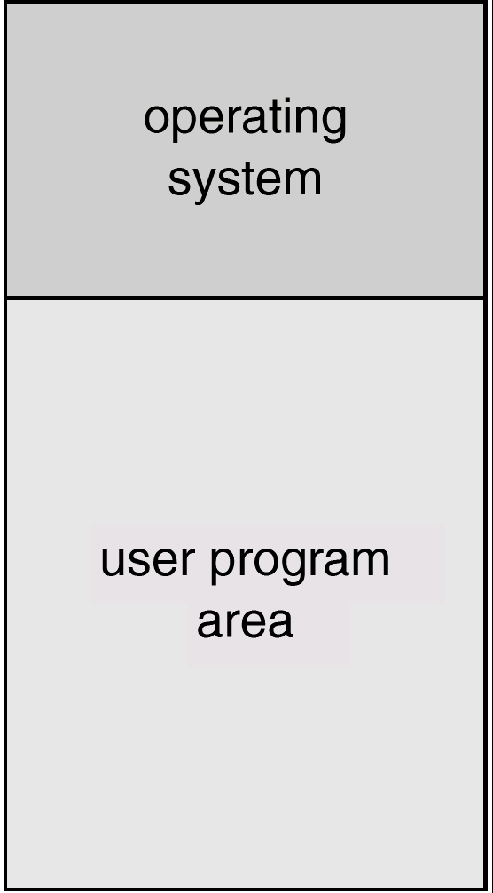
Mainframe Systems Cont’d
Memory Layout for a Simple Batch System

Slide 18
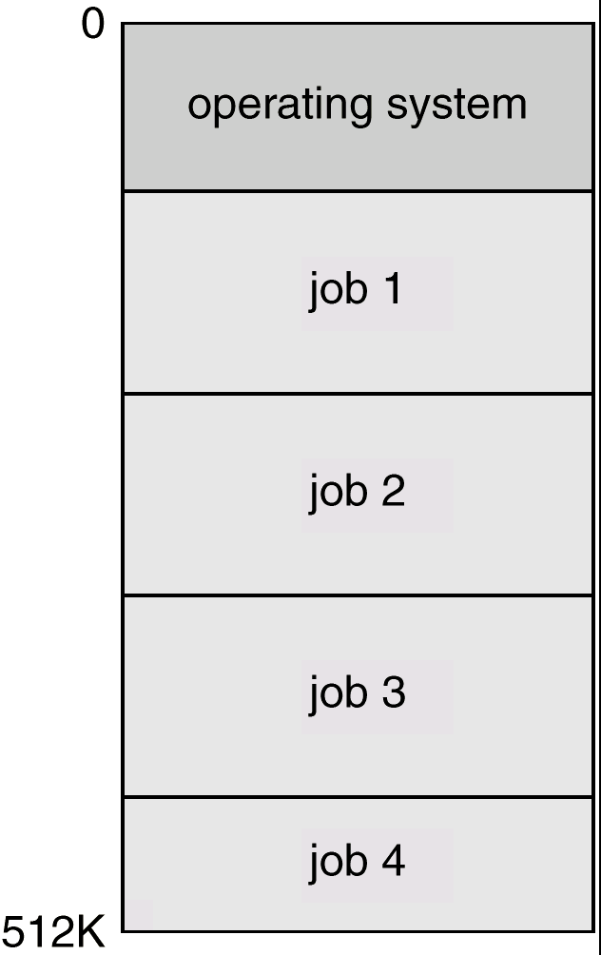
Mainframe Systems Cont’d
Multi-programmed Batch Systems
Several jobs are kept in main memory at the same time, and the CPU is multiplexed among them

Slide 19
Mainframe Systems Cont’d
Time-Sharing Systems (Interactive Computing )
The CPU is multiplexed among several jobs that are kept in memory and on disk
The CPU is allocated to a job only if the job is in memory
A job swapped in and out of memory to the disk
On-line communication between the user and the system is provided
When the operating system finishes the execution of one command, it seeks the next “control statement” from the user’s keyboard
On-line system must be available for users to access data and code

Slide 20
Desktop Systems

Slide 21
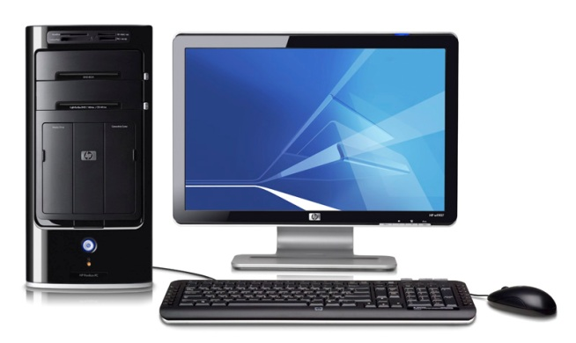
Desktop Systems
Personal computers
Computer system dedicated to a single user
I/O devices
Keyboards
Mice
Display screens
Small printers
User convenience and responsiveness
Can adopt technology developed for larger operating system
Often individuals have sole use of computer and do not need advanced CPU utilization of protection features
May run several different types of operating systems (Windows, MacOS, UNIX, Linux)

Slide 22
Multiprocessor Systems

Slide 23
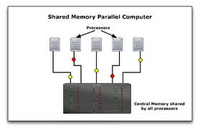
Parallel Systems
Systems with more than one CPU in close communication
Also known as multiprocessor systems
Tightly coupled system
processors share memory and a clock; communication usually takes place through the shared memory
Advantages of parallel system:
Increased throughput
Economical
Increased reliability
graceful degradation
fail-soft systems

Slide 24
Distributed Systems

Slide 25
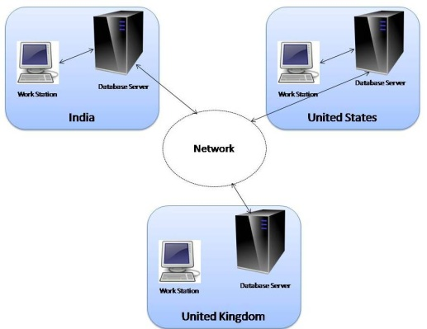
Distributed Systems
Distribute the computation among several physical processors
Loosely coupled system
Each processor has its own local memory
processors communicate with one another through various communications lines, such as high-speed buses or telephone lines
Advantages of distributed systems
Resources Sharing
Computation speed up
load sharing
Reliability

Slide 26
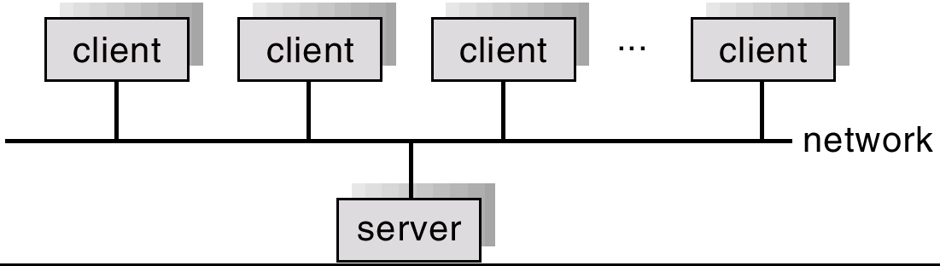
Distributed Systems Cont’d
Requires networking infrastructure
Local area networks (LAN) or Wide area networks (WAN)
May be either client-server or peer-to-peer systems

Slide 27
Clustered Systems

Slide 28
Clustered Systems
Clustering allows two or more systems to share storage
Provides high reliability
Asymmetric clustering: one server runs the application or applications while other servers standby
Symmetric clustering: all N hosts are running the application or applications

Slide 29
Real-Time Systems

Slide 30
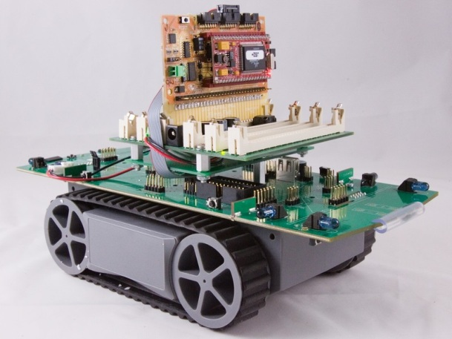
Real-Time Systems
Often used as a control device in a dedicated application such as controlling scientific experiments, medical imaging systems, industrial control systems, and some display systems
Well-defined fixed-time constraints
Real-Time systems may be either hard or soft real-time

Slide 31
Real-Time Systems Cont’d
Hard real-time:
Secondary storage limited or absent, data stored in short term memory, or read-only memory (ROM)
Conflicts with time-sharing systems, not supported by general-purpose operating systems
Soft real-time
Limited utility in industrial control of robotics
Integrate-able with time-share systems
Useful in applications (multimedia, virtual reality) requiring tight response times

Slide 32
Handheld Systems

Slide 33
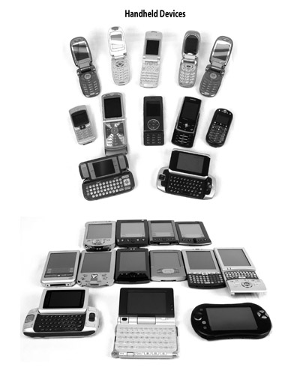
Handheld Systems
Personal Digital Assistants (PDAs)
Cellular Phone & Smart Phone
Issues:
Limited memory
Slow processors
Small display screens

Slide 34
Computing Environments
Traditional computing
PCs, Servers, limited remote access
Web-Based Computing
Client-server and web services, convenient remote access, location-less servers
Embedded Computing
Very limited operating system features
Little or no user interface, remote access

Slide 35

Notes:
35

