Slide 1


Slide 2
Med Care
Doctor Booking Platform
For Your Health Needs

Slide 3
Med Care https://github.com/Ashryz/Med_Care
Mohamed Ahmed Mohamed
Youssef Mohamed
Tarek Ashry Abdehamid
Israa Lotfy Ragab
Hagar Serag Mohamed
Mahmoud Mohamed Mahmoud

Slide 4
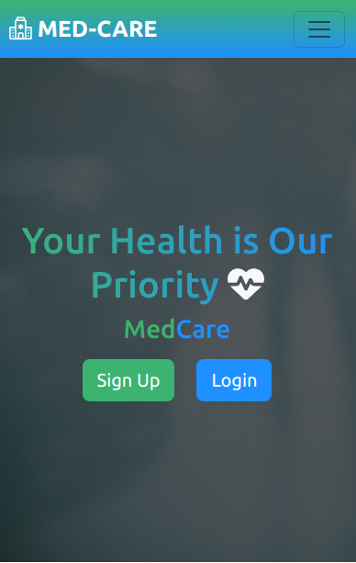
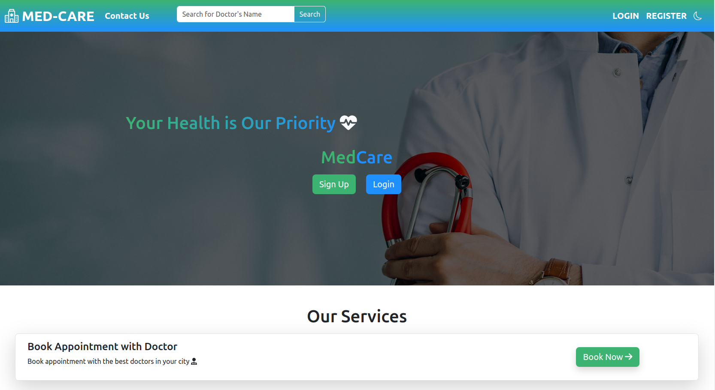

Slide 5
Agenda
01
Project Idea
02
Project Features
03
Tools & Technologies
04
Life Cycle
05
Future Features
06
Demo

Slide 6
01
Project Idea
Project description
Problem to be solved
Feasibility study

Slide 7
Project description
Project Idea
A comprehensive website designed to simplify the process of booking appointments with doctors. This user-friendly website aims to bridge the gap between patients and doctors, providing a seamless experience for scheduling medical consultations and managing appointments efficiently.

Slide 8
Problem to be solved
Project Idea
In the current healthcare landscape, booking appointments with doctors can often be a cumbersome and time-consuming process for patients. Long waiting times, difficulty in finding available slots, and the lack of convenient communication channels contribute to patient dissatisfaction and inefficiencies in clinic operations there's a growing need for a website the appointment booking process.

Slide 9
Feasibility study
Project Idea
Based on the findings of this feasibility study, we aim to determine the viability and potential success of developing an online appointment booking system for healthcare professionals. By addressing market demand, technical feasibility, financial viability, and risk factors, we can make informed decisions regarding the initiation and implementation of the project. This study will serve as a crucial foundation for the development and future success of the proposed online booking Website in the healthcare sector.

Slide 10
02
Project Features

Slide 11
Project structure used
Project Features
App
Med_Care
React
App
Med_Care
Django
Website
Med_Care

Slide 12
1- Functional requirements
Project Features
hhh

Slide 13
2-Non-functional requirements
Project Features

Slide 14
03
Tools & Technologies

Slide 15
1-
Tools & Technologies
¿Sabes qué te ayuda a aclarar tus ideas? Listas como esta:
Son simples
Puedes organizar tus ideas de forma clara
¡Nunca más olvidarás comprar leche!
El público entenderá todo lo que le muestres al instante

Slide 16
2-
Tools & Technologies
¿Sabes qué te ayuda a aclarar tus ideas? Listas como esta:
Son simples
Puedes organizar tus ideas de forma clara
¡Nunca más olvidarás comprar leche!
El público entenderá todo lo que le muestres al instante

Slide 17
04
Life Cycle

Slide 18
Línea de tiempo
Mercurio
Venus
Marte
Mercurio es el planeta más cercano al Sol
Es el segundo planeta más cercano al Sol
A pesar de ser rojo, Marte es muy frío
Júpiter
Saturno
Es el planeta más grande del sistema solar
Está compuesto por hidrógeno y helio

Slide 19
05
Future Features

Slide 20
1-
Future Features

Slide 21
06
Demo

