Slide 1





DOM
LECTURE Four
JavaScript
EVENTS

Slide 2


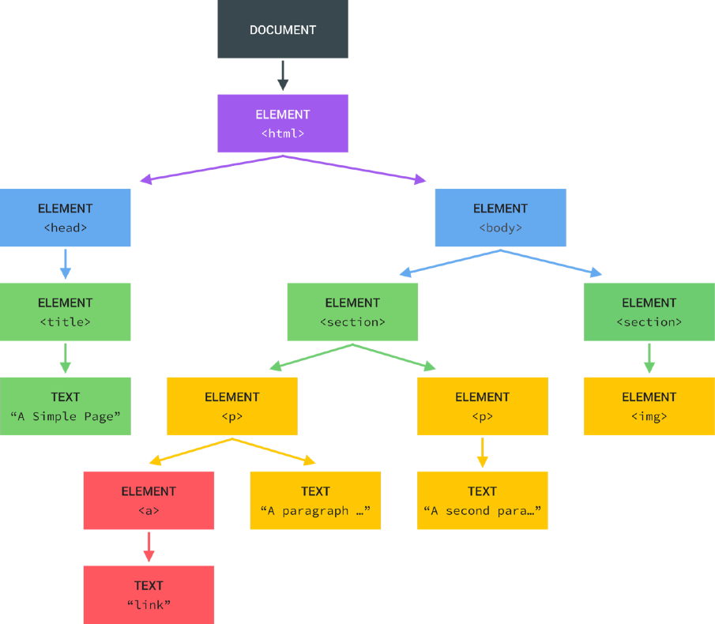
WHAT IS THE DOM?
Tree structure, generated by browser on HTML load
DOM
DOCUMENT OBJECT MODEL: STRUCTURED REPRESENTATION OF HTML DOCUMENTS. ALLOWS JAVASCRIPT TO ACCESS HTML ELEMENTS AND STYLES TO MANIPULATE THEM.
Change text, HTML attributes, and even CSS styles

Slide 3
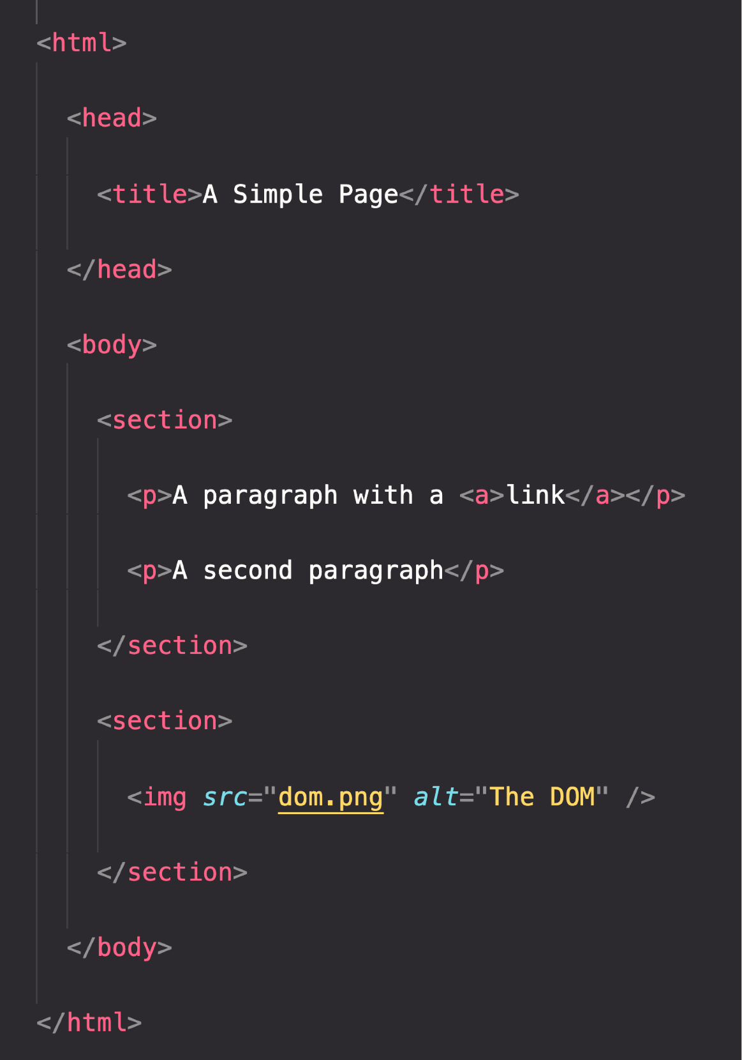

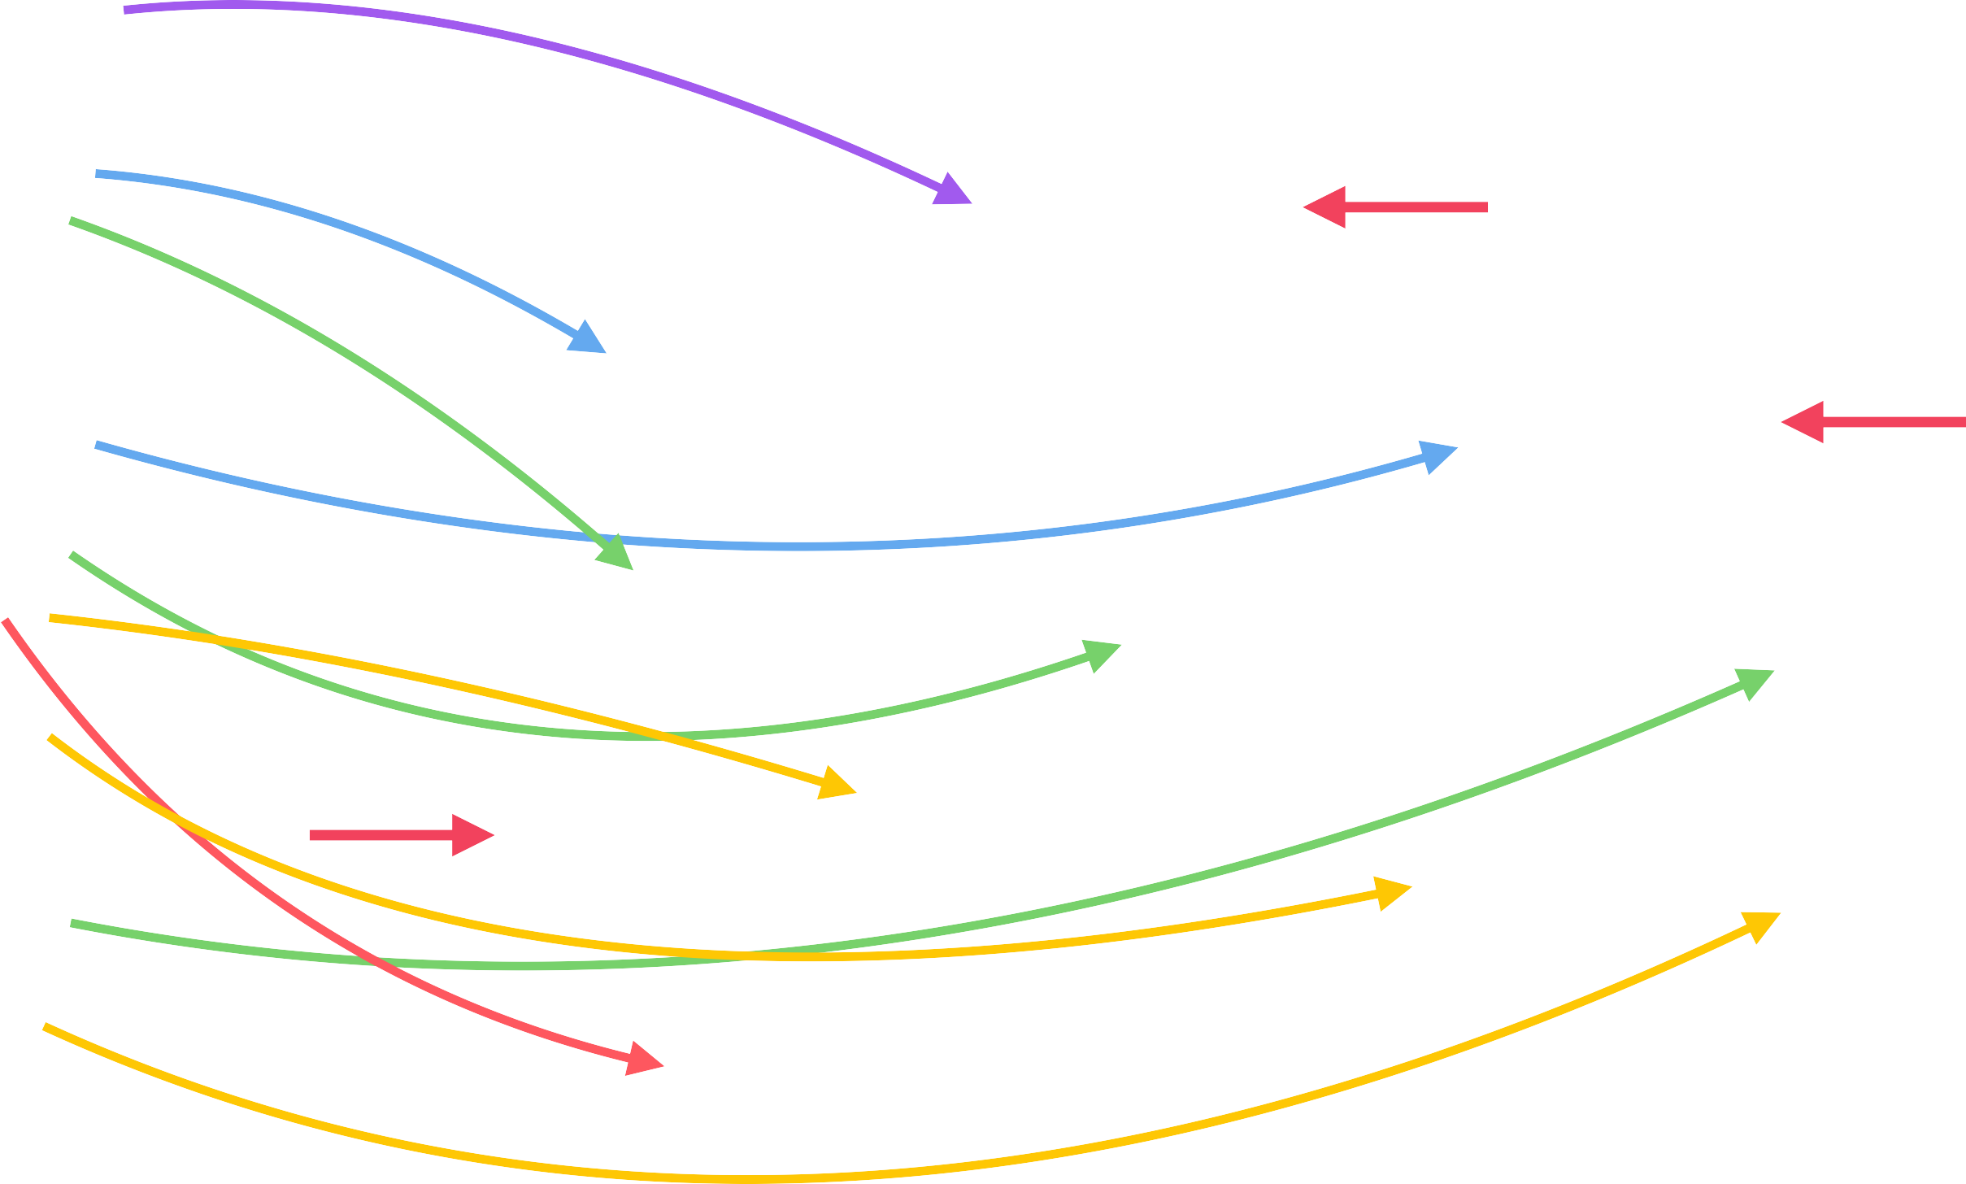
THE DOM TREE STRUCTURE
Special object that is the entry point to the DOM. Example: document.querySelector()

Slide 4









DOM ! ==JAVASCRIPT
DOM Methods and Properties for DOM Manipulation
NOT PART OF
For example
document.querySelector()
API: Application Programming Interface
WEB APIs
DOM Methods and Properties
Timers
CAN INTERACT WITH
Fetch

Slide 5


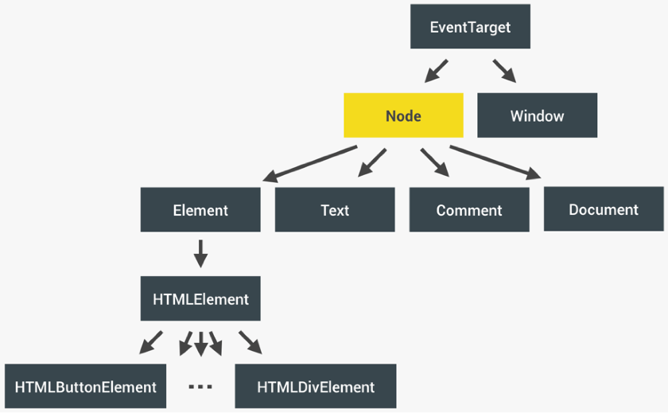
REVIEW : WHAT IS THE DOM?
BROWSER
DOM
INTERFACE
Allows us to make JavaScript interact with the browser;
Nodes
We can write JavaScript to create, modify and delete HTML elements; set styles, classes and attributes; and listen and respond to events;
DOM tree is generated from an HTML document, which we can then
interact with;
Application Programming Interface
DOM is a very complex API that contains lots of methods and properties to interact with the DOM tree
“Types” of DOM objects (next slide)
DOM tree
.querySelector() / .addEventListener() / .createElement() /
.innerHTML / .textContent / .children / etc ...

Slide 6

HOW THE DOM API IS ORGANIZED BEHIND THE SCENES
Represented by JavaScript object
.addEventListener()
.removeEventListener()
EventTarget
.innerHTML
.classList
.children
.parentElement
.append()
.remove()
.insertAdjacentHTML()
.querySelector()
.closest()
.matches()
.scrollIntoView()
.setAttribute()
.textContent
.childNodes
.parentNode
.cloneNode()
Node
Window
Global object, lots of methods and properties, many unrelated to DOM
INHERITANCE OF METHODS AND PROPERTIES
<p>Paragraph<p>
Element
Text
Comment
Document
Example:
Any HTMLElement will have access to
.addEventListener(),
.cloneNode()
or .closest() methods.
<p>Paragraph<p>
<!--Comment-->
.querySelector()
.createElement()
.getElementById()
HTMLElement
HTMLButtonElement
...
HTMLDivElement
(One different type of HTMLElement per HTML element...)
(THIS IS NOT A DOM TREE)

Slide 7
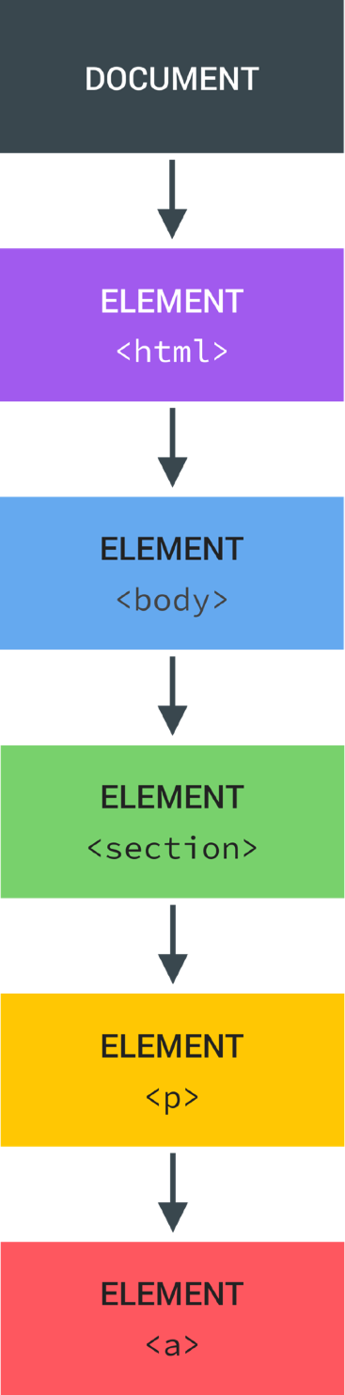
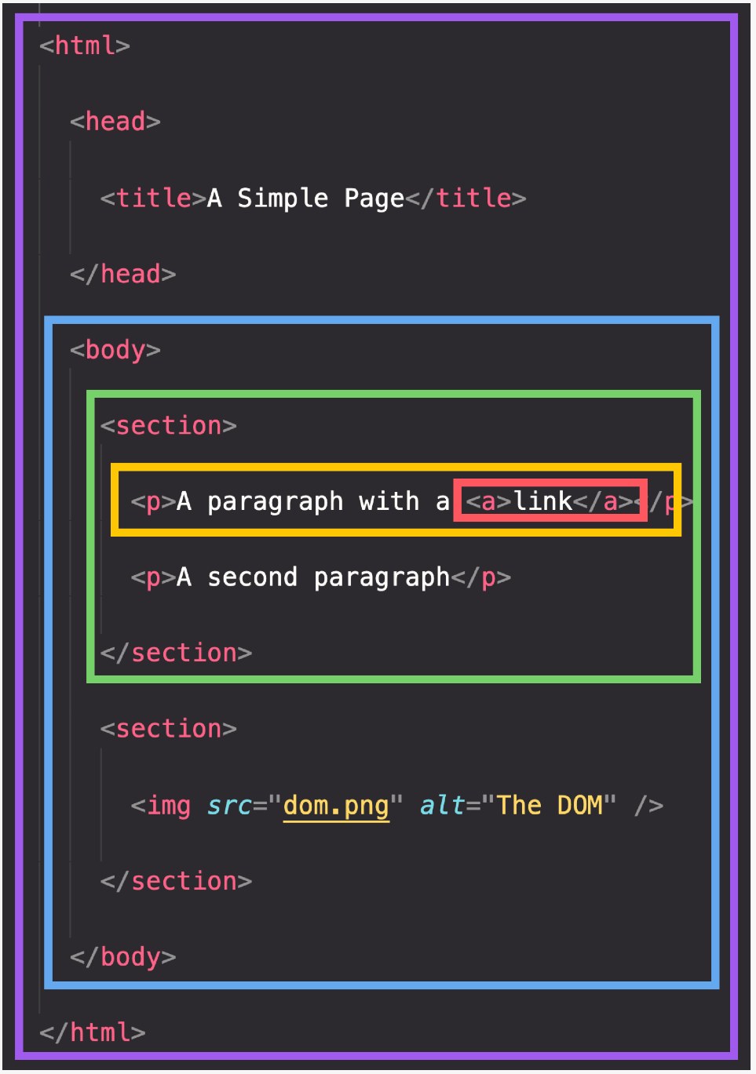
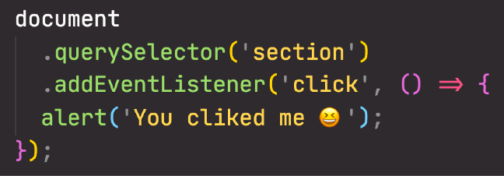

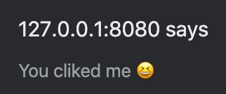
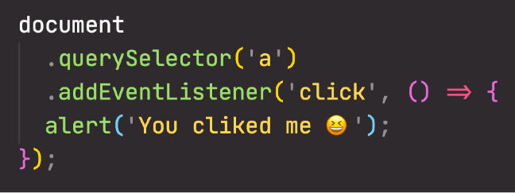
BUBBLING AND CAPTURING
Click event
1
3
CAPTURING PHASE
BUBBLING PHASE
(THIS DOES NOT HAPPEN ON ALL EVENTS)
2
TARGET PHASE

Slide 8
TASKS
Use HTML Dom, to do the following:
Create image node (using document.createElement()).
Set it source image (using setAttribute()).
Append it to a div on the page (Try appendChild() and insertBefore(), what’s the difference)?
After appending the image, alert the number of child nodes to the div (Use element.childNodes.length), what are the count of div child nodes? And Why?
Remove the added image (using removeChild()).

Slide 9
TASKS
2. Create an image like the following one, which has an image, image description text under the text and prev. and next buttons. (Use array to store images name, and another to store images description) [You may use one associative array, instead of 2 arrays].
Make next button display the next image, and prev. button display the prev. image.

Slide 10
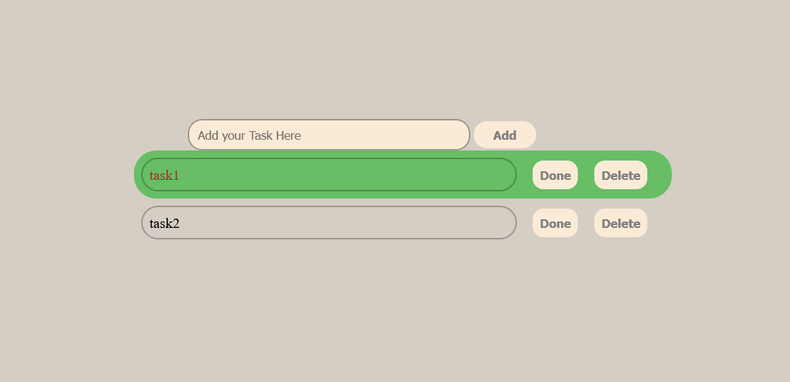
TASKS
3. To Do List → from js

Slide 11
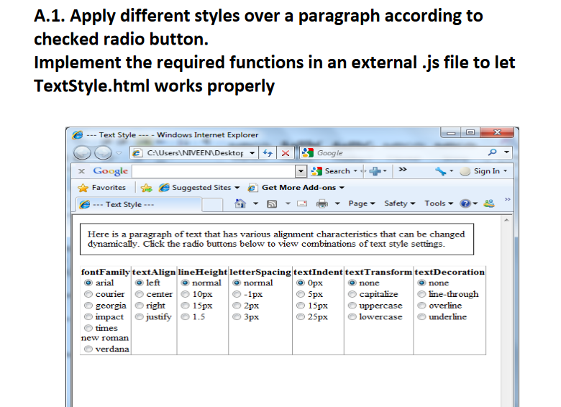
TASKS

Slide 12
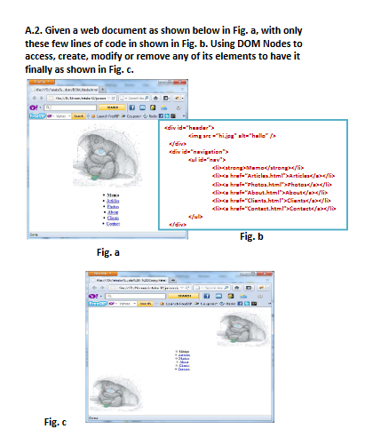
TASKS

Slide 13
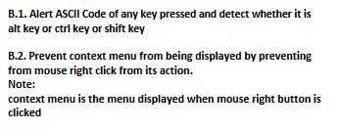
TASKS

Slide 14
TASKS “BONUS”
3. Make a registration form (you can re-use the registration form you did before) as the following (Use HTML 5 new input types and validation attributes):
Form fields:
Full Name (Required)
Email (Required, input type: email)
City (Drop-down list filled with some cities)
Password
Repeat password.
“I accept the terms and conditions” checkbox.
Register button, which redirects to another page saying: “Thank you, Full Name for registering in our website”.
Make full name text has default text “Enter your Name:” [use placeholder attribute].
When the user focus in full name text, show blue border for the input (use element.style.border=”solid 1px blue”), and remove the border when the input loses the focus.
After user finish writing his full name and leaves the text box (lost focus), if full name wasn't in correct format (not empty string and more than 3 letters), show text next to textbox saying “invalid name”, and focus the full name textbox, and select all text on it, else if full name was in correct format hide the text next to textbox.
For Password and repeat password fields, when the user leaves the repeat password field, we need to validate that they’re required, and they’re identical (The same), and if they’re not the same show text besides it saying “password and repeat password should be the same”; remove the validation message when the user enters it correctly.
Change the background color of the text input when it’s not valid to: gray, and to white when it’s valid.
For the Email, use HTML5 “Required” attribute, and input type email.
You’ll remark that HTML5 validation will prevent you from submitting the form unless it’s valid, right?
But for the other custom validation of the name and password & repeat password, will not prevent the form for submitting and you can submit the form even if they’re not valid, why?

Slide 15
TASKS “BONUS”
4. In the previous assignment, you’ll remark that if the full name or password and repeat password are invalid (and validation messages appear next to the text boxes), if you press the submit button, the form will submit regardless the validation you make in the blur event, so we need to fix it as the following.
Handle onSubmit event for the form, and on the event handler function, check for the validation of the full name and password, if they’re correct, then submit the form (use Submit() function), if they’re not correct stop the form submitting (use event.preventDefault()), and show message for the user saying “Plz correct the validation errors first.
save the previous data in cookie then display it in another html page

