Slide 1

Movie Scout
A Movie Recommendation App

Slide 2
Team members & roles
Malek Khaled: Team Leader/Home Page
Doa’a Fakher: User Profile Page
Mohamed Abdallah: Authentication
Ahmed Omar: Movie Details Page

Slide 3



Technologies used
Front-end:
Back-end:

Slide 4
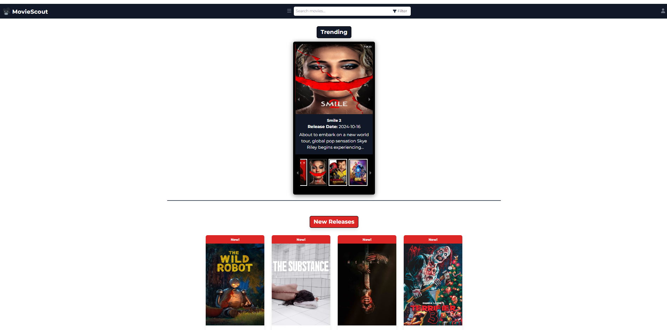
Home Page

Slide 5
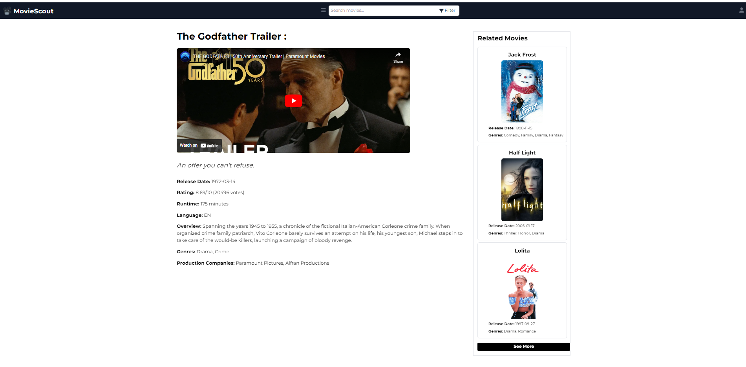
Movie Details page

Slide 6
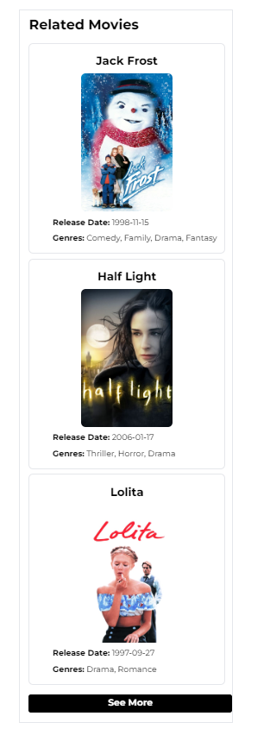
Related Movies section

Slide 7
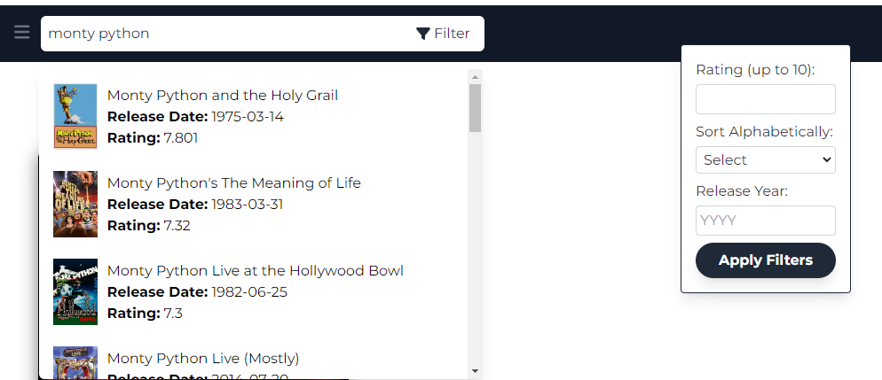
Search Filter

Slide 8
Thank you

