Slide 1
CAN Module In TM4C123GHPM LaunchPad
Mohamed AbdelAzeem
sep, 2021

Slide 2
General Description
Controller Area Network (CAN) is a broadcast type of bus. This means that all nodes can “hear” all transmissions. There is no way to send a message to just a specific node
shared serial bus standard for connecting electronic control units (ECUs).
The CAN hardware, however, provides local filtering so that each node may react only on the interesting messages.

Slide 3
Message types
The Data Frame
The Remote Frame
The Error Frame
The Overload Frame

Slide 4
The Data Frame
“Hello everyone, here’s some data labeled X, hope you like it!”
The data frame is the standard CAN message, broadcasting data from the transmitter to the other nodes on the bus.

Slide 5
The Remote Frame
“Hello everyone, can somebody please produce the data labeled X?”
A remote frame is broadcast by a transmitter to request data from a specific node.
a remote frame contains no data

Slide 6
The Error Frame
(everyone, aloud) “OH DEAR, LET’S TRY AGAIN”
the Error Frame is a special message that violates the framing rules of a CAN message. It is transmitted when a node detects a fault and will cause all other nodes to detect a fault – so they will send Error Frames, too. The transmitter will then automatically try to retransmit the message

Slide 7
The Overload Frame
“I’m a very busy little 82526, could you please wait for a moment?”
It is very similar to the Error Frame with regard to the format and it is transmitted by a node that becomes too busy.

Slide 8
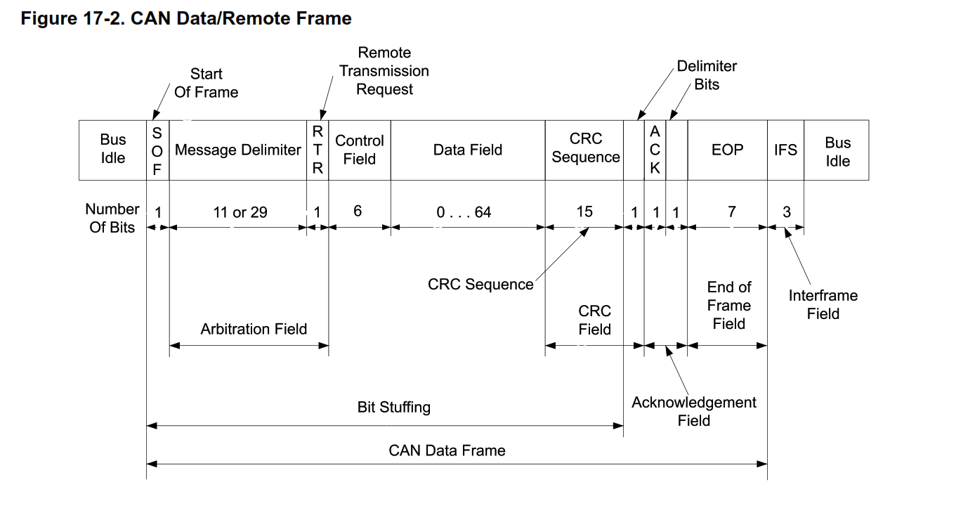

Slide 9
CAN Frame
SOF: The Start of Frame is a 'dominant 0' to tell the other nodes that a CAN node intends to talk
ID: The ID is the frame identifier - lower values have higher priority
RTR: The Remote Transmission Request indicates whether a node sends data or requests dedicated data from another node
Control: The Control contains the Identifier Extension Bit (IDE) which is a 'dominant 0' for 11-bit. It also contains the 4 bit Data Length Code (DLC) that specifies the length of the data bytes to be transmitted (0 to 8 bytes)
Data: The Data contains the data bytes aka payload, which includes CAN signals that can be extracted and decoded for information
CRC: The Cyclic Redundancy Check is used to ensure data integrity
ACK: The ACK slot indicates if the node has acknowledged and received the data correctly
EOF: The EOF marks the end of the CAN frame

Slide 10
CAN driver in TIVA C
The TM4C123GH6PM CAN controller conforms to the CAN protocol version 2.0 .
Message transfers that include data, remote, error, and overload frames with an 11-bit identifier (standard) or a 29-bit identifier (extended) are supported.
Transfer rates can be programmed up to 1 Mbps.
Up to 8 byte data length.

Slide 11
The CAN module consists of three major parts:
CAN protocol controller and message handler
Message memory
CAN register interface

Slide 12
The CAN protocol controller
Controller transfers and receives the serial data from the CAN bus and passes the data on to the message handler.

Slide 13
The message handler
Loads data into the appropriate message object based on the current filtering and identifiers in the message object memory.
Responsible for generating interrupts based on events on the CAN bus.

Slide 14
The message memory
The message object memory is a set of 32 identical memory blocks that hold the current configuration, status, and actual data for each message object.
These memory blocks are accessed via either of the CAN message object register interfaces.
The message memory is not directly accessible in the TM4C123GH6PM memory map, so the
TM4C123GH6PM CAN controller provides an interface to communicate with the message memory
via two CAN interface register sets for communicating with the message objects.
CAN IF1
CAN IF2
In general, one interface is used for transmit data and one for receive data.

Slide 15
CAN Interface
To configure send or receive message objects we need to get the message object from message memory to CAN interface registers and update its data and control bits and then set whether this object is to transmit or receive. Then, As soon as we write object number in its register, updated data and control bits are saved into message memory in the specified object number.
To start transmission of a message object, we need to move data and control bits from message memory to CAN interface registers and update its values and start transmission using TXRQST bit.
Receiving message, Message handler stores a data frame in the message object in message memory. To read received data we need to move data and control bits of that object to interface registers and read DATA registers.

Slide 16
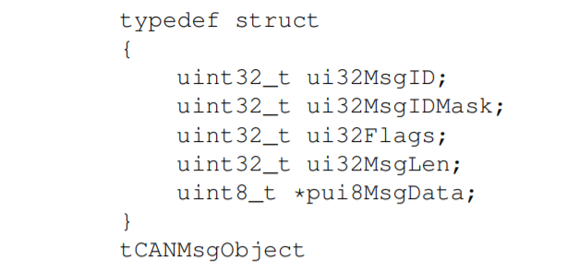
The message object
Message object’s content
The structure used for encapsulating all the items associated with a CAN message object in the CAN controller
Source : TivaWare™ Peripheral Driver Library

Slide 17
CAN Test Modes:
A Test Mode is provided which allows various diagnostics to be performed.
Test Mode is entered by setting the TEST bit in the CANCTL register.
Silent Mode.
Loopback Mode.
Loopback Combined with Silent Mode.
Basic Mode.

Slide 18
CAN module Modes: Silent Mode
Silent Mode can be used to analyze the traffic on a CAN bus .
In Silent Mode, the CAN controller is able to receive valid data frames and valid remote frames, but it sends only recessive bits on the CAN bus and cannot start a transmission.

Slide 19
CAN module Modes: Loopback Mode
Loopback mode is useful for self-test functions. In Loopback Mode, the CAN Controller internally routes the CANnTX signal on to the CANnRX signal and treats its own transmitted messages as received messages and stores them (if they pass acceptance filtering) into the message buffer.
CAN Controller is put in Loopback Mode by setting the LBACK bit in the CANTST register.
The actual value of the CANnRX signal is disregarded by the CAN Controller.

Slide 20
CAN module Modes: Loopback Combined with Silent Mode
Loopback Mode and Silent Mode can be combined to allow the CAN Controller to be tested without affecting a running CAN system connected to the CANnTX and CANnRX signals.

Slide 21
CAN module Modes: Basic Mode
Basic Mode allows the CAN Controller to be operated without the Message RAM.
The CANIF2 Registers are used as a receive buffer. After the reception of a message, the contents of the shift register are stored in the CANIF2 registers, without any acceptance filtering

Slide 22
Message Identification
Example 1: if we want to receive CAN Frame ID's 1,2 & 3, but we don't want to receive CAN frame ID 4 ID1 = 00000000001 ID2 = 00000000010 ID3 = 00000000011 ID4 = 00000000100
set the Mask bits 0,1 = 0. This will cause the filter to ignore the two LSB bits of the CAN ID. Mask = 11111111100

Slide 23
Message Identification
Example 2: Suppose Node1 want to receive the only message with ID 0x245
Acceptance Filter =0x245 (CANIFnARBn register)
0 1 0 0 1 0 0 0 1 0 1 (RecieveID)
&
1 1 1 1 1 1 1 1 1 1 1 (Mask Register) (CANIFnMSK1 register)
-----------------------------------------------------
0 1 0 0 1 0 0 0 1 0 1 -->Accepted ID (0x245)
if((Acceptance Filter & Mask Register)==(RecieveID & Mask Register)) {
receive this message;
}
else
{
Don't receive this message;
}

Slide 24
Message Identification
Example 3:
If node1 wants to allow all Message-ID of range 0x240 to 0x24F
Acceptance Filter =0x240 (CANIFnARBn register)
0 1 0 0 1 0 0 0 0 0 0 (Acceptance Filter)
&
1 1 1 1 1 1 1 0 0 0 0 (Mask Register)
-----------------------------------------------------
0 1 0 0 1 0 0 x x x x -->Accepted ID (x means don't care)
Accepted IDs:
0 1 0 0 1 0 0 0 0 0 0 (0x240)
0 1 0 0 1 0 0 0 0 0 1 (0x241)
0 1 0 0 1 0 0 0 0 1 0 (0x242)
0 1 0 0 1 0 0 0 0 1 1 (0x243)
0 1 0 0 1 0 0 1 1 1 0 (0x24E)
0 1 0 0 1 0 0 1 1 1 1 (0x24F)

Slide 25
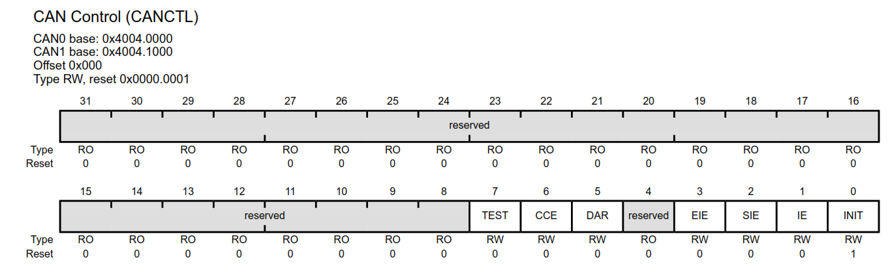
Initialization steps : Initialization
the peripheral clock must be enabled using the RCGC0 register to use the CAN controller.
the clock to the appropriate GPIO module must be enabled via the RCGC2 register.
Pins Initialization and configuration (AFSEL, PMCn .. )
Set INIT bit in the CAN Control (CANCTL) register

Slide 26
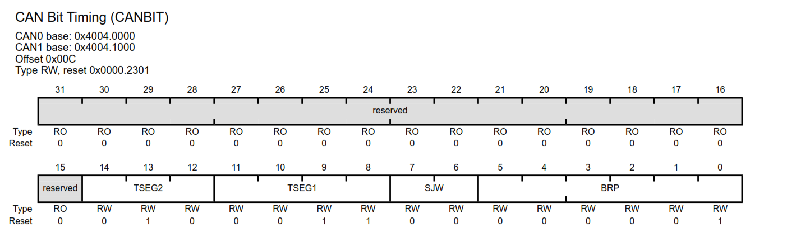
Initialization steps : Initialization
5. Setting the CCE bit to edit CANBIT Register
Set the CAN Bit Timing (CANBIT) register: This register is used to program the bit width and bit quantum.
Clear the INIT bit in the CAN0_CTL_R register. we need to clear this bit to indicate that the CAN module is configured

Slide 27
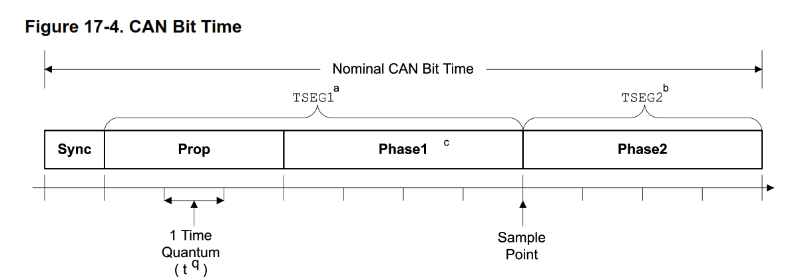
Bit Time and Bit Rate
Each bit on the CAN bus is, for timing purposes, divided into at least 4 quanta. The quanta are logically divided into four groups or segments Each segment consists of a specific, programmable number of time quanta .The length of the time quantum (tq), which is the basic time unit of the bit time

Slide 28
Bit Time and Bit Rate, Why?
During the arbitration, everyone is transmitting and receiving at the same time. This is to figure out who has the lowest address. Every node writes a bit to the bus and reads that bit at the same time. If node 1 writes a recessive bit and node 2 writes a dominant bit, node 1 will read that the bus is dominant and stop transmitting. This is because a dominant bit will overwrite a recessive bit and as soon as a node sees that its recessive bit has been overwritten it know that it does not have priority and stops transmitting. lets imagine the worst case scenario. Node 1 is on one side of the bus and node 2 is on the other. Do to propagation delay the leading edge of the bit takes time to travel from one side of the bus to the other. This worse case is where node 1 issues the SOF (start of frame) which takes time to travel from one side to the other. Then when the arbitration starts the bit edge from node 2 has to travel from the other side of the bus back to node 1. This actually gives a delay of two bus lengths that need to be compensated for.

Slide 29
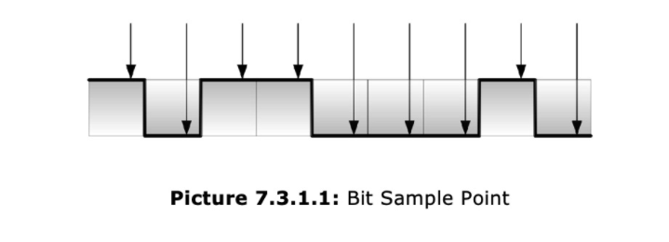
When exactly does a receiving CAN node read the bit information?
The bit sample point is located somewhat close to the end of the actual bit time in order to compensate for signal propagation delays in the CAN network plus delays within the actual CAN receiver/transmitter circuits.

Slide 30
Sync_Seg: Synchronization Segment
This segment is used to synchronize the nodes in a CAN network. A signal edge is expected within this segment. Any deviations, either a premature or delayed signal edge, will be measured and the phase buffer lengths will be adjusted accordingly, which in turn moves the bit sample point (resynchronization).

Slide 31
Prop_Seg: Propagation Time Segment
This segment is used to compensate for the physical delay times within the network, such as signal propagation delay and delays within the actual CAN nodes, namely the receiver/transmitter circuits. The segment’s length must be twice these delay times to compensate for delays from sender to receiver and back to the sender

Slide 32
Phase_Seg1/2: Phase Buffer Segment 1/2
These segments are used to compensate for signal edge phase errors. Their length may be adjusted by resynchronization. Phase_Seg1 may be lengthened while Phase_Seg2 is shortened. The length of Phase_Seg2 is programmed to the maximum length of Phase_Seg1 plus the information processing time.
The Phase Buffer Segments Phase1 and Phase2 surround the Sample Point.

Slide 33
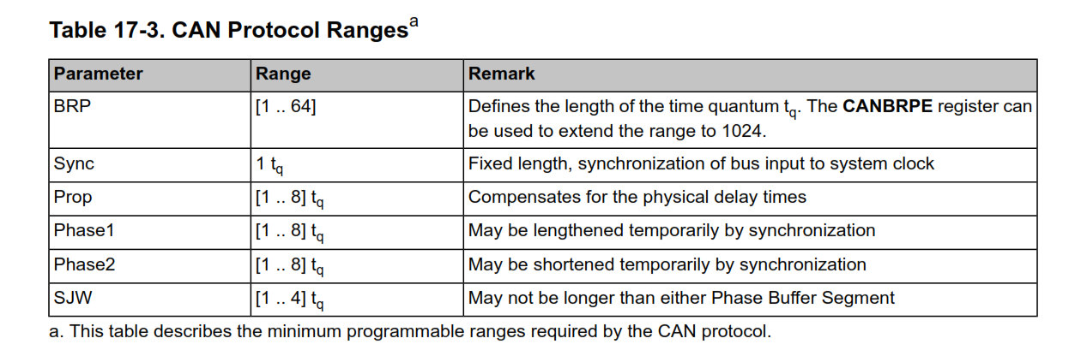
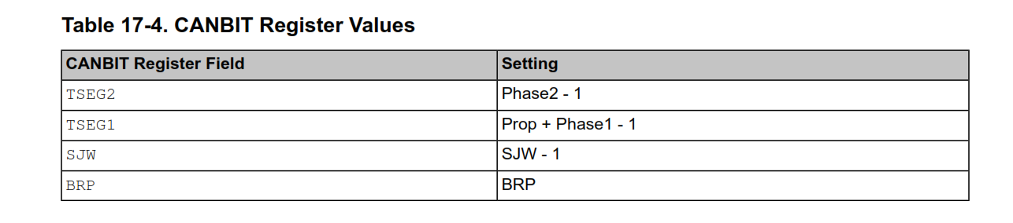

Slide 34
Bit Time and Bit Rate calculations:
The calculation of the bit timing configuration starts with a required bit rate or bit time. The resulting bit time (1/bit rate) must be an integer multiple of the system clock period.
Calculated bit rate should not exceed the required bit rate if we can not calculate the exact value.
The CAN system supports bit rates in the range of lower than 1 Kbps up to 1000 Kbps.
Sync is 1 tq long (fixed).
We need to try all combinations of n (Bit divisor) and prescaler.
Prescaler must be an integer value between 0 and 1023

Slide 35
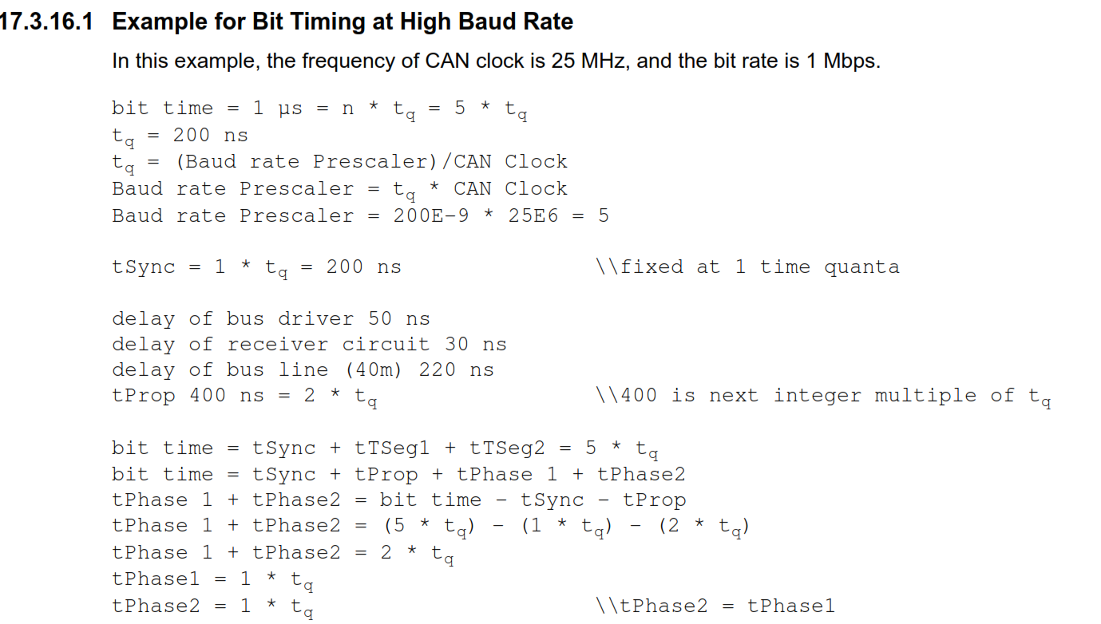

Slide 36
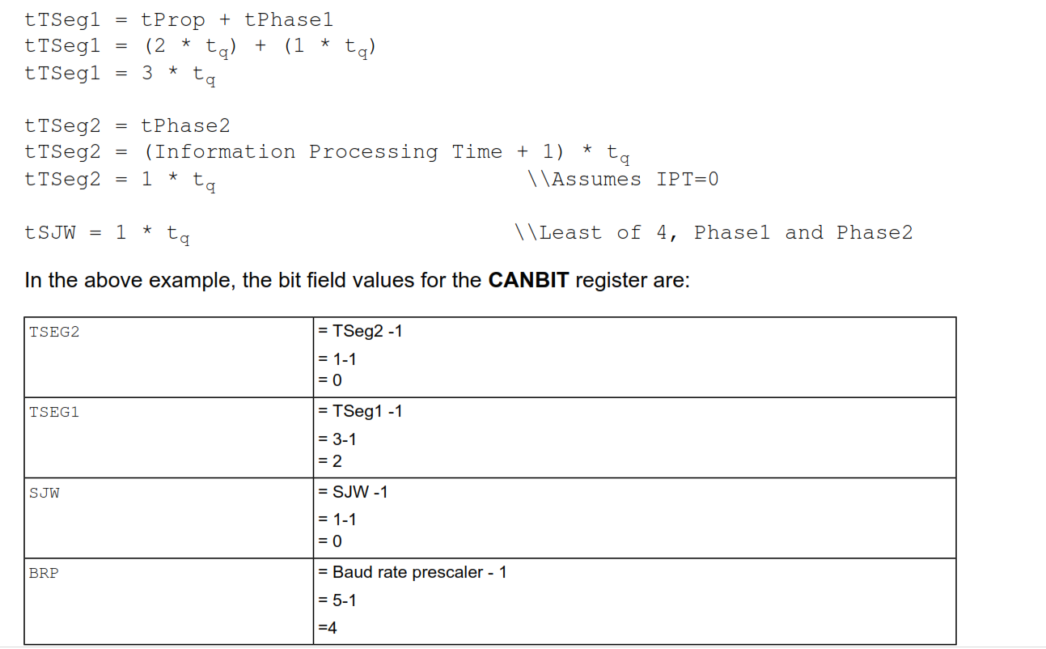

Slide 37
Initialization steps : Initializing transmit message object
Set the WRNRD bit in the CANIF1CMSK register to transfer the data in the CANIFn registers to the CAN message object specified by the MNUM field in the CAN Command Request (CANIFnCRQ). We set MNUM at the end of the initialization of the transmit object.
Set the ARB bit in the CANIF1CMSK register .
Set the CONTROL bit in the CANIF1CMSK register to transfer control bits from the CANIFnMCTL register into the Interface registers. This register holds the control information associated with the message object.
Set the DATAA bit in the CANIF1C MSK register.
Set the DATAB bit in the CANIF1CMSK register.

Slide 38
Initialization steps : Initializing transmit message object
13. In order for MASK bits to be used for acceptance filtering, they must be enabled by setting the UMASK bit in the CANIFnMCTL register
14. In the CANIFnMSK1 register, use the MSK[15:0] bits to specify which of the bits in the 29-bit
or 11-bit message identifier are used for acceptance filtering
MSK[15:0] in CANIFnMSK1 register are used for bits [15:0] of the 29-bit message identifier.
MSK[12:0] are used in the CANIFnMSK2 register for bits [28:16] of the 29-bit message identifier
MSK[12:2] in the CANIFnMSK2 register are used for bits [10:0] of the 11-bit message identifier.

Slide 39
Initialization steps : Initializing transmit message object
15. Configure message identifier:
For a 29-bit identifier:
configure ID[15:0] in the CANIFnARB1 register for bits [15:0] of the message identifier
ID[12:0] in the CANIFnARB2 register for bits [28:16] of the message identifier
Set XTD bit in CANIFnARB2 register to indicate an extended identifier (29-bit identifier)
For an 11-bit identifier:
disregard the CANIFnARB1 register and configure ID[12:2] in the CANIFnARB2 register for bits [10:0] of the message identifier
Clear XTD bit in CANIFnARB2 register to indicate a standard identifier (11-bit identifier)

Slide 40
Initialization steps : Initializing transmit message object
16. Set DIR bit In CANIFnARB2 register to indicate transmit
17. Set the MSGVAL bit In CANIFnARB2 register to indicate that the message object is valid.
18. Load the data to be transmitted into the CAN IFn Data (CANIFnDA1, CANIFnDA2, CANIFnDB1,
CANIFnDB2) registers. Byte 0 of the CAN data frame is stored in DATA[7:0] in the CANIFnDA1
register.
19. Program the number of the message object to be transmitted in the MNUM field in the CANIfn Command Request (CANIFnCRQ) register.
20. set the TXRQST bit in the CANIFnMCTL register. Once this bit is set, the message object is available to be transmitted, depending on priority and bus availability.

Slide 41
Initialization steps : Updating transmit message object
21. In order to update data bytes Transmit Message Object any time neither the MSGVAL bit in the CANIFnARB2 register nor the TXRQST bits in the CANIFnMCTL register have to be cleared before the update.

Slide 42
Polling the transmission (send / receive)
A message transfer is started as soon as there is a write of the message object number to the MNUM field when the TXRQST bit in the CANIF1MCTL register is set. With this write operation, the BUSY bit in CANIFnCRQ is automatically set to indicate that a transfer between the CAN Interface Registers and the internal message RAM is in progress. After a wait time of 3 to 6 CAN_CLK periods, the transfer between the interface register and the message RAM completes, which then clears the BUSY bit.

Slide 43
Transmission Interrupt
When the TXIE bit in the CAN IFn Message Control (CANIFnMCTL) register is set,
the CAN controller is configured to interrupt on a successful transmission of a
message object. the INTPND bit in the CANIFnMCTL register is set after a successful transmission.

Slide 44
Receiving Data frame Interrupt
The NEWDAT bit of the CANIFnMCTL register is set to indicate that new data has been received. The CPU should clear this bit when it reads the message object to indicate to the controller that the message has been received.
Set the RXIE bit to enable the INTPND bit to be set after a successful reception

Slide 45
Receiving a Remote Frame
Set DIR bit in in the CANIFnARB2 register. When the TXRQST bit in the CANIFnMCTL register is set, the respective message object is transmitted as a data frame
Set RMTEN bit in CANIFnMCTL ,Then At the reception of a remote frame, the TXRQST bit in the CANIFnMCTL register is set.
At the reception of a matching remote frame, the TXRQST bit of this
message object is set. The rest of the message object remains
unchanged, and the controller automatically transfers the data in
the message object as soon as possible.

Slide 46
Initialization steps : Initializing Receive message object
22. Program the CAN IFn Command Mask (CANIFnCMASK) register as described in the
“Configuring a Transmit Message Object”, except that the WRNRD bit is set to specify a write to the message RAM.
23. Program the CANIFnMSK1 and CANIFnMSK2 registers. They must be enabled by setting the UMASK bit in the CANIFnMCTL register.
24. Program the CANIFnARB1 and CANIFnARB2 registers.
25. In the CANIFnMCTL register:
Set the EOB bit for a single message object.
Configure the DLC[3:0] field to specify the size of the data frame.

Slide 47
Initialization steps : Initializing Receive message object
26. Program the number of the message object to be received in the MNUM field in the CAN IFn
Command Request (CANIFnCRQ) register. Reception of the message object begins as soon
as a matching frame is available on the CAN bus.

