Slide 1


SQL Server sessions involving worker threads’ CPU actual time, different session state types, and the distinction between preemptive and cooperative scheduling.
Developed by Mohamed Fawzy - CSA

Slide 2
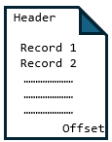

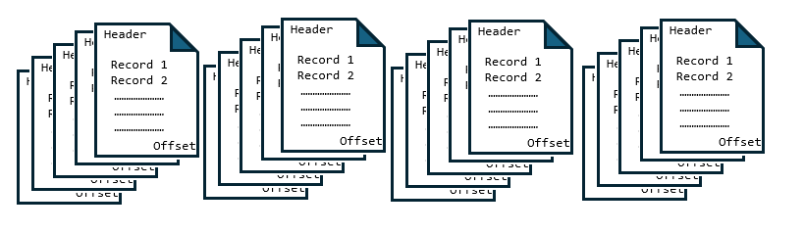
SPID
70
spid | state | Lastwaittype | text
70 |  |  | Select * from person.persons;
running
Pagelatch_*
suspended
runnable
Pageiolatch_*
sos_scheduler_yield
Buffer Pool - Clean Cache
Access Method searches for the required pages. it is retrieving from disk.
because it is not in the clean buffer cache.
RUNNING
1- If there is no contention, the latch is granted immediately, the worker enters the RUNNING state, and no wait type is recorded.
2- In case of contention (hot page), another worker already holds a PAGELATCH_EX or PAGELATCH_UP. The requesting worker then moves to the SUSPENDED state, with the wait_type set to PAGELATCH_SH.
70
Worker Thread
The optimizer generating the execution plan
Actual CPU Time
Quantum =~ 4ms
Read/Write
321
Disk
Data
File
705
543
WAITING LIST
F
I
F
O
67
200
55
123
609
777
Yield voluntarily
886
432
345
589
904
324
198
RUNNABLE – Signaled
SUSPEND – Waiting Resource

