Slide 1

SQL Server sessions involving worker threads’ CPU actual time, different session state types, and the distinction between preemptive and cooperative scheduling.
Developed by
Mohamed Fawzy - CSA

Slide 2
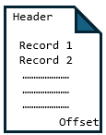

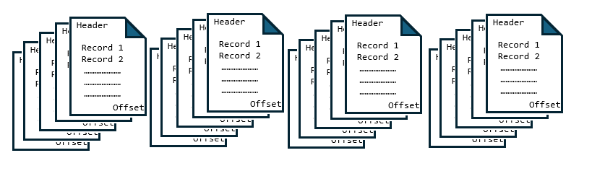
SPID
70
spid | state | Lastwaittype | text
70 |  |  | SELECT [FirstName]+' '+[MiddleName]+'. '+[LastName] FROM [AdventureWorks2022].[Person].[Person] WHERE BusinessEntityID in (2, 290);
runnable
running
Pagelatch_SH
suspended
sos_scheduler_yield
Pageiolatch_SH
Buffer Pool - Clean Cache
RUNNING
The optimizer generating the execution plan
Buffer manager checks if page is already in the buffer pool, if not, submits an async read request to Windows.
70
Worker Thread
1- If there is no contention, the latch is granted immediately, the worker enters the RUNNING state, and no wait type is recorded.
2- In case of contention (hot page), another worker already holds a PAGELATCH_EX or PAGELATCH_UP. The requesting worker then moves to the SUSPENDED state, with the wait_type set to PAGELATCH_SH.
Actual CPU
Time
Quantum =~ 4ms
Read/Write
Preemptive
321
Disk
Data
File
705
543
WAITING LIST
F
I
F
O
67
200
55
123
609
777
Yield voluntarily
Cooperative or Non-Preemptive
(SQLOS)
886
432
345
589
904
324
198
RUNNABLE – Signal = Waiting CPU
SUSPEND – Waiting Resource

Slide 3
Thank you for watching.

