Slide 1


9th International Conference on Environment Friendly Energies and Applications
EFEA 2025, Newcastle upon Tyne, UK. 4-5 December 2025
Paper ID:40
Socio‑Technical, Electrification, and Hydrogen‑Driven Pathways for Residential Heating Decarbonisation in the North of Tyne
Mohamed Abuella¹, Adib Allahham¹, Sara Louise Walker²
¹ Northumbria University, UK
² University of Birmingham, UK

Slide 2
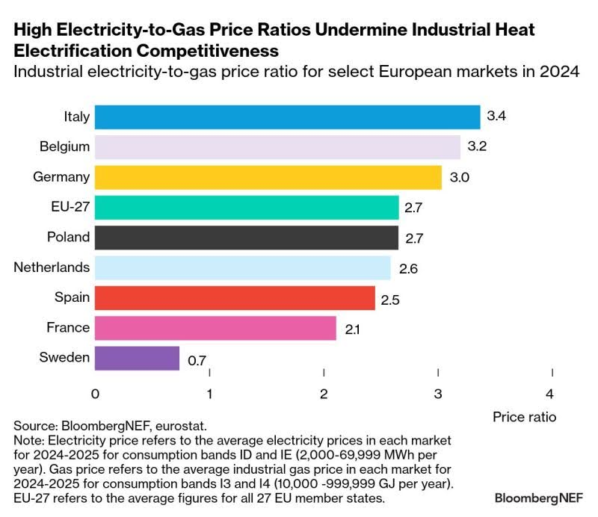
Motivation
Decarbonisation Pathways for Residential Heating, North of Tyne – EFEA 2025
Motivation and Objectives
• Assess socio‑technical interventions
• Evaluate heat pump and hydrogen boiler uptake
• Analyse hydrogen blending impacts
• Identify investment and system efficiency pathways
It is same technology but depending on where you live. … So, we cannot follow a single blueprint!

Slide 3
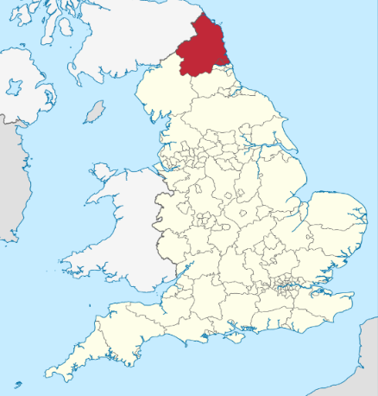
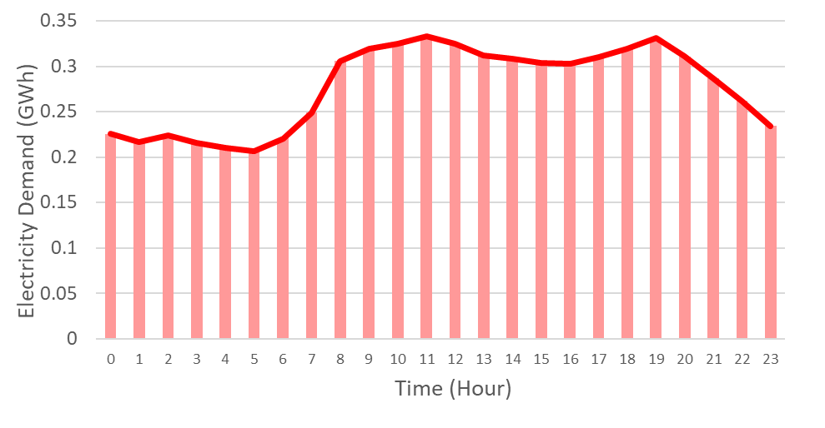
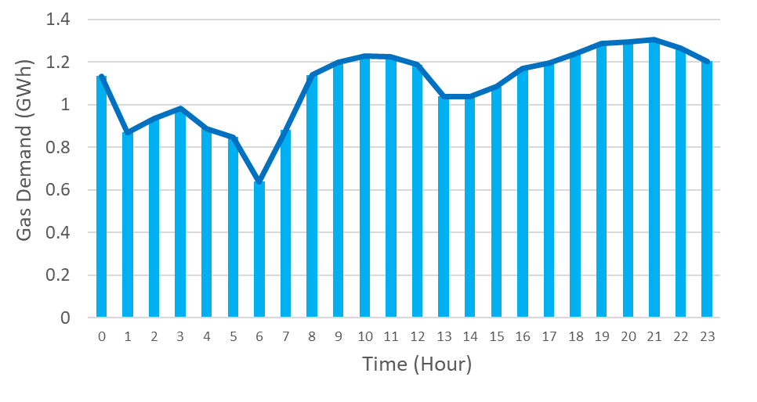
Overview
Decarbonisation Pathways for Residential Heating, North of Tyne – EFEA 2025
North of Tyne (NoT)
• 85% of UK homes use natural gas
• NoT consumed 17.3 TWh gas (2018)
• High fuel poverty and ageing housing
• Need for coordinated, low‑carbon strategies
Demand Overview
We use the coldest day in November 2019 as a baseline to model peak demand.
This day saw total consumption of 31 GWh, with gas (24 GWh) significantly outpacing electricity (7 GWh).
North of Tyne (NoT)
Daily Profile of Total Electricity Demand for NoT in 2019
Daily Profile of Total Gas Demand for NoT in 2019

Slide 4
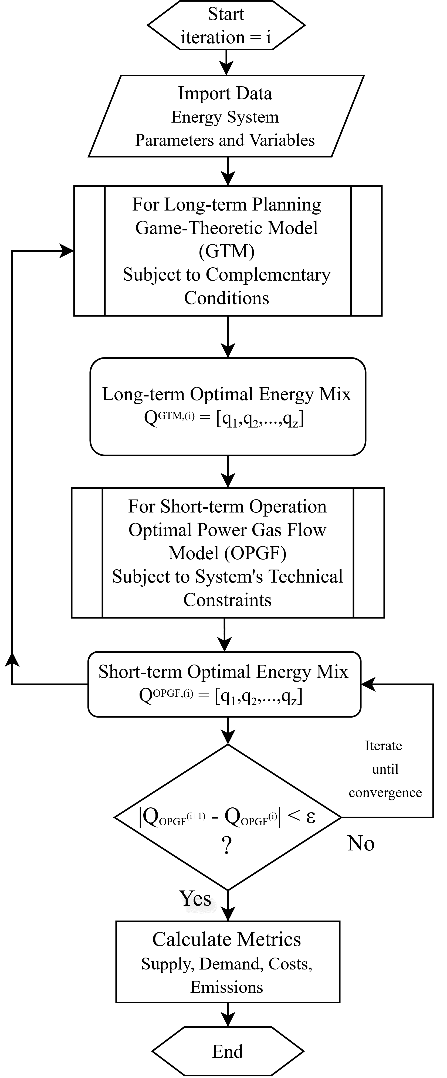
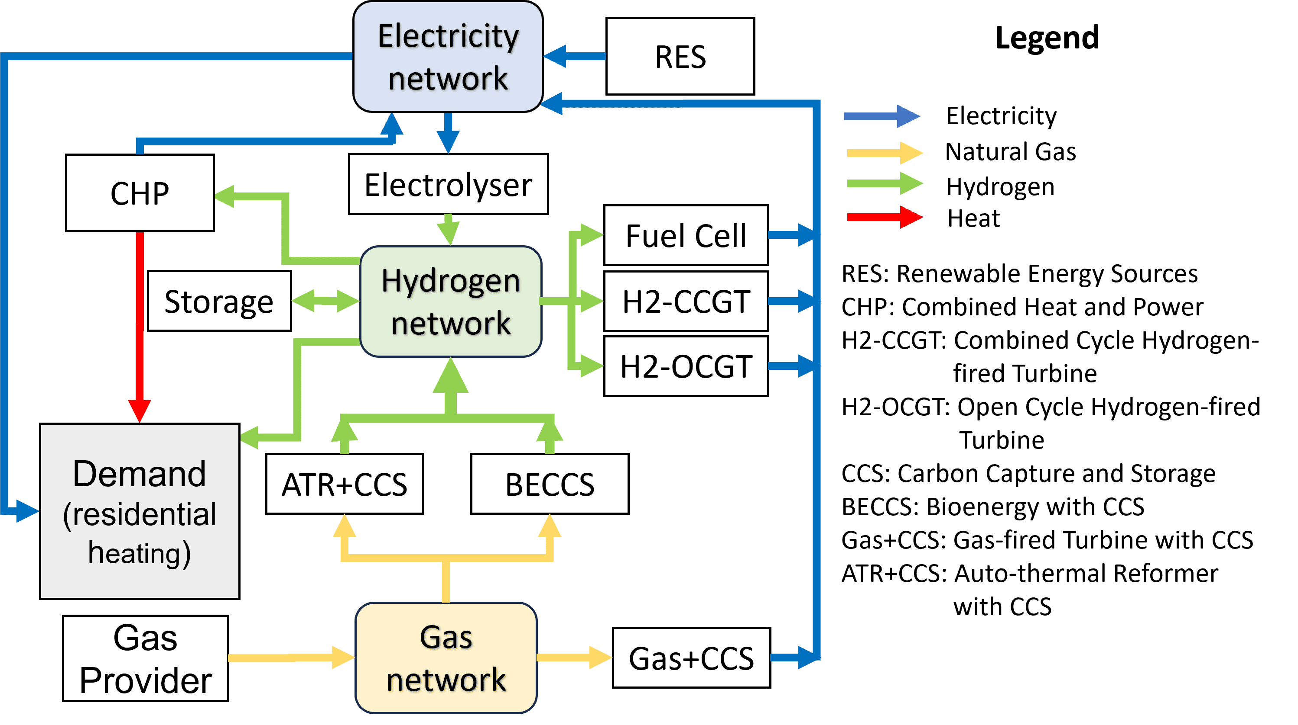
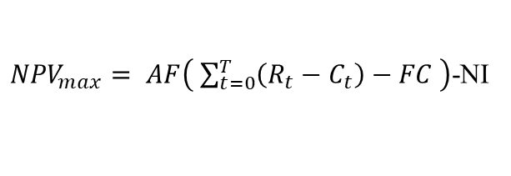
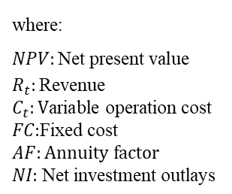
Decarbonisation Pathways for Residential Heating, North of Tyne – EFEA 2025
Integrated multi‑vector system: Electricity, gas, and hydrogen.
Bi-level optimisation framework:
Upper layer for long-term planning,
Lower layer for short-term operation.
Methodology
Coupling units provide system flexibility via multi-vector conversion and storage.
${NPV}_{max}= AF\left( \sum_{t=0}^{T}{\left(R_{t}−C_{t}\right)−FC }\right)$-NI
where:
$$NPV:\text{Net} \text{present} \text{value}$$
$$R_{t}:\text{Revenu}\text{e}$$
$$C_{t}:\text{V}\text{ariable} \text{operation} \text{c}\text{ost}$$
$$FC \text{:}\text{Fixed} \text{cost}$$
$$AF:Annuity factor$$
$$NI\text{: }\text{Net} \text{investment} \text{outlays}$$
Integrated multi-vector energy system framework for NoT region
GTM framework for integrated energy system planning

Slide 5
Decarbonisation Pathways for Residential Heating, North of Tyne – EFEA 2025
Social and Technical Interventions (STI)
Methodology
From the literature, we evaluate how social-based interventions impact electricity and gas demand profiles in North of Tyne (NoT) region.
Formulation of Social and Technical Interventions (STIs) of Residential Heating in NoT
Scenario | Intervention | Effect on Gas Demand | Effect on Electricity Demand
1 | Decreasing the heating set point by 2°C | 20% decrease | No effect
2 | Improving the whole building insulation level similar to Passivhaus standards | 77% decrease | No effect
3 | Delay start of heating from October to November | 5.5% decrease | No effect
4 | Use of radiator valves to turn off heating in unoccupied rooms | 4% decrease | No effect
5 | Use of heat pumps | 10% decrease | 14% increase
6 | Use of hydrogen boilers | 10% decrease | No effect

Slide 6
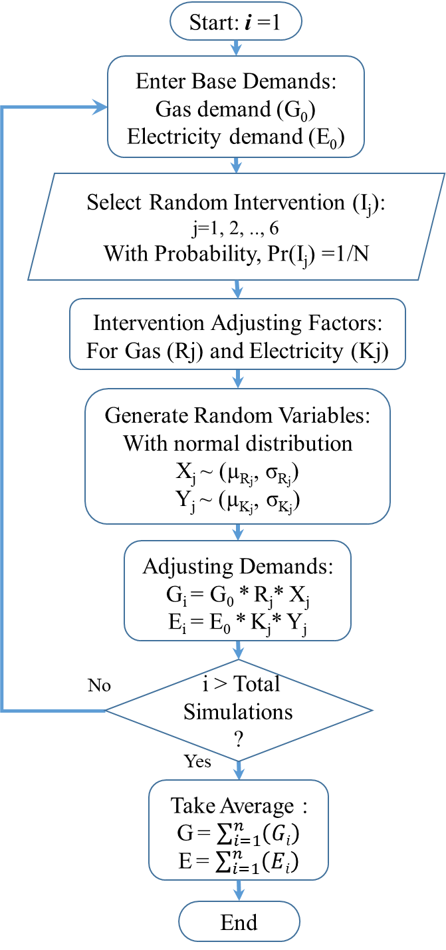
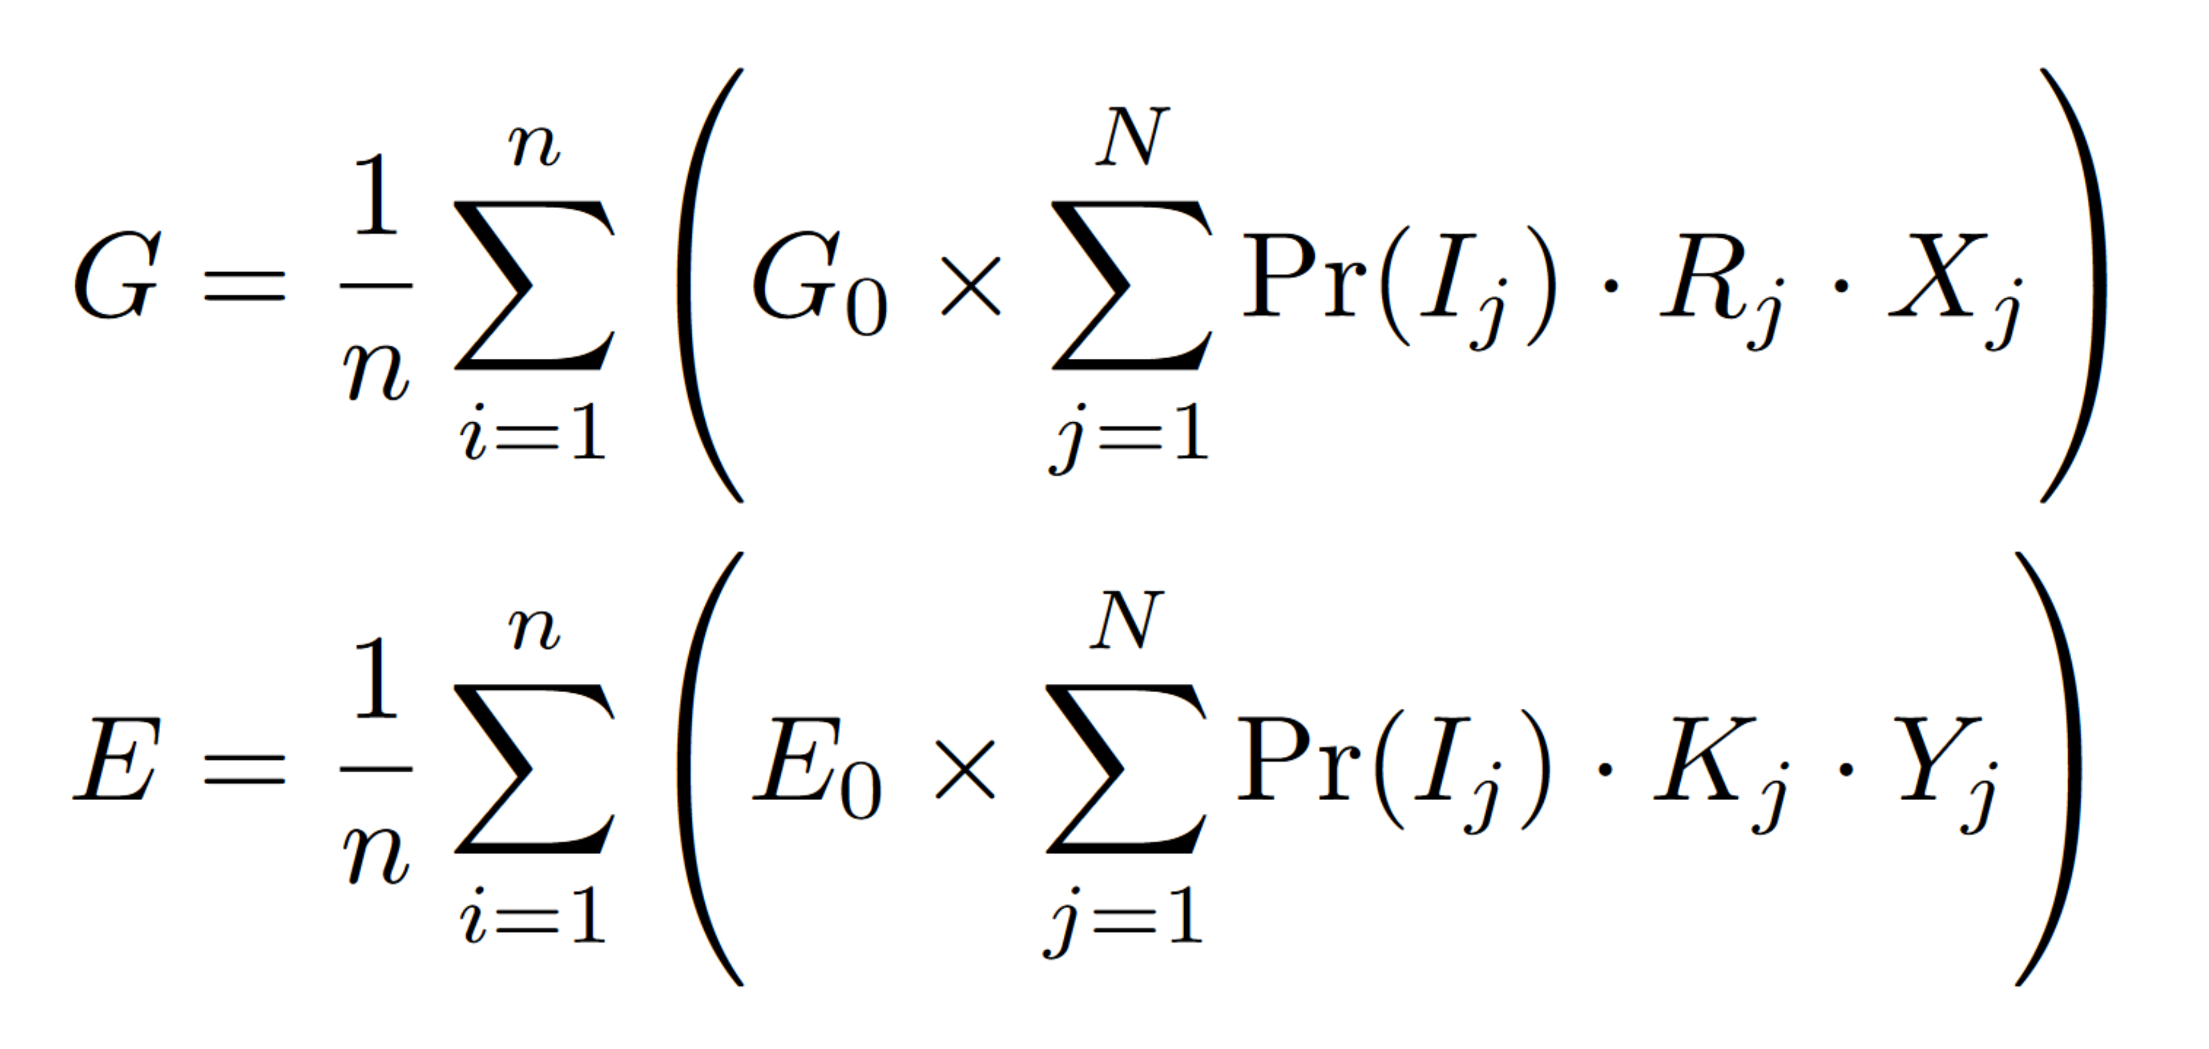
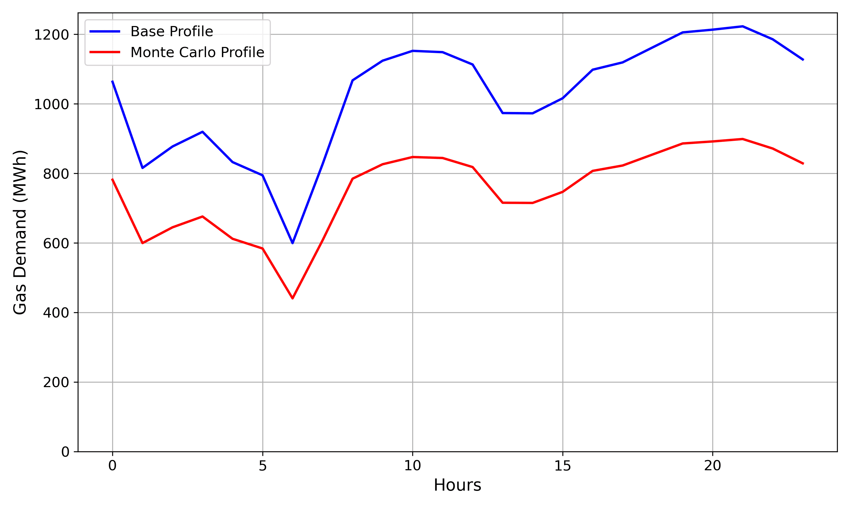
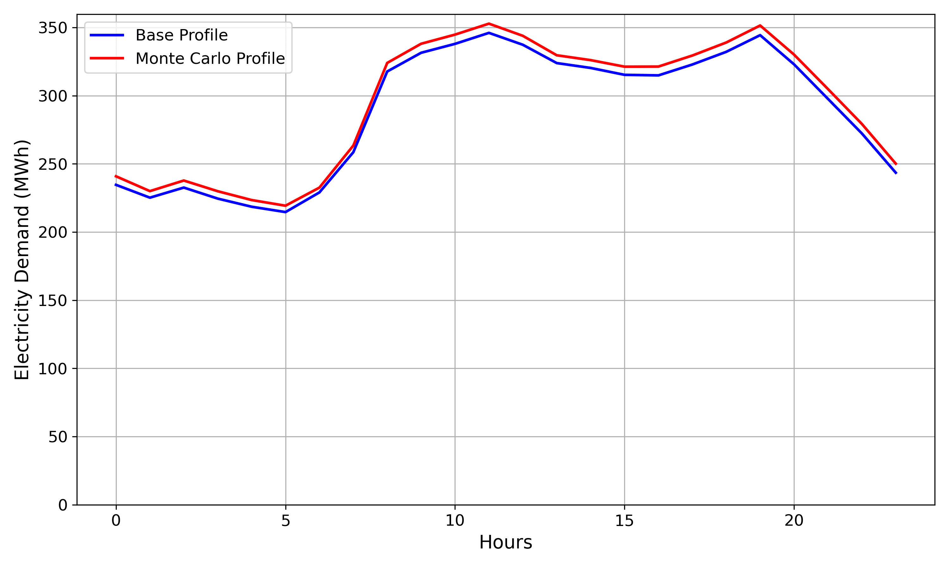
Decarbonisation Pathways for Residential Heating, North of Tyne – EFEA 2025
Monte Carlo Simulation
Methodology
We applied Monte Carlo simulation for the social and technical Interventions (STI) to simulate their impacts on demand profiles.
Let G₀ and E₀ represent the baseline gas and electricity demands, respectively. The adjusted demands G and E after applying a random intervention I_{j} .
Gas Demand
Electricity Demand
The Monte Carlo simulation of heating interventions indicates a noticeable reduction in gas demand, with only a marginal increase in electricity demand.
Monte Carlo Simulation for Social and Technical Interventions of Heating Demand

Slide 7
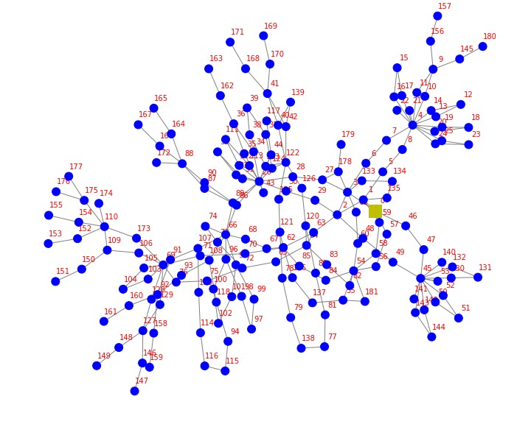
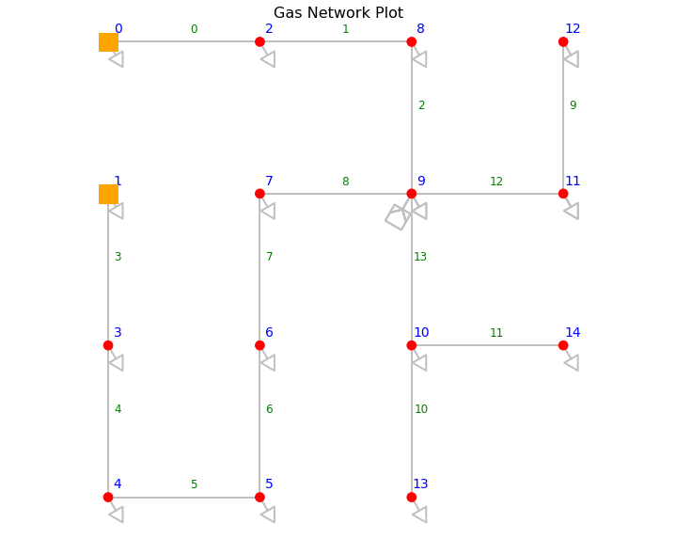
Decarbonisation Pathways for Residential Heating, North of Tyne – EFEA 2025
Hydrogen Blending:
(1) No hydrogen; natural-gas baseline – (0%)
(2) Partial blend; low-disruption transition – (20%)
(3) Full hydrogen conversion; major network change – (100%)
Heating Technologies:
(a) Socio-technological interventions – (STI)
(b) 50% heat pumps (HP) and 50% hydrogen (HB) – (50/50 HP–HB)
(c) 100% heat pumps – (100% HP)
(d) 100% hydrogen boilers – (100% HB)
Case Study
Electricity Network
(Aggregated)
Gas / Hydrogen Network (Aggregated)

Slide 8
Decarbonisation Pathways for Residential Heating, North of Tyne – EFEA 2025
Results
Operational cost (Opex, million £/day), emissions, (tonnes CO2/day), and net present value (NPV, million £) for peak demand in 2050 (full CCS deployment). CCS=Carbon Capture and Storage.
Hydrogen Blending | 0% H₂ |  |  | 20% H₂ |  |  | 100% H₂
Scenario / Metric | Opex | Emis | NPV | Opex | Emis | NPV | Opex | Emis | NPV
STI | 0.64 | 0 | 486 | 0.67 | 0 | 384 | 2.03 | 0 | 323
50/50 HB & HP | 0.82 | 9 | 518 | 0.83 | 8 | 411 | 1.10 | 0 | 253
100% HP | 0.60 | 0 | 419 | 0.65 | 0 | 316 | 1.95 | 0 | 323
100% HB | 1.16 | 0 | 624 | 1.19 | 0 | 519 | 1.93 | 0 | 318
STI: Socio-Technological Interventions
HP: Heat Pumps
HB: Hydrogen Boilers
Heat Pump with COP=3
Prices: Electricity=125£/MWh, Natural gas= 37£/MWh, Hydrogen = 75£/MWh

Slide 9
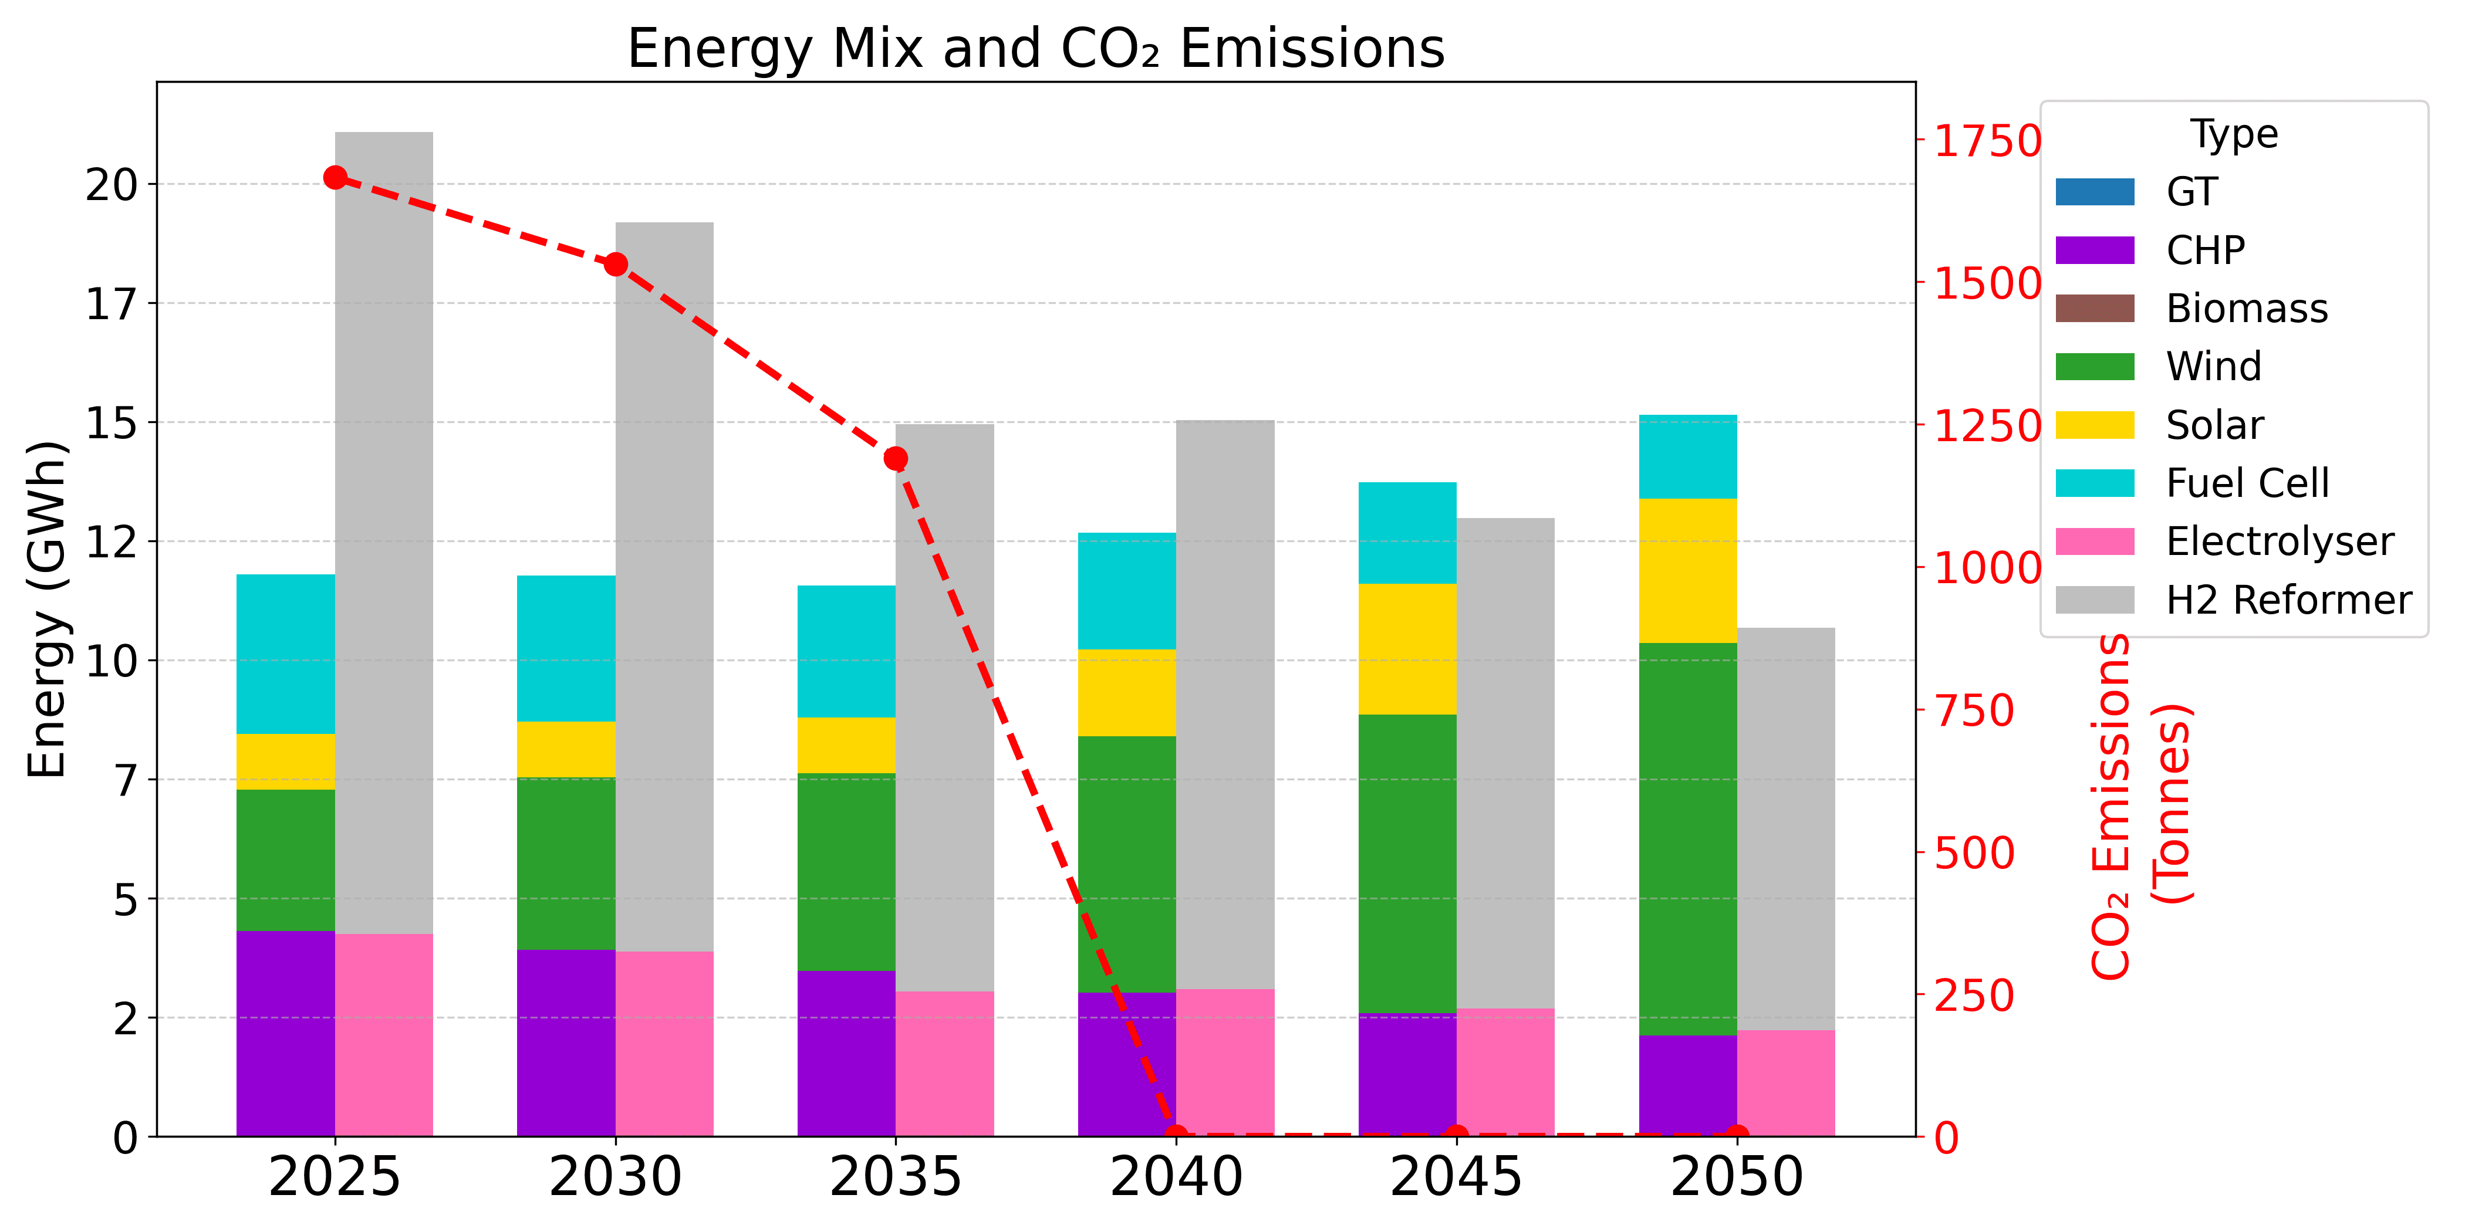
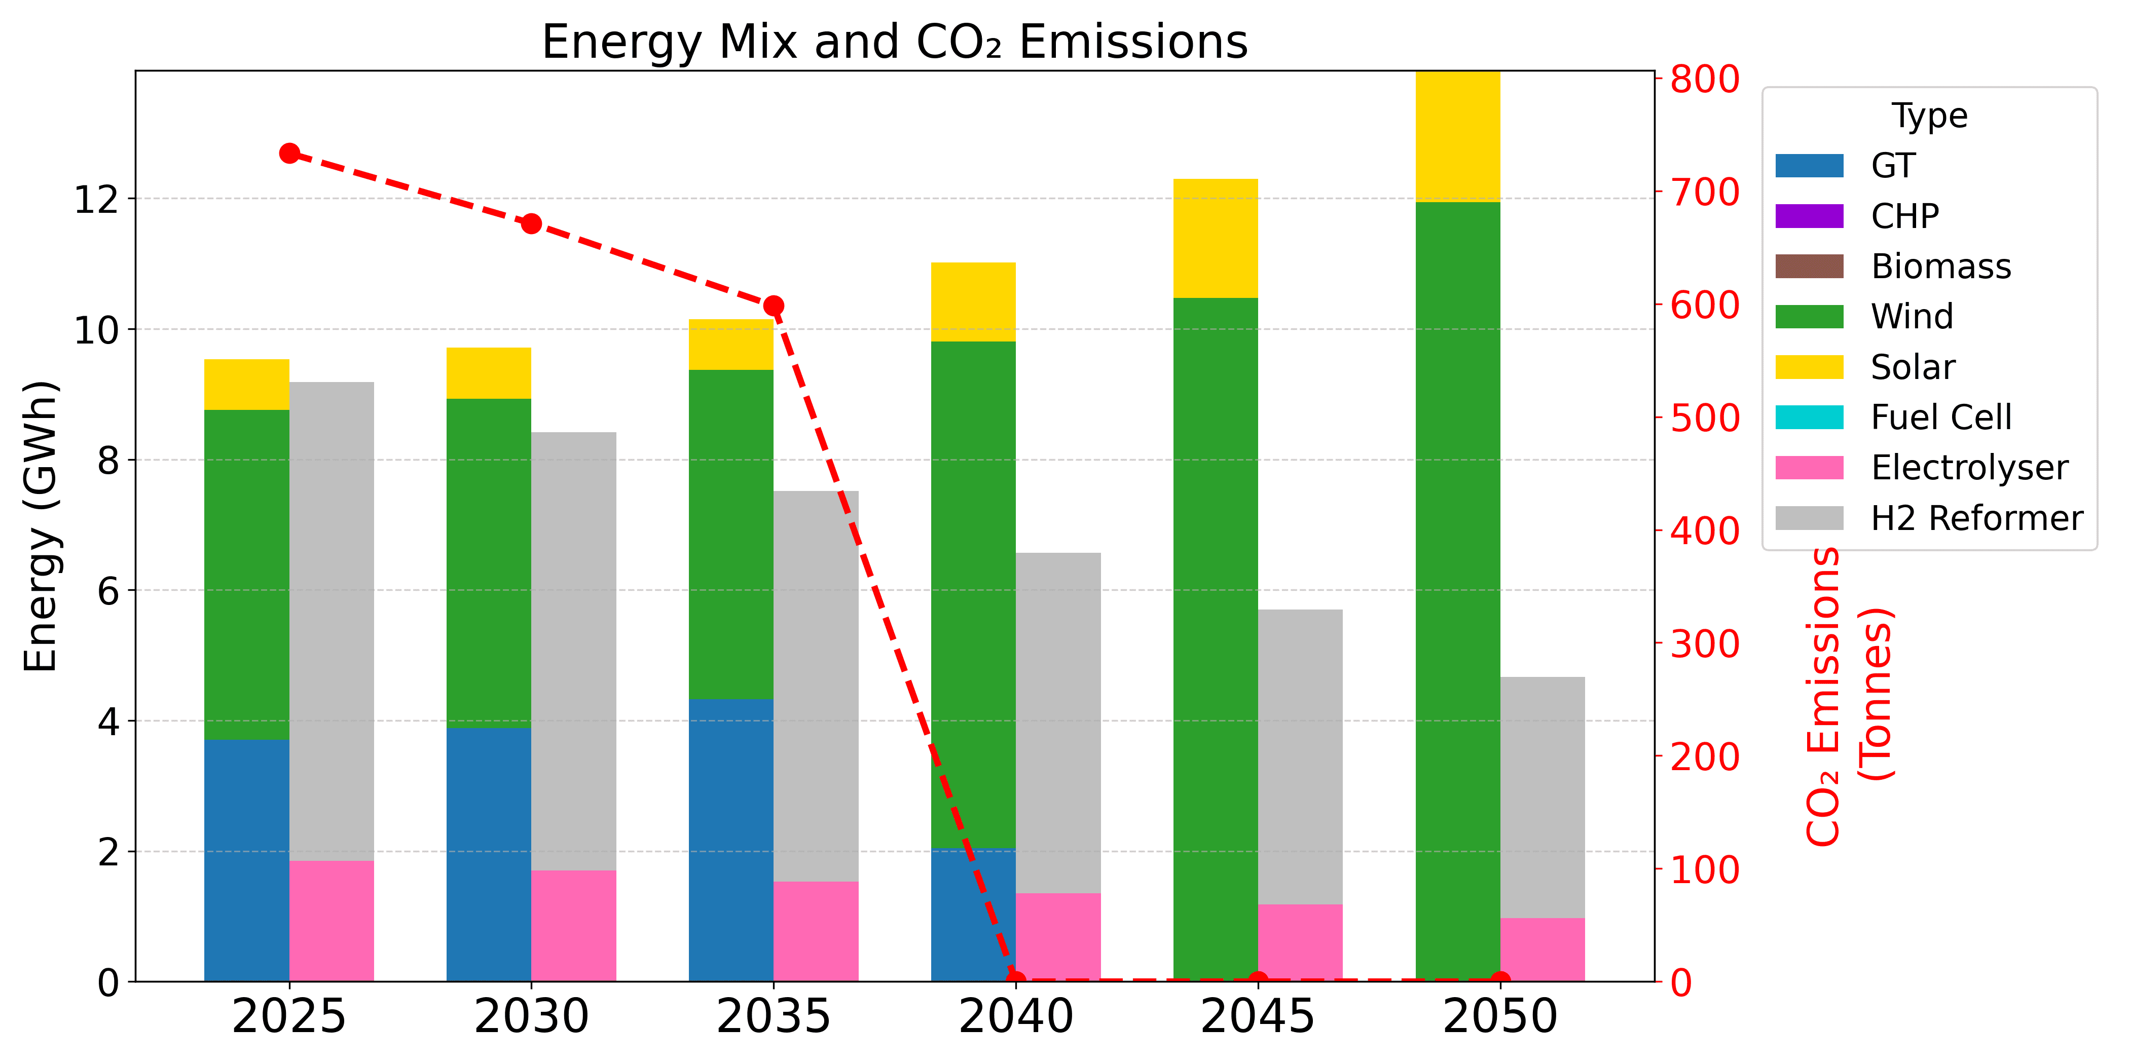
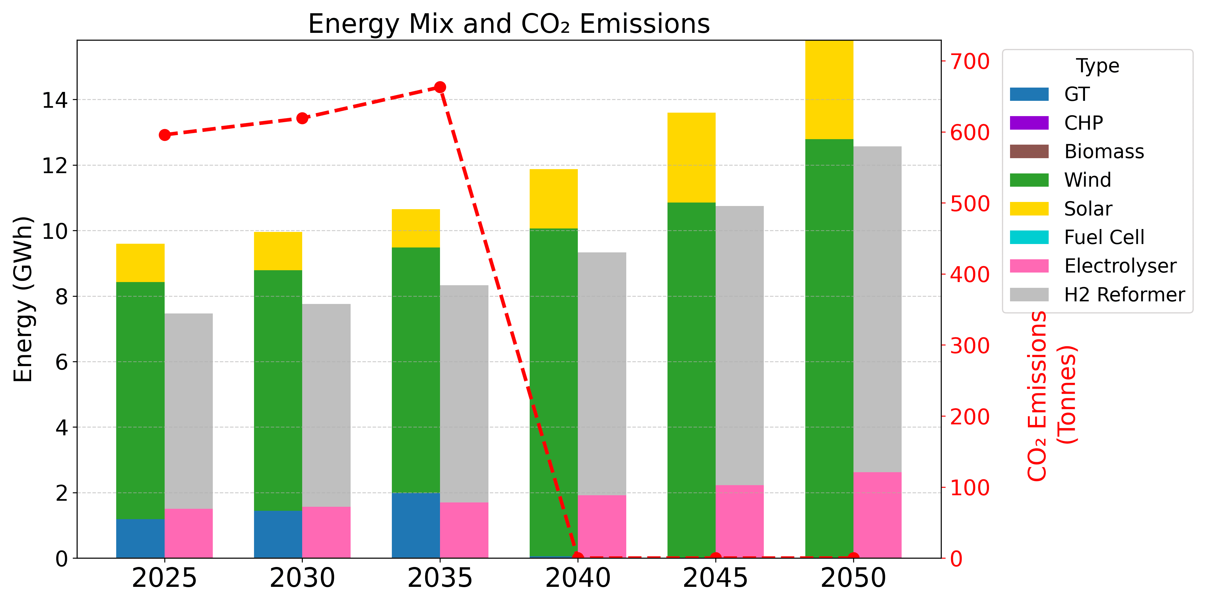
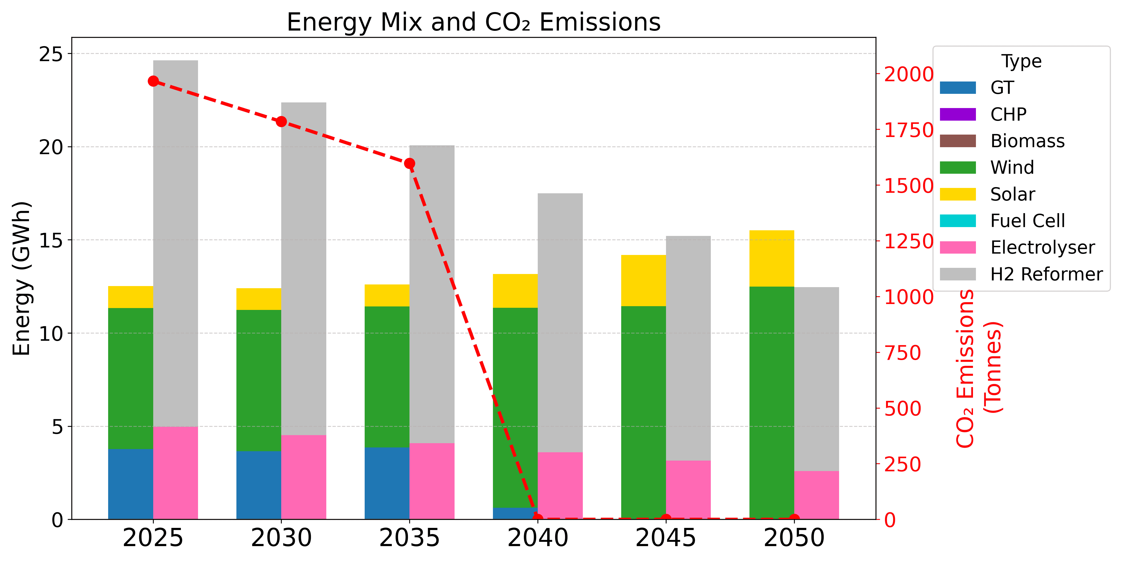
Decarbonisation Pathways for Residential Heating, North of Tyne – EFEA 2025
Investment planning (100% hydrogen blending, CCS from 2040)
Results
(a) Socio-technological interventions (STI)
(b) 50% heat pumps and 50% hydrogen
(c) 100% heat pumps (100% HP)
(d) 100% hydrogen boilers (100% HB)

Slide 10
Decarbonisation Pathways for Residential Heating, North of Tyne – EFEA 2025
Conclusions
Heat pumps: lowest-cost decarbonisation.
Hydrogen: flexible backup, higher running costs.
Demand-side measures help affordability but are insufficient alone.
CCS needed for (near) net-zero with any blue H₂ or gas backup.
Best pathway: demand cuts + electrification + targeted H₂ + CCS.
Success depends on integrated planning and public engagement.

Slide 11
9th International Conference on Environment Friendly Energies and Applications
EFEA 2025, Newcastle upon Tyne, UK. 4-5 December 2025
Thank You for Your Attention
Any Questions?
Socio‑Technical, Electrification, and Hydrogen‑Driven Pathways for Residential Heating Decarbonisation in the North of Tyne
mohamed.abuella@northumbria.ac.uk

