Slide 1

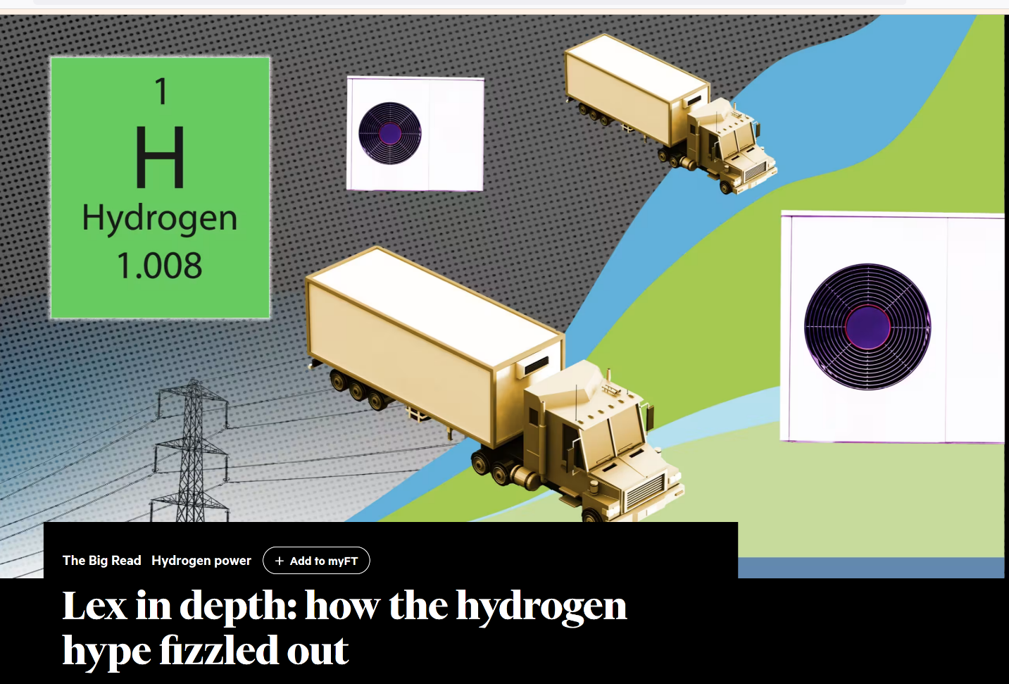

Innovative and Impactful Solutions
Applying the framework from Taming the Sun
Taming the Sun: Innovations to Harness Solar Energy and Power the Planet by Varun Sivaram.
This blog entry is available on Medium, 11 Dec 2019
Reading and Reflection on the Book of Solar Energy
For more deployment of solar energy we need three kinds of innovations:
Published by the MIT Press (March 2, 2018).
which the Financial Times called "the best available overview of where the solar industry finds itself today"
1) Financial,
2) Technological,
3) Systemic innovations.
22 May 2024
Lex in depth:
how the hydrogen hype fizzled out
https://www.ft.com/content/14a60649-172a-45c1-99a9-039f481430e7

Slide 2
Innovative and Impactful Solutions
The framework of innovations for hydrogen supply chain:
Financial innovations are critical to de-risking investments in hydrogen infrastructure and production. Creating attractive financial models can catalyze large-scale hydrogen deployment.
Technological innovations are essential to reduce production costs, improve storage and transportation, and increase the efficiency of electrolyzers. Investment in R&D will be crucial to overcome these barriers.
Systemic innovations must address the infrastructure challenges, integrate hydrogen into existing energy systems, and align policies across sectors. Hydrogen has a unique role to play in decarbonizing various sectors, so a coordinated approach is key.
Each of these innovations must evolve in parallel, building a robust hydrogen economy that can compete with fossil fuels while supporting the global transition to a low-carbon future.

