Slide 1


SMART GRID
Mohamed Abuella
Southern Illinois University Carbondale
September 25, 2012
Notes:
See page 289 in textbook.

Slide 2
THE OUTLINE
The scope of this presentation is about:
ECE580 Seminar Mohamed Abuella Smart Grid
1) Background:
The motivation of smart grid;
The history of smart grid.
2) The requirements and characteristics of smart grid.
3) The results of the Study Case project.
4) Some barriers of smart grid.
5) Conclusion
Notes:
See page 289 in textbook.

Slide 3

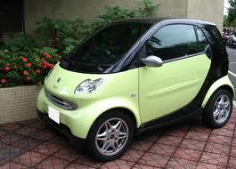

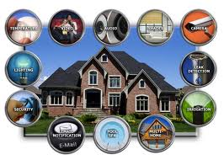
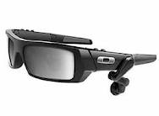
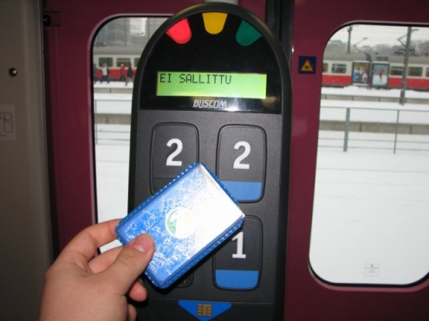
Everything’s gone SMART
ECE580 Seminar Mohamed Abuella Smart Grid
The Motivation of Smart Grid
Notes:
See page 289 in textbook.

Slide 4
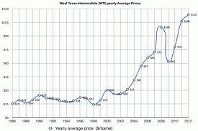
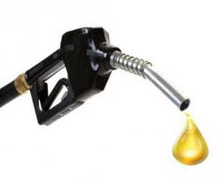
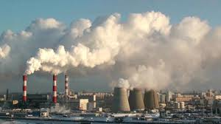
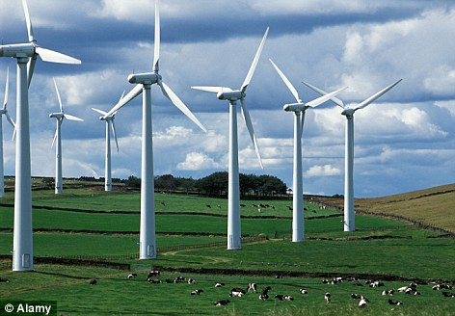
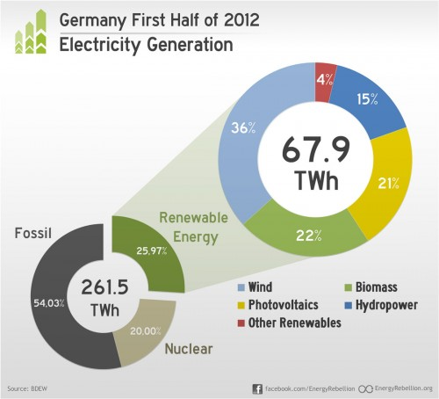

ECE580 Seminar Mohamed Abuella Smart Grid
The Motivation of Smart Grid
Scarcity of fossil fuel & price fluctuation;
Concern on Environment;
Notable increase of using renewable resources.
Notes:
See page 290 in textbook.

Slide 5
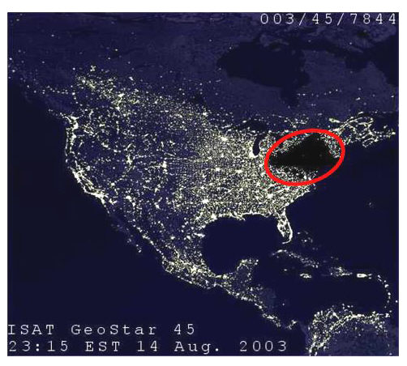
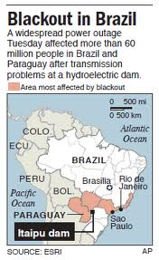
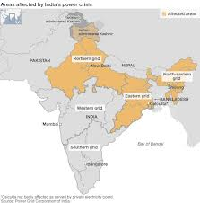
ECE580 Seminar Mohamed Abuella Smart Grid
The Motivation of Smart Grid
Today’s grid Quality Reliability.
Is Electricity always there 24/7?
6 of 7 World’s largest blackouts have happened since 1999
Northeast outage 2003
2009
Affected more than 600M
Notes:
See page 290 in textbook.

Slide 6
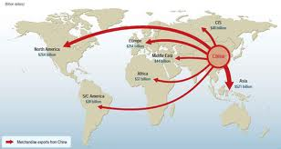

ECE580 Seminar Mohamed Abuella Smart Grid
The Motivation of Smart Grid
Crucial reform to meet new market orientations.
Notes:
See page 290 in textbook.

Slide 7
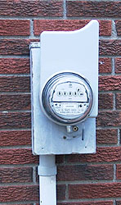
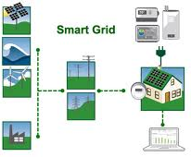
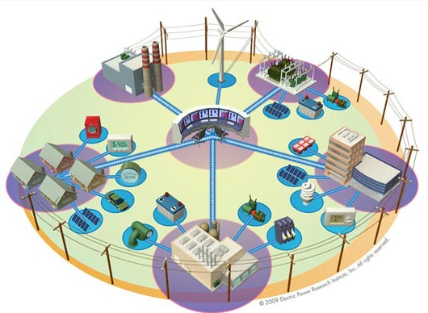
ECE580 Seminar Mohamed Abuella Smart Grid
Background
Smart Grid is the grid that integrates advanced sensing technologies, control methods, and integrated communications into the current electricity grid.
Definition of Smart Grid
U.S. Department of Energy (DoE)
With much more information & control
More precise system design & operation
Notes:
See page 290 in textbook.

Slide 8

ECE580 Seminar Mohamed Abuella Smart Grid
Background
Historical Spots:
EU: European Technology Platform Smart Grids in 2005;
USA: DoE dedicated to reform the current grid from 2002;
China: Starts a grid comprehensive development in 2009.
The target time to complete (2030)
Notes:
See page 290 in textbook.

Slide 9

ECE580 Seminar Mohamed Abuella Smart Grid
Today’s Electric Grid
Pumped Station
Power Plant
Substation
Substation
Transformer
Transformer
Transformer
Transformer

Slide 10


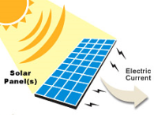

ECE580 Seminar Mohamed Abuella Smart Grid
Future Electric Grid
Pumped Station
Solar Farm
Power Plant
Wind Farm
Thermal Storage
CAES
Batteri
Batteries
Batteries
Communication &
Control
Substation
Substation
Transformer
Transformer
Transformer
Transformer
Solar Cells

Slide 11
ECE580 Seminar Mohamed Abuella Smart Grid
Smart Grid
Pumped Station
Solar Farm
Power Plant
Wind Farm
Thermal Storage
CAES
Batteries
Batteries
Communication &
Control
Substation
Substation
Transformer
Transformer
Transformer
Transformer
Solar Cells

Slide 12


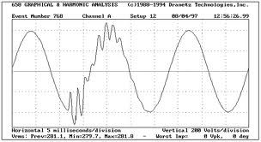

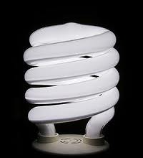
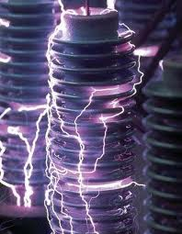
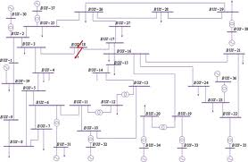
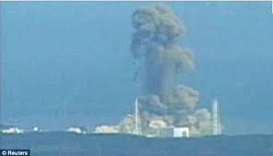

ECE580 Seminar Mohamed Abuella Smart Grid
The requirements and characteristics of Smart Grid
Seven principal Characteristics:
Enables active consumer participation;
Accommodates all generation and storage options;
Enables new products, services, and markets;
Provides power quality for the digital economy;
Optimizes asset utilization and operates efficiently;
Anticipates and responds to system disturbances;
Operates robustly against attack and natural disaster.
Notes:
See page 290 in textbook.

Slide 13
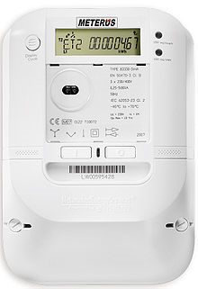
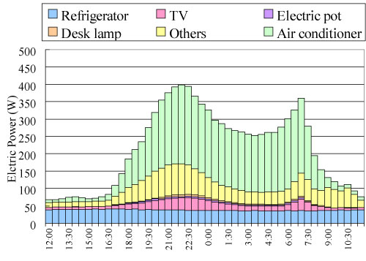
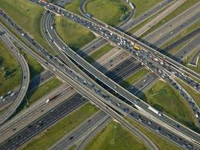
ECE580 Seminar Mohamed Abuella Smart Grid
Requirements of Smart Grid
Advanced measurement Infrastructure (AMI):
  Interface between the utility/customer
  Real-time electricity pricing.
  Multi-choices and Demand Response (DR)

Slide 14
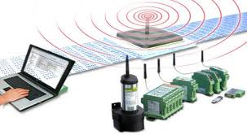
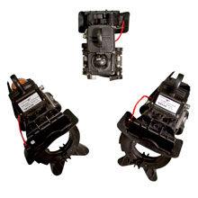
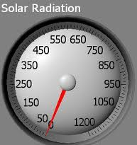
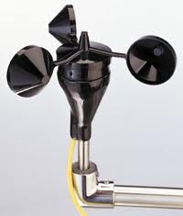
ECE580 Seminar Mohamed Abuella Smart Grid
Requirements of Smart Grid
Advance Sensing systems:
Check health of equipment;
Detecting faults early.
Distributed weather sensing:
    Improve the predictability of renewable energy;
    Adjust controls to ensure the power supply continuity.
Notes:
See page 290 in textbook.

Slide 15
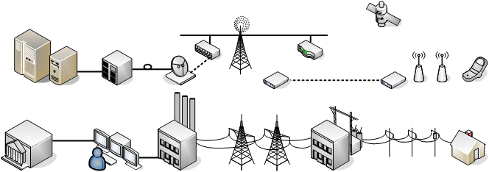
ECE580 Seminar Mohamed Abuella Smart Grid
Requirements of Smart Grid
Advanced communication systems:
Fully integrated, two-way communication technologies for real-time Data;
Store information about the user and grid conditions;
Cyber Security.
Notes:
See page 290 in textbook.

Slide 16
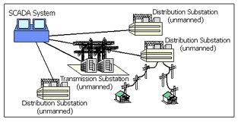


ECE580 Seminar Mohamed Abuella Smart Grid
Requirements of Smart Grid
Automation of power stations:
SCADA (Supervisory Control and Data Acquisition), On substations.
Automation (control & monitoring) within the substations.
Notes:
See page 290 in textbook.

Slide 17
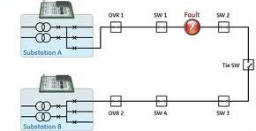
ECE580 Seminar Mohamed Abuella Smart Grid
Requirements of Smart Grid
Automation of distribution areas:
Located on distribution feeders.
Restore the gird in failures;
Reconfigurations during failures;
Improve the voltage.
Notes:
See page 290 in textbook.

Slide 18
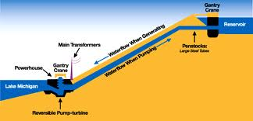
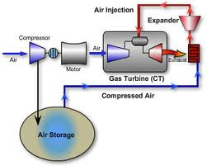
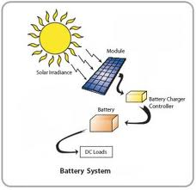
ECE580 Seminar Mohamed Abuella Smart Grid
Requirements of Smart Grid
Energy storage:
Energy Storage Systems needed with renewable energy sources.
Energy storage and Distributed generations should be integrated in grid physically and financially (bills).
Notes:
See page 290 in textbook.

Slide 19
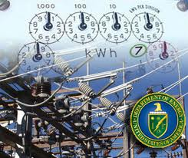
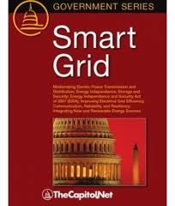
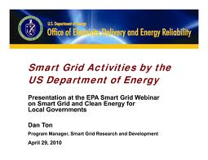

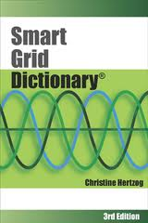


ECE580 Seminar Mohamed Abuella Smart Grid
Requirements of Smart Grid
Regulations and standards:
Standard practices and protocols for smart grid are necessary.
Notes:
See page 290 in textbook.

Slide 20
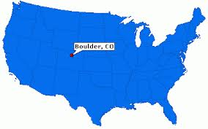
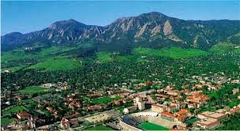
Study Case
ECE580 Seminar Mohamed Abuella Smart Grid
Smart Grid City:
Project Status
Scope: City of Boulder, CO. - 45,000 accounts;
Starts in April 2008;
More than 100 miles of fiber installed for Communication;
About 25,000 two-way smart meters installed;
Monitoring 3,200 transformers and 5,200 network elements;
Web portal and in-home devices offered to customers 2009;
New pricing tariffs, offered in 2010.
The World’s first smart grid city 2009
Notes:
See page 290 in textbook.

Slide 21
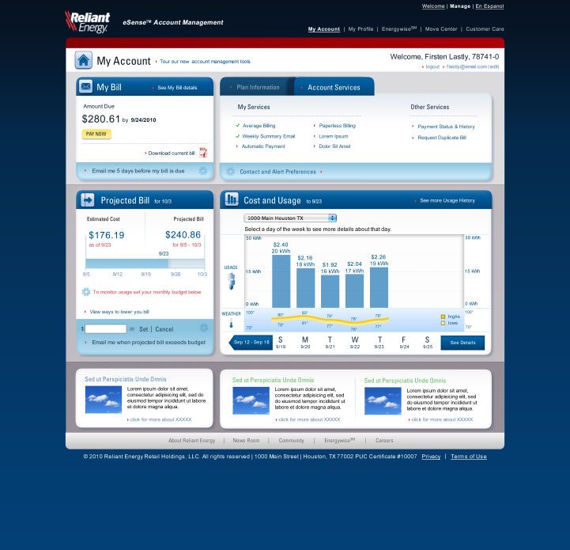
ECE580 Seminar Mohamed Abuella Smart Grid
Study Case
Smart Grid Web portal:
Monitor and manage energy use;
More options, choice and personal control.
Notes:
See page 290 in textbook.

Slide 22
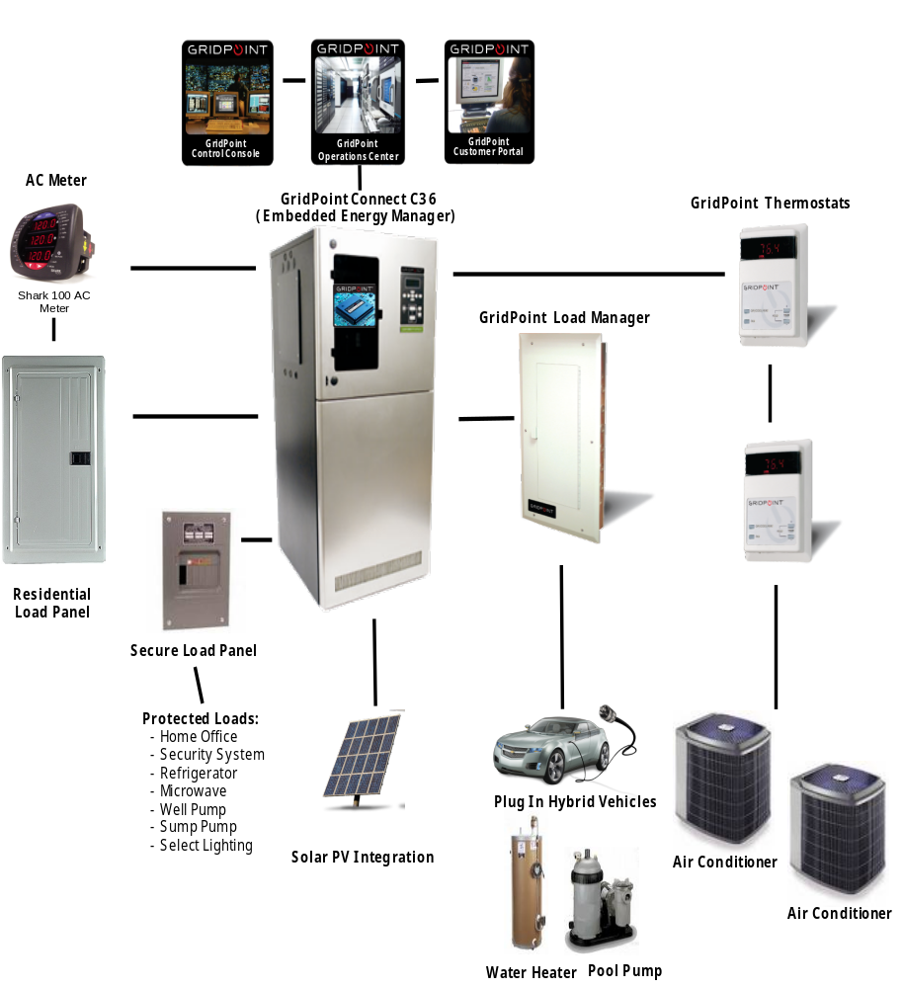
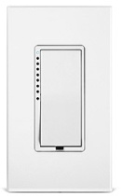
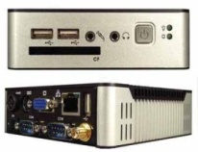
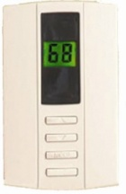

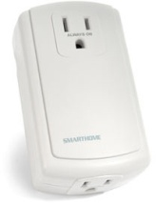
In-Home Energy Management Devices
ECE580 Seminar Mohamed Abuella Smart Grid
Study Case
Homebase
Gateway
Light switch
Controller
Programmable
Thermostat
High Voltage
Controller
Outlet
Controller

Slide 23
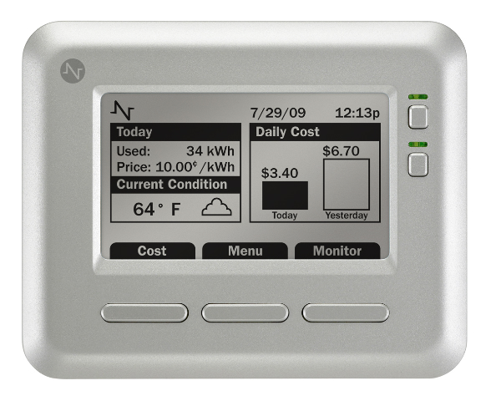
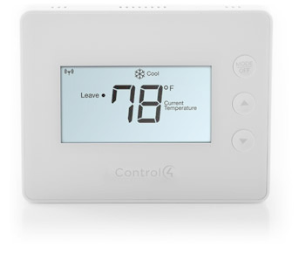
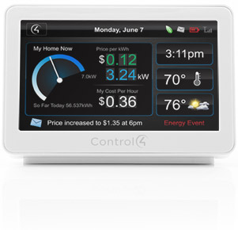
ECE580 Seminar Mohamed Abuella Smart Grid
Study Case
Home Energy Monitor & Programmable Thermostat
Real Time Usage & Cost Information;
Communicates with Smart Meter.

Slide 24
ECE580 Seminar Mohamed Abuella Smart Grid
Study Case
Results of the Smart Grid Demonstration:
Provide real world experience;
Characterize the economics of wide deployment;
Identify the requirements (especially the standards);
Identify work force requirements (manpower, skills, training);
Provide the overall cost and benefits.
Notes:
See page 290 in textbook.

Slide 25




ECE580 Seminar Mohamed Abuella Smart Grid
Smart Grids Constraints
  Uncertainty of costs and Benefits
  Existing Grid is hard enough;
  Will the computerized grid be more efficient?
  The education and welfare of users.
  Grid stability,
  Especially with intermittent energy sources.
  Security and Privacy.
Notes:
See pages 290 and 291 in textbook.

Slide 26
ECE580 Seminar Mohamed Abuella Smart Grid
Conclusion
The transformation from the antiquated electric infrastructure to the modernized smart grid could be the best option to solve many problems in the current electric grid.
Notes:
See pages 290 and 291 in textbook.

Slide 27
ECE580 Seminar Mohamed Abuella Smart Grid
References
Bruce, J. (2003). THE SMART GRID. Electric Perspectives, 28(6), 37. Retrieved from Business Source Complete database.
Charles, D. (2009). Renewables Test IQ of the Grid. Science, 324(5924), 172. Retrieved from: MasterFILE Premier database.
Forte, V. (2010). Smart Grid at National Grid. doi:10.1109/ISGT.2010.5434729.
Jingjing, L., Da, X., & Qian, A. (2009). Research on smart grid in China. doi:10.1109/TD-ASIA.2009.5356959.
Kiesling, L. (2008, September 21). Smart savings. Science in Society. Retrieved from:http://scienceinsociety.northwestern.edu/print/content/articles/2008/kiesling/smart-savings?gclid=CL-v4tXW-6ICFd8B5wodDHPlzw
McDaniel, P., & McLaughlin, S. (2009). Security and privacy challenges in the smart grid. IEEE Security & Privacy, 7(3), 75-77. doi:10.1109/MSP.2009.76.
Wolfs, P., & Isalm, S. (2009). Potential barriers to smart grid technology in Australia. Retrieved from: Inspec database.
Notes:
See page 290 in textbook.

Slide 28

ECE580 Seminar Mohamed Abuella Smart Grid
Thanks for listening
Any questions?
Notes:
See pages 290 and 291 in textbook.

Slide 29

SMART GRID
Mohamed Abuella
Southern Illinois University Carbondale
September 25, 2012

