Slide 1












Strategic Investment Planning for Hydrogen Infrastructure in the UK: Game Theory Insights from Regional and National Case Studies
Adib Allahham and Mohamed Abuella
Northumbria University – School of Engineering, Physics and Mathematics

Slide 2
Outlines
PART 1: Context and Motivation
PART 2: Case Study 1 - North of Tyne Cournot Game
PART 3: Case Study 2 - Competitive vs. Cooperative Comparison for GB National Investment Planning
PART 4: Case Study 3 - From cooperative market design to targeted policy instruments: CO₂ pricing and Contracts for Difference
PART 5: Conclusions and Policy Insights

Slide 3
Context and Motivation

Slide 4
Why does Planning Approach Matter?
The GB Net-Zero Challenge
UK aims to cut emissions by 78% by 2035 and reach net-zero by 2050
The UK Hydrogen Strategy and National Grid’s Future Energy Scenarios (FES) identify hydrogen as a key enabler of this transition.
National Grid FES 2023: projects 100–150 TWh/year of hydrogen by 2050 (Leading the Way scenario) – 55–65% green hydrogen, 30–40% blue hydrogen, and 5–10% emerging ‘turquoise’ pathways
GB operates a liberalised energy market with independent investors
UK policy is promoting greater coordination of hydrogen infrastructure through new hydrogen business models and government-backed cluster programmes
Track-1 / Track-2 CCS & Hydrogen Cluster sequencing to support regional partnerships and investment
Key question: competition or coordination for hydrogen infrastructure?

Slide 5
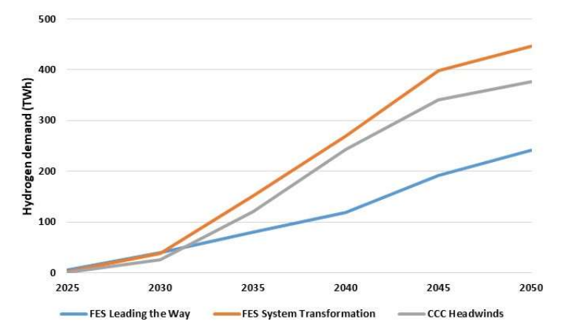
Investment Planning Challenge
Traditional approach: Centralised optimisation (single planner minimises total costs)
Reality: Multiple independent investors making strategic decisions
Key tensions:
Competitive markets (generators, producers competing)
Coordination needs (circular dependencies: production ↔ demand ↔ infrastructure)
Uncertain demand trajectories
While technical and economic factors matter, the fundamental challenge involves strategic interactions between actors with different goals.

Slide 6
Why Game Theory?
Game theory explicitly models strategic interactions
Competitive games (Cournot): Competitive market dynamics, Nash equilibrium
Investors compete for profits and market share.
Each investor chooses how much capacity to build to maximise their own profit.
Investors make their choices simultaneously, understanding that total capacity will influence market prices and their profits.
The Nash equilibrium is the point where no investor can increase their profit by changing their own decision.

Slide 7
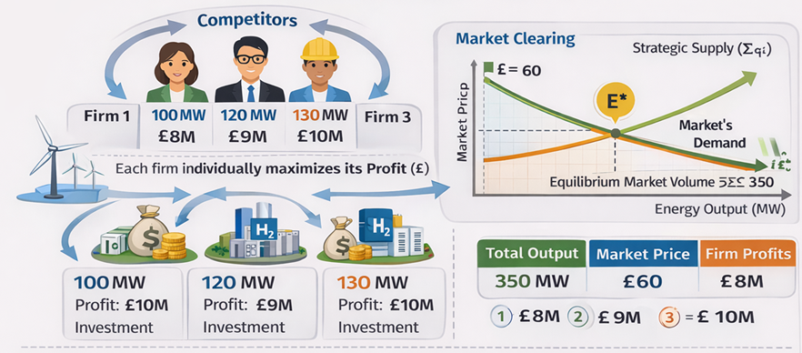
Why Game Theory?
Competitive Investment Game
Independent Investors in Liberalised Energy Market

Slide 8
Why Game Theory?
Cooperative games (Shapley value): Coordinated planning, fair benefit-sharing
Investors cooperate and share the profit/benefit.
Shapley value-based planning is used to model what happens if investors coordinate and share benefits fairly.
Shapley value (Mathematical Method) splits costs and profits and ensures each investor gains from coordination.

Slide 9
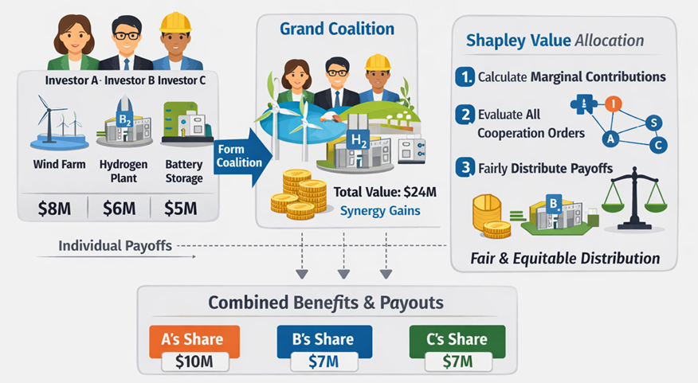
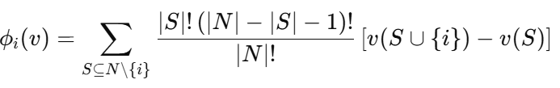
Why Game Theory?
Coalition Formation and Shapley Value
Investment Planning in Energy Systems

Slide 10
Why Game Theory?
Competitive
Cooperative
Independent profit maximisation (What is best for me as given others' actions?)
Decision-Making
Joint planning & coordination (What is best for us collectively?)
Strategy
Multiple firms compete for market share
Coordinated infrastructure planning
Enables comparison: Which approach delivers better outcomes?
Identify which framework delivers the most cost-effective, lower emissions, and a fairer deal for each investor involved

Slide 11
Case Studies Overview
Case Study 1:
North of Tyne Region - Cournot Game (regional scale, multi-sector)
Case Study 2: GB Comparative Analysis - Cournot vs. Shapley value (which framework works better?)
Case Study 3:
From cooperative market design to targeted policy instruments: CO₂ pricing and Contracts for Difference

Slide 12
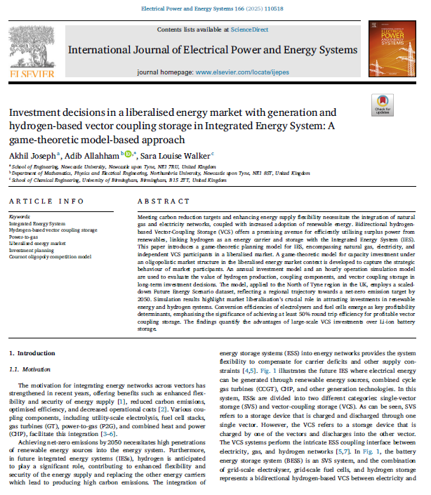
Case Study 1 - North of Tyne Cournot Game

Slide 13
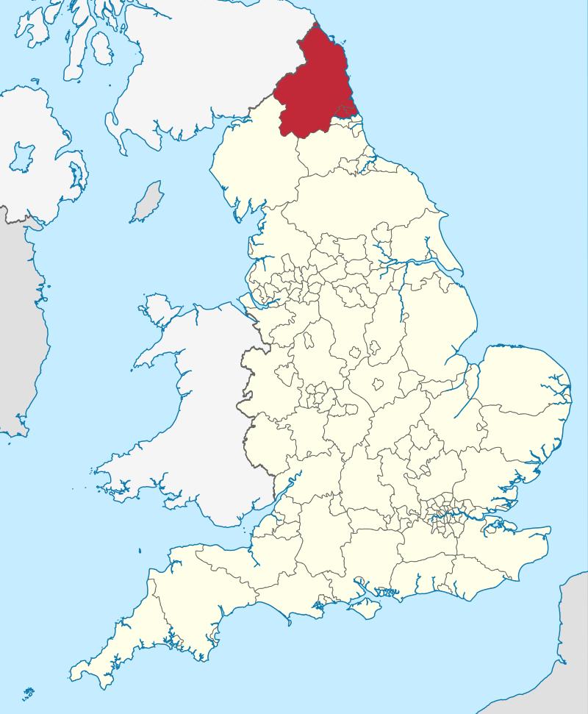
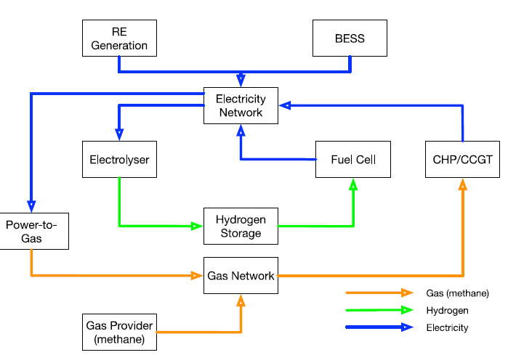
North of Tyne Regional Context
Study Overview:
Objective: How do competing investors in a liberalised energy market make decisions about generation and storage technologies when constrained by policy scenarios and existing infrastructure?
Model: Nash-Cournot game theory with policy constraints
Time Horizon: 2022-2050 (5-year intervals)

Slide 14
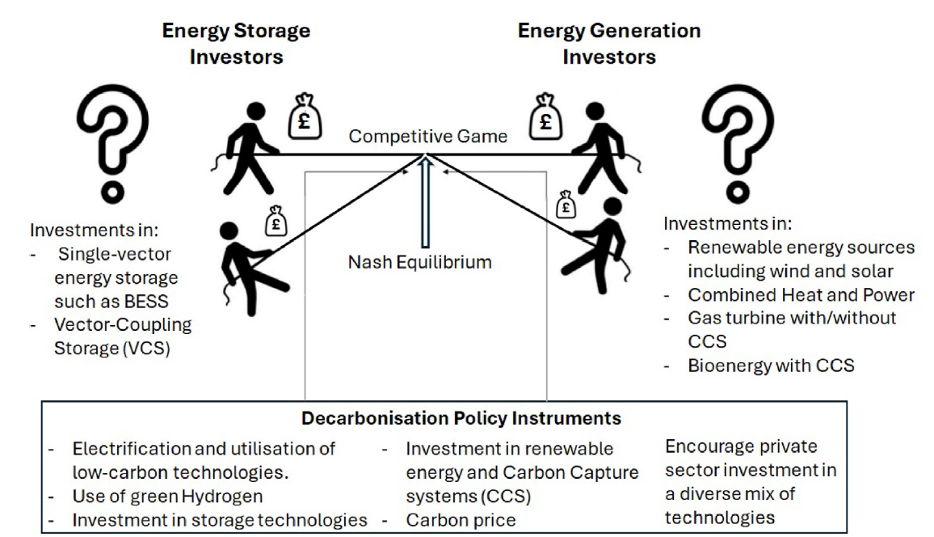
Nash-Cournot game theory with policy constraints

Slide 15
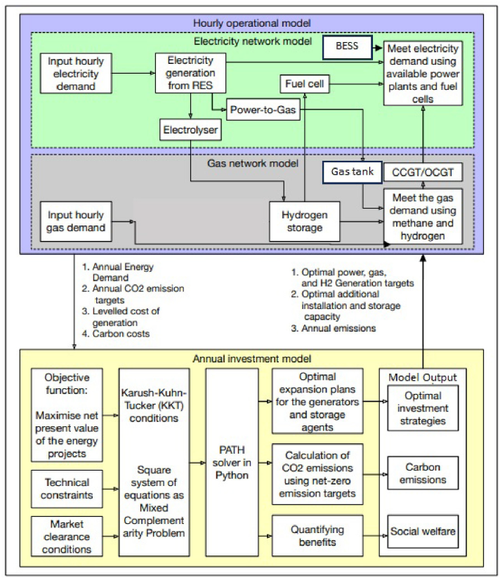
Model Framework
Bi-Level Optimisation Structure
Investment Model (Annual):
30 market players competing (Nash-Cournot game)
Objective: Maximise Net Present Value
Constraint: Investment ≤ iMAX (from FES scenarios)
Solver: Complementarity problem (PATH algorithm)
Operational Model (8760 hours):
Optimal power, gas, hydrogen flow (OPGHF)
Validates investment feasibility
Cost feedback: Iterate until convergence
CCS Implementation:
Based on BEIS Case 1 (CCGT + Post-Combustion CCS)
90.8% capture rate → 0.0343 tCO₂/MWh
Parameters updated by year (2022: 0.488 → 2050: 0.0343)
Represents technology deployment trajectory
Key Parameters:
Electricity: £250/MWh | Carbon: £143-163/tonne (2050)
Discount: 5%

Slide 16
Data procession
Regional Scaling Approach (NoT Region)
National FES data scaled to represent NoT
Assumption: regional trends follow national trajectory
Electricity Demand Scaling
2020 demand used as base year (scale = 1)
Peak demand identified for each scenario to 2050
Demand growth applied proportionally (e.g., +20% → ×1.2)
Growth factors applied to short-term operational load models
Daily load profiles modified to reflect:
- Electrification
- Heat pump penetration
Installed Capacity Scaling
Considered:
Total installed capacity in NoT
Technology-specific capacity
National technology growth trends calculated per FES scenario
Total NoT target capacity aligned with national trend
Consideration of plant decommissioning
Interpolation applied for intermediate years (e.g., 2030, 2040, 2050)
Same methodology applied to gas demand and gas capacity

Slide 17
Technologies in the Model
Technology | Players | 2022 Capacity (MW) | 2050 LCOE (£/MWh) | Emissions 2022/2050 (tCO₂/MWh)
Gas Turbine | 10 | 2,651 | 81 → ~66* | 0.488 → 0.0343 (with CCS)
Wind | 4 | 53 | 39 | 0 → 0
Solar | 3 | 8 | 32 | 0 → 0
Biomass | 4 | 16 | 192 | 0.786 → ~0.079 (with CCS)
CHP | 5 | 140 | 136 | 0.488 → 0.0343 (with CCS)
Electrolyser | 1 | 0 | 42 | 0 → 0
Fuel Cell | 1 | 0 | 42 | 0 → 0
*BEIS "Assessing Cost Reduction Potential of UK Carbon Capture Technology" (2018), Case 1
Initial Capacity Comparison: Ratio: 50:1 (Gas to Wind)

Slide 18
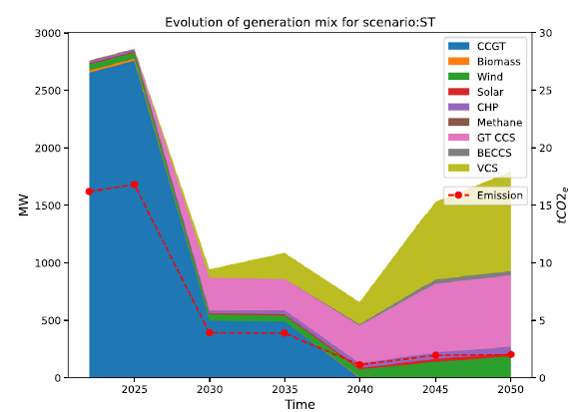
System Transformation Scenario – Hydrogen Intensive Pathway
2050 Generation Mix:
Gas with CCS (90% capture): 34.6%
Hydrogen VCS: 48%
Wind: 10%
Other (BECCS, CHP+CCS, Solar): 7.4%
Achievement: 88% Emission Reduction
Carbon Price Impact:
ST: £142.94/tonne → Aggressive CCS deployment
Gas carbon cost: £4.90/MWh (0.0343 × 143)
Unabated cost would be: £70/MWh (0.488 × 143)
CCS saves £65/MWh in carbon costs
Investment Timeline:
2022-2030: CCS deployment begins, H₂ planning
2030-2040: CCS accelerates, H₂ stagnates
2040-2050: Explosive H₂ growth, mature CCS
Key Insight: Both CCS (34.6% gas) AND hydrogen (48%) are essential for 88% reduction

Slide 19
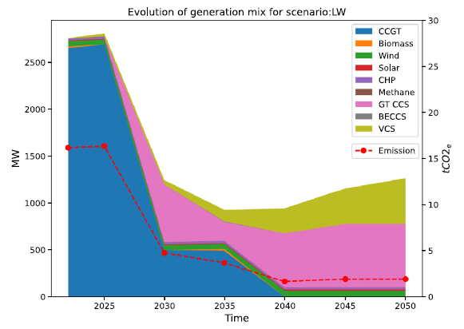
Leading the Way Scenario – Electrification + Hydrogen Pathway
2050 Generation Mix:
Gas with CCS (90% capture): 53%
Hydrogen VCS: 38.5%
Wind: 5%
Other (CHP+CCS, Solar): 3.5%
Achievement: 88% Emission Reduction (same as ST)
Different Balance:
Higher gas+CCS (53% vs. 34.6%)
Lower hydrogen (38.5% vs. 48%)
Lower wind (5% vs. 10%)
Higher carbon price: £162.62/tonne
Paper Finding: Key Insight:
LW relies more on proven CCS technology
ST relies more on emerging hydrogen technology
Both valid pathways to 88% reduction

Slide 20
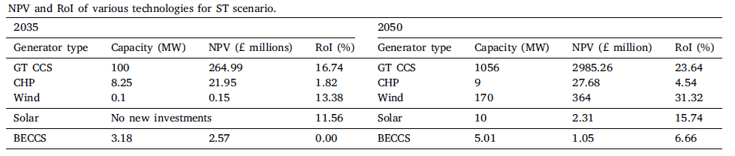
Return on Investment
Key Observations:
Wind shows the highest RoI by 2050 (31.32%)
Wind RoI grows 134% (13.38% → 31.32%)
Gas-CCS receives the most investment despite lower RoI
All technologies show positive NPV (economically viable).

Slide 21
Key Observations
Multiple pathways (LW and ST) achieve the same emission target with different technology mixes.
ST scenario policies are most suitable for decarbonisation by attracting investments in hydrogen production, storage, and conversion systems
If policy wants to shift that balance toward higher-RoI renewables, it needs to do more than rely on economics alone. It needs to address the infrastructure gap and, in future scenarios, potentially adjust the deployment limits.

Slide 22

Case Study 2: Competitive vs. Cooperative Comparison for GB National Investment Planning

Slide 23
From Region to Nation: What Changes at GB Scale?
Case Study 1 showed us what competition looks like at a regional level.
Now we scale up — and introduce cooperation as an alternative.
✓ Case Study 1 — North of Tyne (Done)
→ Case Study 2 — Great Britain (Next)
Scale:
National GB
Scale:
Regional (North of Tyne)
Model:
Nash–Cournot only
Model:
Cournot + Cooperative + Benchmark
Players:
30 individual investors
Scale
up
Players:
Horizon:
18 players representing technology groups (Wind, H₂, Nuclear…)
2022–2050 (5-yr intervals)
H₂ share:
Horizon:
38–48% by 2050 (ST / LW)
2025–2050 | Peak 2050 demand
Finding:
H₂ share:
Multiple pathways → 88% reduction
Varies by scenario (High / Low H₂)
Question:
Does cooperation outperform competition?
Key addition in Case Study 2: Cooperative (Shapley value) and Benchmark (Central Planning) introduced alongside Cournot competition | Same bi-level OPGF structure | Four technology scenarios based on LW scenario

Slide 24
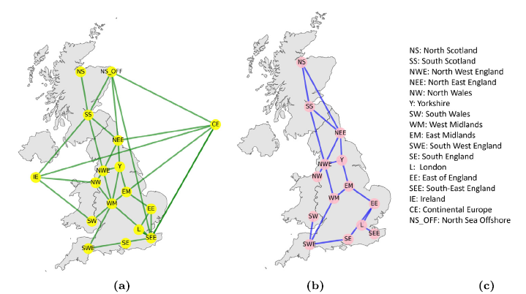
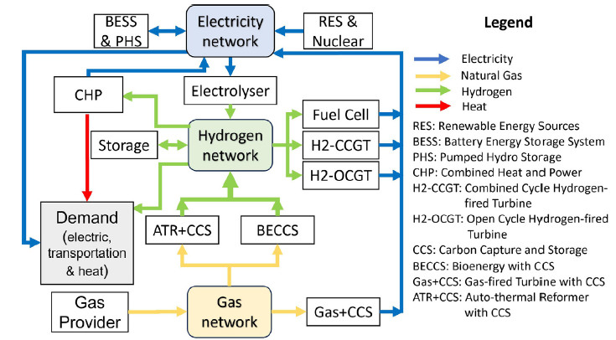
GB’s future energy networks/system
GB’s energy networks: (a) electricity network,
(b) gas/hydrogen network, (c) Legend for distribution DNOs and interconnections
Integrated multi-vector energy system framework for the GB

Slide 25
Modelling Framework: Three Planning Approaches
Competitive
(Nash–Cournot)
Cooperative
(Shapley Value)
Benchmark
(Central Planning)
Each technology-level investor maximises their own NPV
Players form coalitions to maximise joint welfare
Single planner optimises entire system
Strategic interactions via complementarity conditions (MCP)
Shapley value allocates benefits by marginal contribution and represents a coordinated planning alternative
Standard NLP; no strategic interactions
Implemented in Pyomo/IPOPT
Solved using PATH solver
Reference for comparison
Reflects GB’s liberalised market reality
Positive values = net contributors; Negative = need support
Which delivers better outcomes for hydrogen-integrated systems?

Slide 26
Modelling Framework: Three Planning Approaches
Metrics: Costs, emissions, technology mix, fairness
All three approaches share:
Bi-level structure (long-term investment + short-term OPGF)
Same GB data and demand profiles
Same convergence threshold (ε)
Peak 2050 demand: 102.17 GWh electric, 14.27 GWh hydrogen

Slide 27
Four Investment Scenarios (2025–2050)
Focus: Optimal decarbonisation strategy for GB (2050)
Based on FES 2022 – Leading the Way scenario
Key Assumption
Demand is fixed across all scenarios
Scenarios differ by:
Capacity limits (generation, storage, hydrogen)
NOT demand variation
Scenario Design Approach
Scenarios define capacity limits (inputs)
Model determines:
Optimal operation
Cost-effective utilisation
Capacity limits set relative to: 2025 baseline → 2050 targets
Used to test:
Different technology deployment strategies
Role of hydrogen versus storage

Slide 28
Four Investment Scenarios (2025–2050)
Uniform +25 GW
High RES – High H₂
Balanced increase across all technologies.
Objective:
Diversification
Reduced dependency on single technology
Strong expansion of:
Renewable generation
Battery storage
Hydrogen infrastructure
Objective:
Maximise decarbonization
Enhance system flexibility
S1
S2
High RES – Low H₂
High H₂ – Low BESS
High renewable + battery deployment
Limited hydrogen investment
System characteristics:
Batteries for short-term flexibility
Hydrogen plays a minor role
Prioritises: Hydrogen production and storage
Limited: Battery storage expansion
Focus: Long-term flexibility via hydrogen
S4
S3

Slide 29
Results: Costs & Emissions (Profitable Planning)
Scenario | Competitive OpEx (m£) | Cooperative OpEx (m£) | Benchmark OpEx (m£) | Comp. CO₂ (t) | Bench. CO₂ (t)
Uniform +25 GW | 2.22 | 1.47 | 2.14 | 0 | 0
High RES–High H₂ | 2.09 | 1.41 | 1.56 | 0 | 0
High RES–Low H₂ | 1.13 | 1.14 | 1.13 | 0 | 0
High H₂–Low BESS | 3.40 | 1.47 | 3.22 | 8,161 | 4,285
57% Reduction in operational costs (cooperative vs. competitive, High H₂– Low BESS)
8161 Tonnes CO₂ remaining under competitive planning (High H₂– Low BESS scenario)
Cooperative achieves zero CO₂ in all scenarios; Benchmark residual = 4,285 t in High H₂–Low BESS.
£1.47 m Lowest operational cost achieved: Cooperative, High H₂–Low BESS (vs. £3.40m competitive)

Slide 30
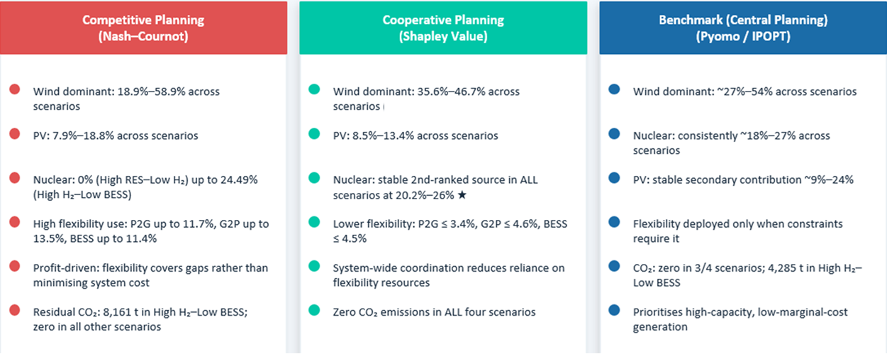
Energy Generation Mix: Structural Differences

Slide 31
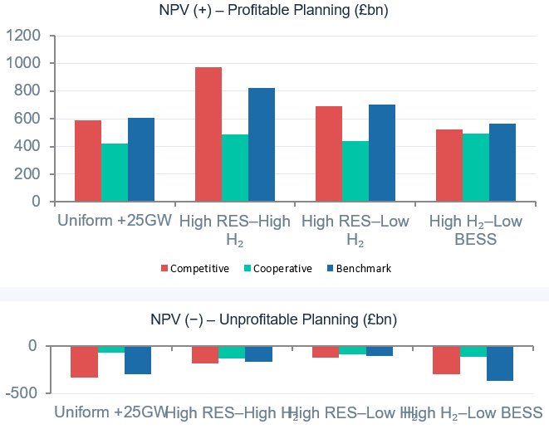
Net Present Value & Financial Robustness
Key Insights
Competitive = Highest NPV(+)
Particularly under high H₂ — strongest private incentives. But accompanied by higher costs and residual emissions.
Cooperative = Most Stable NPV
Moderate but consistent NPV(+) across all scenarios. Smallest NPV(−) in unprofitable conditions — greatest financial robustness.
Benchmark = Intermediate
NPV(+) higher than cooperative but lower than competitive in high H₂ scenarios. Confirms efficiency gains from central planning over market competition.
Smallest NPV gap for Coop.
Cooperative NPV deviation (+ to −) is smallest, meaning it best absorbs market downturns and requires least policy support.

Slide 32
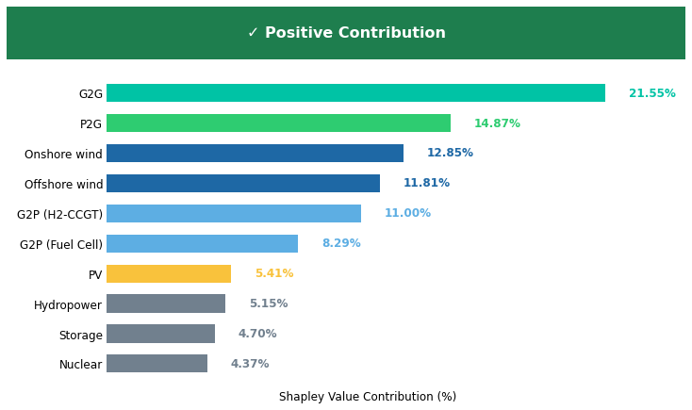
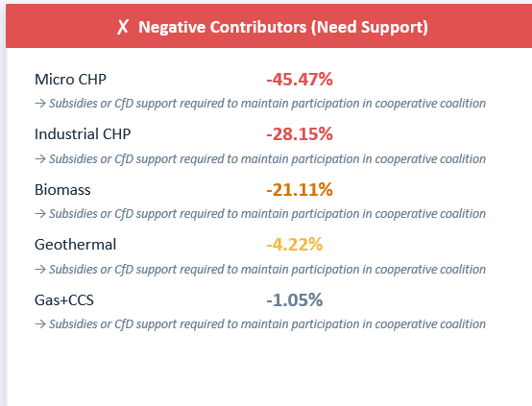
Shapley Value: Who Contributes and Who Needs Support?
Hydrogen technologies (G2G + P2G) are the primary value drivers of the system-wide coalition. Gas+CCS, Biomass, and CHP technologies increase coalition cost and require targeted policy support.

Slide 33
Unprofitable Planning: Robustness Under Adverse Conditions
Unprofitable prices: Electricity = £40/MWh | Hydrogen = £50/MWh | Gas = £15/MWh | CO₂ = £163/tCO₂ (fixed)
Scenario | Comp. NPV (£bn) | Coop. NPV (£bn) | Bench. NPV (£bn) | Comp. CO₂ (t) | Coop. CO₂ (t) | Bench. CO₂ (t)
Uniform +25 GW | −334 | −69 | −301 | 0 | 0 | 0
High RES–High H₂ | −184 | −133 | −171 | 0 | 1,230 | 0
High RES–Low H₂ | −120 | −86 | −107 | 0 | 0 | 0
High H₂–Low BESS | −293 | −118 | −363 | 10,785 | 0 | 1,516
Competitive shows deepest NPV losses; Benchmark is worst in High H₂–Low BESS.
Intermediate performance. Worse than cooperative in High H₂–Low BESS (−£363bn). Still better than competitive in 3/4 scenarios.
Competitive
Cooperative
Benchmark
Consistently deepest losses. Up to −£334bn. Residual CO₂ in High H₂–Low BESS (10,785 t). Market signals fail under adverse conditions.
Smallest NPV losses in ALL scenarios. Zero CO₂ in 3/4 scenarios. Greatest financial robustness. Requires least policy support.

Slide 34
Policy Implications: Quantifying Required Support
Price Case | Metric | Uniform +25GW | High RES–High H₂ | High RES–Low H₂ | High H₂–Low BESS
Profitable | Elec. support (GWh) | 0 | 0 | 0 | 0
 | Opex support – Elec (m£) | 0 | 0 | 0 | 0
Unprofitable | Elec. support (GWh) | 20.54 | 54.06 | 18.20 | 32.49
 | Opex support – Elec (m£) | £0.82m | £2.16m | £0.73m | £1.30m
Hydrogen technologies require zero support in all scenarios. Support for electricity technologies only under unprofitable conditions.
Under Profitable Prices: No policy support needed for any technology in any scenario. The cooperative framework is self-sustaining under favourable market conditions (£100/MWh electricity, £150/MWh hydrogen).
Under Unprofitable Prices: Electricity technologies require £0.73–2.16m in Opex support. Hydrogen technologies require zero support — driven by hydrogen price sensitivity. High RES–High H₂ needs most (£2.16m).
Policy Design Principle: Shapley values identify exactly who needs support and by how much. This enables targeted subsidies (CfD, OpEx grants) rather than broad, inefficient market interventions.

Slide 35
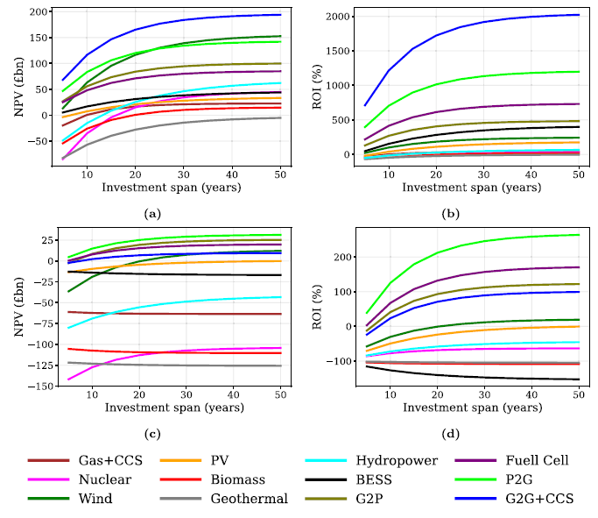
Sensitivity Analysis: Robustness of Findings
NPV & ROI Sensitivity to Investment Horizon
Hydrogen technologies (G2G, P2G): Highest long-term NPV and ROI across all investment horizons. Dominant in profitable AND relatively resilient in unprofitable conditions.
Gas+CCS and Biomass: Negative NPV over entire 50-year horizon — confirm Shapley analysis, policy support required regardless of planning horizon.
Renewables (wind, solar, nuclear): Positive, stable ROI — lower than hydrogen but dependable long-term investments.
(a)–(b) show NPV and ROI under the profitable planning, (c)–(d) correspond to the unprofitable planning,

Slide 36
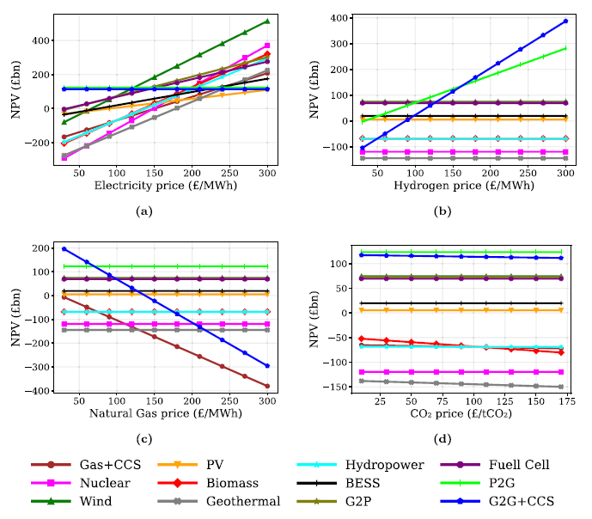
Sensitivity Analysis: Robustness of Findings
NPV Sensitivity to Commodity Prices
Wind, solar, nuclear: Largely insensitive to commodity price volatility → low-risk investments.
Gas+CCS: Highly sensitive to both natural gas AND CO₂ prices → significant market risk.
P2G, G2P (hydrogen): Highly sensitive to electricity and hydrogen price ratio → need stable policy framework to de-risk.
Overall: Hydrogen, nuclear, and renewables are economically robust. Gas+CCS, Biomass, and CHP are market-exposed and require targeted policy.
Sensitivity of net present value (NPV) to prices of (a) electricity, (b) hydrogen, (c) natural gas, and (d) CO2.

Slide 37
Key Observation
Under LOW hydrogen integration: competitive, cooperative, and benchmark frameworks all achieve net-zero feasibility with comparable results.
Under HIGH hydrogen integration: cooperative planning delivers 57% lower operational costs and zero CO₂ vs. 8,161 tonnes under competition.
Benchmark (central planning) provides intermediate outcomes; better than competition but less efficient and less robust than cooperation, particularly under adverse conditions.
Hydrogen technologies (G2G, P2G) are the primary system value drivers; Gas+CCS, Biomass and CHP need policy support.
Cooperative planning is most financially robust: smallest NPV losses under unprofitable conditions and lowest policy support requirement (£0.73–2.16m at peak demand).

Slide 38
Case Study 3:
From cooperative market design to targeted policy instruments: CO₂ pricing and Contracts for Difference
Under review

Slide 39
From Market Structure to Policy Instruments
Cooperative
Game Theory model
Policy Navigation
Key question to answer:
Which combination of CO₂ price and CfD strike price keeps the cooperative system financially viable AND environmentally effective?
Cooperation outperforms competition when hydrogen is deeply integrated
Uses the same cooperative bi-level Shapley framework
Adds CO₂ pricing and CfD as explicit policy instruments
Shapley value identifies which technologies need support
Tests 288 combinations across 4 scenario dimensions
System is self-sustaining under favourable market prices
The cooperative framework
→ What policy makes it work?
Identifies optimal CO₂–CfD corridor to sustain cooperation
But: cooperation breaks down when prices fall
Same GB system | Same Shapley-based cooperative framework | Two policy instruments added: CO₂ price (0–500 £/tCO₂) and CfD (0–250 £/MWh) | 288 scenario combinations

Slide 40
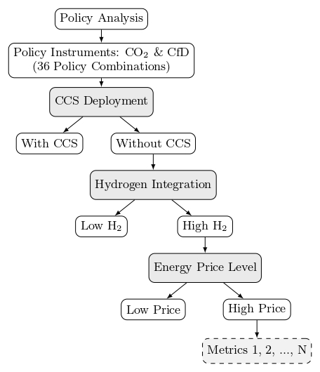
The 288-Scenario Policy Space & Interactive Navigator
A tree-based grid search across CO₂ pricing, CfD support, CCS availability, H₂ demand, and price levels
Policy Tree Structure
36 CO₂ × CfD combinations
× 2 CCS availability (With / Without)
× 2 H₂ integration (High / Low)
× 2 Price level (High / Low)
= 288 policy outcomes
CO₂: 0–500 £/tCO₂ (6 levels) | CfD: 0–250 £/MWh (6 levels)

Slide 41
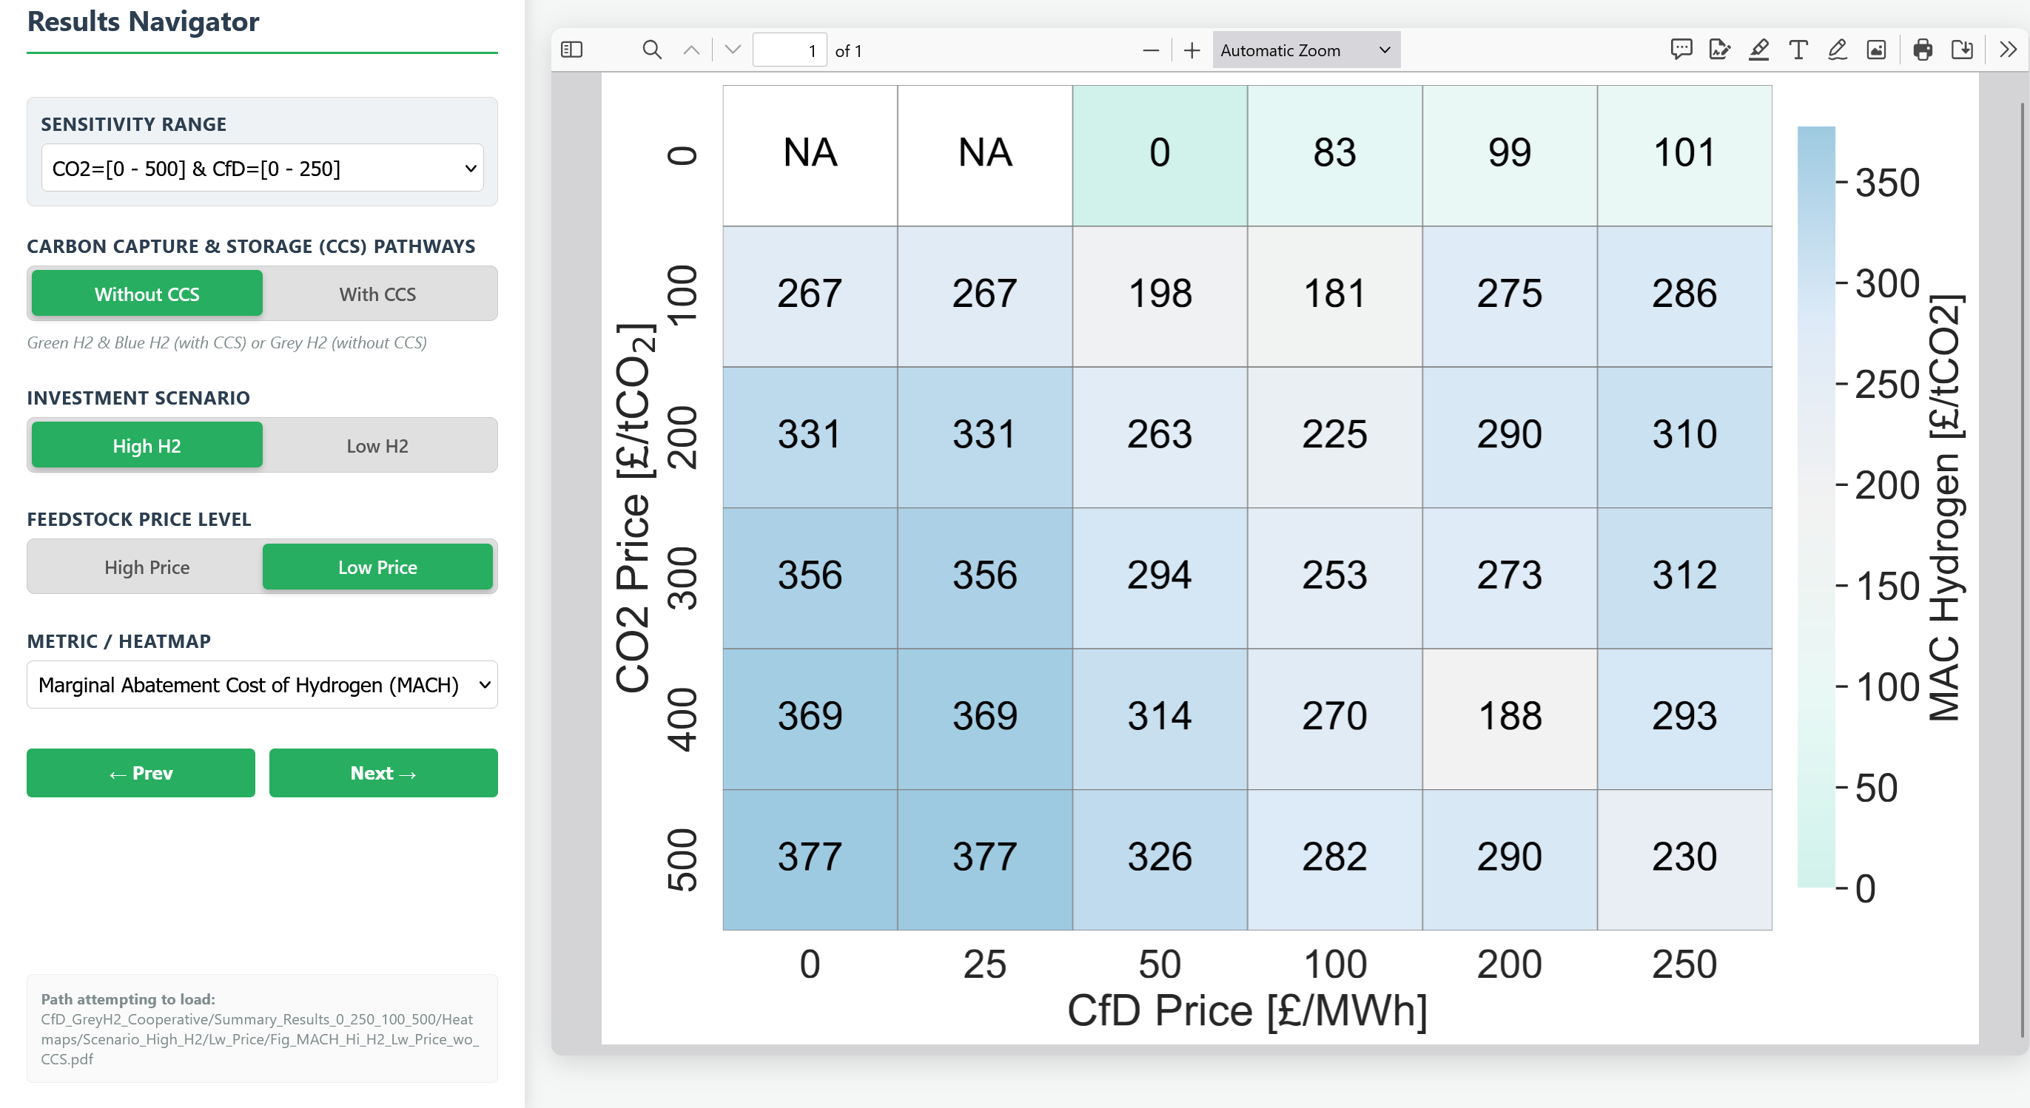
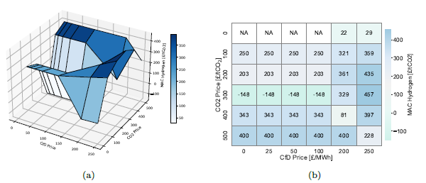
The 288-Scenario Policy Space & Interactive Navigator
Why heatmaps? 3D surface plots obscure gradients and thresholds — heatmaps preserve quantitative detail and reveal policy interactions clearly.
Visualisation comparison for marginal abatement cost of hydrogen sensitivity
under high demand and price without CCS.
Web-based tool — no model re-runs needed. Pre-computed results loaded instantly.
Toggle controls: H₂ demand level, price environment, CCS availability.
Heatmap visualisation: CO₂ price (y-axis) vs CfD level (x-axis).
Metrics: CO₂ emissions, MACH, NPV, green H₂ ratio, total CfD cost.

Slide 42
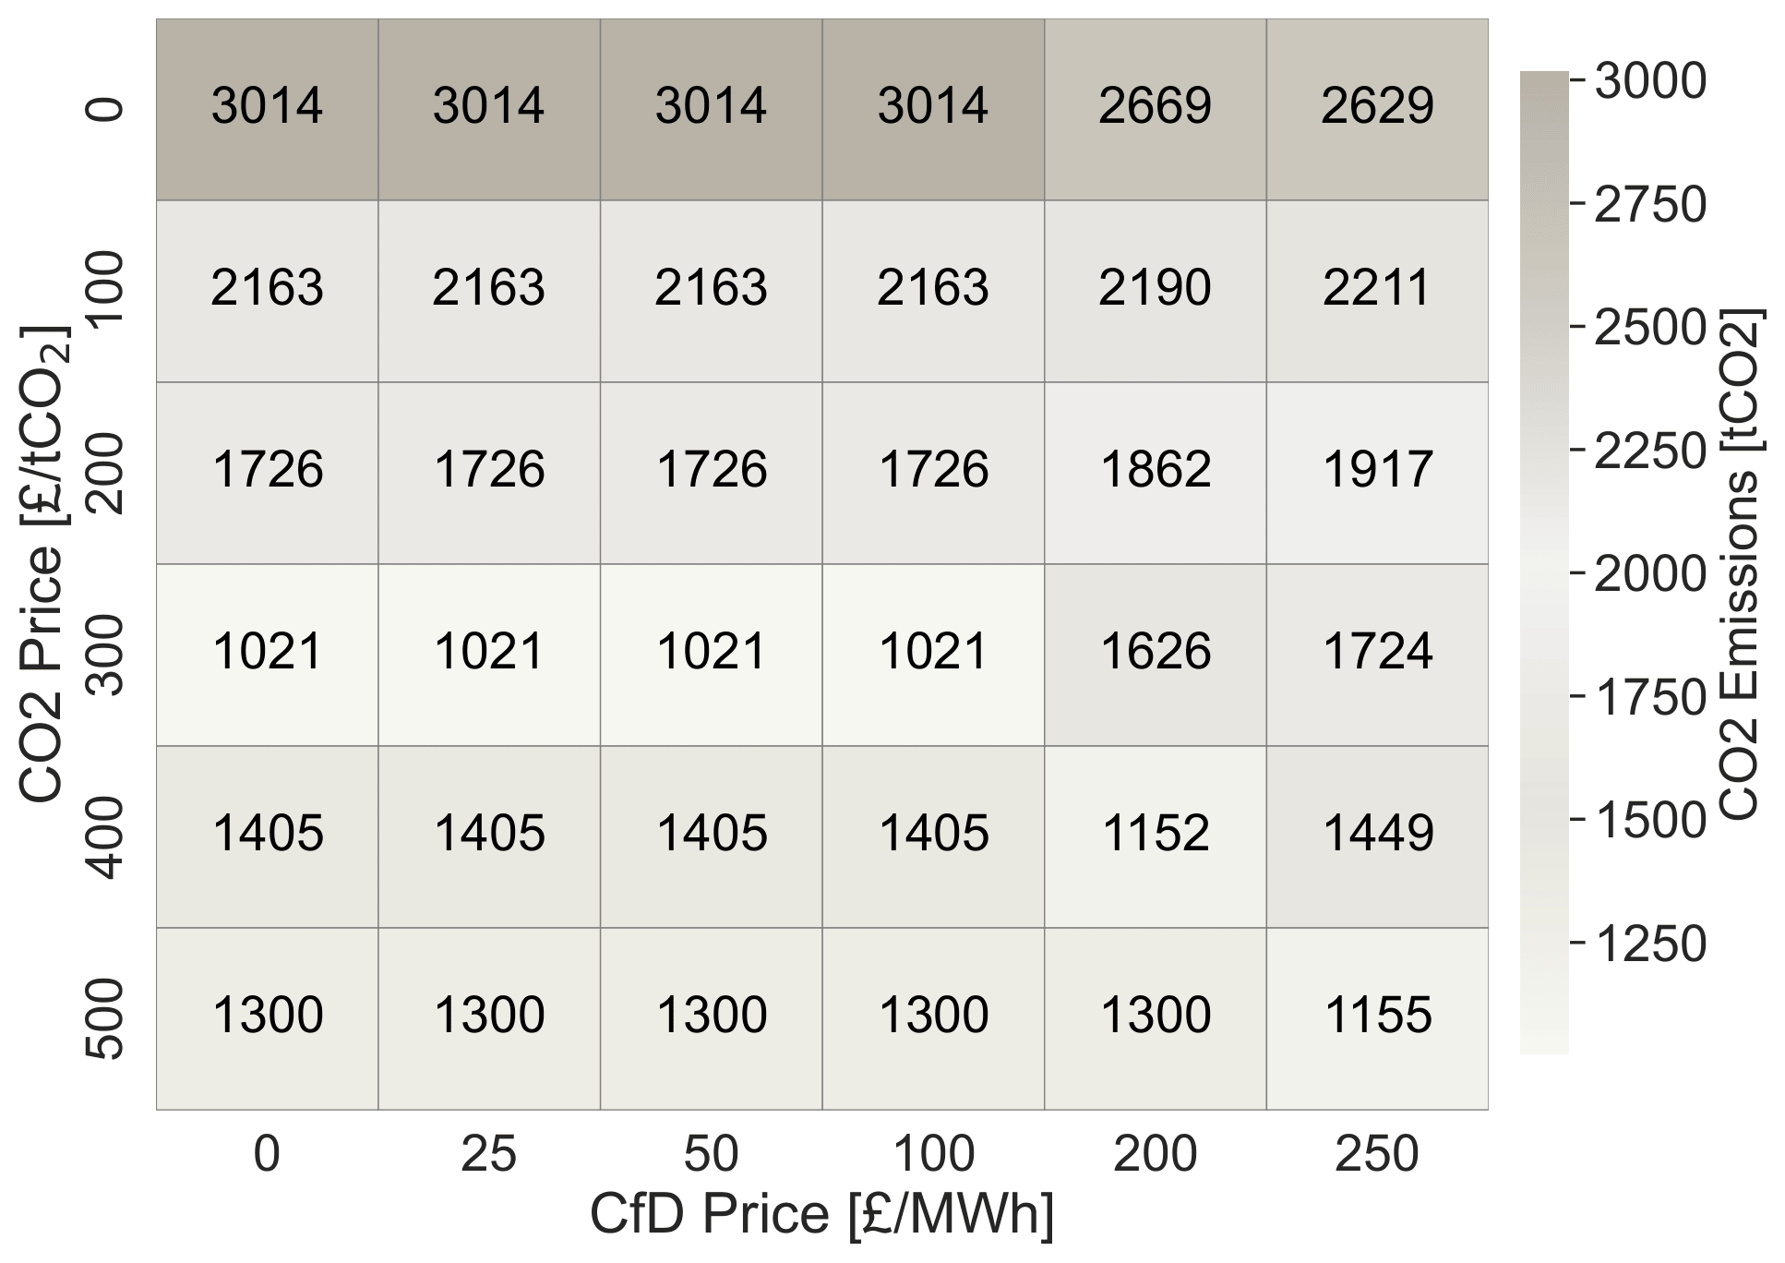
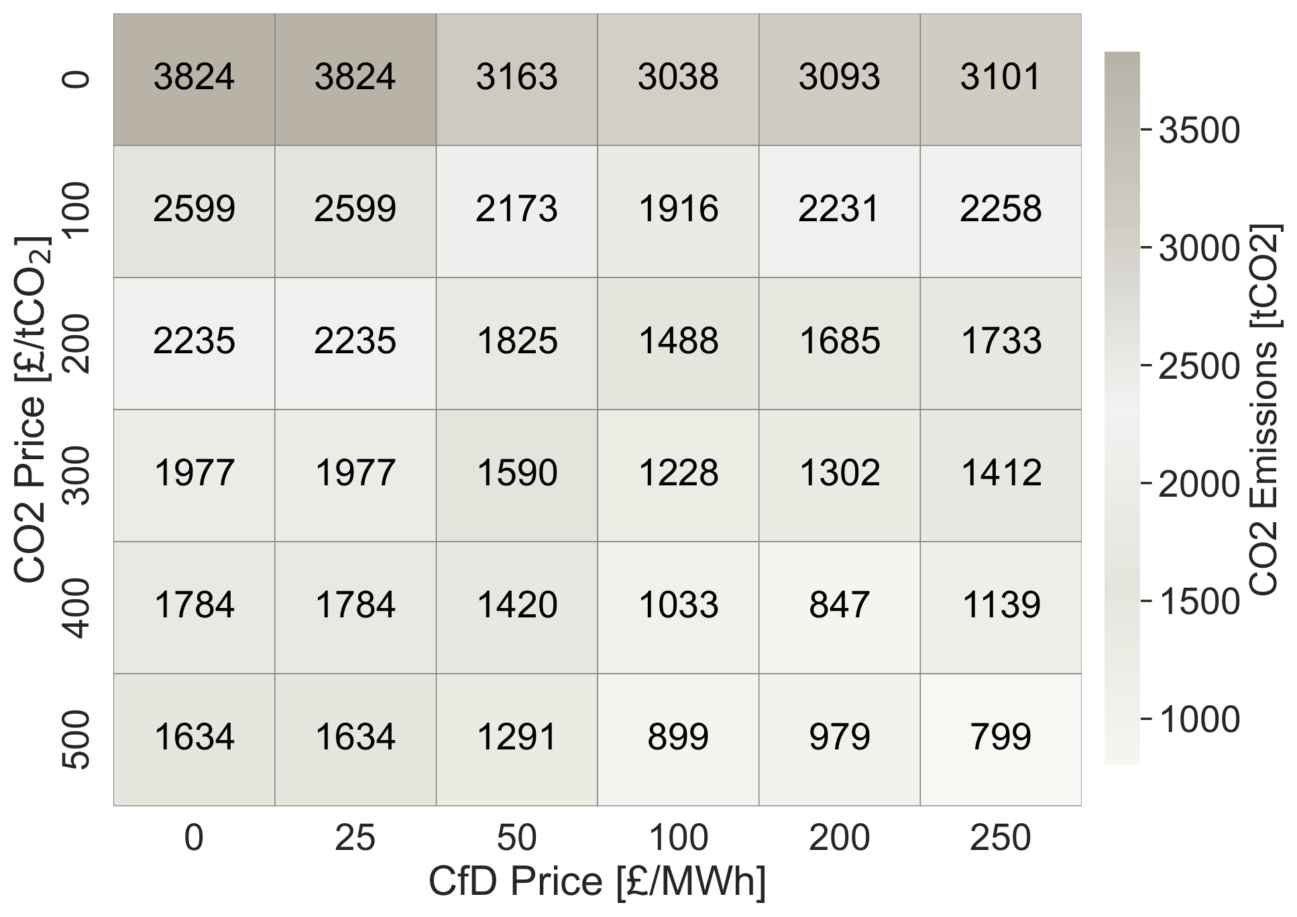
CO₂ Emissions: Carbon Pricing Works — But Has Limits
High H₂ integration scenarios without CCS | Baseline (no policy): 3,014 tCO₂ (high price), 3,824 tCO₂ (low price)
High Energy Price | Emissions (tCO₂) | CO₂ price rows (£/tCO₂) | CfD cols (£/MWh)
Low Energy Price | Emissions (tCO₂) | CO₂ price rows (£/tCO₂) | CfD cols (£/MhW)
CO2 emissions comparison for high hydrogen integration scenarios without CCS
CO₂=300 → 66% reduction (high price). ⚠ CO₂≥400: emissions can rebound without CfD ≥ 200 £/MWh. Low price: CfD at £100 + CO₂ £400 achieves 847 tCO₂ — best result.

Slide 43
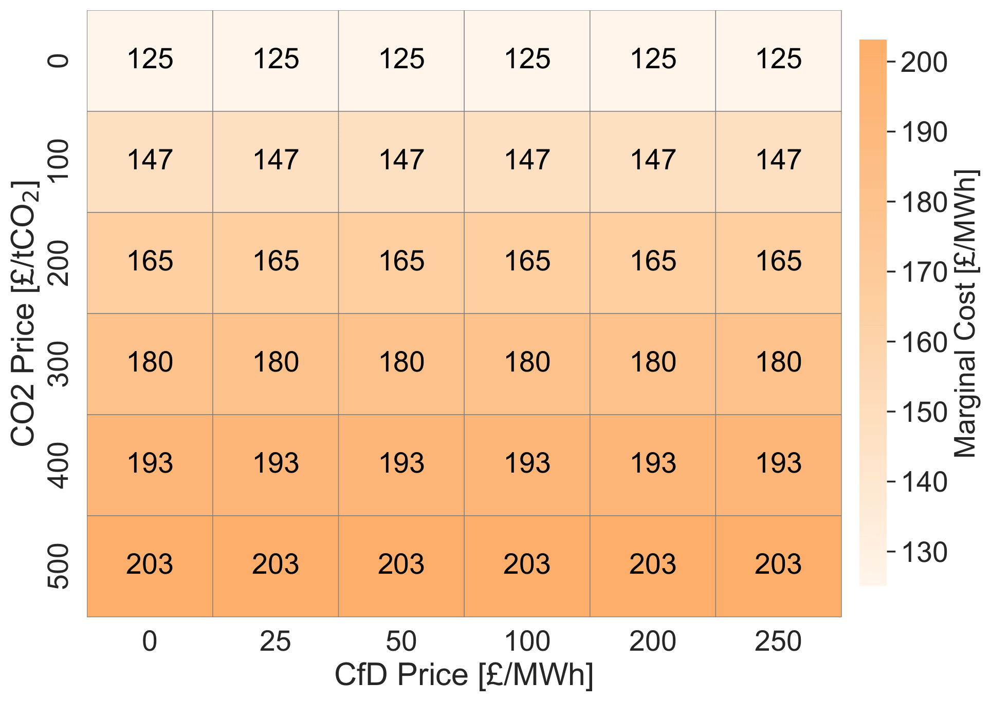
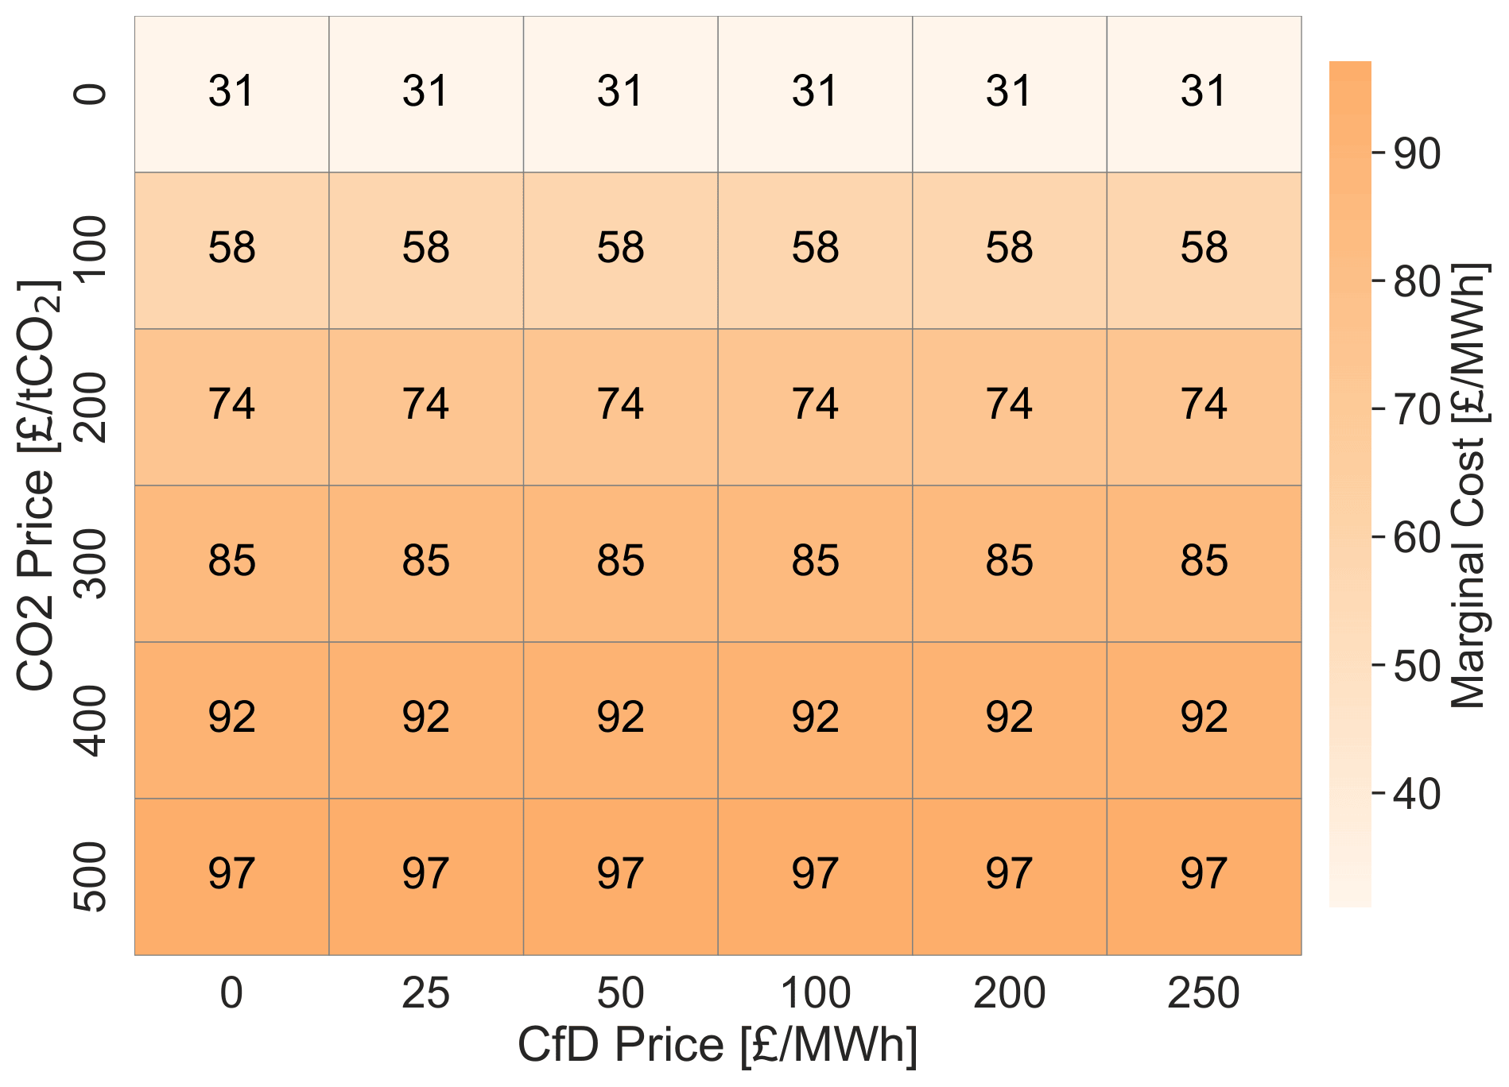
Hydrogen Production Cost & Green H₂ Dominance
CO₂ pricing raises the cost of grey hydrogen and shifts production to green electrolysis | CfD does not affect marginal cost
High Energy Price
Low Energy Price
Marginal cost of hydrogen comparison for high hydrogen integration scenarios without CCS
CfD does not affect marginal cost — it is a revenue instrument, not a cost instrument.

Slide 44
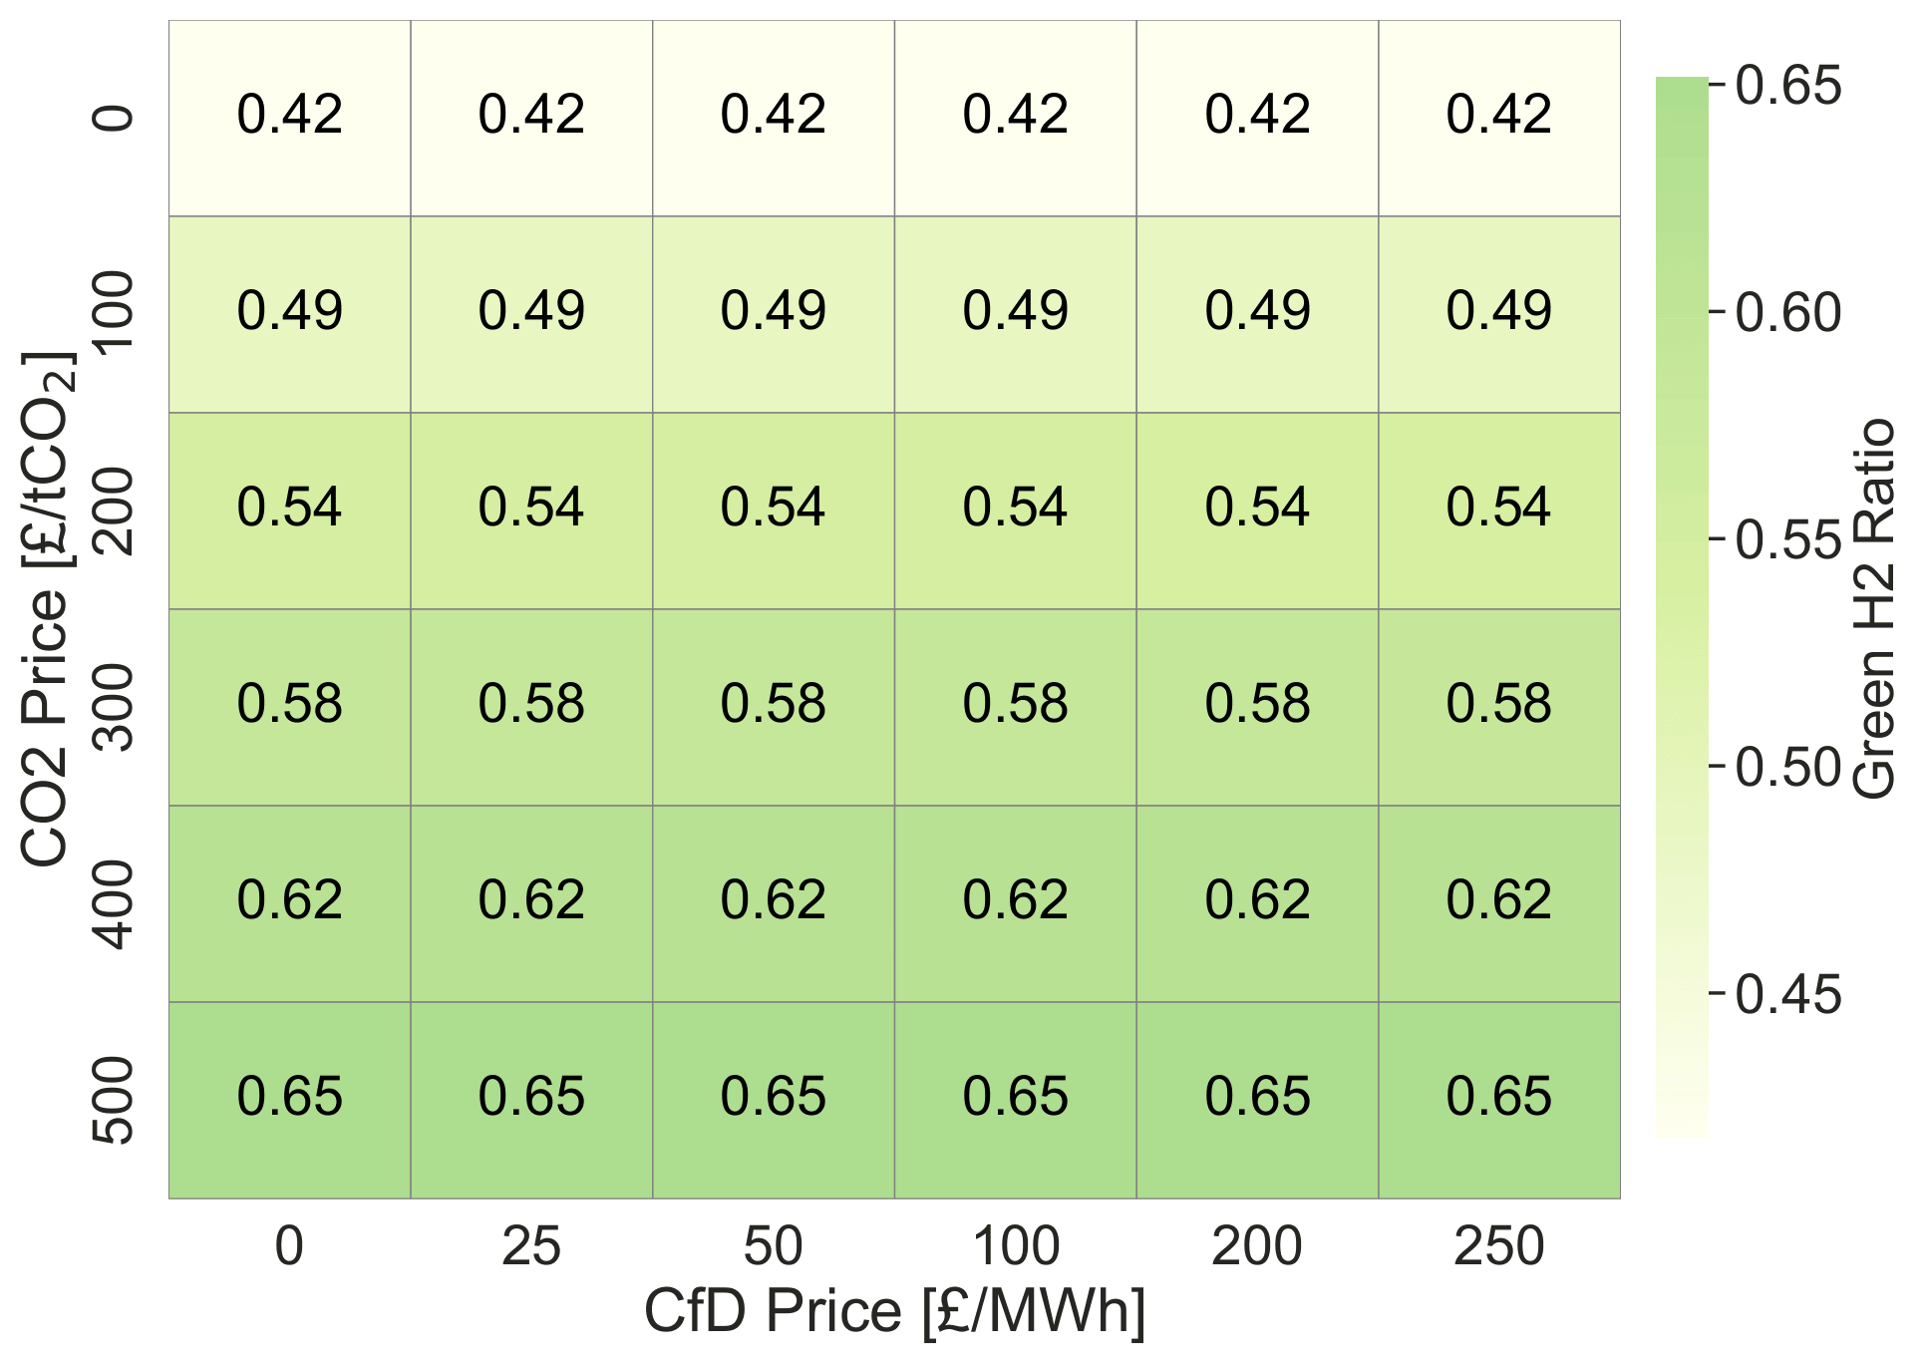
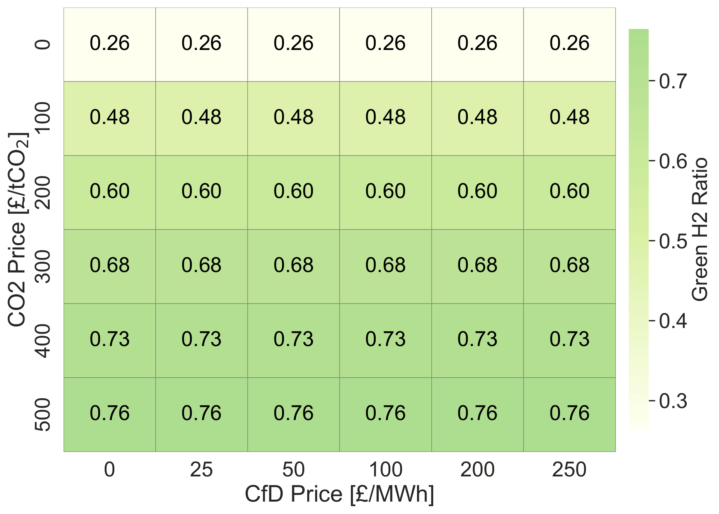
Hydrogen Production Cost & Green H₂ Dominance
≥200
£/tCO₂
High Energy Price
Low Energy Price
minimum CO₂ price
required for green H₂ to exceed 50% of total H₂ production
Green H2 ratio comparison for high hydrogen demand scenarios without CCS
CfD has no effect on green H₂ ratio — CO₂ pricing is the sole driver of production mix.

Slide 45
Recommended Policy Corridor: Balancing All Three Objectives
MACH = (Cost_policy − Cost_baseline) ÷ (Emissions_baseline − Emissions_policy) | Baseline: CO₂=0, CfD=0 | Units: £/tCO₂
RECOMMENDED POLICY CORRIDOR
CO₂ Price
200–300 £/tCO₂
+
CfD Strike Price
100–200 £/MWh
Corridor
MACH (£/tCO₂)
Avg NPV (£bn)
Avg CfD cost (£bn/yr)
Why recommended
CO₂ 200–300
225 ✓
+221 bn
37 bn
Best abatement + positive NPV + moderate cost
CfD 100–200
229
+380 bn ✓
51 bn
Positive NPV, low abatement cost, manageable public spend
What the recommended corridor actually does to the energy mix (CO₂=250 £/tCO₂, CfD=150 £/MWh vs. baseline zero policy)
Wind + Nuclear
P2G (Electrolysis)
Gas & G2G
PV & BESS
↑ Increase
↑ Replaces G2G
↓ Decrease
≈ Stable
38–39% vs 37–42% at baseline — stable dominant source
Green H₂ dominates over blue/grey under recommended CO₂ level
Carbon penalty reduces gas-fired and reforming share significantly
Renewables anchor the system in both scenarios

Slide 46
Conclusions
Planning structure matters — only when hydrogen is deeply integrated
Under low H₂ integration, competition, cooperation, and central planning all converge. Under high H₂ integration, cooperation reduces costs by 57% and achieves zero CO₂ versus 8,161 t under competition
Cooperative planning is the most financially resilient approach
Smallest NPV losses under adverse prices (−£69bn vs −£334bn competitive). Requires the least government support to remain viable. Central planning is intermediate but collapses under constrained flexibility.
CO₂ pricing drives decarbonisation — but CfD sustains the investment
CO₂ pricing alone fails to secure investment in low-price markets. A minimum CfD of £100/MWh is required to keep NPV positive. The two instruments have distinct and complementary roles.
The recommended joint policy corridor: £200–300/tCO₂ + £100–200/MWh CfD
Balances abatement efficiency (MACH=225), investor returns (NPV=+£380bn avg), and fiscal sustainability (~£51bn/yr CfD support). CO₂≥200 also ensures green H₂ exceeds 50% of total production.
Shapley value and MACH provide quantitative tools for targeted policy
Shapley identifies which technologies need support and by how much. MACH integrates cost and emission outcomes into one metric. Together, they replace broad subsidies with evidence-based, targeted interventions.

Slide 47
Policy Insights
Design markets for cooperation, not just competition. Use policy levers — CfDs, network codes, allocation rules — that align investor incentives with system-wide efficiency when hydrogen integration is high.
Set the UK ETS trajectory to reach £200/tCO₂ to unlock green hydrogen dominance and cost-effective abatement. Below this level, blue and grey hydrogen remain financially dominant.
Calibrate hydrogen CfD strike prices at £100–200/MWh to sustain investment viability under low-price conditions. HAR1 awarded £241/MWh — consistent with the upper bound of this corridor.
Use Shapley value analysis before setting subsidy levels. It shows which technologies are net contributors and which need support, enabling targeted policy rather than broad, inefficient instruments.
Use MACH as a policy appraisal metric alongside NPV and fiscal cost. It integrates abatement efficiency with economic outcomes in a single number, aligned with UK Green Book carbon valuation guidance.

Slide 48
Thank you for your attention

