Slide 1


Slide 2
Problem Statement :
A brain stroke occurs when the blood supply to part of the brain is interrupted or reduced, depriving brain tissue of oxygen and nutrients. Brain cells begin to die within minutes, leading to permanent brain damage, disability, or death.
Key facts:
Every 4 minutes, someone dies of stroke worldwide .
More than 80% of strokes are preventable with early risk detection.
Early detection and immediate treatment dramatically improve survival rates and reduce long-term disability.

Slide 3
Current Challenge :
Traditional stroke risk assessment depends on clinical examination after symptoms appear. These methods are reactive (not preventive), costly, and inaccessible in many primary care and rural settings.
Our Goal :
Develop an accurate, low-cost machine learning model that predicts an individual’s stroke risk in advance using only routinely collected data (age, blood pressure, glucose level, BMI, smoking status, etc.), enabling early intervention and prevention before the stroke occurs.

Slide 4
Dataset Overview
Dataset Name: Stroke Prediction Dataset (from Kaggle)
Number of Samples: 5,110 records
Personal Features:
Id, gender , age , ever_married , work_type , Residence_type
Clinical & Health-Related Features :
Hypertension , heart_disease , avg_glucose_level , bmi , smoking_status
The target is stroke

Slide 5
Exploratory Data Analysis (EDA)
• The dataset contains health information for stroke prediction
• There are 201(3.93%) missing values ​​in the BMI
• Numerical features include age, glucose level, and BMI
• Categorical features include gender , ever married , heart disease , work type, residence type, and smoking status
• The target variable (stroke) shows significant class imbalance
• Only 1 record has Gender = "Other" → This single record does not belong to either "Male" or "Female"

Slide 6
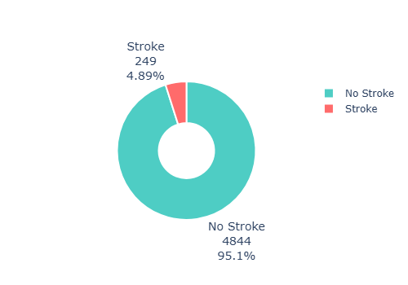
target Variable Distribution (Stroke)
No Stroke: 4,844 cases → 95.1%
Stroke: 249 cases → 4.9%

Slide 7
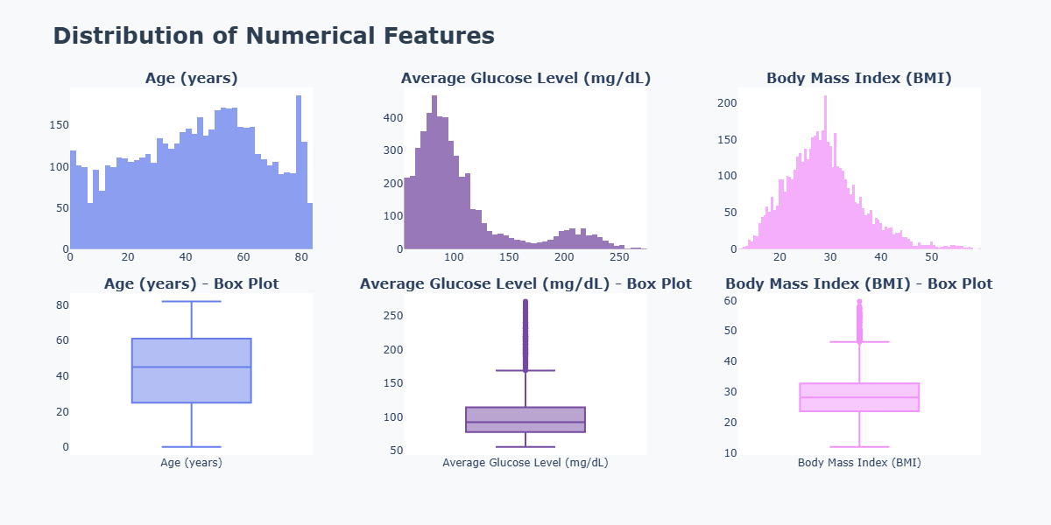
Distribution of Numerical Features

Slide 8
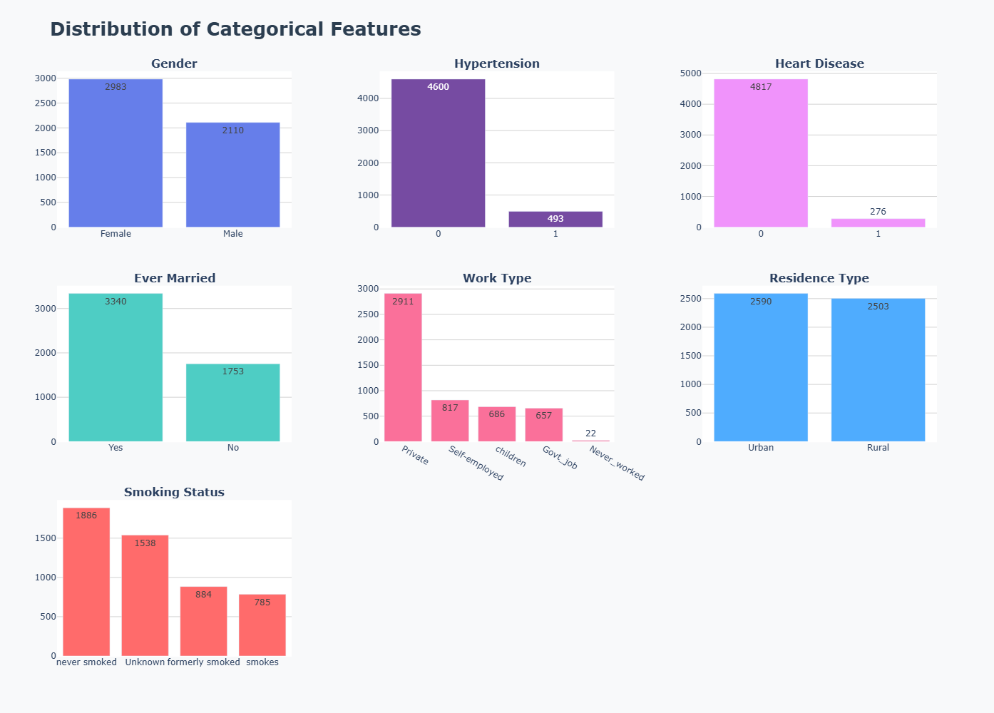
Distribution of Categorical Features

Slide 9
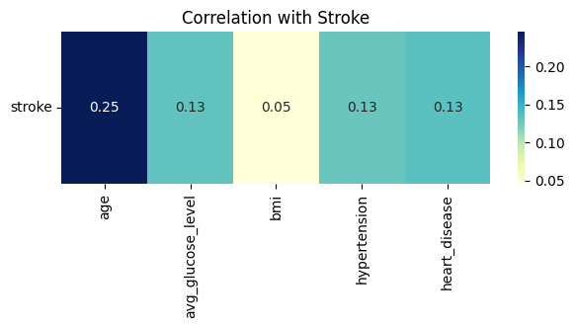
Key Insight: Age is the most important numerical predictor of stroke in this dataset

Slide 10
Data Cleaning Steps
Removed 1 record with Gender = "Other" (non-informative singleton)
Dropped medically implausible BMI values (< 12 or <60)
Imputed 201 missing BMI values using median per age-group & gender
Removed duplicate records
Kept all other outliers (medically plausible in stroke patients)

Slide 11
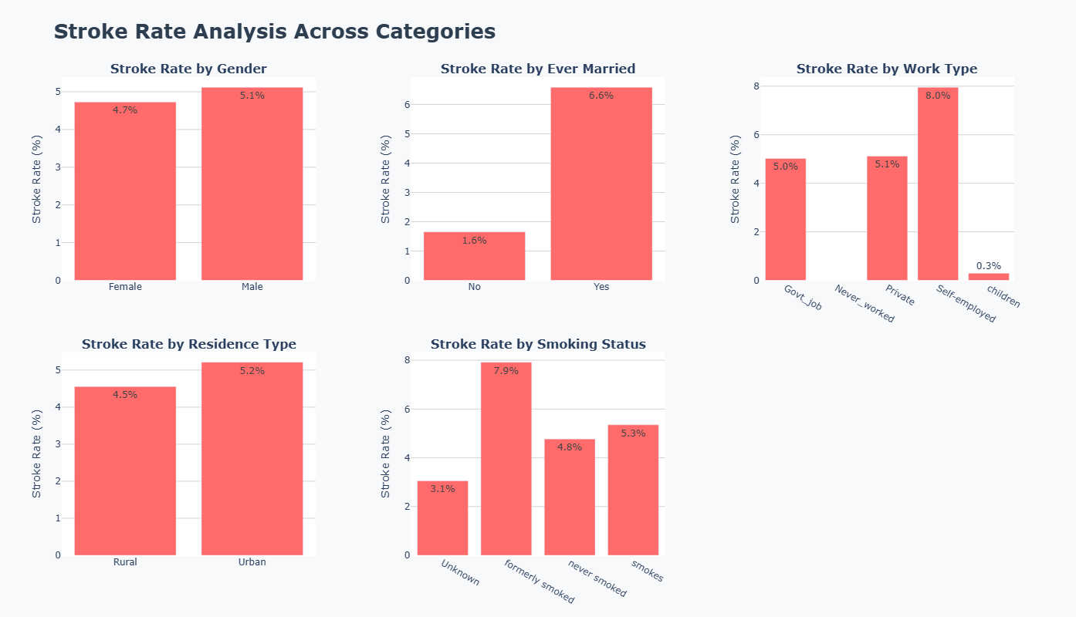
Stroke Rate Analysis Across Categories

Slide 12
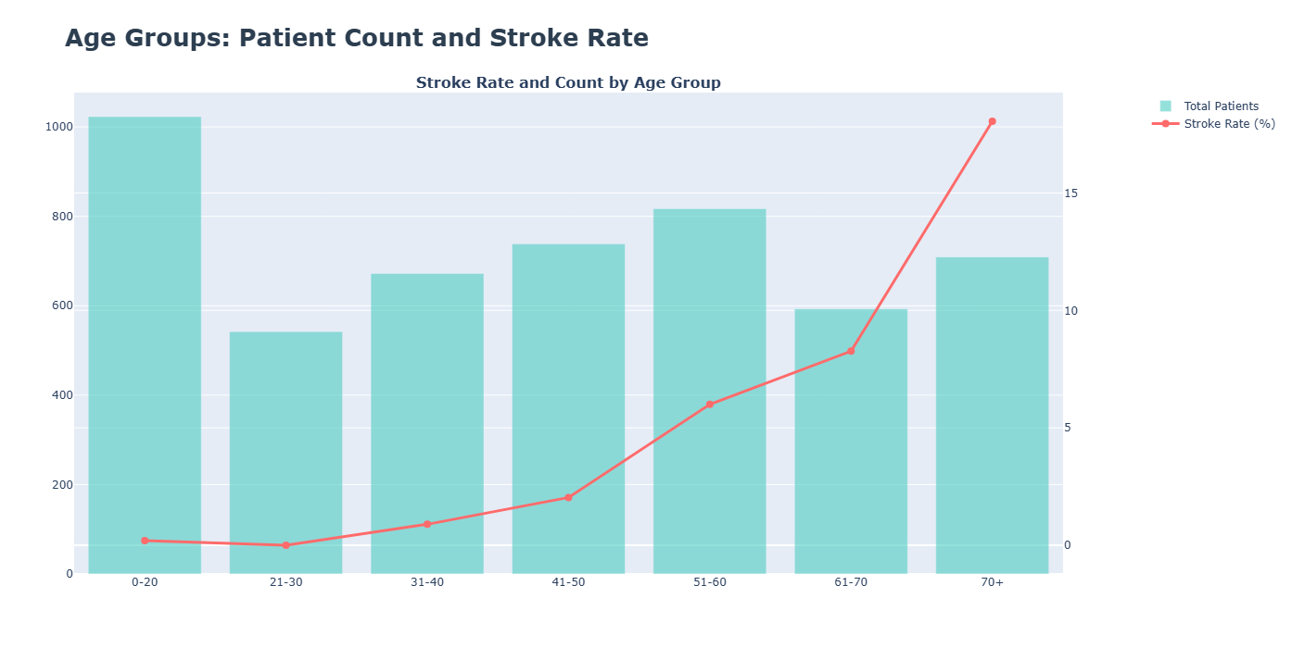
Age Groups: Patient Count and Stroke Rate

Slide 13
Feature Engineering – Added Predictive Power
New Feature:
bmi_class → Converted BMI into categories: Underweight, Normal, Overweight, Obese
glucose_risk → Binned glucose level into: Normal (<140), Prediabetes (140–199),
Diabetes (≥200)
age_bmi_interaction → Interaction term = Age × BMI
cardiovascular_risk_score → Combined hypertension + heart_disease
Result: Created 4 clinically relevant and highly predictive features that improved
model performance .

Slide 14
Final Data Preparation & Train-Test Split
Features (X) & Target (y) separated
Train/Test split: 80% Train – 20% Test
Numerical features standardized using StandardScaler
Categorical features encoded using One-Hot Encoding
Dataset is now fully ready for modeling

Slide 15
Chosen Model: Logistic Regression
1- We selected Logistic Regression with L1 (Lasso) regularization
for the following reasons:
Highly interpretable (critical for stakeholders & auditing)
Built-in feature selection → automatically removes irrelevant/noisy features
Very fast to train and predict (suitable for real-time scoring)
2- we used class_weight='balanced'
Our dataset is highly imbalanced – the positive (minority) class represents only
~3–5% of the total samples.

Slide 16
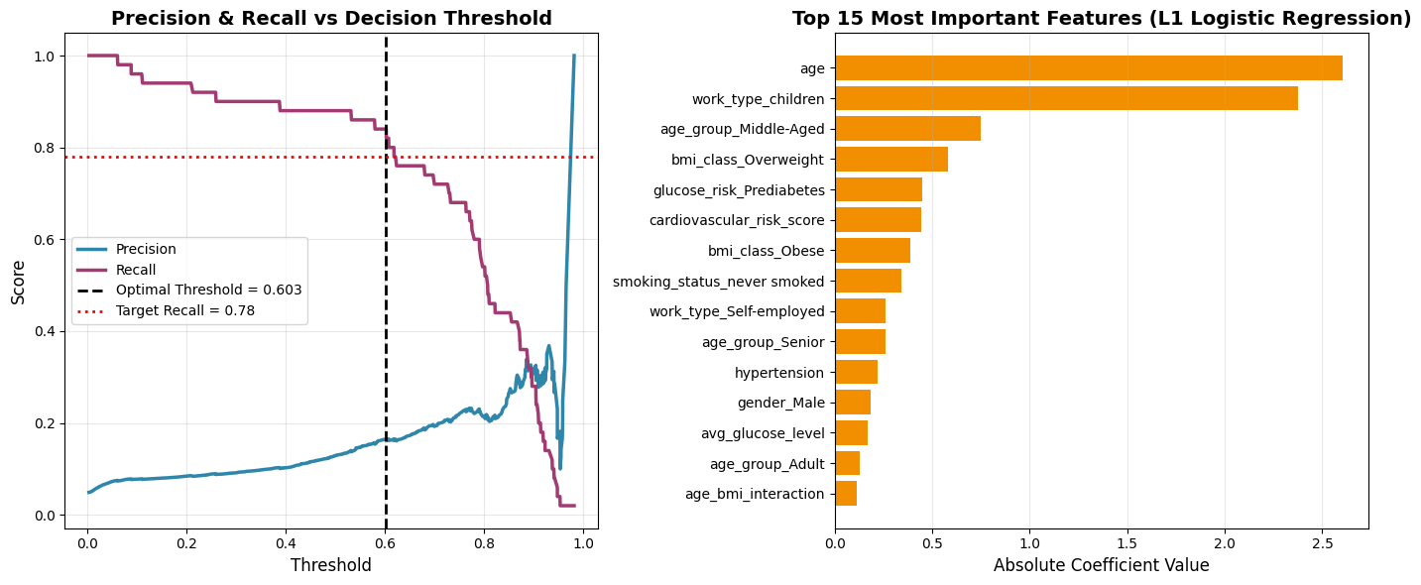
3- Computed Precision-Recall curve To find Best Threshold

Slide 17
Logistic Regression (L1 + class_weight='balanced')
 | precision | recall | f1-score | support
0 | 0.9895 | 0.7802 | 0.8725 | 969
1 | 0.1647 | 0.8400 | 0.2754 | 50
accuracy |  |  | 0.7831 | 1019

Slide 18
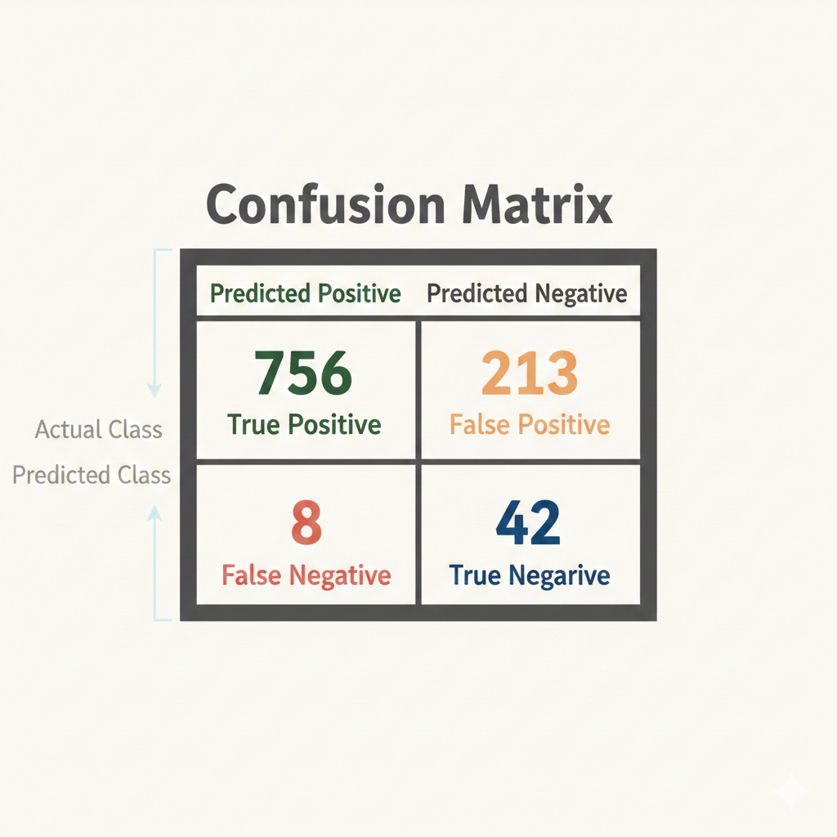

Slide 19
Top 15 Most Important Features

Slide 20
Why Prioritize High Recall Over F1-Score for Stroke
High Cost of Missing a Stroke (False Negative):
Skipping a real stroke can cause disability or death ,
Early detection (even by 30 minutes) saves lives and reduces damage.
Low Cost of False Alarm (False Positive):
Predicting stroke when it's not means just extra checks (like CT/MRI)
or monitoring—safe, cheap, and easy to fix.
Asymmetric Risk in Medicine:
In health alerts (like stroke or fraud), catching positives (Recall) matters more than avoiding false alarms (Precision) or balanced F1. WHO and AHA guidelines push for Recall ≥80-85%.
Our Goal:
Hit Recall ≥0.78 first (key requirement), then boost F1 as much as possible—that's exactly our approach.

Slide 21
Experiment Tracking & Model Registry
Experiment Tracking
Logged hyperparameters (epochs, batch size, optimizer).
Logged metrics such as MSE, MAE, RMSE, and R² .
Logged artifacts (plots, text files, reports).
Model Registry & Versioning
Models were registered in the MLflow Model Registry with descriptive names.
Each training run created a new model version to support reproducibility and rollback.
MLflow automatically inferred model signatures to ensure input/output consistency.

Slide 22
Lifecycle Management & Inference
Lifecycle Management
Managed model stages using MlflowClient:
None → Staging → Production.
Older production versions were automatically archived when new versions were promoted.
Inference (Prediction)
Loaded registered models using mlflow.pyfunc.load_model.
Example model URIs:
models:/RandomForestClassifier/latest
models:/RandomForestClassifier/1
Generated predictions on new, unseen data using production models.

Slide 23
API Deployment (Flask)
Service: Model is exposed via a local Flask REST API.
Base URL: http://127.0.0.1:5000
Primary Endpoint: /predict (POST)
Function: Accepts a JSON object containing 12 required patient fields (e.g., age, bmi, smoking_status).
Output: Returns stroke_probability, final_prediction, and model_decision.
Note: This API is currently for local testing. Official deployment requires cloud hosting.
UI: A simple web UI is accessible at the root endpoint (/ - GET) for manual testing.

