Slide 1
Enhancing Credit Card Fraud Detection: A Machine Learning Approach.

Slide 2
TEAM MEMBERS :
MOHAMED AFFAN M
22MDT0088
MOHAMMED SAQUI T
22MDT0098
UNDER THE GUIDENCE OF:
DR. KHADAR BABU SK
Associate Professor Sr.

Slide 3
INTRODUCTION
Customer transactions are increasingly conducted electronically as a result of the digital revolution in society.
More and more payment systems and services are available online. Which increase the risk of fraudulent activities and credit card fraud is a significant concern in the financial industry.
In our project we present an innovative approach to address this persistent issue by harnessing the potential of Machine Learning (ML).
Our strategy involves the utilization of Amazon Web Services (AWS) SageMaker, a effective cloud-based ML platform.
It comes equipped with pre-built ML models and robust tools for data preprocessing, model training, and deployment.

Slide 4
OBJECTIVES
01
The primary objective of fraud detection is to enhance the system's accuracy while minimizing false alarms.
02
By achieving this, we can reduce financial losses and boost the security of electronic transactions, thus enhancing trust and confidence in financial operations.
03
In our research, we delve into the methodologies, challenges, and potential benefits of using AWS SageMaker for credit card fraud detection.
04
Our research aims to not only shed light on crucial insights but also contribute to the growing knowledge in the area of financial security and the application of ML in this context.

Slide 5
METHODOLOGY
Data Collection
Data Pre-Processing
Data Analysis
AWS Sagemaker
Splitting the Data
Uploading the data in AWS S3
Random-cut Forest
XGBoost

Slide 6
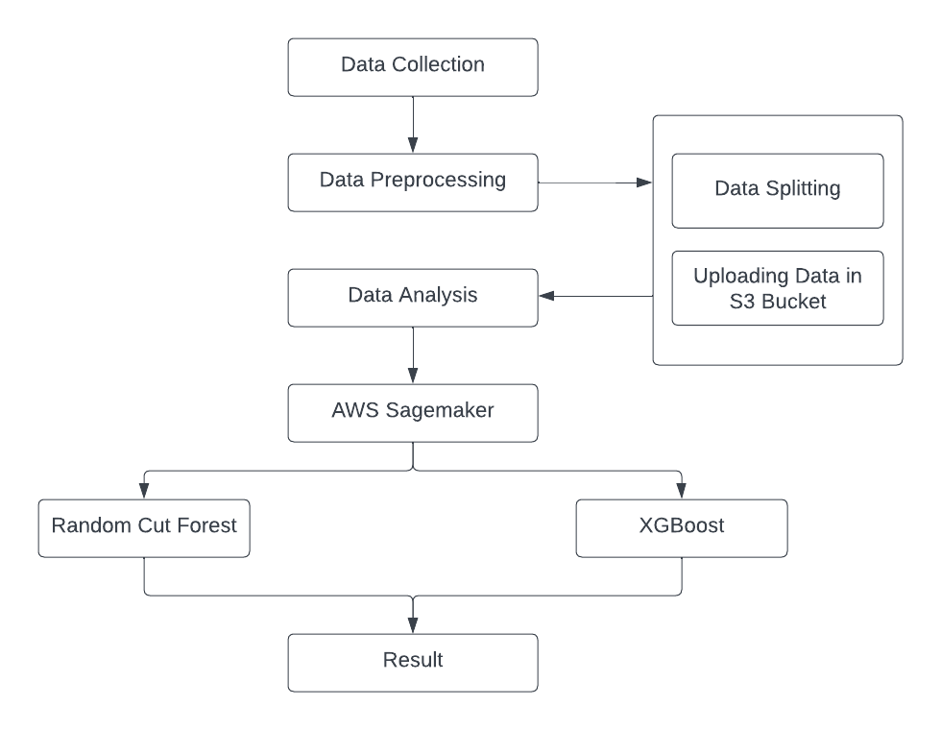
WORK FLOW
work flow or Architecture diagram

Slide 7
METHODOLOGY
Below are the methodology used in our research.
DATA COLLECTION
The dataset used in this solution was downloaded from the Machine Learning Group (http://mlg.ulb.ac.be).
During the two-day period, there were 491 fraudulent transactions out of 284,808 total transactions. As a result, fraud occurs in approximately 1 out of 579 transactions, or 0.172% of all transactions.
In addition to 28 anonymized variables, there are also two named variables "Time" and "Amount.

Slide 8
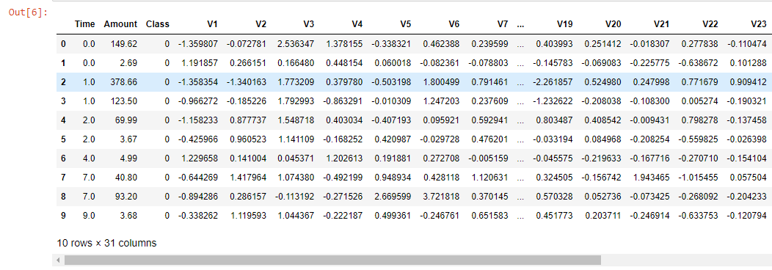
THE DATASET
Below is the image displaying the variables and dataset generated using Python.

Slide 9
METHODOLOGY
Below are the methodology used in our research.
DATA PRE-PROCESSING
In the initial stages of our research, data preprocessing is a pivotal step. We primarily focus on two critical tasks: splitting the data into training and testing datasets and uploading these datasets to an Amazon S3 bucket.
DATA SPLITTING :
Our dataset is divided into two subsets, with 80% allocated for training and 20% for testing.
UPLOADING DATA IN AWS S3 BUCKET:
We use Amazon S3 for storing and managing our datasets. Uploading data to an S3 bucket streamlines data accessibility for AWS SageMaker, ensuring efficient model training and evaluation.

Slide 10
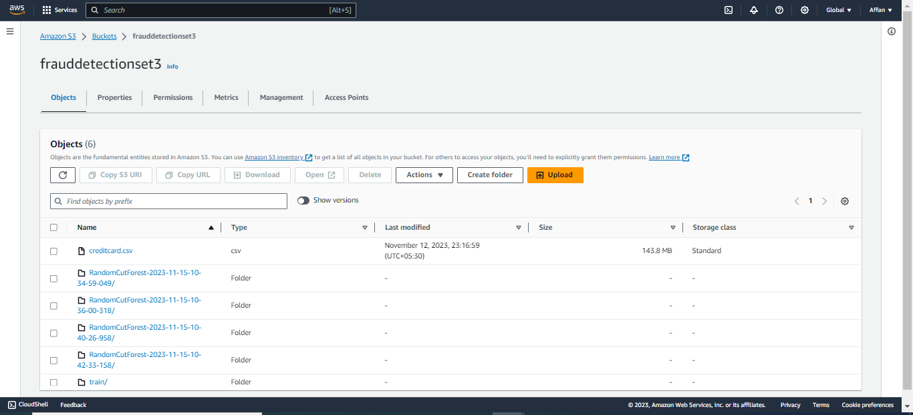
S3 BUCKET SNAPSHOT
This image shows a screenshot of an AWS S3 bucket containing objects used to perform fraud detection

Slide 11
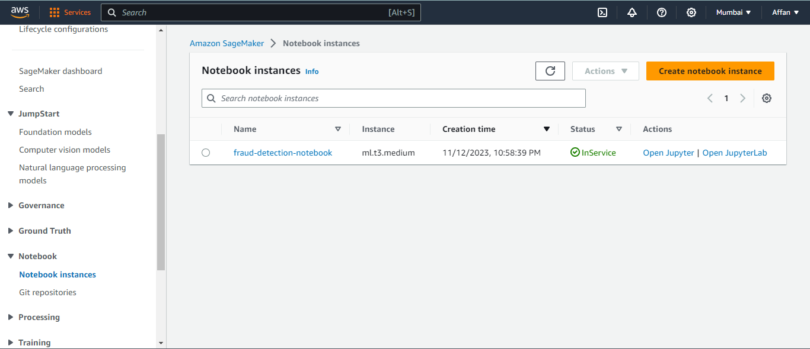
IMPLEMENTATION
AWS SAGEMAKER
Amazon SageMaker is a fully managed service provided by Amazon Web Services (AWS) that simplifies the process of building, training, and deploying machine learning models.
SageMaker is designed to be scalable, cost-effective, and integrates seamlessly with other AWS services, making it a powerful solution for a wide range of machine learning applications.
Snapshot of AWS SageMaker

Slide 12
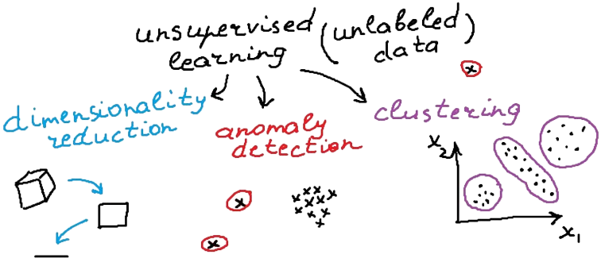
IMPLEMENTATION
RANDOM CUT FOREST
Amazon SageMaker Random Cut Forest (RCF) is an unsupervised algorithm designed for anomaly detection.
Random Cut Forest is a state-of-the-art anomaly detection algorithm that is both accurate and scalable. The algorithm scales efficiently with the number of features, dataset size, and instances, making it versatile for anomaly detection tasks.

Slide 13
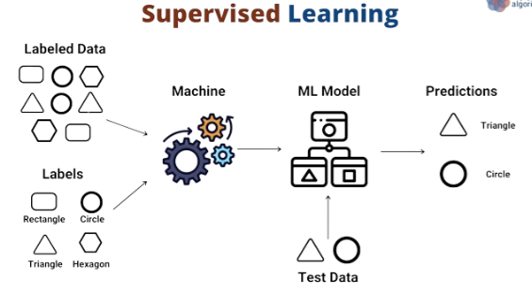
IMPLEMENTATION
XGBoost Algorithm
XGBoost, commonly referred to as eXtreme Gradient Boosting. This algorithm, is a type of supervised learning.
XGBoost's strength lies in its ability to handle diverse data types, relationships, and distributions.
Whether you're dealing with regression, binary or multiclass classification, or ranking problems, XGBoost proves itself as a versatile and powerful tool.

Slide 14
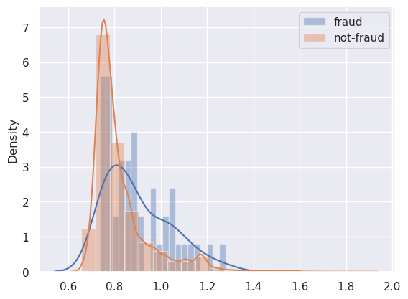
RESULT AND DISCUSSION
Training of Random Cut Forest model
In a fraud detection scenario, we commonly have very few labeled examples, and labeling fraud can take a lot of time and effort.
Histogram of Anomaly scores

Slide 15
RESULT AND DISCUSSION
Training an XGBoost a supervised model
After we’ve gathered an adequate amount of labeled training data, we can use a supervised learning algorithm to discover relationships between the features and the classes..
We choose the XGBoost algorithm because it has a proven track record, is highly scalable, and can deal with missing data.
 | XGBoost
Accuracy | 0.8568
F1 Score | 0.7551
Cohen’s kappa | 0.7548
XGBoost matrices

Slide 16
RESULT AND DISCUSSION
we evaluate our models with the three metrics Accuarcy,f1 score and Cohen’s kappa and larger value indicates the better predictive performance
 | RCF | XGBoost
Accuracy | 0.7438 | 0.8568
F1 Score | 0.1397 | 0.7551
Cohen’s kappa | 0.0718 | 0.7548
RCF and XGBoost Matrices

Slide 17
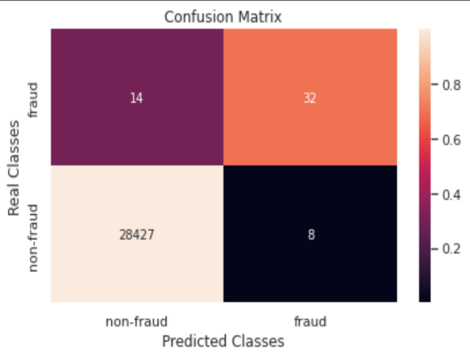
RESULT AND DISCUSSION
Apart from single-value metrics, it’s also useful to look at metrics that indicate performance per class. For example, the confusion matrix, per-class precision, recall, and F1-score can provide more information about our model’s performance.
 | Precision | Re-call | F1-score | Support
non-fraud | 1.00 | 1.00 | 1.00 | 28415
fraud | 0.79 | 0.72 | 0.72 | 54
matrices of each class/Attributes
Confusion matrix

Slide 18
CONCLUSION
Traditional fraud detection systems face challenges in adapting to dynamic fraud strategies, prompting the exploration of machine learning-driven solutions.
In our research the RCF model, proposing a fraud threshold of 1.6, achieved 74.38% accuracy. XGBoost addressed imbalance, achieving 85.68% accuracy.
.Next step we plan to automate the fraud detection system using AWS API Gateway that is backed by AWS Lambda helping financial institutions to reduce the risk of fraudulent transactions in real time with more accuracy.

Slide 19
THANK YOU!!!

