Slide 1
ROS

Slide 2
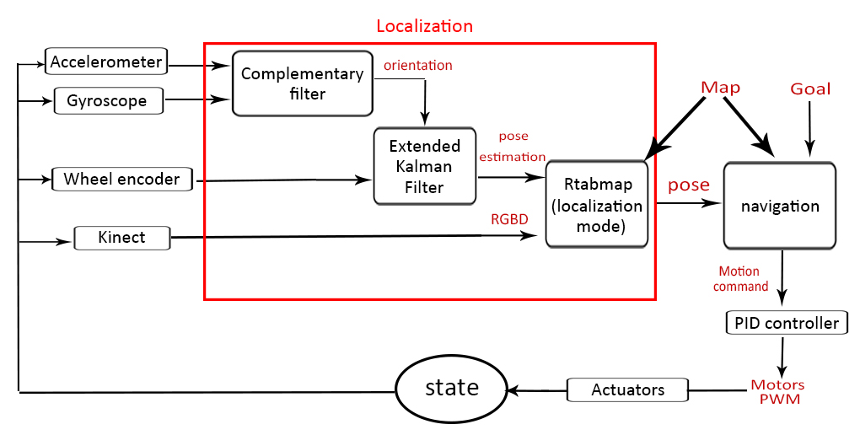
Remember

Slide 3
Workspace
my_project_ws
package_1 node_a node_b node_c package_2 node_d node_e

Slide 4
Steps
Create workspace
$ mkdir -p catkin_ws/src
$ cd catkin_ws/
$ catkin_make
Create Package
$ cd src
$ catkin_create_pkg my_package
Put your python codes in my_package/scripts
Add #!/usr/bin/env python to the first line of your code
Modify my_package/CMakeLists.txt

Slide 5
Steps
Add the following to the end of your CMakeLists.txt
catkin_install_python(PROGRAMS scripts/publisher.py scripts/subscriber.py DESTINATION ${CATKIN_PACKAGE_BIN_DESTINATION})
$ catkin_make in your catkin_ws directory
Add the $ source catkin_ws/devel/setup.bash to your ~/.bashrc
$ chmod -R +x my_package/scripts
Open a new terminal and run your nodes
$ rosrun my_package publisher.py
$ rosrun my_package subscriber.py

Slide 6
Launch files
Run multiple nodes at once!

Slide 7
Turtlebot
https://automaticaddison.com/how-to-launch-the-turtlebot3-simulation-with-ros/
Don’t forget to
Put source devel/setup.bash of your workspace in the ~/.bashrc
export TURTLEBOT3_MODEL=burger

Slide 8
Turtlebot
Run the simulator
$ roslaunch turtlebot3_gazebo turtlebot3_world.launch
Run gmapping slam
$ roslaunch turtlebot3_slam turtlebot3_slam.launch slam_methods:=gmapping
Don’t forget to sudo apt install ros-kinetic-slam-gmapping
Control the robot using keyboard
roslaunch turtlebot3_teleop turtlebot3_teleop_key.launch

Slide 9
Investigate
rosnode list
rostopic list
rostopic hz/echo/info cmd_vel (guess the output of info)
rostopic hz/echo/info imu (guess the output of info)
rostopic hz/echo/info scan (guess the output of info)

Slide 10
Explore
RVIZ
Launch files

Slide 11
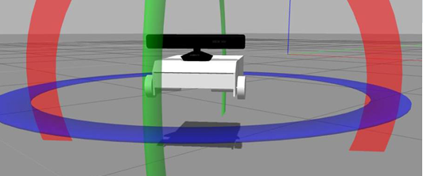
Very useful resources
http://wiki.ros.org/ROS/Tutorials
Book: A Gentle Introduction to ROS
Robot navigation in simulation https://www.youtube.com/playlist?list=PLTEmcYHVE7dPWixFnzkd68jPjwGzxHjUG

Slide 12
Very useful resources
SLAM Course https://www.youtube.com/playlist?list=PLgnQpQtFTOGQrZ4O5QzbIHgl3b1JHimN_

