Slide 1

Customer Shopping Behavior Analysis
Uncovering insights from 3,900 purchases to guide strategic business decisions

Slide 2


DATASET OVERVIEW
The Foundation
3,900
18
50
Total Purchases
Data Points
Locations
Transactions analyzed across all categories
Features per customer transaction
Geographic coverage across regions
Key Features Captured
Customer demographics and location
Purchase details and product categories
Shopping behavior and preferences
Review ratings and shipping choices

Slide 3
PYTHON ANALYSIS
Data Preparation & Cleaning
01
02
Data Loading
Missing Data Handling
Imported dataset using pandas for initial exploration
Imputed 37 missing review ratings using category medians
03
04
Feature Engineering
Database Integration
Created age groups and purchase frequency metrics
Connected to MySQL for advanced SQL analysis

Slide 4

SQL Business Insights
10 key questions answered through structured database analysis
Revenue Analysis
Customer Segments
Product Performance
Gender comparison and spending patterns
New, returning, and loyal classifications
Top-rated items and category leaders
Discount Impact
High-spending discount user behavior

Slide 5
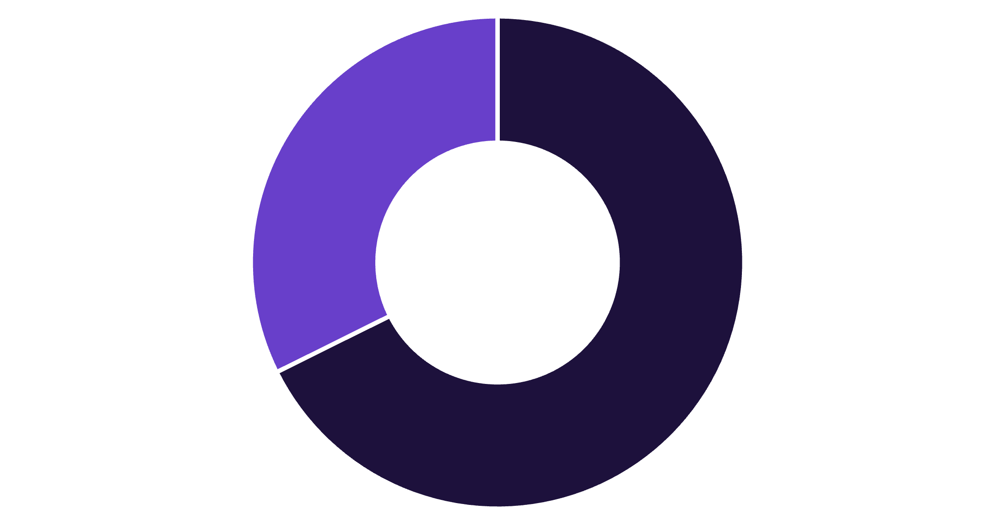
Revenue by Gender
Male Customers Drive Revenue
Male customers generate 68% of total revenue, contributing $157,890 compared to $75,191 from female customers.
This significant gap suggests opportunities for targeted marketing to increase female customer engagement and spending.
Male
Female

Slide 6

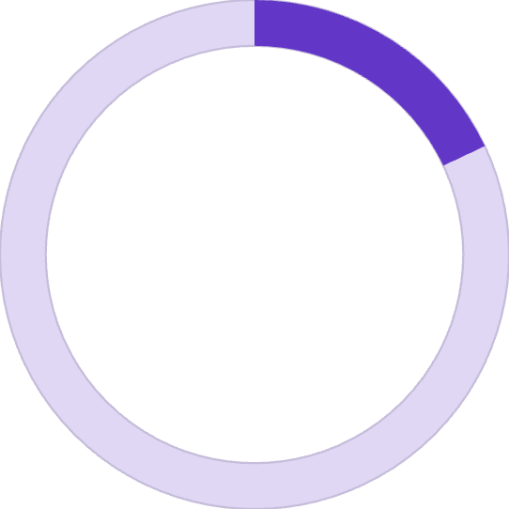


CUSTOMER SEGMENTATION
Loyalty Distribution
80%
18%
2%
Loyal Customers
Returning
New
3,116 customers with 5+ purchases
701 customers with repeat purchases
83 first-time buyers
Strong Loyalty Foundation
The majority of customers are loyal repeat buyers, indicating strong retention. Focus on converting the 18% returning segment into loyal customers.

Slide 7
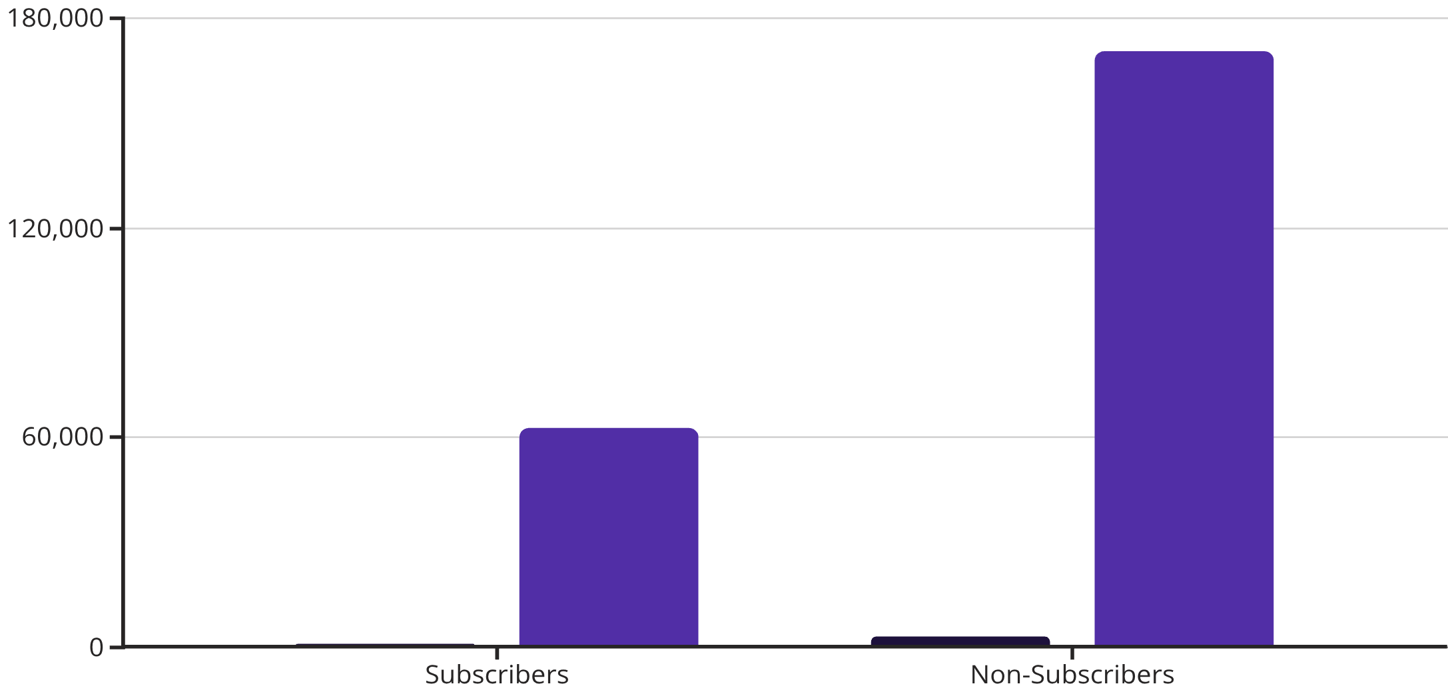
Subscription Status Analysis
Subscription Opportunity
Only 27% subscribe despite similar average spend ($59.49 vs $59.87)
Huge potential to convert non-subscribers and boost recurring revenue
Customers
Revenue

Slide 8
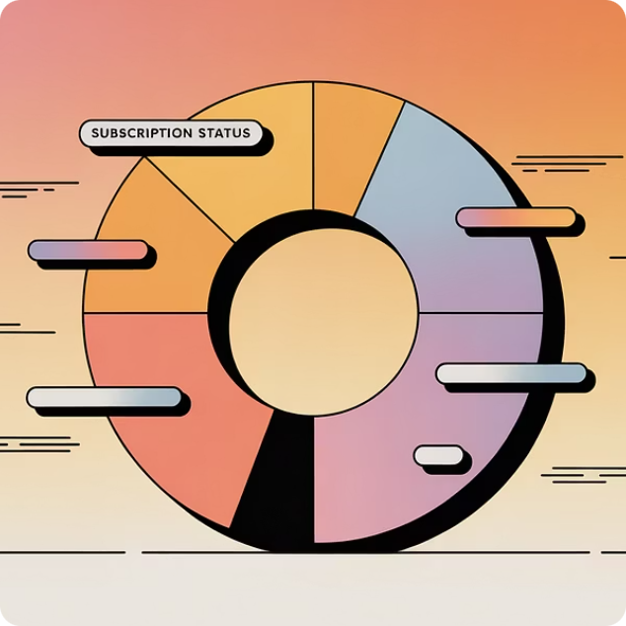
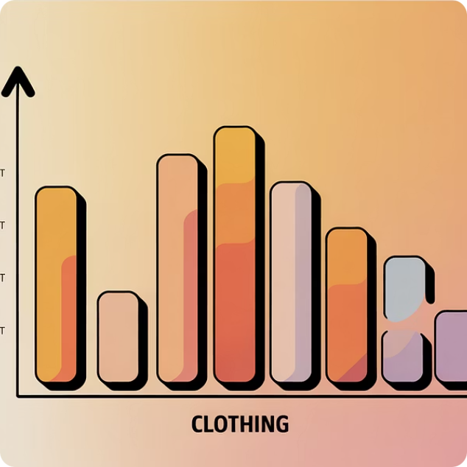

Interactive Dashboard
Power BI visualization bringing insights to life
Subscription Metrics
Category Performance
Age Group Insights
27% subscribed vs 73% non-subscribed
Clothing dominates with $100K revenue
Young adults lead revenue generation

Slide 9
Top Product Insights
Highest Rated Products
1
2
3
Gloves
Sandals
Boots
3.86 rating
3.84 rating
3.82 rating
Discount-Dependent Items
50%
49.7%
49.1%
Hats
Sneakers
Coats
Highest discount rate
Nearly half discounted
Heavy discount reliance

Slide 10
ACTION PLAN
Strategic Recommendations
Boost Subscriptions
Loyalty Programs
Review Discounts
Product Positioning
Promote exclusive benefits to convert 73% non-subscribers
Reward repeat buyers to grow loyal segment
Balance sales boosts with margin control
Highlight top-rated items in campaigns
Targeted Marketing
Focus on high-revenue age groups and express shipping users

