Slide 1
SVM
EXAMPLE PROBLEM

Slide 2
Problem
Classification of three different varieties of wheat.

Slide 3
Dataset
Measurements of geometrical properties of kernels belonging to three different varieties of wheat. A soft X-ray technique and GRAINS package were used to construct all seven, real-valued attributes.
Number of Instances: 210
Number of Attributes: 7
Attribute types: Real Numbers

Slide 4
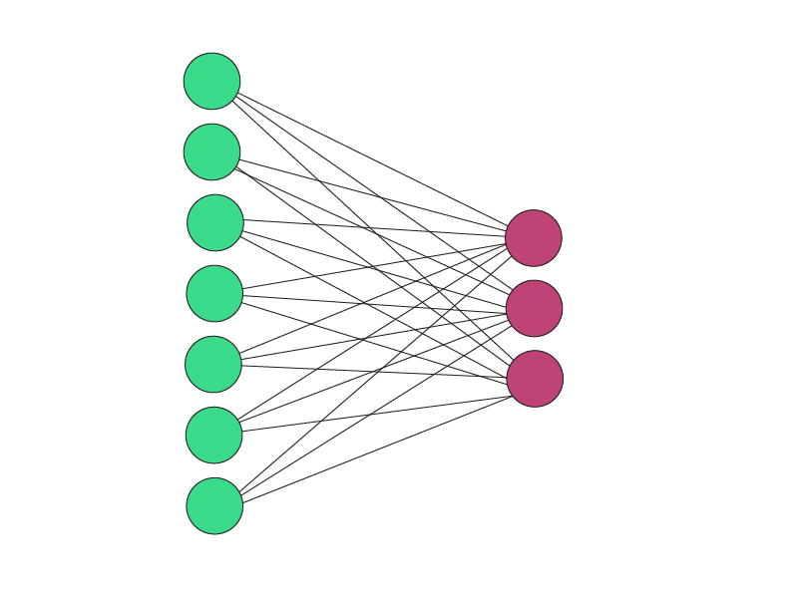
Initial Model

Slide 5
Linear Kernel
Poly Kernel
RBF Kernel
How to tune Parameters of SVM?
- Change the kernel type and look at the impact.
- gamma: Kernel coefficient for ‘rbf’, ‘poly’ and ‘sigmoid’. Higher the value of gamma, will try to exact fit the as per training data set i.e. generalization error and cause over-fitting problem.
- C: Penalty parameter C of the error term. It also controls the trade off between smooth decision boundary and classifying the training points correctly.

Slide 6
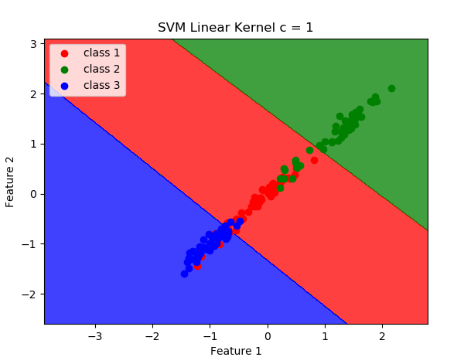
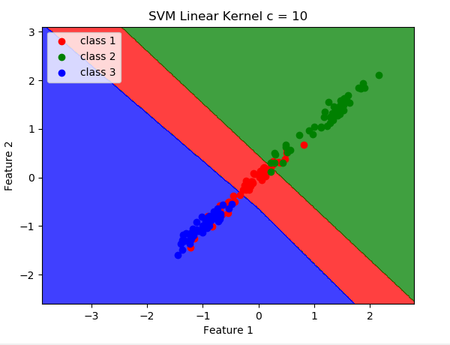
kernel = linear gamma = 1 , 10, 100 C = 1 AC = 96.82% C = 10 AC = 98.42%

Slide 7
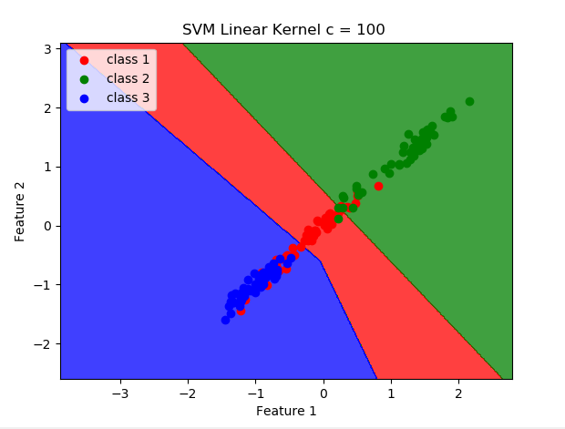
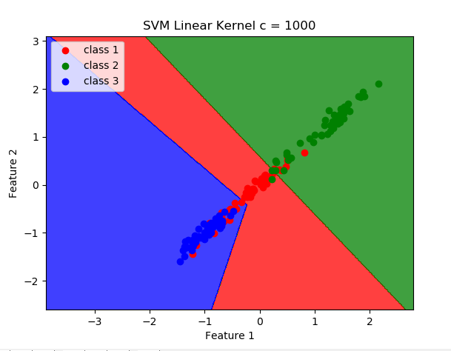
kernel = linear C = 100 AC = 95.41% C = 1000 AC = 96.82%

Slide 8
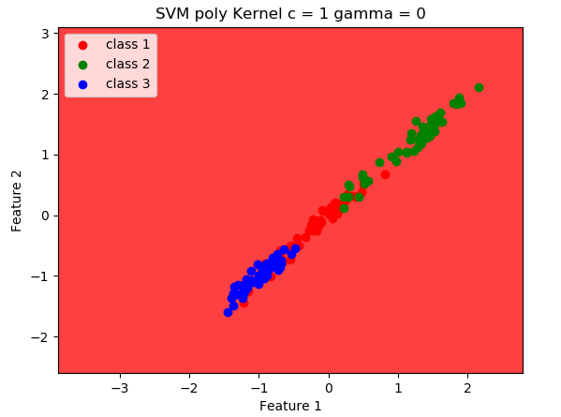
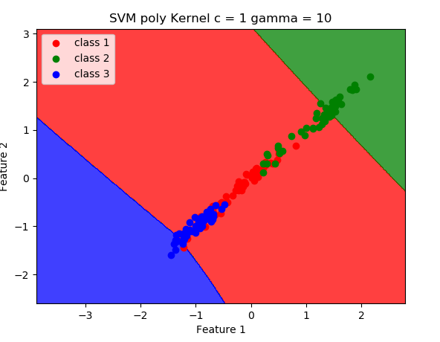
kernel = poly C = 1 gamma = 0 AC = 61.93% C = 1 gamma = 10, 100, 1000 AC = 95.23%

Slide 9
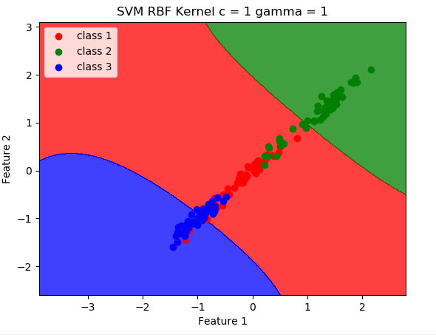
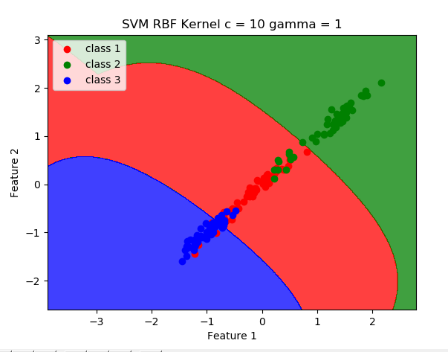
kernel = RBF C = 1 gamma = 1 AC = 95.23% C = 10 gamma = 1 AC = 96.82%

Slide 10
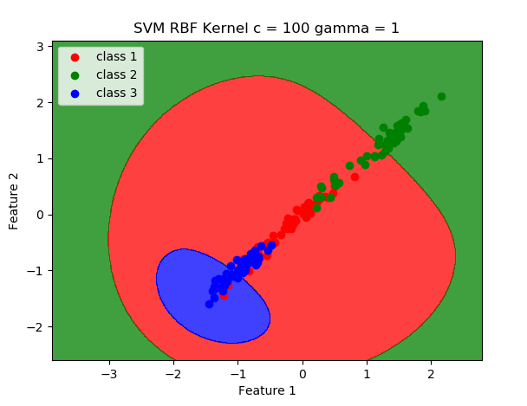
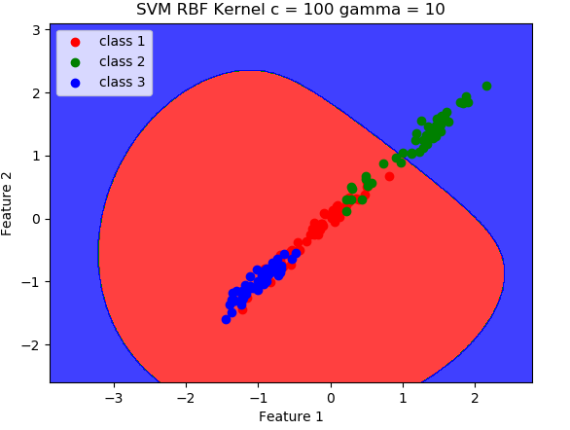
kernel = RBF C = 100 gamma = 1 AC = 96.82% C = 100 gamma = 10 AC = 73.82%

Slide 11
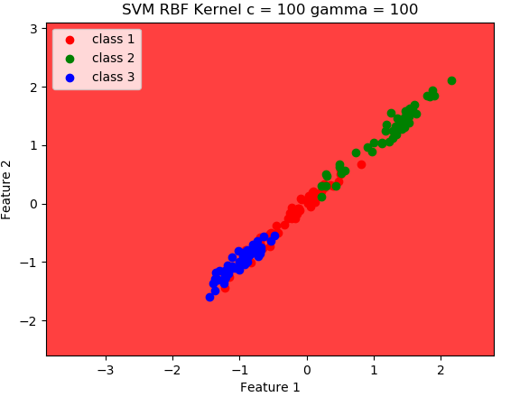
kernel = RBF C = 100 gamma = 100 AC = 34.82%

Slide 12
The best model so far
Kernel = linear
C = 10 AC = 98.41%

Slide 13
THANKS

