Slide 1
Community detection in hypergraphs through hyperedge percolation: a re-implementation and a label-free parameter rule
Course project, based on Kovács, Benedek and Palla, Scientific Reports 2025, arXiv:2504.15213
Mohamed Aklamaash and Luqmaan
‹#›

Slide 2
Hyperedges, not pairs
A hyperedge joins any number of nodes at once.
A graph edge joins two nodes.
A size-8 hyperedge, flattened into pairs, becomes 28 pairs.
That over-counts large hyperedges.
It also forgets that the pairs came from one hyperedge.
‹#›

Slide 3
Communities, partitions and covers
A community is a set of nodes with many hyperedges inside it and few crossing it.
A partition assigns every node to exactly one community.
A cover allows communities to overlap, and leaves some nodes unassigned.
Percolation returns a cover.
‹#›

Slide 4
Clique percolation in ordinary graphs (Palla 2005)
A k-clique is a set of k nodes that are all linked to each other.
Two k-cliques are adjacent if they share k-1 nodes.
Chain adjacent k-cliques: one chain is one community.
Communities may overlap.
Nodes in no k-clique are left unassigned.
‹#›

Slide 5
The paper's idea: chain overlapping hyperedges
Start from one hyperedge.
Add any hyperedge that shares enough nodes with the current community.
Repeat until no hyperedge can be added.
The union of their nodes is one community.
Start again from a hyperedge not yet used.
‹#›

Slide 6
Two versions of adjacency
Large-edge variant: keep only hyperedges of size at least k.
Two hyperedges are adjacent if they share at least I_abs nodes.
It suits data where large hyperedges carry the community structure.
Small-edge variant: keep only hyperedges of size at most K.
A hyperedge of size S joins if at least floor(I_rel times S) of its nodes are already in the community.
It suits data where very large hyperedges are weak ties.
‹#›

Slide 7
What the paper leaves open
Four parameters, k, I_abs, K and I_rel, are set by hand.
Its test has a clean size cut, so the right size filter is obvious.
The comparison with clique percolation is by picture only.
‹#›

Slide 8
The test bed
N = 500 nodes in C = 10 planted communities of 50 nodes.
Intra-community hyperedges: 50 per size per community, nodes drawn from one community.
Random hyperedges: p times 500 per size, nodes drawn from all 500 nodes.
Intra-community sizes 6 to 8 with random sizes 3 to 5, or the mirror; p from 0 to 0.4.
30 realisations per cell (paper: 100).
‹#›

Slide 9
How we score a result
ECS compares the detected cover with the ground-truth partition.
1 means identical; near 0 means unrelated.
For each node, it compares which nodes share its community in both.
It handles overlap and unassigned nodes, which are scored as singleton communities.
Coverage is the fraction of nodes in at least one detected community.
‹#›

Slide 10
What we did
Re-implemented both variants and the generator, with tests.
E1: checked them in the paper's setting.
E3: added a rule that picks the parameters without labels, and compared it with the oracle and the default.
Two more studies are in the backup slides: unclean size cuts (E2) and real committee data (E4).
‹#›

Slide 11
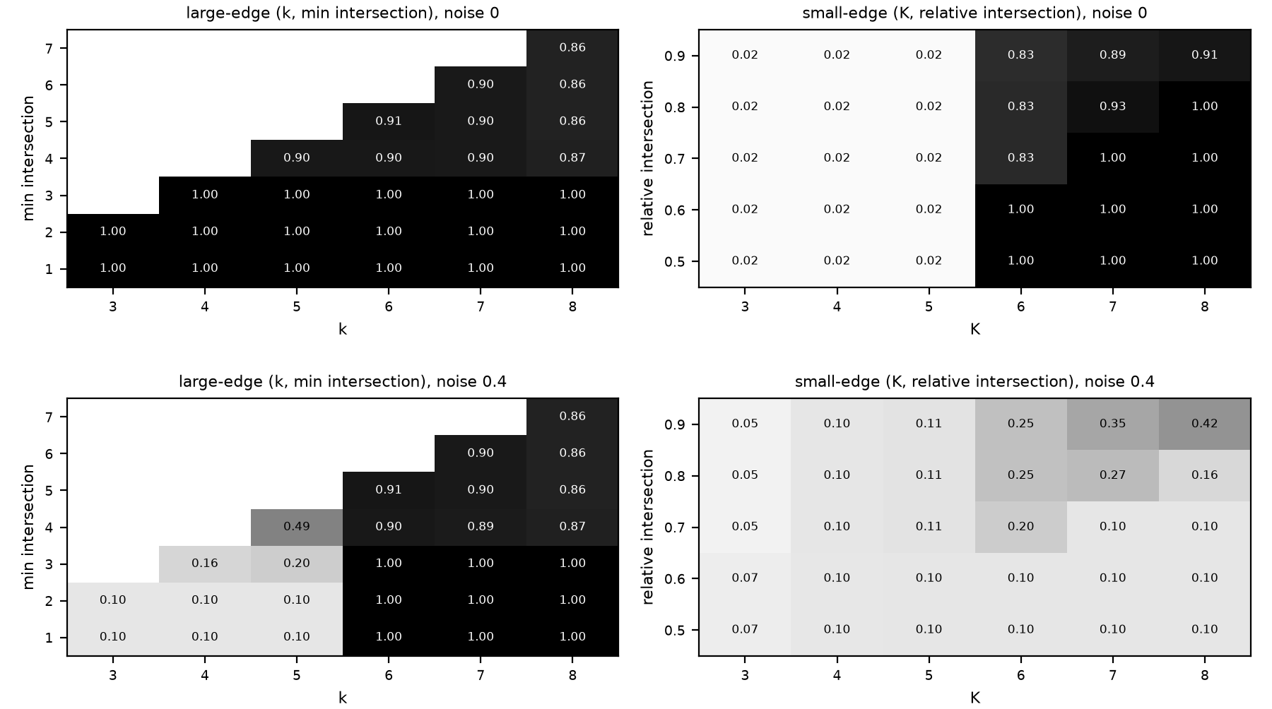
E1: it works exactly as the paper says
Intra-community hyperedges size 6 to 8, random size 3 to 5; two of five rows shown. Top row p = 0: both variants 1.000. Bottom row p = 0.4: large-edge variant 1.000, small-edge variant 0.424.
‹#›

Slide 12
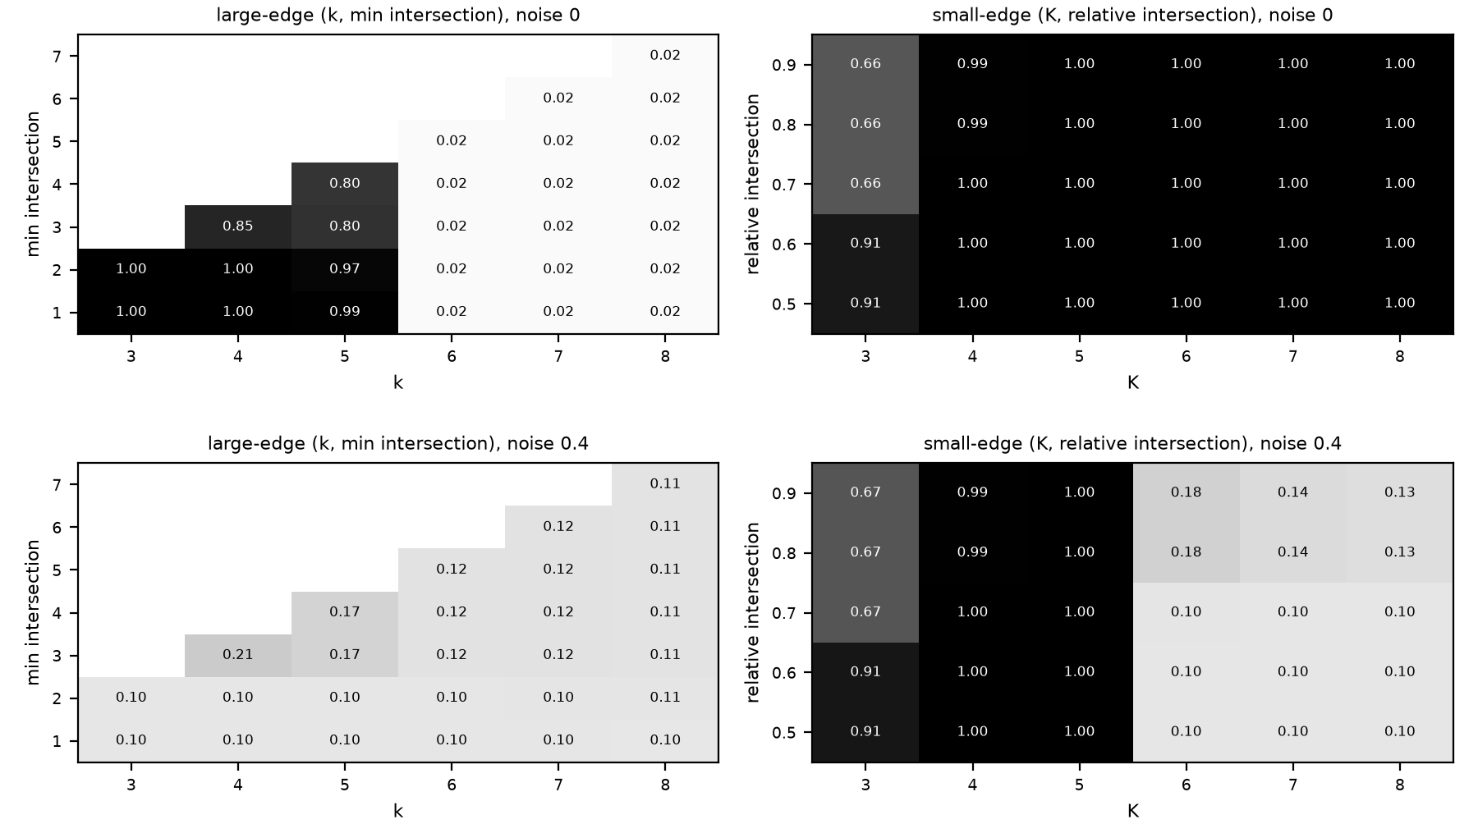
E1, the mirror case
Intra-community hyperedges size 3 to 5, random size 6 to 8; two of five rows shown. Top row p = 0: both variants 1.000. Bottom row p = 0.4: small-edge variant 1.000, large-edge variant 0.206.
‹#›

Slide 13
Our rule for picking parameters without labels
Sweep the parameters.
Discard settings with fewer than two communities, or where the largest community is more than twice the second (one community absorbs the rest).
Among the rest, pick the setting whose communities are large but not giant.
Concentration score: split each node equally across its communities, sum the squared community sizes, divide by n squared.
Ties go to the stricter setting. If nothing survives, use the paper default.
Our first version picked the highest coverage and failed: many tiny overlapping fragments reach coverage near 1.
‹#›

Slide 14
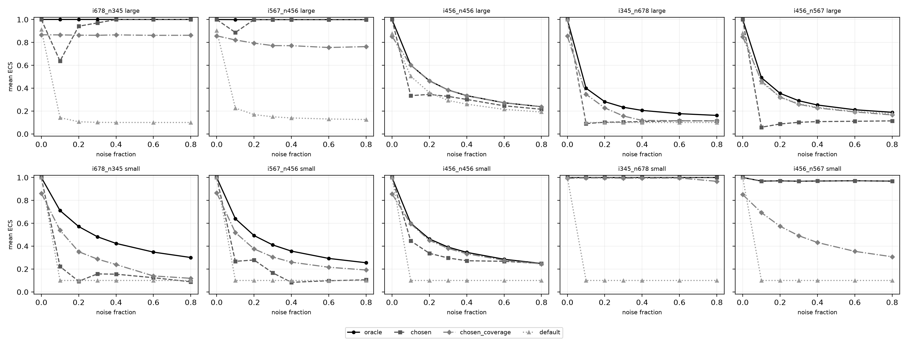
E3: the rule against the oracle and the default
Mean ECS over 1050 hypergraphs per variant. Large-edge: rule 0.555, oracle 0.644, default 0.292. Small-edge: rule 0.586, oracle 0.698, default 0.229. The rule reaches the oracle on 46.6 and 55.4 percent of hypergraphs.
‹#›

Slide 15
What we found
E1: the matching variant scores 1.000 at every p up to 0.4; the wrong variant falls to 0.206 or 0.424.
E3: the rule beats the default by a wide margin but stays below the oracle.
Backup: percolation needs at least one hyperedge size used only by intra-community hyperedges. With identical size ranges both variants collapse (0.601 at p = 0.1, about 0.24 at 0.8).
Backup: on committee data the rule gives no gain, and party labels are a weak test.
‹#›

Slide 16
Limits
Planted communities do not overlap, so overlap is never tested.
Two-party labels are weak ground truth.
Percolation leaves nodes unassigned.
The rule is a heuristic and assumes communities of similar size.
The clique baseline mostly timed out (278 of 350 runs), so it is limited by time, not accuracy.
‹#›

Slide 17
Conclusion
Our code does what the paper says: each variant scores 1.000 up to p = 0.4 when its size assumption fits. We did not reproduce the paper's figures.
Our label-free rule beats the paper's default (0.555 and 0.586 against 0.292 and 0.229) but stays below the oracle (0.644 and 0.698).
When intra-community and random hyperedges have the same sizes, both variants break; on real committee data the rule does not help.
‹#›

Slide 18
Backup, E2: when the size cut is not clean
Clean cut: intra-community and random hyperedges have different sizes, so a size filter removes all random hyperedges.
Partial overlap (intra-community 5 to 7, random 4 to 6): still works, because one pure size remains to filter on. ECS 0.968 to 1.000.
Full overlap (4 to 6 against 4 to 6): size tells nothing, and both variants break.
ECS is 0.601 at p = 0.1, and 0.238 (large-edge) and 0.248 (small-edge) at p = 0.8.
Clique percolation scores 0.101 at p = 0.1, even on the small-community type.
‹#›

Slide 19
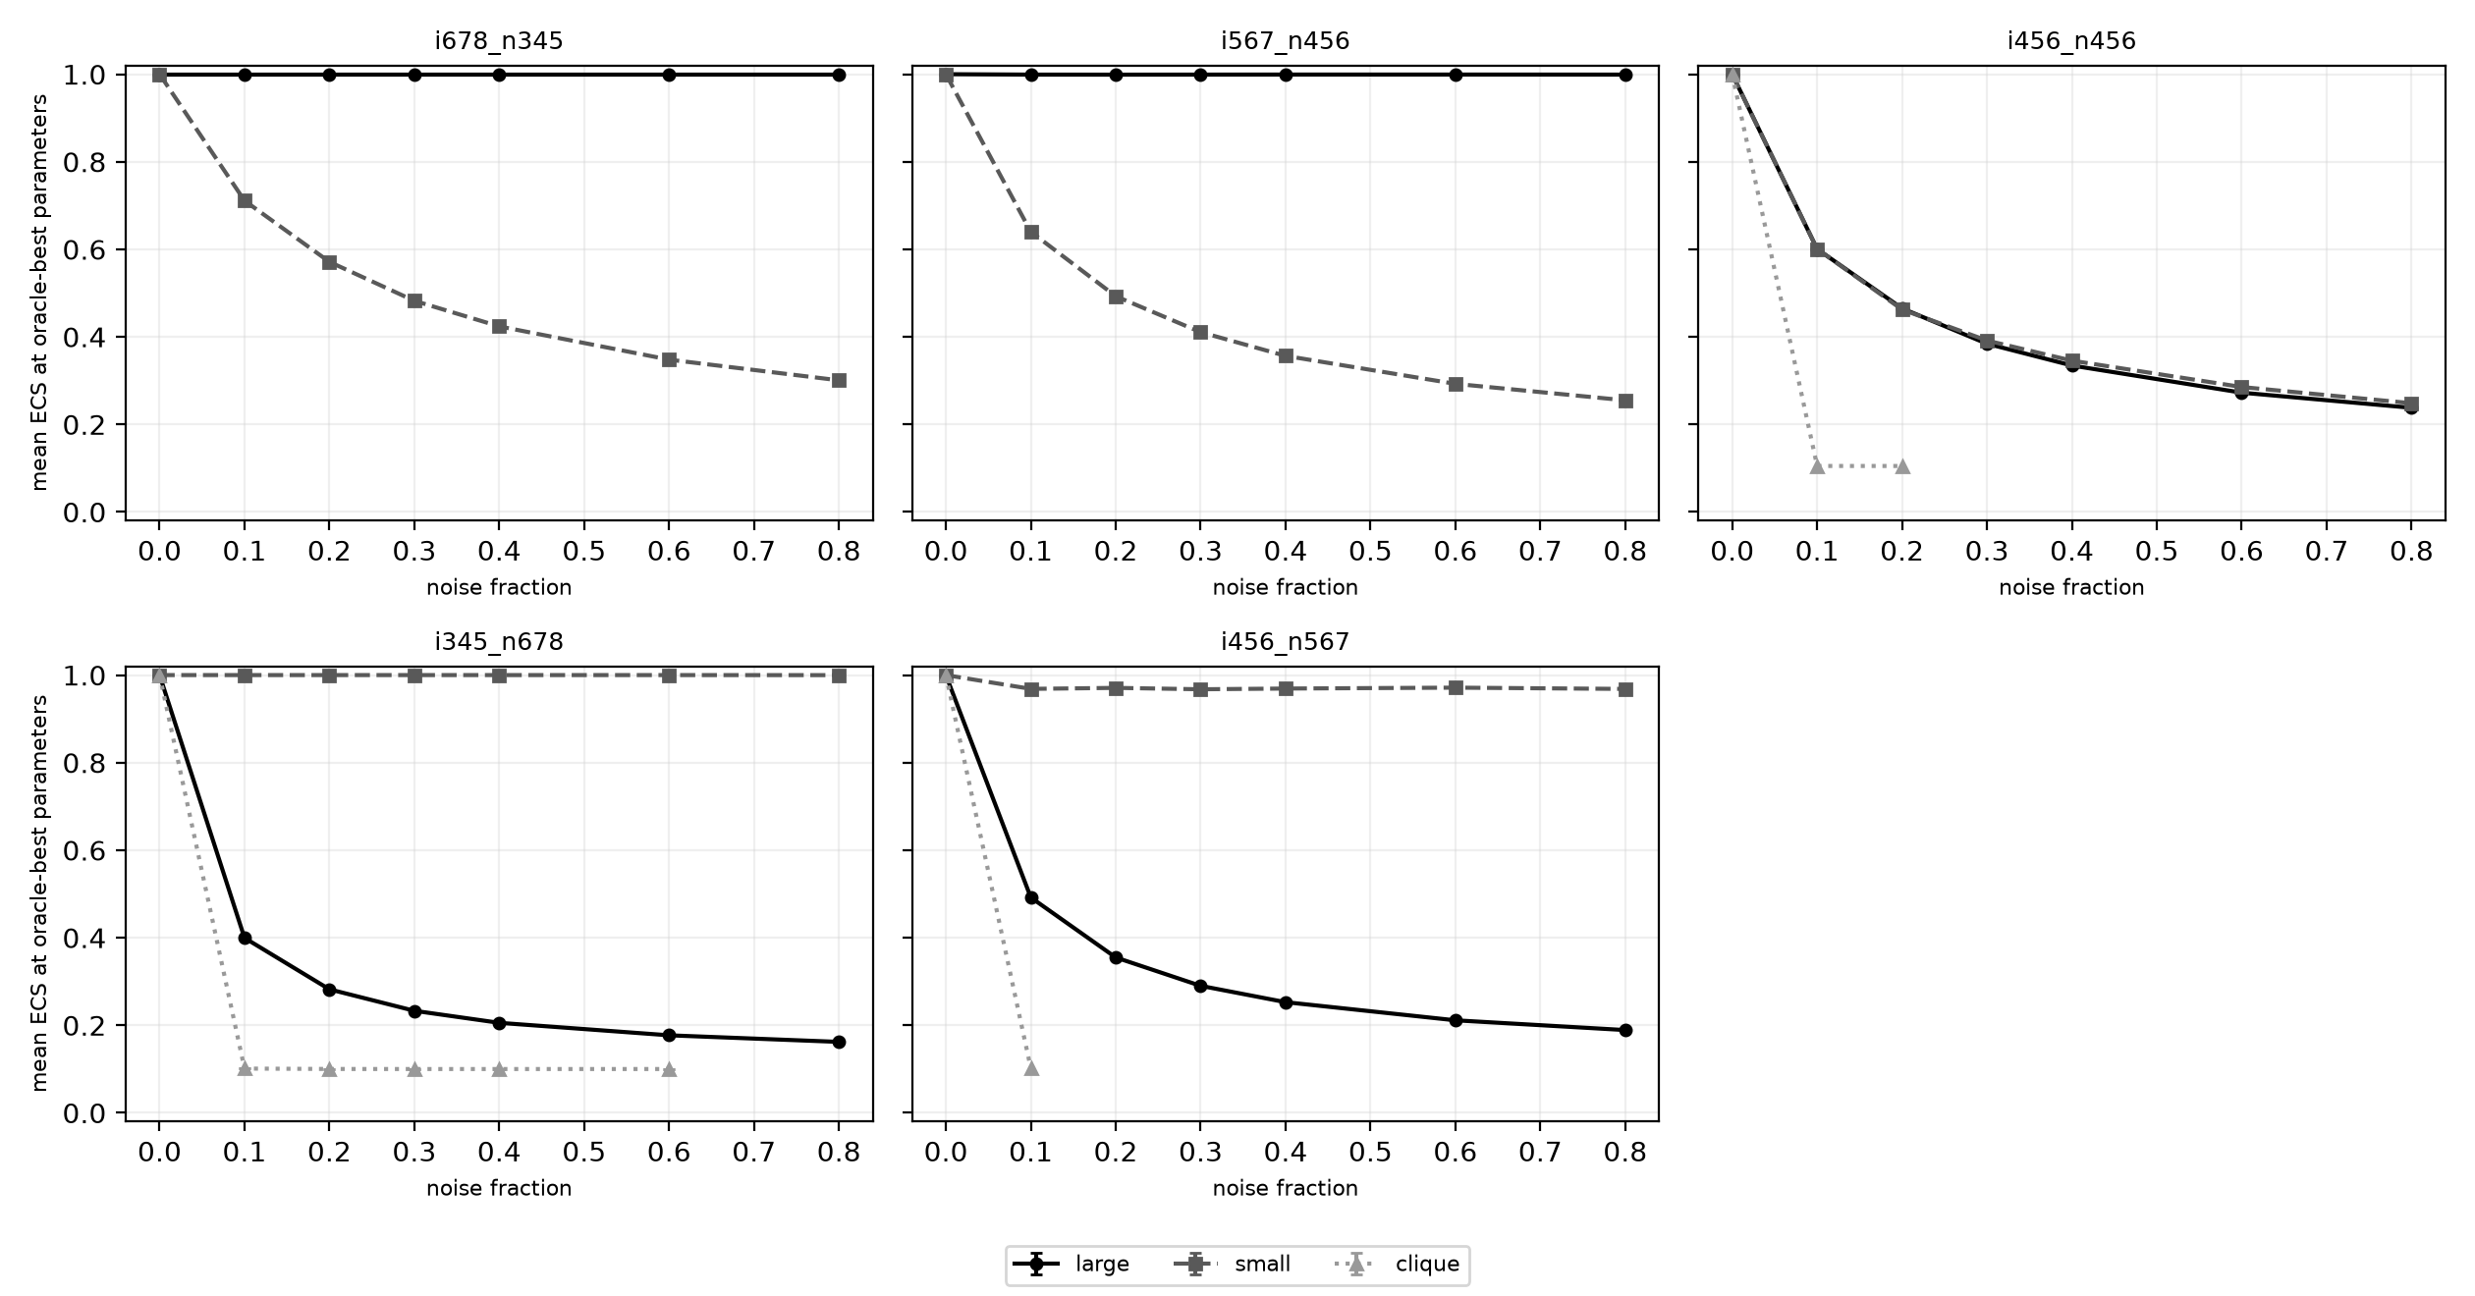
Backup, E2: hyperedge versus clique percolation
Full size overlap: ECS 0.601 at p = 0.1 for both variants, then 0.238 (large) and 0.248 (small) at p = 0.8. Clique percolation scores 0.101 at p = 0.1 even on the small-community type. It timed out in 278 of 350 runs.
‹#›

Slide 20
Backup, E4: real committee data
House, large variant: no setting passes the giant-community test (each gives one community or a giant one), so the rule falls back to the default. Rule, oracle and default all give ECS 0.501, coverage 1.000.
House, small variant: the rule picks K=12, I_rel 0.5 with 6 communities, coverage 0.156, ECS 0.026. Oracle and default (K=81, 0.5) give one community, ECS 0.501.
Senate, large variant: rule picks k=14, I_abs=10 with 18 communities, ECS 0.488, coverage 1.000. Oracle is one community at ECS 0.500; default gives 2 communities at 0.485.
Senate, small variant: rule ECS 0.194, coverage 0.525, 13 communities. Oracle and default give ECS 0.485, 2 communities, coverage 1.000.
The best ECS comes from one or two communities covering all nodes. So party labels are a weak test here, and the rule gives no gain.
‹#›

