Slide 2
Informed Search
How can we make search smarter?
Use problem-specific knowledge beyond the definition of the problem itself
Specifically, incorporate knowledge of how good a non-goal state is

Slide 3
Best-First Search
Node selected for expansion based on an evaluation function f(n) ie. expand the node that appears to be the best
Node with lowest evaluation is selected for expansion
Uses a priority queue
We’ll talk about Greedy Best-First Search and A* Search

Slide 4
Heuristic Function
h(n) = estimated cost of the cheapest path from node n to a goal node
h(goal node) = 0
Contains additional knowledge of the problem

Slide 5
Greedy Best-First Search
Expands the node that is closest to the goal
f(n) = h(n)

Slide 6
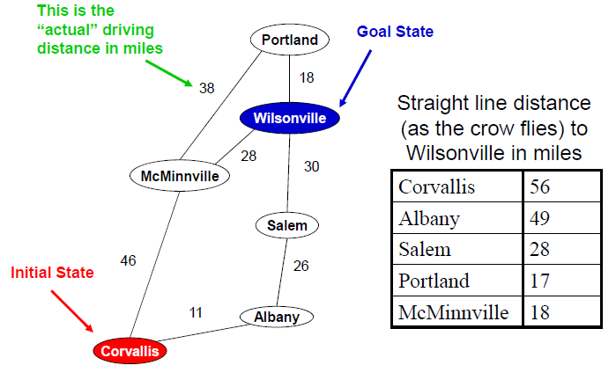
Greedy Best-First Search Example

Slide 7
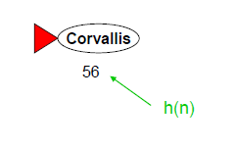
Greedy Best-First Search Example

Slide 8
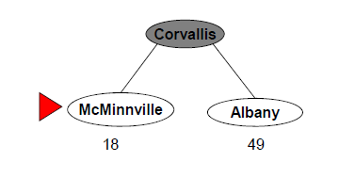
Greedy Best-First Search Example

Slide 9
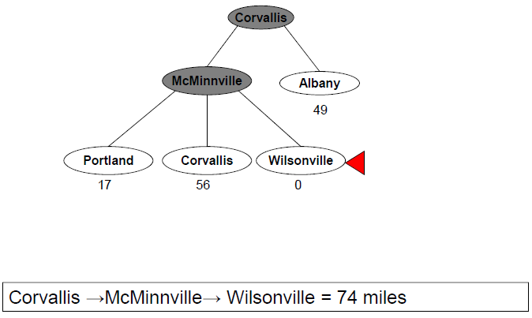
Greedy Best-First Search Example

Slide 10
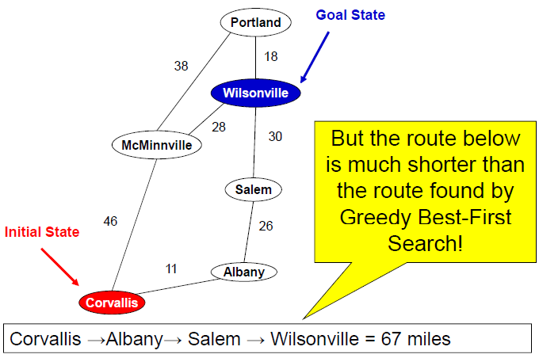
Greedy Best-First Search Example

Slide 11
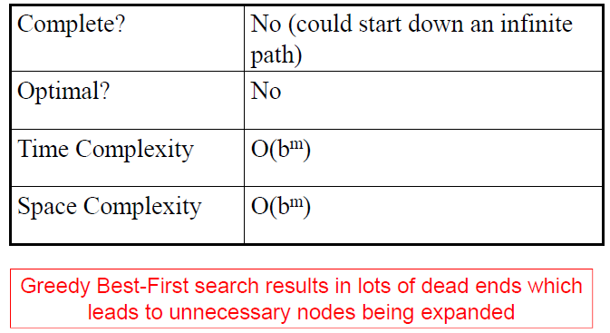
Evaluating Greedy Best-First Search

Slide 12
A* Search
A much better alternative to greedy bestfirst search
Evaluation function for A* is:
f(n) = g(n) + h(n)
where g(n) = path cost from the start node to n
If h(n) satisfies certain conditions, A*search is optimal and complete!

Slide 13
Admissible Heuristics
A* is optimal if h(n) is an admissible heuristic
An admissible heuristic is one that never overestimates the cost to reach the goal
Admissible heuristic = optimistic
Straight line distance was an admissible heuristic

Slide 14
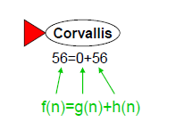
A* Search Example

Slide 15
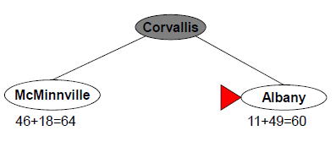
A* Search Example

Slide 16
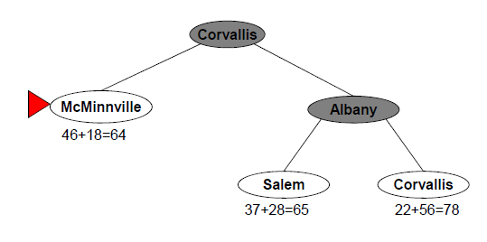
A* Search Example

Slide 17
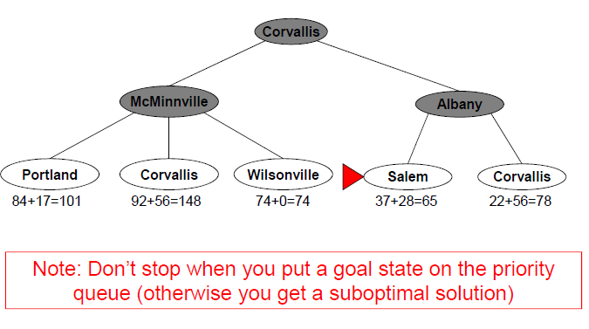
A* Search Example

Slide 18
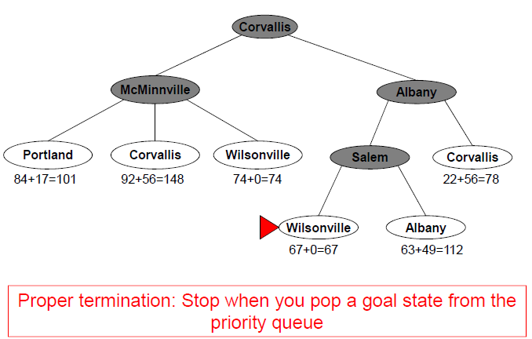
A* Search Example

Slide 19
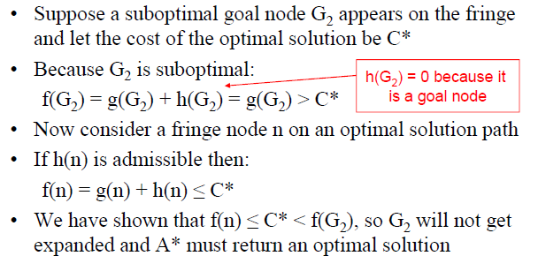
Proof that A* using TREE-SEARCH is optimal if h(n) is admissible

Slide 20
What about search graphs (more than one path to a node)?
What if we expand a state we’ve already seen?
Suppose we use the GRAPH-SEARCH solution and not expand repeated nodes
Could discard the optimal path if it’s not the first one generated
One simple solution: ensure optimal path to any repeated state is always the first one followed (like in Uniform-cost search)
Requires an extra requirement on h(n) call consistency (or monotonicity

Slide 21
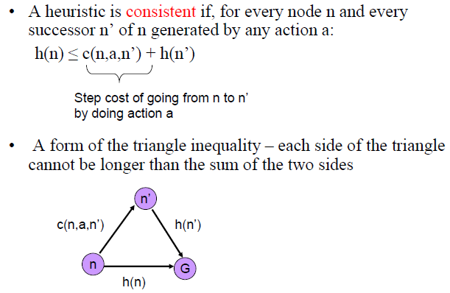
Consistency

Slide 22
Consistency
Every consistent heuristic is also admissible
A* using GRAPH-SEARCH is optimal if h(n) is consistent
Most admissible heuristics are also consistent

Slide 23
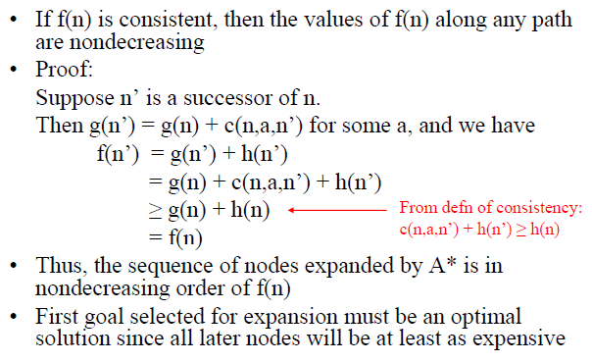
Consistency

Slide 24
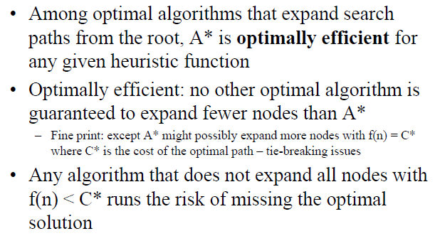
A* is Optimally Efficient

Slide 25
Evaluating A* Search
With a consistent heuristic, A* is complete, optimal and optimally efficient. Could this be the answer to our searching problems?

Slide 26
Evaluating A* Search
With a consistent heuristic, A* is complete, optimal and optimally efficient. Could this be the answer to our searching problems?
The Dark Side of A*
Time complexity is exponential (although it can be reduced significantly with a good heuristic)
The really bad news: space complexity is exponential (usually need to store all generated states). Typically runs out of space on large-scale problems.

Slide 27
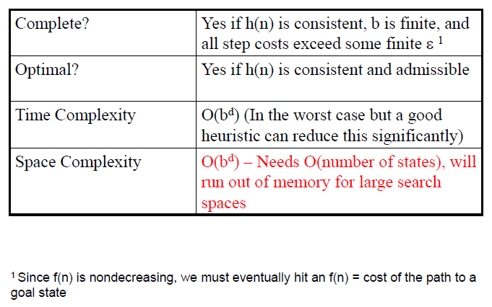
Summary of A* Search

Slide 28
Iterative Deepening A*
Use iterative deepening trick to reduce memory requirements for A*
Cutoff is the f-cost (g+h) rather than the depth
At each iteration, the cutoff is the smallest f-cost that exceeded the cutoff in the previous iteration
Complete, Optimal but more costly than A* and can take a while to run with realvalued costs

Slide 29
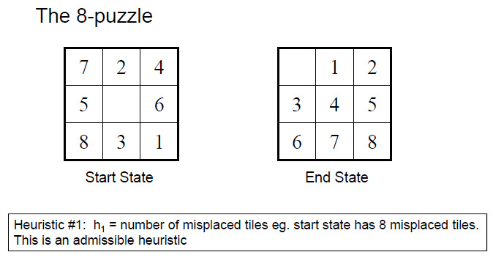
Examples of heuristic functions

Slide 30
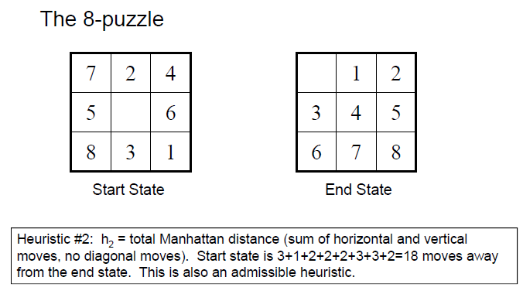
Examples of heuristic functions

Slide 31
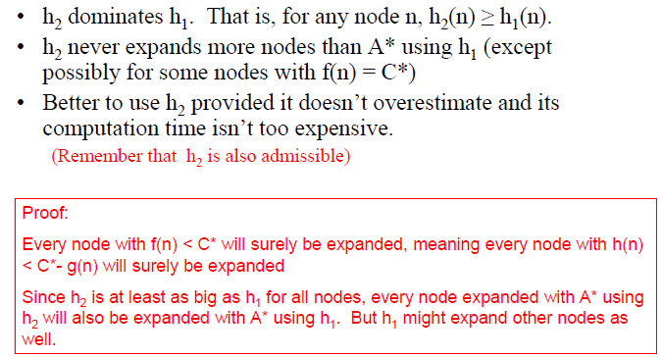
Which heuristic is better?

Slide 32
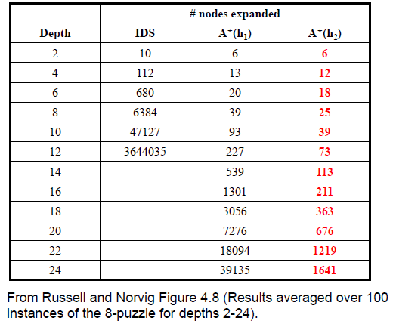
Which heuristic is better?

Slide 33
Inventing Admissible Heuristics
Relaxed problem: a problem with fewer restrictions on the actions
The cost of an optimal solution to a relaxed problem is an admissible heuristic for the original problem
If we relax the rules so that a square can move anywhere, we get heuristic h1
If we relax the rules to allow a square to move to any adjacent square, we get heuristic h2

Slide 34
What you should know
Be able to run A* by hand on a simple example
Why it is important for a heuristic to be admissible and consistent
Pros and cons of A*
How do come up with heuristics
What if means for a heuristic function to dominate another heuristic function

