Slide 1

Gross Domestic Product (GDP)
Mohamed Amer

Slide 2
What is GDP ?
GDP is the total value of goods produced and services provided in a country during one year.

Slide 3
Content
Descriptive Statistics.
Confidence Intervals.
One Sample Test of Hypothesis.
Two Sample Test of Hypothesis.
Linear Regression.
Chi-Square Test.
Wilcoxon Signed Rank Test.

Slide 4
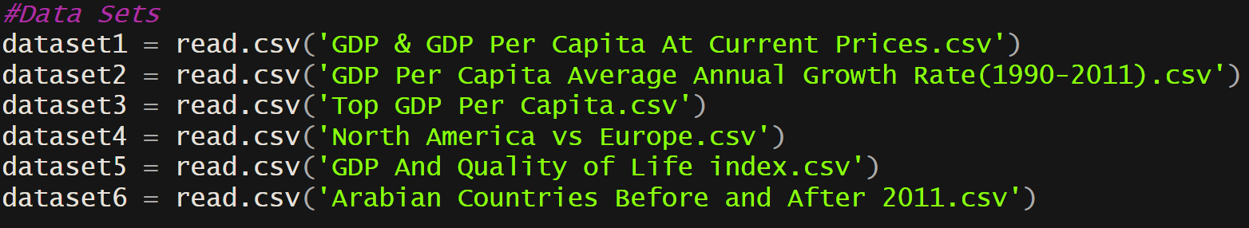
Data Sets Used

Slide 5
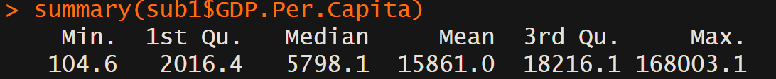
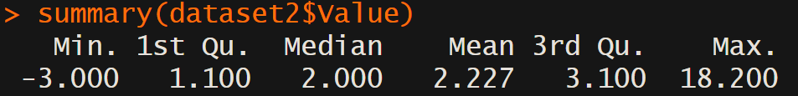
Descriptive Statistics (Summary)
GDP
GDP Per Capita
GDP Average Annual Growth

Slide 6
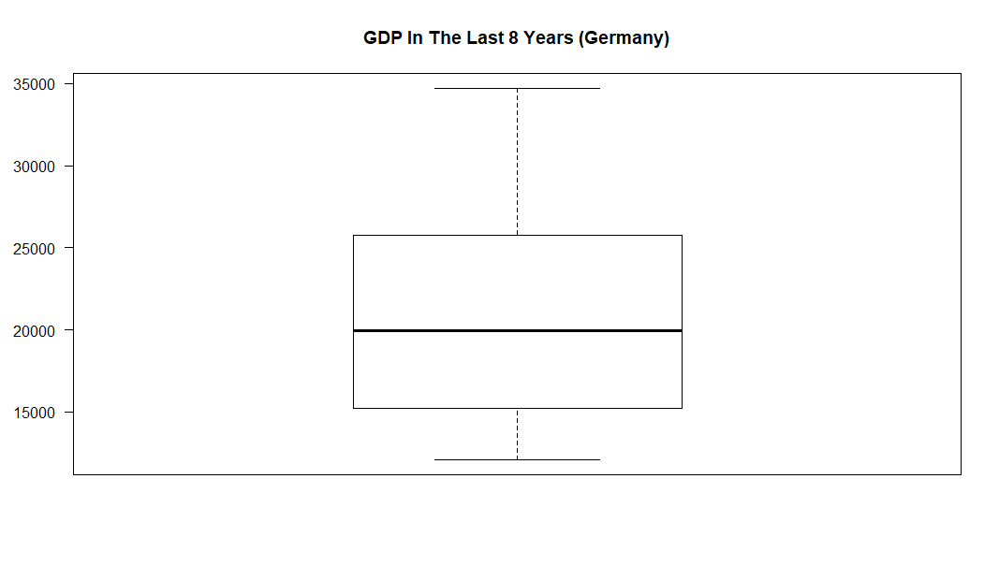

Descriptive Statistics (Plots)
GDP For Germany (2010 - 2017)
Box Plot

Slide 7
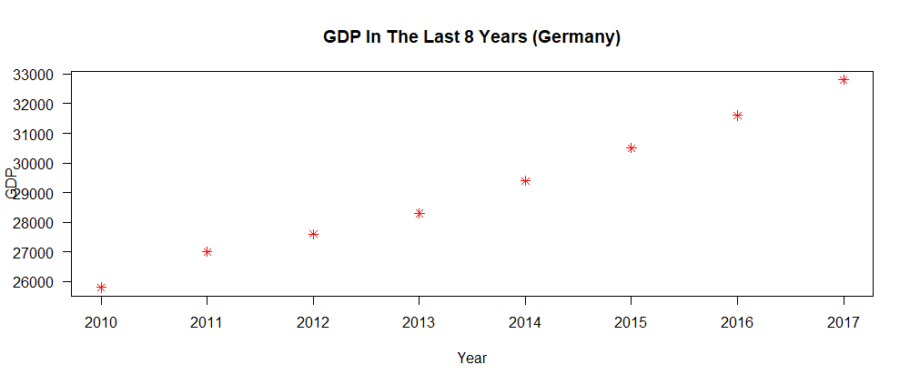
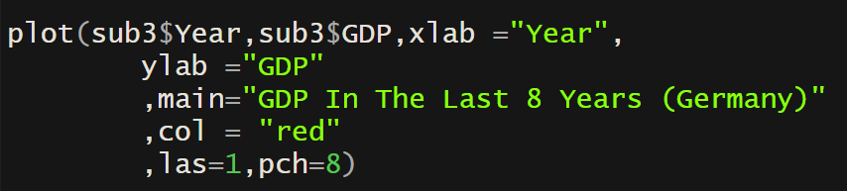
Descriptive Statistics (Plots)
GDP For Germany (2010 - 2017)
Scatter Plot

Slide 8
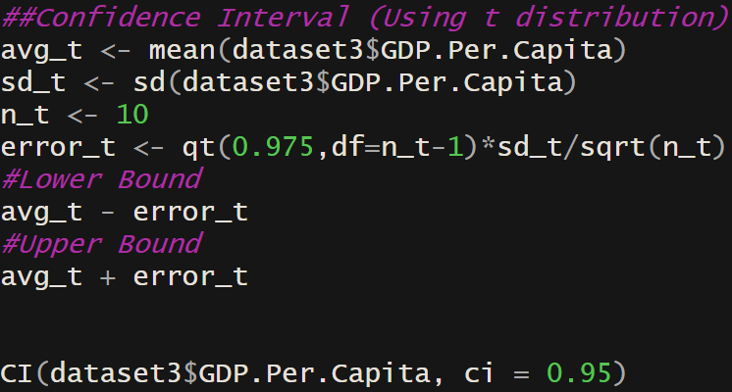
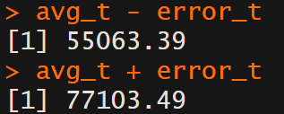

Confidence Interval (t-distribution)
Sample Used : Top 10 Country GDP In 2017

Slide 9
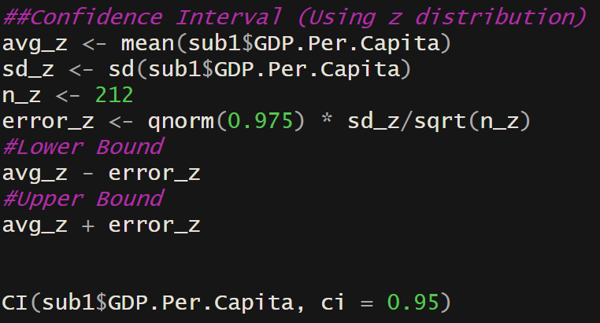
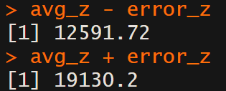
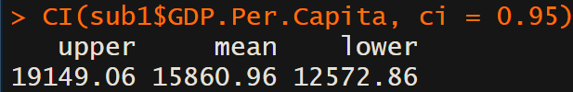
Confidence Interval (z-distribution)
Sample Used : GDP Per Capita In 2017.

Slide 10
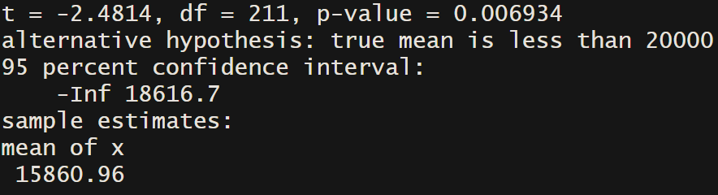

One Sample Test of Hypothesis.
Sample Used : GDP Per Capita In 2017.
H0 : Mean GDP Per Capita>=20000 USD.
H1 : Mean GDP Per Capita < 2000 USD.
P- value = 0.006934 , Therefore we have a very
strong evidence that H0 is not true.

Slide 11
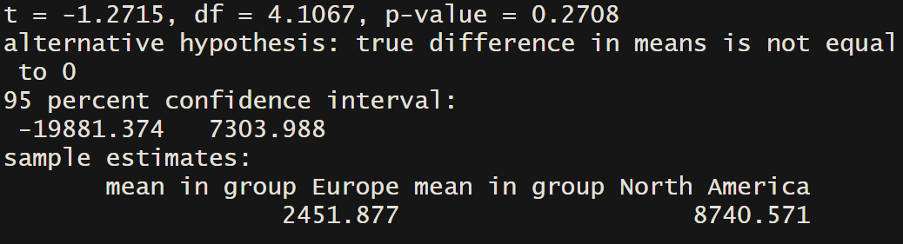
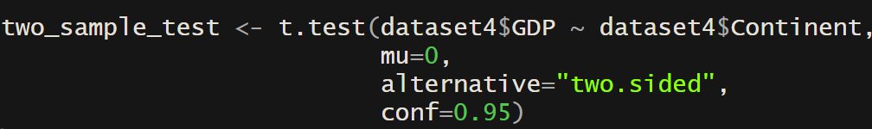
Two Sample Test of Hypothesis.
Sample Used : North America Vs Europe.
H0 : Mean GDP of EUROPE = of North America.
H1 : Mean GDP of EUROPE != of North America.
Difference in mean is not equal to zero therefore
H0 is rejected.

Slide 12

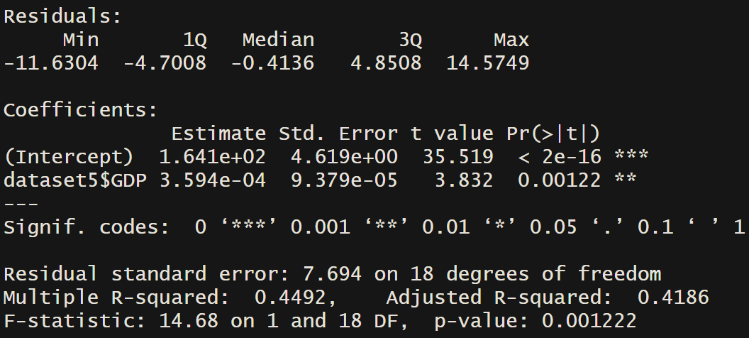
Linear Regression
Sample Used : GDP & Quality of Life.
Correlation Coefficient :
0.6702467 Moderate Positive Correlation.
Model :

Slide 13
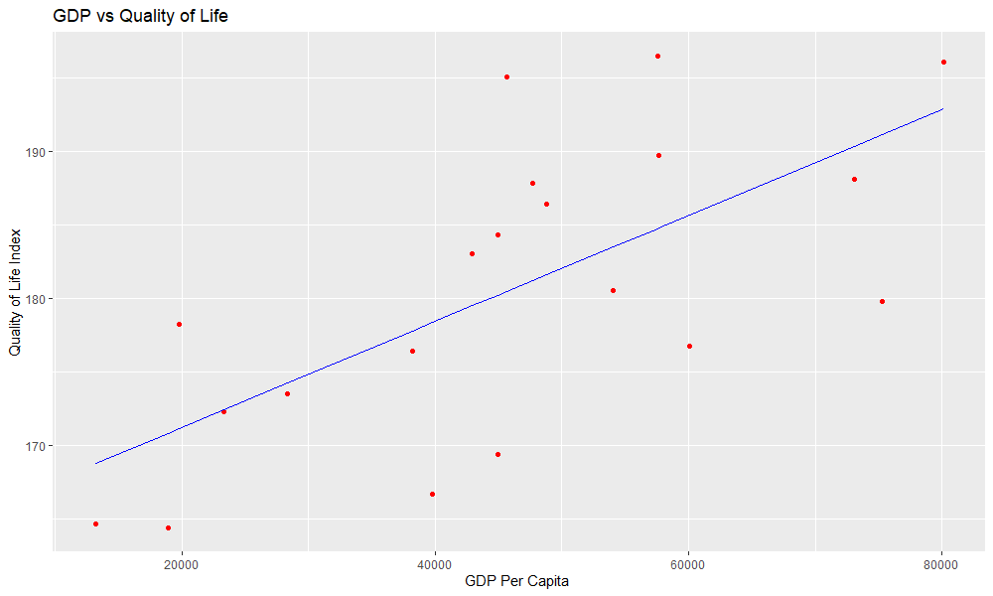
Linear Regression (Representation)

Slide 14

Chi-Square Test
Sample Used : GDP for Germany(2010-2017).
H0: GDP 2010 = 2011 = …. =2017.
H1: GDP 2010 != 2011!= …. !=2017.
Therefore H0 is rejected.

Slide 15
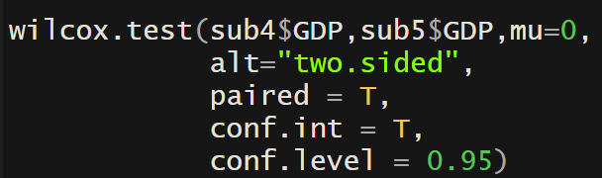
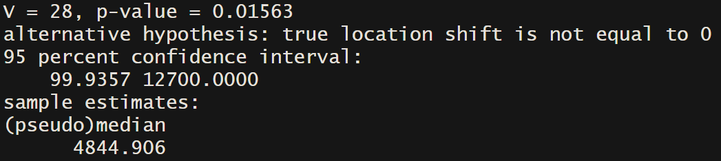
Wilcoxon Signed Rank Test
Sample Used : Arab Countries GDP Before and after 2011 events.
H0: Median Change in GDP = 0
H1: Median Change in GDP != 0

