Slide 1
Synopsis of the research conducted thus far

Slide 2
Theoritical model
Chiller setup
Temperature acquisition

Slide 3
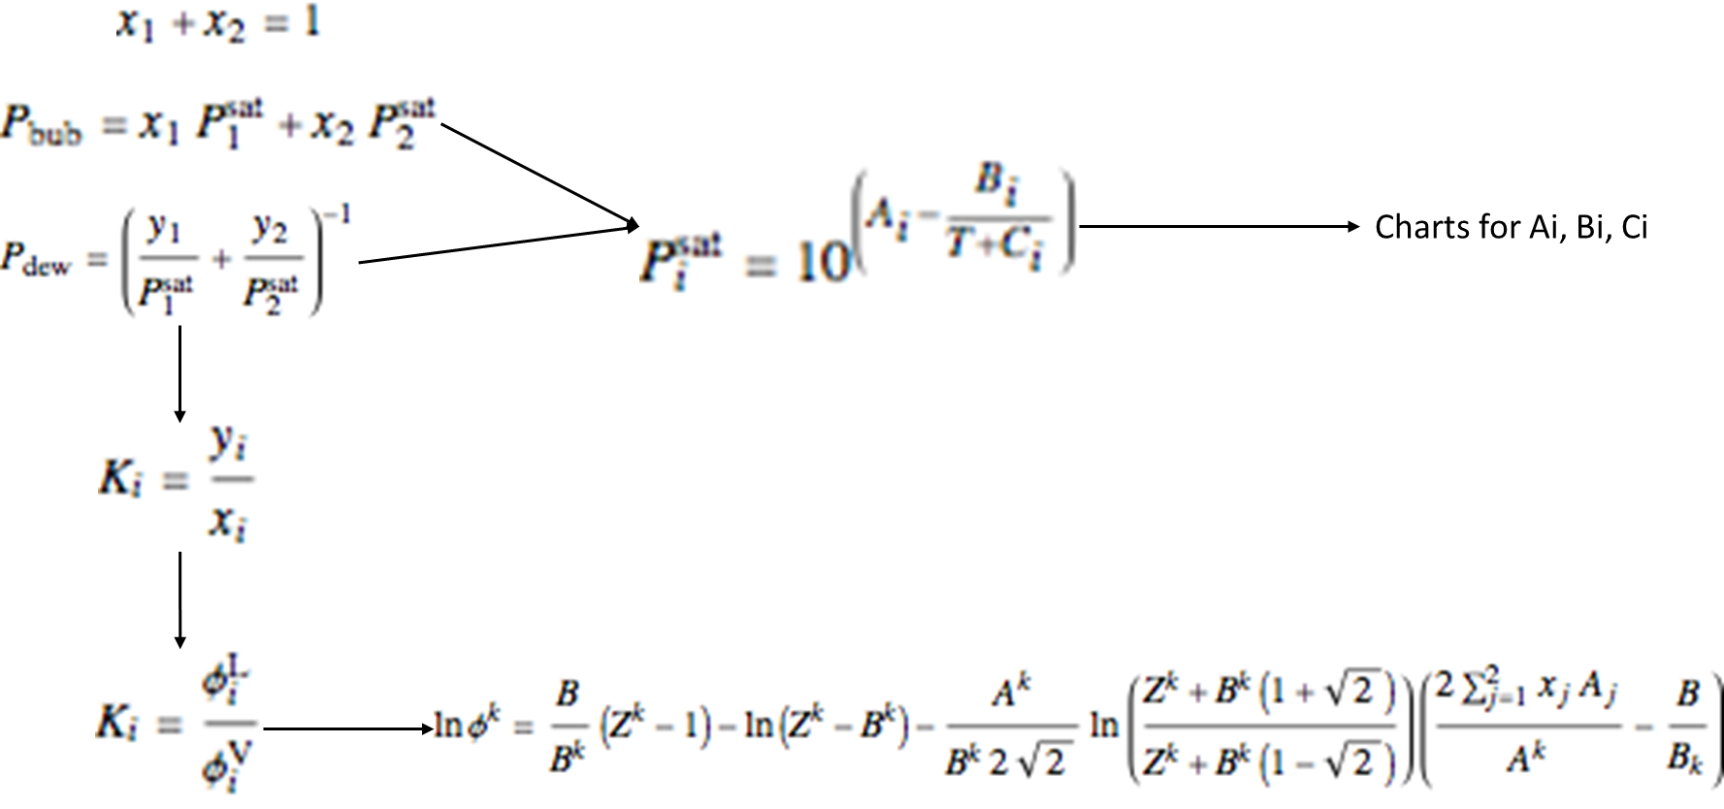
First trial: code everything from scratch
Antoine equations, Raoult's law

Slide 4
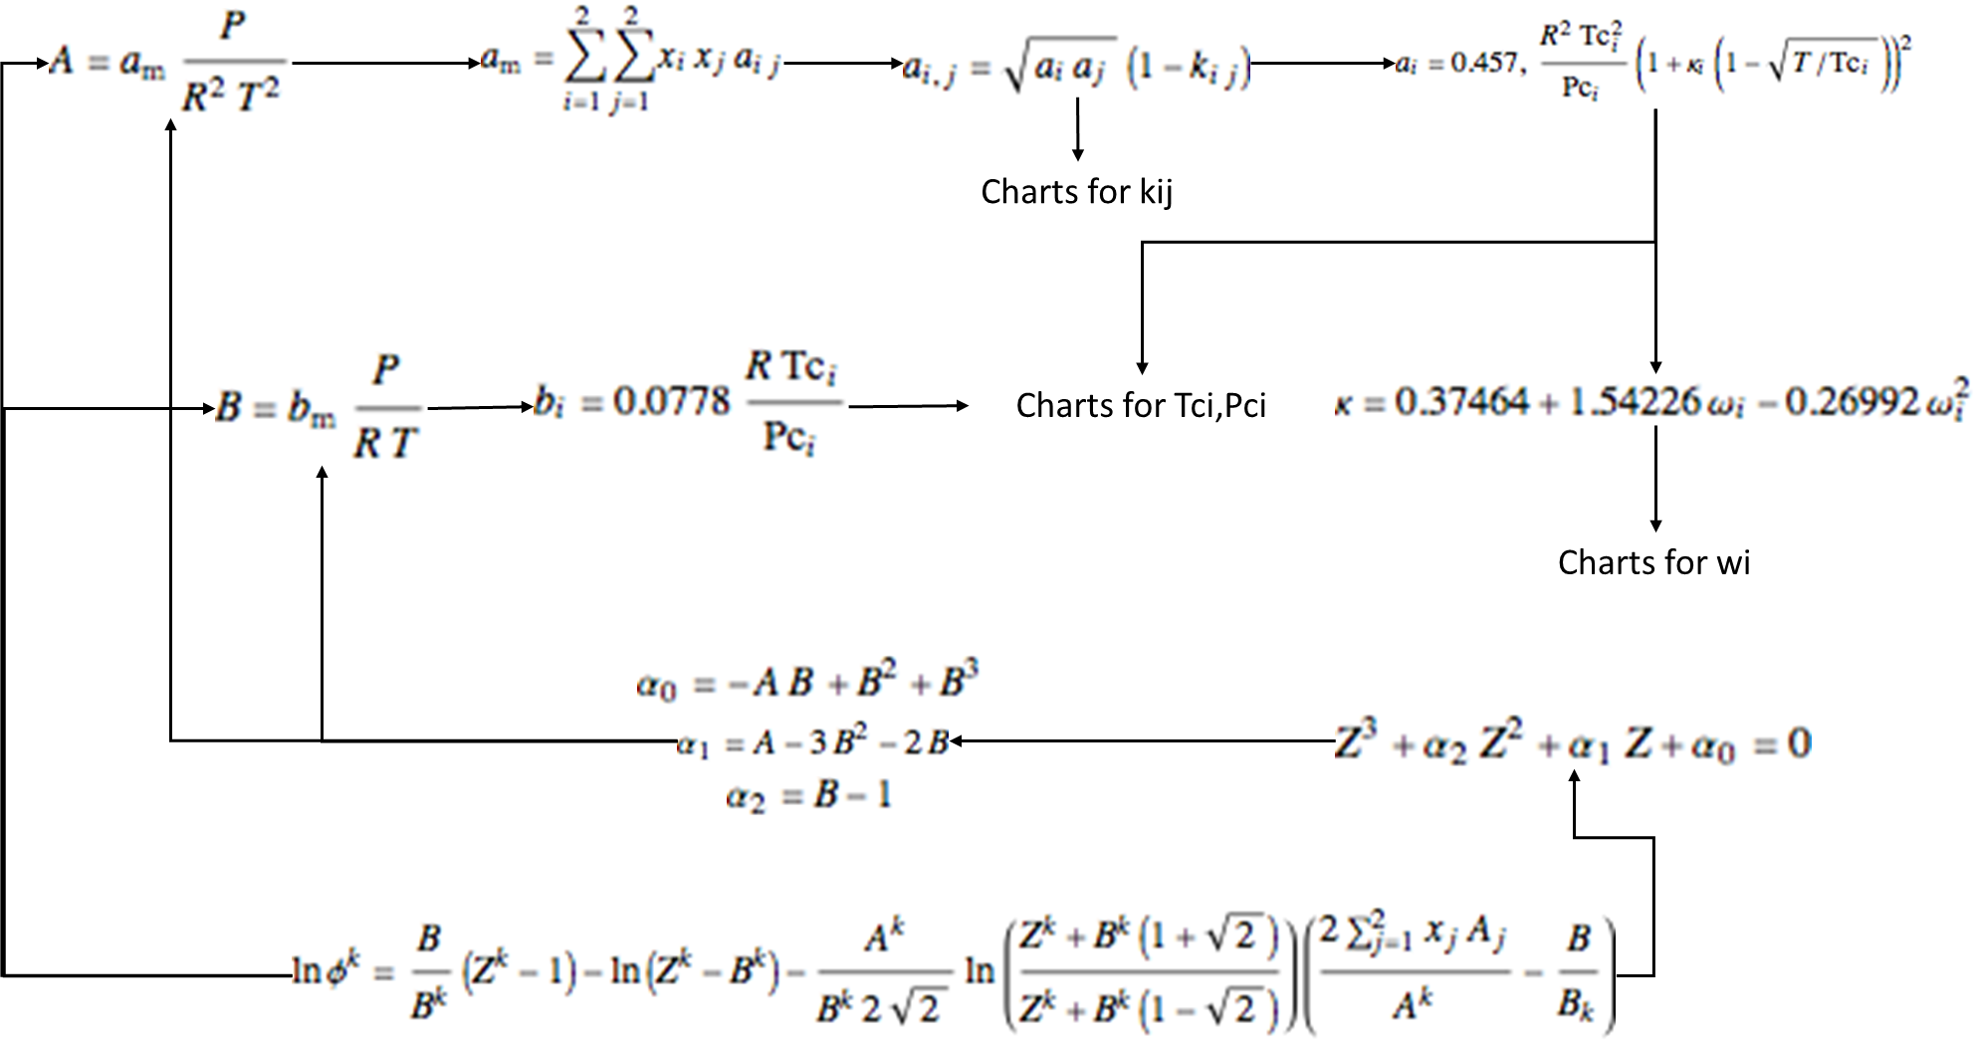
First trial: code everything from scratch
Peng-Robinson EOS

Slide 5
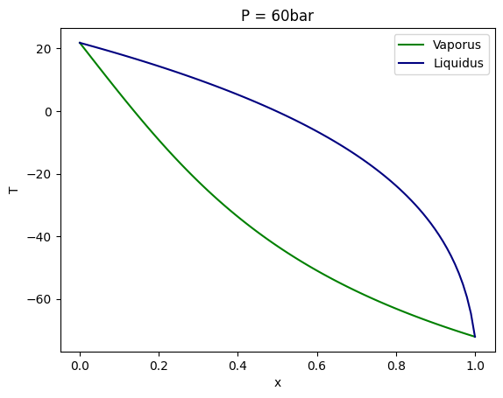
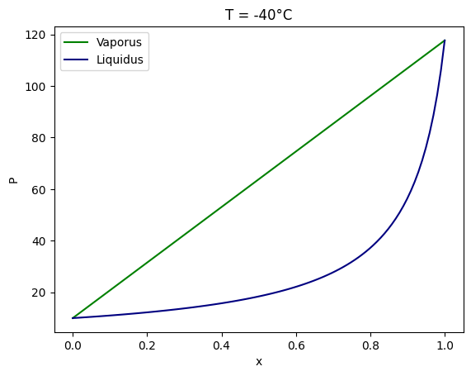
Success: plot Pxy and Txy curves

Slide 6
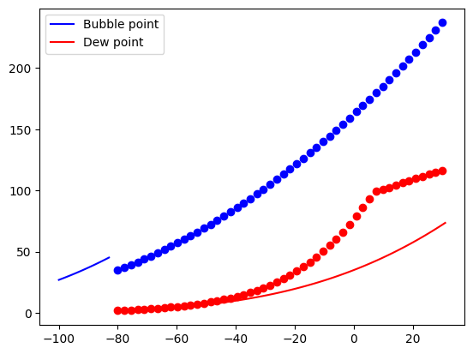
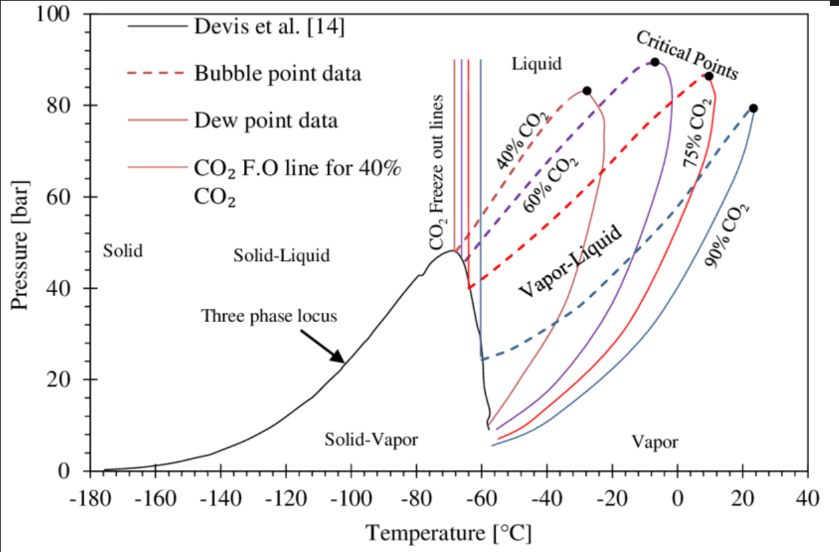
Failure: plot PT curves

Slide 7
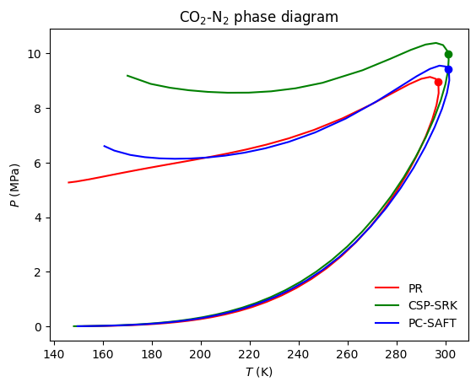
Second tentative: use Thermopack library
Thermopack is a thermodynamics library for multi-component and multi-phase thermodynamics developed at SINTEF Energy Research and NTNU Department of Chemistry.
Notes:
Different models have different accuracies vis-à-vis the experimental data.
Within the same model the accuracy depends on the mixture, molar composition, temperature, pressure,...
Sometimes many models can coincide very well within a domain while are distinct outside.
The use of many models needs fine tuning of parameters, mainly kij (interaction coefficient)
Based on these points, the conclusion is:
One must be familiar with the tools and with a lot of real data (of CO2 and N2 for example) in order to master the fine tuning process and the most convenient model to use.
What counts more a priori is the qualitative behavior of the phase envelope and its approximated domain of temperature and pressure. The quantitative approach needs at least some real data to correct the model.

Slide 8
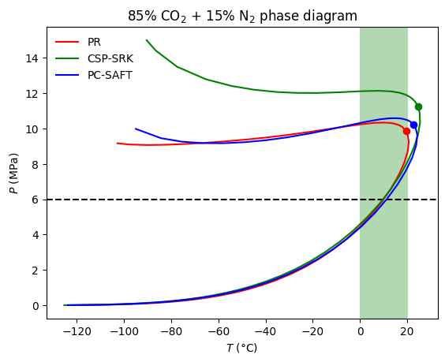
Focus on our range
Our domain: 6MPa, 0°C to room temperature (20°C), 85% CO2 + 15% N2.

Slide 9
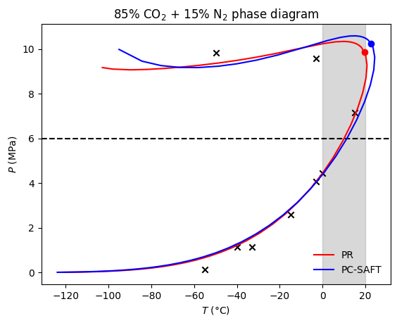
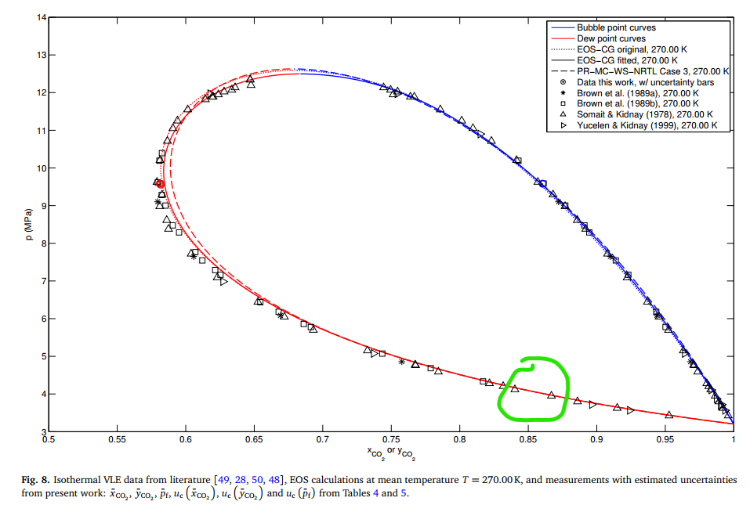
Comparison with real data
Experimental data from: S. F. Westman, H. G. J. Stang, S. W. Løvseth, A. Austegard, I. Snustad, S. Ø. Størset, and I. S. Ertesvåg, Vapor–Liquid Equilibrium Data for the Carbon Dioxide and Nitrogen (CO2 + N2) System at the Temperatures 223, 270, 298 and 303 K and Pressures up to 18 MPa, Fluid Phase Equilibria 409, 207 (2016).

Slide 10
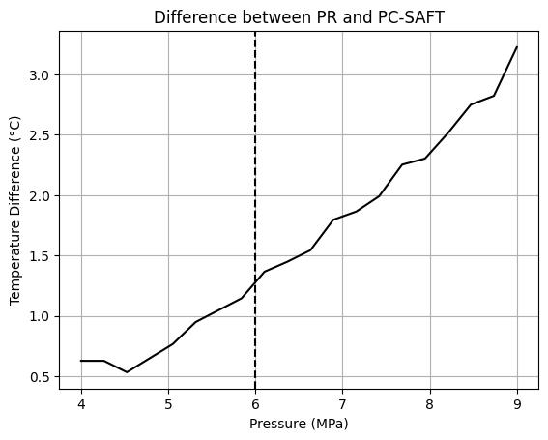
Comparison between models

Slide 11
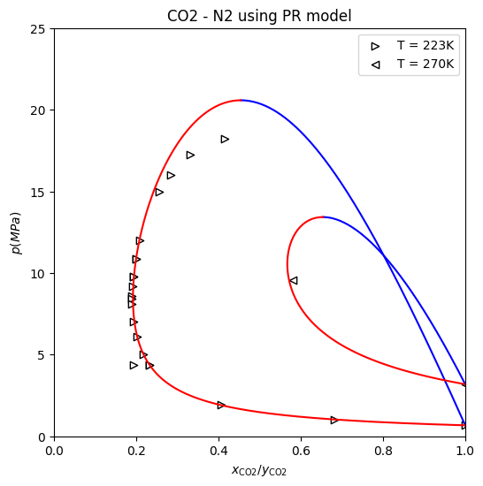
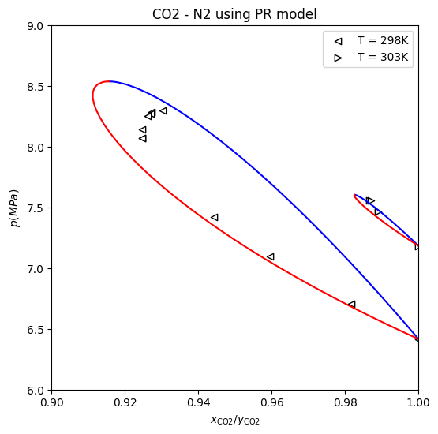
Real data in the vicinity of our domain

Slide 12
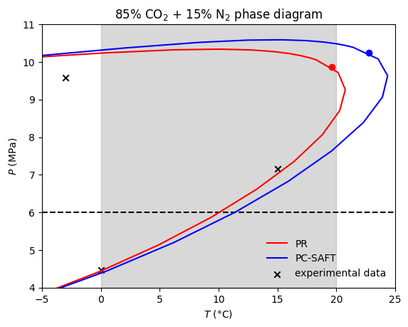
To sum up

Slide 13
Theoritical model
Chiller setup
Temperature acquisition

Slide 14
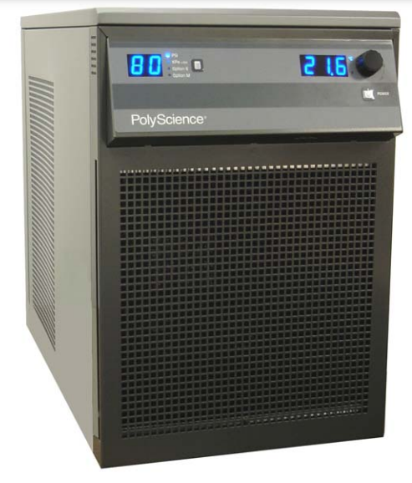
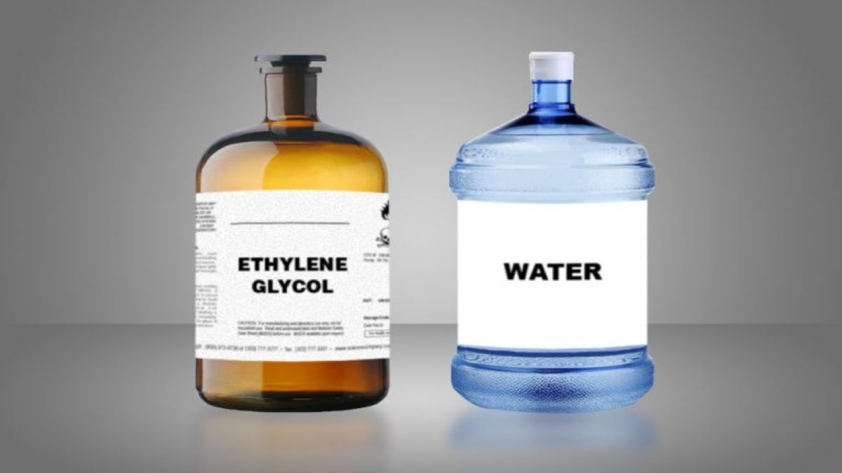
The use of the chiller and preparation of the cooling liquid
For temperatures less than 20°C chiller needs a special cooling fluid
50%
50%
Notes:
Our temperature range requires a special cooling liquid
We can adjust the temperature of the chiller between 0 and 20 to one decimal place

Slide 15
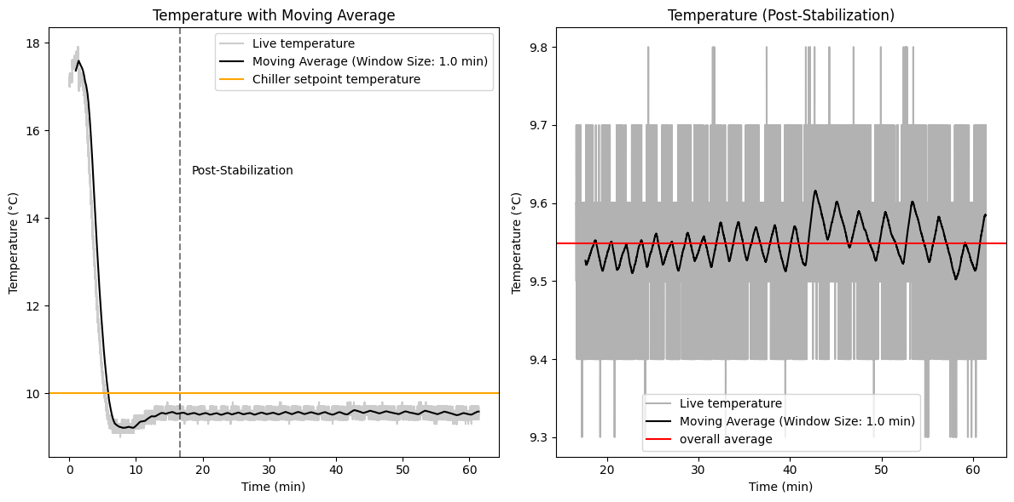
Stability of the Chiller
Notes:
Stabilization time approx. 17 min

Slide 16
Theoritical model
Chiller setup
Temperature acquisition

Slide 17
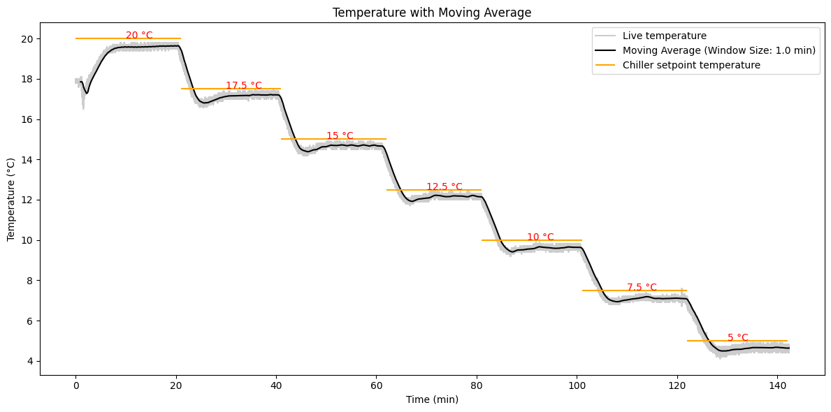
Uncertainty interval of thermocouples

Slide 18
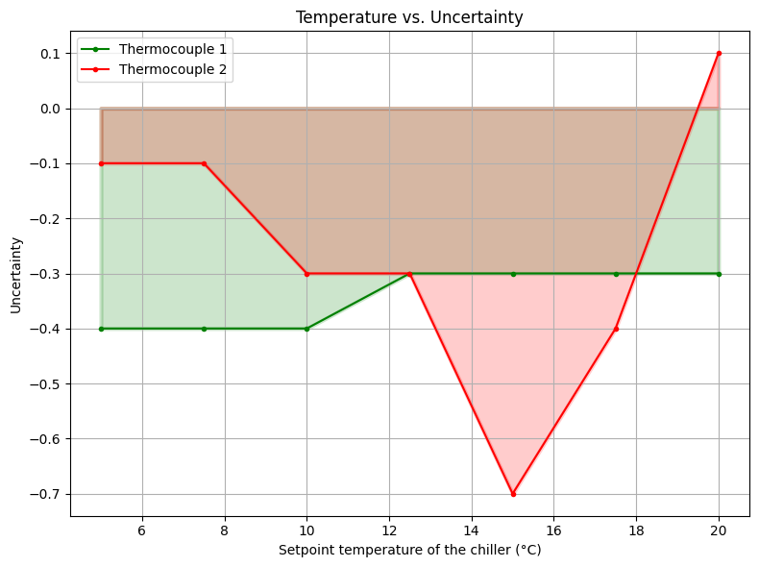
Uncertainty interval of thermocouples

Slide 19
What’s next?
Measure the temperature of the cooling lines
Viscometry
Preparing the gas mixture

