Slide 1
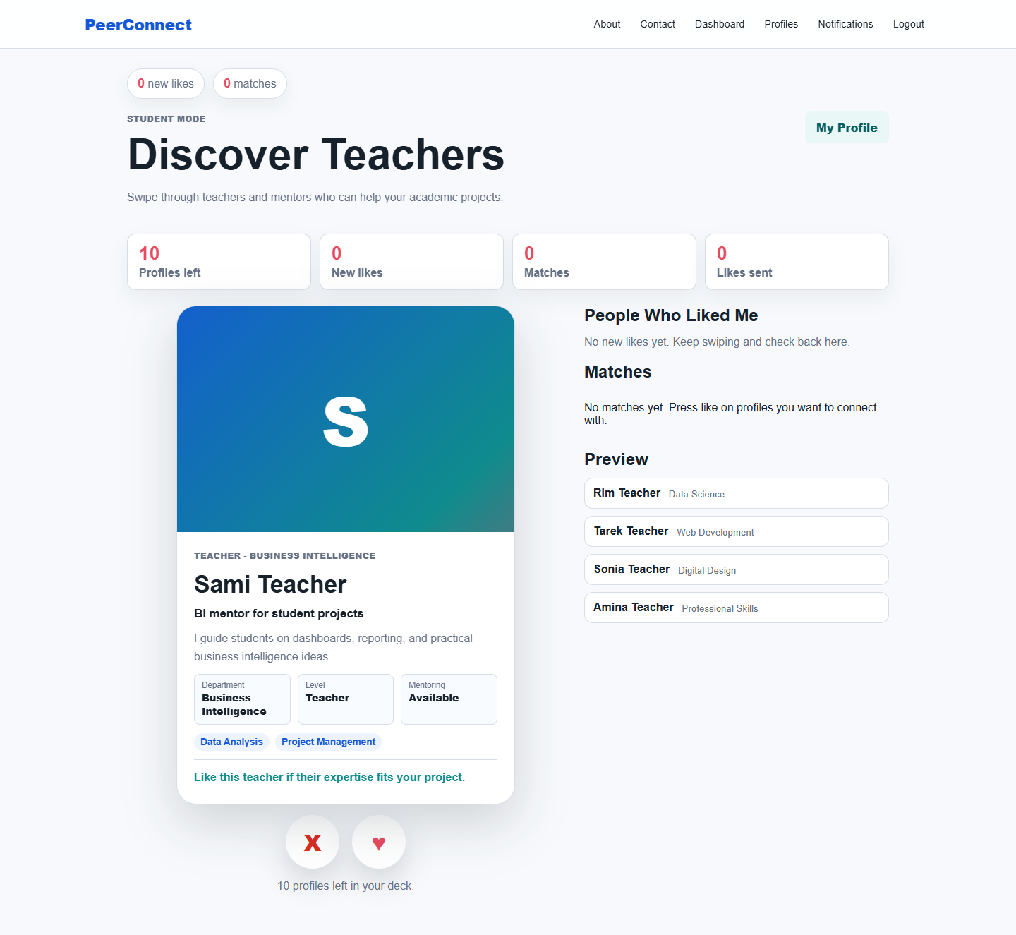
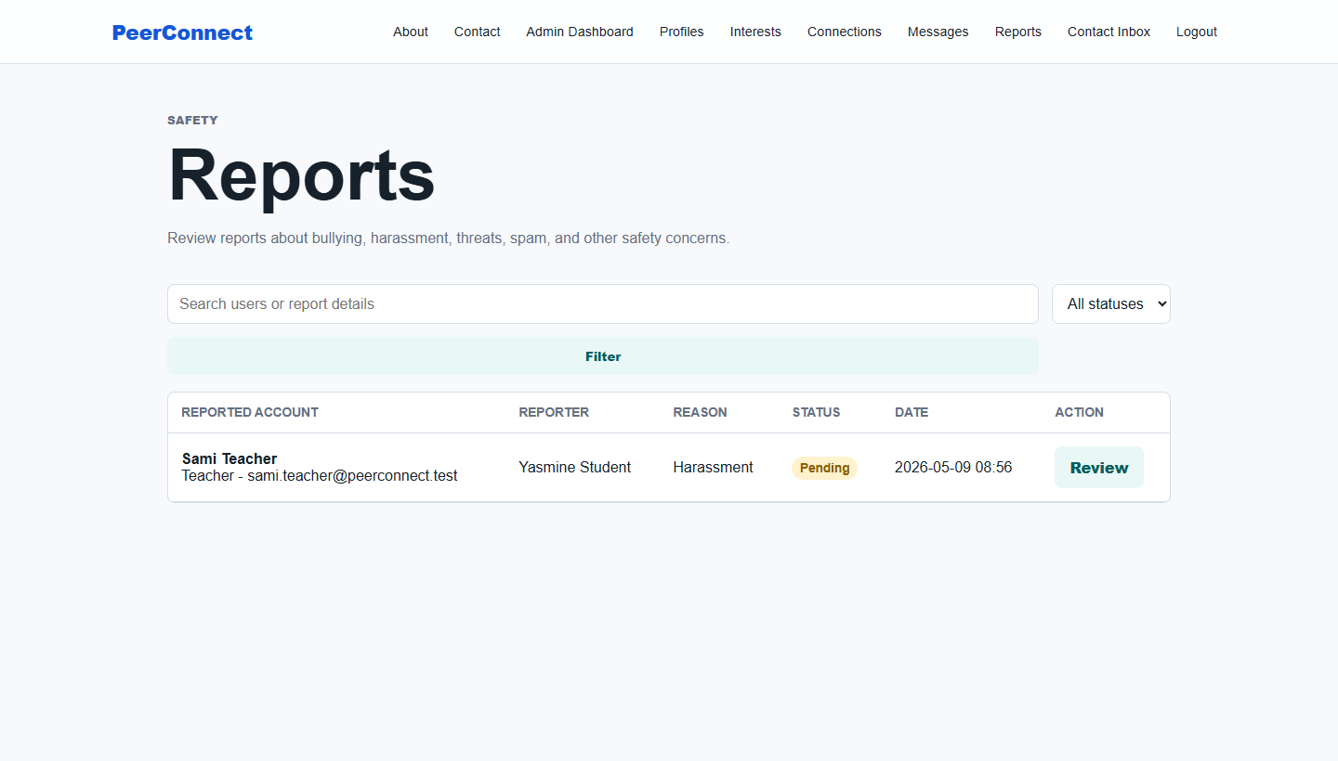
ESPRIT SCHOOL OF BUSINESS
PeerConnect
Step 4: Development of a Dynamic Website
Laravel web application evidence: account management, database integration, reporting moderation, testing, and Git workflow.
21
8
2
demo accounts
captured screenshots
tests passing
Mohamed Amine Klila - Bara Whibi - Eya Rbaii - Nour Mediouni - Yasmine Mejri

Slide 2
PLANNING FIT
Step 4 turns the DS1 design into working software.
The PI planning asks for Laravel development, database integration, account management, testing, and Git/GitHub version control.
1
2
3
4
Requirements
UML design
Database
Dynamic website
DS1 defined the problem, users, features, and constraints.
Use cases, classes, objects, and sequences described the system.
Relational tables translate the object model into persistence.
Laravel implementation connects UI, routes, models, data, tests, and Git.
Deliverable focus: a functioning PeerConnect web app, not only diagrams.

Slide 3
ARCHITECTURE
Laravel MVC keeps the dynamic website organized and reusable.
Controllers coordinate requests, Eloquent models persist data, Blade views render the interface, and middleware protects admin-only pages.
Routes
Controllers
Models
Blade UI
web.php maps public, authenticated, and admin flows.
Dashboard, Profile, Message, Admin, and Report controllers handle behavior.
User, Profile, Connection, Message, Report, Interest, AccessLog.
Responsive pages for discovery, profiles, reports, and admin management.
Implemented Step 4 modules
Authentication
Swipe discovery
Profiles
Reports
Admin dashboard
Access logs
Seeded demo data

Slide 4
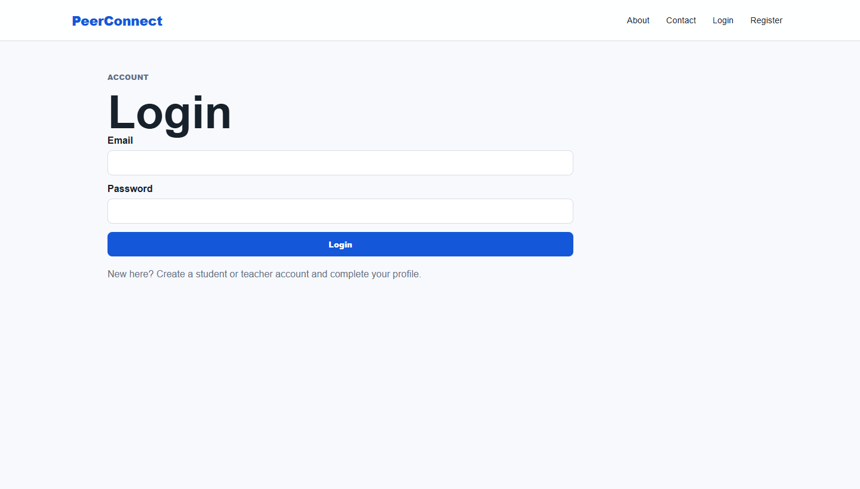
ACCOUNT MANAGEMENT
Simplified demo credentials make the application easy to test.
The seed data creates one admin account and twenty student/teacher profiles for realistic role-based demonstrations.
Credentials file
docs/demo-accounts.md
Admin
admin@peerconnect.test
admin123
Student
yasmine@student.peerconnect.test
password
Teacher
sami.teacher@peerconnect.test
password
1
10
10
admin
students
teachers

Slide 5
LIVE FEATURE
The dashboard proves the matching flow is dynamic.
A logged-in student sees a teacher deck, live counters, preview profiles, and like/pass actions driven by database records.
Role-aware discovery
Students discover teachers; teachers discover students.
Interactive matching
Like/pass actions update connection records.
Notification strip
Likes and matches are surfaced in the navigation.

Slide 6
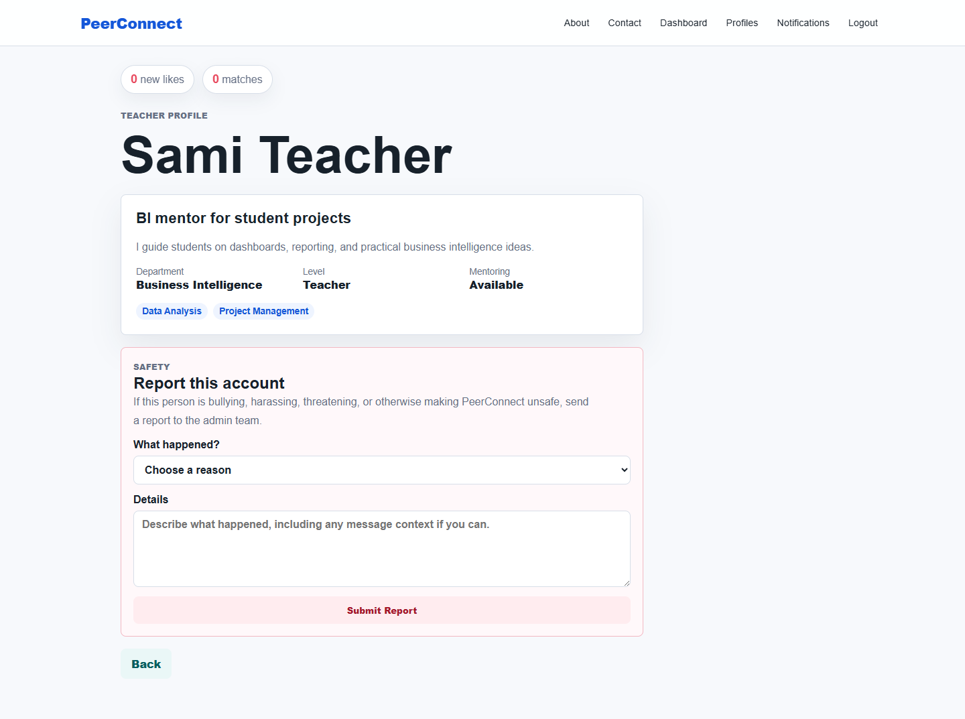
NEW SAFETY FEATURE
Users can report bullying, harassment, threats, spam, or unsafe behavior.
The report form appears on another user's profile and records the reporter, reported account, reason, details, and pending status.
Stored in reports table
reporter_id
reported_id
category
details
status
admin_notes
reviewed_by / reviewed_at
ReportController@store validates and saves

Slide 7
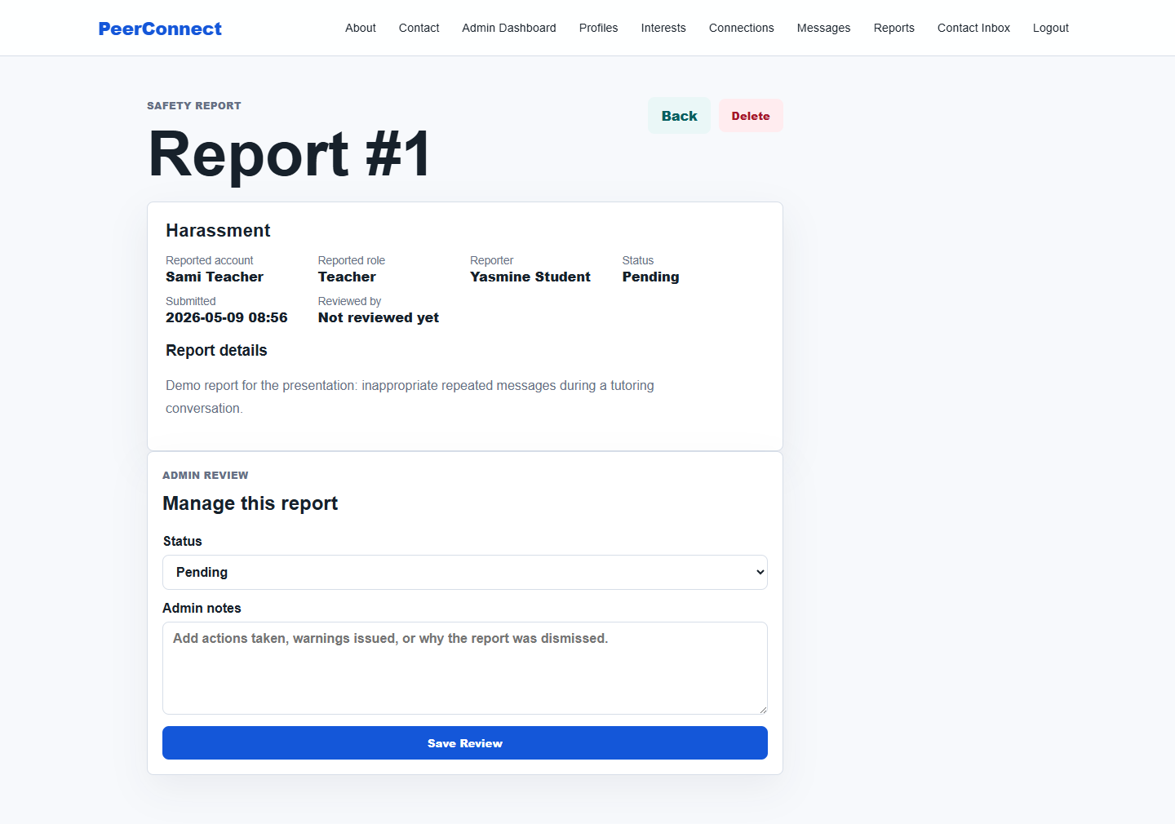
ADMIN CONTROL
Reports become an admin workflow, not a dead-end form.
Admins can filter reports, open a case, update status, write review notes, or delete invalid reports.
Pending
Reviewing
Resolved
Dismissed

Slide 8
DATABASE INTEGRATION
The feature is backed by migrations, models, relationships, and seeded data.
Step 4 development includes persistent tables and Eloquent relationships that connect users, profiles, messages, reports, and access logs.
Migration
Model
Controller
Admin data
create_reports_table adds reporter, reported account, status, notes, reviewer, and timestamps.
Report defines categories, statuses, casts, and reporter/reported/reviewer relations.
ReportController handles user submission and admin index/show/update/delete.
Dashboard counts pending reports and lists recent cases for quick moderation.
Route evidence: POST /reports/{user} + admin/reports index, show, update, destroy

Slide 9
TESTING AND QA
The implementation was exercised through migrations, screenshots, Blade compilation, and automated tests.
The local demo used SQLite for repeatable verification while the production-style .env remains ready for MySQL once XAMPP MySQL is running.
2/2
5
8
21
Laravel tests passed
report routes verified
screenshots captured
seeded demo users
Commands used
Environment note
Evidence folder
migrate:fresh --seed, route:list, view:cache, view:clear, artisan test.
MySQL was stopped locally, so screenshots used SQLite to avoid blocking the demo.
docs/screenshots stores home, login, dashboard, reporting, admin, and Git images.

Slide 10
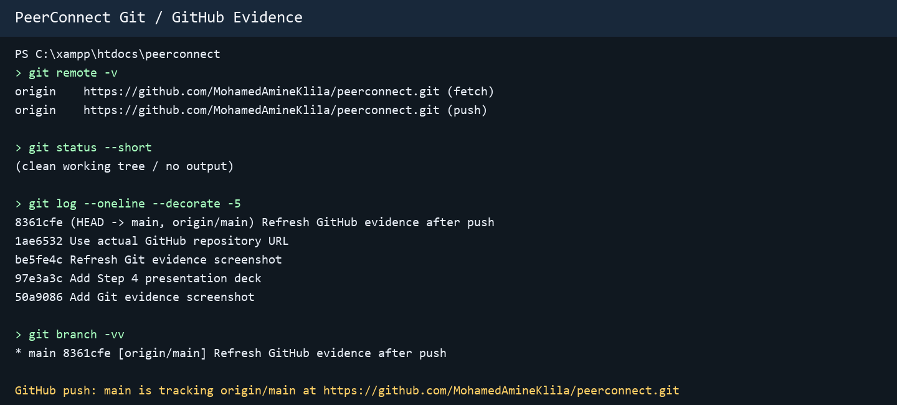
VERSION CONTROL
The Step 4 work is committed locally and ready for GitHub push.
GitHub CLI is not installed and the expected GitHub repository was not found, so push instructions were prepared for the final remote step.
Local Git
Branch main contains the Step 4 development commits.
GitHub status
Repository URL checked; repo not found yet.
Next command file
docs/github-push-steps.md contains the exact push commands.

Slide 11
DEMO PATH
The presentation can close with a short live demonstration.
Use the simplified credentials and follow a path that proves authentication, matching, reporting, admin review, testing, and Git evidence.
1
Login as student
2
Show discovery
3
Submit report
Use yasmine@student.peerconnect.test / password.
Open Dashboard and explain teacher matching.
Open Sami Teacher profile and show the safety form.
4
Login as admin
5
Manage report
6
Show Git
Use admin@peerconnect.test / admin123.
Open Admin Reports and update case status/notes.
Open the Git evidence screenshot and GitHub push steps.
Result: PeerConnect is now a demonstrable dynamic Laravel website with real data, role-based flows, safety moderation, and version-control evidence.

