Slide 1


CYBERSECURITY · EMPLOYEE TRAINING MODULE
Phishing Awareness Training
Recognize the bait. Break the hook. Protect your organization from social engineering and email-based attacks.
Presented by
M MOHAMED ANAS
Security Awareness Series | Module 01

Slide 2






What We'll Cover
A practical, example-driven walkthrough of phishing threats and defenses
01
What Is Phishing?
05
Real-World Examples
Definitions, scale, and why it works
Breaches that started with one email
02
Spotting Phishing Emails
06
Best Practices & Response
Red flags in the sender, subject, and body
Prevention habits and reporting steps
03
Spotting Fake Websites
07
Interactive Knowledge Check
URLs, certificates, and page clues
Quiz yourself before you finish
04
Social Engineering Tactics
The psychology attackers exploit
Phishing Awareness Training
2

Slide 3
SECTION 01
What Is Phishing?
Phishing is a form of social engineering where attackers impersonate a trusted person or organization — via email, text, or a fake website — to trick you into revealing credentials, financial details, or installing malware. It remains the #1 entry point for data breaches worldwide because it targets people, not just systems.
3.4B
phishing emails sent every day worldwide
90%+
of successful breaches start with a phishing email
The name comes from "fishing" — attackers cast bait (a convincing message) and wait for someone to bite.
1 in 4
employees click a simulated phishing link in testing
Phishing Awareness Training
3

Slide 4





SECTION 02
Anatomy of a Phishing Email
Mismatched Sender
Urgency & Threats
Suspicious Links
Display name looks right, but the actual email domain is misspelled or unrelated (e.g. paypa1-support.com).
"Your account will be suspended in 24 hours" — pressure designed to stop you thinking clearly.
Hover before clicking: the visible text and the real destination URL don't match.
Requests for Credentials
Generic Greetings & Errors
Unexpected Attachments
Legitimate companies never ask you to email or type your password to "verify" your account.
"Dear Customer" instead of your name, plus odd grammar, spacing, or formatting.
Invoices, shipping labels, or resumes you didn't request — common malware delivery.
Phishing Awareness Training
4

Slide 5


SECTION 03
Spotting a Fake Website
Check the padlock & "https"
Missing or invalid certificates are a warning sign — but note some scam sites also use https, so it's not proof alone.
http://secure-paypal-login.verify-account.xyz
No padlock · odd domain ending · brand name stitched into a strange URL
Read the domain carefully
Look for extra words, hyphens, or lookalike letters (rn instead of m, 0 instead of O).
Type the address yourself
Instead of clicking a link, navigate to the site directly or use a saved bookmark.
Be wary of urgent pop-ups
Fake "virus detected" or "account locked" banners pressuring immediate action.
Phishing Awareness Training
5

Slide 6


SECTION 04
Social Engineering Tactics
Attackers exploit human psychology, not just technical flaws
Urgency
Authority
Fear & Intimidation
Manufactured deadlines that short-circuit careful thinking.
Impersonating executives, IT, or law enforcement to compel action.
Threats of fines, job loss, or legal trouble.
Curiosity & Reward
Trust & Familiarity
Scarcity
Fake prizes, invoices, or "you won" messages.
Spoofing a colleague, vendor, or known brand.
"Only 2 spots left" or "offer expires tonight."
Phishing Awareness Training
6

Slide 7
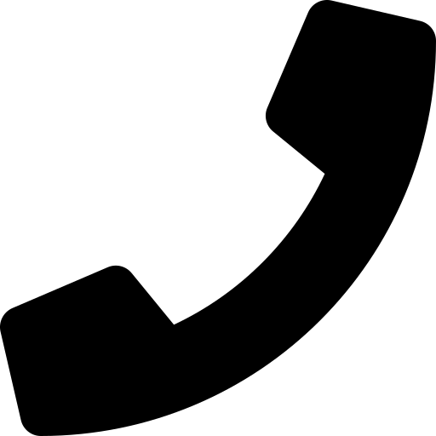


Common Phishing Variants
Different channel, same psychological playbook
Spear Phishing
Whaling
Vishing
Highly targeted emails researched around one specific person or role.
Spear phishing aimed at executives — often fake wire-transfer requests.
Voice phishing: phone calls impersonating banks, IT support, or officials.
Smishing
Clone Phishing
Pharming
SMS text messages with malicious links or fake delivery notices.
A near-identical copy of a real email, with links swapped for malicious ones.
Redirecting users from a legitimate site to a fraudulent look-alike.
Phishing Awareness Training
7

Slide 8

SECTION 05
Real-World Examples
Google & Facebook — $100M
Twitter — 2020 Account Hijack
RSA SecurID — 2011 Breach
2013–2015: A fraudster impersonated a hardware vendor and sent fake invoices, tricking both companies' finance teams into wiring over $100 million combined.
Attackers used a phone-based spear-phishing (vishing) attack on employees to gain internal tool access, hijacking high-profile accounts including Obama and Musk.
An employee opened an Excel attachment titled "2011 Recruitment Plan" from a phishing email, giving attackers a foothold that compromised SecurID tokens used by defense contractors.
Phishing Awareness Training
8

Slide 9



SECTION 06
Best Practices to Stay Safe
Verify Before You Trust
Use Multi-Factor Authentication
Contact the sender through a known, separate channel — not by replying to the suspicious message.
MFA stops most account takeovers even if a password is stolen.
Never Reuse Passwords
Keep Software Updated
Use a password manager so one breach doesn't compromise every account.
Patches close the vulnerabilities phishing malware relies on.
Hover Before You Click
Report, Don't Just Delete
Preview links and check attachments before opening — when in doubt, don't.
Forward suspicious emails to IT/Security so others can be warned and blocked.
Phishing Awareness Training
9

Slide 10

If You Suspect Phishing
A simple four-step response you can always fall back on
1
2
3
4
STOP
CHECK
REPORT
DELETE
Don't click links, open attachments, or reply.
Verify the sender through a separate, trusted channel.
Forward it to IT/Security or use the "Report Phishing" button.
Remove it once it's reported — don't forward to coworkers yourself.
Phishing Awareness Training
10

Slide 11
SECTION 07
Knowledge Check
Test yourself — answers on the next slide
Q1
Q2
Q3
An email from "support@paypa1.com" asks you to confirm your password urgently. What should you do?
Which of these is the strongest sign of a phishing website?
A "CEO" emails you urgently requesting a gift card purchase, refusing phone contact. This is most likely:
A
Click the link and log in to check
A
The page loads slowly
A
A normal executive request
B
Reply with your password to be safe
B
URL has extra words and no valid padlock/certificate
B
Whaling / CEO fraud using urgency and authority
C
Do not click; verify via PayPal's official site/app
C
The site uses a dark color theme
C
A calendar reminder
D
Forward it to a friend for a second opinion
D
The page has a contact form
D
An IT system notification
Phishing Awareness Training
11

Slide 12
Answer Key
How did you do?
Q1
Q2
Q3
Correct: C
Correct: B
Correct: B
Do not click; verify via PayPal's official site/app
URL has extra words and no valid padlock/certificate
Whaling / CEO fraud using urgency and authority
The domain "paypa1.com" uses a digit 1 instead of the letter l — always verify through a known, official channel.
Load speed and color theme are irrelevant to legitimacy; the domain and certificate are the real signal.
Urgency, authority, and refusal to verify by phone are classic whaling / business email compromise tactics.
Phishing Awareness Training
12

Slide 13
Stay Alert. Stay Secure.
When in doubt, don't click — verify, then report. Every employee is a critical line of defense against phishing.
Thank you
M MOHAMED ANAS
Security Awareness Series | Module 01
Phishing Awareness Training
13

