Slide 1

LINEAR REGRESSION
MOHAMED RAGAB

Slide 2
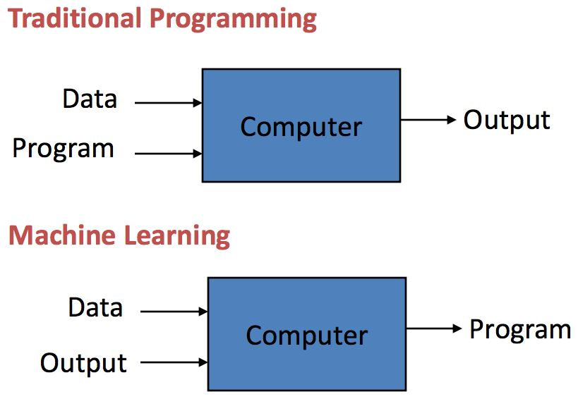
INTRODUCTION
Machine Learning:
It’s an Application.
Computers observe and analyze.
Predict based on previous patterns.

Slide 3
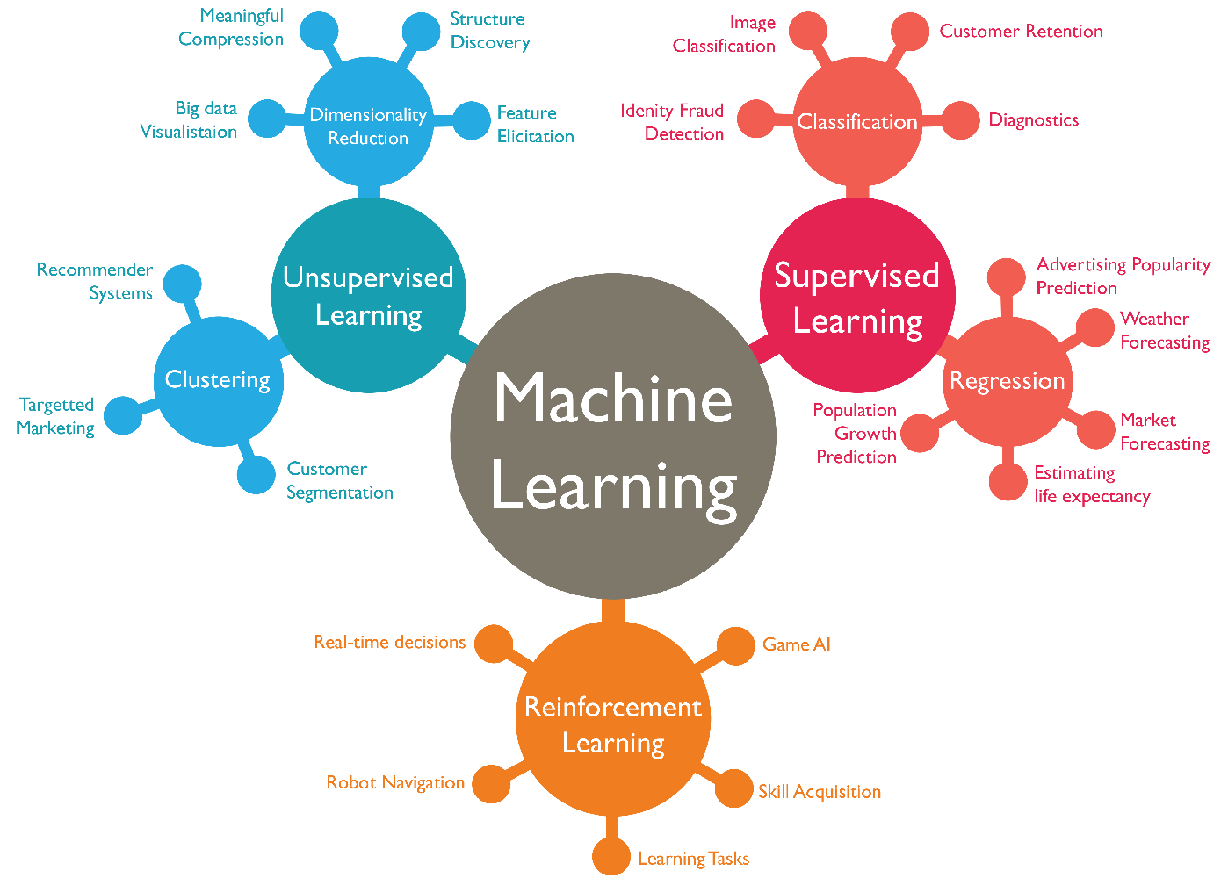
Review for different types of machine learning

Slide 4

Definition:
Machine learning is a field of data science that focuses on designing algorithms that can learn from and make predictions on data.
Machine Learning Types:
Supervised Learning
Unsupervised Learning
Reinforcement Learning

Slide 5
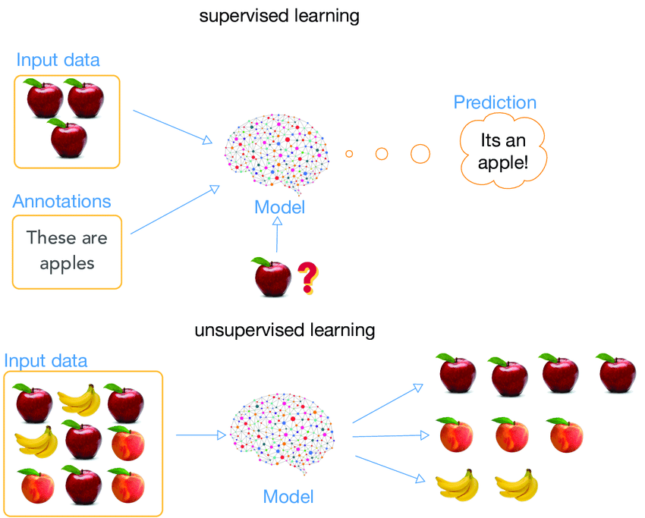
Supervised learning
Supervised learning, an AI system is presented with data which is labeled, which means that each data tagged with the correct label.

Slide 6
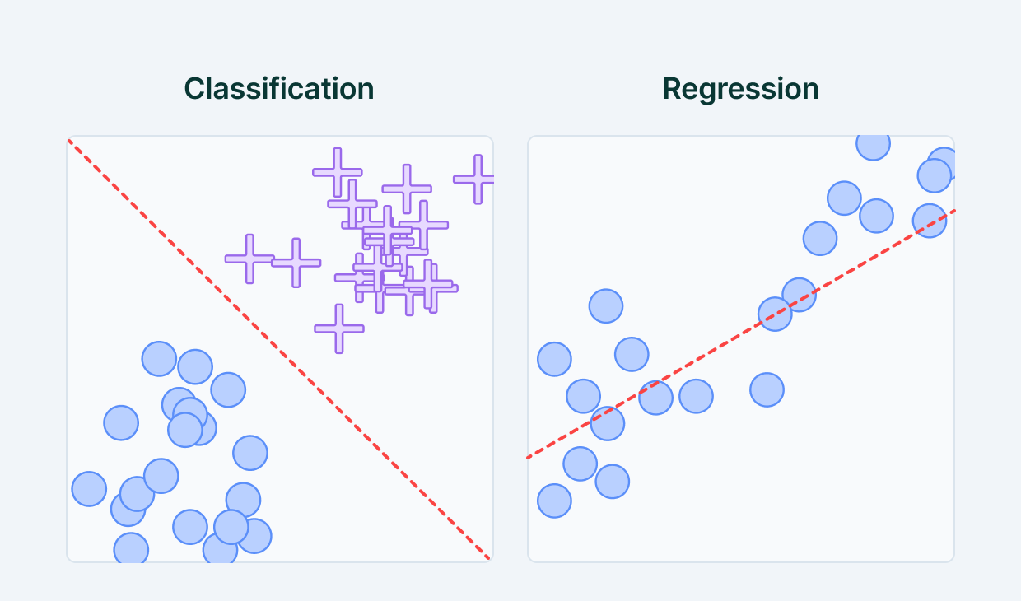
Supervised learning examples
Examples:
Regression
Classification

Slide 7
unsupervised learning
UnSupervised learning, AI system is presented with unlabeled, uncategorized data and the system’s algorithms act on the data without prior training.

Slide 8
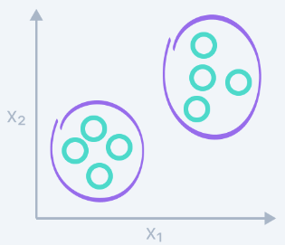
unsupervised learning examples
Examples:
Clustering
Dimensionality Reduction

Slide 9
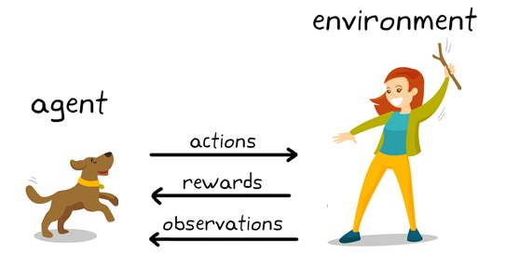
Reinforcement learning
Reinforcement Learning is a type of machine learning in which a computer learns to perform a task through repeated trial-and-error interactions with a dynamic environment.

Slide 10
Regression vs. classification vs. clustering
Regression:
Regression is a technique to model output value with the help of independent predictors.
Regression is used to predict a relationship between a dependent variable and independent variables.
Regression Problem try to learn the real numerical value of the class, such as “dollars” or “weight” or “size”.

Slide 11
Regression vs. classification vs. clustering
Classification:
Classification is a supervised learning concept which basically categorizes a set of data into classes.
It is a predictive modelling problem where a class label is predicted for a given example of input data.
Classification problem try to learn categorical class. such as “red” or “blue” or “yellow”

Slide 12
Regression vs. classification vs. clustering
Clustering
Clustering is the type of Unsupervised Learning where we find hidden patterns in the data based on their similarities or differences.
These patterns can relate to the shape, size, or color and are used to group data items or create clusters.
There are several types of clustering algorithms, such as exclusive, overlapping, hierarchical, and probabilistic.

Slide 13

15 minutes!

Slide 14
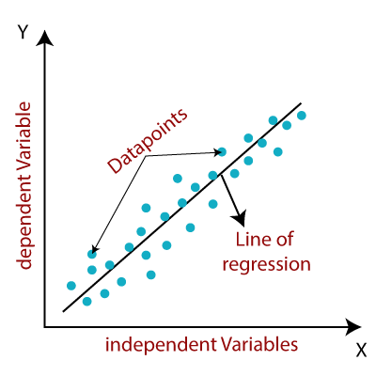
Linear regression algorithm
Linear Regression describes a linear relationship between an independent variable and the dependent variable.
The main idea is to predict the best fit line with the help
of given data points.
The best fit line will have minimum error depicted by the
distance between the points and the line.
Y = a0 + a1 X.

Slide 15
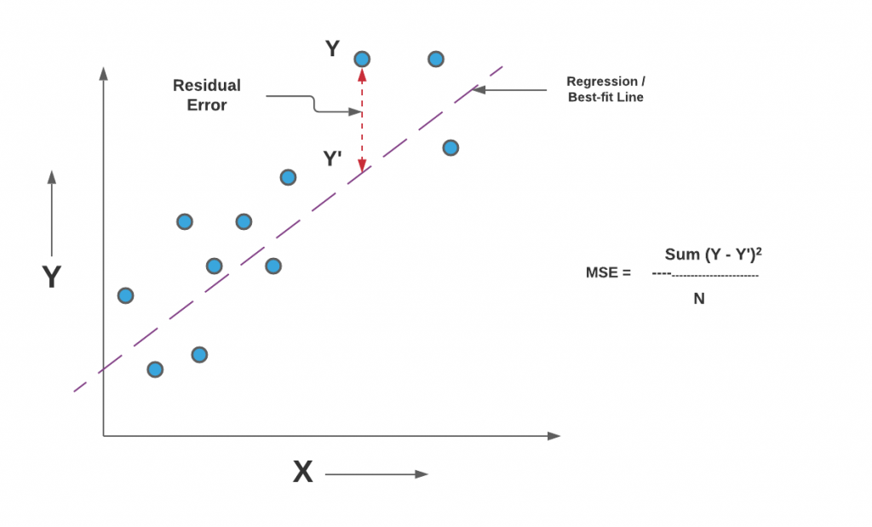
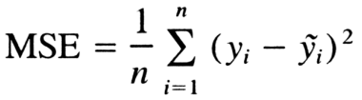
COST FUNCTION
Cost Function helps us to get the best values for a0 and a1, in order to get the best fit line for data points.
The difference between the predicted values and
The actual values gives the error.
We want to minimize this error:
“mean squared error function”.

Slide 16
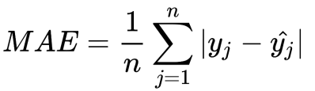
Cost Function (evaluation metrics ) for Regression example:
Mean squared Error (MSE) :
Mean absolute Error (MAE):

Slide 17
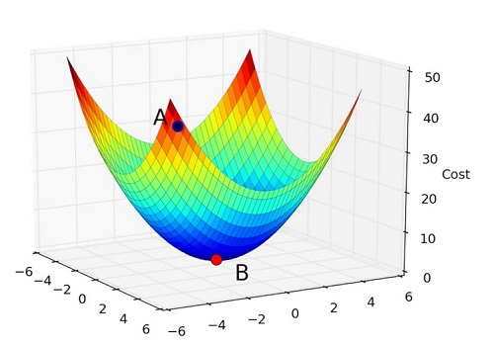
GRADIENT DESCENT:
Gradient Descent helps us to reduce the cost function to reach minima.
Start with some values of a0 and a1 .
Change them iteratively until reaching a minimum for cost function J.
Learning Rate α determines how fast we are going to reach the minima.

Slide 18
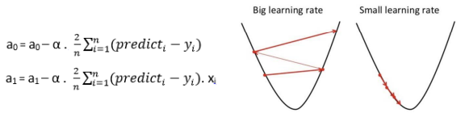
Gradient Descent
To calculate these steps or gradients from cost function, we take gradients (partial derivatives) of a0 and a1 . A little bit of calculus will do the trick here.
Higher learning rate means less time but with a chance of missing the minima and vice versa for the lower learning rate.

Slide 19
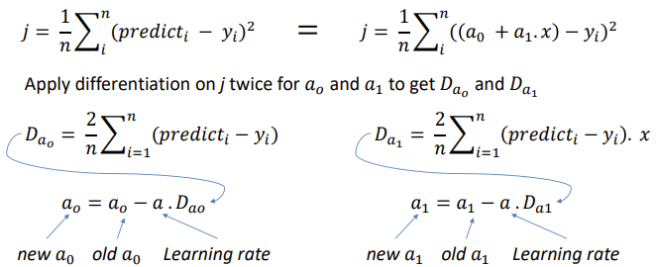
Gradient Descent find new a0 and a1:
REPEAT THIS FOR NUMBER OF EPOCHS.

Slide 20
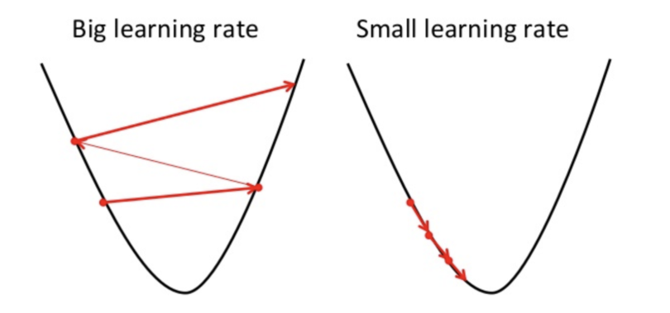
Gradient Descent
If α is too small, gradient descent can be slow.
If α is too large, gradient descent can overshoot the minima. It may fail to converge, or even diverge.

Slide 21
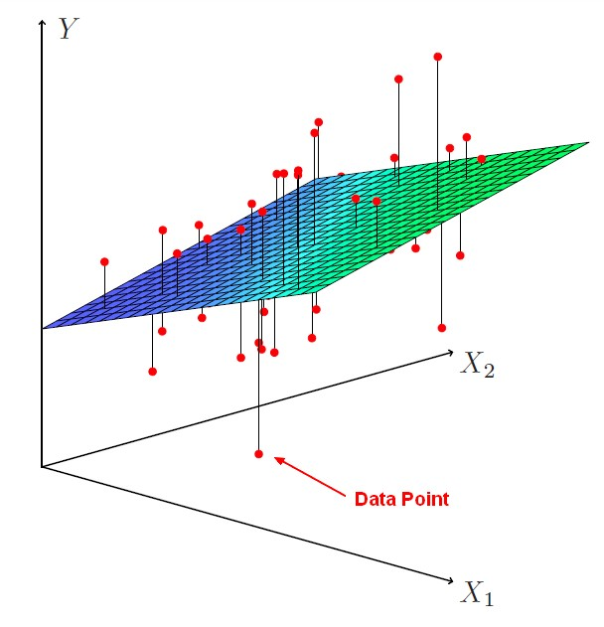
Linear Regression with Multiple Variables
Multivariate Linear Regression uses several explanatory (independent) variables to predict the outcome of a response (dependent) variable.
y = a0 + a1 x1 + a2 x2 + a3 x3 + ...... an xn

Slide 22

Implementation of Linear Regression
Null Hypothesis:
A null hypothesis is a hypothesis that says there is no statistical significance between the two variables in the hypothesis.
Null hypothesis would be something like this: There is no statistically significant relationship between the type of water I feed the flowers and growth of the flowers.
The null hypothesis is nearly always "something didn't happen" or "there is no effect" or "there is no relationship".
The usual method is to test the null at some significance level (most often, 0.05)

Slide 23
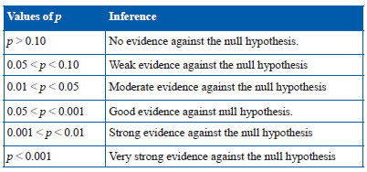
P Value Significance Level

Slide 24
Linear Regression Output Result
Slope: Slope of the regression line (𝒂𝒐).
Intercept: Intercept of the regression line (𝒂𝟏).
P_value: The p-value for a hypothesis test whose null hypothesis is that the slope is zero.
R_value: Correlation coefficient that measures the strength of the linear relationship .
stderr: Standard error of the estimated slope (gradient) represents the average distance that your observed values deviate from the regression line.

Slide 25
Thank you!

