Slide 1
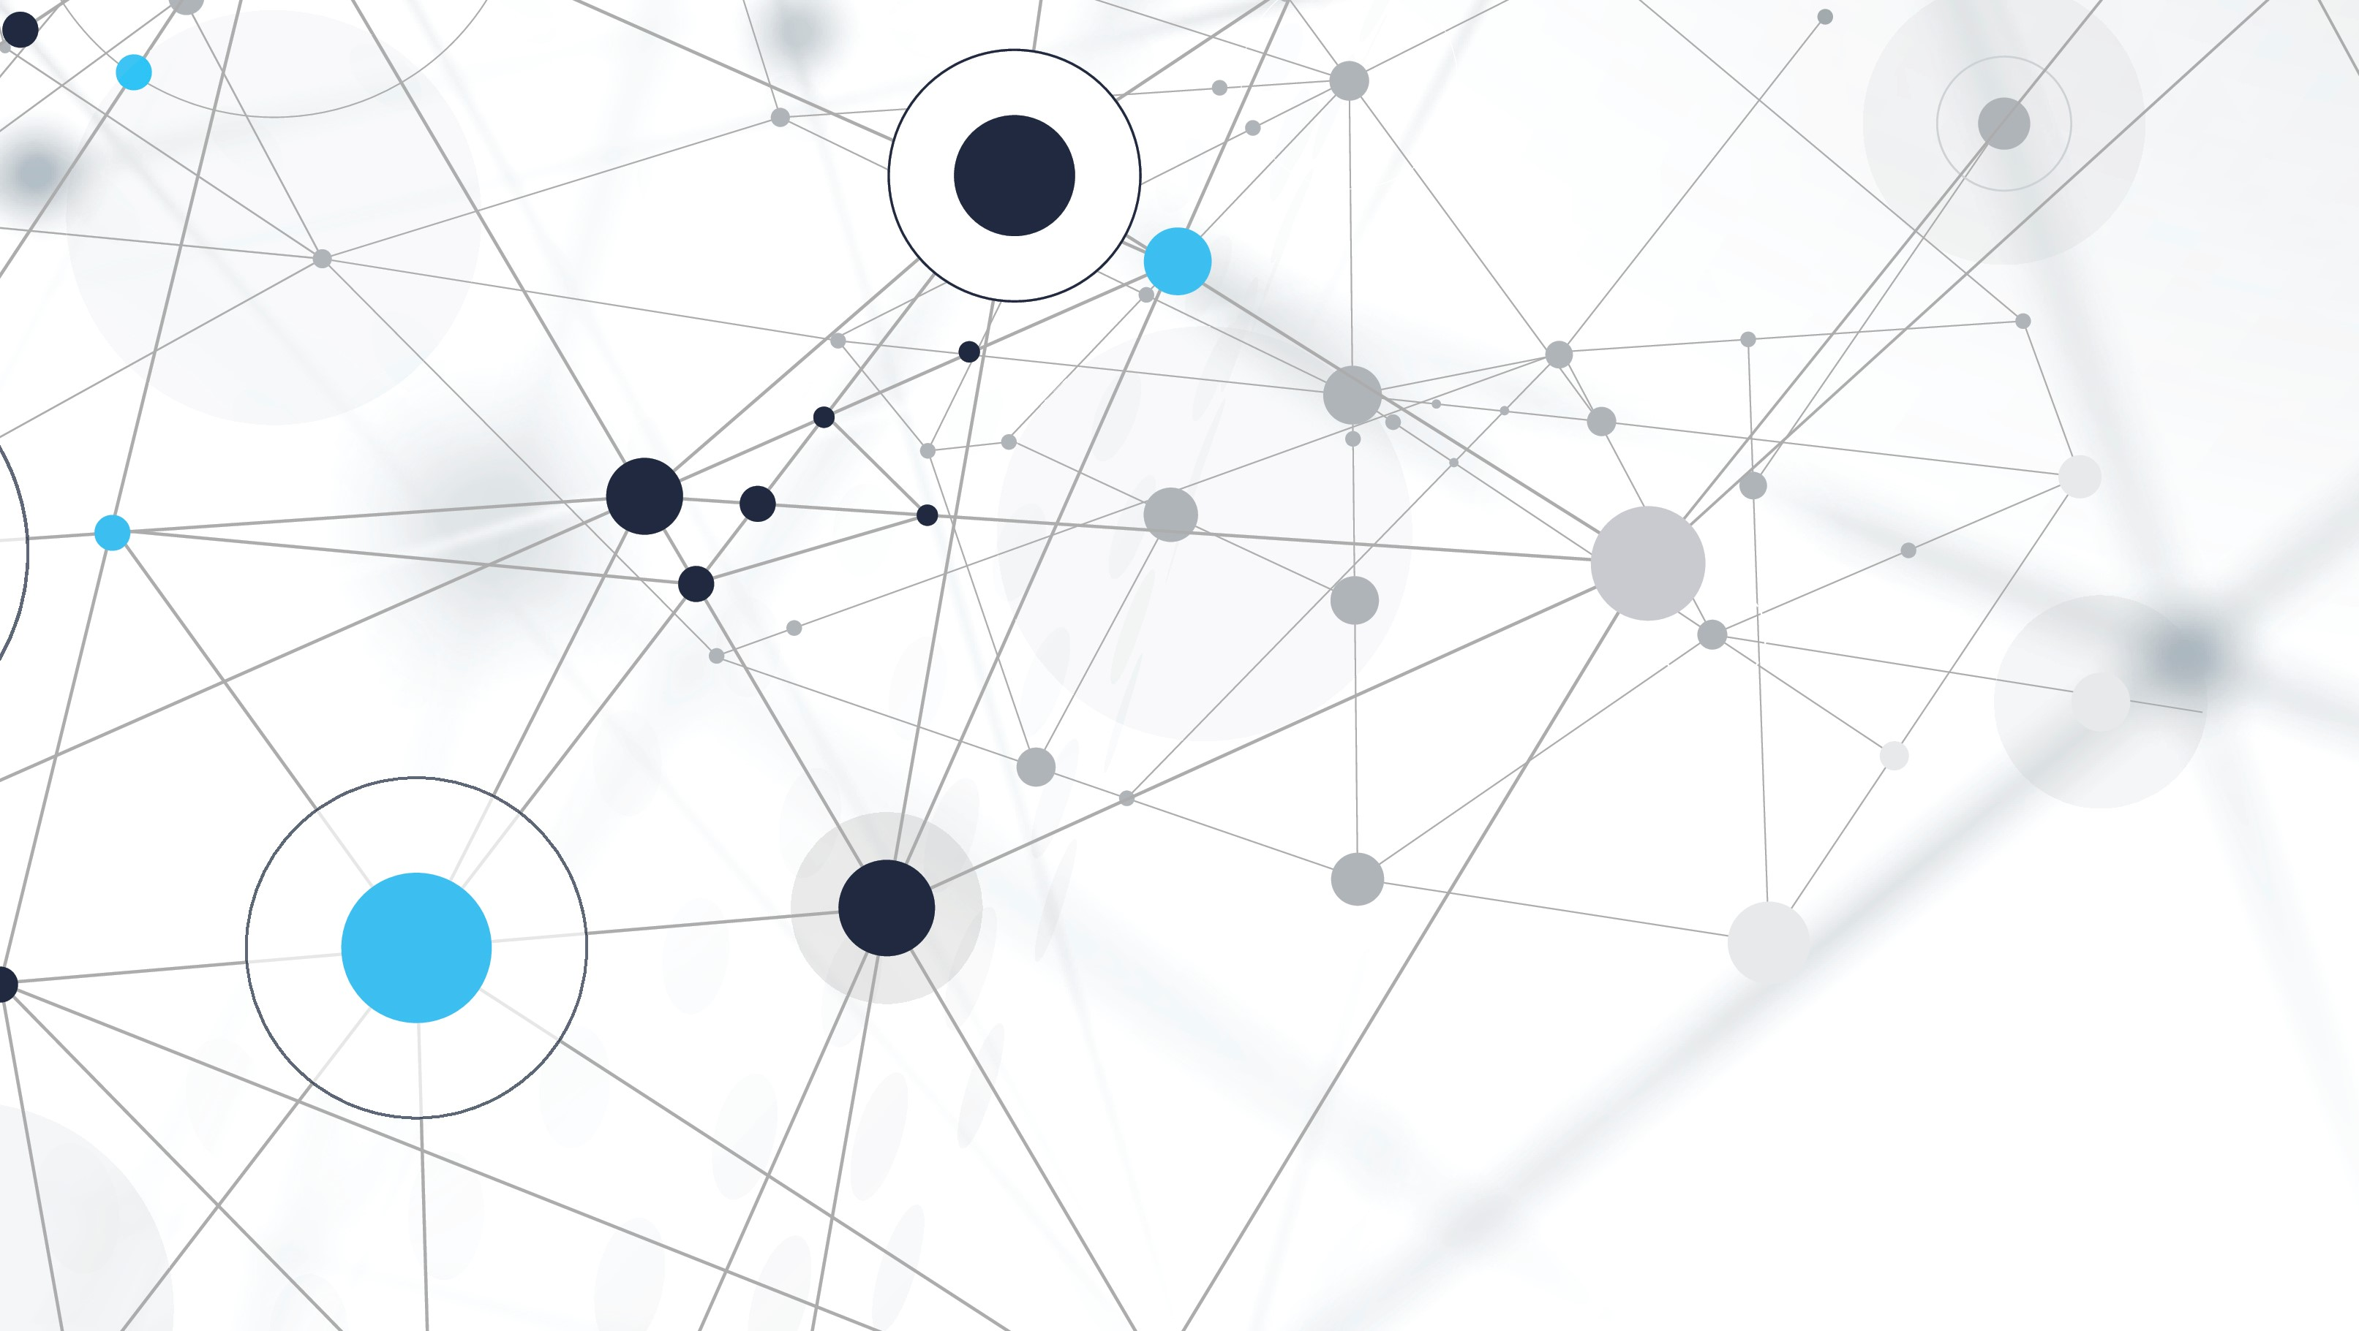
INTRODUCTION TO ARTIFICIAL INTELLIGENCE
MOHAMED RAGAB

Slide 2
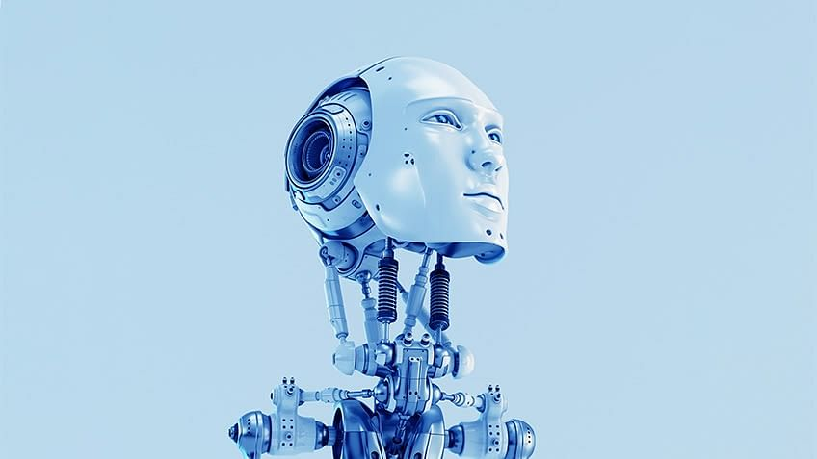
What is ARTIFICIAL INTELLIGENCE
Artificial intelligence (AI) refers to a set of algorithms that makes machine acts more intelligently without the need of being explicitly programmed, This means that it tries its best to mimic the human behavior in learning and making decisions. The ideal characteristic of artificial intelligence is its ability to rationalize and take actions that have the best chance of achieving a specific goal.
The 3 New Powers of Today’s Technology:
Explosion of Data.
Exponential Increase in Computing Power and GPU’s.
Algorithms Advancement.

Slide 3
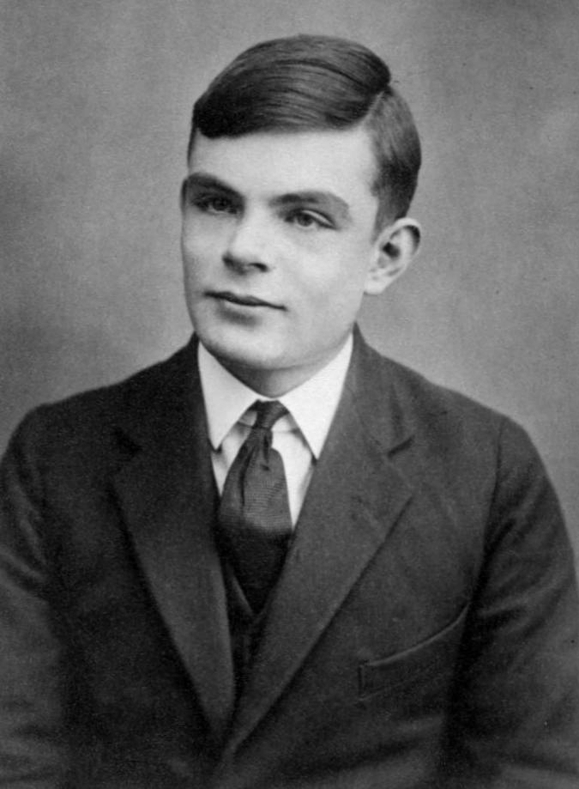
Test Intelligence (The imitation Game )
One of the most famous test for determining if AI acts like human to which extent is the Turing test.
Turing Test is a testing method that inquires of how much is our AI system close to the human response. This test is named after Alan Turing who was a computer scientist, mathematician and biologist who invented it in 1950.
This test mainly requires three ends:
One is managed by computer (machine)
while the two other ends are human beings.
All the three ends are separated from each other.

Slide 4
Test Intelligence (The imitation Game )
The test is as follows:
One of the two humans acts as a questioner who provides some questions and tests for the other two ends.
Each question is interrogated to both the human end and the machine end to solve and give an answer to the human questioner.
After a run of questions, the questioner has to decide which is the machine and which is the computer.

Slide 5
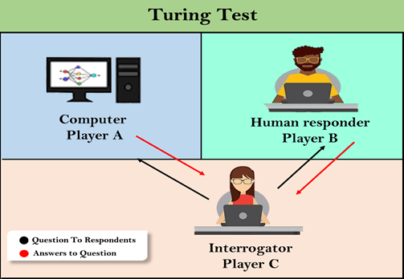
Test Intelligence (The imitation Game )
The previous steps are repeated several times and each time the questioner has to deduce which is machine and which is human based on their run of answers.
If the questioner was able to deduce the machine in more than half of the trials hence the machine is not intelligent enough. Otherwise, the machine is having some sort of intelligence.

Slide 6
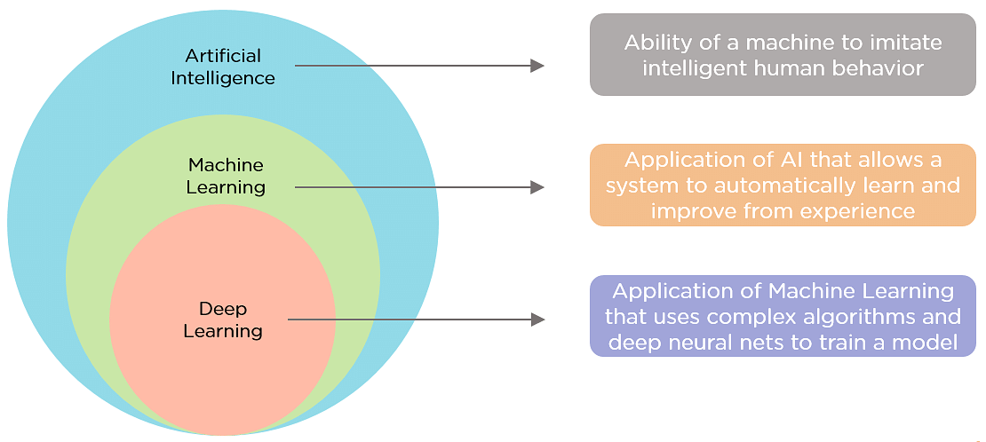
Subfields of Artificial Intelligence

Slide 7
The Advantages of Artificial intelligence
Reduction in human error.
Takes less time than human due to its multiprocessing capabilities.
Zero risks for humans as AI robots can do the tasks instead.
Availability 24x7 with the same performance unlike human-being who needs breaks and their performance degrades with time and effort.
Helps in repetitive tasks which could be boring for human (donkey-work).
Daily applications as Google’s assistant or Siri which is irreplaceable by humans.

Slide 8
The Disadvantages of Artificial intelligence
High cost for both software which needs continuous updating to meet latest requirements and hardware which needs maintenance and replacing in case of failure (machine life span)
Increase of unemployment as humans are replaced by bots in many tasks which leads to the death of many job opportunities such as chat customer service which is replaced by chat bots.
Machines have no emotions which as it is good for giving unbiased decisions but bad in making connection as humans make to have a teamwork.

Slide 9
The Obstacles facing Artificial intelligence
The data availability as machine so far learns from the data to take intelligent decisions based on its training on it. However data is presented in isolation inside companies or across them.
Data can have problems in inconsistencies and being of low quality.
Lack of qualified professionals and skills that can effectively deploy and operate AI solutions. This is mainly because of the short timeline of this field.
Cost and time of generating AI solution (fully implemented) as such solutions take time to be implemented and deployed with a high cost of the engineers’ salaries, updating software and hardware maintenance.
Models misbehaving due to biasing in the training process.
Interaction issues between humans and AI systems which needs raising awareness of such technologies for the public to be able to deal with

Slide 10
Machine Learning Vs Deep Learning
What Is Machine Learning:
The subfield of computer science that “gives computers the ability to learn without being Explicitly Programmed”.
It is machine learning that gives AI the ability to learn. This is done by using algorithms to discover patterns and generate insights from the data they are exposed to.
What Is Deep Learning:
Deep learning is a subset of machine learning
It mimics the workings of the human brain in processing data for use in detecting objects, recognizing speech, translating languages, and making decisions using Neural Networks.

Slide 11
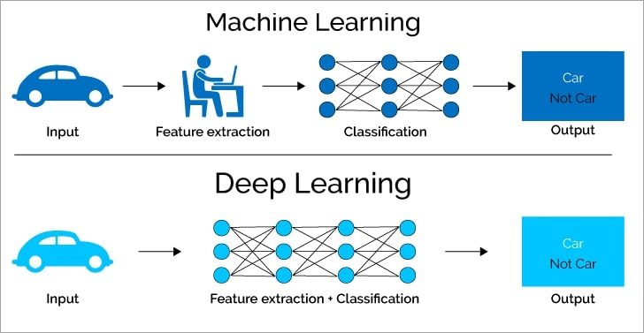
Machine Learning Vs Deep Learning
Traditional ML requires manual feature extraction/engineering, but Deep learning can automatically learn features in data.

Slide 12
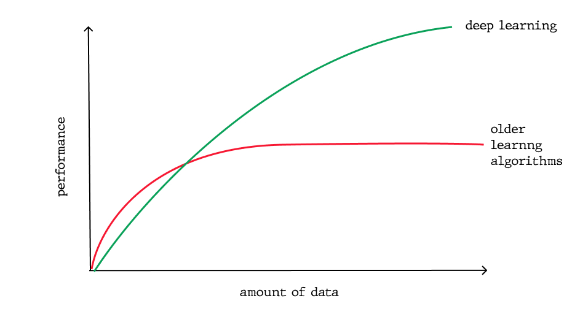
Machine Learning Vs Deep Learning
Deep Learning is suitable when it comes to problems that need large data as It can take a huge amount of data--millions of images.

Slide 13
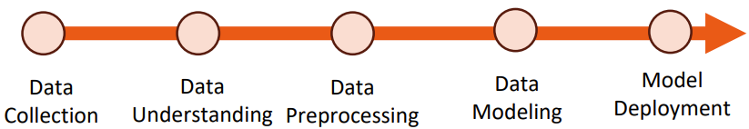
Build An Intelligent AI System
Data Collection:
Gathering and measuring information from countless different sources
Collecting data allows you to capture a record of past events so that we can use data analysis to find recurring patterns
Data Understanding:
Ask business –challenge-objective questions to recognize patterns ,draw conclusions ,visualizations and turns data into insights

Slide 14
Build An Intelligent AI System
Data Preprocessing:
Preparing (cleaning and organizing) the raw data and transforms it into an understandable and readable format
Data Modeling:
Use Machine Learning Techniques to build intelligent models to make useful predictions
Model Deployment:
Put the intelligent model in production to be actively use by consumers.

Slide 15
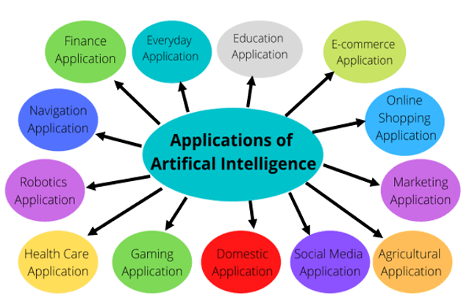
APPLICATIONS OF ARTIFICIAL iNTELLIGENCE

Slide 16
THANK YOU!

